Slide 1
CompSci 101 Introduction to Computer Science
Nov 8, 2016
Prof. Rodger

Slide 2


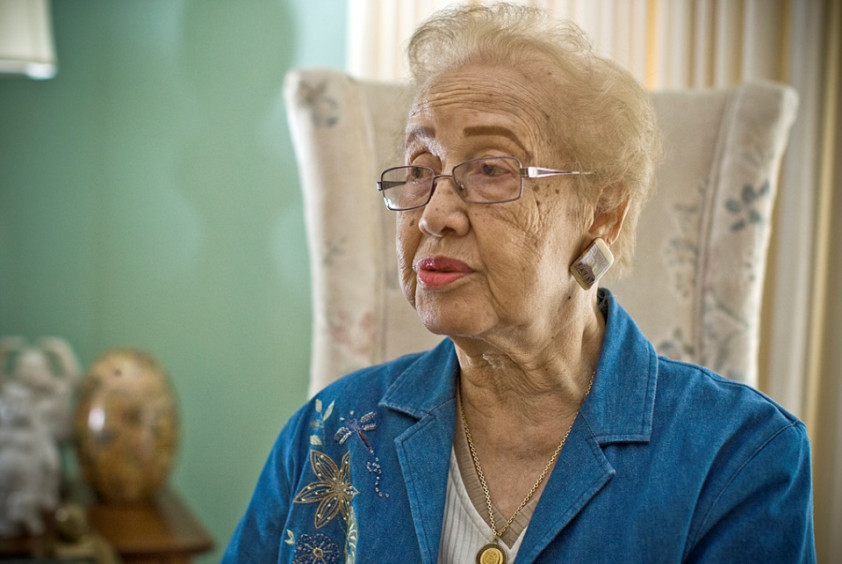
Hidden Figures Author At Duke Wed, 7pm, Reynolds Theatre
Katherine Johnson
Notes:
Katherine Johnson is 98 years old and lives in Virginia
She was one of the earlier “computers” At NASA she computed the trajectory for Alan Shephard the first American in Space. Then later when NASA got electronic computers they would get her to still compute trajectories by hand so they could compare with the computers to see if they were correct!

Slide 3
Announcements
No RQs until after Exam 2
Assignment 6 due Thursday
APT Quiz 2 due tonight
APT 7 due today, APT 8 out
Exam 2 is Nov. 16
Lab this week!
Today:
More practice with Dictionaries

Slide 4
Python shortcut you can ignore
The zip function, tuples from two lists
Does something right if lists have different sizes. Look it up
words = ['dog', 'cat', 'fish', 'guava']
counts = [3, 2, 1, 5]
cc = zip(word,counts)
[('dog', 3), ('cat', 2), ('fish', 1), ('guava', 5)]
Notes:
You could easily write zip....
In one line with
List comprehension to create tuples
min or max? min
Range - need index number for both lists
yy = [(a[i], b[i]) for i in range(min(len(a),len(b)))]

Slide 5
Python functions you CANNOT ignore
We know how to sort, we call sorted
Example: sorting tuples
Function sorted returns a new list, original not changed
What if sort by numbers instead of words?
xx = [('dog', 3), ('cat', 2), ('fish', 1), ('guava', 2)]
yy = sorted(xx)
[('cat', 2), ('dog', 3), ('fish', 1), ('guava', 2)]
Notes:
What if we want to sort by numbers instead of words?

Slide 6
Use what you know
You can re-organize data to sort it as you'd like, list comprehensions are your friend
xx = [('dog', 3), ('cat', 2), ('fish', 1), ('guava', 2)]
...
nlist = [(t[1],t[0]) for t in xx]
[(3, 'dog'), (2, 'cat'), (1, 'fish'), (2, 'guava')]
yy = sorted(nlist)
[(1, 'fish'), (2, 'cat'), (2, 'guava'), (3, 'dog')]
Notes:
Notice that (2,'cat') comes before (2,'guava')
Use what you know

Slide 7
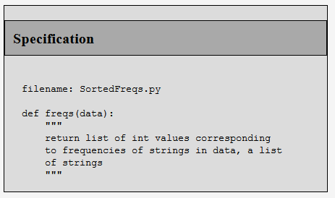

APT – SortedFreqs bit.ly/101f16-1108-1
The returned frequencies represent an
alphabetic/lexicographic ordering of the
unique words, so the first frequency is how
many times the alphabetically first word occurs and the last frequency is the
number of times the alphabetically last word occurs

Slide 8
Ways to count? bit.ly/101f16-1108-2
Dictionaries are faster than using lists?
How fast is list.count(x) for each x?
Notes:
How long does list.count(x) if you do this for each x?
How long does it take to compute a dictionary of counts

Slide 9

Shafi Goldwasser
2012 Turing Award Winner
RCS professor of computer science at MIT
Twice Godel Prize winner
Grace Murray Hopper Award
National Academy
Co-inventor of zero-knowledge proof protocols
How do you convince someone that you know [a secret] without revealing the knowledge?
Honesty and Privacy
Work on what you like, what feels right, I know of no other way to end up doing creative work

Slide 10
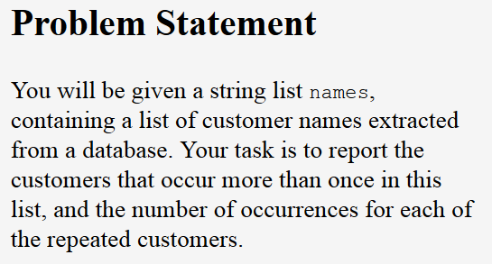

APT Customer Statistics bit.ly/101f16-1108-3

Slide 11
Review Dictionaries
Map keys to values
Counting: count how many times a key appears
Key to number
Store associated values
Key to list or set
Get all
Keys, values or (key,value) pairs
What question do you want to answer?
How to organize data to answer the question

Slide 12
Dictionary problems Number of students in ACM clubs bit.ly/101f16-1108-4
d = {'duke':30, 'unc':50, 'ncsu':40}
d['duke'] = 80
d.update({'ecu':40, 'uncc':70})
print d.values()

Slide 13
Dictionary problems – part 2 bit.ly/101f16-1108-5
Consider the Python dictionary below on schools that map schools to number of students
d = {'duke':30, 'unc':50, 'ncsu':40, 'wfu':50, 'ecu': 80, 'meridith':30, 'clemson':80, 'gatech':50, 'uva':120, 'vtech':110}

