Slide 1
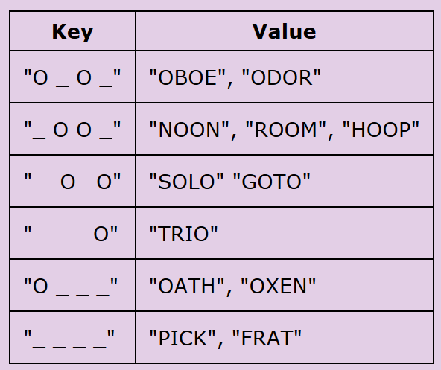
CompSci 101
Introduction to Computer Science
November 10, 2016
Prof. Rodger

Slide 2
Announcements
Assign 6 due extended one day
  Assign 7 out today, due Nov 29
APT 9 due Tuesday (No extensions)
Next week – No lab, Exam Thursday
Practice exams – work on for next class
Today:
  Why are dictionaries so fast?
  More problem solving with dictionaries

Slide 3

Be in the know….
ACM, compsci mailing lists
Association of Computing Machinery (ACM)
  Professional organization for computer science
  Duke Student ACM Chapter – join for free
Join duke email lists to find out info on jobs, events for compsci students
  lists.duke.edu – join lists:
    compsci – info from compsci dept
    dukeacm – info from student chapter

Slide 4
Dictionary Song problem bit.ly/101f16-1110-1
songs = ["Hey Jude:Let it be:Day Tripper",
"Let it be:Drive my car:Hey Jude",
"I want to hold your hand:Day Tripper:Help!",
"Born to run:Thunder road:She's the one",
"Hungry heart:The river:Born to run",
"The river:Thunder road:Drive my car",
"Angie:Start me up:Ruby Tuesday",
"Born to run:Angie:Drive my car"]

Slide 5
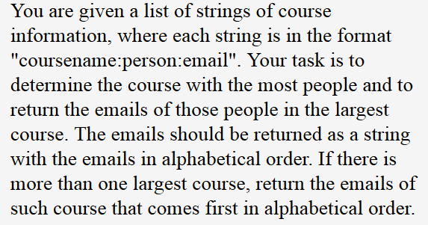
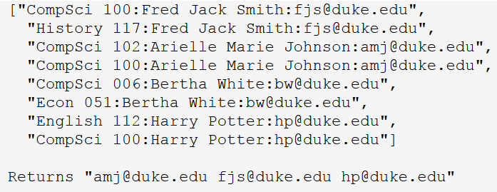
APT EmailsCourse bit.ly/101f16-1110-2

Slide 6
DictionaryTimings.py
Problem: (word,count of words)
Updating (key,value) pairs in structures
Three different ways:
  Search through unordered list
  Search through ordered list
  Use dictionary
Why is searching through ordered list fast?
  Guess a number from 1 to 1000, first guess?
  What is 2¹⁰? Why is this relevant? 2²⁰?
  Dictionary is faster! But not ordered
Notes:
If time, look at different timings in this snarf file from Tuesday, also in today's snarf. The linear they've seen before, the dictionary they've seen before, this also shows binary search, just so at least they know there's a library for it? Why sorting data makes things fast

Slide 7
Linear search through list o' lists
Maintain list of [string,count] pairs
  List of lists, why can't we have list of tuples?
  If we read string 'cat', search and update
  If we read string 'frog', search and update
[ ['dog', 2], ['cat', 1], ['bug', 4], ['ant', 5] ]
[ ['dog', 2], ['cat', 2], ['bug', 4], ['ant', 5] ]
[ ['dog', 2],['cat', 2],['bug', 4],['ant', 5],['frog',1] ]

Slide 8
See DictionaryTimings.py
def linear(words):
data = []
for w in words:
found = False
for elt in data:
if elt[0] == w:
elt[1] += 1
found = True
break
if not found:
data.append([w,1])
return data
N new words?
Notes:
By rows

Slide 9
Binary Search
Find Narten
Anderson
Applegate
Bethune
Brooks
Carter
Douglas
Edwards
Franklin
Griffin
Holhouser
Jefferson
Klatchy
Morgan
Munson
Narten
Oliver
Parker
Rivers
Roberts
Stevenson
Thomas
Wilson
Woodrow
Yarbrow
FOUND!
How many times
divide in half?
log₂(N) for N element list
Notes:
The magenta/purple shows where Narten could be. After each guess, roughly in the middle, we eliminate half of the names from being the range
Of names in which Narten could be. So how many times can we cut the range in half?

Slide 10
Binary search through list o' lists
Maintain list of [string,count] pairs in order
  If we read string 'cat', search and update
  If we read string ‘dog‘ twice, search and update
[ [‘ant', 4], [‘frog', 2] ]
[ [‘ant', 4], [‘cat’, 1], [‘frog', 2] ]
[ [‘ant', 4], [‘cat’, 1], [‘dog’, 1], [‘frog', 2] ]
[ [‘ant', 4], [‘cat’, 1], [‘dog’, 2], [‘frog', 2] ]

Slide 11
See DictionaryTimings.py bit.ly/101f16-1110-3
def binary(words):
data = []
for w in words:
elt = [w,1]
index = bisect.bisect_left(data, elt)
if index == len(data):
data.append(elt)
elif data[index][0] != w:
data.insert(index,elt)
else:
data[index][1] += 1
return data
Notes:
Bisec.bisect_left(data, elt) finds the location of where the data is inserted.
Data.insert is shifting

Slide 12
Search via Dictionary
In linear search we looked through all pairs
In binary search we looked at log pairs
  But have to shift lots if new element!!
In dictionary search we look at one pair
  Compare: one billion, 30, 1, for example
  Note that 2¹⁰ = 1024, 2²⁰ = million, 2³⁰=billion
Dictionary converts key to number, finds it
  Need far more locations than keys
  Lots of details to get good performance
Notes:
One billion for linear, 30 for binary, 1 for dictionary – Quite a difference!

Slide 13
See DictionaryTimings.py
def dictionary(words):
d = {}
for w in words:
if w not in d:
d[w] = 1
else:
d[w] += 1
return [[w,d[w]] for w in d]

Slide 14
Running times @ 10⁹ instructions/sec
N | O(log N) | O(N) | O(N log N) | O(N²)
10² | 0.0 | 0.0 | 0.0 | 0.00001
10³ | 0.0 | 0.0000001 | 0.00001 | 0.001
10⁶ | 0.0 | 0.001 | 0.02 | 16.7 min
10⁹ | 0.0 | 1.0 | 29.9 | 31.7 years
10¹² | 9.9 secs | 16.7 min | 11.07 hr | 31.7 million years
This is a real focus in Compsci 201
linear is N², binary is N log N, dictionary N
Notes:
This is what you do in 201

Slide 15
Running times @ 10⁹ instructions/sec
N | O(log N) | O(N) | O(N log N) | O(N²)
10² | 0.0 | 0.0 | 0.0 | 0.00001
10³ | 0.0 | 0.0000001 | 0.00001 | 0.001
10⁶ | 0.0 | 0.001 | 0.02 | 16.7 min
10⁹ | 0.0 | 1.0 | 29.9 | 31.7 years
10¹² | 9.9 secs | 16.7 min | 11.07 hr | 31.7 million years
This is a real focus in Compsci 201
linear is N², binary is N log N, dictionary N
Notes:
This is what you do in 201

Slide 16
Running times @ 10⁹ instructions/sec
N | O(log N) | O(N) | O(N log N) | O(N²)
10² | 0.0 | 0.0 | 0.0 | 0.00001
10³ | 0.0 | 0.0000001 | 0.00001 | 0.001
10⁶ | 0.0 | 0.001 | 0.02 | 16.7 min
10⁹ | 0.0 | 1.0 | 29.9 | 31.7 years
10¹² | 9.9 secs | 16.7 min | 11.07 hr | 31.7 million years
This is a real focus in Compsci 201
linear is N², binary is N log N, dictionary N
Notes:
This is what you do in 201

Slide 17
Running times @ 10⁹ instructions/sec
N | O(log N) | O(N) | O(N log N) | O(N²)
10² | 0.0 | 0.0 | 0.0 | 0.00001
10³ | 0.0 | 0.0000001 | 0.00001 | 0.001
10⁶ | 0.0 | 0.001 | 0.02 | 16.7 min
10⁹ | 0.0 | 1.0 | 29.9 | 31.7 years
10¹² | 9.9 secs | 16.7 min | 11.07 hr | 31.7 million years
This is a real focus in Compsci 201
linear is N², binary is N log N, dictionary N
Notes:
This is what you do in 201

Slide 18
Running times @ 10⁹ instructions/sec
N | O(log N) | O(N) | O(N log N) | O(N²)
10² | 0.0 | 0.0 | 0.0 | 0.00001
10³ | 0.0 | 0.0000001 | 0.00001 | 0.001
10⁶ | 0.0 | 0.001 | 0.02 | 16.7 min
10⁹ | 0.0 | 1.0 | 29.9 | 31.7 years
10¹² | 9.9 secs | 16.7 min | 11.07 hr | 31.7 million years
This is a real focus in Compsci 201
linear is N², binary is N log N, dictionary N
Notes:
This is what you do in 201

Slide 19

What's the best and worst case?
Bit.ly/101f16-1110-4
If every word is the same ….
  Does linear differ from dictionary? Why?
If every word is different in alphabetical …
  Does binary differ from linear? Why?
When would dictionary be bad?
Notes:
In practice dictionary never bad

Slide 20
Next Assignment –
Clever, Snarky, Evil, Frustrating Hangman
Computer changes secret word every time player guesses to make it "hard" to guess
  Must be consistent with all previous guesses
  Idea: the more words there are, harder it is
    Not always true!
Example of greedy algorithm
  Locally optimal decision leads to best solution
  More words to choose from means more likely to be hung

Slide 21
Canonical Greedy Algorithm
How do you give change with fewest number of coins?
  Pay $1.00 for something that costs $0.43
  Pick the largest coin you need, repeat
Notes:
If you have 50 cent piece it also works
50cent is the guy in the right, a wrapper

Slide 22
Greedy not always optimal
What if you have no nickels?
  Give $0.31 in change
  Algorithms exist for this problem too, not greedy!

Slide 23
Clever Hangman
When you guess a letter, you're really guessing a category (secret word "salty")
_ _ _ _ _ and user guesses 'a'
  "gates", "cakes", "false" are all the same
  "flats", "aorta", "straw", "spoon" are all different
How can we help ensure player always has many words to distinguish between?
Notes:
Should we tell the user she has guessed an 'a' correctly? Or should we switch to a new secret word. IT DEPENDS!
If we switch to "aorta", user might get word quickly, how many words fit A _ _ _ A? If we switch to SPOON?
Run it with DEDUG OFF
Run it with DEBUG ON

Slide 24
Debugging Output
number of misses left: 8
secret so far: _ _ _ _ _ _ _ _
(word is catalyst )
# possible words: 7070
guess a letter: a
a__a___a 1
…
_a______ 587
__aa____ 1
…
__a_____ 498
________ 3475
___a____ 406
…
____a___ 396
# keys = 48
number of misses left: 7
letters not yet guessed: bcdefghijklmnopqrstuvwxyz
…
(word is designed )
# possible words: 3475
guess a letter:
Notes:
This is debugging output, shows some of the 48 different categories when an 'a' is guessed for an 8 letter word. Notice
That after one guess the computer switches to "designed" which has 3,475 possibilities to distinguish between, where as switching
To _ A A _ _ _ _ wouldn't give so many words, turns out that' isaacson, not really a word anyway ☺, but the secret word ANACONDA would be just
as bad, only one word fitting that pattern too

Slide 25
Debugging Output and Game Play
Sometimes we want to see debugging output, and sometimes we don't
  While using microsoft word, don't want to see the programmer's debugging statements
  Release code and development code
You'll approximate release/development using a global variable DEBUG
  Initialize to False, set to True when debugging
  Ship with DEBUG = False
Notes:
The program is in the code directory for assignment6 on the course site, I tested it there and it runs

Slide 26
Look at howto and categorizing words
Play a game with a list of possible words
  Initially this is all words
  List of possible words changes after each guess
Given template "_ _ _ _", list of all words, and a letter, choose a secret word
  Choose all equivalent secret words, not just one
  Greedy algorithm, choose largest category
words = categorize(words, guess, letter)
Notes:
This slide is all about explaining the code at the end of the slide, which is from the howto

Slide 27
Computing the Categories
Loop over every string in words, each of which is consistent with guess (template)
  This is important, also letter cannot be in guess
  Put letter in template according to word
  _ _ _ a _ t might become _ _ _ a n t
Build a dictionary of templates with that letter to all words that fit in that template.
How to create key in dictionary?

Slide 28
Dictionary to help solve…
Example: Four letter word, guess o
Key is string, value is list of strings that fit

Slide 29
Keys can’t be lists
[“O”,”_”,”O”,”_”] need to convert to a string to be the key representing this list:
“O_O_”

