Slide 1
CompSci 101 Introduction to Computer Science
Nov 15, 2016
Prof. Rodger
Review
for
exam

Slide 2
Announcements
Exam 2 Thursday
Reading and RQ for next week – coming…
Assignment 7 due Nov 29
APT 8 due today
Doing extra ones – good practice for exam
No Lab this week!
No Consulting Hours Thursday night
Review Session – Wed 7:30pm LSRC B101
Today:
Finish notes from last time – Dictionary timings
Reviewing for the exam
Notes:
Assignment 7 – add a dictionary but note it is not as simple a dictionary as Assignment 6 was. It is a bit more challenging. Don’t wait til the last minute to start!

Slide 3
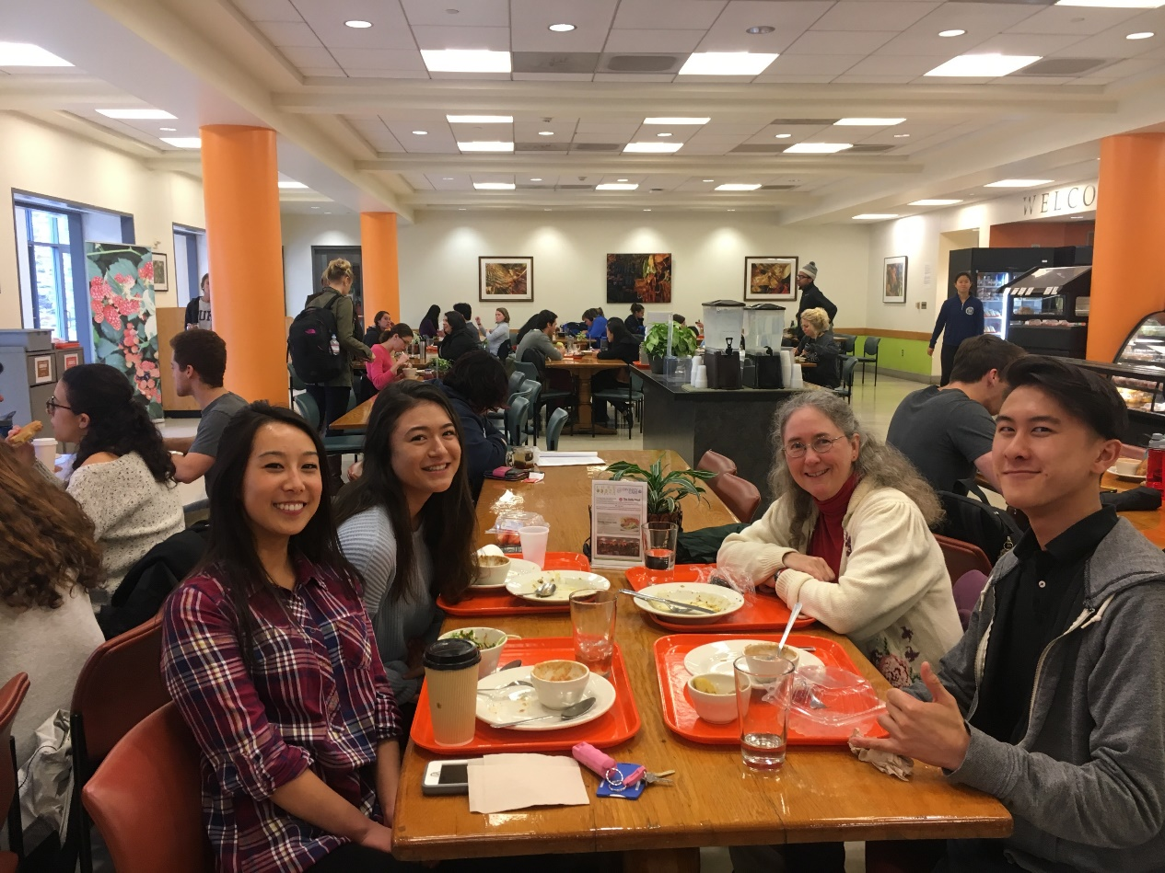
Future Duke CS Alum
Flunching with CompSci 101 students
Notes:
Time for flunching is running out. Two weeks after thanksgiving break is last chance this semester

Slide 4
Clever Hangman
Version of Hangman that is hard to win.
Program keeps changing secret word to make it hard to guess!
User never knows!
Once a letter is chosen and shown in a location, program picks from words that only have that letter in that location
Program smart to pick from largest group of words available

Slide 5
Clever Hangman - Dictionary
Builds a dictionary of categories
Start with list of words of correct size
Repeat
User picks a letter
Make dictionary of categories based on letter
New list of words is largest category
Category includes already matched letters
List shrinks in size each time

Slide 6
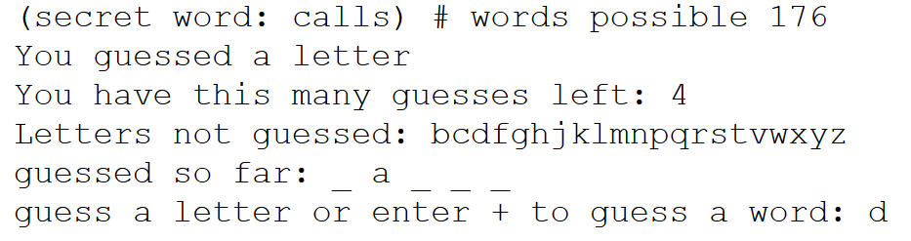
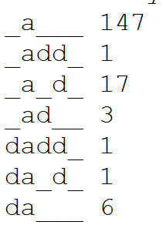
Clever Hangman Example
Possible scenerio after several rounds
From list of words with a the second letter. From that build a dictionary of list of words with no d and with d in different places:
Choose “no d”, most words, 147
Only 17 words of this type
Only 1 word of this type
Notes:
Great Dictionary example to solve a problem!

Slide 7
Exam logistics
Only need a pen or pencil
No scratch paper
See the reference sheet of Python information you will get with the test (see resources page)
Closed book, closed notes, closed neighbor
Covers lecture, lab and assigned reading
Have put old quizzes back up as quiz review
This is NOT for a grade, for studying only

Slide 8
Understand old and new topics
Old topics: if, for, while, lists, strings
list comprehension, enumerate
Files – write code - Will give you a file already opened and ready for reading
Sets, Dictionaries – write code – create and use
Understand items on Python review sheet on resources page
HAVE NOT COVERED TOPICS – regular expressions or recursion

Slide 9
The best way to study
Write code on paper!
Resources page has old tests and solutions
Try writing code, then look at solutions
Rewrite an APT
Rewrite code we did in lecture
Rewrite code we did in classwork or lab

Slide 10
Looping by index or by element
Strings and lists: use either
range(len(x)) for index, can get element
enumerate(somelist)
Sets and Dictionaries: element only
Loop over d or d.keys() for dictionary
The keys are a set, so similar to set loop
Which is best when choice? It depends!
Can you get element from index?
Can you get index from element?

Slide 11
Questions bit.ly/101f16-1115-1

Slide 12
Unpacking a list comprehension
[f(x) for x in foo if condition with x]
[w for w in words if w.endswith('e')]
[(w,words.count(w)) for w in set(words)]
Always possible to use a loop
build = [ ]
for x in foo:
if condition with x:
build.append(f(x))
build = [ ]
for w in set(words):
build.append((w,words.count(w)))

Slide 13
Set Concepts
Set union, intersection, difference
s.intersection(t) is the same as s&t
s.union(t) is the same as s|t
s.difference(t) is the same as s-t
Sets aren't in order during iteration
Convert to list, create from list
Sets are really, really efficient for add/search

Slide 14
Dictionaries
Build a dictionary
Counting dictionary
string to number
Grouping dictionary
string to list of items related
Use a dictionary
Get values
Get keys
Get key,value pair

Slide 15
Questions bit.ly/101f16-1115-2

Slide 16
Now go over Test Practice problems

