Slide 1
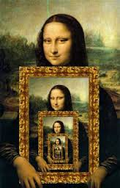
CompSci 101
Introduction to Computer Science
Nov. 29, 2016
Prof. Rodger

Slide 2
Announcements
Reading and RQ 17 due next time
Assignment 7 due today
  Assign 8 due Dec 6
  APT 9 due Thursday
  Exam 2 back tomorrow
  Coming… Points dropped on RQ, Lecture and Lab
Today:
  How do you access directories
  Recursion – Solving problems by solving smaller and smaller similar problems

Slide 3

Lab this week - Madlibs
Rudolph the <adjective>-nosed <noun>
had a very <adjective> nose. And if you ever <verb> it, you would really say it glowed.
Rudolph the large-nosed pig had a very crooked nose. And if you ever swim it, you would really say it glowed.
Noun: pig, cow, book, car, hand, lamp, bed, …
Notes:
We'll only get to sorts today, but files in directories and on websites are part of lab and we can go over them (will) on Thursday. Directory traversals may lead to recursion, but are used in lab
WBTB – week before thanksgiving break
Python .sort - same sort Timsort
Python sorted() - same sort Timsort

Slide 4
Prof Rodger Office Hours today shifted…
Today Only: 3:30-4:45pm

Slide 5


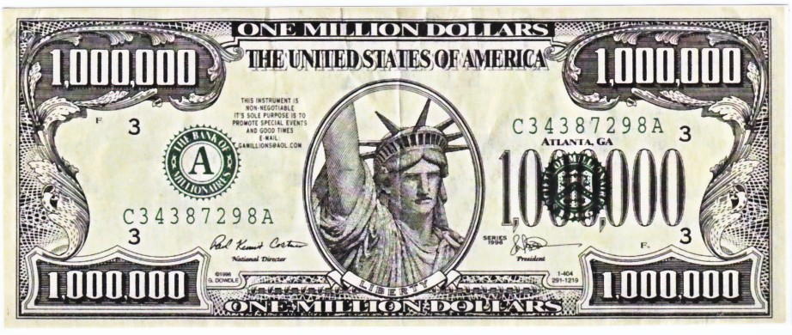
Math, Engineering, Sociology
Netflix prize in 2009
  Beat the system, win
  http://nyti.ms/sPvR
Notes:
Movie – Napolean Dynamite – caused problems you hate it or love it but it makes havoc with recommender systems
The Netflix Prize was an open competition for the best collaborative filtering algorithm to predict user ratings for films, based on previous ratings without any other information about the users or films,

Slide 6
Assignment 8: Collaborative Filtering
How does Amazon know what I want?
  Lots of customers, lots of purchases
How does Pandora know music like Kanye's?
  This isn't really collaborative filtering, more content-based
How does Netflix recommend movies?
  Why did they offer one million $$ to better their method?
Students at Duke who like Compsci also like …
  Could this system be built?
Notes:
Pandora - Having analyzed the musical structures present in the songs you like, it plays other songs that possess similar musical traits.

Slide 7





From User Rating to Recommendations
Spectre | Martian | Southpaw | Everest | PitchPerfect 2
3 | -3 | 5 | -2 | -3
2 | 2 | 3 | 2 | 3
4 | 4 | -2 | 1 | -1
What should I choose to see?
  What does this depend on?
Who is most like me?
  How do we figure this out
Notes:
Each row is one rater, they have each rated five movies.
Go over assignment and data files….

Slide 8
Plan for Today
Recursion
  Solving problems by solving similar but smaller problems
Programming and understanding …
  Hierarchical structures and concepts
    What is a file system on a computer?
    What is the Internet?
    How does the Domain Name System Work?
How do you access directories?
    And all the files in a directory, and the …
Notes:
How we interact with hierarchical structures that are self-referential.
You have a file system on your computer – you have files, you have folders with files and folders that may have files, etc.
You understand files and folders – today we will be looking at how to list all your files using a technique that is self-referential
What is the Internet? You have all probably been on the internet today, the internet is a large network, a large hierarchical structure made up of many networks and is also self-referential

Slide 9
Recursion
Solving a problem by solving similar but smaller problems

Slide 10
Recursion
Solving a problem by solving similar but smaller problems
Question - How many rows are there in this classroom?
Similar but smaller question - How many rows are there until your row?
I don’t know,
let me ask
Last row
Row count = 4+1 = 5
S
S
S
S
S
I don’t know,
let me ask
Return Value = 3+1 = 4
I don’t know,
let me ask
Return Value = 2+1 = 3
I don’t know,
let me ask
Return Value = 1+1 = 2
Return value = 1
I don’t have anyone to ask.
So I am in Row#1

Slide 11
http://computer1.sales.microsoft.com
Domain Name System (DNS)
Link:

Slide 12
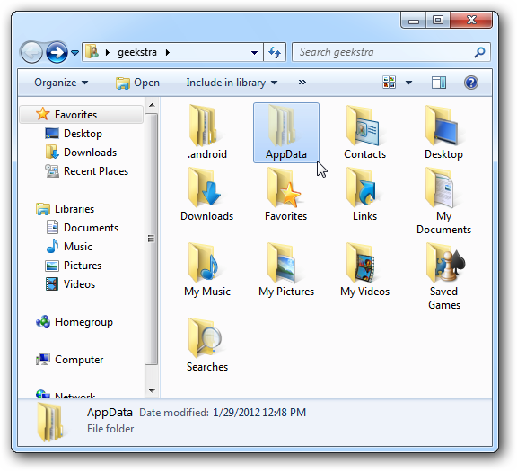
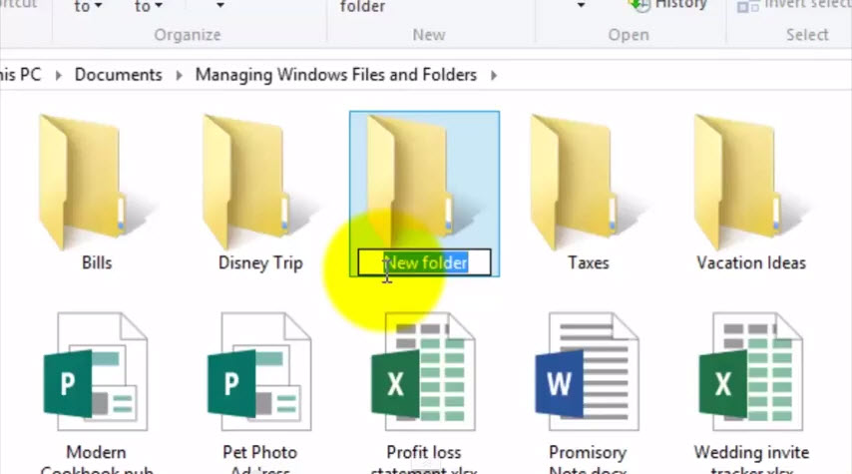
What's in a file-system Folder?
Notes:
This is a picture of folders and files on a windows machine. All of you have folders (likely) and files on your computer.

Slide 13
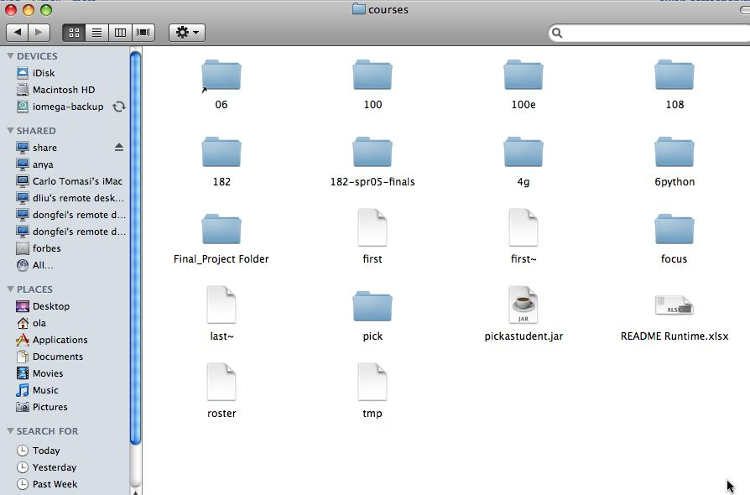
Notes:
Here is another picture from a Mac
When you click on a folder it opens up and there could be another folder in it and files. The folders could have a folder in it, and put papers in it, etc.

Slide 14
What's in a folder on your computer?
Where are the large files?
How do you find them?
They take up space!
  What’s the plan –
    Erase?
    Backup?
Notes:
Here is another picture from a Mac
When you click on a folder it opens up and there could be another folder in it and files. The folders could have a folder in it, and put papers in it, etc.

Slide 15
Hierarchy in Folder Structure
Level 0
Level 1
Level 2
Level 3
Level 4
Folder 1
Folder 2
Folder 3
Folder 4
Base Case
Folder 5
Folder 6

Slide 16
Recursion to find ALL files in a folder
A folder can have sub folders and files
A file cannot have sub files
def visit(dirname):
  for inner in dirname:
  if isdir(inner):
  visit(inner)
  else:
  print name(inner), size(inner)
Is that a directory?
If not a directory, it will be a file
Notes:
Calls an instance that is smaller

Slide 17
Finding large files: FileVisit.py
def bigfiles(dirname,min_size):
large = []
for sub in os.listdir(dirname):
path = os.path.join(dirname,sub)
if os.path.isdir(path):
subs = bigfiles(path,min_size)
large.extend(subs)
else:
size = os.path.getsize(path)
if size > min_size:
large.append((path,size))
return large
# on Mac like this:
#bigs = bigfiles("/Users/Susan/Documents",10000)
# on Windows like this:
bigs = bigfiles("C:\\Users\\Susan\\Documents",10000)
Notes:
Here is code you can snarf. This code finds all the files that are bigger than 10000 Kilobytes
It is useful to find big files on your computer if you need more space. So this code finds big files.
Which line identifies a big file? Dirname is the name of the folder.
This uses the os library, os is for operating systems.
Which line identifies big files? “ If size > min_size” is the line
Ask someone to identify the line
In the past we called folders directories… This library uses the older name directories
For loop visits everything in the folder. Everything in the folder is a folder or a file
If os.path.isdir - asks if this is a folder (directory)
If it is a file (else part) ask about the size to see if it is a big file and if so we append it to large
If it is a folder, we call bigfiles –hey that is the name of this function. That will be a separate call to this function with the folder that is in this folder. It will find all the big files and return them to the variable subs and then we put all those big files into large using extends (which is like append but for a list of things, not just one.

Slide 18
Example Run
('C:\\Users\\Susan\\files\\courses\\cps101\\workspace\\spring2015\\assign4_transform\\data\\romeo.txt', 153088L)
('C:\\Users\\Susan\\files\\courses\\cps101\\workspace\\spring2015\\assign4_transform\\data\\twain.txt', 13421L)
('C:\\Users\\Susan\\files\\courses\\cps101\\workspace\\spring2015\\assign5_hangman\\src\\lowerwords.txt', 408679L)
…
Notes:
Run the program and show large files on your computer
These are just three of my large files. You should recognize these big files romeo.txt, twain.txt and lowerwords.txt
You can see their size

Slide 19
Finding Large Files questions bit.ly/101f16-1129-1

Slide 20
The os and os.path libraries
Libraries use an API to isolate system dependencies
  C:\\x\\y # windows
  /Users/Susan/Desktop # mac
FAT-32, ReFS, WinFS, HFS, HSF+, fs
  Underneath, these systems are different
  Python API insulates and protects programmer
Why do we have os.path.join(x,y)?
  x = /Users/Susan/Documents
  y = file1.txt
  Output = /Users/Susan/Documents/file1.txt
Notes:
FileVisit code is for accessing all your files words regardless of max or pc
With these python libraries, you don’t have to worry how to access the files and folders for different systems, the writers of these libraries figured this for you and you just use the libraries.

Slide 21
Dissecting FileVisit.py
How do we find the contents of a folder?
  Another name for folder: directory
How do we identify folder? (by name)
  os.listdir(dirname) returns a list of files and folder
Path is c:\user\ola\foo or /Users/ola/bar
  os.path.join(dir,sub) returns full path
  Platform independent paths
What's the difference between file and folder?
  os.path.isdir() and os.path.getsize()
Notes:
If time go over these

Slide 22
Does the function call itself? No!
def visit(dirname):
  for inner in dirname:
  if isdir(inner):
  visit(inner)
  else:
  print name(inner), size(inner)
Is a file inside itself? No!
Does pseudo code make sense?
  Details make this a little harder in Python, but close!
Notes:
Calls an instance that is smaller

Slide 23
Structure matches Code
Find large files
If you see a folder,
1. Find the large files and subfolders
2. For the subfolders, repeat the process of finding large files
and any other folders within that subfolder
3. Repeat the process until you reach the last folder
Compress or Zip a folder
If you see a folder,
1. Find the files and subfolders
2. For the subfolders, repeat the process of finding files
and any other folders within that subfolder
3. At the last stage, start compressing files and move up
the folder hierarchy

Slide 24
Structure matches Code
Structure of list of lists
  Can also lead to processing a list which requires processing a list which …
[ [ [a,b], [c,d], [a, [b,c],d] ]
(a *(b + c (d + e*f)) + (a* (b+d)))

Slide 25
Recursion
Simpler or smaller calls
Must have a base case when no recursive call can be made
    Example - The last folder in the folder hierarchy will not have any subfolders. It can only have files. That forms the base case
Notes:
When you are trying to print out all folders eventually you get a folder with only files, no folders. Then you don’t need to call bigfiles again.
Quicksort is on the next slide

Slide 26
Sir Anthony (Tony) Hoare
There are two ways of constructing a software design. One way is to make it so simple that there are obviously no deficiencies. And the other way is to make it so complicated that there are no obvious deficiencies.
Turing Award, didn’t get recursion…..
Inventor of quicksort
Notes:
He is SIR, won the turing award and also has been knighted by queen Elizabeth.
As an aside, he invented quicksort in 1960. It is a very fast sort, used to be the quickest, but no longer is the fastest, Python uses another sort, timsort.
When he named it in 1960 he didn’t get recursion. He wrote code for this that was really long, but if you use recursion the solution is only about 5 lines.

Slide 27
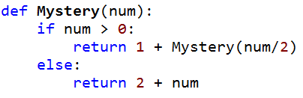
Mystery Recursion bit.ly/101f16-1129-2

Slide 28
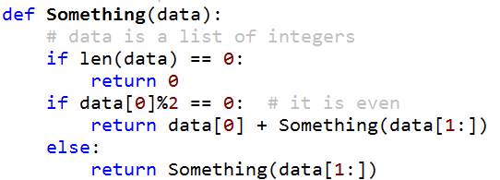
Something Recursion bitly/101f16-1129-3

