Slide 1
CompSci 101 Introduction to Computer Science
 | ABP | BlueEx | McDon | Loop | Panda | Nasher
Sam | 0 | 3 | 5 | 0 | -3 | 5
Chris | 1 | 1 | 0 | 3 | 0 | -3
Nat | -3 | 3 | 3 | 5 | 1 | -1
Dec 1, 2016
Prof. Rodger

Slide 2
Announcements
Reading and RQ due Tuesday
Assign 8 due Tue., Assign9 due Dec 9
APT 11 due Dec 9, no penalty til Dec 12!
Today:
Review Recursion
Regular Expressions
Assignment 8 Recommender

Slide 3

Assignment 9 Due Dec 9 Shhh! No late penalty til Dec 12!
Write a song, make a video about your experience with CompSci 101

Slide 4





Assignment 8 From User Rating to Recommendations
Spectre | Martian | Southpaw | Everest | PitchPerfect 2
3 | -3 | 5 | -2 | -3
2 | 2 | 3 | 2 | 3
4 | 4 | -2 | 1 | -1
What should I choose to see?
What does this depend on?
Who is most like me?
How do we figure this out

Slide 5
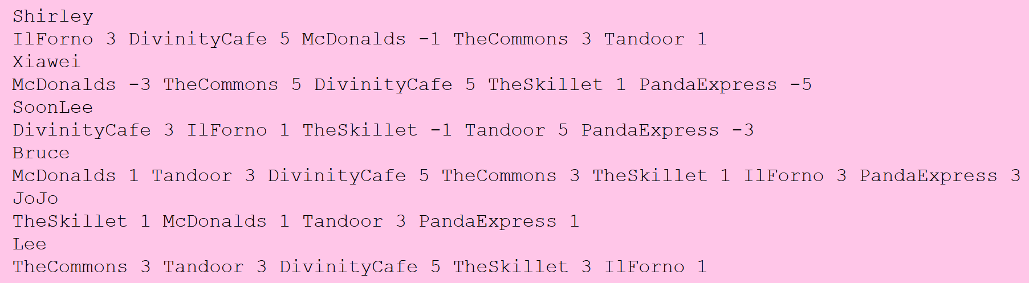
ReadFood modules: Food Format bit.ly/101f16-1201-A
All Reader modules return a tuple of strings: itemlist and dictratings dictionary
Translated to:
Notes:
Give the example formated

Slide 6
Data For Recommender
Users/Raters rate Items
We need to know the items
We need to know how users rate each item
Which eatery has highest average rating?
Conceptually: average columns in table
How is data provided in this assignment?
 | ABP | BlueEx | McDon | Loop | Panda | Nasher
Sam | 0 | 3 | 5 | 0 | -3 | 5
Chris | 1 | 1 | 0 | 3 | 0 | -3
Nat | -3 | 3 | 3 | 5 | 1 | -1
Notes:
Seven items – 3 sets of ratings for each – have to rate everything
Divide by 2 – don’t count 0 – allratings don’t include 0
One way of doing a recommendation – what yelp does
Average rating

Slide 7
Data For Recommender
itemlist are provided in a list of strings
Parsing data provides this list
dictratings provided in dictionary
Key is user ID
Value is list of integer ratings
 | ABP | BlueEx | McDon | Loop | Panda | Nasher
Sam | 0 | 3 | 5 | 0 | -3 | 5
Chris | 1 | 1 | 0 | 3 | 0 | -3
Nat | -3 | 3 | 3 | 5 | 1 | -1
Notes:
You need items as a list of strings (restaurants)
Required to create a dictionary
Note they are in the same order

Slide 8
Data For Recommender
Given Parameters
itemlist: a list of strings
dictratings: dictionary of ID to ratings list
Can you write
Average(itemlist, dictratings)
 | ABP | BlueEx | McDon | Loop | Panda | Nasher
Sam | 0 | 3 | 5 | 0 | -3 | 5
Chris | 1 | 1 | 0 | 3 | 0 | -3
Nat | -3 | 3 | 3 | 5 | 1 | -1
Notes:
Id is person and list of their ratings as ints
Average for McDonalds? 4

Slide 9
Drawbacks of Item Averaging
Are all ratings the same to me?
Shouldn't I value ratings of people "near" me as more meaningful than those "far" from me?
Collaborative Filtering
https://en.wikipedia.org/wiki/Collaborative_filtering
How do we determine who is "near" me?
Mathematically: treat ratings as vectors in an N-dimensional space, N = # ratings
Informally: assign numbers, higher the number, closer to me
Notes:
All ratings are the same.
Don’t you want to only consider ratings that are near you and value their ratings.

Slide 10
Collaborative Filtering: Recommender
First determine closeness of all users to me:
"Me" is a user-ID, parameter to function
Return list of (ID, closeness-#) tuples, sorted
Use just the ratings of person closest to me
Is this a good idea?
What about the 10 closest people to me?
What about weighting ratings
Closer to me, more weight given to rating
Notes:
How many do you use
You could weight those closer to you and use everyone

Slide 11
How do you calculate a similarity?
Me: [3, 5, -3]
Joe: [5, 1, -1]
Sue: [-1, 1, 3]
Joe to Me
= (3*5 + 5*1 + -3 * -1) = 23
Sue to Me
= (3*-1 + 5 * 1 + -3 * 3) = -7

Slide 12
How do you calculate a similarity?
Me: [3, 5, -3]
Joe: [5, 1, -1]
Sue: [-1, 1, 3]
Joe to Me
= (3*5 + 5*1 + -3 * -1) = 23
Sue to Me
= (3*-1 + 5 * 1 + -3 * 3) = -7
Notes:
The higher the number the closer they are to me. Negative numbers are really far from me.

Slide 13

Collaborative Filtering
For Chris: 12 * [1,1,0,3,0,-3] =
[12,12,0,36,0,-36]
For Sam: [0,75,125,0,-75,125]
Chris:12
Nat:37
Sam:25
 | ABP | BlueEx | McDon | Loop | Panda | Nasher
Sam | 0 | 3 | 5 | 0 | -3 | 5
Chris | 1 | 1 | 0 | 3 | 0 | -3
Nat | -3 | 3 | 3 | 5 | 1 | -1
Notes:
Here we are calculating ratings with weights.
Chris is 12 away from me
Nat is 37 away from me
Sam is 25 away from me
High number is closer to you .
Show how you multiple the closeness number times every rating.

Slide 14
Adding lists of numbers
[12, 12, 0, 36, 0,-36]
[ 0, 75, 125, 0,-75,125]
[-111,111,111,185,37, -37]
---------------------------
[-99, 198, 236, 221, -38, 52]
Adding columns in lists of numbers
Using indexes 0, 1, 2, … sum elements of list
sum([val[i] for val in d.values()])
Notes:
I would probably like 236 item, then
Note the -75 could be an outlier, only one person rated it.

Slide 15
Then divide by number of nonzeros
[12, 12, 0, 36, 0,-36]
[ 0, 75, 125, 0,-75,125]
[-111,111,111,185,37, -37]
---------------------------
[-99, 198, 236, 221, -38, 52]
/2 /3 /2 /2 /2 /3
[ -49, 66, 118, 110 -19, 17]
 | ABP | BlueEx | McDon | Loop | Panda | Nasher
Sam | 0 | 3 | 5 | 0 | -3 | 5
Chris | 1 | 1 | 0 | 3 | 0 | -3
Nat | -3 | 3 | 3 | 5 | 1 | -1
Recommend
3rd item
Notes:
I would probably like 139 item, then
Note the -75 could be an outlier, only one person rated it.

Slide 16
Follow 12-step process
ReadFood first!
Read input and save it
Get list of restaurants – use that ordering! Set?
For each person
For each restaurant and its rating
Must find location of restaurant in itemlist
Then update appropriate counter
Print any structure you create to check it

Slide 17
Recursion Review
Function calls a clone of itself
Smaller problem
Must be a way out of recursion
Notes:
Solving a smaller version of the original problem, must be smaller in some way.
Must also get smaller and smaller and then must be a way where it is so small you can just solve the problem.

Slide 18
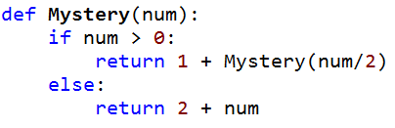
Example
Mystery(5) is 1 + Mystery(2)
Mystery(2) is 1 + Mystery(1)
Mystery(1) is 1 + Mystery(0)
Mystery(0) is 2
= 1 + 4 = 5
= 1 + 3 = 4
= 1 + 2 = 3

Slide 19
Review: Recursion to find ALL files in a folder
A folder can have sub folders and files
A file cannot have sub files
def visit(dirname):
for inner in dirname:
if isdir(inner):
visit(inner)
else:
print name(inner), size(inner)
Is that a directory?
If not a directory, it will be a file
Notes:
Calls an instance that is smaller

Slide 20
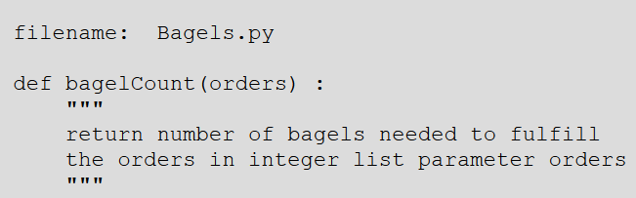
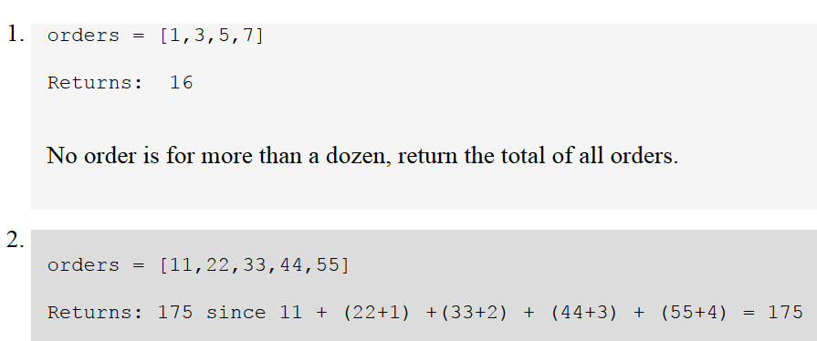
Revisit the APT Bagels Recursively

Slide 21
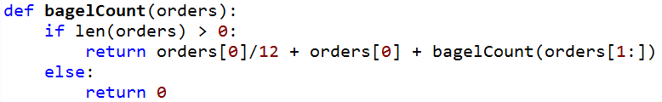
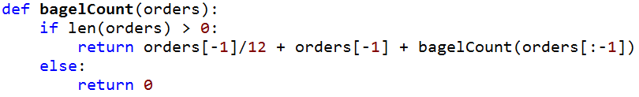
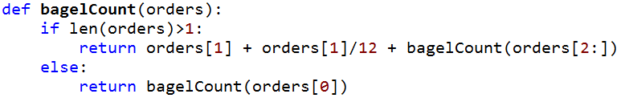
APT Bagels Recursively bit.ly/101f16-1201-2
A)
B)
C)
D)

Slide 22

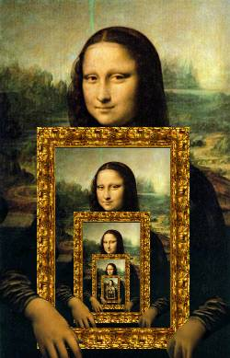
Recursion in Pictures
http://xkcd.com/543/

Slide 23
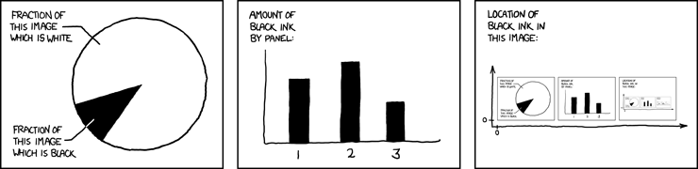
More: Recursion in Pictures
http://xkcd.com/688/

Slide 24
What is Computer Science?
… "it is the study of automating algorithmic processes that scale."
https://en.wikipedia.org/wiki/Computer_science
If you need to find one email address on a webpage, you don't need computer science
If you need to scrape every email address, that number in the 10's to 100's, you could use help

Slide 25
How do you solve a problem like …
How many words end in "aria"?
Start with "aria"? Contain "aria"?
Why would you care about this?
Can you find ola@cs.duke.edu, susan.rodger@duke.edu, and andrew.douglas.hilton@gmail.com when searching through a webpage source?
What is the format of a "real" email address?
Notes:
How do you solve a problem like "Maria" is from sound of music

Slide 26
Examples of regex's at work
What do aria$ and ^aria and aria share?
Answers to previous question
What about the regex .+@.+
Turns out that . has special meaning in regex, so does +, so do many characters
We'll use a module RegexDemo.py to check
Uses the re Python library
Details won't be tested, regex knowledge will

Slide 27
Regex expressions
Regex parts combined in powerful ways
Each part of a regex "matches" text, can extract matches using programs and regex library
^ is start of word/line, $ is end
Expressions that match single characters:
A, a, 9 or … | Any character matches itself
. | Matches any character
\w | Matches alphanumeric and _
\d | Matches digit
\s | Matches whitespace

Slide 28
Regex expressions
Repeat and combine regex parts
* means 0 or more occurrences/repeats
+ means 1 or more occurrences/repeats
? Means (after * or +) to be non-greedy
Expressions match more than one character
[a-zAB] | Brackets create character class
(regex) | Tag or group a regex
\1 or \2 | Matches previously grouped regex
{1} or {n} | Repeat regex 1 or n times

Slide 29
Regex examples tried and explained
Five letter words ending in p? Starts 'd'?
^\w\w\w\wp$ but not ....p$
Seven letter words, or seven ending with 'z'
Difference between ^\w{7}$ and ^\w{7}
Words that start with a consonant:
^[^aeiou] double meaning of ^

Slide 30
Regex examples tried and explained
Five letter words ending in p? Starts 'd'?
^\w\w\w\wp$ but not ....p$
Seven letter words, or seven ending with 'z'
Difference between ^\w{7}$ and ^\w{7}
Start and end with the same two letters like sense and metronome, decipher this:
^(\w\w).*\1$
Start and end with three letters reversed, like despised and foolproof?

Slide 31
Summary of Regular Expressions
regex | purpose |  | regex | purpose
. | any character |  | * | zero or more of previous regex
\w | any alphanumeric character (and _) |  | + | one or more of previous regex
\s | any whitespace character |  | *? or +? | non-greedy version of either * or +
\d | any digit character |  | () | tag/group a regular expression
[] | character class, e.g., [A-Z] or [aeiou] |  | \1, \2, .. | match numbered tagged/grouped regex
{n} | n occurrences of preceding regex |  | ^ | beginning of line/string
[^...] | not the characters in the class, e.g., [^aeiou] |  | $ | end of line/string

Slide 32
Regex Questions bit.ly/101f16-1201-3

Slide 33
Take Exam questions

