Slide 1
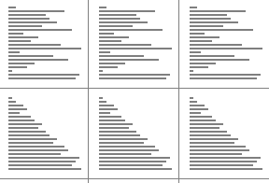
CompSci 101
Introduction to Computer Science
Dec 6, 2016
Prof. Rodger

Slide 2
Announcements
RQ done!
Assign 8 due today
APT 10, Assign 9 – due Friday(Monday)
Final Exam:
  Sec 01 Mon Dec 19 2pm, LSRC B101
  Sec 02 Thur Dec 15 7pm, BIO Sci 111
  Get accommodations?
  Room for some to take final with the other section
  Must fill out form by THIS FRIDAY, Dec 9.

Slide 3
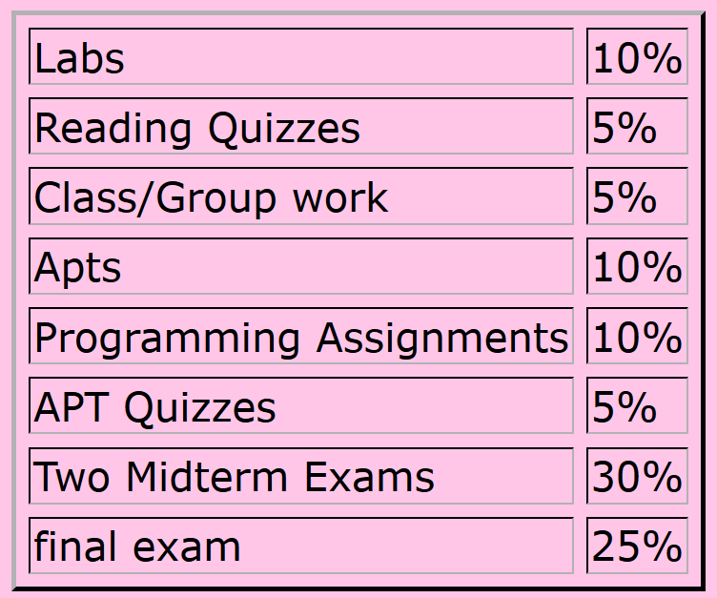
Calculate Your Grade
From “About” tab on course web page

Slide 4
More on Grades
Lecture – ignore the first two weeks (drop/add period), plus drop 4 points
Reading Quizzes – will drop 30 points
  Lots of problems with Sakai this semester
  Check your grades to make sure they copied over – fill out duke oit help form if they are wrong
Lab – drop 6 points (each lab is 4 pts)
  44 pts total– 38 pts is 100%

Slide 5
More Announcements
Regrades for Exam 2 – submit by Fri. Dec 9
Be a UTA for CompSci 101
  Rewarding and Learning Experience
  Apply: http://www.cs.duke.edu/csed/uta
Last Lab this week
Today:
  More on Recursion, Regex
  More on Sorting and analyzing it

Slide 6
Provide Comments on UTAs
Lab UTAs
Any other UTAs who helped you?
See announcement in Sakai
  Anonymous Feedback for course
  Anonymous feedback on UTAs

Slide 7
Regex Questions bit.ly/101f16-1206-1

Slide 8
Review Recursion and Regex bit.ly/101f16-1206-2

Slide 9
Dictionary Comprehension
List comprehension - builds a new list
Dictionary comprehension - builds a new dictionary
Format
d = { key:value for key in somelist if ....}
:

Slide 10
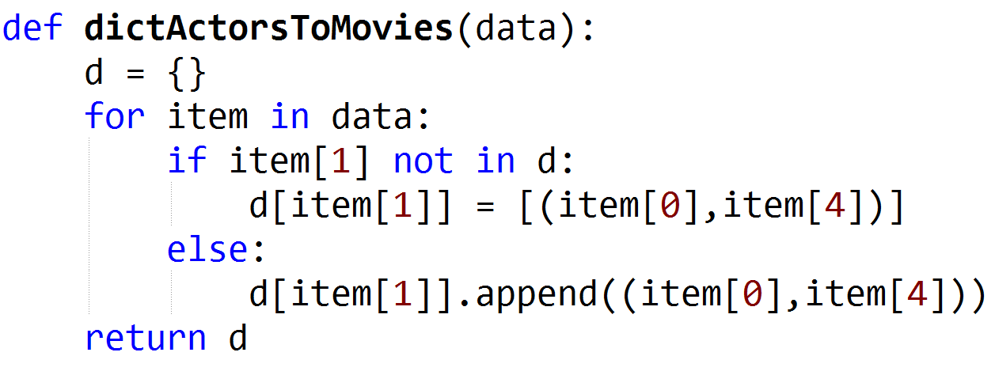
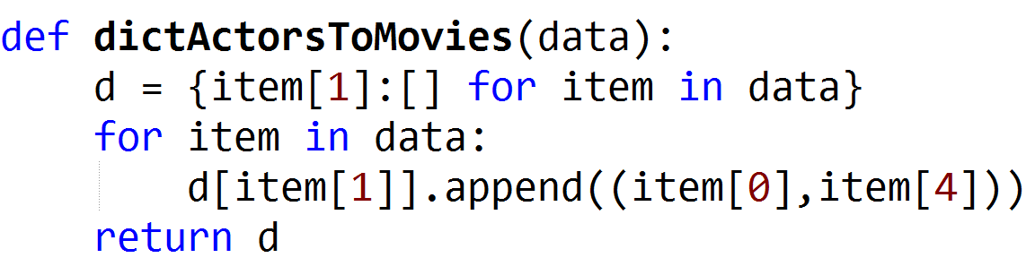
Example: From Exam 2 – dict of Actors to list of movies: (movie in, num minutes in)
Notes:
Save three lines. By initializing the item in the dictionary comprehension, you don’t need to check if it is in the dictionary or not.

Slide 11
Example: Assignment 8
ReadFood: Initialize dictionary ratingsdict
Compute number of restaurants, say n
Create alldata – list of
[[name1,ratings1], [name2, ratings2], [name3,ratings3], …]
[[‘JoJo’, [‘Skillet’,1,’McDonalds’,1,’Tandoor’,3, ’PandaExpress’,3]], …
Then create dictionary:
ratingsdict = {person[0]:[0]*n for person in somelist}
Then update dictionary by processing alldata

Slide 12
Sorting
In python:
  alist = [8, 5, 2, 3, 1, 6, 4]
  alist.sort() OR result = sorted(alist)
  Now alist OR result is [1, 2, 3, 4, 5, 6, 8]
How does one sort elements in order? How does “sort” work?

Slide 13
Selection Sort
Sort a list of numbers.
Idea:
  Repeat til sorted
    Find the smallest element in part of list not sorted
    Put it where it belongs in sorted order.
      Swap it with the element where it should be
Sort example
Sorted, won’t move
final position
???
Notes:
Use cards, mention a pass

Slide 14
Selection Sort http://bit.ly/101f16-1206-3
Sort the list of numbers using Selection Sort.
The body of the loop is one pass.
Show the elements after each pass.
9, 5, 1, 4, 3, 6

Slide 15
Code for Selection Sort
def selectsort(data):
for i in range(len(data)):
mindex = minindex(i)
data[i],data[mindex] =data[mindex],data[i]
Notes:
Need to write minindex to find the location of the smallest.

Slide 16

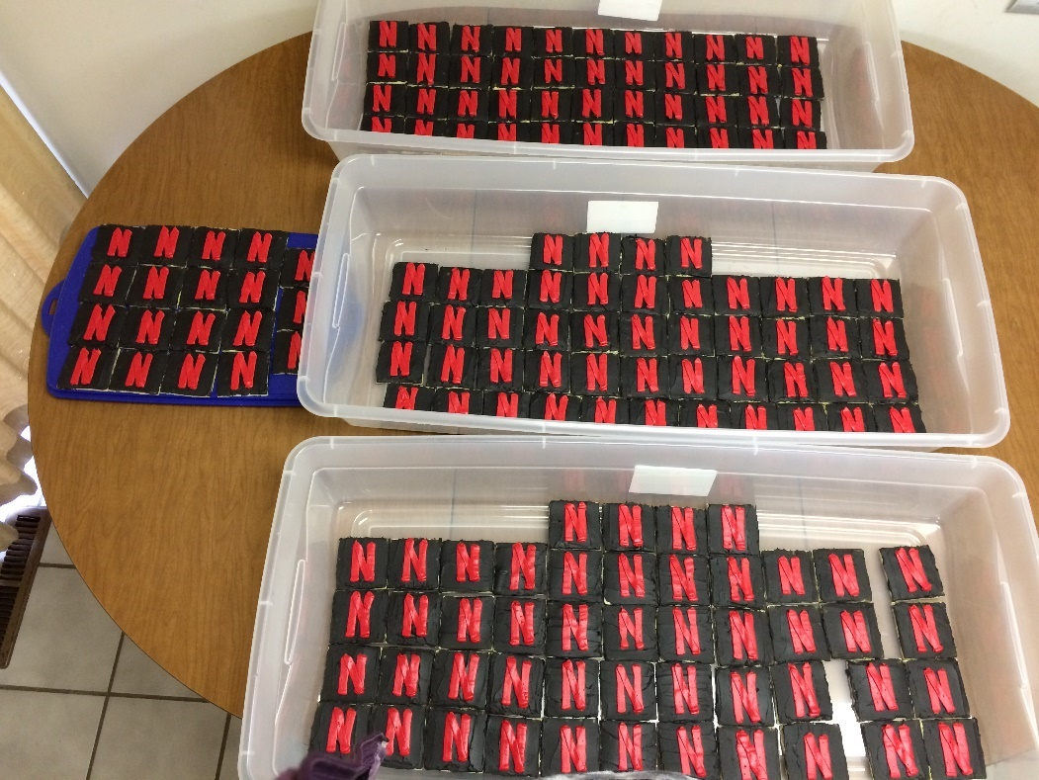
One Cookie Per Person!
Netflix - Recommender

