Slide 1
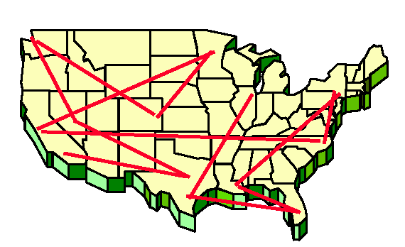
CompSci 101 Introduction to Computer Science
Dec 8, 2016
Prof. Rodger

Slide 2
Announcements
Last Day of class!
Assign 8 – With LATE Penalty thru Fri, Dec 9
Assign 9 by Monday, none accepted after that
APT 10 due by Monday, no Late APTs
Form for taking Final exam another time
accommodations?
Three exams in a 24 hour period?
Room for some to take final with the other section
Fill out by tomorrow for consideration!!!

Slide 3
More Announcements
Regrade for Exam 2 – submit by Friday, Dec 9
Review Session – Tuesday 4pm (LSRC B101)
Last Consulting Hours tonight
Prof. Rodger will have office hours
Today 3-5pm, Tomorrow 2-5pm, more…
Concern form – last minute concerns
Today:
Wrapping up, Beyond CompSci 101
The Final exam

Slide 4
Final Exam
Sec 01– Monday, Dec 19, 2pm, LSRC B101
Sec 02 – Thurs, Dec 15, 7pm, Bio Sci 111
Closed Book, Closed Notes, Closed neighbor
Python Reference Sheet
Covers all topics through today
Best way to study is practice writing code!
See old tests (no old final exams)

Slide 5
Final Exam (cont)
Test format
Multiple choice
Writing code – similar to exam 2
Topics include:
if, loops, lists, sets, dictionaries, files, functions, sorting, etc
recursion, regular expressions – reading level only

Slide 6
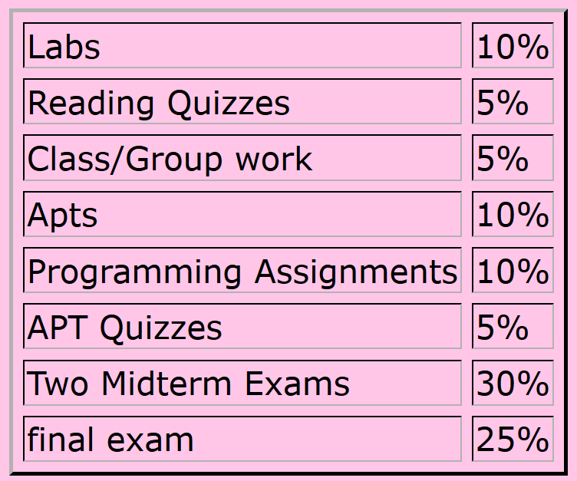
Calculate Your Grade
From “About” tab on course web page

Slide 7
More on Grades
Lecture – ignore the first two weeks (drop/add period), plus drop 4 points
Reading Quizzes – will drop 30 points
Lots of problems with Sakai this semester
Check your grades to make sure they copied over – fill out duke oit help form if they are wrong
Lab – drop 6 points (each lab is 4 pts)
44 pts total– 38 pts is 100%

Slide 8
Fill out Duke Course Eval
Please fill out Duke Course Eval on DukeHub now
Only 15% have filled it in as of last night
If you already have , then go to Sakai and fill out feedback on UTAs

Slide 9
Review - Selection Sort
Sort a list of numbers.
Idea:
Repeat til sorted
Find the smallest element in part of list not sorted
Put it where it belongs in sorted order.
Swap it with the element where it should be
Sort example
Sorted, won’t move
final position
???
Notes:
Use cards, mention a pass

Slide 10
Selection Sort – red area sorted
5 4 1 3 6 - find smallest, swap
5 4 9 3 6 - end of 1st pass
5 4 9 3 6 - find smallest, swap
3 4 9 5 6 - end of 2nd pass
1 3 4 9 5 6 - find smallest, swap

Slide 11
Selection Sort (cont.)
1 3 4 9 5 6 - end of 3rd pass
3 4 9 5 6 - find smallest, swap
3 4 5 9 6 - end of 4th pass
1 3 4 5 9 6 - find smallest, swap
1 3 4 5 6 9 - end of 5th pass, done

Slide 12
Bubble Sort
Sort a list of numbers.
Idea:
Repeat til sorted
Compare all adjacent pairs, one at a time. If out of order then swap them
Sort example
Sorted, won’t move
final position
???

Slide 13
Bubble Sort bit.ly/101f16-1208-1
Sort the list of numbers using BubbleSort.
The body of the loop is one pass.
Show the elements after each pass.
[9, 5, 4, 1, 3, 6]

Slide 14
Bubble Sort – red area sorted
5 4 1 3 6 - compare, swap
5 9 4 1 3 6 - compare, swap
5 4 9 1 3 6 - compare, swap
5 4 1 9 3 6 - compare, swap
5 4 1 3 9 6 - compare, swap
5 4 1 3 6 9 - end of 1st pass
5 4 1 3 6 9

Slide 15
Bubble Sort – red area sorted
5 4 1 3 6 9 - compare, swap
4 5 1 3 6 9 - compare, swap
4 1 5 3 6 9 - compare, swap
4 1 3 5 6 9 - compare, no swap
4 1 3 5 6 9 - end of 2cd pass
4 1 3 5 6 9

Slide 16
Bubble Sort – red area sorted
4 1 3 5 6 9 - compare, swap
1 4 3 5 6 9 - compare, swap
1 3 4 5 6 9 - compare, no swap
1 3 4 5 6 9 - end of 3rd pass
1 3 4 5 6 9
Two more passes would guarantee sorted.
Or Check if sorted and skip last two passes

Slide 17
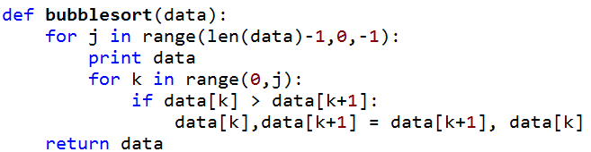
Code for Bubblesort

Slide 18
Insertion Sort
Sort a list of numbers.
Idea:
Sort by repeated inserting another element
Leftmost element is sorted part of list
Insert another element in that sublist keeping it sorted
Insert another element in that sublist keeping it sorted
Etc.
Sort example
Sorted relative to
each other
???

Slide 19
Insertion Sort bit.ly/101f16-1208-2
Sort the list of numbers using InsertionSort.
The body of the loop is one pass.
Show the elements after each pass.
[9, 5, 1, 4, 3, 6]

Slide 20
Insertion Sort – red area sorted
5 1 4 3 6 - insert 5
5 9 1 4 3 6 - 1st pass, now insert 1
5 9 4 3 6 - 2nd pass, now insert 4
4 5 9 3 6 - 3rd pass, now insert 3
1 3 4 5 9 6 - 4th pass, now insert 6

Slide 21
Insertion Sort – red area sorted
3 4 5 6 9 - 5th pass

Slide 22
Merge Sort
Idea: Divide and Conquer
Divide list into two halves
Sort both halves (smaller problem)
Merge the two sorted halves
9 5 1 4 3 6 2 7
Notes:
Quite a different approach than the others. Uses recursion with multiple recursive calls
Timsort invented by Tim Peters – a hybrid sort combines mergesort and insertion sort
Shellsort invented by Donald Shell– uses insertion sort as part of it
You can invent a sort and get them named after you!

Slide 23
Merge Sort
Idea: Divide and Conquer
Divide list into two halves
Sort both halves (smaller problem)
Merge the two sorted halves
9 5 1 4 3 6 2 7
9 5 1 4 3 6 2 7 divide list into 2 halves
Notes:
Quite a different approach than the others. Uses recursion with multiple recursive calls
Timsort invented by Tim Peters – a hybrid sort combines mergesort and insertion sort
Shellsort invented by Donald Shell– uses insertion sort as part of it
You can invent a sort and get them named after you!

Slide 24
Merge Sort
Idea: Divide and Conquer
Divide list into two halves
Sort both halves (smaller problem)
Merge the two sorted halves
9 5 1 4 3 6 2 7
9 5 1 4 3 6 2 7 divide list into 2 halves
1 4 5 9 2 3 6 7 recursively sort each half
Notes:
Quite a different approach than the others. Uses recursion with multiple recursive calls
Timsort invented by Tim Peters – a hybrid sort combines mergesort and insertion sort
Shellsort invented by Donald Shell– uses insertion sort as part of it
You can invent a sort and get them named after you!

Slide 25
Merge Sort
Idea: Divide and Conquer
Divide list into two halves
Sort both halves (smaller problem)
Merge the two sorted halves
9 5 1 4 3 6 2 7
9 5 1 4 3 6 2 7 divide list into 2 halves
1 4 5 9 2 3 6 7 recursively sort each half
1 2 3 4 5 6 7 9 merge the two sorted list
Notes:
Quite a different approach than the others. Uses recursion with multiple recursive calls
Timsort invented by Tim Peters – a hybrid sort combines mergesort and insertion sort
Shellsort invented by Donald Shell– uses insertion sort as part of it
You can invent a sort and get them named after you!

Slide 26
What does recursively sort mean? Merge Sort
Use the same Merge Sort algorithm
Divide list into two halves
Sort both halves (smaller problem)
Merge the two sorted halves
9 5 1 4
9 5 1 4 divide list into 2 halves
5 9 1 4 recursively sort each half
1 4 5 9 merge the two sorted list

Slide 27
MergeSort idea for code
def mergesort(data)
n = len(data)
if n == 1:
return data
else:
d1 = mergesort(data[:n/2])
d2 = mergesort(data[n/2:])
return merge(d1, d2)

Slide 28
bit.ly/101f16-1208-3 Question 1 Question 2
Which sort is this? Which sort is this?
4 10 5 3 8 2 4 10 5 3 8 2
4 10 5 3 8 2 4 2 5 3 8 10
4 5 10 3 8 2 4 2 5 3 8 10
3 4 5 10 8 2 4 2 3 5 8 10
3 4 5 8 10 2 3 2 4 5 8 10
2 3 4 5 8 10 2 3 4 5 8 10
Notes:
SHOW NEXT SLIDE TOO!

Slide 29
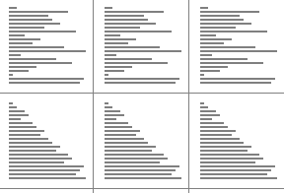
Wrap up Sorting
Some Ways to Compare sorts.
How many total swaps?
Is one faster for certain types of input?
Does the input matter
Different ways to sort?
Over 50 sorting algorithms
Does President Obama know his sorts?
Sorting animations
http://www.sorting-algorithms.com/
Notes:
All do one pass to sort numbers.
Python – probably uses quicksort, a divide and conquer algorithm
DIDN’t GET TO THESE SLIDES

Slide 30
More on Sorting in CompSci 201
Learn about this and other sorts in CompSci 201, also how to analyze them to determine which one works best.
Python: Timsort
combines mergesort and insertion sort
Shellsort
uses insertion sort on parts of the list repeatedly - those parts getting larger each time
Notes:
Quite a different approach than the others. Uses recursion with multiple recursive calls
Timsort invented by Tim Peters – a hybrid sort combines mergesort and insertion sort
Shellsort invented by Donald Shell– uses insertion sort as part of it
You can invent a sort and get them named after you!

Slide 31
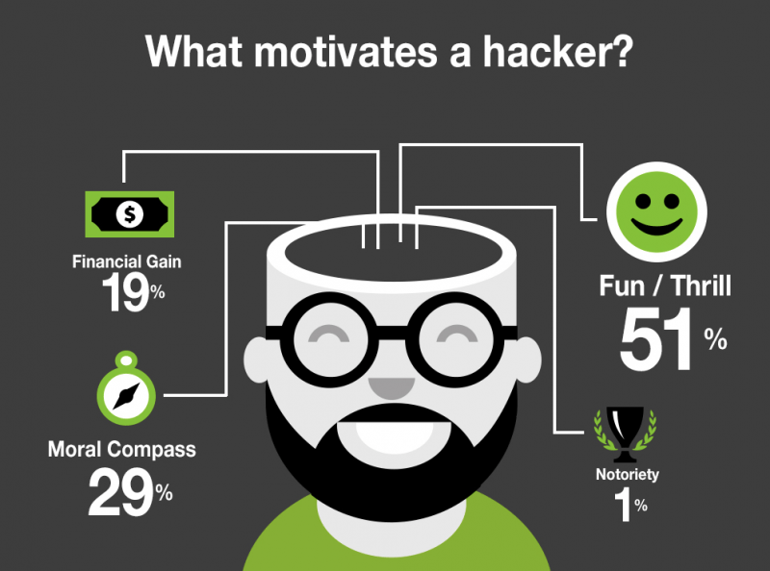
Scraping email address from websites
Suppose we want to send email to all Duke Faculty to let them know …
Visit Departmental website, people, faculty
View (HTML) Source
Develop regex to access email – if possible!
RegexScraper.py
Python makes this simple
Ethical hacking?

Slide 32
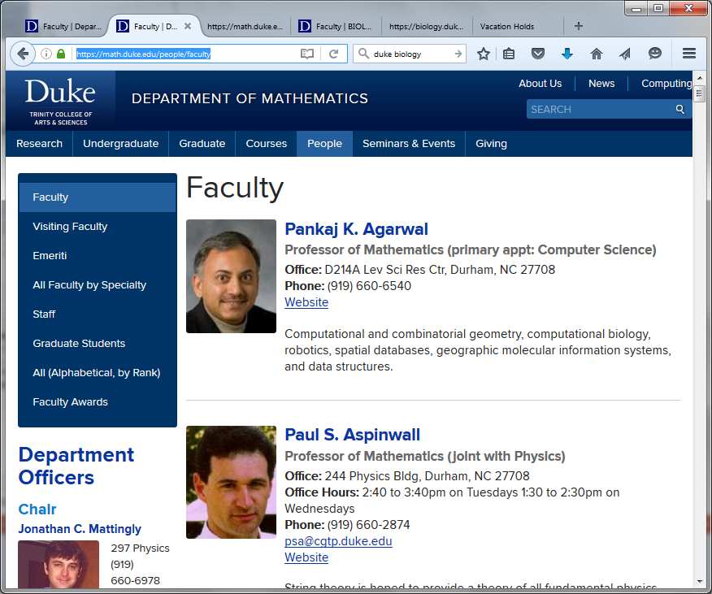
Math Website – Faculty on one page
Notes:
Note not everyone has an email Aspinwall does, Agarwal doesn’t

Slide 33
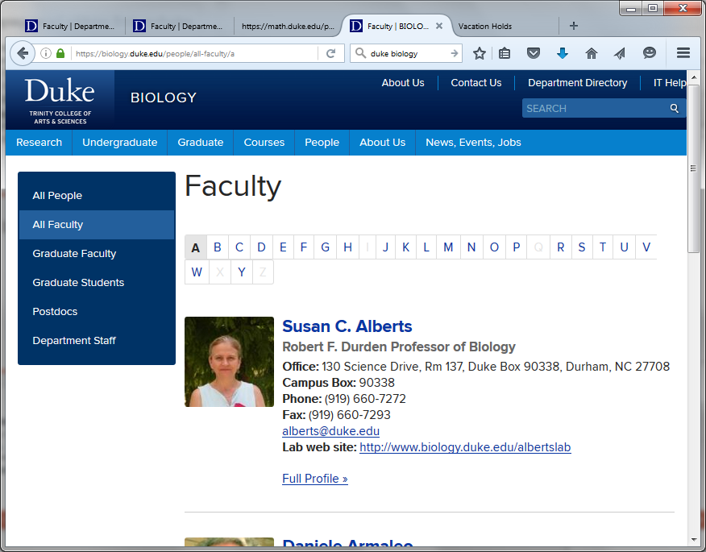
Duke Biology Website A-Z pages
Notes:
Note they have a different page for every letter of the alphabet

Slide 34
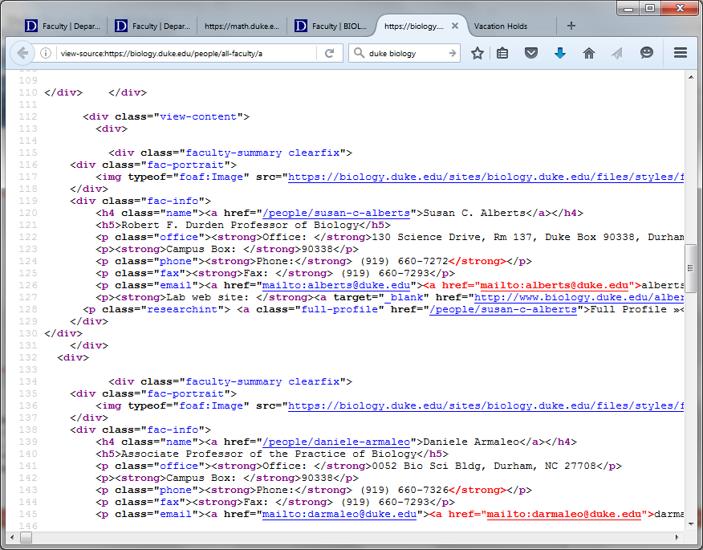
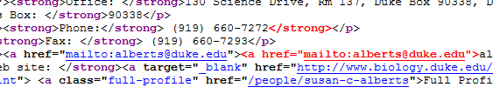
View page source of html

Slide 35
Scraping Biology faculty
Pattern:
r'mailto:(\w+[.\w]*)@(\w+[.\w+]*)'
URL
https://biology.duke.edu/people/all-faculty/a
Matches (call 26 times with different URL)
…
('emily.bernhardt', 'duke.edu')
('emily.bernhardt', 'duke.edu')
('bhandawat', 'gmail.com')
('bhandawat', 'gmail.com')
('jboynton66', 'gmail.com')
('jboynton66', 'gmail.com')
Notes:
Find the mailto: then character to the @, then characters after the @, won’t match the “

Slide 36
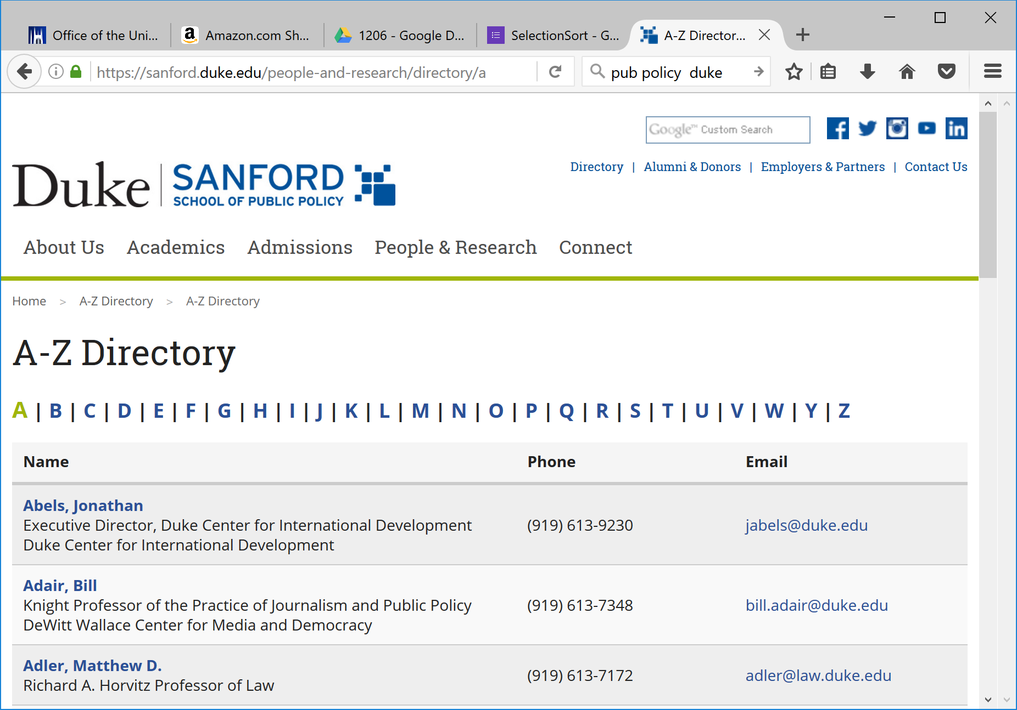
Public Policy pages for A-Z
Notes:
Similar pages to math – One page for each letter of the alphabet

Slide 37
Scraping Sanford/PubPol faculty
Pattern:
r'(\w+[.\w]*)@(\w+[.\w+]*)'
URL
https://sanford.duke.edu/people…/
Matches (call 26 times with different URL)
…
('schanzer', 'duke.edu')
('steveschewel', 'gmail.com')
('michael.schoenfeld', 'duke.edu')
('schroeder', 'law.duke.edu')

Slide 38
What is Computing? Informatics?
What is computer science, what is its potential?
What can we do with computers in our lives?
What can we do with computing for society?
Will networks transform thinking/knowing/doing?
Society affecting and affected by computing?
Changes in science: biology, physics, chemistry, …
Changes in humanity: access, revolution (?), …
Privileges and opportunities available if you know code
Writing and reading code, understanding algorithms
Majestic, magical, mathematical, mysterious, …

Slide 39
Computing - solve all problems?
Some problems can be solved 'efficiently'
Run large versions fast on modern computers
What is 'efficient'? It depends
Some cannot be solved by computer.
Provable! We can't wait for smarter algorithms
Some problems have no efficient solution
Provably exponential 2^{n} so for "small" n …
Some have no known efficient solution, but
If one does they all do!

Slide 40
Problem: Traveling Band
Band wants you to schedule their concerts.
They don’t like to travel. Minimize the time they are on the bus!
Given N cities, what is the best schedule (shortest distance) to visit all N cities once?

Slide 41
How do you calculate the best path?
Try all paths
Atlanta, Raleigh, Dallas, Reno, Chicago
Dallas, Atlanta, Raleigh, Reno, Chicago
Etc.
Would you agree to code this up?

Slide 42
Answer questions bit.ly/101f16-1208-4

Slide 43
How long?
Number of Cities | All paths – N! | Time to solve - 10⁹ Instructions per second
10 | 3 million
15 | 10¹²
18 | 10¹⁵
20 | 10¹⁸
25 | 10²⁵

Slide 44
How long?
Number of Cities | All paths – N! | Time to solve - 10⁹ Instructions per second
10 | 3 million | < sec
15 | 10¹²
18 | 10¹⁵
20 | 10¹⁸
25 | 10²⁵

Slide 45
How long?
Number of Cities | All paths – N! | Time to solve - 10⁹ Instructions per second
10 | 3 million | < sec
15 | 10¹² | 16 min
18 | 10¹⁵
20 | 10¹⁸
25 | 10²⁵

Slide 46
How long?
Number of Cities | All paths – N! | Time to solve - 10⁹ Instructions per second
10 | 3 million | < sec
15 | 10¹² | 16 min
18 | 10¹⁵ | 11 days
20 | 10¹⁸
25 | 10²⁵

Slide 47
How long?
Number of Cities | All paths – N! | Time to solve - 10⁹ Instructions per second
10 | 3 million | < sec
15 | 10¹² | 16 min
18 | 10¹⁵ | 11 days
20 | 10¹⁸ | 31 years
25 | 10²⁵

Slide 48
How long?
Number of Cities | All paths – N! | Time to solve - 10⁹ Instructions per second
10 | 3 million | < sec
15 | 10¹² | 16 min
18 | 10¹⁵ | 11 days
20 | 10¹⁸ | 31 years
25 | 10²⁵ | 10⁸ years

Slide 49
How is Python like all other programming languages, how is it different?

Slide 50
A Rose by any other name…C or Java?
Why do we use [Python|Java] in courses ?
[is|is not] Object oriented
Large collection of libraries
Safe for advanced programming and beginners
Harder to shoot ourselves in the foot
Why don't we use C++ (or C)?
Standard libraries weak or non-existant (comparatively)
Easy to make mistakes when beginning
No GUIs, complicated compilation model
What about other languages?

Slide 51
Find all unique/different words in a file, in sorted order

Slide 52
Unique Words in Python
def main():
f = open('/data/melville.txt', 'r')
words = f.read().strip().split()
allWords = set(words)
for word in sorted(allWords):
print word
if __name__ == "__main__":
main()
Notes:
Saw something like this the first day.
Now it probably makes sense.
Look how short it is

Slide 53
Unique words in Java
import java.util.*;
import java.io.*;
public class Unique {
public static void main(String[] args)
throws IOException{
Scanner scan =
new Scanner(new File("/data/melville.txt"));
TreeSet<String> set = new TreeSet<String>();
while (scan.hasNext()){
String str = scan.next();
set.add(str);
}
for(String s : set){
System.out.println(s);
}
}
}

Slide 54
Unique words in C++
#include <iostream>
#include <fstream>
#include <set>
using namespace std;
int main(){
ifstream input("/data/melville.txt");
set<string> unique;
string word;
while (input >> word){
unique.insert(word);
}
set<string>::iterator it = unique.begin();
for(; it != unique.end(); it++){
cout << *it << endl;
}
return 0;
}

Slide 55
Unique words in PHP
<?php
$wholething = file_get_contents("file:///data/melville.txt");
$wholething = trim($wholething);
$array = preg_split("/\s+/",$wholething);
$uni = array_unique($array);
sort($uni);
foreach ($uni as $word){
echo $word."<br>";
}
?>
Notes:
Scripting language, much shorter huh?

Slide 56
End with A CS Story bit.ly/101f16-1208-5
Notes:
Skip slides 13-17

