Slide 1
CompSci 101 Introduction to Computer Science
Aug 31, 2017
Prof. Rodger

Slide 2
Announcements
Reading for next time on calendar page
RQ 2 due Tuesday
Assignment 1 due Tuesday
Have fun with Blockly
Plan for Today:
Algorithms, Problem Solving and Python
Notes:
Where do you find the assignment?
Where do you find install instructions?

Slide 3
Tips on Using the VM
Each netid only one VM
Kill the tab you are in when you are done!
On Windows 10? Try Microsoft Edge
OIT is making available a local VM

Slide 4
Software Failure

Slide 5
Software Failure

Slide 6
Software Failure

Slide 7
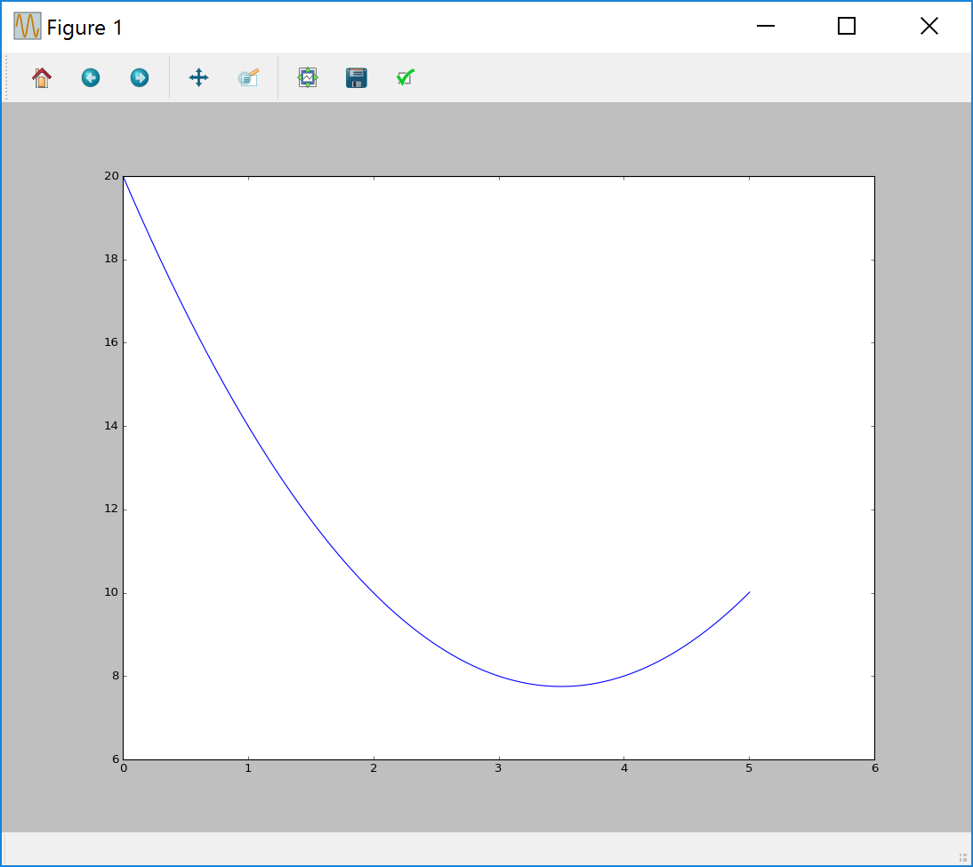
Lab 1 This Week Done!
Run the VM
Modify Python program
Scratch program for fun
Notes:
We know you don’t know much Python yet, but hopefully you could read a program and figure out just the part you need to modify to make a change.
You also got a chance to experiment with Scratch.
Scratch and Blockly are both

Slide 8
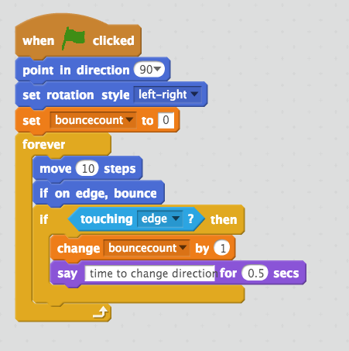
Last Time Scratch program
"Hello World"
Scratch Program
Colors
Duke blue: motion
Mustard: control
Light blue: sensing
Orange: data
Purple: looks
Notes:
Here is the program we saw last time.
This code is all associated with the girl.
A program executes commands one after the other.
After “when Green flag is clicked” we then go to the next command.

Slide 9
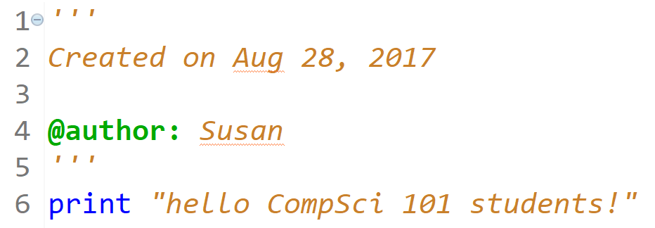
Python code hello.py
Notes:
Here is a very simple Python program.
Run this in Eclipse

Slide 10
Python data reading code
f = open("kjv10.txt")
st = f.read()
total = len(st)
zc = st.count('z')
print "total # chars = ",total
print "number of z’s",zc
for ch in 'aeiou':
print ch, st.count(ch)
Notes:
Run this program after they answer the questions.

Slide 11
Woa!!! Am I suppose to understand all that code right now!!!!
No!!!
We will learn all that over
The next month!

Slide 12
Explain Python data reading code bit.ly/101f17-0831-1
f = open("kjv10.txt")
st = f.read()
total = len(st)
zc = st.count('z')
print "total # chars = ",total
print "number of z’s",zc
for ch in 'aeiou':
print ch, st.count(ch)
Notes:
Run this program, after they answer the questions. The google form gives you the output from this code and you want to answer questions about it.

Slide 13
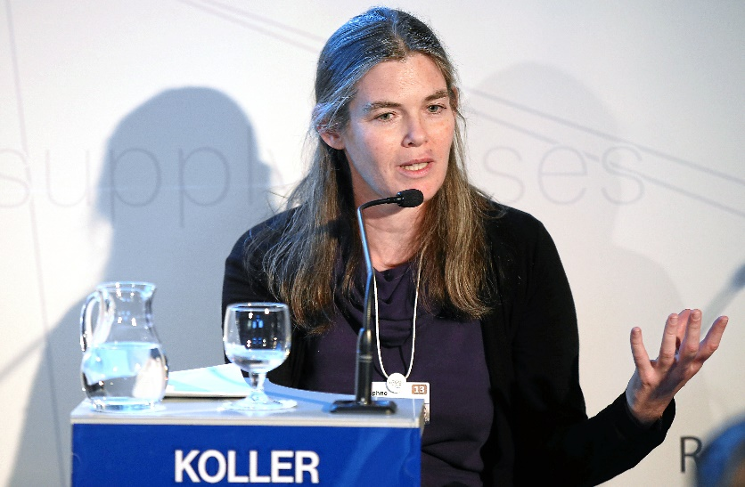
Daphne Koller, AI Pioneer, Educator
Computers learn to diagnose breast cancer? And more? The Data Scientist on a Quest to turn Computers into Doctors
http://bit.ly/koller-cancer
http://wrd.cm/1E9zFqy
On Coursera: "But to practice problem-solving, a student must first master certain concepts. By providing a cost-effective solution for this first step, we can focus precious classroom time on more interactive problem-solving activities that achieve deeper understanding — and foster creativity."
Coursera Founder, NY Times, December 5, 2011
Notes:
She is an Israeli-American who is a computer scientist who works in the area of Artificial Intelligence. Machine Learning,
The way breast cancer tissue is evaluated is people look at the tissue under a microscope and score it on a scale based on how it looks.
She with other researchers built a software program called C-Path that uses machine learning techniques to analyze the images. They want to predict the scale of the cancer and predict the survival rate. How do they do this, they train the computer by giving it a variety of samples from people who already have cancer and from people who don’t. The program learns what an image should look like for each part of the scale. This program does a pretty good job of determining if someone new has cancer or not. It was more accurate then humans looking at images.
She also is the founder of Coursera. Anyone take a course on Coursera?
In 2016, became Chief computing officer at Calico, a research and development biotech company

Slide 14
Our Programming Environment
Install 5 items or just use VM!
Why Java? – not using
Eclipse – platform for development
Python – programming language
Pydev – Python IDE for Eclipse
Canopy – python libraries
Ambient – turnin/snarf files to/from Duke

Slide 15
How does one get help in CompSci 101?
Consulting hours
Sunday-Thursday 7:30-11:30pm
Office hours (prof, TAs)
Collaborate with other students
Piazza
Ask questions
Do not post your code and ask what is wrong!
Post error message and line of code for error message
If added class late, may need to add yourself
Notes:
Piazza is your friend!

Slide 16
How to succeed in Compsci 101
Start assignments early, they'll take longer than you think
Read the book, we'll build on it in class
Collaborate well, but be sure you can do work on your own!
Be curious, work hard at beginning, think carefully
Notes:
Show collaboration policy and talk about it.

Slide 17
Your goal is to …
Get all assignments completed and turned in on time.
AND…

Slide 18
Your goal is to …
Get all assignments completed and turned in on time.
Understand the code you turn in.
Be able to explain the code you turn in.
AND…

Slide 19
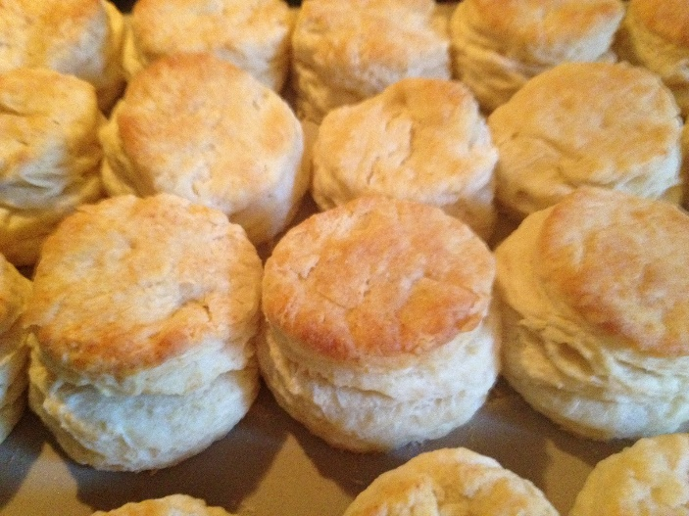
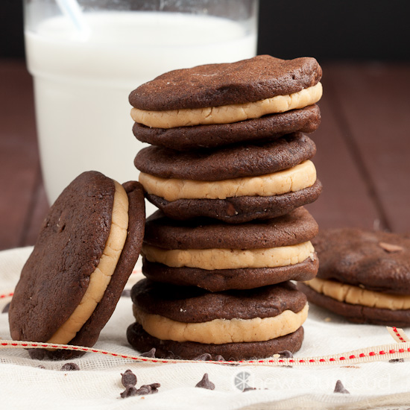
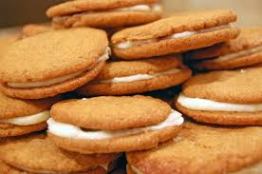
Algorithm
Recipe
Sequence of steps that constitute instructions
Step-by-step procedure for calculations
Biscuits
Cookie Sandwich
Notes:
Algorithm
Many recipes, such as baking bread you have to follow the recipe exactly or it could be a disaster.
Mention my grandmother’s biscuit recipe. I tried to follow her as she made them but she didn’t measure anything Just kept adding ingredients until they felt right.
We will look at a much simpler recipe. Make a cookie sandwich. Given cookies and icing.
Have students give instructions on how to make a cookie sandwich

Slide 20
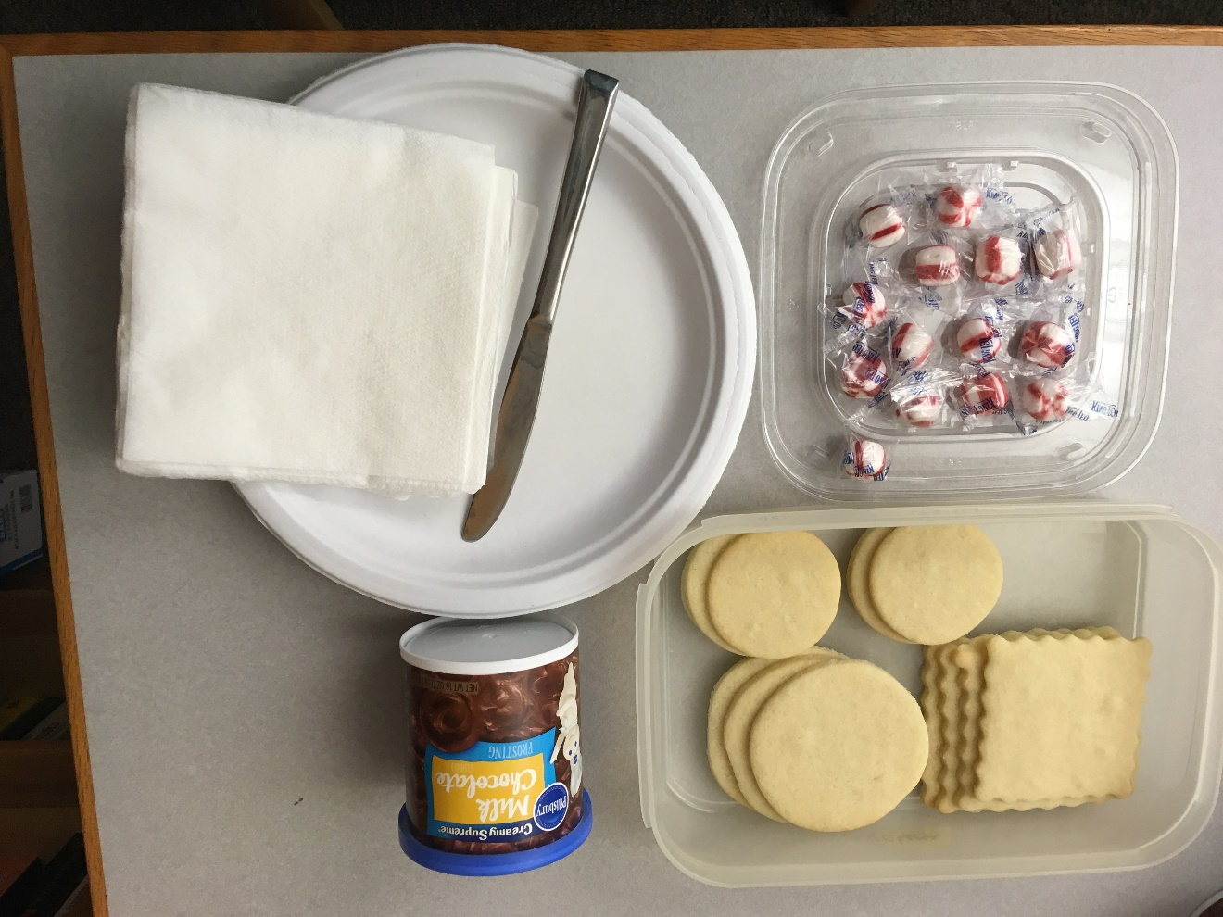
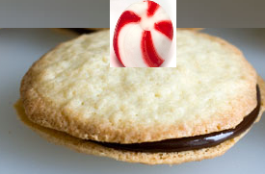
Write an algorithm for making a cookie sandwich bit.ly/101f17-0831-2
Cookie Sandwich Here are your supplies:
should look like:
Notes:
Algorithm
Many recipes, such as baking bread you have to follow the recipe exactly or it could be a disaster.
We will look at a much simpler recipe. Make a cookie sandwich. Given cookies and icing.
Have students give instructions on how to make a cookie sandwich

Slide 21
Algorithm
Recipe
Sequence of steps that constitute instructions
Step-by-step procedure for calculations
How do Netflix and Amazon know me?
Compsci101 project: capable of implementation as a program, but much more basic
What does Nate Silver do?
http://53eig.ht/1tZy909
More on algorithms:
http://moreintelligentlife.com/content/features/anonymous/slaves-algorithm
Notes:
Nate Silver – Statitician and journalist. he has predicted presidential winner in every state – last two years, also big in sports
Nate Silver – Baby Names
Recommender - project later in the semester another algorithm

Slide 22
Algorithm – Nate Silver and others
Notes:
Data from the social security administration on the names of babies for each year. For some names they were only popular at certain times. So if your name is Betty or Dorothy, you are probably in your 60’s or older. If your name is Brittany, you are probably in your 20’s. Some names keep popular through the years, such as Anna

Slide 23
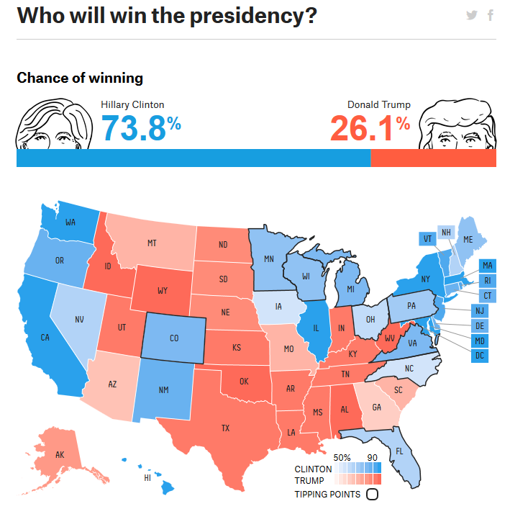
Notes:
Nate silver also does these kinda polls
This picture is from late August 2016.

Slide 24
Google Algorithm – with News
Notes:
Algorithms are in the news everywhere. Google algorithms but look in the news feed. They are being used in all disciplines to solve problems

Slide 25
Google Algorithm – with News
Notes:
Algorithms are in the news everywhere. Google algorithms but look in the news feed. They are being used in all disciplines to solve problems

Slide 26
Algorithms that scale: An example
Human Genome Project
Multiple approaches, relying heavily on computational power and algorithms
Combine reads of DNA sequences, we'll look at an illustrative example
These combine bio/chemistry techniques with computational techniques to recreate the sequencing, e.g., CGATTCCG… from "live data", actual DNA.
Notes:
Human Genome project has revolutionized biology, genomic medicine
All kinds of ways of understanding disease, and cures, new drugs
They are all here because we have the human genome mapped out.
The whole field of biology has been transformed by being able to digitize dna.
Once you have that dna, then you can replicate it and you can do amazing things.
It is computer scientists that made it possible,
Computer Scientists read these DNA sequences and used biochemistry techniques
And computational techniques to digitize., get the CGAT’s from real live data
I want to get those sequences into my computer. Because once I know what the sequences are I so I can design experiments on them, and then I can try the experiements on live DNA that can change human kind.
OLD
, Digitize DNA – duplicate it a lot and chop it up
Want to construct it digitally – turn it into 0’s and 1’s
Google genome shotgun – combining new sequencing scientist and algorithms working together that collaborate – CS couldn’t do this by themselves

Slide 27
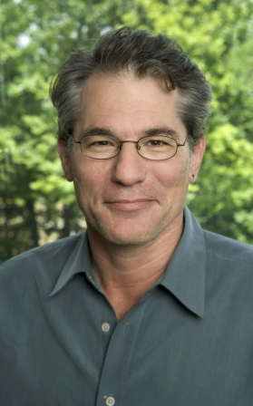
Eugene (Gene) Myers
Lead computer scientist/software engineer at Celera Genomics, then at Berkeley, now at Janelia Farms Research Institute (HHMI)
"What really astounds me is the architecture of life. The system is extremely complex. It's like it was designed." … " There's a huge intelligence there.”
BLAST and WG-Shotgun
Notes:
It was interesting because there were two big groups who were racing to sequence the human genome.
Gene Myers was the main computer scientist. He collaborated with other scientists. They worked together to come up with the algorithm. By themselves they may not have been able to solve this problem.
These are the algorithms they came up with many years ago that are still being used.
BLAST - search tool to look up proteins in a database to look for similarities
Where does this genome come from?

Slide 28
Whole Genome Shotgun with words
olve problems.
ratively, create,
compsci101 we get t
01 we get to work colla
vely, create, and
s. In compsci1
y, create, and s
e get to work collabo
…
Creation algorithm
Take a phrase
Replicate it four times
Chop into "chunks"
15-22 characters
How to recreate original phrase?
http://bit.ly/101f17-0831-3
Notes:
We have a problem for you to solve. We have come up with a problem that is like the whole genome shotgun algorithm, but we are applying it to words, a paragraph, instead of DNA.
You take a whole bunch of text, you replicate it and then you chop it up. Then you try to reassemble it by looking at areas of overlap. This is what they do with DNA.
In this case we have already replicated it and chopped it up. We want you to think about how you would use the pieces to recreate the original phrase.
Think about how you are solving the problem as you solve it. What are the steps in the algorithm

Slide 29
From Algorithms to Code
An algorithm that scales needs to run on a computer --- programming to the rescue!
Extensive libraries help with programming
Brain or Neuroscience
Engineering and Mathematics
Genomics
Graphic User Interfaces, …
We are using Python, extensible and simple
Notes:
We will be using large amounts of data and look at algorithms that scale.
Python has a lot of libraries

