Slide 1
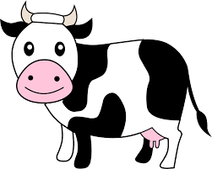
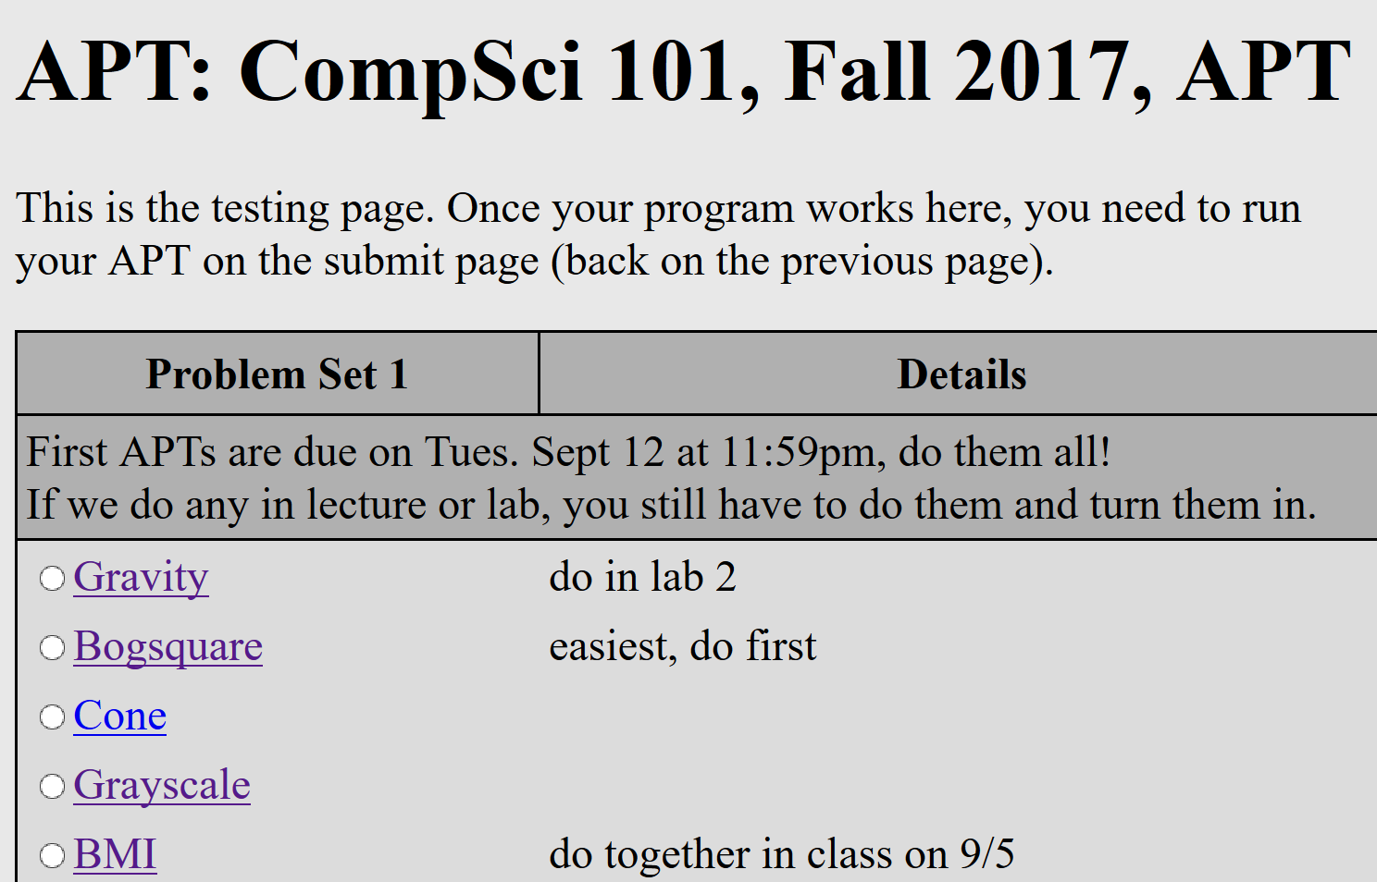
CompSci 101 Introduction to Computer Science
Sep 5, 2017
Prof. Rodger

Slide 2
Announcements
Reading and RQ3 due next class
Assignment 1 due today!
See the catch up schedule – for everyone!
APT 1 out and due on Tuesday, Sep 12
Need a pin to add class – fill out form
Exam accommodations – fill out form
Lab 2 this week
Today –Variables and Functions, Solve an APT, Problem solving

Slide 3
The Online Textbook
Text part describes Python Version 3
My version of the book, Python Version 2 just in the code boxes
Main Differences:
Divide, not using //
Use / for division, 7/2 will be 3
7.0/2 will be 3.5
Print
We will use: print x
Not using with parenthesis: print(x)

Slide 4
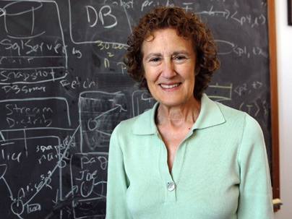
Barbara Liskov
(one of) first women to earn PhD from compsci dept
Stanford 1968
Turing award in 2008
Programming Languages
CLU
“It's much better to go for the thing that's exciting. But the question of how you know what's worth working on and what's not separates someone who's going to be really good at research and someone who's not. There's no prescription. It comes from your own intuition and judgment.”
Notes:
Created a new programming language (CLU). Not widespread use, but it had new features that are now in object oriented languages like Java and C++. She also did work on operating systems
Her ideas helped form the foundation for modern programming languages such as Java, which are designed to make use of self-contained modules of data and instructions that can be developed once and reused to many different ends. In 1961, she got her undergrad degree in Mathematics. Instead of pursuing an advanced degree in math after college, she got a job as a computer programmer at Mitre, a not-for-profit organization in the Boston area that conducts federally funded research in systems engineering and information technology. At the time, hardly anyone was trained in computer science. From Mitre, Liskov moved on to work on a Harvard University project that sought to automatically translate English sentences into something a computer could understand. Though natural-language processing is a problem that computer scientists are still working on, back then people expected that it would be solved in a few years. She decided she wanted to go to grad school so she applied to graduate school at Princeton and got a postcard from them that said “They didn’t accept female students.”. So she went to Stanford.

Slide 5
Starting with Python
Variable
Name of a storage location – holds a value
= to assign a value to a variable
Type
Different types of data
A variable can store data of a certain type
int, float, str
operators in Python for numbers
Arithmetic: + - * / % **
Built-in functions: pow, abs, round, int, float
example: pow(2,3) + round (1.6)

Slide 6
Starting with Python http://bit.ly/101f17-0905-1

Slide 7
Eclipse – Three ways to run
Write program and store in file
Create a PyDev project – a folder for programs
Create a PyDev module for each program (file)
Run in console
Create an APT in Eclipse and run on web
Run interactively
Open PyDev console
Execute each line as typed
Code not saved

Slide 8
Demo: Run interactively in Eclipse PyDev Console
If Console window is not showing then
Click on Window, Show View, Console
Then at the bottom of Eclipse, click here:
Select PyDev Console, Python Console

Slide 9
Variables, Types, Expressions?
print a + b * 3
print (a + b) * 3
print a / b
print a / (b * 1.0)
a = 5
b = 4
print b
a = a + b
print a
c = "fred"
print c
Notes:
Use shoeboxes to step through what is happening with these statements

Slide 10
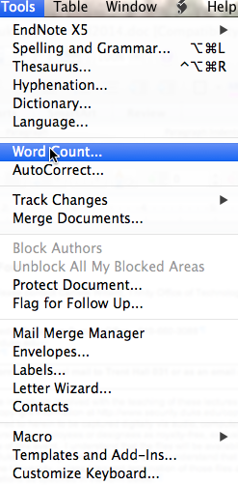
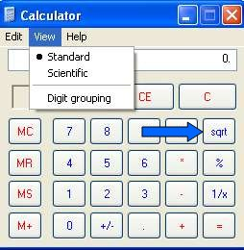
Examples of functions
Notes:
See the next slide. These are three examples of functions seen by students. Go over these quickly, understand from next slide why these pictures are here

Slide 11
Functions explained
In a calculator, sqrt: number in -> number out
What is domain, what is range?
In MSWord, word count: document -> number
Domain is word doc, range is integer
In browser, web: URL -> HTML formatted "page"
Domain is valid URL, range is HTML resources
In Python we see similar structure!

Slide 12
Function
def functionName(parameters):
block of code
Parameters – place holder, will store value passed in
Arguments – values in the call, that you pass to the function to use as input
Body of function must be indented
Notes:
Point out the parameters

Slide 13
Demo
In Eclipse write a file with a function and run it
stuff.py
def sum(a, b):
return a+b
if __name__ == '__main__':
print sum(3,5)
print sum(1,4)
Notes:
Try strings

Slide 14
APTs

Slide 15
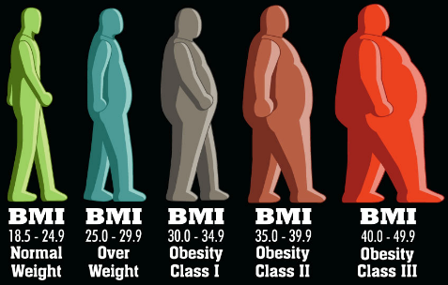
What is an APT? BMI APT
Automated/Algorithmic Problem Testing
Write one function, 2-30 lines, solve a problem
Tested automagically in Eclipse or the browser
Lots of test cases – test test test
Start simple, build toward more complex
What is a function? A function call?
What is a parameter? Argument?
How do you run/execute a program
Notes:
Google BMI and show the calculator on the web. Type in funny numbers weight 50 or weight 450
The www.cdc.gov gives error for 7 ft 8 in 110 lbs – ask to check your entries

Slide 16
Demo Solving APT BMI
Write your code in Eclipse
Create python file
Name of file important – case matters
name of function important – cut and paste this
Write your code
Test a few examples in Eclipse
Run online on using APT Tester
Tests on lots of examples, Debug, fix
Get all GREEN
Submit on APT page
REFLECT form too

Slide 18
APT: BMI (cont)

Slide 19
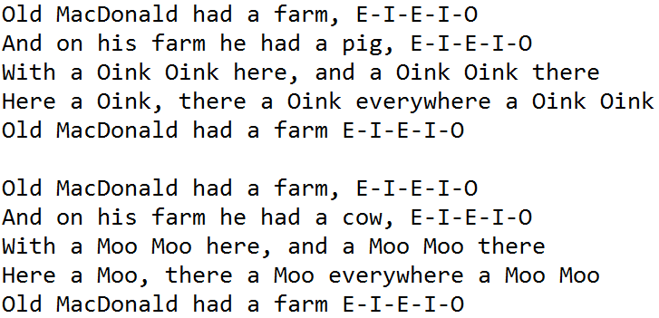
Write a program to print the Old MacDonald Song
Write a Program to print this song

Slide 20
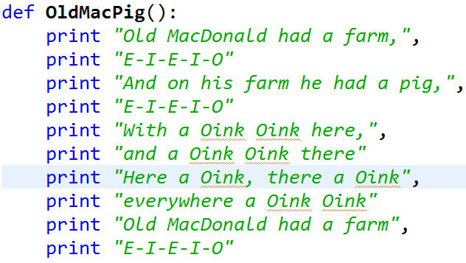
Function OldMacPig()

Slide 21
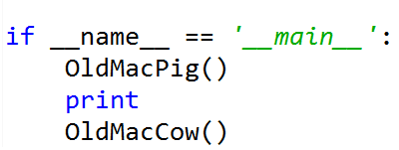
Rest of Code
Function OldMacCow
Replace “pig” with “cow”
Replace “Oink” with “Moo”
Code to start:

Slide 22
Discuss how to make code better bit.ly/101f17-0905-2
Describe in words how you can make the code better? More efficient?
Fewer lines of code?
Use more functions?
Discuss your changes.
What advantages do the changes you make have?

Slide 23
Demo – Old Mac improvements
What does the horse say?
What does the cow say?
What does the fox say?
Notes:
Google “what does the fox say” and show part of video
Ring-ding-ding-ding

Slide 24
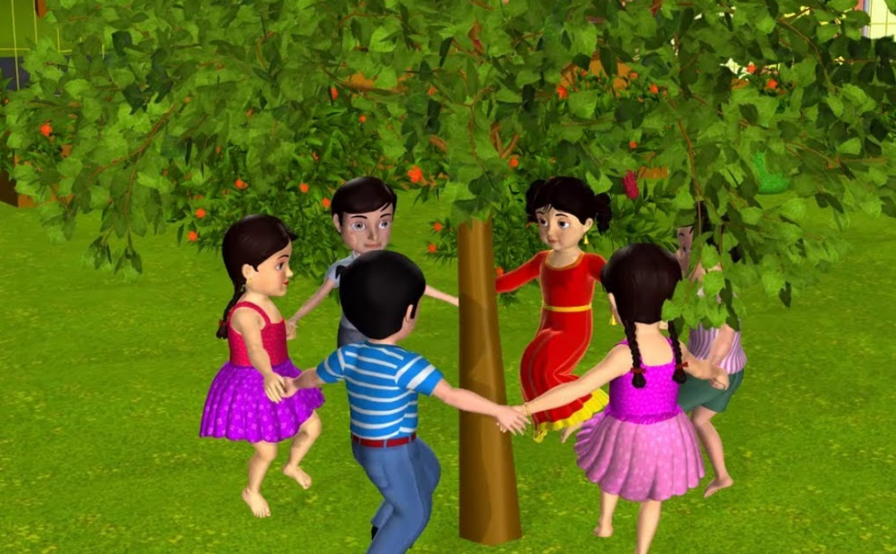
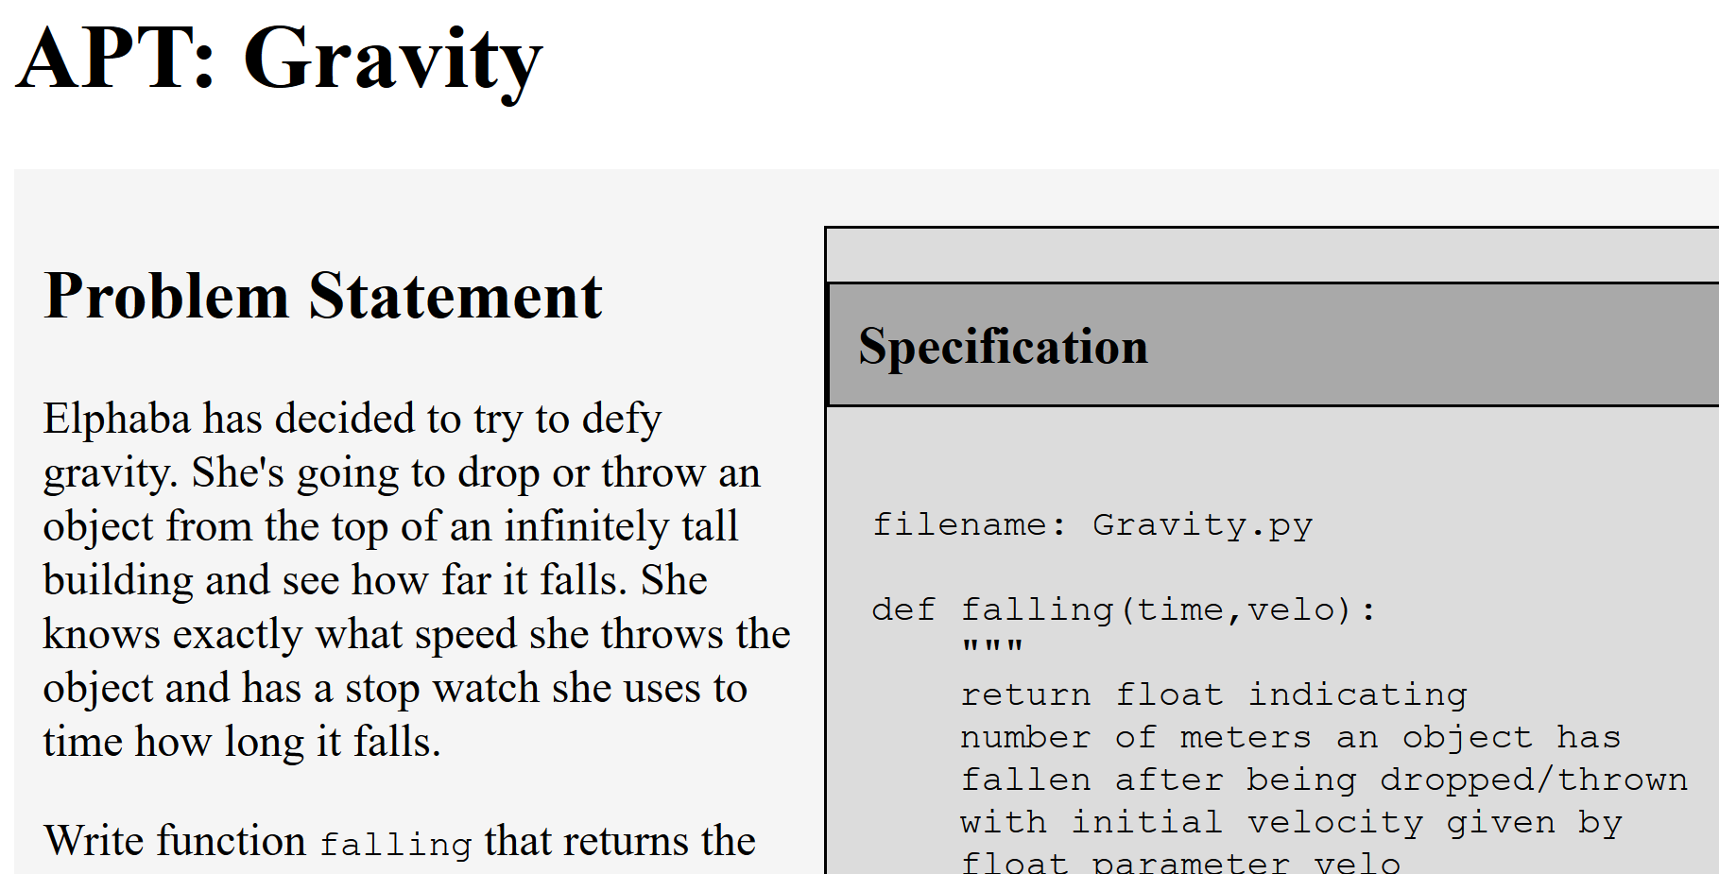
Lab 2 this week
Write a program to print a song
Work on the Gravity APT

