Slide 1
CompSci 101 Introduction to Computer Science
Sept. 7, 2017
Prof. Rodger

Slide 2
Announcements
Reading and RQ 4 due next time
Asgn 2 out, APT 1 is due Tuesday
Add class/change sections? – see forms tab on
www.cs.duke.edu/courses/compsci101/fall17
Today - FTIS
functions, parameters
Names, types and values
Notes:
First Thursday in September

Slide 3
Assignment 2 out
Totem poles
printing heads
Functions
Note: You have different requirements

Slide 4
REVIEW: Solving APT BMI
Write your code in Eclipse
Create python file - with Module:Main
Name of file important – case matters
name of function important – cut and paste this
Write your code
Test a few examples in Eclipse
Run online on using APT Tester
Test on examples, Debug, fix, get all GREEN
Submit on APT page
must run again, then check score
Fill out REFLECT form too
Notes:
REVIEW what they need to do to turn in the APT

Slide 5
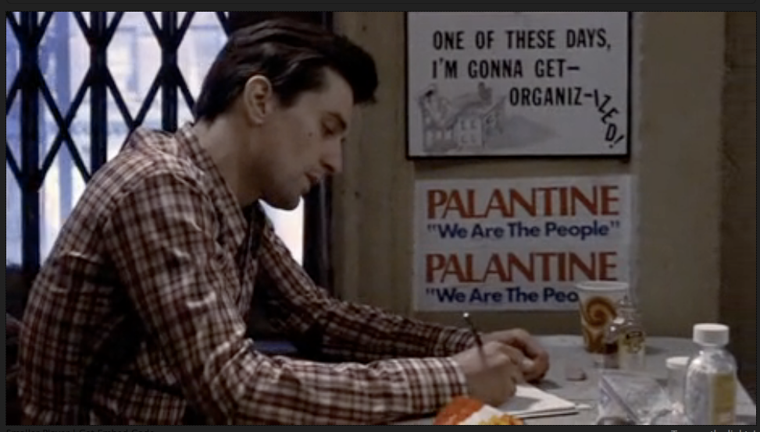
Organization matters
https://www.youtube.com/watch?v=1ve57l3c19g
Notes:
This is an all time favorite. I think when Robert de Niro looks at Cybil Shepard in the clip it's clear that he's infatuated with her. It's a long time ago. We are still infatuated with teaching and coding and we hope they will be. We also want to be organizized with building programs.
Movie Taxi Driver

Slide 6
APT organization, Code organization
You’ve written the BMI.py APT
Where is that module? How do you test it?
PyDev console, but then must import it
Adding print statements in BMI.py to test
Putting sentences together in order…
“Once upon a time…” “It was the best of times…” “Aujord’hui ma maman est morte”
Putting code together in order
Takes judgment and experience
Notes:
The second bullet is about famous 'first lines'. You don't need a good first line in a program. You need all the code to work together. Unlike a book where sentences can be skipped, you can't skip things in a program.. The 'judgment and experience' could lead to a famous quote "good judgment comes from experience, experience comes from bad judgment'

Slide 7
Running and Understanding Code
Need Python compiler/interpreter
We're using Canopy, includes libraries
Need an editor development environment
We use Eclipse and PyDev, open source and widely used, Ambient is Duke Plugin
You need experience thinking and coding and debugging ideas and code:
Installing the suite of tools can be cumbersome
Persist, Perservere, Get Help, start over ☹
Notes:
Spending time at the beginning to get your envinroment set up – we will help you with that.
Course is not

Slide 8
Understanding terminology: code
Move from "Hello World" to "Hello Around the World"
Look at Python, code, libraries
Learning (reviewing) terminology about Python
print "hello world"
f = open("hello.txt")
for line in f:
print line
Notes:
Hello around the world
Ask students to say hello in another language than English, Then show them this program to read in greetings from a file

Slide 9
Hello around world code
http://bit.ly/101f17-0907-1

Slide 10
Hello from the web bit.ly/101f17-0907-2
import urllib2
if __name__ == '__main__':
url = "http://www.cs.duke.edu/courses/compsci101/fall17/data/hello.txt"
f = urllib2.urlopen(url)
for line in f:
print line

Slide 11
Hello from the Web in Python
We open a file, and we open a URL
Syntax slightly different, concept is similar
Real-world differences between files and URLs?
Must adhere to syntactic rules of Python
Naming, whitespace, : or . or ( or ) or [ or ]
Must adhere to semantic rules of Python
Can't loop over anything, more rules to follow
f = open("hello.txt")
Notes:
Why is the syntax different, does it have to be urlopen instead of open? Know, but the differences can be useful, in making it clear to reader what kind of thing is being opened URL or file. Where do dots go, where do ()’s go

Slide 12
Hello from the Web in Python
We open a file, and we open a URL
Syntax slightly different, concept is similar
Real-world differences between files and URLs?
Must adhere to syntactic rules of Python
Naming, whitespace, : or . or ( or ) or [ or ]
Must adhere to semantic rules of Python
Can't loop over anything, more rules to follow
f = open("hello.txt")
f = urllib2.urlopen("http://nytimes.com")
Notes:
Why is the syntax different, does it have to be urlopen instead of open? Know, but the differences can be useful, in making it clear to reader what kind of thing is being opened URL or file. Where do dots go, where do ()’s go

Slide 13
Functions return values
Most functions return values
Sometimes used to make things simpler, but returning values is a good idea
def inch2centi(inches):
answer = 2.54*inches
return answer
xh = inch2centi(72)
def pluralize(word):
return word + "es"
pf = pluralize("fish")
Notes:
Simple examples, these will be in snarf-for-class examples – tinker with – cat we will need more powerful
Return is usually the last statement. You may have other statements such as an assignment statement in there.

Slide 14
Functions can print info
Some functions only print info
Note there is no return statement in the function
def helloPerson(name):
print "hello" + name
helloPerson("Susan")
helloPerson("Ademola")
Notes:
Simple examples, these will be in snarf-for-class examples – tinker with – cat we will need more powerful
There is no value to return!!!

Slide 15
Simple Python Functions http://bit.ly/101f17-0907-3
Answer these questions based on thinking, don't run any code
Why do we need functions?
Manage complexity of large programs
Test and develop code independently
Reuse code in new contexts: create APIs!
Notes:
You don't need to understand the program, but we could run the code and that would help. But answer the questions without running the code!

Slide 16
Function – return or print? bit.ly/101f17-0907-4
Example function that returns a value
def sum(a, b):
return a+b
Example function that prints
def hw(name):
print "Hello " + name
Call Functions
print sum(4,7) name = hw(“Sue”)
answer = sum(4,7) hw(“Sue”)
sum(4, 7) print hw(“Jo”)
Notes:
Point out the parameters and arguments

Slide 17
Function – return or print? bit.ly/101f17-0907-4
Example function that returns a value
def sum(a, b):
return a+b
Example function that prints
def hw(name):
print "Hello " + name
Call Functions
print sum(4,7) name = hw(“Sue”)
answer = sum(4,7) hw(“Sue”)
sum(4, 7) print hw(“Jo”)
x
x
x
Notes:
Point out the parameters and arguments

Slide 18
Function Detective
http://bit.ly/101f17-0907-5

Slide 19
Results of Code Analysis
For details on plurals: http://bit.ly/1N49u6b
How did we call pluralize many times?
Loop. What is an alternative?
What does the 'if' statement do?
Selects a code block to execute (more next week)
If you have a question? Write and run code!
Notes:
Might have other things to note based on responses from class. Might want to run some calls of 'pluralize'. Can snarf it, add to list, try a few other things

