Slide 1
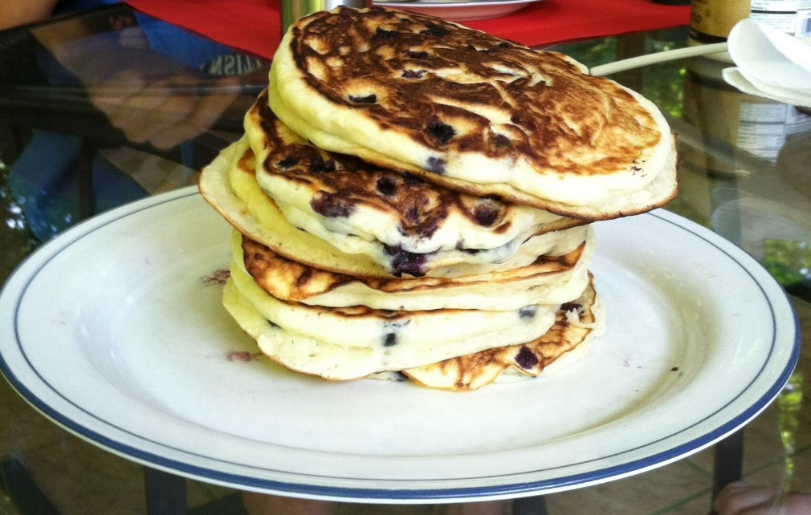
CompSci 101
Introduction to Computer Science
Sept 12, 2017
Prof. Rodger
Notes:
Blueberry pancakes, yum!
Bring Blank paper for this lecture!

Slide 2
Announcements
Reading and RQ5 due next time
Assignment 2 due Thursday
APT 1 is due today, APT 2 out today
Catch up Schedule on main web page
Lab 3 – splicing, making decisions
Today – TWOTS
  Solving problems – 7 Step process
  Decisions - if, Boolean
Notes:
Third Week of the Semester (TWOTS)

Slide 3

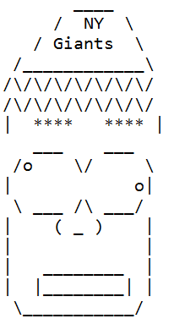
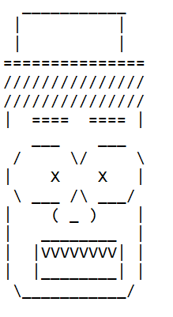
Assignment 2
Questions?
Notes:
Show Student Solution

Slide 4
Submitting Assignment 2
Use Ambient/eclipse to submit!
  Check if submitted with Submit History – files submitted should be listed!
  Alternative submit – use websubmit – on assign tab
  What time is it due? Thursday 11:59pm

Slide 5
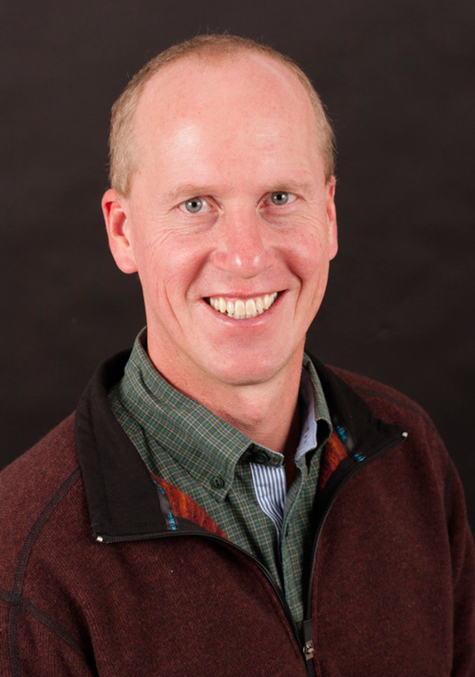
Why is this person so important to this course?
Notes:
Brad Miller took Python book from Elkner, Downey and Meyer and created the software for an online textbook that allows you to experiment with the python right in the book
Without him, no free book!

Slide 6
Why is this person so important to this course?
Have you donated yet?
Notes:
Brad Miller took Python book from Elkner, Downey and Meyer and created the software to allow you to experiment with the python right in the book
Without him, no free book!

Slide 7
Top 10 list for surviving in CompSci 101
10. Read the book and Ask questions
9. Eat lots of pizza
8. Learn how to spell Rodger
7. Understand what you turn in
6. Follow the 7 step process
Notes:
Learn seven step process today

Slide 8
Top 10 list (cont)
5. Check Piazza every day
4. Visit your prof in her office
3. Learn how to debug your programs
2. Seek help (one hour rule!)
1. Start programming assignments early
Notes:
Seek help (consulting hours, piazza, office hours)
Start early

Slide 9
Finish from last time…..
Function Detective
http://bit.ly/101f17-0907-5
if __name__ == "__main__":
f = open("words.txt")
for w in f:
w = w.strip()
print w, pluralize(w)
Notes:
Process a file line by line, one way to process a file. However each line has its end of line marker at the right end so most likely you don’t want that and you can use the strip function on a string to remove it.
Note w is a string representing one line from the file.

Slide 10
Finish from last time…..
Function Detective
http://bit.ly/101f17-0907-5
if __name__ == "__main__":
f = open("words.txt")
for w in f:
w = w.strip()
print w, pluralize(w)
# f is the file
# for each line in the file
# remove carriage return from line
# process word
# in this example, each line happened to be just one word, #this loop iterates over lines

Slide 11
Another way for the main
Iterate over words, not lines
if __name__ == "__main__":
f = open("words.txt")
all = f.read()
wordlist = all.split()
for w in wordlist:
print w, pluralize(w)

Slide 12
Another way for the main
Iterate over words, not lines
if __name__ == "__main__":
f = open("words.txt")
all = f.read()
wordlist = all.split()
for w in wordlist:
print w, pluralize(w)
# f is the file
# all is the file as one string, carriage returns are removed!
# split string into list of words
# iterate over the words
# process each word
# would work if there were multiple words on a line in the file

Slide 13
Python – Names and Types
Names vs abstractions
  What is http://152.3.140.1
  What is http://www.amazon.com
Types are important
  What is foo.pdf, foo.mp4, foo.jpg, foo.wav
  Do the file extensions guarantee file type?
Python – what types are these?
first = "Susan"
  x = 6
  y = 3.4
Notes:
First link is duke computer science – how would you know?
If I change the name of a file, I could change the extension, but then that file name is misleading…

Slide 14
Strings
Sequence of characters in quotes
  "I" + 'Love' + '''Python'''
  "I" 'Love' '''Python'''
'ILovePython'
String operators: concatenation (+), repeat(*)
Precedence?
  "a" + "b" + "c" * 3
  'abccc'
Precedence?
  "a" + "b" "c" * 3
  'abcbcbc'
Notes:
Don’t type these in, answers on next page
Read about strings for next time

Slide 15
Strings
Sequence of characters in quotes (same result)
  "I" + 'Love' + '''Python'''
  "I" 'Love' '''Python'''
'ILovePython'
String operators: concatenation (+), repeat(*)
Precedence?
  "a" + "b" + "c" * 3
  'abccc'
Precedence?
  "a" + "b" "c" * 3
  'abcbcbc'

Slide 16
Names, Types and Values
bit.ly/101f17-0912-1

Slide 17
Names, Types and Values
import urllib2
if __name__ == "__main__":
source = urllib2.urlopen(“http://.../poe.txt")
s = source.read()
words = s.split()
total = len(s)
all = len(words)
print total > all

Slide 18
Names, Types and Values
import urllib2
if __name__ == "__main__":
source = urllib2.urlopen(“http://.../poe.txt")
s = source.read()
words = s.split()
total = len(s)
all = len(words)
print total > all
# source is the file
# s is the file as one long string
# words is list of words from s
# total is the number of char in s
# all is the number of words in s
# True, more char than words!

Slide 19
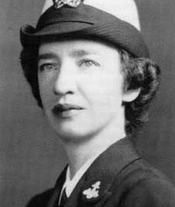
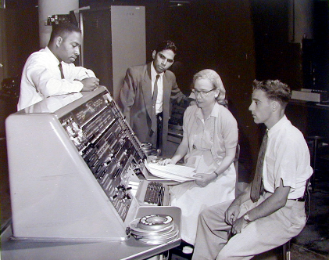
Grace Murray Hopper (1906-1992)
“third programmer on world's first large-scale digital computer”
  US Navy: Admiral
“It's better to show that something can be done and apologize for not asking permission, than to try to persuade the powers that be at the beginning”
https://www.youtube.com/watch?v=1-vcErOPofQ
ACM Hopper award given for contributions before 35
  2010: Craig Gentry: http://www.youtube.com/watch?v=qe-zmHoPW30
  2011: Luis von Ahn
  2013: Pedro Felzenszwab
  2014: Sylvia Ratnasamy
  2015: Brent Waters
Notes:
Play between start to 1:15, then nanosecond 4 to 5:30
Craig Gentry is Duke class of 1995, then Duke Law School, then Stanford PhD in computer science,
Second link is video about Craig’s work in cryptography.
Luis von Ahn is Duke class of 2000, then CMU PD.
See ACM website for details on others who are more recent winners

Slide 20
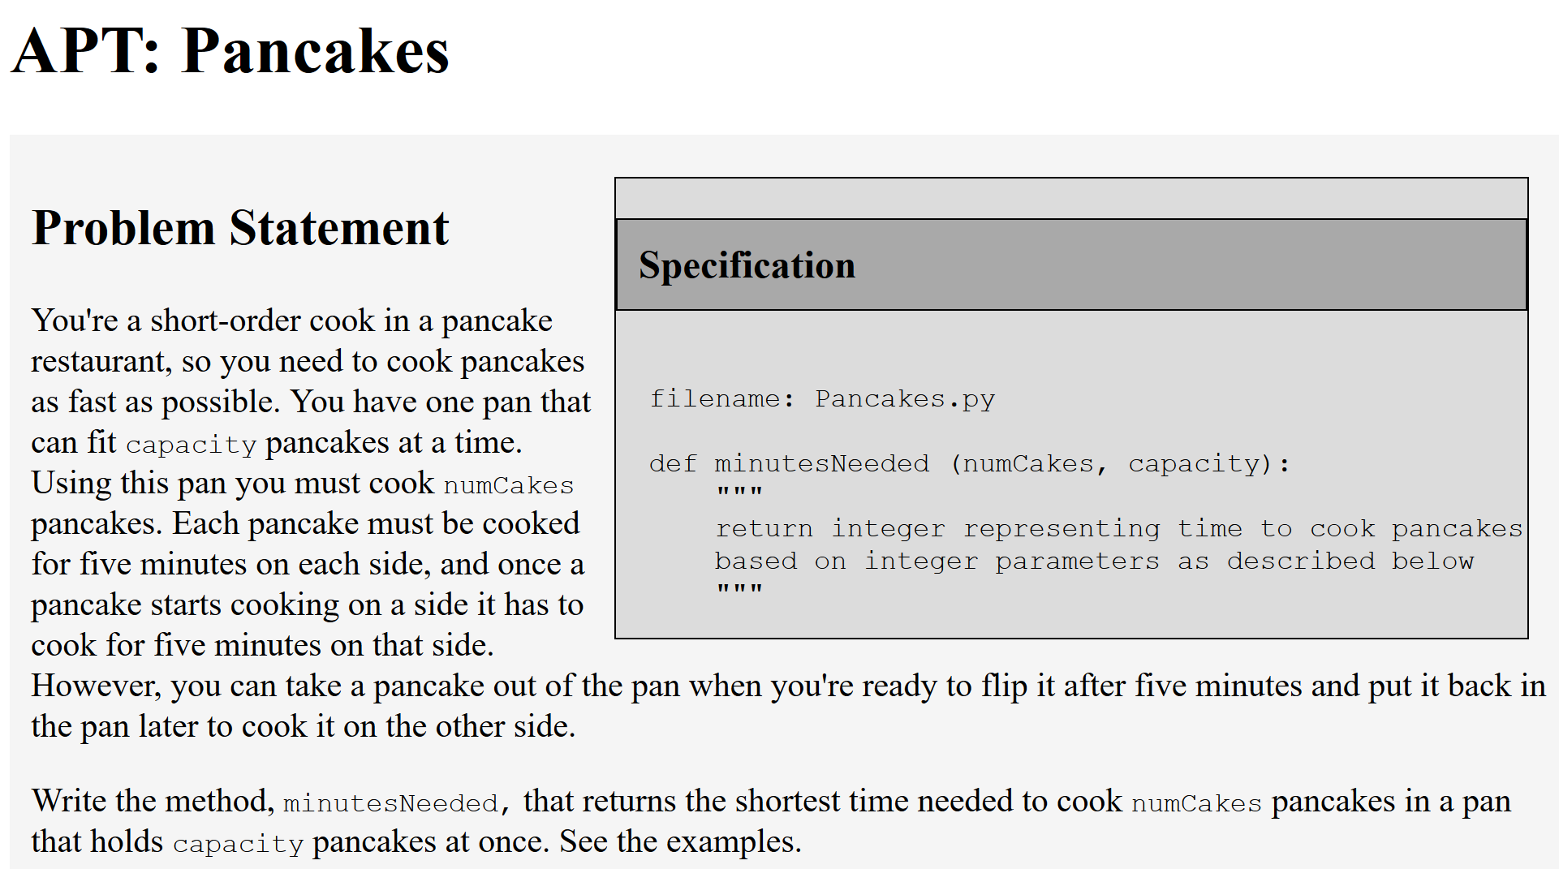

Slide 21
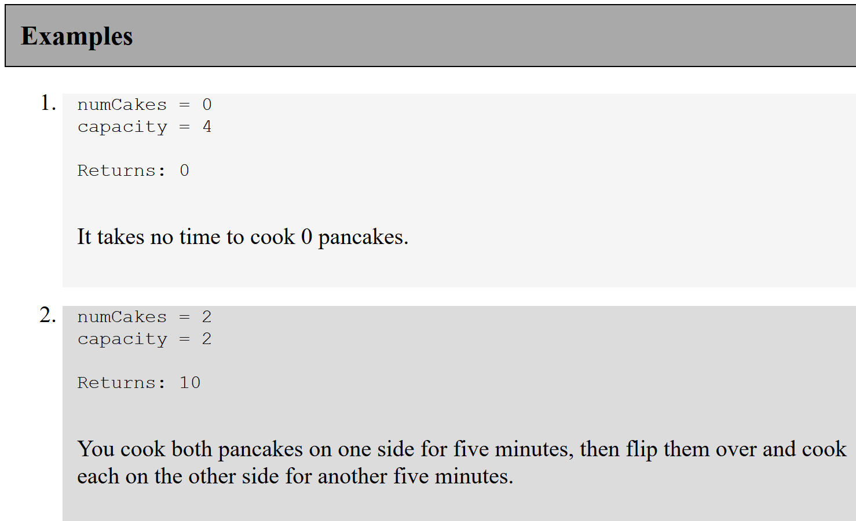

Slide 22

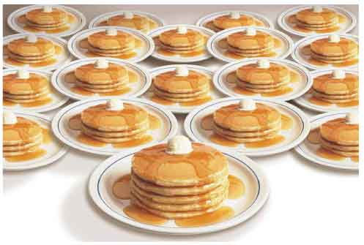
APT Pancake:
How do you solve this problem?
  First steps: are there simple cases that can be solved immediately?
    What are these for the pancake problem?
  Sometimes it helps to know if you are on track, should you use Python to check your paper and pencil work?
Get specific, solve for 5, not N
  Fix one parameter, vary the other
  Identify the cases and continue

Slide 23
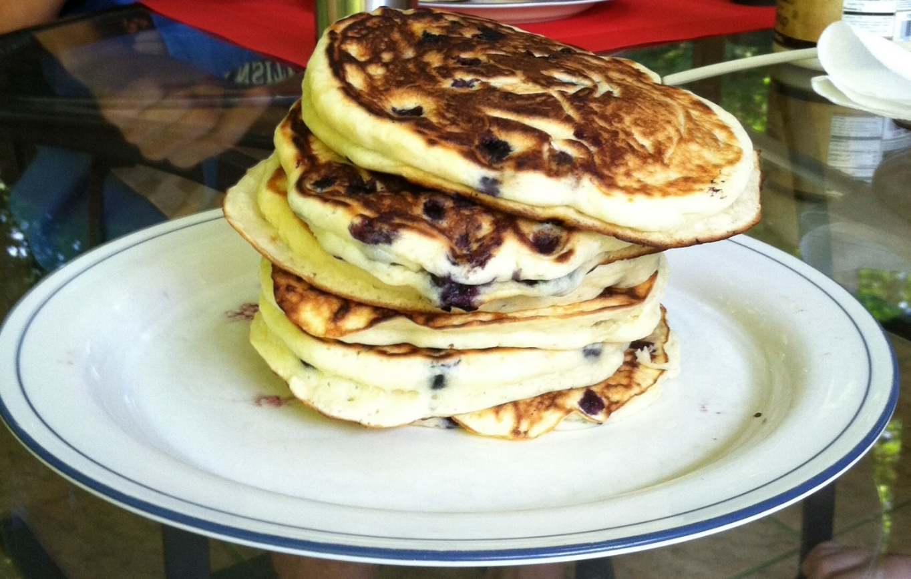
Solve an APT - Pancakes bit.ly/101f17-0912-2

Slide 24
Problem Solving to Code
7 Step Process
Work small examples by hand
Write down what you did in words (algorithm)
Find Patterns (generalize algorithm)
Work another example by hand (does your algorithm work? If not, go back to 2)
Translate to code
Test several cases
Debug failed test cases
Notes:
Now you have several APTs to solve. It is a huge step to go from problem statement to code!
Use the seven step process
Which step is writing code? It is not step one!!!!!!

Slide 25
Pancake Problem
Work through the 7 step process….
Notes:
This takes awhile to solve
Work the example by hand with pansize 4 pancakes – draw a picture. How do you calculate the answer. Try the example pansize 2, 3 pancakes. (see notes from last semester Jan 28 code – actually me working problem, then I did the code)
Write down algorithm

Slide 26
Three pancakes in a two-cake pan…
Number of cakes in the system
  First 5 minutes
Number of cakes in the system
  Second 5 minutes

Slide 27
Three pancakes in a two-cake pan…
Number of cakes in the system
  Third 5 minutes
How many minutes to cook all three pancakes?

Slide 28
How to solve problems with different cases?
Keep score in a video game?
  Different points for different tasks?
Translate a book from English to Spanish?
  Different words, different rules
Identify proteins in strands of DNA?
  Start codon: atg Stop Codon: tag
Different cases with Pancake APT?
In Python use: if, else ,elif

Slide 29
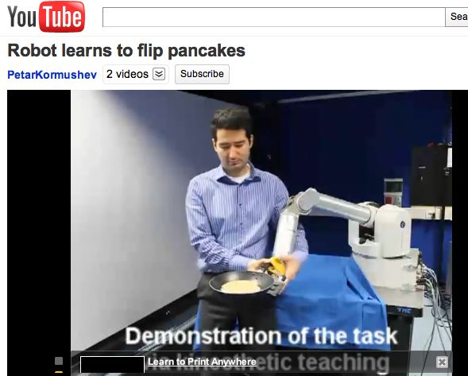
How to teach pancake Flipping
http://www.youtube.com/watch?v=W_gxLKSsSIE
  Is this computer science? http://bit.ly/zykOrh
  For longer, more complex robotic tasks
    http://www.youtube.com/watch?v=4usoE981e7I

Slide 30
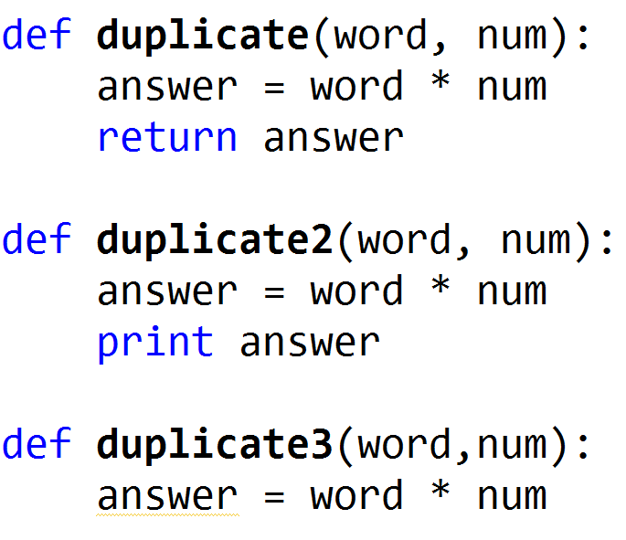
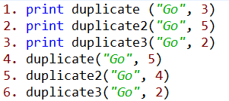
Review Functions
www.bit.ly/101f17-0912-3
Notes:
Show this in Python Tutor!

Slide 31
Review Functions
Output
www.bit.ly/101f17-0912-3
1. GoGoGo
2. GoGoGoGoGo
None
3. None
5. GoGoGoGo
Notes:
Show this in Python Tutor!

Slide 32
How many ways can I run Python in this course?
Eclipse
  Complete program
  Interactive Console
  APT
Online textbook
  We are using Python 2.7
  ‘/’ (2.7) vs ‘//’ (3)
Python Tutor
Notes:
What is an APT, testing one method and it comes with free tests.
YOU WILL KNOW when an APT is correct!
You may not know for an assignment.
Have not seen python tutor yet, will see today

Slide 33
Use Python Tutor
Debug/trace your code
Doesn’t work with input files
Notes:
Trace through previous example with Python Tutor

