Slide 1
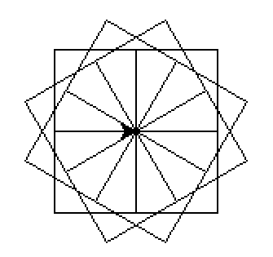
CompSci 101 Introduction to Computer Science
Sep 14, 2017
Prof. Rodger

Slide 2
Announcements
Reading and RQ6 due next time
Assignment 2 due today, Assignment 3 out
APT 2 due on Tuesday
Today:
Problem solving: Strings, Lists
Looping over structures (characters, words) and building something
Notes:
Middle of September – Sept 15

Slide 3
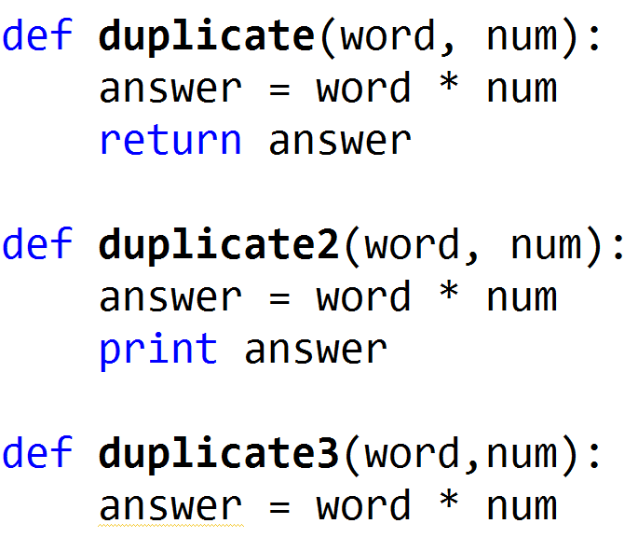
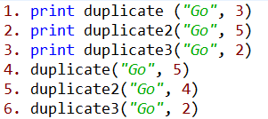
Review Functions
www.bit.ly/101f17-0912-3
Notes:
Show this in Python Tutor!

Slide 4
Review Functions
Output
www.bit.ly/101f17-0912-3
1. GoGoGo
2. GoGoGoGoGo
None
3. None
5. GoGoGoGo
Notes:
Show this in Python Tutor!

Slide 5
How many ways can I run Python in this course?
Eclipse
Complete program
Interactive Console
APT
Online textbook
We are using Python 2.7
‘/’ (2.7) vs ‘//’ (3)
Python Tutor
Notes:
What is an APT, testing one method and it comes with free tests.
YOU WILL KNOW when an APT is correct!
You may not know for an assignment.
Have not seen python tutor yet, will see today

Slide 6
Use Python Tutor
Debug/trace your code
Doesn’t work with input files
Notes:
Trace through previous example with Python Tutor

Slide 7
More on Strings
Strings are indexed starting at 0
Example: ‘word’
Use [x] – to refer to a particular character in word
Use [x:y] to refer to a slice of the string starting at position x and up to but not including position y. Can leave out x or y.
w
o
r
d
0 1 2 3

Slide 8
Examples bit.ly/101f17-0914-1
phrase = "Duke Blue Devils"
1) phrase[0] + phrase[-3] + phrase[-2]*2
2) phrase[5:10] + phrase[:4] 3)(phrase[phrase.find('ev'):]).upper()
4) phrase[-5::2] + phrase[:4:-1]
String fun
Crazy import
Notes:
antigravity

Slide 9
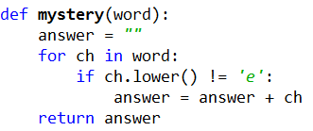
Loop over all characters in a String
Notes:
Show in Python tutor
Ask what the purpose of answer is

Slide 10
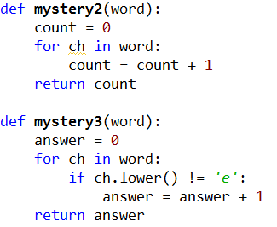
Loop over string
www.bit.ly/101f17-0914-2

Slide 11
Loop over all words in a list

Slide 12
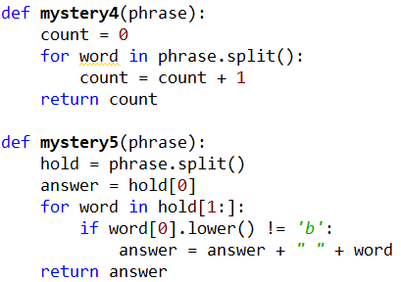
Loop over words
www.bit.ly/101f17-0914-3

Slide 13
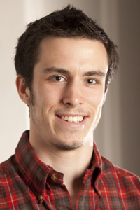
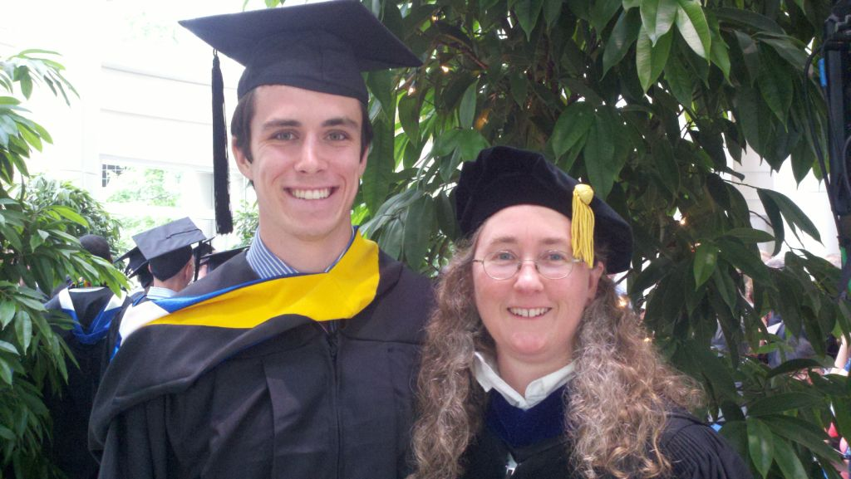
Computer Science Alum
Biology and CS
Undergraduate Research - JFLAP
Epic
Now in Med School at Vanderbilt
Notes:
STARTED THE MAJOR LATE!
Julian Genkins – he came to Duke premed. His fourth semester he took a computer science course and fell in loved it. He decided then to double major in CS and Biology. He did research with me on creating educational software. Then he took a gap year and worked at Epic for a year while he applied for med schools, and got a full scholarship to Vanderbilt.
With me just being in the hospital. It is pretty neat that Julian contributed to the EPIC medical software that Duke uses to manage my care while I am in the hospital.
He just wrote me sept 2014 and said he is on a student technology committee, focused on using technology in medical education. He is implementing new tools. “I cannot tell you how many times my experiences working on JFLAP have come in handy”

Slide 14
Assignment 3 snarf to use starter files
Turtles
Creative
Earthquakes
Data from last 30 days around the world
Example - Find the largest earthquake

Slide 15
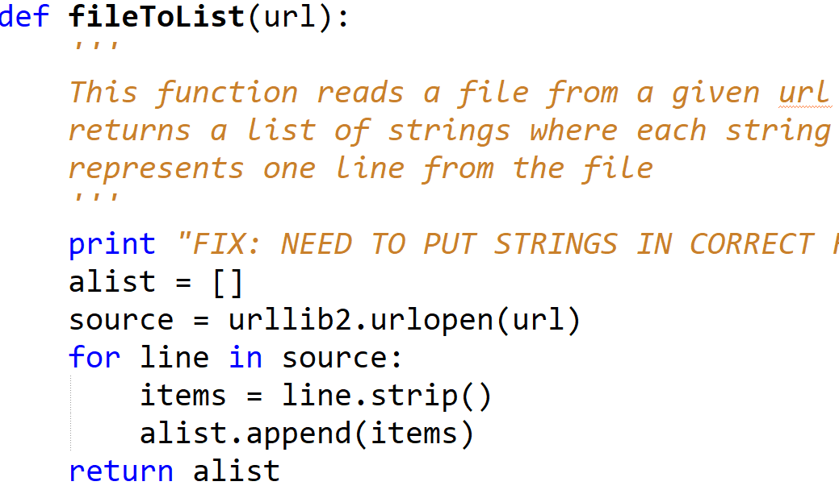
Getting Started with Earthquake part
Read lines of data into a list of strings

Slide 16
Getting Started with Earthquake part
Read lines of data into a list of strings
You must modify to put in correct format!
Create Empty list
source is a file
Iterate over lines in file
Remove carriage return from line
Add line from file to the list
Return list of strings

Slide 17
Getting Started with Earthquake part
Here is first few lines of the small file:
Read into a list, reformatting the lines
Write function getParts to get parts of a line

Slide 18
Use the list to calculate facts about earthquakes
Two parameters – number and list of strings
Returns a LIST of strings that meet criteria
Use PrintQuakes with the list to print
Notes:
We ask you to write some specific functions and you can write other functions

Slide 19
Use the list to calculate facts about earthquakes
Two parameters – number and list of strings
Returns a LIST of strings that meet criteria
Use PrintQuakes with the list to print

Slide 22
LastNameFirst APT
http://www.cs.duke.edu/csed/pythonapt/lastnamefirst.html
Answer Questions here:
bit.ly/101f17-0914-4
Notes:
Come back to this a bit later.

Slide 23
Problem Solving to Code 7 Step Process
Work small examples by hand
Write down what you did in words (algorithm)
Find Patterns (generalize algorithm)
Work another example by hand (does your algorithm work? If not, go back to 2)
Translate to code
Test several cases
Debug failed test cases
Notes:
Now you have several APTs to solve. It is a huge step to go from problem statement to code!
Use the seven step process
Which step is writing code? It is not step one!!!!!!

Slide 24
Use 7 step process to solve LastName First

Slide 25
Unused slides

Slide 26
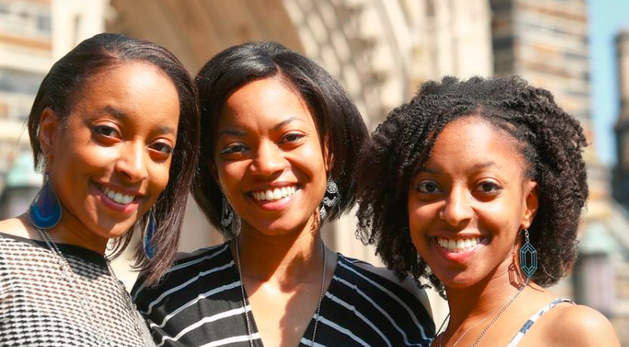
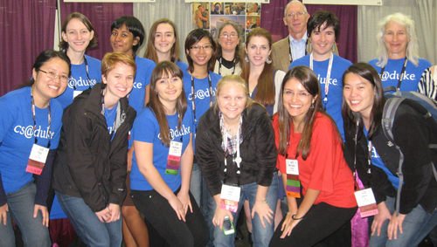
More Computer Science Duke Alums
Notes:
Becky DeNardis (UTA and worked at Google two summers, then got a full time job at google, valedictorian, unfortunately, she was killed by a drunk driver, some of you may have heard about her. She was incredibly passionate about computer science and passionate about helping people learn computer science). , Deborah Nelson (rightmost triplet) took CompSci 101 – she taught English in Turkey for a year, then went to graduate school in Human Computer Interaction, now is a User Experience Designer for Blackbaud

Slide 27
Apply now for a scholarship to go to GHC 2017
Notes:
15000 women in 2016!!
Incredible conference for women in computing. Women are a minority in computing but not here! You won’t believe all these passionate women in computing

