Slide 1
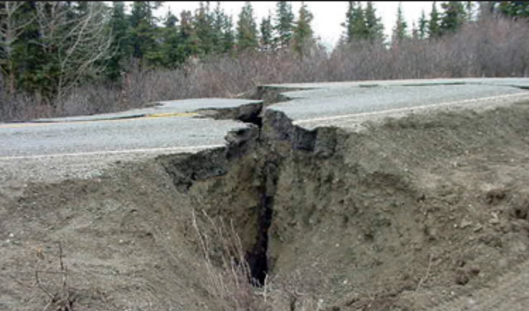
CompSci 101 Introduction to Computer Science
Sept 19, 2017
Prof. Rodger
EARTHQUAKE!!!!!!!
Notes:
To comment a function in eclipse, highlight the function and then do CTRL-\
Do it again and it is uncommented

Slide 2
Announcements
Reading and RQ7 due next time
Assignment 3 due Thursday
APT 2 due today, APT 3 out
APT Quiz 1 – Sunday -Tuesday night
Up for about 3 days, you pick 3 hours to do it
Practice quiz out by Friday
Today
Calculating info about earthquake data
Really doing? (Functions, if, strings, lists)

Slide 3
Lab 4 this week
Lists – indexing and splicing (like strings!)
Processing a data file
Putting each line from file in a different form
Writing functions to calculate information about the data

Slide 4
Stuck on solving a problem? Don’t know where to start?
Use the 7 step process!

Slide 5
Problem Solving to Code 7 Step Process
Work small examples by hand
Write down what you did in words (algorithm)
Find Patterns (generalize algorithm)
Work another example by hand (does your algorithm work? If not, go back to 2)
Translate to code
Test several cases
Debug failed test cases
Notes:
Now you have several APTs to solve. It is a huge step to go from problem statement to code!
Use the seven step process
Which step is writing code? It is not step one!!!!!!

Slide 8
Step 1) Work small example by hand
name is “Moe Jess Bo Lu Yue”
first is “Moe”
last is “Yue”
middle is “Jess Bo Lu”
“Jess” gives us “J.”
“Bo” gives us “B.”
Join together “J. B.”
“Lu” gives us “L.”
Join together “J. B. L.”
Last, First Middle: “Yue, Moe J. B. L.”

Slide 9
Step 2) Describe in words what you did
Name is: “Moe Jess Bo Lu Yue”
Determine first name: “Moe”
Determine last name: “Yue”
Determine all middle names: “Jess Bo Lu”
Look at first word in middle: “Jess”
newMiddle is “J.”
Look at second word: “Bo”
NewMiddle is “J. B.”
Look at third word: “Lu”
NewMiddle is “J. B. L.”
Put together last, first and newMiddle
Notes:
Are you ready to code it up yet? NOOOO

Slide 10
Step 3) Find Patterns (Generalize)? Don’t see it? Work another example
Name is: “Sue Mo Lucy Lo So Fa Ti”
Firstname is “Sue”, Lastname is “Ti”
Middle is “Mo Lucy Lo So Fa”
“Mo”, newMid is “M.”,
“Lucy”, newMid is “M. L.”
“Lo”, newMid is “M. L. L.”
“So”, newMid is “M. L. L. S.”
“Fa”, newMid is “M. L. L. S. F.”
Put together: “Ti, Sue M. L. L. S. F.”

Slide 11
Step 3) Find Patterns (Generalize)
Name is: “Moe Jess Bo Lu Yue”
Firstname is first word
Lastname is last word
Middle is string of all the middle words
Initialize newMiddle
For each word in middle:
Add first letter of word, period and blank to newMiddle
Build new string:
lastname, firstname newMiddle
Return answer

Slide 12
Step 4) Work another example by hand using your algorithm
Name = “Jo Flo Bo Yup”
Firstname = “Jo”
Lastname = “Yup”
Middle = “Flo Bo”
newMid = “”
For word in Middle:
newMid = “F.” (first time thru loop)
newMid = “F. B.” (second time thru loop)
Answer = “Yup, Jo F. B.”
IT WORKS!

Slide 13
Step 5) Translate to Code
Firstname is first word
pos = name.find(“ “)
first = name[:pos]
Lastname is last word
rpos = name.rfind(“ “)
last = name[rpos+1:]
Middle is string of all the middle words
middle = name[pos+1:rpos]

Slide 14
Step 5) Translate to Code
Firstname is first word
pos = name.find(“ “)
first = name[:pos]
Lastname is last word
rpos = name.rfind(“ “)
last = name[rpos+1:]
Middle is string of all the middle words
middle = name[pos+1:rpos]

Slide 15
Step 5) Translate to Code
Initialize newMiddle
newMiddle = “”
For each word in middle:
Add first letter, period and blank to newMiddle
For word in middle:
newMiddle = newMiddle + word[0] + “. “
Build new string:
lastname, firstname newMiddle
Answer = last + “, “ + first + newMiddle
return answer

Slide 16
Step 5) Translate to Code
Initialize newMiddle
newMiddle = “”
For each word in middle:
Add first letter, period and blank to newMiddle
for word in middle.split():
newMiddle = newMiddle + word[0] + “. “
Build new string:
lastname, firstname newMiddle
answer = last + “, “ + first + “ “ + newMiddle
return answer

Slide 17
Step 6) Test Several Cases
Does our algorithm work for?
Name = “Ronald McDonald”
Name = “Simon”
Name = “Felicia Mary Moffet”
Need to handle special cases

Slide 18
Step 6) Test Several Cases
Does our algorithm work for?
Name = “Ronald McDonald”
Name = “Simon”
Name = “Felicia Mary Moffet”
Need to handle special cases
One or two words handle first
NO
NO
YES

Slide 19
Step 7) Debug Failed Test Cases
How do you debug? Some tips
Isolate where the problem is
You think your code is correct, but is it?
Print out the value of variables.
Break code apart and print
Print, print, print
Identify your output
OR put function in Python tutor and call it on an example
Notes:
How do you know your code is correct?

Slide 20
Break Code apart so you can print parts of it
return foo(y, 3, calculate(y, j))
INSTEAD:
temp = calculate(y,j)
print “temp is”, temp
temp2 = foo(y, 3, temp)
print “temp2 is”, temp2
return temp2
Comment out
prints for debugging
later with #
#print “temp” is temp
Notes:
Code does the same thing but also prints!
Comment out
Where is the error? Is it in the calculate function? Or is it in the foo function?

Slide 21
Given a string of words, this function should return a new string with ‘s’ removed at the end of every word bit.ly/101f17-0919-1
def removePlurals(phrase):
answer = ""
alist = phrase.split()
for word in alist:
if word[-1] == "s":
answer = word[:-1] + " "
else:
answer = word + " "
return answer.strip()

Slide 22
Lynn Conway
See Wikipedia and lynnconway.com
Joined Xerox Parc in 1973
Revolutionized VLSI design with Carver Mead
Joined U. Michigan 1985
Professor and Dean, retired '98
NAE '89, IEEE Pioneer '09
Helped invent dynamic scheduling early '60s IBM
Transgender, fired in '68
Notes:
She did the foundational work on VLSI design, making it possible to put thousands of logic gates on a chip.
One of the people who made it possible for you to have a laptop and a phone in your pocket.

Slide 23
Assignment 3
Turtles
Creative
Earthquakes
Data from last 30 days around the world
Example - Find the largest earthquake

Slide 24
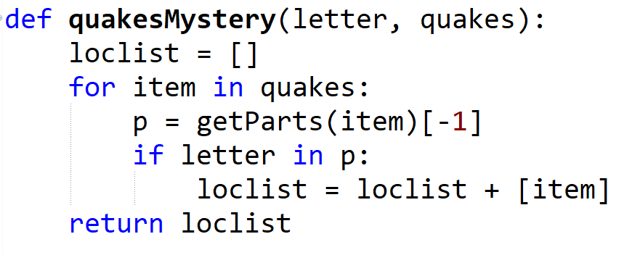
EarthQuake bit.ly/101f17-0919-2

Slide 25
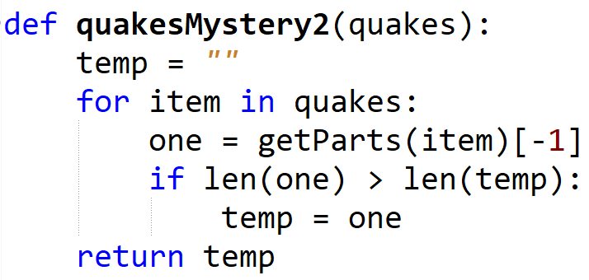
EarthQuake (cont)

Slide 26
How to tackle the earthquake part of assignment?
Write one function at a time
TEST IT, make sure it works! Super important!!
Then move to next function
Example: Write a function named getParts.
getParts("earthquake, 1.3, 81km SSW of Kobuk, Alaska") would return
[1.3, "earthquake", "81km SSW of Kobuk, Alaska"]
Notes:
FOCUS on What are the inputs, What type are you suppose to return, a list, how do you get the string into a list of three parts!
Use the seven steps! Work an example by hand first. How would you do it? Generalize, then code.

Slide 27
Calling your Earthquake functions
Assume eqList is a list of all the earthquakes, each earthquake is a string in the correct format.
quakes1 = bigQuakes(3.0, eqList)
quakes2 = locationQuakes(“Alaska”, quakes1)
printQuakes(quakes2, 5)
What can you say about quakes2?
Type, value

Slide 28
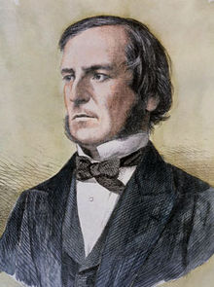
Python if statements and Booleans
In python we have if: else: elif:
Used to guard or select block of code
If guard is True then code block, else other
What type of expression used in if/elif tests?
==, <=, <, >, >=, !=, and, or, not, in
Value of expression must be either True or False
Type is bool - George Boole, Boolean,
Examples with if
String starts with vowel
(useful for APT Emphasize)
Notes:
George Boole was a mathematician who did foundational work in Boolean algebra and Boolean logic. Boolean logic laid the foundation for the information age. How computers work

Slide 29
Four versions of isVowel? bit.ly/101f17-0919-3
def isVowel(ch):
c = "aeiou".count(ch)
if c > 0:
return True
A
B
def isVowel(ch):
if ch =='e':
return True
if ch == 'a':
return True
if ch == 'i':
return True
if ch == 'o':
return True
if ch == 'u':
return True
return False
C
def isVowel(ch):
return "aeiou".count(ch) > 0
D
def isVowel(ch):
if ch in "aeiou":
return True
else:
return False
Notes:
Write helper function to solve problems, will make your life easier!
B doesn’t work, missing a False case. All others work

Slide 30
Anatomy of a Python String
String is a sequence of characters
Functions we can apply to sequences: len, slice [:], others
Methods applied to strings [specific to strings]
st.split(), st.startswith(), st.strip(), st.lower(), …
st.find(), st.count()
Strings are immutable sequences
Characters are actually length-one strings
Cannot change a string, can only create new one
What does upper do?
See resources for functions/methods on strings
Iterable: Can loop over it, Indexable: can slice it

Slide 31
Counting vowels in a string
Accumulating a count in an int is similar to accumulating characters in a string
Alternative version of adding:
value += 1
def vowelCount(word):
value = 0
for ch in word:
if isVowel(ch):
value = value + 1
return value
Notes:
Notice the pattern again

Slide 32
Incremental + : numbers and strings
Wtht vwls cn y stll rd ths sntnc?
Create a no-vowel version of word
Examine each character, if it's not a vowel …
Pattern of building a string
def noVowels(word):
ret = ""
for ch in word:
if not isVowel(ch):
ret = ret + ch
return ret
Notes:
in the loop we are iterating over the characters in the word.
Ret is accumulating characters – building a new string
Consider writing a helper function!!!!

Slide 33
APT Emphasize
Use a helper function! isVowel(ch)

Slide 34
Slides did not use

Slide 35
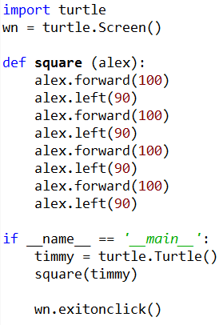
Turtles: bit.ly/101s17-0202-2
Run in eclipse
Make square with different sizes?
Make a rectangle?
Where is the repetition?
New commands:
up(), down(), position(), goto()

