Slide 1
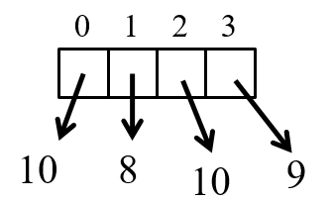
CompSci 101 Introduction to Computer Science
score = [10,8,10,9]
Sep 21, 2017
Prof. Rodger

Slide 2
Announcements
Reading and RQ8 due next time
Assignment 3 due tonight
Assignment 4 out, due Oct. 3
APT 3 is due on Tuesday
APT Quiz 1 take Sunday-Wednesday 11:59pm
practice APT quiz available
Today
Breaking apart and putting back together.
Thinking about solving assignments, apts
Notes:
End of Week Four

Slide 3
Assignment 4 out today, due Oct 3
Transform 1 – PigLatin.
The angry bear climbed the tree.
e-thay angry-way ear-bay imbed-clay e- thay ee.-tray
→ The angry bear climbed the tree.
Transform 2 – Caesar Cipher encryption
The angry bear climbed the tree.
Aol hunyf ilhy jsptilk aol ayll.
→ The angry bear climbed the tree.

Slide 4
Getting help
Consider a peer tutor – one hour of one on one help a week.
Many take advantage of this
contact peer tutoring center
Are you getting too much help?
After solving APT
Can you solve again with a blank sheet of paper or blank file and no help?
Are you using 7 step process to solve?
Notes:
I will recruit more tutors if they do not have enough .
Bring form by and I will sign it.
This class is different than others, you may have never needed a tutor before.

Slide 5
Are you Learning How to Debug?
Do a little bit at a time, make sure it works!
Print is your friend!
Create variables!
Isolate the problem
Comment out sections until you can isolate where the problem is
Python Tutor – trace
Doesn’t work with files but comment out file and create variable with sample input
Notes:
Works with APTS, you just need to call the function

Slide 6
Incremental + : numbers and strings
Wtht vwls cn y stll rd ths sntnc?
Create a no-vowel version of word
Examine each character, if it's not a vowel …
Pattern of building a string
def noVowels(word):
ret = ""
for ch in word:
if not isVowel(ch):
ret = ret + ch
return ret
Notes:
in the loop we are iterating over the characters in the word.
Ret is accumulating characters – building a new string
Consider writing a helper function!!!!

Slide 7
Counting vowels in a string
Accumulating a count in an int is similar to accumulating characters in a string
Alternative version of adding:
value += 1
def vowelCount(word):
value = 0
for ch in word:
if isVowel(ch):
value = value + 1
return value
Notes:
Notice the pattern again

Slide 8
Assignment 3 Questions bit.ly/101f17-0921-1

Slide 9
Filtering data
List of all the earthquakes
FILTER – those magnitude 2.0 or greater
→ List of earthquakes 2.0 or greater
FILTER – those earthquakes in Alaska
→ List of earthquakes from Alaska 2.0 or greater
NOTE you still have a list

Slide 10
String Functions – What is output?

Slide 11
String Functions – What is output?
Darth Vater Darth Vater
mippippippi
Desth Voter es Desth Voter
False

Slide 12
Making Decisions
Question?
True
if block
False

Slide 13
Making Decisions in Python
if condition1:
Block of code to do if condition is true
elif condition2:
Block of code to do if condition1 false, condition2 is true
else:
Block of code to do if other conditions false
Can have many elifs, leave out elif, leave out else

Slide 14
Making Decisions tools
Boolean values: True, False
Boolean operators: and, or, not
Relational operators: <, <=, >, >=
Equality operators: ==, !=
X | Y | X and Y | X or Y
True | True | True | True
True | False | False | True
False | True | False | True
False | False | False | False

Slide 15
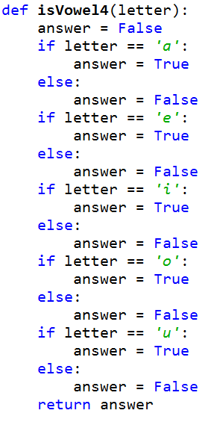
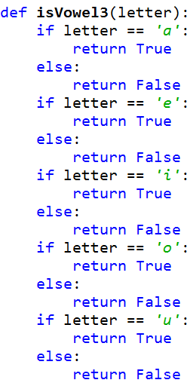
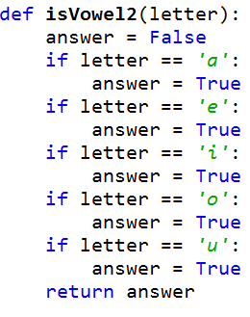
bit.ly/101f17-0921-2

Slide 16
Lists
A list is a collection of objects
scores = [99, 78, 91, 84]
allAboutMe = [“Mo”,25, “934-1234”]
club=[‘Mo’,‘Jo’,‘Po’, ‘Flo’, ‘Bo’]
Lists are mutable – use [num] to change a value
Lists are indexed starting at 0, or -1 from the end
Functions: max, min, len, sum
Slice lists [:]

Slide 17
List Examples
scores = [10, 8, 10, 9]
print scores
scores[2] = 5
print scores
print max(scores), len(scores)
print sum(scores)
print scores[1:]
print scores[1], scores[-1]
scores.append(4)
scores += [5]
print scores
Notes:
Show them also
Scores += 5

Slide 18
List Examples
scores = [10, 8, 10, 9]
print scores
scores[2] = 5
print scores
print max(scores), len(scores)
print sum(scores)
print scores[1:]
print scores[1], scores[-1]
scores.append(4)
scores += [5]
print scores
[10, 8, 10, 9]
[10, 8, 5, 9]
10, 4
32
[8, 5, 9]
8, 9
[10, 8, 5, 9, 4, 5]
Notes:
Show them also
Scores += 5

Slide 19
List before/after modification
0 1 2 3
score = [10,8,10,9]
10
8
9
10
0 1 2 3
score [2] = 5
10
8
9
5
10

Slide 20
More List Examples
phrase = "earthquake, 1.3, 81km SSW of Kobuk, Alaska"
phrase.split(“ ,“) vs phrase.split() vs phrase.split(“a”)
phrase = “Duke will beat UNC”
alist = phrase.split()
‘ ‘.join(alist) vs ‘+’.join(alist) vs “YES”.join(alist)
append vs += [item]

Slide 21
Design pattern of accumulation for item in something
Summing to tally a count
value += 1
Building a new string by concatenating
str += ch
Building a new list by appending
lst.append(element)
OR
lst += [element]

Slide 22
Design pattern of accumulation for item in something
Summing to tally a count
value += 1
Building a new string by concatenating
str += ch
Building a new list by appending
lst.append(element)
OR
lst += [element]
lst = lst + [element]
Note no “=“ here
Note the brackets!

Slide 23
Processing List Items
Process all the items in a list, one item at a time
Format: for variable in list:
process variable
Example:
sum = 0
nums = [6, 7, 3, 1, 2]
for value in nums:
sum = sum + value
print sum

Slide 24
Learn list functions
nums = [6, 7, 3, 1, 2]
print sum(nums)

Slide 25
Problem: Sum up even numbers in list of numbers
Could do it similar to two slides back
OR Build a list of the correct numbers, then sum
Notes:
You could do it the way two slides back, but you could also build

Slide 26
How to build list of evens and sum? bit.ly/101f17-0921-3
def sumUpEven(nums):
answer = question1
for item in nums:
if question2:
question3
return question4

Slide 27
From APT 3 - TxMsg
http://www.cs.duke.edu/csed/pythonapt/txmsg.html

Slide 28
Examples
Do one by hand?
Explain to partner?
Identify Pythonic/programming challenges?

Slide 29
Debugging APTs: Going green
TxMsg APT: from ideas to code to green
What are the main parts of solving this problem?
Transform words in original string
Abstract that away at first
Finding words in original string
How do we do this?
def getMessage(original):
ret = ""
for word in :
ret = ret + " " + transform(word)
return ret #initial space?
original.split()
Notes:
Same idiom
Didn’t use join so you have an extra space,
Use join or strip, slide later also

Slide 30
Debugging APTs: Going green
TxMsg APT: from ideas to code to green
What are the main parts of solving this problem?
Transform words in original string
Abstract that away at first
Finding words in original string
How do we do this?
def getMessage(original):
ret = ""
for word in :
ret = ret + " " + transform(word)
return ret #initial space?
original.split()
Notes:
Same idiom
Didn’t use join so you have an extra space,
Use join or strip, slide later also

Slide 31
Write helper function transform
How?
Use seven steps
Work an example by hand

Slide 32
Transform word - Step 1: work small example by hand
Word is “please”
Letter is ‘p’, YES
answer is “p”
Letter is ‘l’, NO
Letter is ‘e’, NO
Letter is ‘a’, NO
Letter is ‘s’, YES
answer is “ps”
Letter is ‘e’, NO

Slide 33
Step 2: Describe what you did
Word is “please”, create an empty answer
Letter is ‘p’, consonant, no letter before, YES
Add ‘p’ to answer
Letter is ‘l’, consonant, letter before “p”, NO
Letter is ‘e’, vowel, letter before ‘l’, NO
Letter is ‘a’, vowel, letter before ‘e’, NO
Letter is ‘s’, consonant, letter before ‘a’, YES
Add ‘s’ to answer
Letter is ‘e’, vowel, letter before ‘s’, NO
Answer is “ps”
Notes:
I notice that I need the letter before to answer if I want the letter for the answer

Slide 34
Step 3: Find Pattern and generalize
Need letter before, pick “a”
answer is empty
for each letter in word
If it is a consonant, and the letter before is a vowel, then add the letter to the answer
This letter is now the letter before
return answer

Slide 35
Step 4 – Work another example
Word is message
Letter is ‘m’, before is ‘a’, add ‘m’ to answer
Letter is ‘e’, before is ‘m’, NO
Letter is ‘s’, before is ‘e’, add ‘s’ to answer
Letter is ‘s’, before is ‘s’, NO
Letter is ‘a’, before is ‘s’, NO
Letter is ‘g’, before is ‘a’, add ‘g’ to answer
Letter is ‘e’, before is ‘g’, NO
Answer is “msg” WORKS!!

Slide 36
Step 5: Translate to Code
# Letter before is “a” # start with a vowel
before = ‘a’
# answer is empty
answer = ‘’
# for each letter in word
for ch in word:

Slide 37
Step 5: Translate to Code
# Letter before is “a” # start with a vowel
before = ‘a’
# answer is empty
answer = ‘’
# for each letter in word
for ch in word:

Slide 38
Step 5: Translate to Code (code)
#If it is a consonant, and the letter before is a #vowel, then add the letter to the answer
if !(isVowel(ch)) and isVowel(before):
answer += ch
#This letter is now the letter before
before = ch
# return answer
return answer

Slide 39
Step 5: Translate to Code (code)
#If it is a consonant, and the letter before is a #vowel, then add the letter to the answer
if !(isVowel(ch)) and isVowel(before):
answer += ch
#This letter is now the letter before
before = ch
# return answer
return answer

Slide 40
Will our program work for?
STRING GET SHOULD GET
green
apple
a
aeiuo
grrr
gn YES
p YES
a
aeiou
g YES

Slide 41
Will our program work for?
STRING GET SHOULD GET
green
apple
a
aeiuo
grrr
gn YES
p YES
a
aeiou
g YES
Handle special cases first, maybe write a function for some?

Slide 42
Why use helper function 'transform'?
Structure of code is easier to reason about
Harder to develop this way at the beginning
Similar to accumulate loop, build on what we know
We can debug pieces independently
What if transform returns "" for every string?
Can we test transform independently of getMessage?
Notes:
Make it look like something you know
Now solve txtmsg with code!!!!

Slide 43
Python via Problem Solving
In the loop for TxMsg we saw:
ret = ret + " " + transform(word)
- Why does this leave "extra" space at front?
- Eliminate with ret.strip()
Alternate: collect transform words in list, use join to return
Rather than construct string via accumulation and concatenation, construct list with append
Notes:
Use join here

Slide 44
Extra slides below here

Slide 45
Problem: What is length of longest string in list of strings?
Notes:
We develop this further in the next lecture

