Slide 1
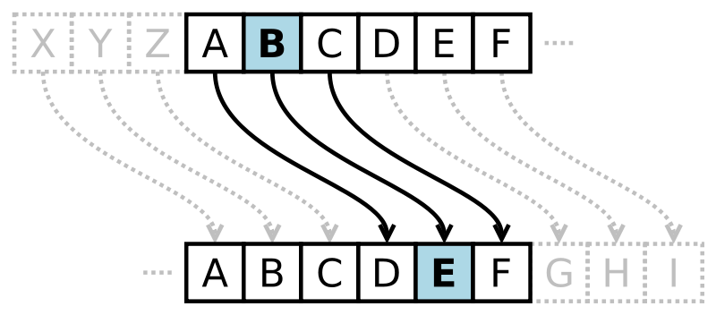
CompSci 101 Introduction to Computer Science
Sept 26, 2017
Prof. Rodger

Slide 2
Announcements
RQ for Thursday.
Assignment 4 due next Tuesday
APT 3 is due today, no new APT out
APT Quiz 1 finish by Midnight Wednesday
Exam 1 is Oct 5
Lab 5 this week! Legos and coding
Today: problem solving with files
largest word in file, where is largest word

Slide 3
Looping over and accumulating…
initialize
for variable in something:
ask question about variable?
accumulate or build a structure
return answer
Loop over characters in strings, items in lists, lines in a file
Notes:
Given a problem – do need a loop or an if? If a loop, what do you want to loop over? Understand the accumulator pattern

Slide 4
Largest number in list bit.ly/101f17-0926-1
def biggest(numbers):
max = numbers[0]
for num in numbers:
if num > max:
max = num
return num
x = biggest([8, 3, 9, 1, 5, 7])
Then x is 7? What is wrong?
Notes:
What is wrong?
Last line should be: return max

Slide 5
More on lists
range(5) is [0,1,2,3,4]
range(2,6) is [2, 3, 4, 5]
alist = [“a”, “b”, “d”, “c”]
for i in range(len(list)):
x = “ “.join(alist) # alist must be list of strings
y = list(“peach”)
Notes:
Range creates a list, use it with a for loop
Crazy import

Slide 6
Difference between
alist = ‘cannot stop Duke’.split()
for word in alist:
print word
for index in range(len(alist)):
print index, alist[index]
When to use index?

Slide 7
Back to APT TxMsg – with index! Step 5: Translate to Code
# Letter before is “a” # start with a vowel
before = ‘a’
# answer is empty
answer = ‘’
# for each letter in word
for ch in word:

Slide 8
Step 5: Translate to Code
# Letter before is “a” # start with a vowel
word = “a” + word # add extra vowel to front
# answer is empty
answer = ‘’
# for each letter in word
for index in range(1, len(word)): #indexing
ch = word[index] # can get ch
before = word[index-1]
Notes:
Why are we starting the range at 1 instead of 0? There is nothing before 0

Slide 9
Step 5: Translate to Code (code)
#If it is a consonant, and the letter before is a #vowel, then add the letter to the answer
if !(isVowel(ch)) and isVowel(before):
answer += ch
#This letter is now the letter before
before = ch
# return answer
return answer

Slide 10
Step 5: Translate to Code (code)
#If it is a consonant, and the letter before is a #vowel, then add the letter to the answer
if !(isVowel(ch)) and isVowel(before):
answer += ch
#This letter is now the letter before
# don’t need, getting letter before earlier with index
# return answer
return answer
Notes:
We don’t need to keep track of the letter before, because we have the index.

Slide 11
Problem Solving
How do we count words in a file?
How do we find the length of the longest word?
wordsInFile.py
Notes:
Solve this one way, then have them answer questions on the next sheet
Go over the code for lengthLongestWord and countWords

Slide 12
bit.ly/101f17-0926-2
Answer questions about computing the length of the longest word in a file
words is a list of strings
def lengthLongestWord(words):
maxSoFar = 0
for w in words:
if len(w) > maxSoFar:
maxSoFar = len(w)
return maxSoFar

Slide 13
More Problem Solving
How do we find the longest word?
How do we find where the longest word is?
Do we read a file into a list of words? A list of lines of words?

Slide 14
Assignment 4 – Piglatin/Caesar Reading from Files, Writing to Files
Programs generate data, store for access
Notes we take, notebooks we keep
Files we make our programs create and add to
File concepts for reading and writing
Call open with a path to file, how to open?
Choice of reading, writing, appending
Read or Write (depending on "r", "a", "w")
Close the file when done
Notes:
“a” – append to file
DON’t tell them on quiz - “w” – if already exists erases file and starts from scratch
Limit of how many files you can have open – so make sure you close the file – at scale matters

Slide 15
Reading from files: see PiglatinTransform.py
Open file for reading
Read lines: for line in f:
Read file: st = f.read()
Both get strings, convert as needed
If fname not found?
Type of f?
Type of st?
def readFile(fname):
f = open(fname)
st = f.read()
f.close()
return st.split()
Notes:
First one reads from file line by line
f.read() – files as a string
Fname – program dies

Slide 16
writefile Code in PiglatinTransform.py
def writeFile(words, fname):
LINE_SIZE = 80
f = open(fname,"w")
wcount = 0
for word in words:
f.write(word)
wcount += len(word)
if wcount + 1 > LINE_SIZE:
f.write('\n')
wcount = 0
else:
f.write(' ')
f.close()
Notes:
Have any questions about any of this? let them answer questions about it, then go over it
See there is an error, not counting spaces

Slide 17
Questions: File writing and Transform
bit.ly/101f17-0926-3
Notes:
Go

Slide 18
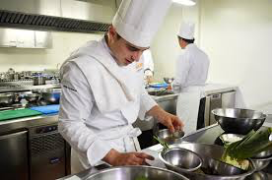
How to approach a 101 Assignment
Programming compared to Cooking
Follow a recipe to create {food or masterpiece}?
Understand the whole project before coding
Know at least a few steps before coding
Notes:
Chefs are also designing , you need to be able to
Biscuit recipe from grandmother
Coder vs programmer – want you to be creative

Slide 19
What do we learn from assignment?
We will snarf to get started
We will modify PiglatinTransform.py
We will create CaesarTransform.py
We might want to use parts of PiglatinTransform.py for CaesarTransform.py
Notes:
From the assignment page (READ)

Slide 20
What does Howto say about PiglatinTransform.py
Lots of details on how to pigify a word
Ignore at first, make the structure of the program work
We have to write four functions
Details on function headers/prototypes given
Details on function functionality given
Types and values in main program
Work to understand the flow
Run the program, where do you start?
Notes:
What do you ignore at first

Slide 21
Making lineToPiglatin work
Make sure you understand this
What do you need to do so this works?
What is header, signature, prototype: lineToPiglatin
def lineToPiglatin(st):
all = []
for word in st.split():
all.append(wordToPiglatin(word))
return ' '.join(all)
Notes:
Like we did with textmessage

Slide 22
Making wordToPiglatin work
Once you know what wordToPiglatin does, how do you implement it?
Review rules for piglatin
Review code for APT you hopefully did ☺
Don’t try to make every case work at once!
Start small and grow a working program.
How about first word is a vowel to begin …
Then add another case, …

Slide 23
If wordToPiglatin is done …
Get to piglatinToLine and piglatinToWord
Which will be easy? Why?
Can you do one easy case in piglatinToWord?
Why does it help to do one case at a time?
Builds confidence in reaching completion
Decreases time-to-completion: code works! Bugs easier to find.
Notes:
piglatinToLine should be almost identical to lineToPiglatin!!!!

Slide 24
In class Questions
bit.ly/101f17-0926-4

Slide 25
Cracking the Caesar Cipher
First create CaesarTransform.py
Where do you start?
What’s in the main program?
What’s copied from PiglatinTransform.py
What functions will you write first?
Where do you find this information?
What’s not clear about it?

Slide 26
Lots of details in making this work
How do you loop over characters in word?
Is there anything familiar here?
How do you know if a character is
Alphabetic?
Uppercase or lowercase?
A vowel or a consonant?
Once again: start simple, make something work, add functionality incrementally

Slide 27
How do you know encryption works?
Is this a chicken and egg question?
Could you write decrypt first?
Isn’t decrypting by eyeball decryption just encrypting 26 times?
14 Pljbqfjbp fq'p bxpv ql zlrkq colj 1-10, yrq klq xitxvp
15 Qmkcrgkcq gr'q cyqw rm amslr dpmk 1-10, zsr lmr yjuywq
16 Rnldshldr hs'r dzrx sn bntms eqnl 1-10, ats mns zkvzxr
17 Sometimes it's easy to count from 1-10, but not always
18 Tpnfujnft ju't fbtz up dpvou gspn 1-10, cvu opu bmxbzt
19 Uqogvkogu kv'u gcua vq eqwpv htqo 1-10, dwv pqv cnycau

Slide 28
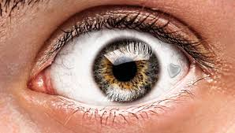
Can you call a function 26 times?
Encrypt using 26 shift keys and … eyeball!
Also write automatic decryption by determining which words are real words…
em = #encrypted message
for n in range(26):
sem = encrypt(em,n)
print n,sem
Notes:
If time back to apt txtmsg

Slide 29
Automatically determine what the key is….
Translate each line 1-26
Which one has more English words?
Use a file of English words
Count how many are in each translation
14 Pljbqfjbp fq'p bxpv ql zlrkq colj 1-10, yrq klq xitxvp
15 Qmkcrgkcq gr'q cyqw rm amslr dpmk 1-10, zsr lmr yjuywq
16 Rnldshldr hs'r dzrx sn bntms eqnl 1-10, ats mns zkvzxr
17 Sometimes it's easy to count from 1-10, but not always
18 Tpnfujnft ju't fbtz up dpvou gspn 1-10, cvu opu bmxbzt
19 Uqogvkogu kv'u gcua vq eqwpv htqo 1-10, dwv pqv cnycau

Slide 30
Automatically determine what the key is….
Translate each line 1-26
Which one has more English words?
Use a file of English words
Count how many are in each translation
Count
21
15
10
7698
24
17
14 Pljbqfjbp fq'p bxpv ql zlrkq colj 1-10, yrq klq xitxvp
15 Qmkcrgkcq gr'q cyqw rm amslr dpmk 1-10, zsr lmr yjuywq
16 Rnldshldr hs'r dzrx sn bntms eqnl 1-10, ats mns zkvzxr
17 Sometimes it's easy to count from 1-10, but not always
18 Tpnfujnft ju't fbtz up dpvou gspn 1-10, cvu opu bmxbzt
19 Uqogvkogu kv'u gcua vq eqwpv htqo 1-10, dwv pqv cnycau
Notes:
Not shown but you will get some matches, especially small words
You may not match every word in the line that translates, depends on if that word happens to be in the file.
You could use a dictionary, but turns out a file of English words (not all, but a lot, probably works)

Slide 31
What do you output for assignment 4?
Demonstrate with clear output that all parts of your program work.
Notes:
If time back to apt txtmsg

