Slide 1
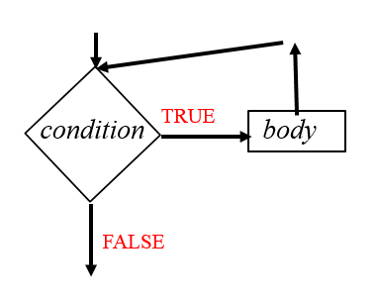
CompSci 101 Introduction to Computer Science
Sept 28, 2017
Prof. Rodger

Slide 2
Announcements
Exam 1 is Thursday, Oct 5
RQ Reviews available today – not for credit
Practice exams on today’s date
Work them on paper before Tuesday
Assignment 4 due Tuesday, try for Monday!
No Lab next 2 weeks
Today:
Loops – While, While True
Problem Solving

Slide 3
Lab 5 – First part
Practicing the first four steps of the 7 steps for problem solving
Find the pattern, what is next, then generalize

Slide 4
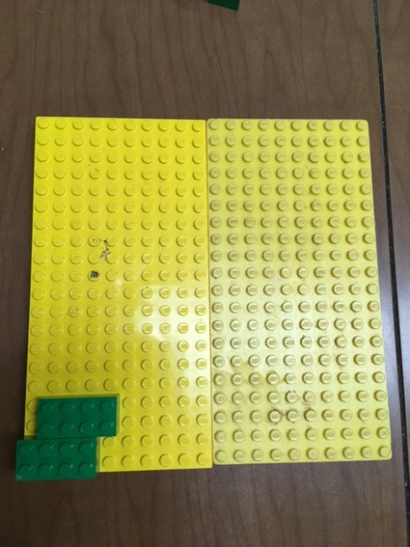
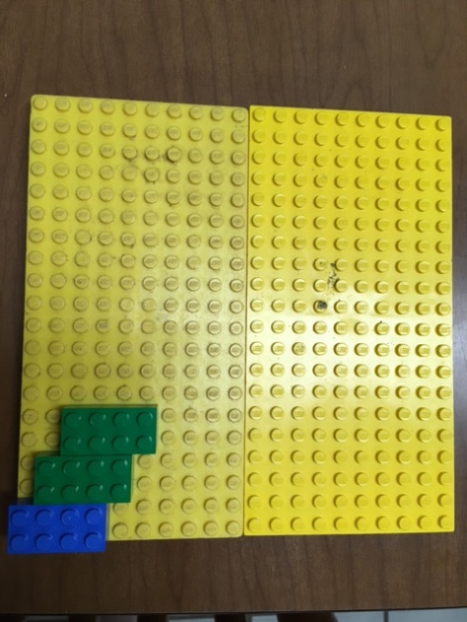
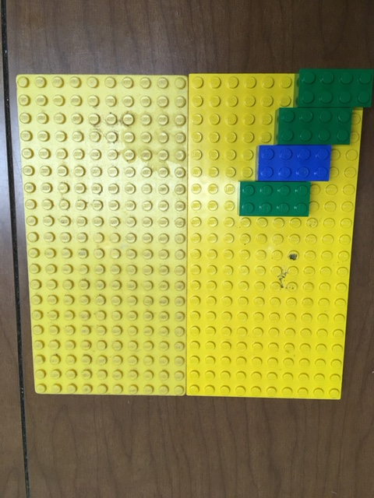
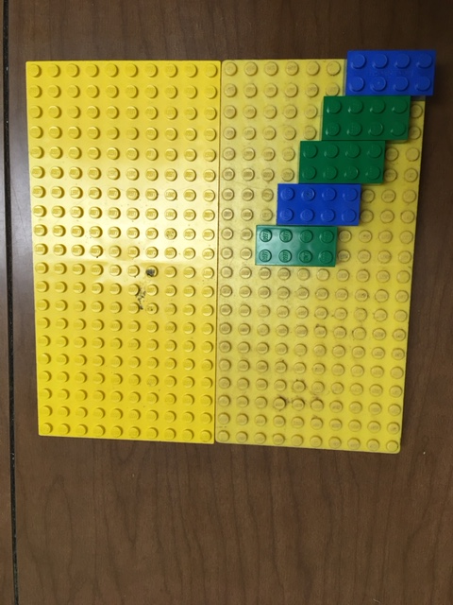
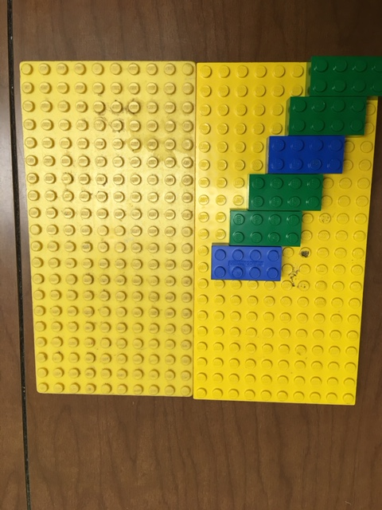
Pattern 1

Slide 5
Notice things about the pattern
You want to place N legos
If N is odd – Start with a green
First blue is third lego
If N is even – start with a blue
Every third lego is blue

Slide 6
Bottom Left is (0,0)
(2,3)
(0,0)

Slide 7
Try it N=8
Num Location Lego color
1 (0,0) blue
2 (1,2) green
3 (2,4) green
4 (3,5) blue
5 (4, 6) green
6 (5, 8) green
7 (6, 10) blue
8 (7, 12) green

Slide 8
Algorithm for placing N legos
Legos placed long way with bottom left at location, explain the grid
For num from 1 to N
Location is ( (num-1), (num-1)*2 )
If N is even
If num is divisible by 3
Place blue lego at location
Else
Place green lego at location
If N is odd
…

Slide 9
Developing an Algorithm
http://www.youtube.com/watch?v=AEBbsZK39es
$193, $540, $820, $700, $749. Are these reasonable? Why?
Notes:
This is the price is right game where you bid to try to guess the price of an item and you get several tries.
Play the video
Are these numbers reasonable? Poll the class

Slide 10
I'm thinking of a number …
You guess. I'll tell you high, low, or correct
Goal: guess quickly, minimal number of guesses
Number between 1 and 100…
Number between 1 and 1000…
Can you describe an algorithm, instructions, that would allow someone to use your instructions to play this game correctly. Start with 1 and 100, but ideally your instructions work with 1 and N
bit.ly/101f17-0928-1
Notes:
Ask for a volunteer
What is the best first guess? Second guess

Slide 11
Analyzing the binary search algorithm
Is the algorithm correct?
Try it, again, and again and …
Reason about it: logically, informally, …
How efficient is the algorithm?
How many guesses will it take (roughly, exactly)
Should we care about efficiency?
When do we really care about efficiency?
Examples?
Notes:
Algorithm correct? Can you try all possible data? Too much!
Why does google care about efficiency, and what does "efficient" mean? Searching billions of webpages in no time, making the user think it's no time, even when it is, e.g., auto-complete search query and scrolling google maps. Sometimes about algorithm and sometimes about user experience and making the web more efficient
Also efficiency of the user experience

Slide 12
Anderson
Applegate
Bethune
Brooks
Carter
Douglas
Edwards
Franklin
Griffin
Holhouser
Jefferson
Klatchy
Morgan
Munson
Narten
Oliver
Parker
Rivers
Roberts
Stevenson
Thomas
Wilson
Woodrow
Yarbrow
Find Narten
Notes:
The magenta/purple shows where Narten could be. After each guess, roughly in the middle, we eliminate half of the names from being the range
Of names in which Narten could be. So how many times can we cut the range in half?

Slide 13
Anderson
Applegate
Bethune
Brooks
Carter
Douglas
Edwards
Franklin
Griffin
Holhouser
Jefferson
Klatchy
Morgan
Munson
Narten
Oliver
Parker
Rivers
Roberts
Stevenson
Thomas
Wilson
Woodrow
Yarbrow
Find Narten
FOUND!
Notes:
The magenta/purple shows where Narten could be. After each guess, roughly in the middle, we eliminate half of the names from being the range
Of names in which Narten could be. So how many times can we cut the range in half?

Slide 14
Looking for a Needle in a Haystack
If a computer can examine 10 million names/numbers a second, suppose the list isn't sorted, or I say "yes/no", not "high/low"
How long to search a list of 10 million?
How long to search a list of a billion?
14 billion pixels in a 2 hour blu-ray movie
What about using binary search? How many guesses for 1000, 10⁶, 10^{9,} 10¹²
One of the things to remember: 2¹⁰ = 1024
Notes:
1 sec – 10 million
100 sec – billion – 2 min
14 billion pixels in 2 hour blu-ray movie
– days to render a movie
Faster
1000 – 10
10^6 – 20
10^9 – 30
10^12 - 40

Slide 15
Review - Searching for words
If we had a million words in alphabetical order, how many would we need to look at worst case to find a word?
If you are clever, cut the number of numbers to look
at in half, over and over again
Notes:
If you are clever, you only have to look at a few word!

Slide 16
Review - Searching for words
If we had a million words in alphabetical order, how many would we need to look at worst case to find a word?
20 words!
1,000,000
500,000
250,000
125,000
62,500
31,250
15,625
7812.5
3906
1953
976.56
488
244
122
61
30
15
7.5
3.75
1.875
If you are clever, cut the number of numbers to look
at in half, over and over again
Notes:
If you are clever, you only have to look at a few word!

Slide 17
Prime Numbers
An integer > 1 is prime if it has no positive divisors other than 1 and itself.
12 is not prime!
12 is divisible by 2, 3, 4, 6
3*4 = 12, 2*6 = 12
Prime numbers: 2, 3, 5, 7, 11, 13, 17, 19, 23
Is 8315411 prime?
Notes:
What if we write a program to determine if a number is prime

Slide 18
Is number a Prime number? Bit.ly/101f17-0928-2
def isPrime(number):
if number < 2: # must be greater than 1
return False
if number < 4: # 2 and 3 are prime
return True
for n in range(4,number):
if number/n * n == number:
return False
return True
Notes:
Run this one

Slide 19
Write Helper functions to help solve problems!!!!
Find all the primes between 10 and 100
Use isPrime as a helper function
Assignment 4 helper functions
isVowel(letter) – return true if letter is a vowel
NoVowels(word) – return True if no vowels in word
Automatic Decrypt, what helper function?
countWords(wordlist, shift, phrase)
Decrypt with shift, then count how many words in phrase are in wordlist
Notes:
Helper functions make your code shorter,

Slide 20
Write Helper functions to help solve problems!!!!
Find all the primes between 10 and 100
Use isPrime as a helper function
Assignment 4 helper functions
isVowel(letter) – return true if letter is a vowel
NoVowels(word) – return True if no vowels in word
Automatic Decrypt, what helper function?
countWords(wordlist, shift, phrase)
Decrypt with shift, then count how many words in phrase are in wordlist
Notes:
Helper functions make your code shorter,

Slide 21
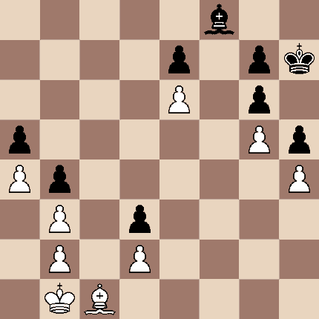
Undetermined Repetition
Game of chess, when does it end?
What is the 100th prime number?
Guessing a number from 1 to 100?
Notes:
How many numbers are you going to check?

Slide 22
While loops
Repetition when you stop a loop based on a condition
while CONDITION:
BODY
As long as condition is true, keep executing loop.
Must have an update in the body to get closer to condition being false

Slide 23
Example for while
Playing chess
while (game not over)
make a move in the game
(game must get closer to ending)
Notes:
With the indefinite loop you have to be getting closer and closer to stopping the loop.

Slide 24
Example2 for while
What is the 100th prime number?
number = 2
while (not 100th prime)
is number prime?
update count
generate next number to check
(program must get closer to ending)

Slide 25
Example3 - Factorial
5! = 5 * 4 * 3 * 2 * 1 = 120
3! = 3 * 2 * 1 = 6

Slide 26
Example with while loop

Slide 27
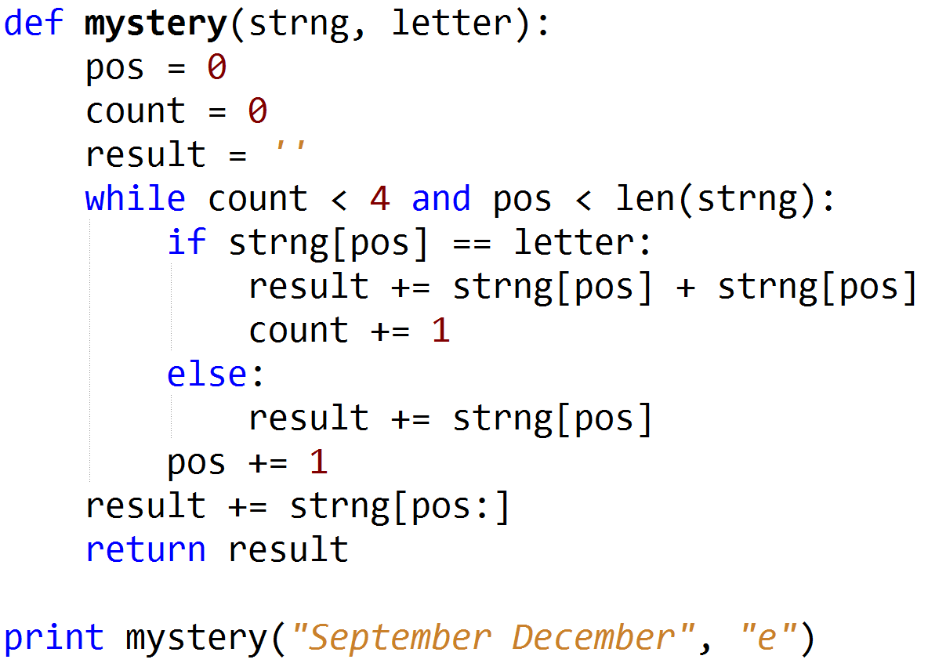
Mystery While example
bit.ly/101f17-0928-3
Notes:
Where is the update? What does this do?

Slide 28
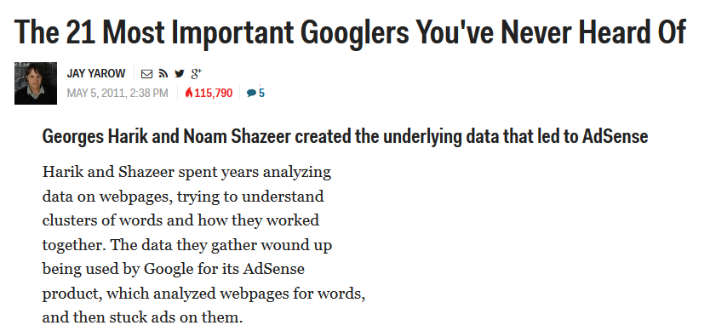
Computer Science Duke Alum
Notes:
Noam Shazeer (works at google, sat in the front row in B101 in CompSci 101!)

Slide 29
Looping with while – not sure when to stop
Playing chess
Determining the 100th prime number
Another way – while True – EASIER!
Must have ways to break out of infinite loop
Must have update – gets closer to ending

Slide 30
while condition vs while True
while condition: while True:
body body
continue if condition:
break
continue
While condition is true - must update
- must get closer to making condition false
- use break to exit

Slide 31
Format of While True
initialize
while True:
if something:
break
if something2:
update
update
Continue or return

Slide 32
Revisit Factorial with while True

Slide 33
Revisit Mystery with while True bit.ly/101f17-0928-4

Slide 34
Problem: Find the location of first adjacent duplicate word bit.ly/101f17-0928-5
“This is a story about a a girl with a red hood…”
Return six as the location of the second word “a”

Slide 35
Extra Slides

Slide 36
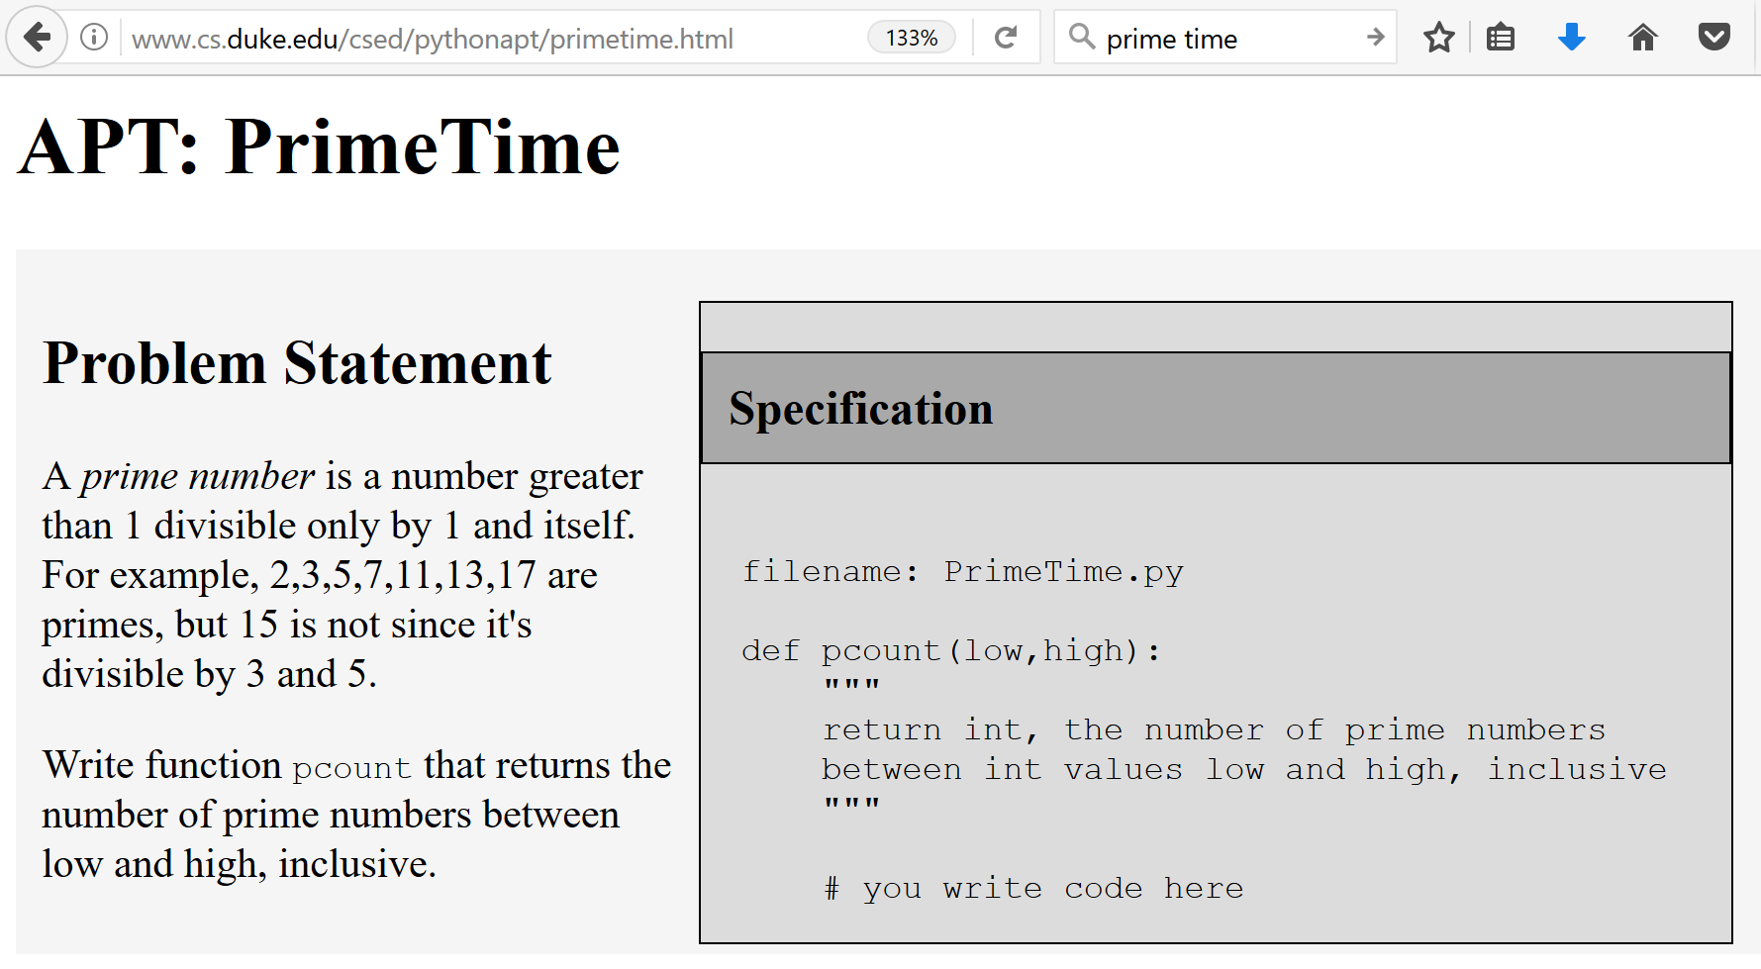
APT PrimeTime

