Slide 1
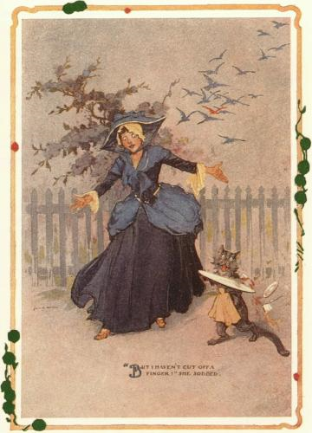
CompSci 101 Introduction to Computer Science
Oct 3, 2017
Prof. Rodger
“All your troubles are due to those ‘ifs’,”
declared the Wizard. If you were not a
Flutterbudget you wouldn’t worry.”
- The Emerald City of Oz by Frank Baum

Slide 2
Announcements
Test 1 is Thursday, Oct 5!
You must take the exam in your lecture section
Accommodations for test 1? Should have already filled out form on website
Assignment 4 due TODAY
Late penalty 10% extended through Friday, Oct 6
See Regrades form on website
No labs this week
Consulting hours this week
Ask UTAs to go over exam questions, etc.

Slide 3
Exam logistics
Exam is in the regular classroom
Only need a pen or pencil
No calculator, smart watch, electronics, scratch paper
Will give you a reference sheet of Python information with the test (see resources page)
Closed book, closed notes, closed neighbor
Covers lecture, lab and assigned reading, assignments, apts
Have put old quizzes back up as quiz review
This is NOT for a grade, for studying only

Slide 4
The best way to study
Write code on paper!
Don’t spend time debugging!
Resources page has old tests and solutions
Try writing code, then look at solutions
Rewrite an APT
Rewrite code we did in lecture
Rewrite code we did in lab
Notes:
Don’t spend a lot of time debugging!!!!!!!! Move on to the next problem!!!!!!!!

Slide 5
What we have not done
Test 1 from Fall 2014 on we have covered everything.
If looking at old exams, note we have not done the following:
List comprehensions
Code in square brackets such as
y = [w for w in alist]
There may be other things…. If it looks strange, it might be we haven’t done it….

Slide 6
Not covered on the exam
While loops
Writing files
Turtles

Slide 7
Understand
What is the difference between:
[ ] and ( )
w = and w +=
print value and assigning value to a variable
When do you print? When do you return?
Does a function print or return?
if, for, range, strings, lists
Understand format and how they work
Looping over items VS looping over index
Parameters vs arguments

Slide 8
Writing functions with formulae
bit.ly/101f17-1003-1

Slide 9
Writing functions with formulae
Using extra variables: can be really smart
Helps in making each line simple
Easy to correct if you've made a mistake
See triangleArea, what about other math symbols and formula?
What do +, -, *, /, % do?
What about math.sqrt or 5**0.5 or math.sin …

Slide 10
APT Quiz 1 Solns on today’s date

Slide 12
Accumulating in a loop
If you are going to return a string
Initialization, return value, how to "build it"
If you are going to return an int (counter)
Initialization, return value, how to "build it"
If you are going to return a list
Initialization, return value, how to "build it"

Slide 13
Counting 'a's in a string, 'fox' in a list?
What Python functions/methods help
If you forget, how can you recreate yourself?
See exam Python reference sheet

Slide 14
Basic List/file Processing
bit.ly/101f17-1003-2
Notes:
Problem from Fall 2011

Slide 15
Review Old Exam Questions

