Slide 1
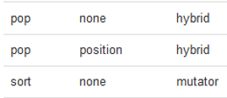
CompSci 101 Introduction to Computer Science
Oct 12, 2017
Prof. Rodger

Slide 2
Announcements
Reading and RQ 11 due next time
APT 4 out due next Thursday
Today:
More on Lists
Solving APTs with: while True
Coming – more ways to process data
Exam 1 back next time

Slide 3
Problem: Find the location of first adjacent duplicate word
“This is a story story about a girl with a red hood…”
Return 3 as the location of the first word that has a duplicate adjacent word (start at 0)
Notes:
Convert to a list of words

Slide 4
Seven Steps – Step 1 work example by hand
This is a story story about a girl …
This is a story story about a girl …
This is a story story about a girl …
This is a story story about a girl …
Step 2 – write down what you did
Step 3 – generalize, special cases
Step 4 – work another example

Slide 5
Seven Steps – Step 1 work example by hand
This is a story story about a girl …
This is a story story about a girl …
This is a story story about a girl …
This is a story story about a girl …
Step 2 – write down what you did
Step 3 – generalize, special cases
Step 4 – work another example
Position 0
Position 1
Position 2
Position 3
Return 3

Slide 6
Bit.ly/101f17-1012-1

Slide 7
APTs solved in a similar way with: while True
Pikachu
NameGroup
Notes:
Talk about these where is the iteration

Slide 8
APTs solved in a similar way
NameGroup
Pikachu

Slide 10
Pikachu APT
APT: Pikachu
What is the iteration?
What are the choices: pi ka chu
pichukarunkapi
Try:
Good:

Slide 11
Pikachu APT
APT: Pikachu
What is the iteration?
What are the choices: pi ka chu
pichukarunkapi
NOT VALID
chu
pi
pi
pi
pi
ka
chu
Try:
ka
ka
Good:
pi
chu
ka
Notes:
Use a while True loop
How do you move through the string? Sometimes by 2 and sometimes by 3.

Slide 12
APT NameGroup

Slide 13
APT NameGroup
Notes:
Process it left to right in a similar way.

Slide 14
7 steps – Step 1 work example calculate(names, “joe”, “bo”, 2)
moe joe sue bo joe po fa bo sue
moe joe sue bo joe po fa bo sue
moe joe sue bo joe po fa bo sue
moe joe sue bo joe po fa bo sue
moe joe sue bo joe po fa bo sue

Slide 15
7 steps – Step 1 work example calculate(names, “joe”, “bo”, 2)
moe joe sue bo joe po fa bo sue
moe joe sue bo joe po fa bo sue
moe joe sue bo joe po fa bo sue
moe joe sue bo joe po fa bo sue
moe joe sue bo joe po fa bo sue
YES
NO
Found!
YES
YES

Slide 17
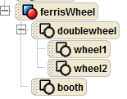
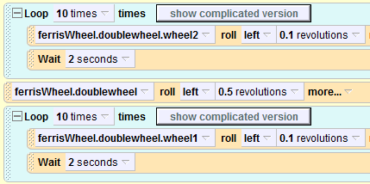
Alice programming language alice.org, Alice version 2.4
Notes:
See folder AliceDemos/TheFair/ for Alice Worlds

Slide 18
Nested Loop

Slide 19
Fair Ride – Octopus

Slide 20
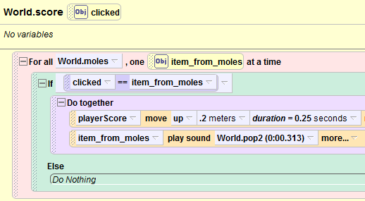
Wac-A-Mole
Notes:
How is wac a mole implemented? A list of moles, go through and check if what you clicked on is in the list

Slide 21
Creating a list
Given a list of numbers, create a second list of every number squared.
nums = [8, 3, 5, 4, 1]
sqnums = []
for v in nums:
sqnums.append(v*v)
print sqnums
[64, 9, 25, 16, 1]
Notes:
Talk about append. It modifies the list. Note there is not a return value.
Also note that it is a function that is applied to the list – notice the dot
Nameoflist.function
We have functions

Slide 22
More on List operations
Previous page
nameOfList “dot” function (parameter)
sqnums.append(v*v)
See list operations on next page
Mutator vs hybrid vs return
Mutator changes the list (no return value)
Hybrid changes list and returns value
Return – returns value, no change to list

Slide 23
List operations from book

Slide 24
Problem
Remove all negative numbers from list
[4, -2, 5, 6, -3] → [4, 5, 6]
Two ways
1) return a new list with all negative numbers removed
2) Modify a list to remove negative numbers

Slide 25
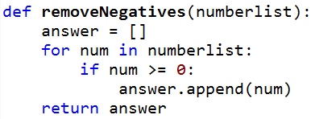
www.bit.ly/101f17-1012-2
somenums = [3, -1, 8, -5, -2, 6, 7]
nonegs = removeNegatives(somenums)

Slide 26
www.bit.ly/101f17-1012-3
somenums = [3, -1, 8, -5, -2, 6, 7]
removeNegatives2(somenums)

Slide 27
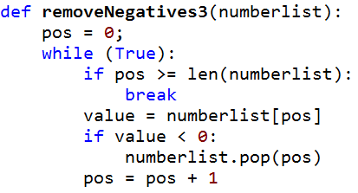
www.bit.ly/101f17-1012-4
somenums = [3, -1, 8, -5, -2, 6, 7]
removeNegatives3(somenums)

Slide 28
APT MorseCode

Slide 29
Solving problems – APT MorseLikeCode
Compare find vs index
find with string – returns -1 when not found
index with list – CRASHES if not there!
You can’t say: pos = alist.index(“…”)
Instead: if “…” in alist:
pos = alist.index(“…”)
How to get started?
Notes:
What do you do instead? If “…” in alist, then set pos
Started? Consider writing a function helper
If time look at other apts such as minPalindrome

