Slide 1
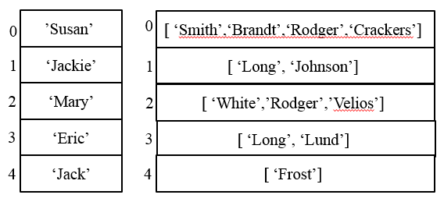
CompSci 101 Introduction to Computer Science
Oct 19, 2017
Prof. Rodger
Notes:
Too much code writing, need questions instead!!!!!!!!!!!!!!!!!!!!!!!!!!!!!!!

Slide 2
Announcements
Reading and RQ due next time
APT 4 due tonight
Assignment 4 due Oct 26
Today:
Review Sets
Tuples/generators
Enumerate
Processing data – how to organize it?
Notes:
First Tuesday after Spring Break

Slide 3
Latanya Sweeney
Former Chief Technologist at FTC. I am a computer scientist with a long history of weaving technology and policy together to remove stakeholder barriers to technology adoption. My focus is on "computational policy" and I term myself a "computer (cross) policy" scientist. I have enjoyed success at creating technology that weaves with policy to resolve real-world technology-privacy clashes.
http://latanyasweeney.org/
Identify 87% of US population using (dob,zip,gender). Director of Harvard Data Privacy Lab, instrumental in HIPAA because of de-identification work
Notes:
Keynote Speaker at GHC 2016

Slide 4
aboutmyinfo.org
Entered my data
Easily identifiable by birth date (about 1)
Lots with my birth year (about 273)
Lots of people in my age range (of four years) – (1365)
Notes:
One of her sites

Slide 5
aboutmyinfo.org
Entered my data
Easily identifiable by birth date (about 1)
Lots with my birth year (about 273)
Lots of people in my age range (of four years) – (1,365)
Notes:
One of her sites

Slide 6
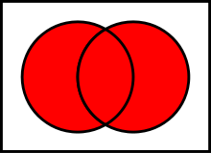
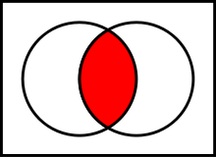
Set Operations from pictures bit.ly/101s17-0302-2
Question: Which operation does the red represent?
A)
D)
C)
B)
E)
Notes:
Answers below
http://en.wikipedia.org/wiki/File:Venn0111.svg
Symmetric Difference B) intersection C) everything not in either set D) Union e) Difference

Slide 7
Tuples
Like a list, but cannot change them
Define them with “,”
(5, 7, 8) or 5, 7, 8
Use most list operations on them
they are a type of list
But immutable
Examples
Notes:
Could use an activity on tuples?

Slide 8
Example
x = (4, 6, 8)
y = 9, 5, 6
print x
print y
print x[1]
print y[1]
y[0] = 2
z = ([5,6], [7,8])
print z
z[0][1] = 12
print z
z[0].append(4)
print z
z[0].remove(5)
z[0].remove(12)
z[0].remove(4)
print z
v,w = 8,3
Notes:
These are for the console only
Also v,w = 8, 3

Slide 9
Problem: Longest Name
Given a list of names (one word only) and a letter (assume names start with capital letter, and letter is capital)
names = [‘Helen’, ‘Bob’, ‘Bart’, ‘Hugh’]
Find the longest name that starts with that letter
Notes:
Mention Examples

Slide 10
Code for longest name
def longestName(alist, letter):
longest = ''
for name in alist:
if letter == name[0] and
len(name) > len(longest):
longest = name
return longest
How do you modify to find the location (position) of the longest name?

Slide 11
Problem: Find the position in alist of the longest name that starts with that letter bit.ly/101s17-0321-1
Notes:
Go over code solutions

Slide 12
Enumerate
An iterator, generates a sequence
Generates tuples of (index, item)
Used with for loop to get both index and item
for (index,item) in enumerate(somelist):
You get both at the same time!

Slide 13
Solve previous problem with enumerate

Slide 14
Problem: Popular Name
Given a list of names, determine the most popular first name and print that name with all of its last names.
Input: Names are always two words, names are in a file. If multiple names are on the same line they are separated by a “:”
Output: Most popular first name, followed by a “:”, followed by corresponding last names separated by a blank

Slide 15
Example Input File with 5 lines
Susan Smith:Jackie Long:Mary White
Susan Brandt
Jackie Johnson:Susan Rodger:Mary Rodger
Eric Long:Susan Crackers:Mary Velios
Jack Frost:Eric Lund
Corresponding Output
Susan: Smith Brandt Rodger Crackers

Slide 16
What do you need to solve this problem? bit.ly/101s17-0321-2

Slide 17
How might one organize the data to solve this problem?
How many different ways to solve this problem?

Slide 18
One way to solve
Create a list of unique first names
Create a list of lists of last names that are associated with each first name

Slide 19
Example – two lists
Unique
First names
Corresponding Last names
’Susan’’
0
[ ‘Smith’,‘Brandt’,‘Rodger’,‘Crackers’]’
0
1
‘Jackie’
1
[ ‘Long’, ‘Johnson’]’
2
‘Mary’
[ ‘White’,’Rodger’,’Velios’]’
2
3
‘Eric’
3
[ ‘Long’, ‘Lund’]’
4
‘Jack’
4
[ ‘Frost’]’

Slide 20
Example – two lists
Unique
First names
Corresponding Last names
’Susan’’
0
[ ‘Smith’,‘Brandt’,‘Rodger’,‘Crackers’]’
0
1
‘Jackie’
1
[ ‘Long’, ‘Johnson’]’
2
‘Mary’
[ ‘White’,’Rodger’,’Velios’]’
2
3
‘Eric’
3
[ ‘Long’, ‘Lund’]’
4
‘Jack’
4
[ ‘Frost’]’
Jackie in position 1
Jackie’s last names in position 1

Slide 21
Now can we solve the problem?
Compute those two lists that are associated with each other
List of unique first names
List of corresponding last names
Compute the max list of last names
Now easy to print the answer.
See popular.py

Slide 22
Look at the code for popular.py www.bit.ly/101s17-0321-3
Which datafile is read in?
What format is namelist in?
Write the code for uniqueFirstNames

Slide 23
Write the code: www.bit.ly/101s17-0321-4
allLastNames
correspondingLastNames
printFirstWithLasts

Slide 24
Finish
maxnum = max([len(item) for item in lastNames])
print maxnum
lastIndex = [index for (index, v) in enumerate(lastNames) if len(v) == maxnum]
print "first name with most last names is:"
Notes:
What is the last line of code?

Slide 25
Another way – list of lists
First word in each list is a first name
The rest are last names.
[ ‘Susan’, ‘Smith’,‘Brandt’,‘Rodger’,‘Crackers’]’
0
1
[‘Jackie’, ‘Long’, ‘Johnson’]’
2
[‘Mary’, ‘White’,’Rodger’,’Velios’]’
3
[ ‘Eric’, ‘Long’, ‘Lund’]’
4
[ ‘Jack’, ‘Frost’]’
Notes:
Another way to do it. What would change? How you process the data?
Can you find the max size list still? yes

Slide 26
Expanding the Problem
Suppose we want to read from multiple data files
names1.txt, names2.txt, names3.txt
See processFiles in popular.py

