Slide 1
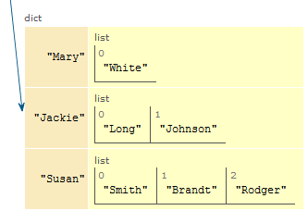
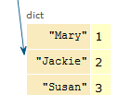
CompSci 101 Introduction to Computer Science
Oct 24, 2017
Prof. Rodger

Slide 2
Announcements
RQ 14 due Thursday
Assignment 5 due Thursday
APT 5 out, due Tues, Oct 31
Extend Exam 1 regrade requests by Oct 26!
Contact gradescope if you cannot see your exam
Lab this week! Songs and movies
Today:
Finish example from last time
Dictionaries – a way to organize data for fast lookup

Slide 3
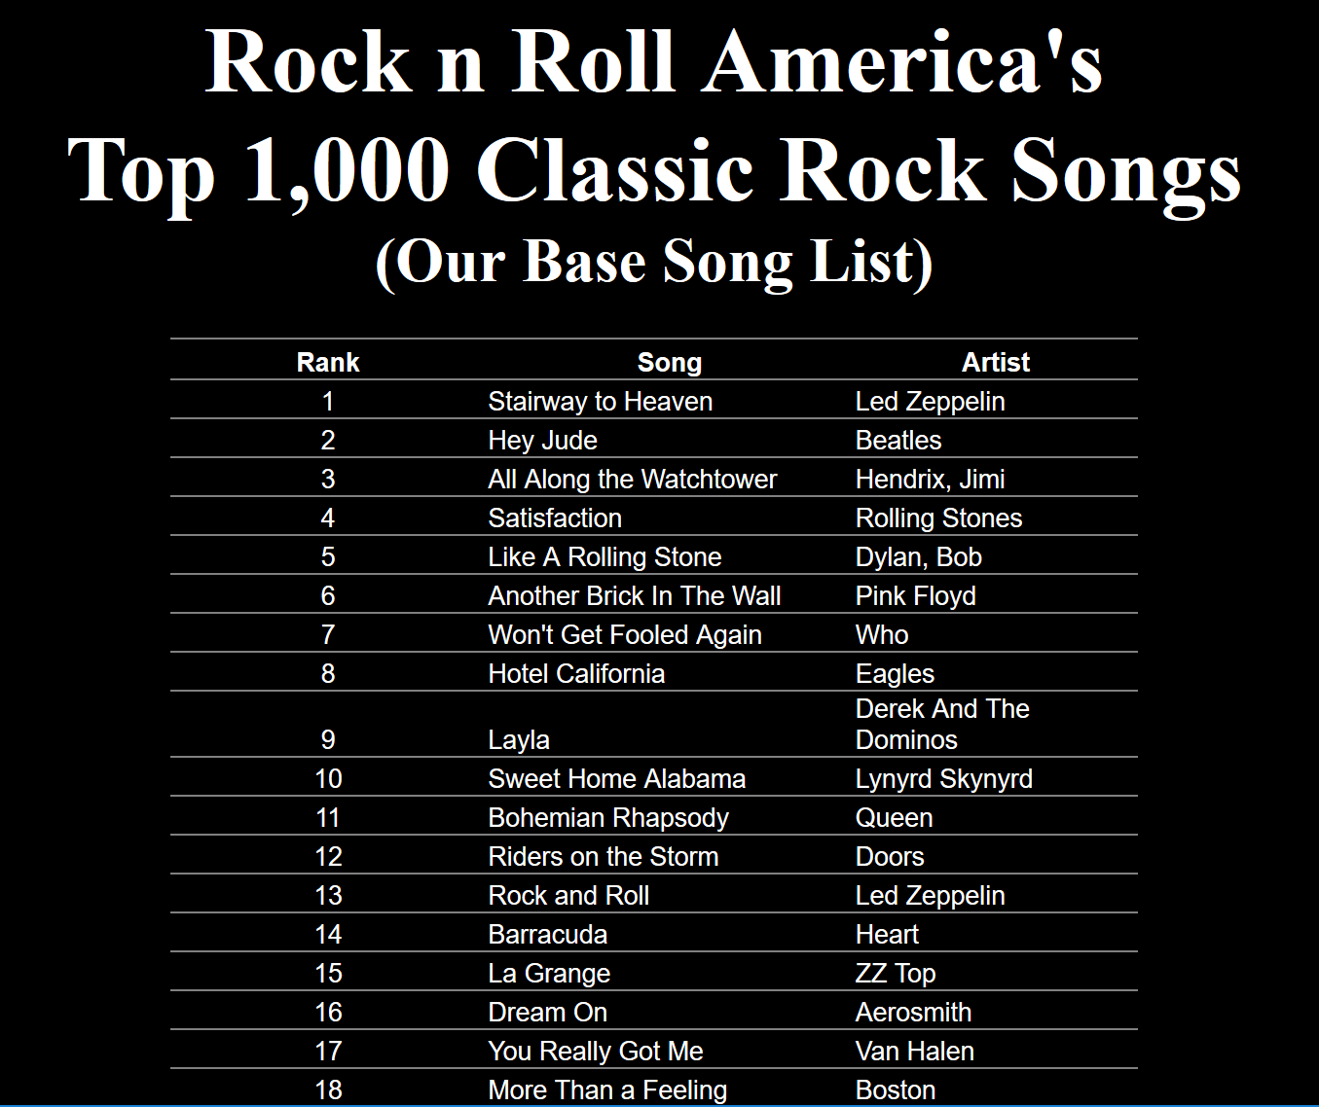
Lab this week - .csv files
Answering questions about songs and movies

Slide 4
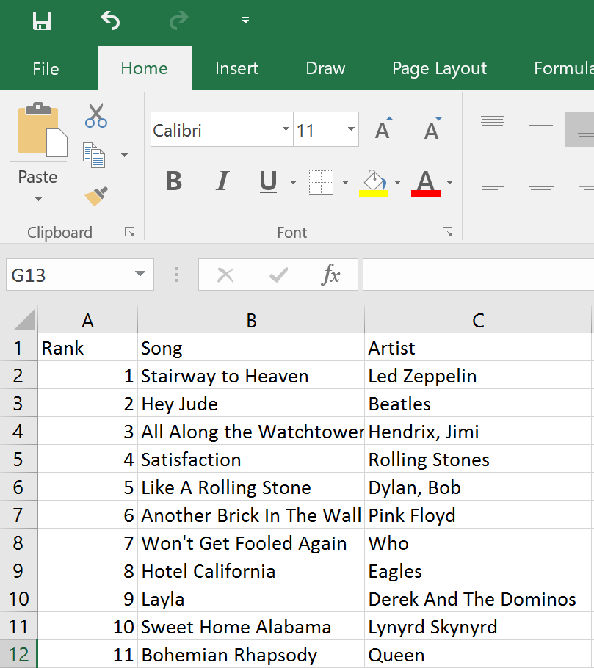
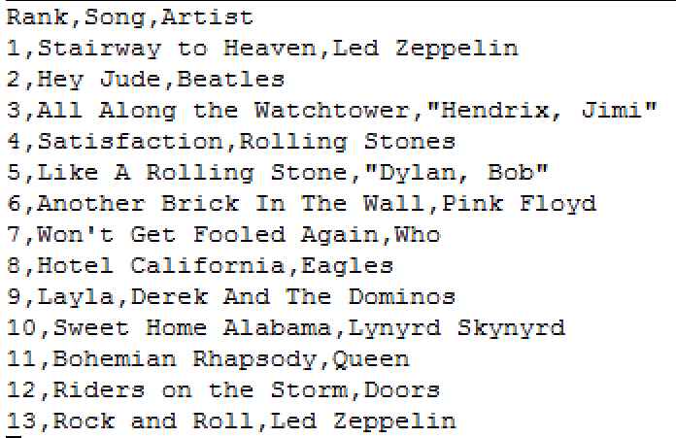
Lab - .csv file

Slide 5
Registration time…
What CS courses can you take next?
CompSci 201
CompSci 216 - Everything Data
CompSci 230 - Discrete Mathematics
CompSci 230 is prereq for CompSci 330
CompSci 201 is prereq for many electives

Slide 6
LAST TIME: Problem: Popular Name
Given a list of names, determine the most popular first name and print that name with all of its last names.
Input: Names are always two words, names are in a file. If multiple names are on the same line they are separated by a “:”
Output: Most popular first name, followed by a “:”, followed by corresponding last names separated by a blank

Slide 7
Example Input File with 5 lines
Susan Smith:Jackie Long:Mary White
Susan Brandt
Jackie Johnson:Susan Rodger:Mary Rodger
Eric Long:Susan Crackers:Mary Velios
Jack Frost:Eric Lund
Corresponding Output
Susan: Smith Brandt Rodger Crackers

Slide 8
Example – two lists
firstNames
lastNames
’Susan’’
0
[ ‘Smith’,‘Brandt’,‘Rodger’,‘Crackers’]’
0
1
‘Jackie’
1
[ ‘Long’, ‘Johnson’]’
2
‘Mary’
[ ‘White’,’Rodger’,’Velios’]’
2
3
‘Eric’
3
[ ‘Long’, ‘Lund’]’
4
‘Jack’
4
[ ‘Frost’]’

Slide 9
Now can we solve the problem?
Compute those two lists that are associated with each other
List of unique first names
List of corresponding last names
Compute the max list of last names
Now easy to print the answer.
See popular.py

Slide 10
This function generates the list of lists
of corresponding last names
def correspondingLastNames(data, firstNames):
lastNames = [ ]
for name in firstNames: lastNames.append(allLastNames(data,name))
return lastNames

Slide 11
Finish
maxnum = max([len(item) for item in lastNames])
print maxnum
lastIndex = [index for (index, v) in enumerate(lastNames) if len(v) == maxnum]
print "first name with most last names is:"
Notes:
What is the last line of code?

Slide 12
Expanding the Problem
Suppose we want to read from multiple data files
names1.txt, names2.txt, names3.txt
See processFiles in popular.py

Slide 13
Another way – list of lists
First word in each list is a first name
The rest are last names.
[ ‘Susan’, ‘Smith’,‘Brandt’,‘Rodger’,‘Crackers’]’
0
1
[‘Jackie’, ‘Long’, ‘Johnson’]’
2
[‘Mary’, ‘White’,’Rodger’,’Velios’]’
3
[ ‘Eric’, ‘Long’, ‘Lund’]’
4
[ ‘Jack’, ‘Frost’]’
Notes:
Another way to do it. What would change? How you process the data?
Can you find the max size list still? yes

Slide 14
Now, a new way to organize data….

Slide 15
Dictionaries/Maps
Dictionaries/maps are another way of organizing data
Keys and Values
Each key maps to a value
Some keys can map to the same value
Can change the value a key maps to

Slide 16
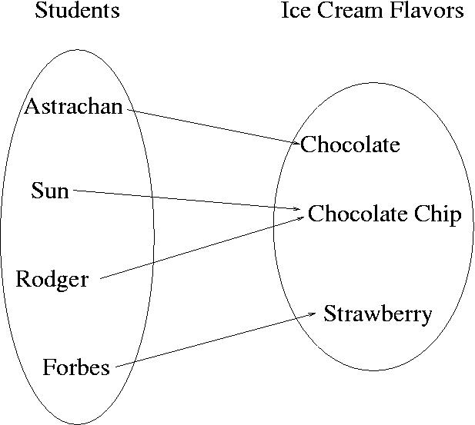
Example
Each student could be mapped to their favorite ice cream flavor
Notes:
How is this different then

Slide 17
How is dictionary different than a list?
List – have to search for name first
Dictionary – each key maps to a value
getting name (or key) is automatic! Fast!
Keys
Values
Notes:
In a list if we wanted to know the ice cream flavor for Rodger, we would have to search for Rodger and then could get it. If we use a dictionary, we don’t have to search for Rodger, the dictionary knows where the name is and thus can return what it is matched to quickly.
In 101 we are just focused on using a dictionary. In 201, you learn how dictionaries are implemented.

Slide 18
Implementing a Dictionary/Map Keys map to values
Create Empty dictionary
somemap = {}
Put in a key and its value
somemap[“Forbes”] = “Strawberry”
Get a value for a dictionary
value = somemap[“Forbes”]
OR value = somemap.get(“Forbes”, “default”)
Change a value for a dictionary
somemap[“Forbes’] = “Chocolate”
Notes:
Default – returns default value if there is no value

Slide 19
More on using a Dictionary/Map
Get all the keys (as a list)
listKeys = somemap.keys()
Get all the values (as a list)
listValues = somemap.values()
Other methods
clear – empty dictionary
items – return (key,value) pairs
iteritems – return (key,value) pairs more efficiently, iterator – must use with for
update – update with another dictionary

Slide 20
Change Astrachan’s value somemap[“Astrachan”] = Coffee Mocha

Slide 21
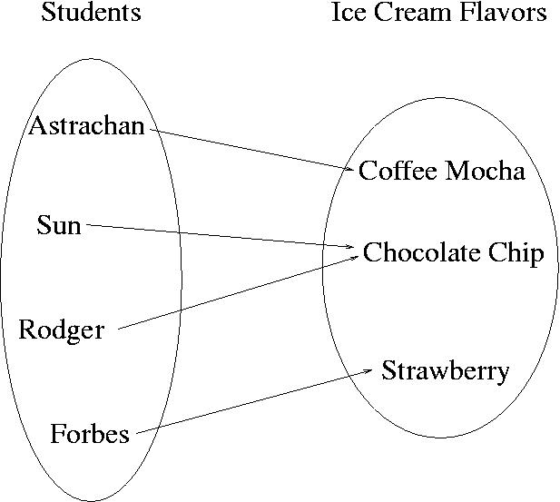
Change Astrachan’s value somemap[“Astrachan”] = Coffee Mocha

Slide 22
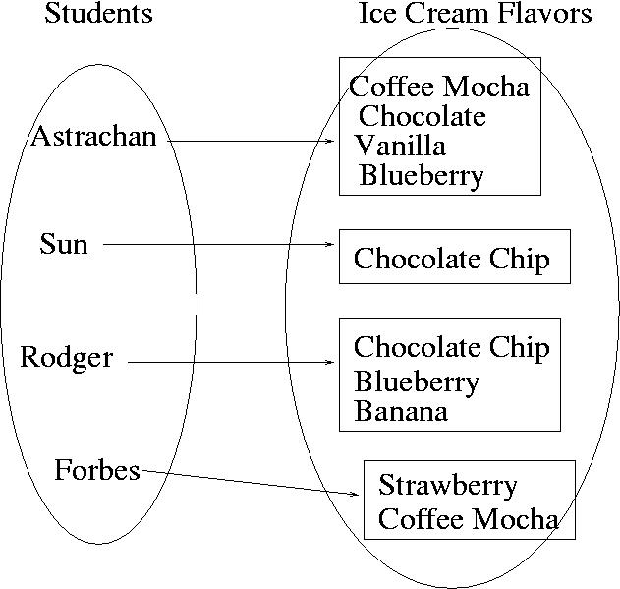
Value could be a set or list

Slide 23
Simple dictionary bit.ly/101f17-1024-1

Slide 24
More simple dictionaries bit.ly/101f17-1024-2

Slide 25
Back to Popular Name Problem:
Given a list of names, determine the most popular first name and print that name with all of its last names.
Input: Names are always two words, names are in a file. If multiple names are on the same line they are separated by a “:”
Output: Most popular first name, followed by a “:”, followed by corresponding last names separated by a blank

Slide 26
Example Input File with 5 lines
Susan Smith:Jackie Long:Mary White
Susan Brandt
Jackie Johnson:Susan Rodger:Mary Rodger
Eric Long:Susan Crackers:Mary Velios
Jack Frost:Eric Lund
Corresponding Output
Susan: Smith Brandt Rodger Crackers

Slide 27
Use a dictionary/map www.bit.ly/101f17-1024-3
Map first names to count of corresponding last names
def mapNameToNumberLastNames(data):
Use a dictionary/map
popularMap.py

Slide 28
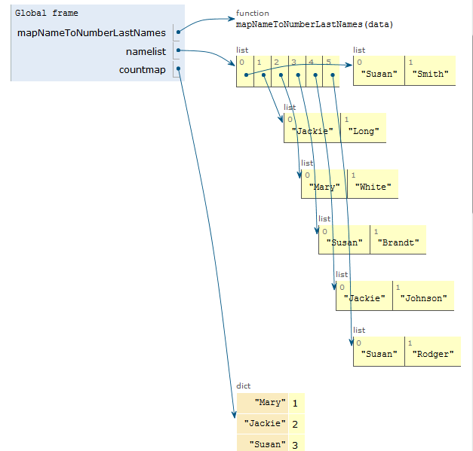
Trace example with Python Tutor see popularMapSolnSmall.py

Slide 29
Use a dictionary/map www.bit.ly/101f17-1024-4
Map first name to list of corresponding last names
def mapNameToLastNames(data):

Slide 30
Trace through example with Python Tutor
See the small example popularMapSolnSmall.py

Slide 31
Use dictionary of first names mapped to corresponding last names
How do you find the most popular first name?

Slide 32
Use a dictionary/map www.bit.ly/101f17-1024-5
Map first name to set of corresponding last names
def mapNameToSetLastNames(data):

Slide 33
Compare
Using two parallel lists?
Using one dictionary/map
Which dictionary is most useful to solve the most popular name problem?

