Slide 1
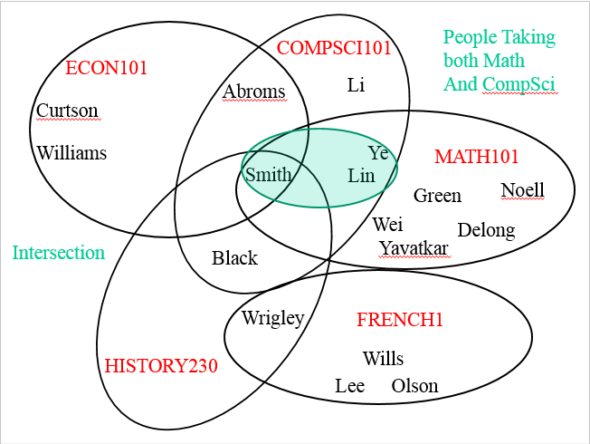
CompSci 101 Introduction to Computer Science
Oct 26, 2017
Prof. Rodger

Slide 2
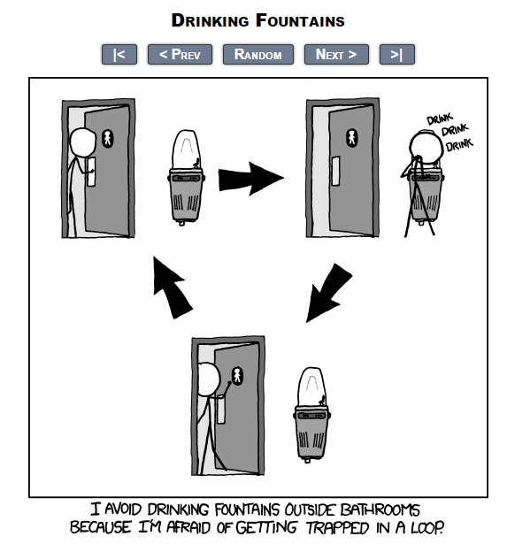
fromxkcd

Slide 3
Announcements
Reading and RQ15 due next time
Assignment 5 due today, Assign 6 out
APT 5 due Tuesday
Today:
Problem solving using set operations

Slide 4
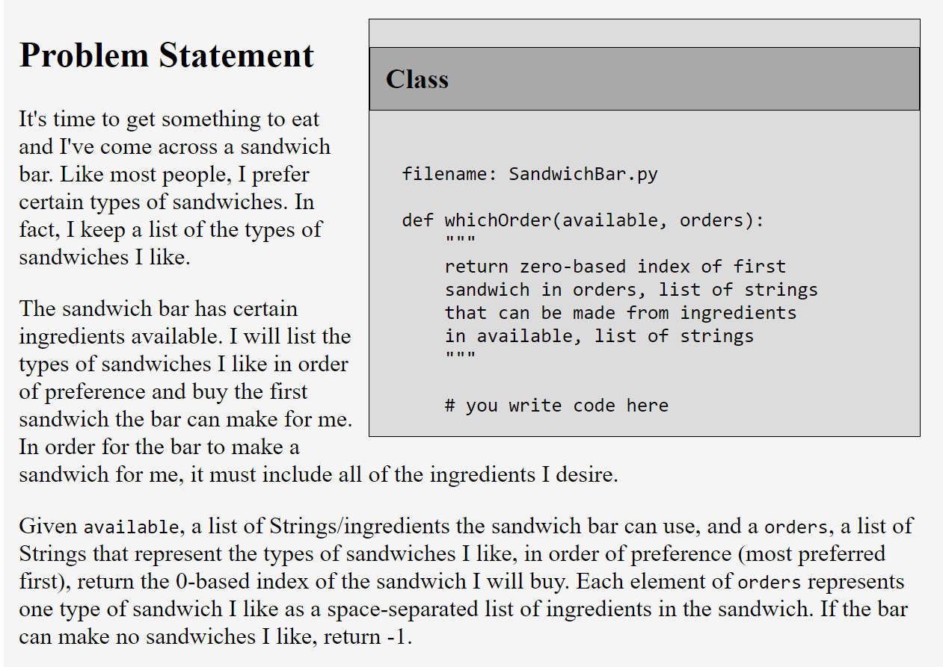
APT SandwichBar

Slide 5
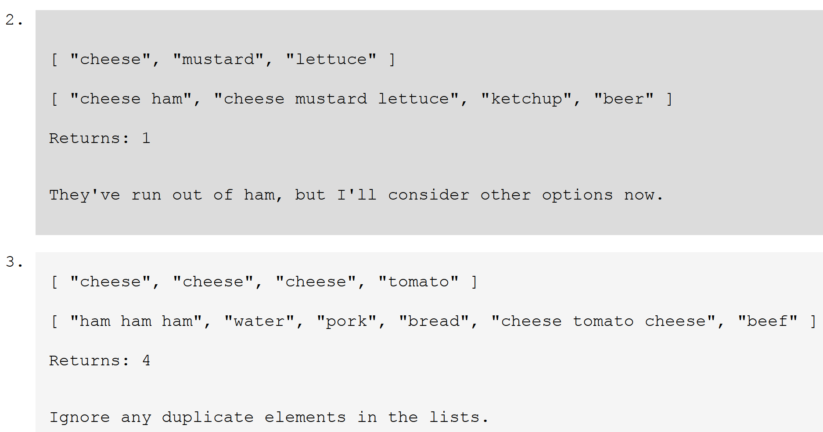
APT SandwichBar
Notes:
Solve APT Sandwichbar with feedback from them, use sets

Slide 6
APT SandwichBar bit.ly/101f17-1026-1

Slide 7
Problems – snarf setExample.py
Given a list of strings that have the name of a course (one word), followed by last names (one word each) of people in the course:
Find total number of people taking any course
Find number of people taking just one course
["econ101 Abroms Curtson Williams Smith”,
"history230 Black Wrigley Smith”, … ]
Process data – create lists of strings of names for each course
Notes:
Do we need the course names to answer these questions? No. We need to keep the students in a course together to represent a course, but we don’t need the names of the courses to answer these questions.

Slide 8
Data for example
[“compsci101 Smith Ye Li Lin Abroms Black“,
“math101 Green Wei Lin Williams DeLong Noell Ye Smith”,
“econ101 Abroms Curtson Williams Smith”,
“french1 Wills Wrigley Olson Lee”,
"history230 Black Wrigley Smith” ]
TO easier format to work with:
[ [ ‘Smith’, ‘Ye’, ‘Li’, ‘Lin’, ‘Abroms’, ‘Black’],
[‘Green’, ‘Wei’, ‘Lin’, ‘Williams’, ‘DeLong’, ‘Noell’, ‘Ye’, ‘Smith’], [‘Abroms’, ‘Curtson’, ‘Williams’, ‘Smith’], …. ]

Slide 9
COMPSCI101
Set Picture of
Data
ECON101
Abroms
Li
Curtson
Williams
Ye
MATH101
Smith
Lin
Green
Noell
Wei
Delong
Yavatkar
Black
Wrigley
FRENCH1
HISTORY230
Wills
Lee
Olson
Notes:
Visual way to look at this example. Look at Smith – in four courses.
Wrigley in two courses

Slide 10
COMPSCI101
People in
CompSci 101
ECON101
Abroms
Li
Curtson
Williams
Ye
MATH101
Smith
Lin
Green
Noell
Wei
Delong
Yavatkar
Black
Wrigley
FRENCH1
HISTORY230
Wills
Lee
Olson

Slide 11
People Taking
both Math
And CompSci
COMPSCI101
ECON101
Abroms
Li
Curtson
Williams
Ye
MATH101
Smith
Lin
Green
Noell
Wei
Delong
Intersection
Yavatkar
Black
Wrigley
FRENCH1
HISTORY230
Wills
Lee
Olson
Notes:
Intersection is the green

Slide 12
Part 1 – processList bit.ly/101f17-1026-2
Given a list of strings that have the name of a course (one word), followed by last names of people in the course:
Convert list into lists of strings of names for each course
["econ101 Abroms Curtson Williams Smith",
"history230 Black Wrigley Smith", … ]
[ [‘Abroms’, ‘Curtson’, ‘Williams’, ‘Smith’], [‘Black’, ‘Wrigley’, ‘Smith’, …] ]

Slide 13
Part 2 – peopleTakingCourses bit.ly/101f17-1026-3
Given a list of lists of names, each list represents the people in one course:
Find total number of people taking any course
peopleTakingCourses should return unique list of names
Small Example
[[‘Abroms’, ‘Curtson’, ‘Williams’, ‘Smith’], [‘Black’, ‘Wrigley’, ‘Smith’]]
Answer is 6 unique names

Slide 14
COMPSCI101
People taking
Courses - Union
ECON101
Abroms
Li
Curtson
Williams
Ye
MATH101
Smith
Lin
Green
Noell
Wei
Delong
Yavatkar
Black
Total
Number
Is
17
unique names
Wrigley
FRENCH1
HISTORY230
Wills
Lee
Olson

Slide 15
Next, find the number of people taking just one course

Slide 16
COMPSCI101
Union all sets
But French1
ECON101
Abroms
Li
Curtson
Williams
Ye
MATH101
Smith
Lin
Green
Noell
Wei
Delong
Yavatkar
Black
Wrigley
FRENCH1
HISTORY230
Wills
Lee
Olson
Notes:
Discuss, wouldn’t it help if you had the union of all sets but the one

Slide 17
To solve this problem
First let’s write a helper function

Slide 18
Part 3 – unionAllSetsButMe bit.ly/101f17-1026-4
Given example, a list of sets of strings, and the index of one of the sets, return the union of all the sets but that one
example = [set(["a", "b", "c"]), set(["b", "c", "d", "g"]), set(["e", "d", "a"])]
unionAllSetsButMe(example,1) is
set(["a", "b", "c", "e", "d" ])

Slide 19
Part 4 – peopleTakingOnlyOneCourse bit.ly/101f17-1026-5
Given a list of lists of strings of names representing people from courses
Find number of people taking just one course
[[‘Abroms’, ‘Curtson’, ‘Williams’, ‘Smith’], [‘Black’, ‘Wrigley’, ‘Smith’, ‘Abroms’]]
4
Notes:
If this was just our data, we have 4 people taking just one course – either econ101 or history230

Slide 20
COMPSCI101
People taking
Only one course
ECON101
Abroms
Li
Curtson
Williams
Ye
MATH101
Smith
Lin
Green
Noell
Wei
Delong
Yavatkar
Black
Wrigley
FRENCH1
HISTORY230
Wills
Lee
Olson

Slide 21
Problem: Given list of words, find word with most vowels
Example:
Given [‘dog’, ‘cat’, ‘gerbil’, ‘elephant’]
‘elephant’ has 3 vowels, the most
To solve – nested loops:
Loop over words in list
For each word: Loop over characters in word

Slide 22
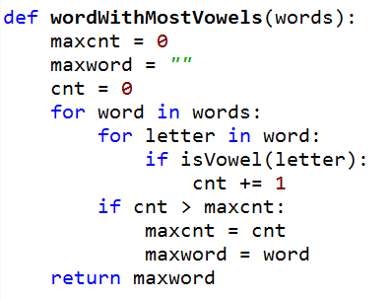
Bit.ly/101f17-1026-6
a
Notes:
Point out nested loops
Doesn’t work, what is wrong?

Slide 23
Problem – Given two lists of names, print a list of pairs of names in which the two names are the same length
A = [‘mo’,’ted’,’bill’]
B = [‘billie’, ‘jes’, ‘bo’]
To solve
for name in A:
for name in B: Check length
print pair
mo, bo
ted, jes

Slide 24
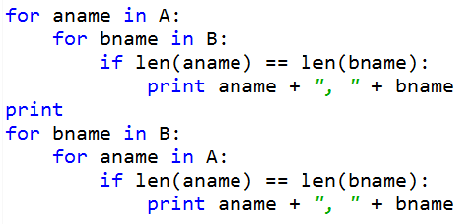
Bit.ly/101f17-1026-7
a

