Slide 1
CompSci 101 Introduction to Computer Science
Oct 31, 2017
Prof. Rodger
Notes:
THIS LECTURE NEEDS MORE INTERACTION I TALK TOO LONG
Need to do the Image exercise earlier!!! Also note we didn’t do anything with the
Too many slides on image part – condense
See slides for next lecture where I redid one of these slides

Slide 2
Announcements
Next Reading and RQ due Thursday
Assignment 6 due Thursday
APT 5 due tonight, APT 6 due Nov 7
APT Quiz2 Sun-Wed next week
Lab this week - images
Today:
Nested loops, tuples, images

Slide 3
ACM Programming Contest Need Volunteers Saturday, Nov 11 at Duke
Over 120 teams, 8 university sites
Team:
3 people, 1 computer
8 problems, 5 hours
Need volunteers to deliver printouts, etc
8:15am-12:30 OR 11:20am-6pm
Get tshirt and meals!

Slide 4
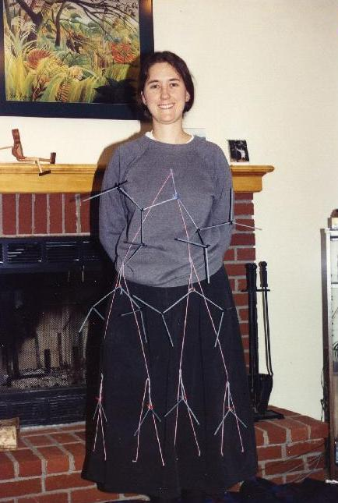
It’s Halloween
What is Prof. Rodger’s Halloween costume, from long ago….
Notes:
This is me in my Halloween costume back in 1989, teaching the algorithms course. Anyone know what I am?
I am a 2D-range tree data structure

Slide 5
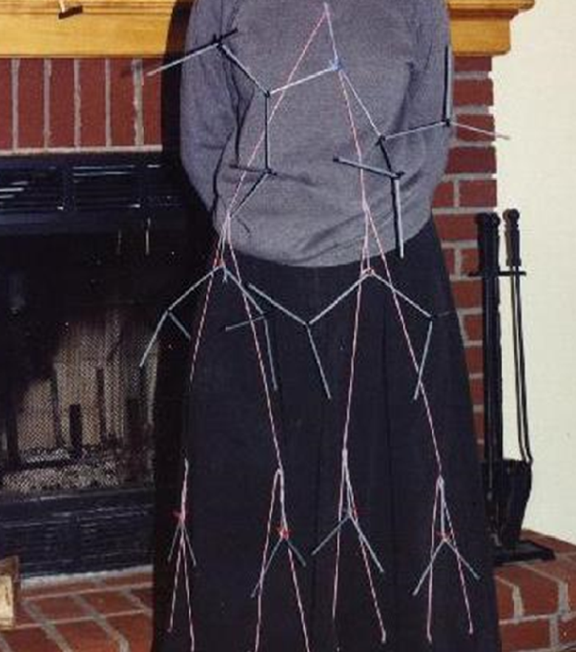
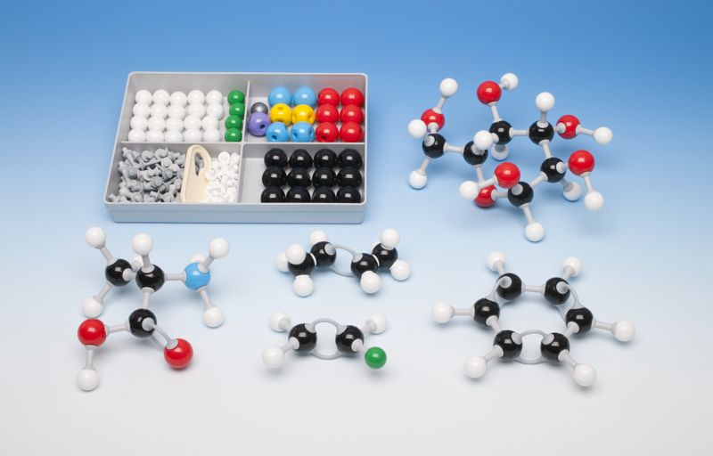
YARN, in the shape of a binary tree
Subtrees made with molecule kit
What is it?

Slide 6
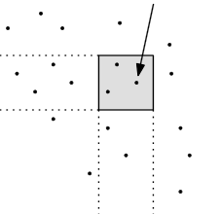
2D-range tree
Search in x-y plane
Main tree organized by x-values
Subtree organized by y values
y-range
x-range

Slide 7
Binary Search tree of points in the plane – sorted by X-value
Each subtree organized by y-value
Search each subtree by y-value
In the x-range

Slide 8
Problem: Given list of words, find word with most vowels
Example:
Given [‘dog’, ‘cat’, ‘gerbil’, ‘elephant’]
‘elephant’ has 3 vowels, the most
To solve – nested loops:
Loop over words in list
For each word: Loop over characters in word

Slide 9
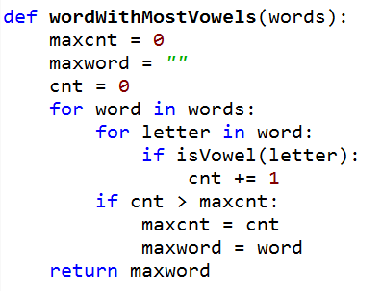
Bit.ly/101f17-1031-1
a
Notes:
Point out nested loops
Doesn’t work, what is wrong?

Slide 10
Problem – Given two lists of names, print a list of pairs of names in which the two names are the same length
A = [‘mo’,’ted’,’bill’]
B = [‘billie’, ‘jes’, ‘bo’]
To solve
for name in A:
for name in B: Check length
print pair
mo, bo
ted, jes

Slide 11
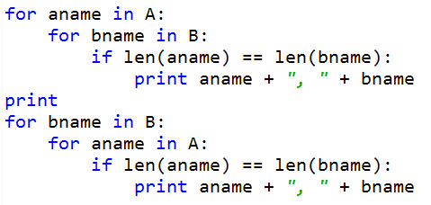
Bit.ly/101f17-1031-2
a

Slide 12
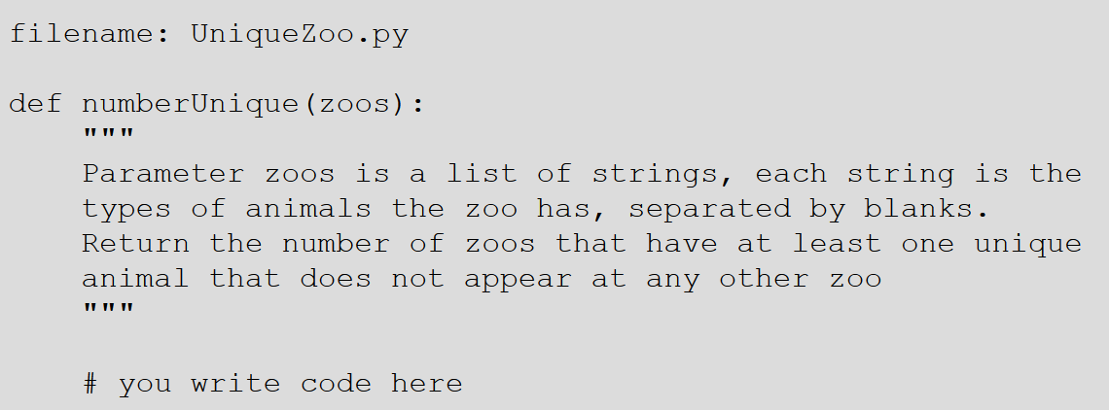
APT - UniqueZoo
How do you solve this problem?
How is it similar to the problem we just solved
Notes:
For example, the only zoo on the west coast with Panda Bears is San Diego.

Slide 13
Example Data for UniqueZoo
["zebra bear fox elephant","bear crocodile fox",
"rhino elephant crocodile kangaroo", "elephant bear"]
zebra
fox
bear
crocodile
elephant
rhino
kangaroo

Slide 14
UniqueZoo – two zoos have unique animals
zebra
fox
bear
crocodile
elephant
rhino
kangaroo

Slide 15
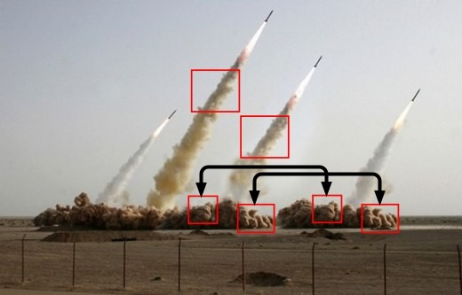
Image Processing
What's real, what's Photoshopped
http://bit.ly/1Kj0Kn6 from 2008
Learn more at http://bit.ly/1Psi0hG, we'll do very basic stuff in class and lab, next assignment too!
Notes:
Now we'll use image processing as an area of research and practice to illustrate python concepts; tuples in detail, generators in passing
Iranian government in 2008 to show off their new missiles, One must have failed because the second from the right is clearly photoshopped into the picture.

Slide 16
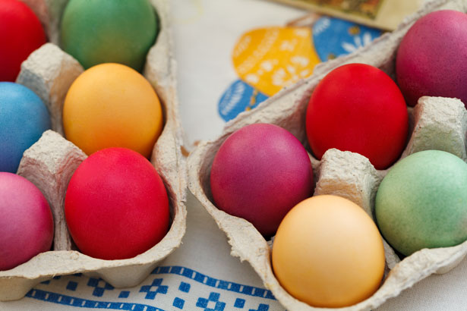
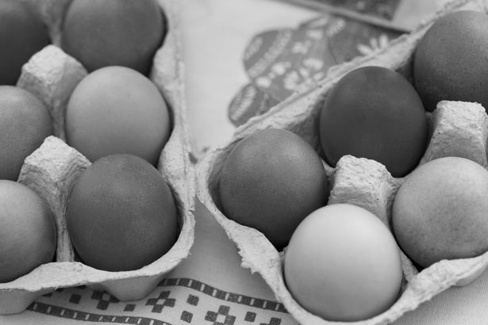
Example: convert color to gray scale
Process each pixel
Convert to gray
Notes:
We'll see this example and go over it in detail in class today

Slide 17
Example: convert blue to green
Process each pixel
Convert blue ones to green
Is this like red-eye removal?
Notes:
We'll see this example

Slide 18
Lab 8
You’ll create new images
Invert
Solarize
Darken
Brighten
etc

Slide 19
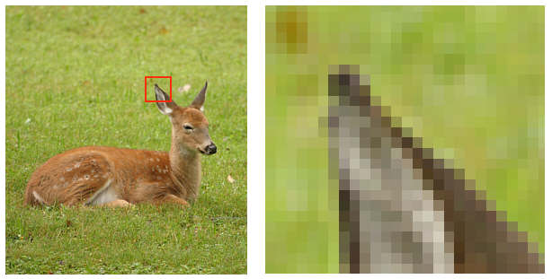
Need new concepts and Image library
Red, Green, Blue color model
Triples of (R,G,B) are processed as Python tuples.
Let's study tuples!
Images can be very big, what's 4K display?
4,096 x 2,160 = 8,847,360 pixels, 8Mb at least
Creating huge lists takes up memory
Sometimes only need one pixel at-a-time
Let's study generators!
Notes:
Show colorpicker –
Introducing tuples and generators --- two Python concepts in the context of doing image processing This page describes the ideas in general, motivating understanding python concepts in the context of image processing

Slide 20
Need new concepts and Image library
Red, Green, Blue color model
Additive model, each pixel specified by (r,g,b) triple, values of each between 0-255
https://en.wikipedia.org/wiki/RGB_color_model
White is (255,255,255) and Black is (0,0,0)
Images stored as sequence of (r,g,b) tuples, typically with more data/information too
256 values, represented as 8 bits, 2⁸ = 256
32 bits per pixel (with alpha channel)
In Python we can largely ignore these details!
Notes:
Some details on (RGB). Highlight 2^8 is 256 values that are in range 0..255.
8 bits for each of r g and b, 8 bits for alpha
Alpha represents the opacity of the object

Slide 21
Image library: Two ways to get pixels
Each pixel is a tuple in both models
Like a list, indexable, but immutable
pix = (255,0,0)
What is pix?, pix[0]? What is pix[5]?
Invert a pixel: by subscript or named tuple
Access by assignment to variables!
npx = (255-pix[0],255-pix[1],255-pix[2])
(r,g,b) = pix
npx = (255-r,255-g,255-b)
Notes:
Use python console to show tuples
Try to do this pix = (0,1,2)
pix[0] = 255 XXXXXXX, immutable

Slide 22
Let's look at GrayScale.py
Key features we see
Import Image library, use API by example
Image.open creates an image object
Image functions for Image object im
im.show(),displays image on screen
im.save("xy"), saves with filename
im.copy(), returns image that's a copy
im.load(),[x,y] indexable pixel collection
im.getdata(),iterable pixel collection
Let's look at two ways to process pixels!
Notes:
Look at GrayScale.py, run it, highlight the lines in each function and explain what they do. How to modify the code there to invert an image? That is, 255-x for x each of r,g,b. DO this for grayit2, lead class through discussion about copying fucntion, and making invert fucntion called in list comprehension
API – Application program interface

Slide 23
Pixels in an image Background is black, 12x9
[0,0]
x
[11,0]
y
[8,4]
Notes:
X range goes from 0 to 11, y range goes from 0 to 8
Background is black so you can see the pixel squares

Slide 24
Image Library: open, modify, save
Image.open can open most image files
.png, .jpg, .gif, and more
Returns an image object, so store in variable of type Image instance
Get pixels with im.getdata()or im.load()
Image.new can create a new image, specify color model "RGB" and size of image
Add pixels with im.putdata()
These belong to Image package
Notes:
New image is blank ,you need to call putdata with a list of pixels to fill the image

Slide 25
im.getdata(), accessing pixels
Returns something like a list
Use: for pix in im.getdata():
Generates pixels on-the-fly, can't slice or index unless you use list(im.getdata())
Structure is called a Python generator!
Saves on storing all pixels in memory if only accessed one-at-a-time
See usage in GrayScale.py, note how used in list comprehension, like a list!
Notes:
Do example in console with x = [2*n for n in range(10000)] and y = (2*n for n in range(10000))
Print them, do sum, do len on x and y and loop over them
Maybe a bitly form on this topic?

Slide 26
Questions bit.ly/101f17-1031-3
Notes:
We call makeGray on every pixel.
Note getdata is a generator.

Slide 27
Alternate : Still Tuples and Pixels
The im.getdata() function returns list-like iterable
Can use in list comprehension, see code
Use .putdata() to store again in image
pixels = [makeGray(pix) for pix in im.getdata()]
def makeGray(pixel):
r,g,b = pixel
gray = (r+g+b)/3
return (gray,gray,gray)

Slide 28
Making Tuples and Generators
Overuse and abuse of parentheses
To create a tuple, use parentheses
To create a generator use parentheses as though creating a list comprehension!
See this in PyDev console
for pix in im.getdata():
(r,g,b) = pix
npx = (255-r,255-g,255-b)
[2*n for n in range(10000)]
(2*n for n in range(10000))
Notes:
Show tuples and generators in pydev console, using len(x) for each and seeing it fail on generator, and using loopover each and see that succeed.
Y = (2*n for n in range(10000))
Z = [w for w in y]
Zz = [v for v in y] - doesn’t work, elements already generated

