Slide 1
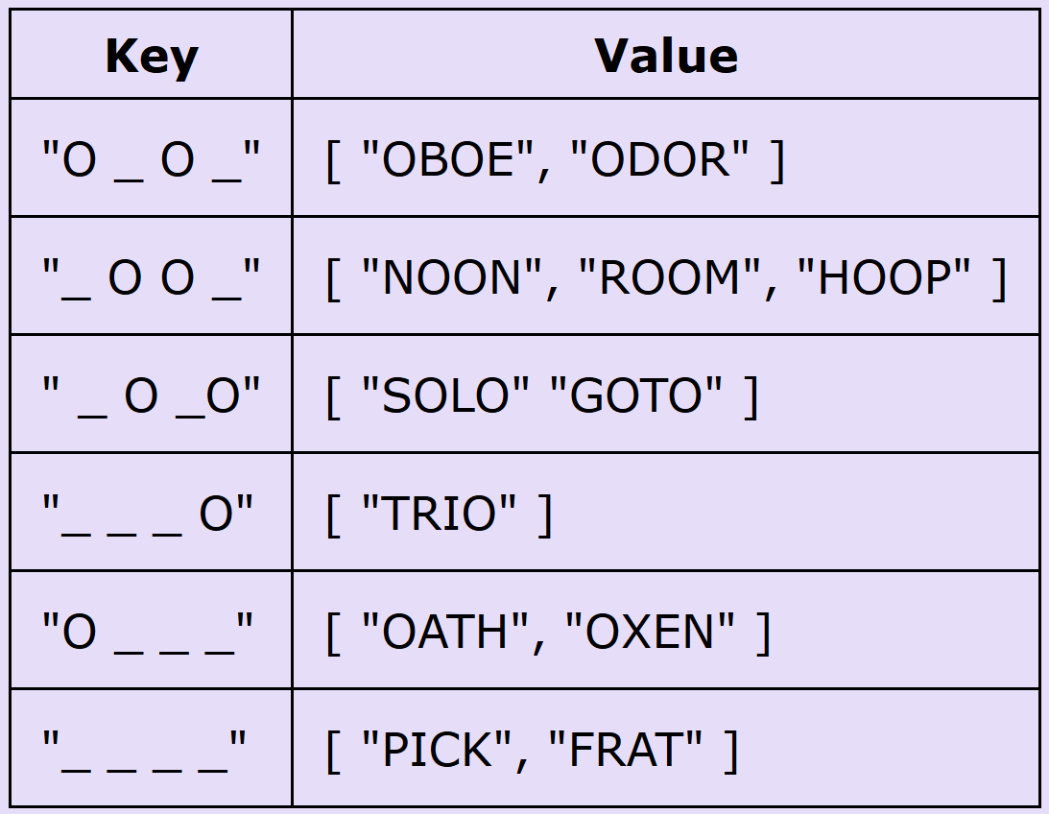
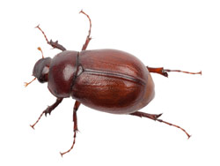
CompSci 101 Introduction to Computer Science
Nov 2, 2017
Prof. Rodger

Slide 2
Announcements
No Reading/RQ until after Exam 2
Assignment 5 due, Assignment 6 due Nov 8
APT 6 due Tuesday
APT Quiz 2 - Sunday-Wednesday
Today:
Debugging
Which code is better?

Slide 3
Assignment 7 – Demo Smarty, Evil, Frustrating Hangman
Computer changes secret word every time player guesses to make it "hard" to guess
Must be consistent with all previous guesses
Idea: the more words there are, harder it is
Not always true!
Example of greedy algorithm
Locally optimal decision leads to best solution
More words to choose from means more likely to be hung

Slide 4
Canonical Greedy Algorithm
How do you give change with fewest number of coins?
Pay $1.00 for something that costs $0.43
Pick the largest coin you need, repeat
Notes:
If you have 50 cent piece it also works
50cent is the guy in the right, a wrapper

Slide 5
Greedy not always optimal
What if you have no nickels?
Give $0.31 in change
Algorithms exist for this problem too, not greedy!

Slide 6
Smarty Hangman
When you guess a letter, you're really guessing a category (secret word "salty")
_ _ _ _ _ and user guesses 'a'
"gates", "cakes", "false" are all a the same, in 2cd position
"flats", "aorta", "straw", "spoon" are all a in different places
How can we help ensure player always has many words to distinguish between?
Notes:
Should we tell the user she has guessed an 'a' correctly? Or should we switch to a new secret word. IT DEPENDS!
If we switch to "aorta", user might get word quickly, how many words fit A _ _ _ A? If we switch to SPOON?
Run it with DEDUG OFF
Run it with DEBUG ON

Slide 7
Debugging Output
number of misses left: 8
secret so far: _ _ _ _ _ _ _ _
(word is catalyst )
# possible words: 7070
guess a letter: a
a__a___a 1
…
_a______ 587
__aa____ 1
…
__a_____ 498
________ 3475
___a____ 406
…
____a___ 396
# keys = 48
number of misses left: 7
letters guessed: a
…
(word is designed )
# possible words: 3475
guess a letter:
Notes:
This is debugging output, shows some of the 48 different categories when an 'a' is guessed for an 8 letter word. Notice
That after one guess the computer switches to "designed" which has 3,475 possibilities to distinguish between, where as switching
To _ A A _ _ _ _ wouldn't give so many words, turns out that' isaacson, not really a word anyway ☺, but the secret word ANACONDA would be just
as bad, only one word fitting that pattern too

Slide 8
Debugging Output and Game Play
Sometimes we want to see debugging output, and sometimes we don't
While using microsoft word, don't want to see the programmer's debugging statements
Release code and development code
You'll approximate release/development using a global variable DEBUG
Initialize to False, set to True when debugging
Ship with DEBUG = False
Notes:
The program is in the code directory for assignment6 on the course site, I tested it there and it runs

Slide 9
Look at howto and categorizing words
Play a game with a list of possible words
Initially this is all words
List of possible words changes after each guess
Given template "_ _ _ _", list of all words, and a letter, choose a secret word
Choose all equivalent secret words, not just one
Greedy algorithm, choose largest category
words = categorize(words, guess, letter)
Notes:
This slide is all about explaining the code at the end of the slide, which is from the howto

Slide 10
Computing the Categories
Loop over every string in words, each of which is consistent with guess (template)
This is important, also letter cannot be in guess
Put letter in template according to word
_ _ _ a _ t might become _ _ _ a n t
Build a dictionary of templates with that letter to all words that fit in that template.
How to create key in dictionary?

Slide 11
Everytime guess a letter, build a dictionary based on that letter
Example: Four letter word, guess o
Key is string, value is list of strings that fit

Slide 12
Keys can’t be lists
[“O”,”_”,”O”,”_”] need to convert to a string to be the key representing this list:
“O_O_”

Slide 13
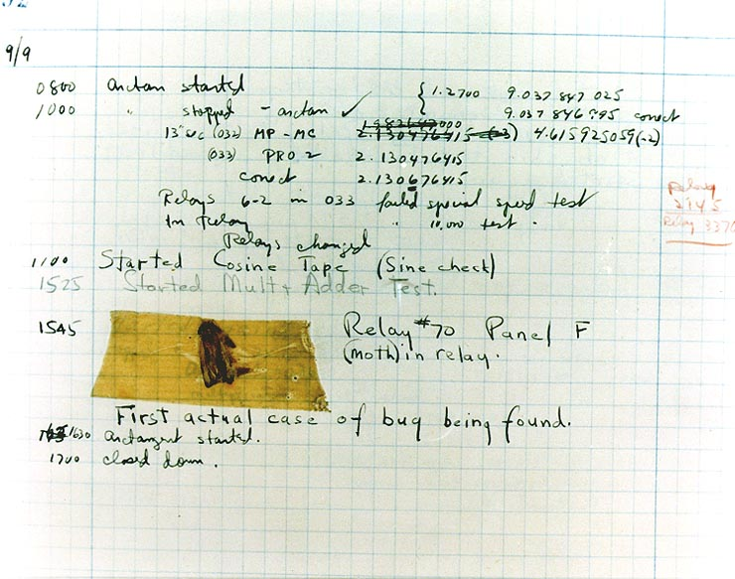
Bug and Debug
software 'bug'
Start small
Easier to cope
Simplest input?
Judicious 'print'
Debugger too
Python tutor
Visualizes data
step through
Verify the approach being taken, test small, test frequently
How do you 'prove' your code works?
Notes:
Rarely do you use a large data file to test your program, how do you know it works? Use a small data file
This is the moth that Grace Hopper found in the Harvard Mark 2, so she put it in the log book

Slide 14
Debugging Problems
Today the main focus is on debugging.
There are several problems. Trace by hand to see if you can figure out if they are correct or not, or what to do to correct them.

Slide 15
Debug 1 – Does it work? bit.ly/101f17-1102-1
The function sizes has a parameter named words that is a list of strings. This function returns a list of the sizes of each string. For example, sizes(['This', 'is', 'a', 'test']) should return the list
[4, 2, 1, 4]
def sizes(words):
nums = [ ]
for w in words:
nums = len(w)
return nums

Slide 16
Debug 2 – Does it work? bit.ly/101f17-1102-2
The function buildword has a parameter words that is a list of strings. This function returns a string that is made up of the first character from each word in the list. For example, buildword(['This', 'is', 'a', 'test']) returns 'Tiat'
def buildword(words):
answer = ''
for w in words:
answer += w[:1]
return answer

Slide 17
Debug 3 – Does it work?
The function middle has a parameter names that is a list of strings, which each string is in the format "firstname:middlename:lastname". This function returns a list of strings of the middlenames.
For example, the call middle( "Jo:Mo:Tree",
"Mary:Sue:Perez", "Stephen:Lucas:Zhang")
returns
[ ‘Mo’, ‘Sue’, ‘Lucas’]

Slide 18
Debug 3 – Does it work? bit.ly/101f17-1102-3
The function middle has a parameter names that is a list of strings, which each string is in the format "firstname:middlename:lastname". This function returns a list of strings of the middlenames.
def middle(names):
middlelist = []
for name in names: name.split(":") middlelist.append(name[1]) return middlelist

Slide 19
Debug 4 – Does it work? bit.ly/101f17-1102-4
The function removeOs has one string parameter named names. This function returns a string equal to names but with all the lowercase o's removed. For example,
removeOs(‘Mo Moo Move Over’) returns ‘M M Mve Over’
def removeOs(word):
position = word.find("o")
while position != -1:
word = word[:position] + word[position+1:]
return word

Slide 20
Problem 5 – Does it work? bit.ly/101f17-1102-5
The function uniqueDigits has one int parameter number. This function returns the number of unique digits in number. For example, the call uniqueDigits(456655) should return 3.
def uniqueDigits(number)
digits = [ ]
while number > 0:
digits.append(number % 10)
number = number / 10
return len(digits)

Slide 21
Which code is better?
For the next two problems, we will look at two examples of code that both work in solving the problem, and think about which code is better.

Slide 22
Problem 6: Which code is better?
Problem: Given a string parameter named phrase and string named letter, the function findWords returns a list of all the words from phrase that have letter in them.
Example:
findWords("the circus is coming to town with elephants and clowns", "o") would return
[‘coming’, ‘to’, ‘town’, ‘clowns’]

Slide 23
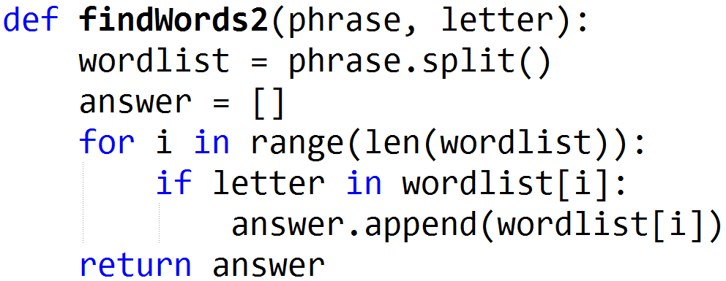
Consider two solutions, which is better? bit.ly/101f17-1102-6

Slide 24
Problem 7 – Which number appears the most times?
The function most has one parameter nums, a list of integers. This function returns the number that appears the most in the list.
For example, the call most([3,4,2,2,3,2]) returns 2, as 2 appears more than any other number.

Slide 25
Solution 1

Slide 26
Compare with Solution 2 bit.ly/101f17-1102-7

