Slide 1
CompSci 101 Introduction to Computer Science
Nov. 7, 2017
Prof. Rodger

Slide 2
Announcements
No RQs until after Exam 2
Assignment 6 due Thursday
APT Quiz 2 – must do by Wed midnight
APT 6 due today, APT 7 out
Exam 2 is Nov 16
Lab this week!
Today:
More practice with Dictionaries, finish last time

Slide 3
Announcements
No RQs until after Exam 2
Assignment 6 due Thursday - now Monday
APT Quiz 2 – must do by Wed midnight
APT 6 due today, APT 7 out
Exam 2 is Nov 16
Lab this week!
Today:
More practice with Dictionaries, finish last time

Slide 4
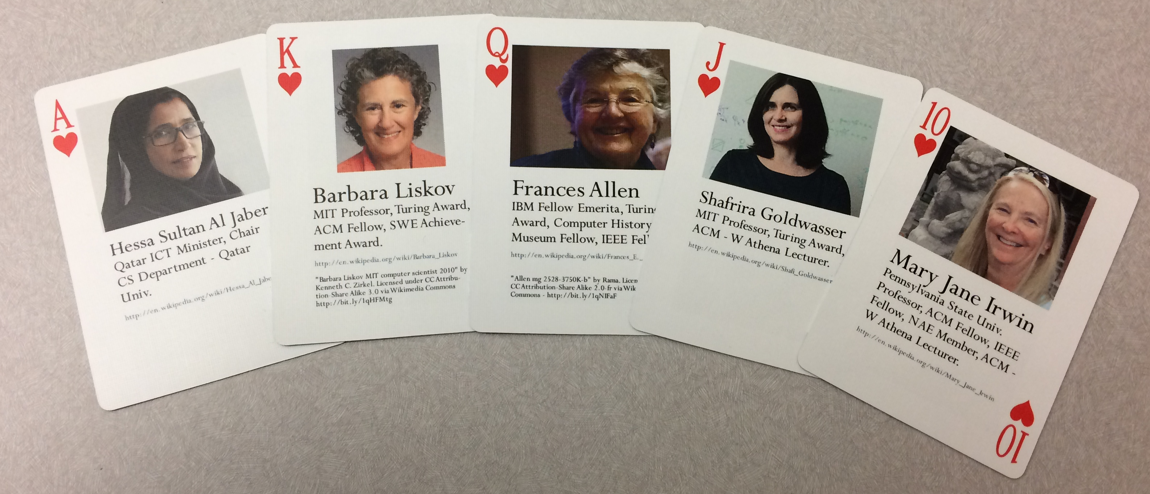
Lab this week! - Odds with poker!
Notes:
Deck of playing cards I made of 54 notable women in computing!
Full House – three jacks and 2 fours – what are the odds?
Flush

Slide 5
Smarty Hangman
Version of Hangman that is hard to win.
Program keeps changing secret word to make it hard to guess!
User never knows!
Once a letter is chosen and shown in a location, program picks from words that only have that letter in that location
Program smart to pick from largest group of words available

Slide 6
Smarty Hangman - Dictionary
Builds a dictionary of categories
Start with list of words of correct size
Repeat
User picks a letter
Make dictionary of categories based on letter
New list of words is largest category
Category includes already matched letters
List shrinks in size each time

Slide 7
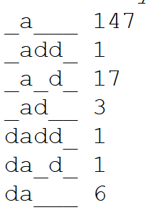
Smarty Hangman Example
Possible scenario after several rounds
From list of words with a the second letter. From that build a dictionary of list of words with no d and with d in different places:
Choose “no d”, most words, 147
Only 17 words of this type
Only 1 word of this type
Notes:
Great Dictionary example to solve a problem!

Slide 8
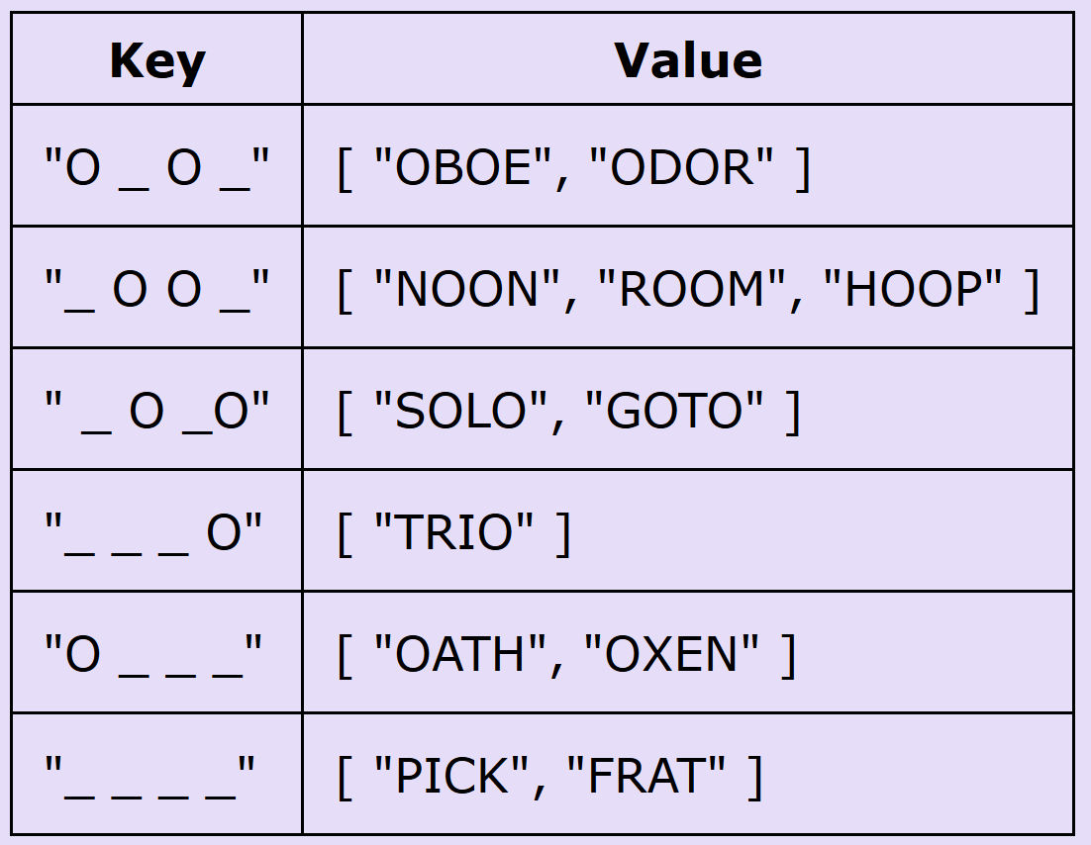
Everytime guess a letter, build a dictionary based on that letter
Example: Four letter word, guess o
Key is string, value is list of strings that fit

Slide 9
Keys can’t be lists
[“O”,”_”,”O”,”_”] need to convert to a string to be the key representing this list:
“O_O_”

Slide 10
Smarty Hangman
How to start? How to modify assignment 5?
What helper function(s) would be useful?
Helper function to create new list of words, new secret word, new template
Pass in current list of words, current template (such as [‘_’, ‘a’, ‘_’, ‘_’, ‘_’]) and the letter guessed
Pass back a tuple : new secret word, now list of words, new template
(x, y, z) = someFunction(a, b, c)
Notes:
Template shows the word and letters that were correct and where they are

Slide 11
Take another look at the last two problems from last time

Slide 12
Problem 6: Which code is better?
Problem: Given a string parameter named phrase and string named letter, the function findWords returns a list of all the words from phrase that have letter in them.
Example:
findWords("the circus is coming to town with elephants and clowns", "o") would return
[‘coming’, ‘to’, ‘town’, ‘clowns’]

Slide 13
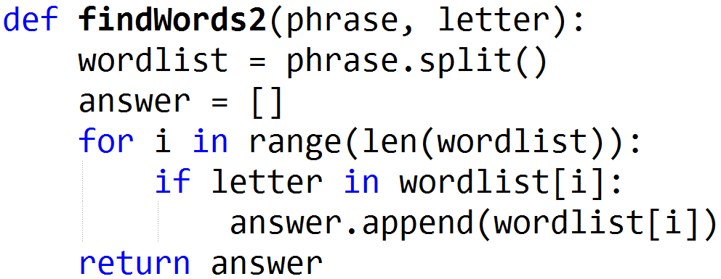
Different questions about these bit.ly/101f17-1107-1

Slide 14
How long does phrase.split() take?
“how are you”

Slide 15
How long does phrase.split() take?
“how are you”
words = [‘how’]
words = [‘how’, ‘are’]
words = [‘how’, ‘are’, ‘you’]
For N chars in phrase, takes about N steps

Slide 16
How long for this solution? Have N chars, M words in phrase
range(len(phrase.split()))
for i in range(…):
If letter in phrase.split()[i]
phrase.split()[i]
Notes:
For each word we do 2*N work

Slide 17
How long for this solution? Have N chars, M words in phrase
range(len(phrase.split()))
for i in range(…):
If letter in phrase.split()[i]
phrase.split()[i]
N steps
For M words
N steps
N steps
Total: N + M*(2*N)
~ M*N
Notes:
For each word we do 2*N work
In the if we have to split it and still we have to look at all the chars in the word

Slide 18
How long for this solution? Have N chars, M words
phrase.split()
for each word
If letter in word
Answer.append

Slide 19
How long for this solution? Have N chars, M words
phrase.split()
for each word
If letter in word
Answer.append
N steps
For M words
len(word) steps
1 step
Total: N + N = ~ N
N steps

Slide 20
Problem 7 – Which number appears the most times?
The function most has one parameter nums, a list of integers. This function returns the number that appears the most in the list.
For example, the call most([3,4,2,2,3,2]) returns 2, as 2 appears more than any other number.

Slide 21
How long for Solution 1?

Slide 22
How long for Solution 2 bit.ly/101f17-1107-2

Slide 23
How long for Solution 1? N numbers

Slide 24
How long for Solution 1? N numbers
N steps
Loop N times
1 step
3 steps
Total: N + 4N
~ N

Slide 25
Example: [5, 3, 4, 3, 3, 5]
[ 0, 0, 0, 0, 0, 0, 0] list of counters
0 1 2 3 4 5 6 indexes
After updating the counts we have:
[ 0, 0, 0, 3, 1, 2, 0] 3 3’s, 1 4, 2 5’s
0 1 2 3 4 5 6

Slide 26
Example: [5, 3, 4, 3, 3, 5]
[ 0, 0, 0, 0, 0, 0, 0] list of counters
0 1 2 3 4 5 6 indexes
After updating the counts we have:
[ 0, 0, 0, 3, 1, 2, 0] 3 3’s, 1 4, 2 5’s
0 1 2 3 4 5 6

Slide 27
How long for Solution 2 N numbers (M unique numbers)

Slide 28
How long for Solution 2 N numbers (M unique numbers)
Loop M times
N steps
3 steps
Total: M * (N+3)
~ M*N

Slide 29
Python shortcut you can ignore
The zip function, tuples from two lists
Does something right if lists have different sizes. Look it up
words = ['dog', 'cat', 'fish', 'guava']
counts = [3, 2, 1, 5]
cc = zip(word,counts)
[('dog', 3), ('cat', 2), ('fish', 1), ('guava', 5)]
Notes:
You could easily write zip....
In one line with
List comprehension to create tuples
min or max? min
Range - need index number for both lists
yy = [(a[i], b[i]) for i in range(min(len(a),len(b)))]

Slide 30
Python functions you CANNOT ignore
We know how to sort, we call sorted
Example: sorting tuples
Function sorted returns a new list, original not changed
What if sort by numbers instead of words?
xx = [('dog', 3), ('cat', 2), ('fish', 1), ('guava', 2)]
yy = sorted(xx)
[('cat', 2), ('dog', 3), ('fish', 1), ('guava', 2)]
Notes:
What if we want to sort by numbers instead of words?

Slide 31
Use what you know
You can re-organize data to sort it as you'd like, list comprehensions are your friend
xx = [('dog', 3), ('cat', 2), ('fish', 1), ('guava', 2)]
...
nlist = [(t[1],t[0]) for t in xx]
[(3, 'dog'), (2, 'cat'), (1, 'fish'), (2, 'guava')]
yy = sorted(nlist)
[(1, 'fish'), (2, 'cat'), (2, 'guava'), (3, 'dog')]
Notes:
Notice that (2,'cat') comes before (2,'guava')
Use what you know

Slide 32
APT – SortedFreqs bit.ly/101f17-1107-3
The returned frequencies represent an
alphabetic/lexicographic ordering of the
unique words, so the first frequency is how
many times the alphabetically first word occurs and the last frequency is the
number of times the alphabetically last word occurs

Slide 33
Ways to count? bit.ly/101f17-1107-4
Dictionaries are faster than using lists?
How fast is list.count(x) for each x?
Notes:
How long does list.count(x) if you do this for each x?
How long does it take to compute a dictionary of counts

Slide 34
Shafi Goldwasser
2012 Turing Award Winner
RCS professor of computer science at MIT
Twice Godel Prize winner
Grace Murray Hopper Award
National Academy
Co-inventor of zero-knowledge proof protocols
How do you convince someone that you know [a secret] without revealing the knowledge?
Honesty and Privacy
Work on what you like, what feels right, I know of no other way to end up doing creative work

Slide 35
APT Customer Statistics bit.ly/101f17-1107-5

Slide 36
Review Dictionaries
Map keys to values
Counting: count how many times a key appears
Key to number
Store associated values
Key to list or set
Get all
Keys, values or (key,value) pairs
What question do you want to answer?
How to organize data to answer the question

Slide 37
Dictionary problems Number of students in Photo clubs bit.ly/101f17-1107-6
d = {'duke':30, 'unc':50, 'ncsu':40}
d['duke'] = 80
d.update({'ecu':40, 'uncc':70})
print d.values()

Slide 38
Dictionary problems – part 2 bit.ly/101f17-1107-7
Consider the Python dictionary below on schools that map schools to number of students
d = {'duke':30, 'unc':50, 'ncsu':40, 'wfu':50, 'ecu': 80, 'meridith':30, 'clemson':80, 'gatech':50, 'uva':120, 'vtech':110}

