Slide 1
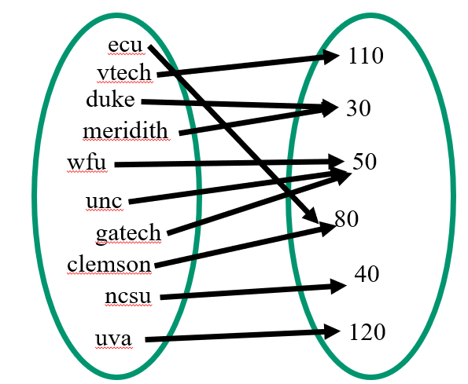
CompSci 101 Introduction to Computer Science
November 9, 2017
Prof. Rodger
Notes:
There are too many slides here, take the end ones off….

Slide 2
Announcements
Assign 7 due Monday
APT 7 due Tuesday
Exam 2 Thursday, November 16
See practice exams from Fall 16 and Spring 17
Today:
More problem solving with dictionaries
Finish problem from last time

Slide 3
Be in the know…. ACM, compsci mailing lists
Association of Computing Machinery (ACM)
Professional organization for computer science
Duke Student ACM Chapter – join for free
Join duke email lists to find out info on jobs, events for compsci students
lists.duke.edu – join lists:
compsci – info from compsci dept
dukeacm – info from student chapter

Slide 4
Review Dictionaries
Map keys to values
Counting: count how many times a key appears
Key to number
Store associated values
Key to list or set
Get all
Keys, values or (key,value) pairs
What question do you want to answer?
How to organize data to answer the question

Slide 5
Dictionary problems Number of students in Photo clubs bit.ly/101f17-1109-1
d = {'duke':30, 'unc':50, 'ncsu':40}
d['duke'] = 80
d.update({'ecu':40, 'uncc':70})
print d.values()

Slide 6
Dictionary problems – part 2 bit.ly/101f17-1109-2
Consider the Python dictionary below maps schools to number of students in the Photo Club at their school
d = {'duke':30, 'unc':50, 'ncsu':40, 'wfu':50, 'ecu': 80, 'meridith':30, 'clemson':80, 'gatech':50, 'uva':120, 'vtech':110}
Dictionary to answer which schools have X students? … which schools have groups of students 1-49, 50-99, etc?

Slide 7
Dictionary of schools to number students
keys
values
ecu
110
vtech
duke
50
clemson
30
wfu
unc
80
gatech
meridth
ncsu
40
uva
120
Notes:
Note we do not know their ordering for either keys or values

Slide 8
Dictionary of schools to number students
ecu
110
vtech
duke
30
meridith
wfu
50
unc
80
gatech
clemson
40
ncsu
uva
120

Slide 9
Dictionary of schools to number students Dictionary of number students to schools
ecu
110
vtech
duke
30
meridith
wfu
50
unc
80
gatech
clemson
40
ncsu
uva
120

Slide 10
Dictionary of schools to number students Dictionary of number students to schools
ecu
110
vtech
duke
30
meridith
wfu
50
unc
80
gatech
clemson
40
ncsu
uva
120

Slide 11
Dictionary of schools to number students Dictionary of number students to schools
vtech
ecu
110
vtech
duke
meridith
duke
30
meridith
wfu
gatech
unc
wfu
50
unc
80
gatech
ecu
clemson
clemson
40
ncsu
ncsu
uva
120
uva

Slide 12
Dictionary of number groups to list of schools
duke
Meridith
ncsu
0-49
wfu
gatech
unc
50-99
100-150
ecu
clemson
vtech
uva

Slide 13
Inverted Dictionary bit.ly/101f17-1109-3
Start with dictionary of keys to values
Schools to number of students
Use it to build an inverted dictionary of values to keys (actually list of keys)
Number of students to list of schools
Lets look at the code

Slide 14
Dictionary Song problem bit.ly/101f17-1109-4
songs = ["Hey Jude:Let it be:Day Tripper",
"Let it be:Drive my car:Hey Jude",
"I want to hold your hand:Help!:Day Tripper",
"Born to run:Thunder road:She's the one",
"Hungry heart:The river:Born to run",
"The river:Thunder road:Drive my car",
"Angie:Start me up:Ruby Tuesday",
"Born to run:Angie:Drive my car"]

Slide 15
Building the dictionary d
"Hey Jude:Let it be:Day Tripper"

Slide 16
Building the dictionary d
"Hey Jude:Let it be:Day Tripper“
d[“Hey Jude”] =
d[“Let it be”] =
d[“Day Tripper”] =
[ 1, 0, 0]
[ 0, 1, 0]
[ 0, 0, 1]

Slide 17
Building the dictionary d
"Hey Jude:Let it be:Day Tripper“
d[“Hey Jude”] =
d[“Let it be”] =
d[“Day Tripper”] =
[ 1, 0, 0]
[ 0, 1, 0]
[ 0, 0, 1]

Slide 18
Building the dictionary d
"Let it be:Drive my car:Hey Jude"
d[“Hey Jude”] =
d[“Let it be”] =
d[“Day Tripper”] =
[ 1, 0, 0]
[ 0, 1, 0]
[ 1, 1, 0]
[ 0, 0, 1]

Slide 19
Building the dictionary d
"Let it be:Drive my car:Hey Jude"
d[“Hey Jude”] =
d[“Let it be”] =
d[“Day Tripper”] =
d[“Drive my car”] =
[ 1, 0, 0]
[ 1, 1, 0]
[ 0, 0, 1]
[ 0, 1, 0]

Slide 20
Building the dictionary d
"Let it be:Drive my car:Hey Jude"
d[“Hey Jude”] =
d[“Let it be”] =
d[“Day Tripper”] =
d[“Drive my car”] =
[ 1, 0, 0]
[ 1, 0, 1]
[ 1, 1, 0]
[ 0, 0, 1]
[ 0, 1, 0]

Slide 21
Building the dictionary d
"I want to hold your hand:Help!:Day Tripper"
d[“Hey Jude”] =
d[“Let it be”] =
d[“Day Tripper”] =
d[“Drive my car”] =
d[“I want to hold your hand”] =
[ 1, 0, 1]
[ 1, 1, 0]
[ 0, 0, 1]
[ 0, 1, 0]
[ 1, 0, 0]

Slide 22
Building the dictionary d
"I want to hold your hand:Help!:Day Tripper"
d[“Hey Jude”] =
d[“Let it be”] =
d[“Day Tripper”] =
d[“Drive my car”] =
d[“I want to hold your hand”] =
d[“Help!”] =
[ 1, 0, 1]
[ 1, 1, 0]
[ 0, 0, 1]
[ 0, 1, 0]
[ 1, 0, 0]
[ 0, 1, 0]

Slide 23
Building the dictionary d
"I want to hold your hand:Help!:Day Tripper"
d[“Hey Jude”] =
d[“Let it be”] =
d[“Day Tripper”] =
d[“Drive my car”] =
d[“I want to hold your hand”] =
d[“Help!”] =
[ 1, 0, 1]
[ 1, 1, 0]
[ 0, 0, 1]
[ 0, 0, 2]
[ 0, 1, 0]
[ 1, 0, 0]
[ 0, 1, 0]

Slide 24
Building the dictionary d
"I want to hold your hand:Help!:Day Tripper"
d[“Hey Jude”] =
d[“Let it be”] =
d[“Day Tripper”] =
d[“Drive my car”] =
d[“I want to hold your hand”] =
d[“Help!”] =
[ 1, 0, 1]
[ 1, 1, 0]
[ 0, 0, 2]
[ 0, 1, 0]
[ 1, 0, 0]
[ 0, 1, 0]

Slide 25
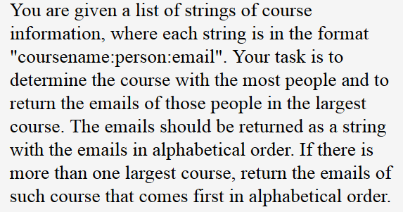
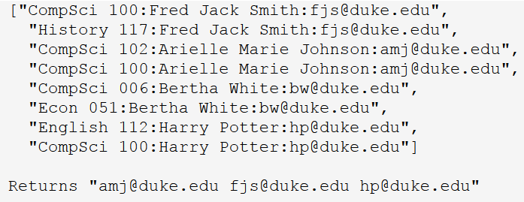
APT EmailsCourse bit.ly/101f17-1109-5

Slide 26
Step 1 – Work small example by hand

Slide 27
Step 1 – Work small example by hand
CompSci 100 =>
History 117 =>
English 112 =>
fjs@duke.edu
fjs@duke.edu
hp@duke.edu

Slide 28
Step 1 – Work small example by hand
CompSci 100 =>
History 117 =>
English 112 =>
fjs@duke.edu, hp@duke.edu
fjs@duke.edu
hp@duke.edu
Answer is: fjs@duke.edu, hp@duke.edu

Slide 29
Step 2 – Write down what you did
Extracted out CompSci 101, and email
Mapped CompSci 101 to fjs@duke.edu
Extracted out History 117 and email
Mapped History 117 to fjs@duke.edu
Extacted out English 112 and email
Mapped English 112 to hp@duke.edu
Extracted out CompSci 101 and email
Mapped CompSci 101 to another, hp@duke.edu

Slide 30
Step 3 – Generalize, find patterns
Initialize structure for answer
Initialize structure for mapping items
For each item in the given list
Extract out course
Extract out the email
Map the course to email (need a list of emails)
Find largest list of emails
Sort email list and return

Slide 31
Step 4 – try another example
Step 5– Translate to code

