Slide 1
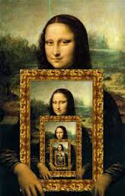
CompSci 101 Introduction to Computer Science
Nov 28, 2017
Prof. Rodger

Slide 2
Announcements
Last RQ, RQ18 Thursday!
Assign 8 due Dec 5, Assign 9 due Dec 8
APT 8 Due Dec 7
Exam 2 back – Regrades through Dec 7
Lab this week
Today:
Assign 8 - Recommender
How do you access directories/folders
Recursion – Solving problems by solving smaller and smaller similar problems

Slide 3
Exam 2 Back
Stats
Average 85/92
Request regrade through gradescope by Dec 7
Questions?

Slide 4
Final Exam – SECTION 02
You can sign up to take the Final exam earlier with Section 01 at 9am Thursday, Dec 14.
Sign up on the course web page on the forms tab!
Space is limited!

Slide 5
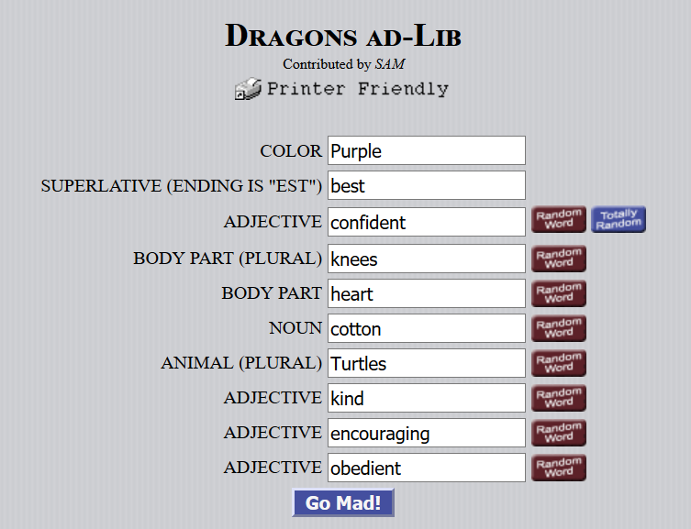
Lab this week!

Slide 6
Lab this week (cont)

Slide 7
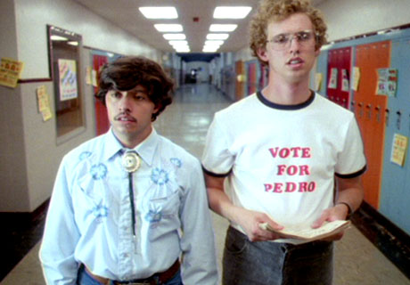
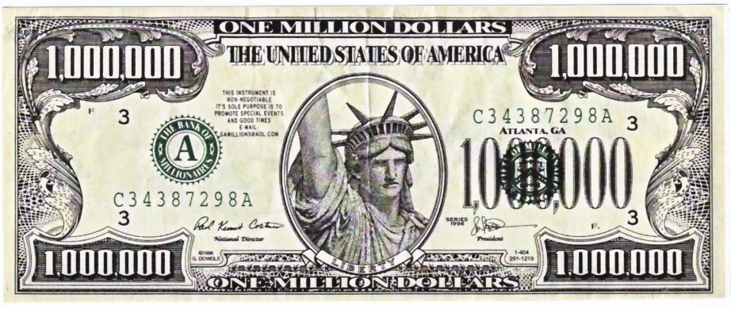
Math, Engineering, Sociology
Netflix prize in 2009
Beat the system, win
http://nyti.ms/sPvR
Notes:
Movie – Napolean Dynamite – caused problems you hate it or love it but it makes havoc with recommender systems
The Netflix Prize was an open competition for the best collaborative filtering algorithm to predict user ratings for films, based on previous ratings without any other information about the users or films,

Slide 8
Assignment 8: Collaborative Filtering
How does Amazon know what I want?
Lots of customers, lots of purchases
How does Pandora know music like Kanye's?
This isn't really collaborative filtering, more content-based
How does Netflix recommend movies?
Why did they offer one million $$ to better their method?
Students at Duke who like Compsci also like …
Could this system be built?
Notes:
Pandora - Having analyzed the musical structures present in the songs you like, it plays other songs that possess similar musical traits.

Slide 9
From User Rating to Recommendations
Spectre | Martian | Southpaw | Everest | PitchPerfect 2
3 | -3 | 5 | -2 | -3
2 | 2 | 3 | 2 | 3
4 | 4 | -2 | 1 | -1
What should I choose to see?
What does this depend on?
Who is most like me?
How do we figure this out
Notes:
Each row is one rater, they have each rated five movies.
Go over assignment and data files….

Slide 10
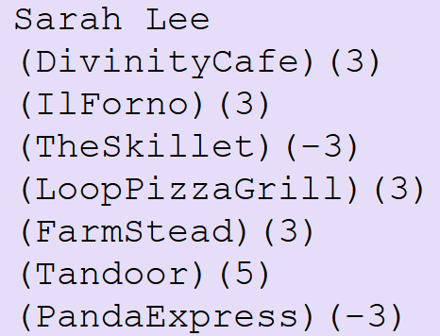
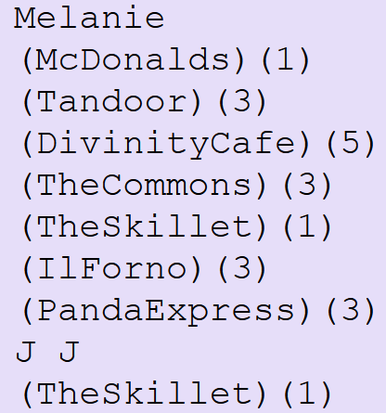
ReadAllFood modules: Food Format bit.ly/101f17-1128-1
All Reader modules return a tuple of strings: itemlist and dictratings dictionary
Translated to list and dictionary:
not
all
shown
…
Notes:
Give the example formatted, BUT NOTE THE RIGHT END IS CUT OFF

Slide 11
Data For Recommender
Users/Raters rate Items
We need to know the items
We need to know how users rate each item
Which eatery has highest average rating?
Conceptually: average columns in table
How is data provided in this assignment?
 | ABP | BlueEx | McDon | Loop | Panda | Nasher
Sam | 0 | 3 | 5 | 0 | -3 | 5
Chris | 1 | 1 | 0 | 3 | 0 | -3
Nat | -3 | 3 | 3 | 5 | 1 | -1
Notes:
Seven items – 3 sets of ratings for each – have to rate everything
Divide by 2 – don’t count 0 – allratings don’t include 0
One way of doing a recommendation – what yelp does
Average rating

Slide 12
Data For Recommender
itemlist are provided in a list of strings
Parsing data provides this list
dictratings provided in dictionary
Key is user ID
Value is list of integer ratings
 | ABP | BlueEx | McDon | Loop | Panda | Nasher
Sam | 0 | 3 | 5 | 0 | -3 | 5
Chris | 1 | 1 | 0 | 3 | 0 | -3
Nat | -3 | 3 | 3 | 5 | 1 | -1
Notes:
You need items as a list of strings (restaurants)
Required to create a dictionary
Note they are in the same order

Slide 13
Data For Recommender
Given Parameters
itemlist: a list of strings
dictratings: dictionary of ID to ratings list
Can you write
Average(itemlist, dictratings)
 | ABP | BlueEx | McDon | Loop | Panda | Nasher
Sam | 0 | 3 | 5 | 0 | -3 | 5
Chris | 1 | 1 | 0 | 3 | 0 | -3
Nat | -3 | 3 | 3 | 5 | 1 | -1
Notes:
Id is person and list of their ratings as ints
Average for McDonalds? 4
Don’t include those who did not rate

Slide 14
Drawbacks of Item Averaging
Are all ratings the same to me?
Shouldn't I value ratings of people "near" me as more meaningful than those "far" from me?
Collaborative Filtering
https://en.wikipedia.org/wiki/Collaborative_filtering
How do we determine who is "near" me?
Mathematically: treat ratings as vectors in an N-dimensional space, N = # ratings
Informally: assign numbers, higher the number, closer to me
Notes:
All ratings are the same.
Don’t you want to only consider ratings that are near you and value their ratings.

Slide 15
Collaborative Filtering: Recommender
First determine closeness of all users to me:
"Me" is a user-ID, parameter to function
Return list of (ID, closeness-#) tuples, sorted
Use just the ratings of person closest to me
Is this a good idea?
What about the 10 closest people to me?
What about weighting ratings
Closer to me, more weight given to rating
Notes:
How many do you use
You could weight those closer to you and use everyone

Slide 16
How do you calculate a similarity?
Me: [3, 5, -3]
Joe: [5, 1, -1]
Sue: [-1, 1, 3]
Joe to Me
= (3*5 + 5*1 + -3 * -1) = 23
Sue to Me
= (3*-1 + 5 * 1 + -3 * 3) = -7

Slide 17
How do you calculate a similarity?
Me: [3, 5, -3]
Joe: [5, 1, -1]
Sue: [-1, 1, 3]
Joe to Me
= (3*5 + 5*1 + -3 * -1) = 23
Sue to Me
= (3*-1 + 5 * 1 + -3 * 3) = -7
Notes:
The higher the number the closer they are to me. Negative numbers are really far from me.

Slide 18
Collaborative Filtering
For Chris: 12 * [1,1,0,3,0,-3] =
[12,12,0,36,0,-36]
For Sam: [0,75,125,0,-75,125]
Chris:12
Nat:37
Sam:25
 | ABP | BlueEx | McDon | Loop | Panda | Nasher
Sam | 0 | 3 | 5 | 0 | -3 | 5
Chris | 1 | 1 | 0 | 3 | 0 | -3
Nat | -3 | 3 | 3 | 5 | 1 | -1
Notes:
Here we are calculating ratings with weights.
Chris is 12 away from me
Nat is 37 away from me
Sam is 25 away from me
High number is closer to you .
Show how you multiple the closeness number times every rating.

Slide 19
Adding lists of numbers
[12, 12, 0, 36, 0,-36]
[ 0, 75, 125, 0,-75,125]
[-111,111,111,185,37, -37]
---------------------------
[-99, 198, 236, 221, -38, 52]
Adding columns in lists of numbers
Using indexes 0, 1, 2, … sum elements of list
sum([val[i] for val in d.values()])
Notes:
I would probably like 236 item, then
Note the -75 could be an outlier, only one person rated it.

Slide 20
Then divide by number of nonzeros
[12, 12, 0, 36, 0,-36]
[ 0, 75, 125, 0,-75,125]
[-111,111,111,185,37, -37]
---------------------------
[-99, 198, 236, 221, -38, 52]
/2 /3 /2 /2 /2 /3
[ -49, 66, 118, 110 -19, 17]
 | ABP | BlueEx | McDon | Loop | Panda | Nasher
Sam | 0 | 3 | 5 | 0 | -3 | 5
Chris | 1 | 1 | 0 | 3 | 0 | -3
Nat | -3 | 3 | 3 | 5 | 1 | -1
Recommend
3rd item
Notes:
I would probably like 139 item, then
Note the -75 could be an outlier, only one person rated it.

Slide 21
Follow 12-step process
ProcessAllFood first!
Read input and save it
Get list of restaurants – use that ordering! Set?
For each person
For each restaurant and its rating
Must find location of restaurant in itemlist
Then update appropriate counter
Print any structure you create to check it

Slide 22
Plan for Today
Recursion
Solving problems by solving similar but smaller problems
Programming and understanding …
Hierarchical structures and concepts
What is a file system on a computer?
What is the Internet?
How does the Domain Name System Work?
How do you access directories?
And all the files in a directory, and the …
Notes:
How we interact with hierarchical structures that are self-referential.
You have a file system on your computer – you have files, you have folders with files and folders that may have files, etc.
You understand files and folders – today we will be looking at how to list all your files using a technique that is self-referential
What is the Internet? You have all probably been on the internet today, the internet is a large network, a large hierarchical structure made up of many networks and is also self-referential

Slide 23
Recursion Solving a problem by solving similar but smaller problems

Slide 24
Recursion Solving a problem by solving similar but smaller problems
Question - How many rows are there in this classroom?
Similar but smaller question - How many rows are there until your row?
I don’t know,
let me ask
Last row
Row count = 4+1 = 5
S
S
S
S
S
I don’t know,
let me ask
Return Value = 3+1 = 4
I don’t know,
let me ask
Return Value = 2+1 = 3
I don’t know,
let me ask
Return Value = 1+1 = 2
Return value = 1
I don’t have anyone to ask.
So I am in Row#1

Slide 25
http://computer1.sales.microsoft.com
Domain Name System (DNS)
Link:

Slide 26
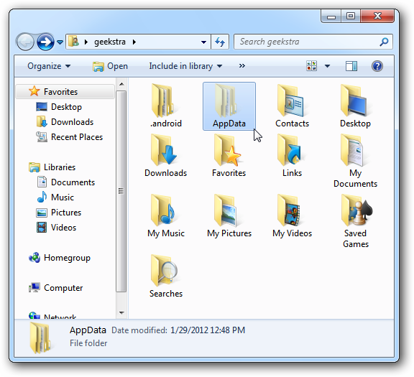
What's in a file-system Folder?
Notes:
This is a picture of folders and files on a windows machine. All of you have folders (likely) and files on your computer.

Slide 27
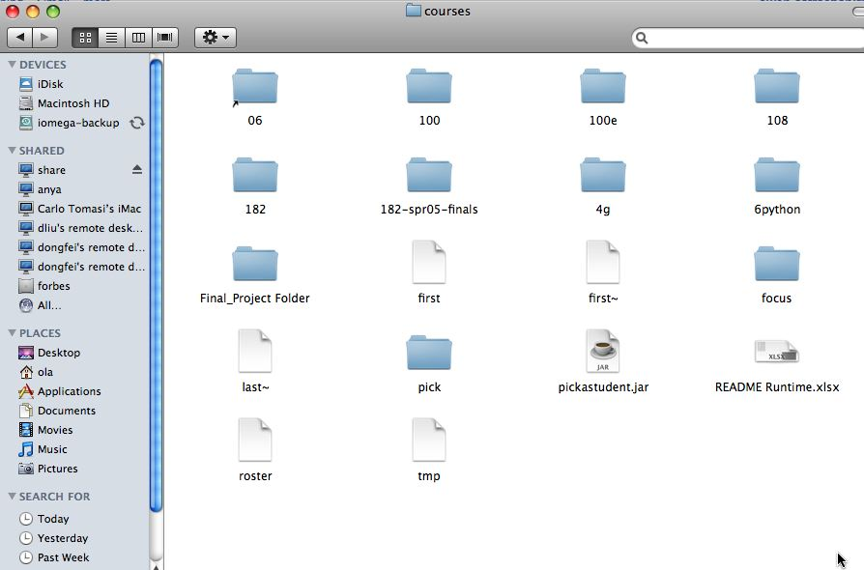
Notes:
Here is another picture from a Mac
When you click on a folder it opens up and there could be another folder in it and files. The folders could have a folder in it, and put papers in it, etc.

Slide 28
What's in a folder on your computer?
Where are the large files?
How do you find them?
They take up space!
What’s the plan –
Erase?
Backup?
Notes:
Here is another picture from a Mac
When you click on a folder it opens up and there could be another folder in it and files. The folders could have a folder in it, and put papers in it, etc.

Slide 29
Hierarchy in Folder Structure
Level 0
Level 1
Level 2
Level 3
Level 4
Folder 1
Folder 2
Folder 3
Folder 4
Base Case
Folder 5
Folder 6

Slide 30
Recursion to find ALL files in a folder
A folder can have sub folders and files
A file cannot have sub files
def visit(dirname):
for inner in dirname:
if isdir(inner):
visit(inner)
else:
print name(inner), size(inner)
Is that a directory?
If not a directory, it will be a file
Notes:
Calls an instance that is smaller

Slide 31
Finding large files: FileVisit.py
def bigfiles(dirname,min_size):
large = []
for sub in os.listdir(dirname):
path = os.path.join(dirname,sub)
if os.path.isdir(path):
subs = bigfiles(path,min_size)
large.extend(subs)
else:
size = os.path.getsize(path)
if size > min_size:
large.append((path,size))
return large
# on Mac like this:
#bigs = bigfiles("/Users/Susan/Documents",10000)
# on Windows like this:
bigs = bigfiles("C:\\Users\\Susan\\Documents",10000)
Notes:
Here is code you can snarf. This code finds all the files that are bigger than 10000 Kilobytes
It is useful to find big files on your computer if you need more space. So this code finds big files.
Which line identifies a big file? Dirname is the name of the folder.
This uses the os library, os is for operating systems.
Which line identifies big files? “ If size > min_size” is the line
Ask someone to identify the line
In the past we called folders directories… This library uses the older name directories
For loop visits everything in the folder. Everything in the folder is a folder or a file
If os.path.isdir - asks if this is a folder (directory)
If it is a file (else part) ask about the size to see if it is a big file and if so we append it to large
If it is a folder, we call bigfiles –hey that is the name of this function. That will be a separate call to this function with the folder that is in this folder. It will find all the big files and return them to the variable subs and then we put all those big files into large using extends (which is like append but for a list of things, not just one.

Slide 32
Example Run
('C:\\Users\\Susan\\files\\courses\\cps101\\workspace\\spring2015\\assign4_transform\\data\\romeo.txt', 153088L)
('C:\\Users\\Susan\\files\\courses\\cps101\\workspace\\spring2015\\assign4_transform\\data\\twain.txt', 13421L)
('C:\\Users\\Susan\\files\\courses\\cps101\\workspace\\spring2015\\assign5_hangman\\src\\lowerwords.txt', 408679L)
…
Notes:
Run the program and show large files on your computer
These are just three of my large files. You should recognize these big files romeo.txt, twain.txt and lowerwords.txt
You can see their size

Slide 33
Finding Large Files questions bit.ly/101f17-1128-2

Slide 34
The os and os.path libraries
Libraries use an API to isolate system dependencies
C:\\x\\y # windows
/Users/Susan/Desktop # mac
FAT-32, ReFS, WinFS, HFS, HSF+, fs
Underneath, these systems are different
Python API insulates and protects programmer
Why do we have os.path.join(x,y)?
x = /Users/Susan/Documents
y = file1.txt
Output = /Users/Susan/Documents/file1.txt
Notes:
FileVisit code is for accessing all your files words regardless of max or pc
With these python libraries, you don’t have to worry how to access the files and folders for different systems, the writers of these libraries figured this for you and you just use the libraries.

Slide 35
Dissecting FileVisit.py
How do we find the contents of a folder?
Another name for folder: directory
How do we identify folder? (by name)
os.listdir(dirname) returns a list of files and folder
Path is c:\user\ola\foo or /Users/ola/bar
os.path.join(dir,sub) returns full path
Platform independent paths
What's the difference between file and folder?
os.path.isdir() and os.path.getsize()
Notes:
If time go over these

Slide 36
Does the function call itself? No!
def visit(dirname):
for inner in dirname:
if isdir(inner):
visit(inner)
else:
print name(inner), size(inner)
Is a file inside itself? No!
Does pseudo code make sense?
Details make this a little harder in Python, but close!
Notes:
Calls an instance that is smaller

Slide 37
Structure matches Code
Find large files
If you see a folder,
1. Find the large files and subfolders
2. For the subfolders, repeat the process of finding large files
and any other folders within that subfolder
3. Repeat the process until you reach the last folder
Compress or Zip a folder
If you see a folder,
1. Find the files and subfolders
2. For the subfolders, repeat the process of finding files
and any other folders within that subfolder
3. At the last stage, start compressing files and move up
the folder hierarchy

Slide 38
Structure matches Code
Structure of list of lists
Can also lead to processing a list which requires processing a list which …
[ [ [a,b], [c,d], [a, [b,c],d] ]
(a *(b + c (d + e*f)) + (a* (b+d)))

Slide 39
Recursion
Simpler or smaller calls
Must have a base case when no recursive call can be made
Example - The last folder in the folder hierarchy will not have any subfolders. It can only have files. That forms the base case
Notes:
When you are trying to print out all folders eventually you get a folder with only files, no folders. Then you don’t need to call bigfiles again.
Quicksort is on the next slide

Slide 40
Sir Anthony (Tony) Hoare
There are two ways of constructing a software design. One way is to make it so simple that there are obviously no deficiencies. And the other way is to make it so complicated that there are no obvious deficiencies.
Turing Award, didn’t get recursion…..
Inventor of quicksort
Notes:
He is SIR, won the turing award and also has been knighted by queen Elizabeth.
As an aside, he invented quicksort in 1960. It is a very fast sort, used to be the quickest, but no longer is the fastest, Python uses another sort, timsort.
When he named it in 1960 he didn’t get recursion. He wrote code for this that was really long, but if you use recursion the solution is only about 5 lines.

Slide 41
Mystery Recursion bit.ly/101f17-1128-3
Notes:
DIDN”T GET TO THIS

Slide 42
Something Recursion bitly/101f17-1128-4

