Slide 1
CompSci 101 Introduction to Computer Science
 | ABP | BlueEx | McDon | Loop | Panda | Nasher
Sam | 0 | 3 | 5 | 0 | -3 | 5
Chris | 1 | 1 | 0 | 3 | 0 | -3
Nat | -3 | 3 | 3 | 5 | 1 | -1
November 30, 2017
Prof. Rodger

Slide 2
Announcements
No more RQ!
Assign 8 due Dec 5, Assign9 due Dec 8-11
APT 8 due Dec 7
Be a UTA – sign up – or Peer Tutor
Today:
Review Recursion
Regular Expressions
Assignment 8 Recommender

Slide 3
Exam 2 Scores
92 92 92 92 92 92 92 92 92 92 92 92 92 92
91 91 91 91 91 91 91 91 91 91 91 91 91 91 91 91 91 91 91 91 91 91 91 91 91 91 91 91 91 91 91 91 91 91 91 91 91 91 91 91 91 91 91 91 91 91
90 90 90 90 90 90 90 90 90 90 90 90 90 90 90 90 90 90 90 90 90 90 90 90 90 90 90 90 90 90 90 90 90 90 90 90 90 90 90 90 90
89 89 89 89 89 89 89 89 89 89 89 89 89 89 89 89 89 89 89 89 89 89 89 89 89 89 89 89
88 88 88 88 88 88 88 88 88 88 88 88 88 88 88 88 88 88 88 88 88 88 88 88 88 88 88 88 88 88 88 88 88 88 88 88 88
87 87 87 87 87 87 87 87 87 87 87 87 87 87 87 87 87 87 87 87 87 87 87 87 87 87 87 87 87 87 87 87
86 86 86 86 86 86 86 86 86 86 86 86 86 86 86 86 86 86 86 86 86 86 86 86 86 86 86 86
85 85 85 85 85 85 85
84 84 84 84 84 84 84 84 84 84 84 84
83 83 83 83 83 83 83 83 83
82 82 82 82 82 82 82 82
81 81 81 81 81 81 81 81 81
80 80 80 80 80 80
79 79
78 78 78 78
77 77 77 77 77
76 76 76 76
75 75 75 75
74 74
73 73 73
72
71 71 71
69
67 67 67
66
64
63
62
59 59
58
55
25
Notes:
Average was 85/92

Slide 4
Assignment 8 From User Rating to Recommendations
Spectre | Martian | Southpaw | Everest | PitchPerfect 2
3 | -3 | 5 | -2 | -3
2 | 2 | 3 | 2 | 3
4 | 4 | -2 | 1 | -1
What should I choose to see?
What does this depend on?
Who is most like me?
How do we figure this out

Slide 5
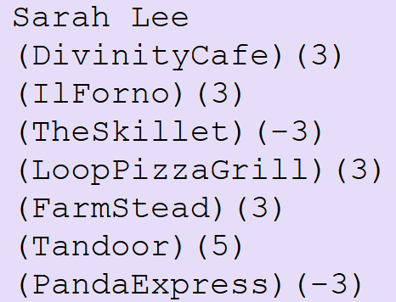
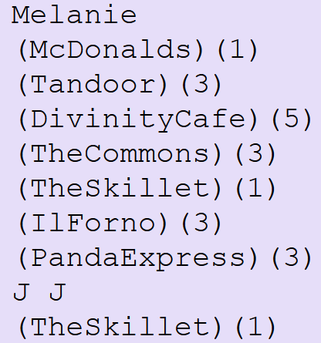
ReadAllFood modules: Food Format
All Reader modules return a tuple of strings: itemlist and dictratings dictionary
Translated to list and dictionary:
not
all
shown
…

Slide 6
Follow 12-step process
ReadFood first!
Read input and save it
Get list of restaurants – use that ordering! Set?
For each person
For each restaurant and its rating
Must find location of restaurant in itemlist
Then update appropriate counter
Print any structure you create to check it

Slide 7
Recursion Review
Function calls a clone of itself
Smaller problem
Must be a way out of recursion
Notes:
Solving a smaller version of the original problem, must be smaller in some way.
Must also get smaller and smaller and then must be a way where it is so small you can just solve the problem.

Slide 8
Mystery Recursion bit.ly/101f17-1130-1
Notes:
DIDN”T GET TO THIS

Slide 9
Example
Mystery(5) is 1 + Mystery(2)
Mystery(2) is 1 + Mystery(1)
Mystery(1) is 1 + Mystery(0)
Mystery(0) is 2
= 1 + 4 = 5
= 1 + 3 = 4
= 1 + 2 = 3

Slide 10
Review: Recursion to find ALL files in a folder
A folder can have sub folders and files
A file cannot have sub files
def visit(dirname):
for inner in dirname:
if isdir(inner):
visit(inner)
else:
print name(inner), size(inner)
Is that a directory?
If not a directory, it will be a file
Notes:
Calls an instance that is smaller

Slide 11
Something Recursion bitly/101f17-1130-2

Slide 12
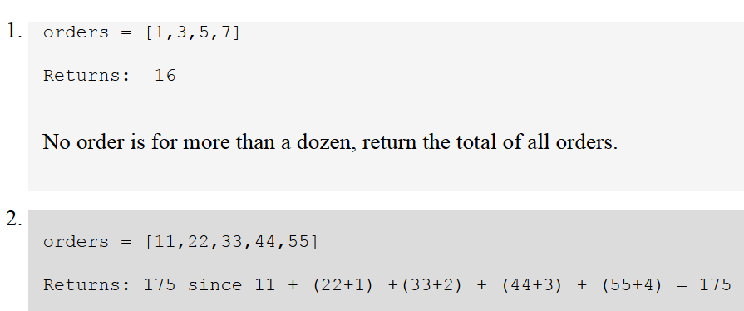
Revisit the APT Bagels Recursively

Slide 13
APT Bagels Recursively bit.ly/101f17-1130-3
A)
B)
C)
D)

Slide 14
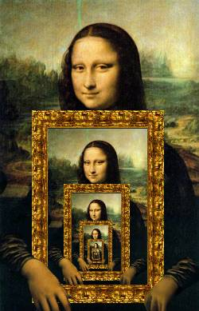
Recursion in Pictures
http://xkcd.com/543/

Slide 15
More: Recursion in Pictures
http://xkcd.com/688/

Slide 16
What is Computer Science?
… "it is the study of automating algorithmic processes that scale."
https://en.wikipedia.org/wiki/Computer_science
If you need to find one email address on a webpage, you don't need computer science
If you need to scrape every email address, that number in the 10's to 100's, you could use help

Slide 17
How do you solve a problem like …
How many words end in "aria"?
Start with "aria"? Contain "aria"?
Why would you care about this?
Can you find ola@cs.duke.edu, susan.rodger@duke.edu, and andrew.douglas.hilton@gmail.com when searching through a webpage source?
What is the format of a "real" email address?
Notes:
How do you solve a problem like "Maria" is from sound of music

Slide 18
Examples of regex's at work
What do aria$ and ^aria and aria share?
Answers to previous question
What about the regex .+@.+
Turns out that . has special meaning in regex, so does +, so do many characters
We'll use a module RegexDemo.py to check
Uses the re Python library
Details won't be tested, regex knowledge will

Slide 19
Regex expressions
Regex parts combined in powerful ways
Each part of a regex "matches" text, can extract matches using programs and regex library
^ is start of word/line, $ is end
Expressions that match single characters:
A, a, 9 or … | Any character matches itself
. | Matches any character
\w | Matches alphanumeric and _
\d | Matches digit
\s | Matches whitespace

Slide 20
Regex expressions
Repeat and combine regex parts
* means 0 or more occurrences/repeats
+ means 1 or more occurrences/repeats
? Means (after * or +) to be non-greedy
Expressions match more than one character
[a-zAB] | Brackets create character class
(regex) | Tag or group a regex
\1 or \2 | Matches previously grouped regex
{1} or {n} | Repeat regex 1 or n times

Slide 21
Regex examples tried and explained
Five letter words ending in p? Starts 'd'?
^\w\w\w\wp$ but not ....p$
Seven letter words, or seven ending with 'z'
Difference between ^\w{7}$ and ^\w{7}
Words that start with a consonant:
^[^aeiou] double meaning of ^

Slide 22
Regex examples tried and explained
Five letter words ending in p? Starts 'd'?
^\w\w\w\wp$ but not ....p$
Seven letter words, or seven ending with 'z'
Difference between ^\w{7}$ and ^\w{7}
Start and end with the same two letters like sense and metronome, decipher this:
^(\w\w).*\1$
Start and end with three letters reversed, like despised and foolproof?

Slide 23
Summary of Regular Expressions
regex | purpose |  | regex | purpose
. | any character |  | * | zero or more of previous regex
\w | any alphanumeric character (and _) |  | + | one or more of previous regex
\s | any whitespace character |  | *? or +? | non-greedy version of either * or +
\d | any digit character |  | () | tag/group a regular expression
[] | character class, e.g., [A-Z] or [aeiou] |  | \1, \2, .. | match numbered tagged/grouped regex
{n} | n occurrences of preceding regex |  | ^ | beginning of line/string
[^...] | not the characters in the class, e.g., [^aeiou] |  | $ | end of line/string

Slide 24
Regex Questions bit.ly/101f17-1130-4

Slide 25
Answer Questions bit.ly/101f17-1130-5
SortByFreqs APT
Sort items by their frequency, break ties alphabetically

