Slide 1
CompSci 101 Introduction to Computer Science
December 5, 2017
Prof. Rodger
Notes:
See animations of sorting on the next set of slides!!!!

Slide 2
Announcements
Regrades Exam 2 – submit by Thursday, Dec 7
Regrades for Asg 1-5, APT 1-7 by Dec 8
Check your grades! RQ too!
Assign 8 due today, last late day Dec 8!
APT 8 due Thursday, Dec 7, last late day, Dec 10!
Assign 9 – due Dec 11, no late after this date
Final Exam:
Sec 01 Thur, Dec 14, 9am, LSRC B101
Sec 02 Sat, Dec 16, 2pm, LSRC B101
Get accommodations? Fill out for Final Exam

Slide 3
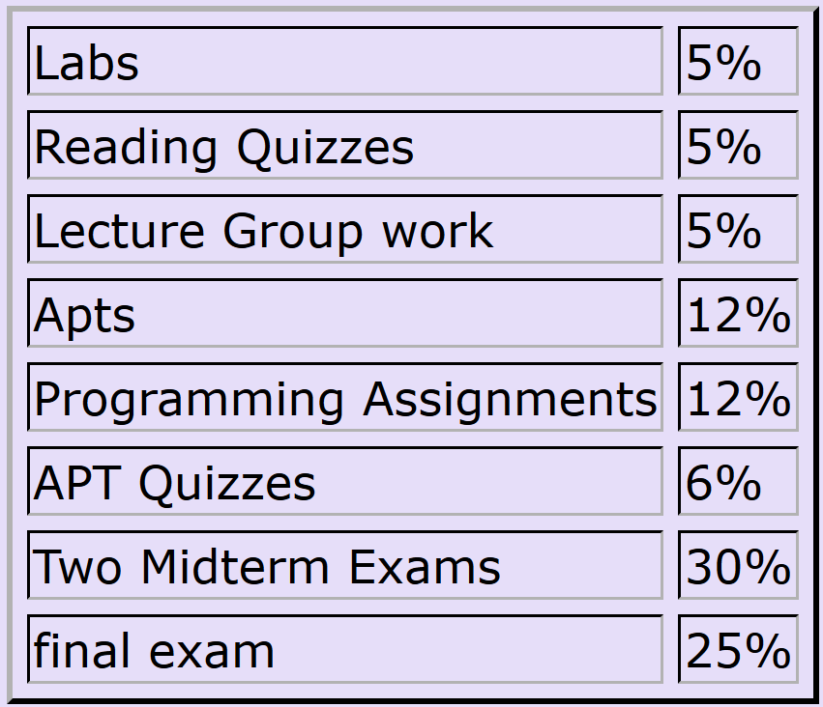
Calculate Your Grade
From “About” tab on course web page

Slide 4
More on Grades
Lecture – ignore the first two weeks (drop/add period), plus drop 4 points
Reading Quizzes – will drop 30 points
Check your grades to make sure they copied over – fill out duke oit help form if they are wrong
Lab – drop 6 points (each lab is 4 pts)
44 pts total– 38 pts is 100%
Lab 11 covers two new topics!

Slide 5
More Announcements
Be a UTA for CompSci 101
Rewarding and Learning Experience
Apply: see link in Sakai announcement
Today:
Finish from last time
Why are dictionaries so fast?
More on Recursion, Regex
More on Sorting and analyzing it

Slide 6
Answer Questions bit.ly/101f17-1205-1
SortByFreqs APT
Sort items by their frequency, break ties alphabetically

Slide 7
Review Recursion and Regex bit.ly/101f17-1205-2

Slide 8
Dictionary Comprehension
List comprehension - builds a new list
Dictionary comprehension - builds a new dictionary
Format
d = { key:value for key in somelist if ....}
:

Slide 9
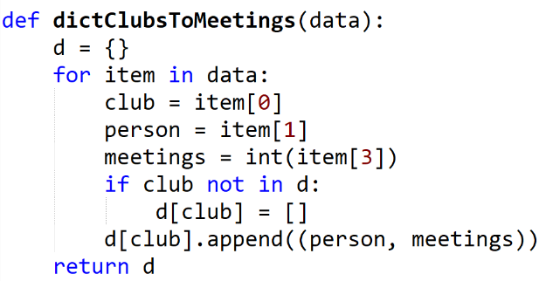
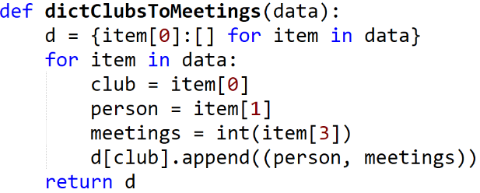
Example: From Exam 2 Sec 01– dict of clubs to list of tuples
Notes:
Save two lines. By initializing the item in the dictionary comprehension, you don’t need to check if it is in the dictionary or not.

Slide 10
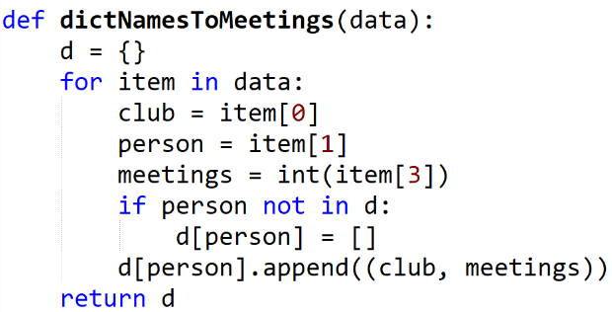
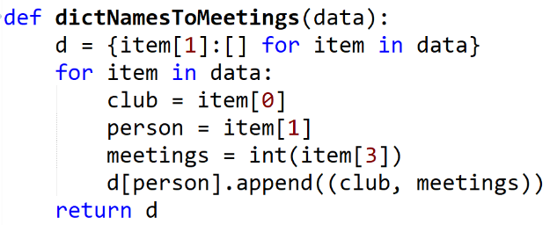
Example: From Exam 2 Sec 02– dict of names to list of tuples
Notes:
Save two lines. By initializing the item in the dictionary comprehension, you don’t need to check if it is in the dictionary or not.

Slide 11
Why are dictionaries so fast?
They use a technique called hashing
Each key is converted to hopefully a unique storage location address.
Then each key’s value can be found quickly by indexing to that location
A dictionary may really be a list underneath, its how you use the list….

Slide 12
Simple Example Hashing Want a mapping of Soc Sec Num to Names
Duke's ACM Chapter wants to be able to quickly find out info about its members. Also add, delete and update members. Doesn't need members sorted.
267-89-5431 John Smith
703-25-6141 Jack Adams
319-86-2115 Betty Harris
476-82-5120 Rose Black
Hash Table size is 0 to 10
Possible Hash Function: H(ssn) = last 2 digits mod 11

Slide 13
Have a list of size 11 from 0 to 10
Insert these into the list
Insert as (key, value) tuple
(267-89-5431, John Smith)
(in example, only showing name)
H(267-89-5431) = 31 %11 = 9
John Smith
H(703-25-6141) = 41%11 = 8
Jack Adams
H(319-86-2115 )= 15 %11 = 4
Betty Harris
H(476-82-5120) = 20%11 = 9
Rose Black
0
1
2
3
4
5
6
7
8
9
10
Notes:
These are some of the cool things you would learn about in CompSci 201

Slide 14
Have a list of size 11 from 0 to 10
Insert these into the list
Insert as (key, value) tuple
(267-89-5431, John Smith)
(in example, only showing name)
H(267-89-5431) = 31 %11 = 9
John Smith
H(703-25-6141) = 41%11 = 8
Jack Adams
H(319-86-2115 )= 15 %11 = 4
Betty Harris
H(476-82-5120) = 20%11 = 9
Rose Black
0
1
2
3
4
Betty Harris
5
6
7
8
Jack Adams
Rose Black
9
John Smith
10
Notes:
These are some of the cool things you would learn about in CompSci 201

Slide 15
Have a list of size 11 from 0 to 10
Insert these into the list
Insert as (key, value) tuple
(267-89-5431, John Smith)
(in example, only showing name)
H(267-89-5431) = 31 %11 = 9
John Smith
H(703-25-6141) = 41%11 = 8
Jack Adams
H(319-86-2115 )= 15 %11 = 4
Betty Harris
H(476-82-5120) = 20%11 = 9
Rose Black
0
1
2
3
4
Betty Harris
5
6
7
8
Jack Adams
9
John Smith
10
Rose Black
Notes:
These are some of the cool things you would learn about in CompSci 201

Slide 16
Hashing, dictionaries bit.ly/101f17-1205-3

Slide 17
Review: Sorting with itemgetter
We can write: import operator
Then use key=operator.itemgetter(…)
We can write: from operator import itemgetter
Then use key=itemgetter(…)
Notes:
Import cannon is a joke

Slide 18
Review Example with itemgetter
Because sort is stable sort first on tie-breaker, then that order is fixed since stable
a0 = sorted(data,key=operator.itemgetter(0))
a1 = sorted(a0,key=operator.itemgetter(2))
a2 = sorted(a1,key=operator.itemgetter(1))
data
[('f', 2, 0), ('c', 2, 5), ('b', 3, 0),
('e', 1, 4), ('a', 2, 0), ('d', 2, 4)]
a0
[('a', 2, 0), ('b', 3, 0), ('c', 2, 5),
('d', 2, 4), ('e', 1, 4), ('f', 2, 0)]
Notes:
Notice that data is jumbled, and that a0 is sorted alphabetically: a b c d e f
Why? Itemgetter(0)

Slide 19
Two-pass (or more) sorting
a0 = sorted(data,key=operator.itemgetter(0))
a1 = sorted(a0,key=operator.itemgetter(2))
a2 = sorted(a1,key=operator.itemgetter(1))
a0
[('a', 2, 0), ('b', 3, 0), ('c', 2, 5),
('d', 2, 4), ('e', 1, 4), ('f', 2, 0)]
a1
[('a', 2, 0), ('b', 3, 0), ('f', 2, 0),
('d', 2, 4), ('e', 1, 4), ('c', 2, 5)]
a2
[('e', 1, 4), ('a', 2, 0), ('f', 2, 0),
('d', 2, 4), ('c', 2, 5), ('b', 3, 0)]
Notes:
A0 is sorted by first tuple element, the string: order is a b c d e f
A1 is that list, sorted by last element in each triple/tuple: order on last is 0,0,0,4,4,5
A2 is final list by first number, index[1]: e a f d c b
Why in a2 is order of tuples with 2 as second entry: a f d c, notice a2[3] here: 4, 0, 0, 4, 5, 0

Slide 20
Stable, Stability
What does the search query 'stable sort' show us?
Image search explained
First shape, then color: for equal colors?
Notes:
Explain stable. First line is jumbled shapes. We first sort based on shape: triangles squares, circles: could be by number of sides, for example
Then we sort by color with order yellow < green < red
Notice that in each color group the shapes have the same order. Why? Stable sort!

Slide 21
Stable sorting: respect re-order
Women before men …
First sort by height, then sort by gender
Notes:
Top row sorted by height
Then second row by gender, notice that women are in order and all women precede men: assuming women < men

Slide 22
Answer Questions bit.ly/101f17-1205-4
MedalTable APT
Sort items by their frequency, then sorted in frequencies.

Slide 23
Sorting
In python:
alist = [8, 5, 2, 3, 1, 6, 4]
alist.sort() OR result = sorted(alist)
Now alist OR result is [1, 2, 3, 4, 5, 6, 8]
How does one sort elements in order? How does “sort” work?

Slide 24
Selection Sort
Sort a list of numbers.
Idea:
Repeat til sorted
Find the smallest element in part of list not sorted
Put it where it belongs in sorted order.
Swap it with the element where it should be
Sort example
Sorted, won’t move
final position
???
Notes:
Use cards, mention a pass

Slide 25
Example: Selection Sort
Sort the list of numbers using Selection Sort.
The body of the loop is one pass.
Show the elements after each pass.
9, 5, 4, 1, 3, 6

Slide 26
Selection Sort – red area sorted
5 4 1 3 6 - find smallest, swap
5 4 9 3 6 - end of 1st pass
5 4 9 3 6 - find smallest, swap
3 4 9 5 6 - end of 2nd pass
1 3 4 9 5 6 - find smallest, swap

Slide 27
Selection Sort (cont.)
1 3 4 9 5 6 - end of 3rd pass
3 4 9 5 6 - find smallest, swap
3 4 5 9 6 - end of 4th pass
1 3 4 5 9 6 - find smallest, swap
1 3 4 5 6 9 - end of 5th pass, done

Slide 28
Selection Sort http://bit.ly/101f17-1205-5
Sort the list of numbers using Selection Sort.
The body of the loop is one pass.
Show the elements after each pass.
6, 4, 9, 7, 1, 3

Slide 29
Selection Sort – red area sorted
6 4 9 7 1 3 - find smallest, swap
4 9 7 6 3 - end of 1st pass
4 9 7 6 3 - find smallest, swap
3 9 7 6 4 - end of 2nd pass
1 3 9 7 6 4 - find smallest, swap

Slide 30
Selection Sort (cont.)
1 3 4 7 6 9 - end of 3rd pass
3 4 7 6 9 - find smallest, swap
3 4 6 7 9 - end of 4th pass
1 3 4 5 7 9 - find smallest, swap
1 3 4 5 7 9 - end of 5th pass, done

Slide 31
Code for Selection Sort
def selectsort(data):
for i in range(len(data)):
mindex = minindex(i)
# swap elements at indexes i and mindex
tmp = data[i]
data[i] = data[mindex]
data[mindex] = tmp
Notes:
Need to write minindex to find the location of the smallest.

Slide 32
Bubble Sort
Sort a list of numbers.
Idea:
Repeat til sorted
Compare all adjacent pairs, one at a time. If out of order then swap them
Sort example
Sorted, won’t move
final position
???

Slide 33
Bubble Sort – red area sorted
5 4 1 3 6 - compare, swap
5 9 4 1 3 6 - compare, swap
5 4 9 1 3 6 - compare, swap
5 4 1 9 3 6 - compare, swap
5 4 1 3 9 6 - compare, swap
5 4 1 3 6 9 - end of 1st pass
5 4 1 3 6 9

Slide 34
Bubble Sort – red area sorted
5 4 1 3 6 9 - compare, swap
4 5 1 3 6 9 - compare, swap
4 1 5 3 6 9 - compare, swap
4 1 3 5 6 9 - compare, no swap
4 1 3 5 6 9 - end of 2cd pass
4 1 3 5 6 9

Slide 35
Bubble Sort – red area sorted
4 1 3 5 6 9 - compare, swap
1 4 3 5 6 9 - compare, swap
1 3 4 5 6 9 - compare, no swap
1 3 4 5 6 9 - end of 3rd pass
1 3 4 5 6 9
Two more passes would guarantee sorted.
Or Check if sorted and skip last two passes

Slide 36
Bubble Sort bit.ly/101f17-1205-6
Sort the list of numbers using BubbleSort.
The body of the loop is one pass.
Show the elements after each pass.
[6, 4, 9, 7, 1, 3]

Slide 37
Bubble Sort – red area sorted
6 4 9 7 1 3 - compare, swap
4 6 9 7 1 3 - compare, no swap
4 6 9 7 1 3 - compare, swap
4 6 7 9 1 3 - compare, swap
4 6 7 1 9 3 - compare, swap
4 6 7 1 3 9 - end of 1st pass
4 6 7 1 3 9

Slide 38
Bubble Sort – red area sorted
4 6 7 1 3 9 - compare, no swap
4 6 7 1 3 9 - compare, no swap
4 6 7 1 3 9 - compare, swap
4 6 1 7 3 9 - compare, swap
4 6 1 3 7 9 - end of 2nd pass
4 6 1 3 7 9

Slide 39
Bubble Sort – red area sorted
4 6 1 3 7 9 - compare, no swap
4 6 1 3 7 9 - compare, swap
4 1 6 3 7 9 - compare, swap
4 1 3 6 7 9 - end of 3rd pass
4 1 3 6 7 9

Slide 40
Bubble Sort – red area sorted
4 1 3 6 7 9 - compare, swap
1 4 3 6 7 9 - compare, swap
3 4 6 7 9 - end of 4th pass
1 3 4 6 7 9
Sorted, just needed 4 passes

Slide 41
Code for Bubblesort

Slide 42
Enjoy a Cookie! One per person

