Slide 1
Network Measurement
Shane (Xiao) Zhang
Bruce Maggs

Slide 2
What is network measurement?
Use Packets:
  Ping
  Traceroute
  IP Option
  etc.
with Vantage Points:
  PlanetLab (Decommissioned)
  RIPE Atlas
Or
  DNS server logs
  RouteViews
  etc.
to Measure:
  Evaluate deployment
  Find problem
  Propose solution
Active Measurement
Passive Measurement

Slide 3
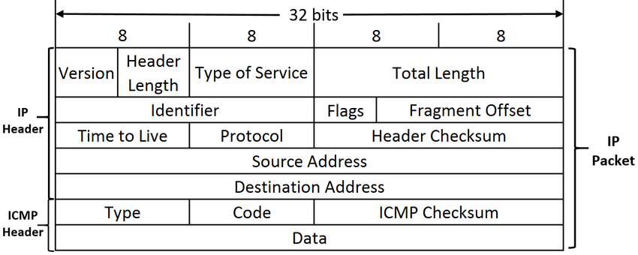
ICMP
Internet Control Message Protocol

Slide 4
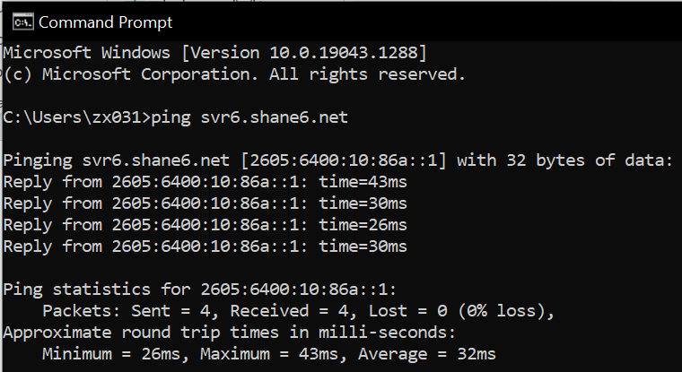
ICMP Ping-RTT (RFC 792)
Src
Dst
Echo Request
  Type 8 code 0
Echo Reply
  Type 0 code0
Q: What is the drawback of synchronized ping?
t0
t1
t2

Slide 5
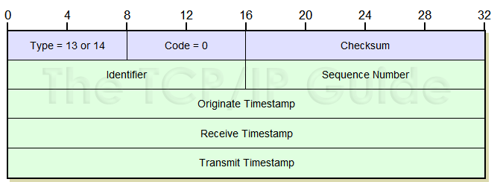
IP Option Timestamp (RFC 781, RFC 791)
Src
Dst
WAN(Wide Area Network) latency are typical tens ms
Can be used to measure the one-way delay
But require strict clock synchronization
NTP only provides 10ms error range
t0
t1
t2
t3

Slide 6
Traceroute-Path (RFC792)
Incremental TTL
Recall the homework
  Asymmetric Internet
Only one way path
TTL=2
TTL=3
TTL=1
TTL=4
TTL=5

Slide 7
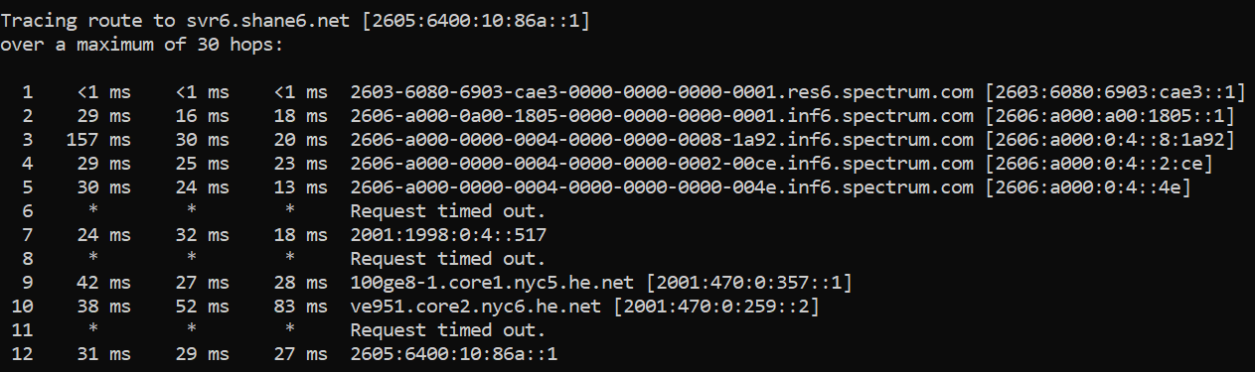
Problems with Traceroute
Missing/Unresponsive hop
Load-balance hop
Only one way path
TTL=2
TTL=3
TTL=1
TTL=4
TTL=5

Slide 8
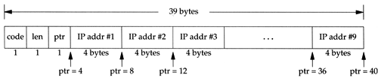
IP Route Record Option (RFC 791)
Can store 9 IP hops along the path
Both forward path and backward path
Same problem: missing hop
TTL=2
TTL=3
TTL=1
TTL=4
TTL=5

Slide 9
flattening Internet and Route Record
Goodchild et al, The Record Route Option is an Option! [IMC 2017]
“We find that 75% of addresses that respond to ping without RR also respond to ping with RR, and 66% of these RR-responsive addresses are within the nine-hop limit of at least one vantage point.”

Slide 10
Other Packets
DNS A/AAAA/CNAME
  Send DNS from multiple locations
  We see it later today
DNS CHAOS * RFC 4892
Diagnostic Text informaiton
especially useful for anycast network
  server.id/hostname.bind

Slide 11
Anycast Catchment Measurement with DNS
How to measure the catchment of an anycast network?
  Use DNS Server log
  DNS CHAOS Query
    dig +short @f.root-servers.net hostname.bind. ch txt
    "pao1b.f.root-servers.org“
    Palo Alto
    Site and service id

Slide 12
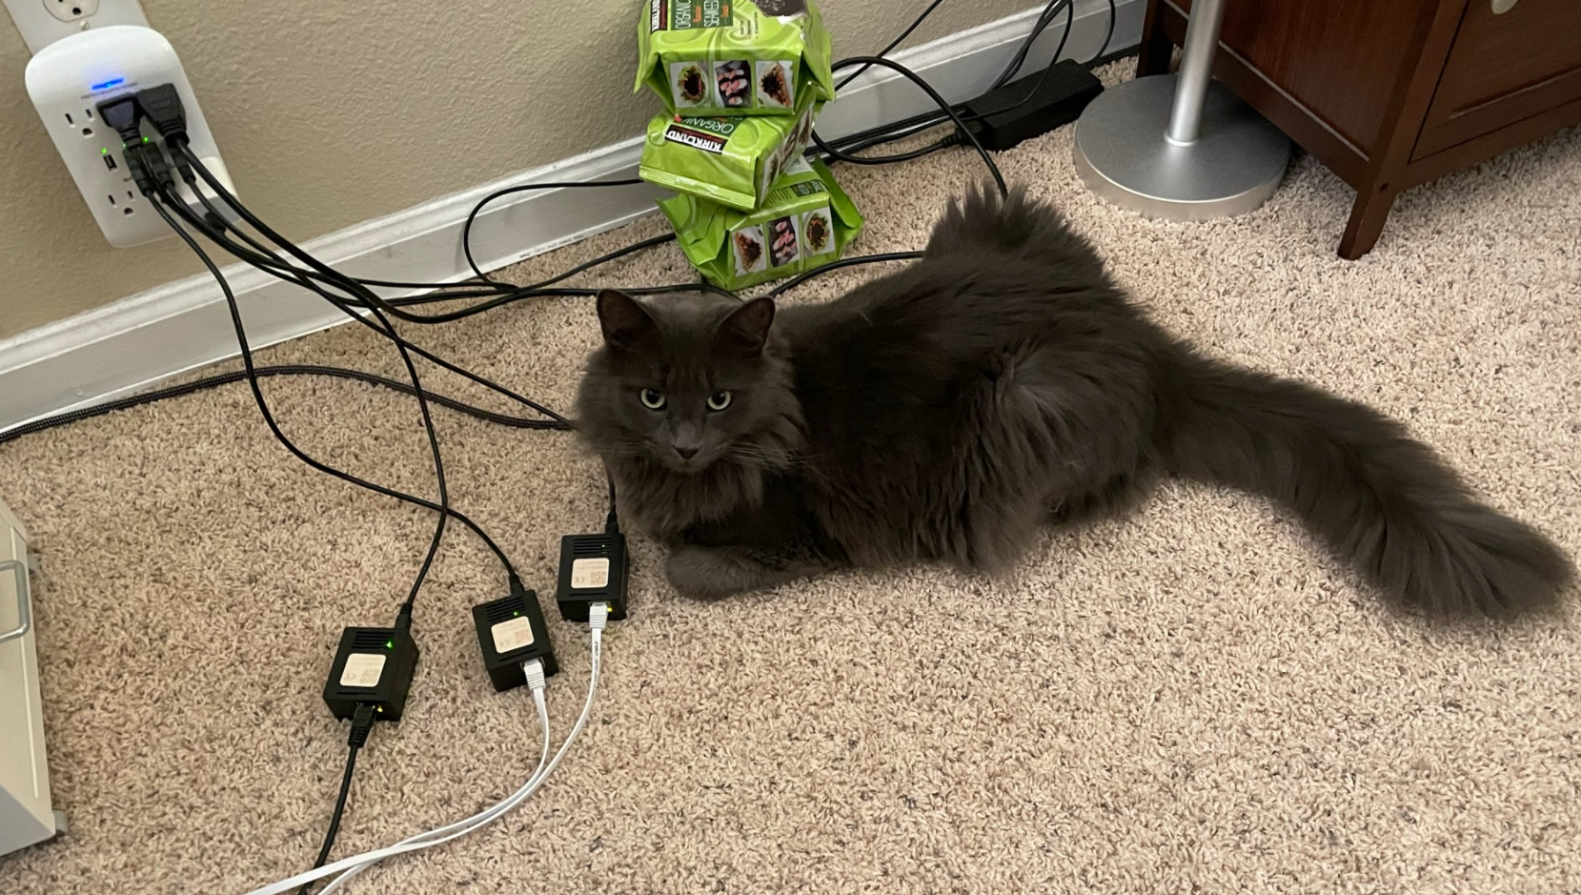
Vantage Points
RIPE Atlas Probes

Slide 13

PlanetLab
Led by Princeton University and UCB
PlanetLab was a global research network that supported the creation of new network services. Since first coming on-line in mid-2002, over 9,000 researchers at Universities and research labs around the world used PlanetLab to develop technologies for distributed storage, content distribution, peer-to-peer systems, distributed hash tables, query processing, and network telemetry.

Slide 14
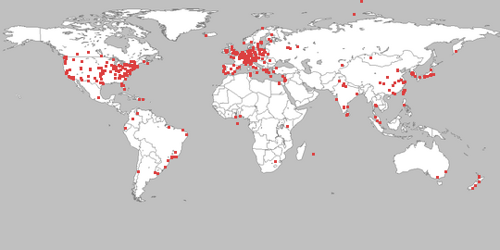
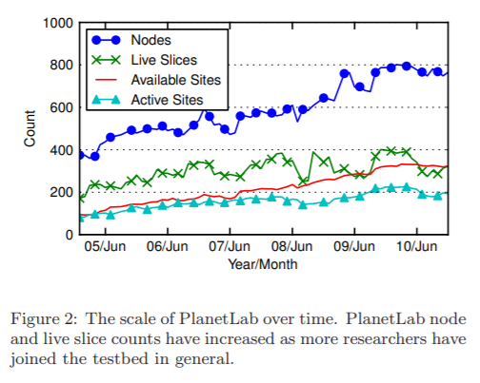
A global platform
Active sites reached around 200 at 2010
But only around 40 in the end
*Mostly deployed in educational network
Kim et al, Understanding and Characterizing PlanetLab Resource Usage for Federated Network Testbeds [IMC 11]

Slide 15
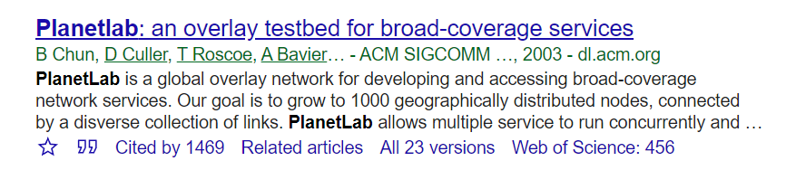
Related research
Measurement:
  RTT
  Connectivity
Distributed service evaluation
  CDN
  P2P

Slide 16
Decommissioned last year

Slide 17

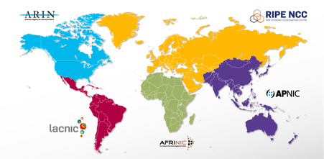
RIPE Atlas
“RIPE NCC is building the largest Internet measurement network ever made. RIPE Atlas employs a global network of probes that measure Internet connectivity and reachability, providing an unprecedented understanding of the state of the Internet in real time.”

Slide 18
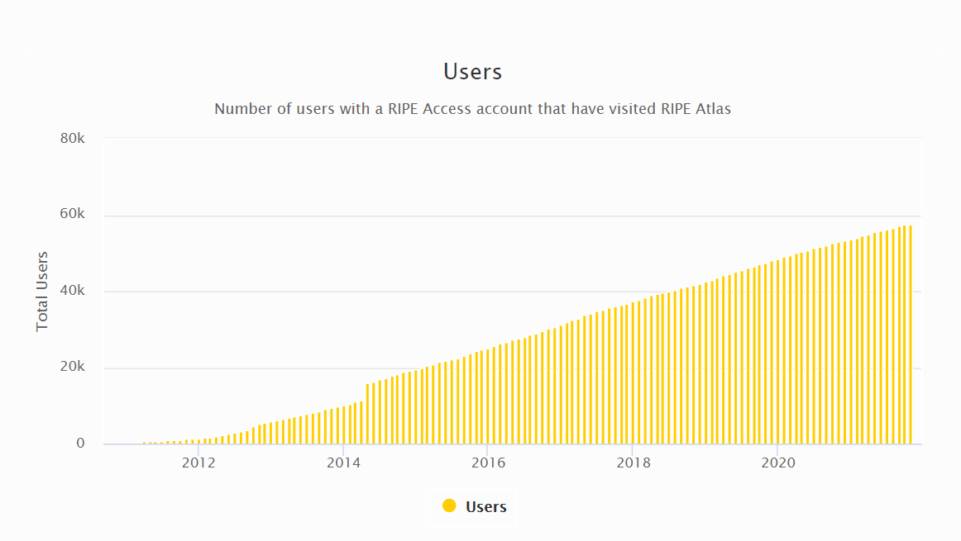
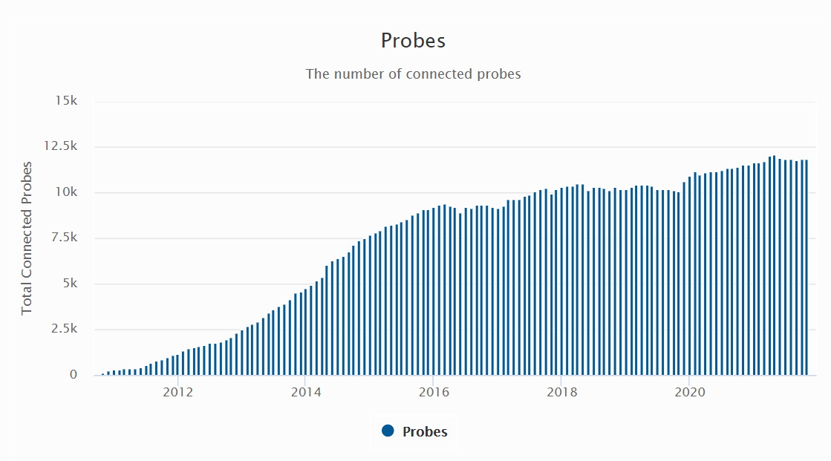
RIPE Atlas Scale
More than 10k probes cover various networks
  Submarine cable
  Seattleite network
  Cellular network

Slide 19
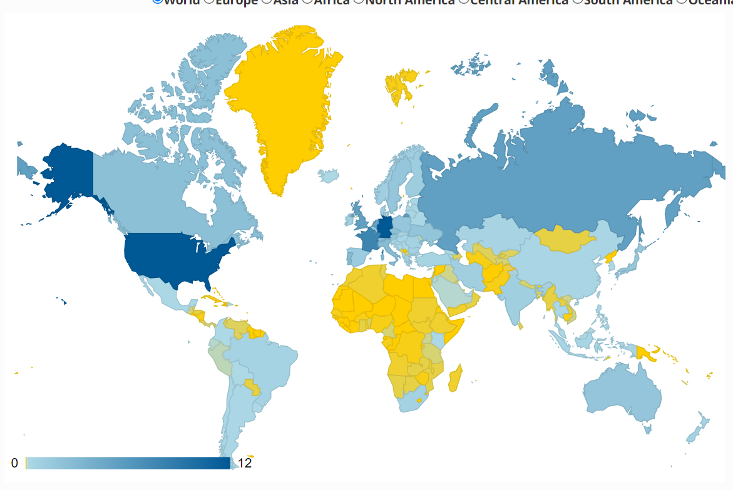
RIPE Atlas Coverage
Shows the percentage of the coverage
Germany has more probes that U.S.
*Densely distributed in EU and NA

Slide 20
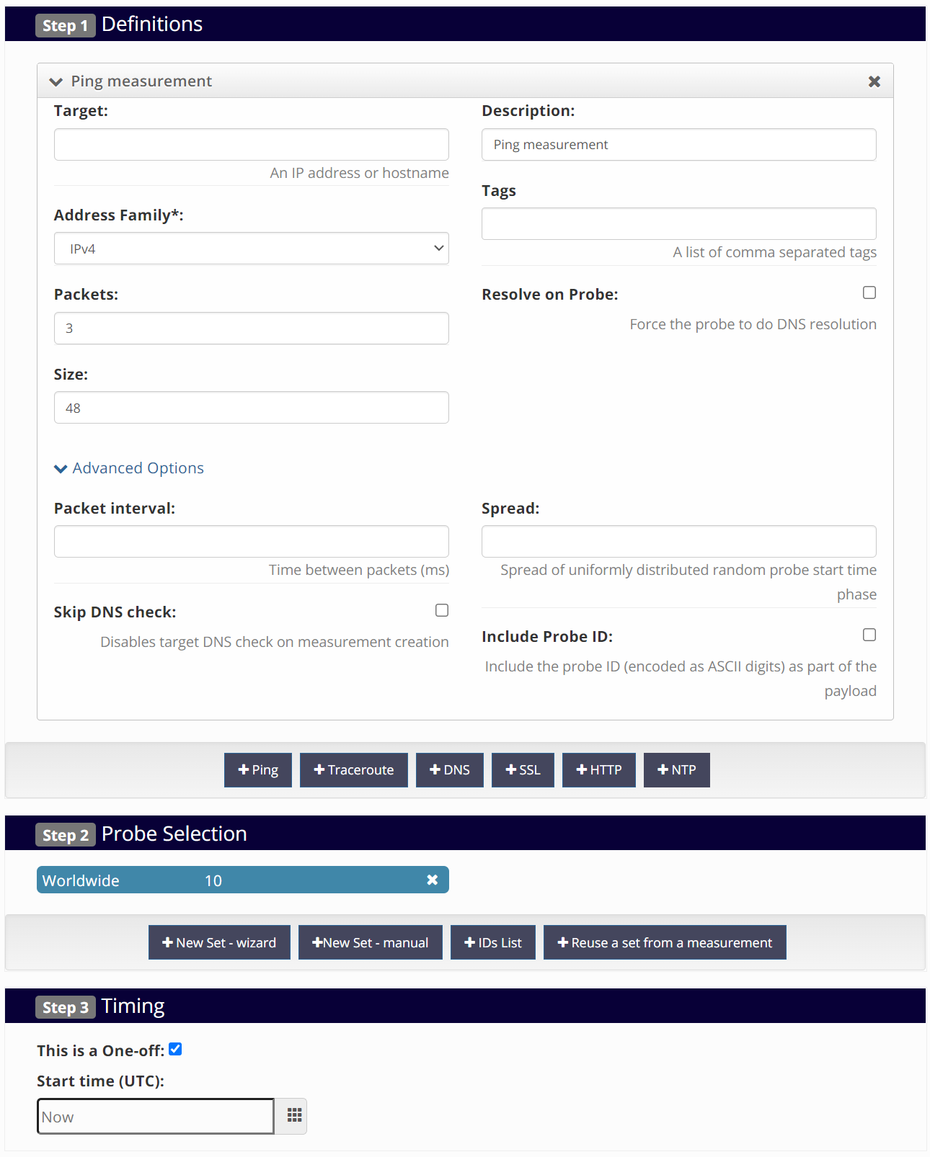
RIPE Atlas Ping
Specify the target
And ping parameters
  Interval (ICMP firewall rate limiting)
  Spread
  Use Local DNS?

Slide 21
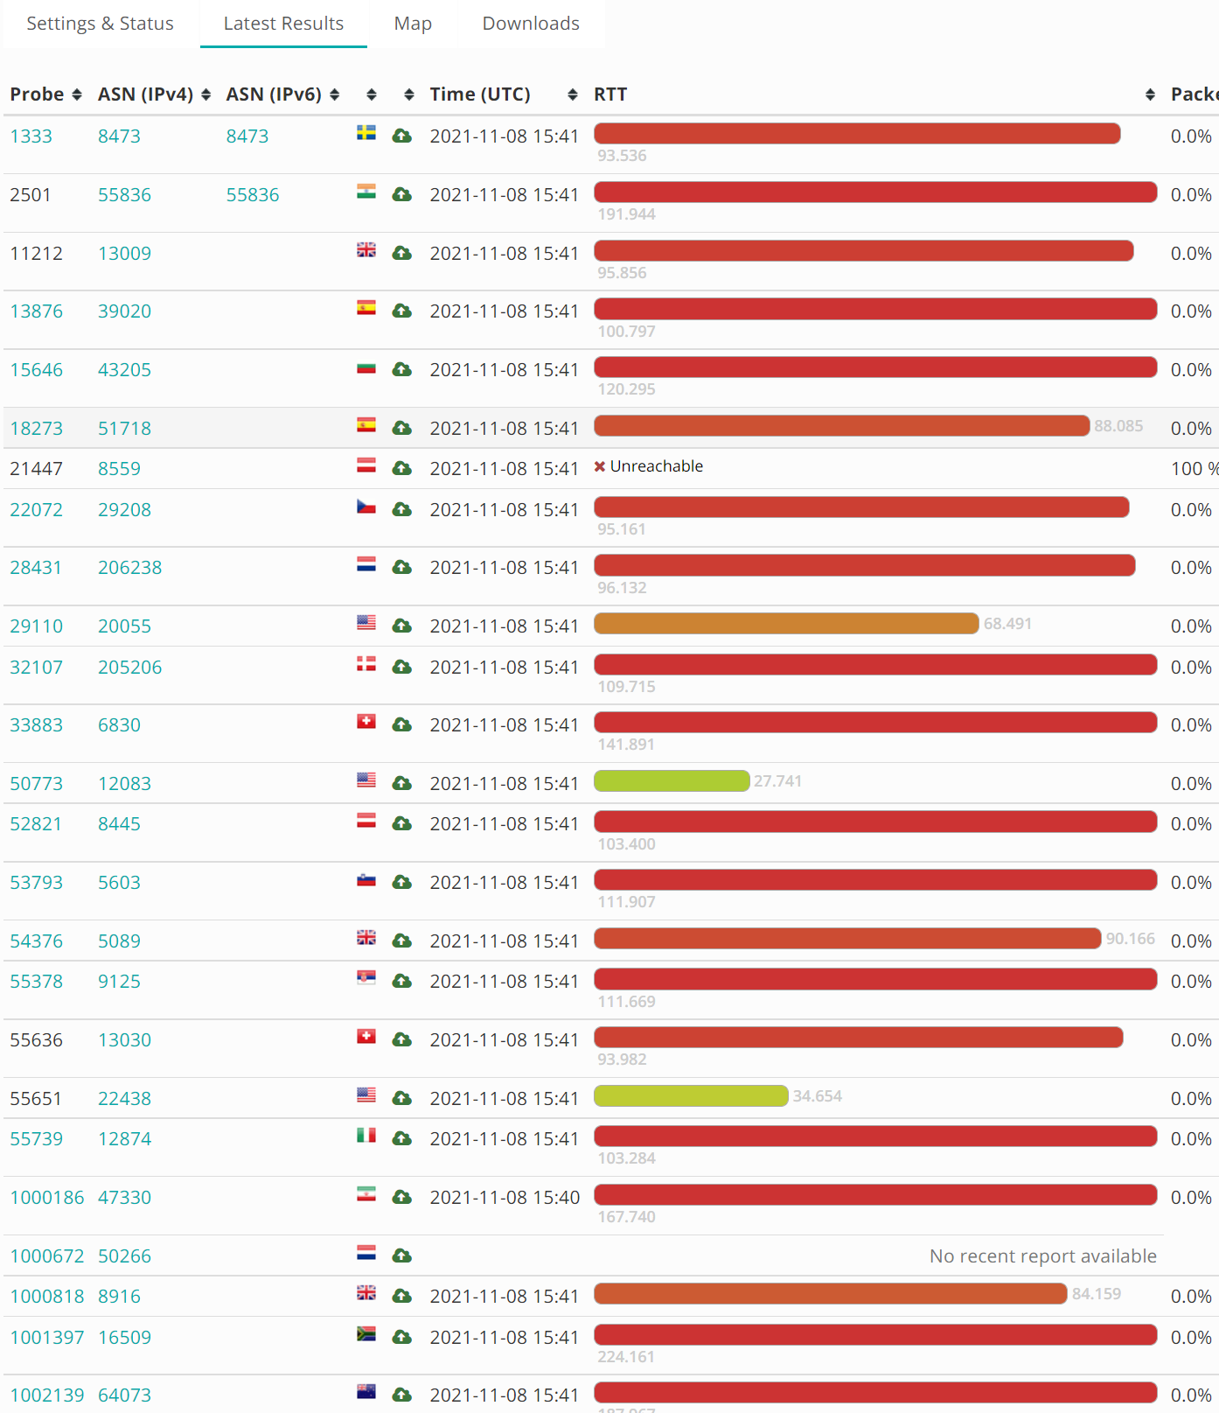
RIPE Atlas Ping result
https://atlas.ripe.net/measurements/33232479/#general
Ping to ec2-35-153-0-3.compute-1.amazonaws.com with several global probes
Better find a good CDN

Slide 22
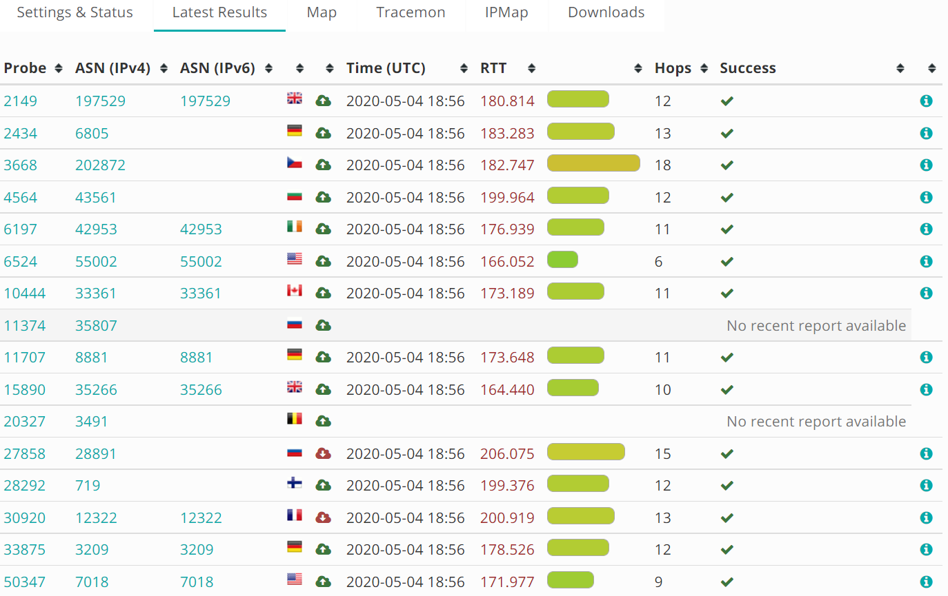
RIPE Atlas Traceroute
Tell you the path from probes to the target
Connectivity information rather than just RTT

Slide 23
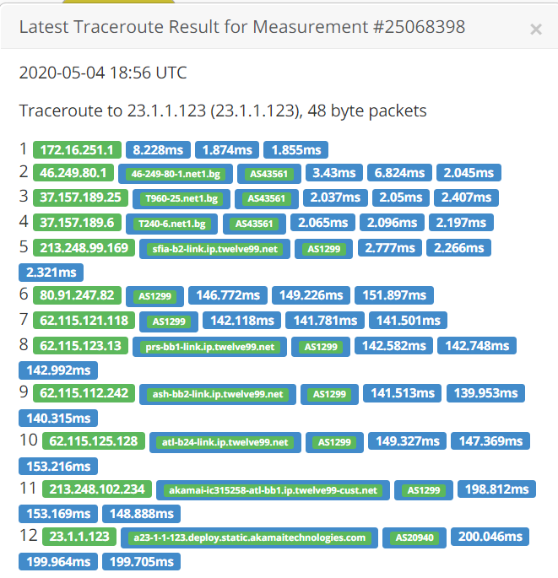
What more in trace?
Hop-wise performance
AS path
Geographical info
  rDNS

Slide 24
RIPE Atlas DNS CHAOS
dig @199.7.91.13 CH TXT hostname.bind. chaos
;; Warning, extra class option
; <<>> DiG 9.11.3-1ubuntu1.9-Ubuntu <<>> @199.7.91.13 CH TXT hostname.bind. chaos
; (1 server found)
;; global options: +cmd
;; Got answer:
;; ->>HEADER<<- opcode: QUERY, status: NOERROR, id: 14509
;; flags: qr rd; QUERY: 1, ANSWER: 1, AUTHORITY: 0, ADDITIONAL: 1
;; WARNING: recursion requested but not available
;; OPT PSEUDOSECTION:
; EDNS: version: 0, flags:; udp: 1450
;; QUESTION SECTION:
;hostname.bind. CH TXT
;; ANSWER SECTION:
hostname.bind. 0 CH TXT "abva1.droot.maxgigapop.net"
;; Query time: 12 msec
;; SERVER: 199.7.91.13#53(199.7.91.13)
;; WHEN: Fri Oct 18 14:39:05 EDT 2019
;; MSG SIZE rcvd: 81

Slide 25

RouteViews
Led by University of Oregon
BGP feeds to public
39 collectors peered with more than 200 routers

Slide 26
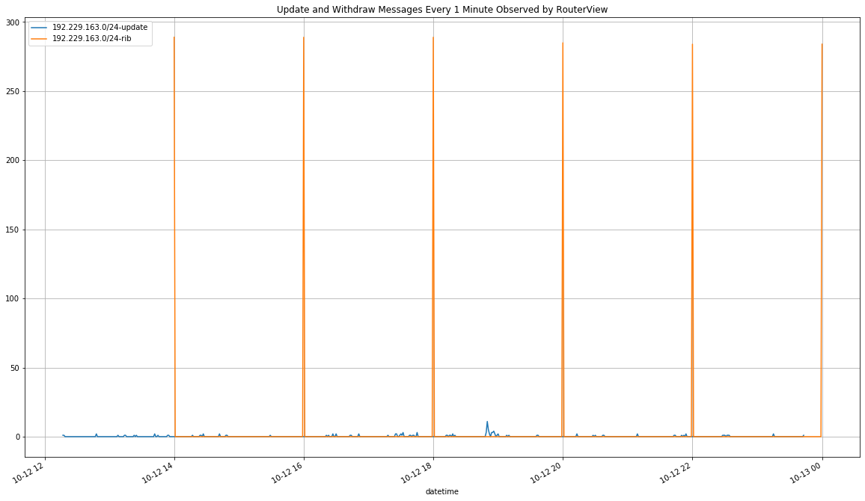
BGP feeds Record
Contain RIB (Routing Information Base) and update information
RIB dump every 2 hours, real-time update

Slide 27
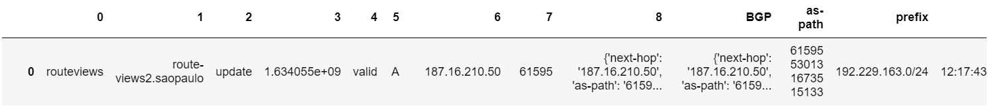
{'next-hop': '187.16.210.50', 'as-path': '61595 53013 16735 15133', 'communities': set(), 'prefix': '192.229.163.0/24'}

Slide 28
Other Measurement ?
Akamai Ping points
  Bunch of anchors around the world
  Regularly aggregate the crucial Internet intersection routers
  Used for the global network performance evaluation

Slide 29
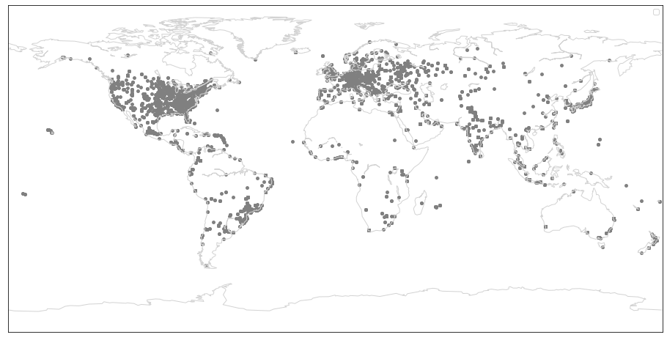
Both traffic concentration
And geographical distribution
Around 22k routers

Slide 30
Service Log
Microsoft CDN backend
  Customer IP, RTT (TCP), Site
Can tell the catchment passively

Slide 31
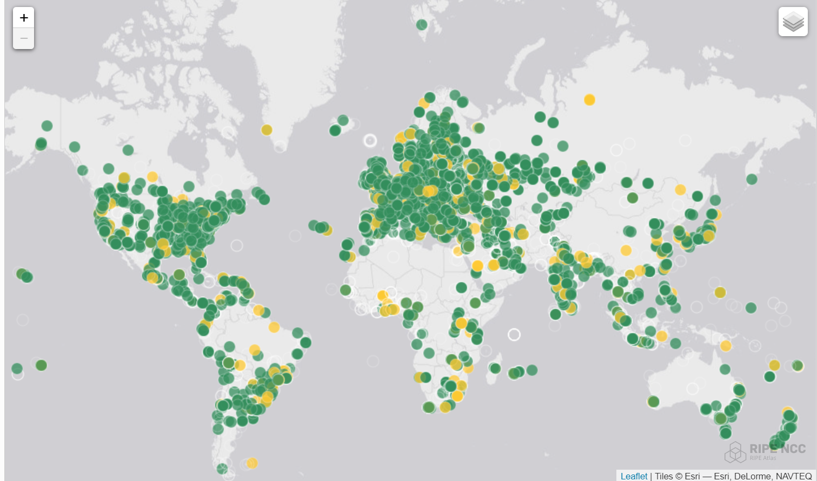
One more problem
Both heavily distributed in EU and NA

Slide 32
Bias
Optimize for global performance with RIPE Atlas
Optimize for EU+NA performance

Slide 33
How to resolve the Bias
Sampling
Comparison in the same partition
Weighted with the traffic volume

Slide 34
What can we do with measurement?
Evaluate the deployment
Find the problem
Propose a solution

Slide 35
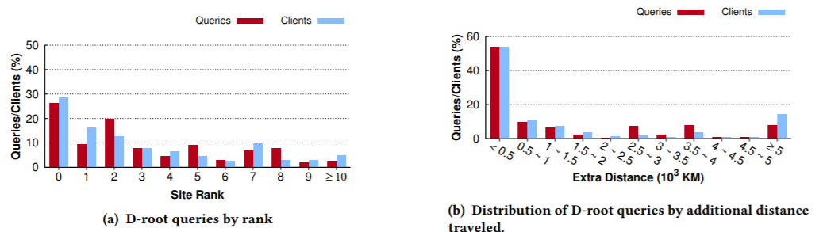
D-root measurement
Li et al, Internet anycast: performance, problems, & potential [SIGCOMM 2018]
Less than 30% of clients were routed to the optimal site
“Over 1/3rd of the queries travel over 1000 km more than minimal, and over 8.0% travel more 5000 km extra”

Slide 36

D-root problem
Anycast Site B
D-root name server has 168 sites
More sites deployed, more routes available to the clients
BGP can not break the tie wisely because BGP is performance agnostic
Announce
23.1.0.0/24
Announce
23.1.0.0/24
Announce
23.1.0.0/24
A’s catchment
C’s catchment
B’s catchment

Slide 37
D-root solution: Geographical Hints with BGP
Use Community Number (Key:Value like)
  16bit:16bit
  First 16bit usually is the AS number
  Last 16bit 7bit(Latitude) + 9bit(Longitude)
Each Router Chooses the Nearest path based on:
  BGP’s geographical hits and
  Router’s geographical location

Slide 38
Microsoft CDN Deployment Evaluation
Calder et al, Analyzing the performance of an anycast cdn [IMC2015]
Dataset:
  Passive Server Logs
  Active JS Beacon on webpage

Slide 39
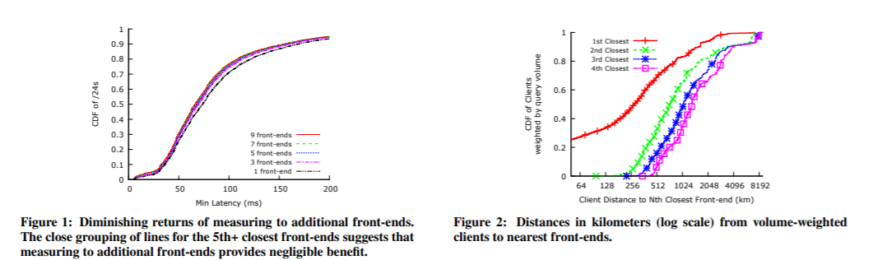
Measurement
The labeled Nth line includes latency measurements from the nearest N front-ends to the LDNS.
“Fig2 shows the distance from clients to nearest front-ends, weighted by client Bing query volumes. The median distance of the nearest front-end is 280 km, of the second nearest is 700 km, and of fourth nearest is 1300 km.”

Slide 40
Conclusion
“We find that anycast usually performs well despite the lack of precise control but that it directs roughly 20% of clients to a suboptimal front-end.”
Why different conclusion from D-root work?
Koch et al, Anycast In context: a tale of two systems [SIGCOMM 2021]

Slide 41
More than RTT and Internet
Security and Privacy Related Measurement

Slide 42
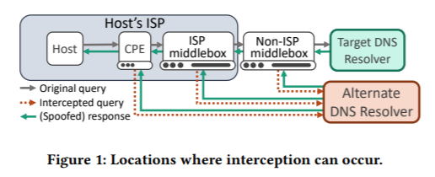
DNS interception
Randall et al, Home is Where the Hijacking is: Understanding DNS Interception by Residential Routers [IMC 2021]

Slide 43
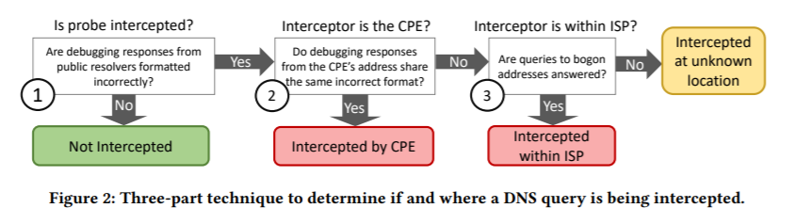
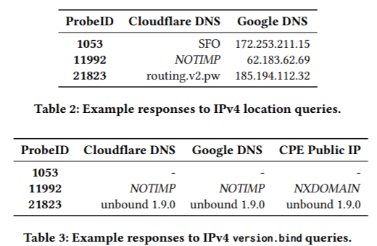
Methdology
Use location query from RIPE Atlas to detect the DNS Interception
  Cloudflare DNS (CH)
  Google DNS (TXT)
  Quad9 (CH)
  OpenDNS (TXT)

Slide 44
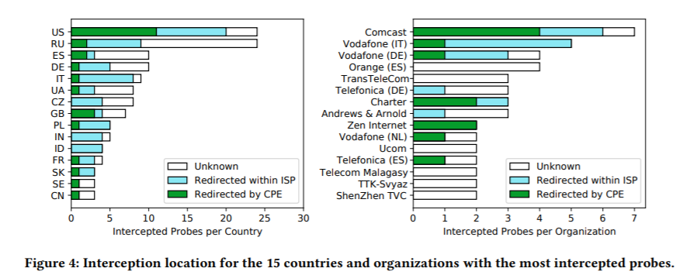
Findings
CPE-based transparent interception constitues a signifiant fraction

Slide 45
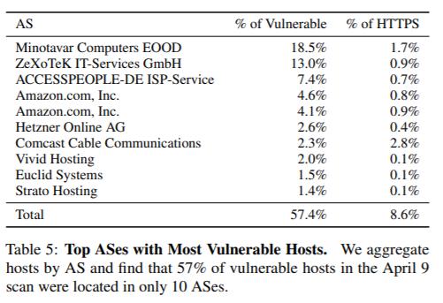
Heartbleed Measurement
Durumeric et al, The Matter of Heartbleed [IMC 2014]
Use ZMap to send Heartbeat requests with no payload nor padding, and the length field set to zero

