Slide 1
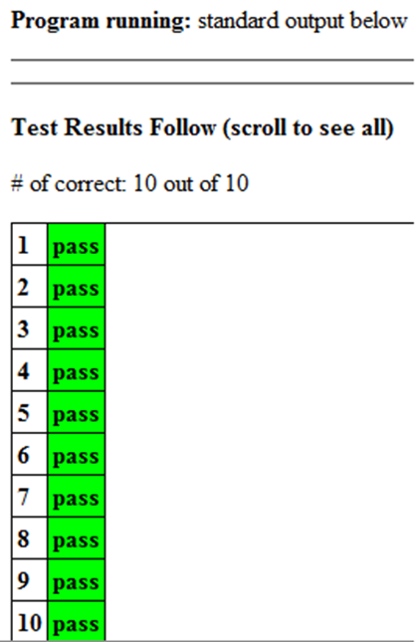
CompSci 100e Program Design and Analysis II
January 18, 2011
Prof. Rodger

Slide 2
Announcements
Lab 0 was to get Eclipse/Ambient running
Lab 1 (Jan 21/24) – APTs
APT Assignment out (do 7 APTs)
2 done in class, 2 in lab, 3 on your own
Submit all 7 together one Java Project by Jan 25
Consulting hours starting soon…..

Slide 3
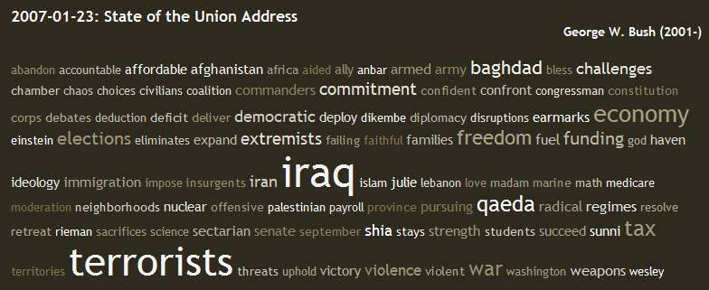
Visualizing Text
Text Cloud aka Tag Cloud?
Number of occurrences/emphasis indicated by size of word
Great visual/statistic: http://chir.ag/phernalia/preztags/
http://www.nytimes.com/gst/mostsearched.html?period=30&format=tagcloud
What information is stored in the URL of the NYTimes site above?

Slide 4
Lab 0: Text Clouds
Point – To install Eclipse, Ambient, Java
Text clouds: A simple yet powerful idea
Visualization of most frequently occurring words within some body of text
Color or font size indicates word frequency
What is involved with generating text clouds?
Steps? Issues?
See SimpleWordCount.java and SimpleCloudMaker.java

Slide 5
Problem Solving and Programming
How many words are in a file?
What’s a word?
What’s a file?
How do we solve this: simply, quickly, …?
What’s the best we can do? Constraints?
How many different/unique words are in a file?
How is this related to previous task?
How many words do two files have in common?
Spell-checking, stemming, Did you mean ..?
How many codons does DNA have in common?

Slide 6
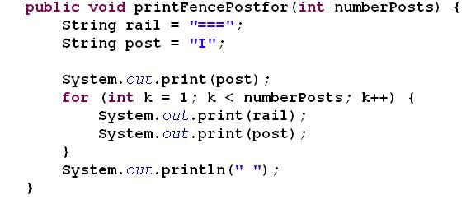
Java - for loop

Slide 7
Array
Declare and initialize an array of integers
Set it to these values:
Access item in slot 6 in the array
Array is fixed size. The size is:

Slide 8
Example
for (int k=0; k<values.length; k++)
{
values[k] = values[k] + values[k-1];
}
What does this do?
Is it correct?

Slide 9
Classwork
SimpleWordCount.java

Slide 10
Reading from Files
import java.io.File;
Declare a file
File fileOfCats = new File(“cats.txt”);
Use file – pass it as an argument to a Scanner
Scanner in = new Scanner(fileOfCats);

Slide 11
Using Scanner class to read
Import java.util.Scanner;
Declare Scanner and bind it to a file (last slide)
Make sure there is input still to read
while (in.hasNext())
Read next line
String line = in.nextLine();
Read next word/token
String word = in.next();
Read next integer
String word = in.nextInt();

Slide 12
What will we use Eclipse for in CompSci 100e?
Use to write complete java programs
Access libraries
Use as an editor to write text files
README – gives info about the program
Use to write simple methods, then test with APT

Slide 13
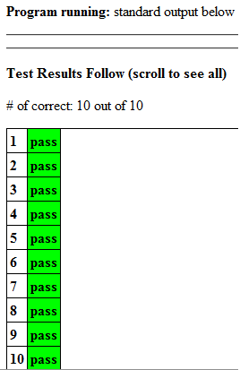
APT – Algorithmic Program Testing
Not a complete java program
No main method
Focus on and solve one small problem
Rich set of data for testing
Use Eclipse editor for APT, but cannot run program! Why?
Goal: all green

Slide 14
Solve APT
DNAreverse

Slide 15
Strings
String
a sequence of characters
objects of the String class
String constants: "Hello, World!"
All Strings are constants don’t use “new” w/ String
String variables: String message = "Hello, World!";
String length: int n = message.length();
Empty string: ""

Slide 16
String
Concatenating Strings
Use the + operator:
String name = "Dave";
String message = "Hello, " + name;
Automatic type conversion
String a = "Agent00"; int n = 7;
String bond = a + n;
// bond is "Agent007"

Slide 17
What can you do with strings?
Look at API
int length()
Returns length of string
String substring(int beginIndex)
Returns substring from beginIndex to end of string
String substring(int beginIndex, int endIndex)
Returns substring from beginIndex to endIndex -1

Slide 18
Example
String one = “ferriswheel”;
String two = one.substring(5);
String three = one.substring(4,6);
What are two and three?

Slide 19
Finding substrings in strings
int indexOf(String str)
Returns first position of str in the string
First position in a string is 0
int indexOf(String str, int fromIndex)
Returns first position of str starting at fromIndex

Slide 20
Example
String one = “Cotton Candy”;
String two = one.substring(indexOf(“Can”),
indexOf(“Can”)+4);
What is two?

Slide 21
Strings
String word = “CompSci 100e”;
word.length() – returns length of string
word.toCharArray() – returns string as an array of characters
word.charAt(5) – returns character at position 5
Loop over characters in a string
for (char ch: word.toCharArray())
{
}

Slide 22
Solve APT
ClassScores

