Slide 1
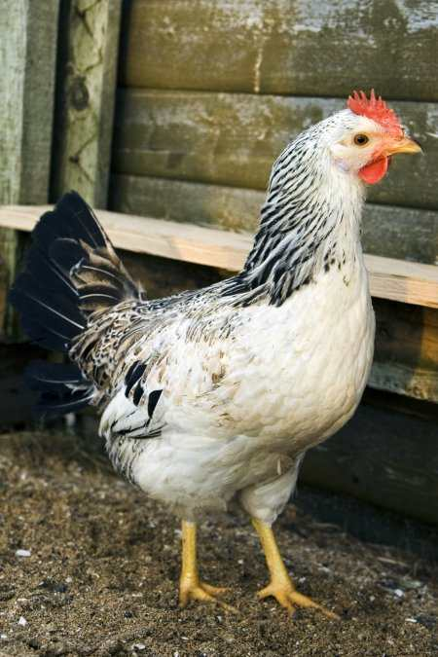
CompSci 100e Program Design and Analysis II
January 27, 2011
Prof. Rodger

Slide 2
Announcements
Apt-0127 due tonight
Apt-0201 due Tuesday
Lab 02 Friday and Monday
Thesaurus APT

Slide 3
Object, Classes, Methods
Classes define
the state (data), usually private
behavior (methods) for an object, usually public
There can be many objects created based on a class.
Method – sequence of instructions that access the data of an object
Accessor – access, don’t change data
Mutator – changes the data

Slide 4
Example - class Chicken
State
weight, height, name
Behavior (methods)
Accessor methods
getWeight, getHeight, getName
Mutator methods
eat – adds weight, adds some height if under 12.0
sick – lose weight
changeName
Notes:
What data do the mutator methods change?

Slide 5
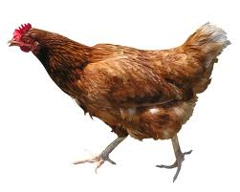
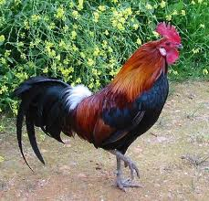
Constructing Objects - new
Create three chickens
“Fred”, weight 2.0, height 3.8
“Sallie Mae”, weight 3.0, height 4.5
“Momma”, weight 6.0, height 8.3
Use Chicken constructor
Chicken one = new Chicken(2.0, 3.8, "Fred");
Chicken two = new Chicken(3.0, 4.5, "Sallie Mae");
Chicken three = new Chicken(6.0, 8.3, "Momma");

Slide 6
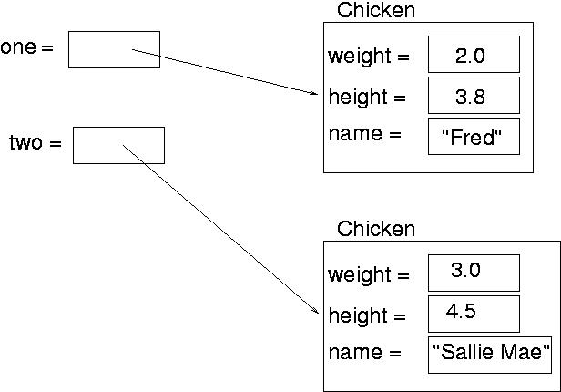
Object References
Variable of type object – value is memory location

Slide 7
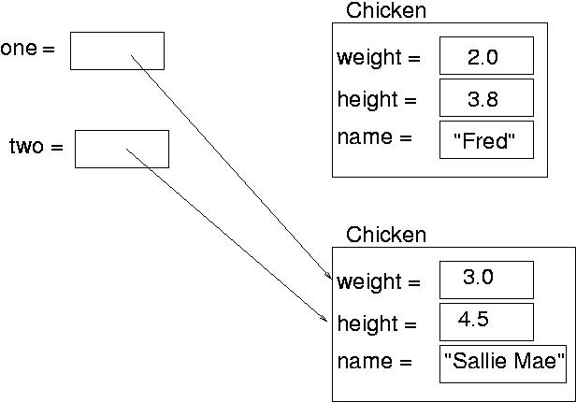
one = two;
Now they reference the same object
System.out.println(one.getName() + “ has “ + one.getName().length() + “ letters.”);
System.out.println(two.getName() + “ has “ + two.getName().length() + “ letters.”);

Slide 8
Parts of a Class
State
Data
Constructors
Initialize state when object is created
Accessor methods
Accessing data
Mutator methods
Modify data – change the state

Slide 9
Class Example
Chicken class – Chicken.java
Defines state and behavior of Chicken
Farm class – Farm.java
Creates Chickens with “new”
Invokes the Chicken constructor
Calls chicken methods on Chickens to access or change state

Slide 10
What happens here? How many Chickens are constructed?
Chicken x, y;
Chicken z = new Chicken(1.0, 2.1, “baby”);
x = new Chicken(10.3, 8.1, “ed”);
y = new Chicken(6.2, 6.3, “mo”);
Chicken temp = x;
x = y;
y = temp;
z = x;

Slide 11
Generating Random Numbers
java.util.Random class in Java library
Random generator = new Random();
Methods:
int nextInt(int n) - returns integer from 0 up to but not including n
double nextDouble() – returns double between 0.0 and 1.0
int num = generator.nextInt(10);

Slide 12
Examples
Go over Chicken.java, Farm.java
Go over Skier.java, SkiRace.java, RunSkiRace.java

