Slide 1
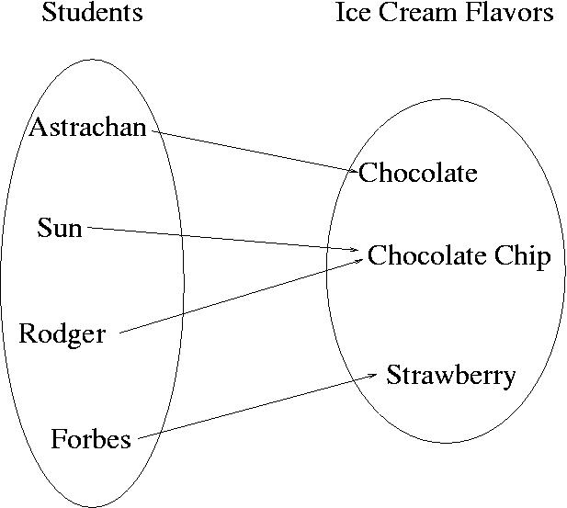
CompSci 100e Program Design and Analysis II
February 1, 2011
Prof. Rodger

Slide 2
Announcements
APT 0201 due today!
Assignment Prestidigitation due 2/3

Slide 3
Maps
Maps are another way of organizing data
Keys and Values
Each key maps to a value
Some keys can map to the same value
Can change the value a key maps to

Slide 4
Example
Each student could be mapped to their favorite ice cream flavor

Slide 5
Implementing a Map
We will use TreeMap in Java
Will also use HashMap, another implementation
Example:
TreeMap<String, String> fav = new TreeMap<String,String>();
Keys map to values

Slide 6
To use a Map
Put in a key and its value
fav.put(“Forbes”, “Strawberry”);
Get a value for a key
val = fav.get(“Forbes”);
Change value for key
fav.put(“Astrachan”, “Coffee Mocha”);
Get all the keys as a set
Treeset<String> ky = fav.keyset();

Slide 7
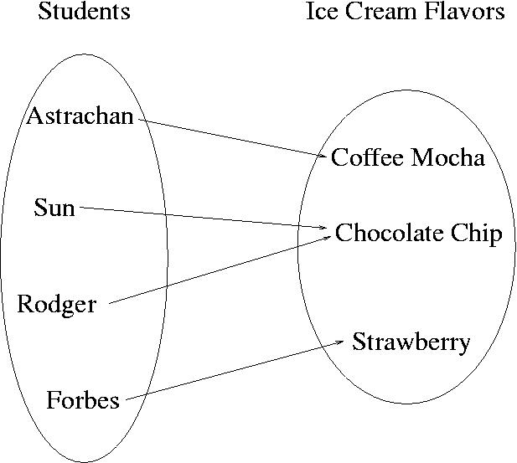
Change Astrachan’s value

Slide 8
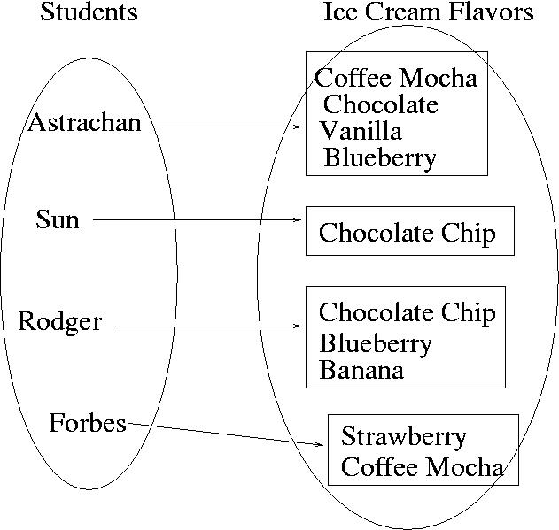
Value could be a set

Slide 9
Let’s go back to ClassScores
Find all the modes in an array of ints
This time solve it using a map

