Slide 1
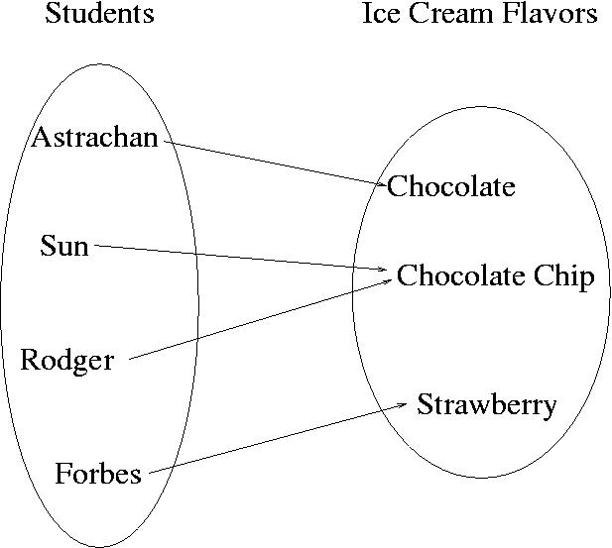
CompSci 100e
Program Design and Analysis II
February 3, 2011
Prof. Rodger

Slide 2
Announcements
APT 0210 due next Thursday!
Assignment Prestidigitation due 2/8

Slide 3
Debugging
What can you do when your APT/program doesn’t work?
  Consulting hours
  Get Sleep – rest those eyes
  Debug
    Add print statements
      APTs – output right away “Starting new problem”
      Add in focused output (inside a loop (if k=mulitple of 10, print)
    Make it simpler – add a main and test with smallest case it doesn’t work for
    Trace simple case by hand
    Test each method with input and output

Slide 4
Assignment Prestidigitation – now due Tuesday, Feb 8
Getting Started – no snarf
Create Java Project
  Create Class file
Use previous code – cut and paste
  Read in input from file
Copy data files

Slide 5
Sets - Operations
What operations can you do on a set?
Classwork 3

Slide 6
Maps
Maps are another way of organizing data
Keys and Values
  Each key maps to a value
  Some keys can map to the same value
  Can change the value a key maps to

Slide 7
Example
Each student could be mapped to their favorite ice cream flavor

Slide 8
Implementing a Map
We will use TreeMap in Java
  Will also use HashMap, another implementation
Example:
TreeMap<String, String> fav = new TreeMap<String,String>();
Keys map to values

Slide 9
To use a Map
Put in a key and its value
fav.put(“Forbes”, “Strawberry”);
Get a value for a key
val = fav.get(“Forbes”);
Change value for key
fav.put(“Astrachan”, “Coffee Mocha”);
Get all the keys as a set
Treeset<String> ky = fav.keyset();

Slide 10
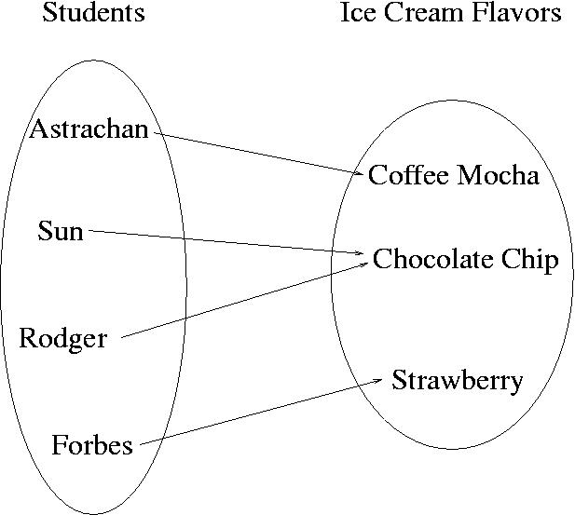
Change Astrachan’s value

Slide 11
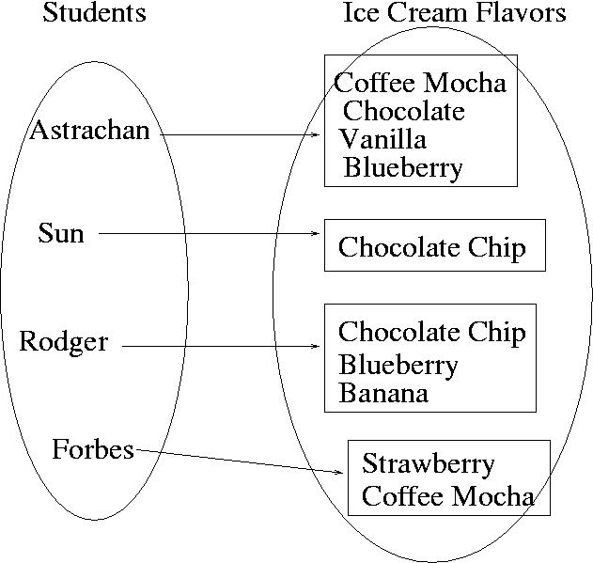
Value could be a set

Slide 12
Let’s go back to ClassScores
Find all the modes in an array of ints
This time solve it using a map

