Slide 1
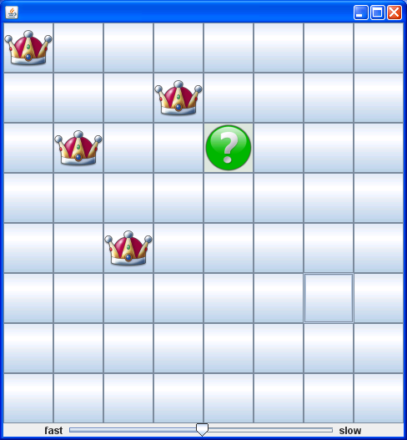
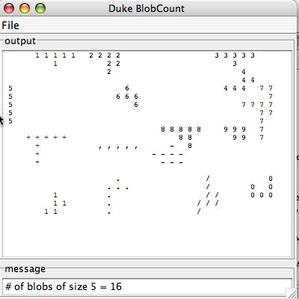
CompSci 100e
Program Design and Analysis II
March 3, 2011
Prof. Rodger

Slide 2
Announcements
Written assignment due tonight – put .pdf file in Eclipse and submit it
APTS due Tuesday after break – use recursion
No Lab Friday March 4 or Monday March 14
Today – two examples of recursion
  Blob counting
  8 Queens - backtracking

Slide 3
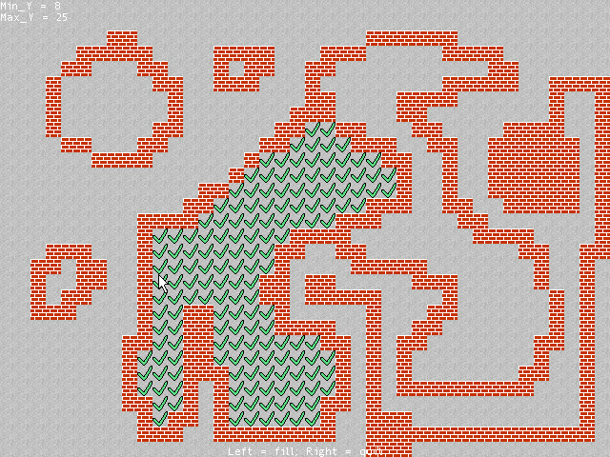

Blob Counting, Flood Fill
Flood a region with color
  Erase region, make transparent, ..
  How do find the region?
Finding regions, blobs, edges, ..
  See blob counting code
  What is a blob?
Recursion helps, but necessary?
  Performance, clarity, …
  Ease of development

Slide 4
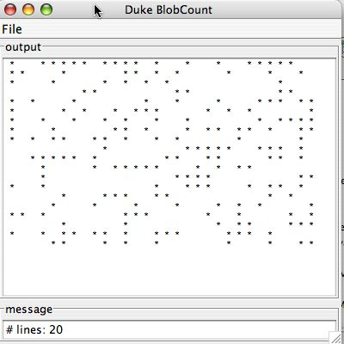
First Example - BlobCount
How do we find images? Components? Paths?
  Create information from data

Slide 5
Details and Idioms in blob code
Method blobFill has four parameters
  (row,column) of where search starts
  Character being searched for (initially * or blob)
  Character to fill with on success (e.g., count ‘2’ or ‘4’)
    Mark for visualization
    Mark to ensure we don’t search again!
If (row,column) is part of blob, count it and ask neighbors for their counts
  They’re part of blob (if never visited before)
Return total of yourself and neighbors
  Key to recursion: do one thing and ask for help

Slide 6
Blob questions
What changes if diagonal cells are adjacent?
  Conceptually and in code
How do we find blob sizes in a range?
  Not bigger than X, but between X and Y
How would we number blobs by size rather than by when they’re found?
  Do we have the tools to do this in existing code?
Can we avoid recursion and do this iteratively?

Slide 7
Second Example – 8 Queens

Slide 8
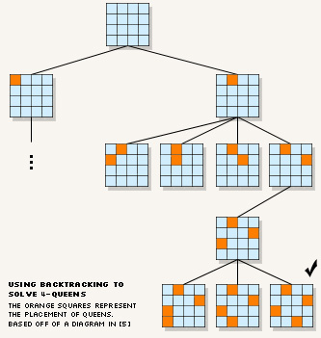


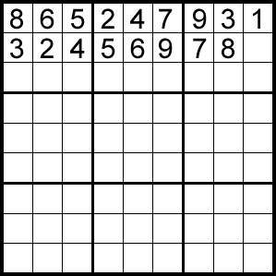
Backtracking by image search

Slide 9
Searching with no guarantees
Search for best move in automated game play
  Can we explore every move?
  Are there candidate moves ranked by “goodness”?
  Can we explore entire tree of possible moves?
Search with partial information
  Predictive texting with T9 or iTap or …
  Finding words on a Boggle board
  What numbers fit in Sudoku square
Try something, if at first you don’t succeed ….

Slide 10
Search, Backtracking,Heuristics
How do you find a needle in a haystack?
  How does a computer play chess?
  Why would you write that program?
How does Bing/Googlemap find routes from one place to another?
  Shortest path algorithms
  Longest path algorithms
Optimal algorithms and heuristic algorithms
  When is close good enough? How do measure “closeness”?
  When is optimality important, how much does it cost?

Slide 11



Classic problem: N queens
Can queens be placed on a chess board so that no queens attack each other?
  Easily place two queens
  What about 8 queens?
Make the board NxN, this is the N queens problem
  Place one queen/column
  Horiz/Vert/Diag attacks
Backtracking
  Tentative placement
  Recurse, if ok done!
  If fail, undo tentative, retry
wikipedia-n-queens

Slide 12
Backtracking idea with N queens
For each column C, tentatively place a queen
  Try first row in column C, if ok, move onto next column
    Typically “move on” is recursive
  If solved, done, otherwise try next row in column C
    Must unplace queen when failing/unwind recursion
Each column C “knows” what row R it’s on
  If first time, that’s row zero, but might be an attack
  Unwind recursion/backtrack, try “next” location
Backtracking: record an attempt go forward
  Move must be “undoable” on backtracking/unwinding

Slide 13
N queens backtracking: Queens.java
public boolean solve(int col){
if (col == mySize) return true;
// try each row until all are tried
for(int r=0; r < mySize; r++){
if (myBoard.safeToPlace(r,col)){
myBoard.setQueen(r,col,true);
if (solve(col+1)){
return true;
}
myBoard.setQueen(r,col,false);
}
}
return false;
}

Slide 14
Basic ideas in backtracking search
Enumerate all possible choices/moves
  We try these choices in order, committing to a choice
  If the choice doesn’t pan out we must undo the choice
    Backtracking step, choices must be undoable
Inherently recursive, when to stop searching?
  When all columns tried in N queens
  When we have found the exit in a maze
  When every possible moved tried in Tic-tac-toe or chess?
    Is there a difference between these games?
Summary: enumerate choices, try a choice, undo a choice, this is brute force search: try everything

Slide 15
Pruning vs. Exhaustive Search
If we consider every possible placement of 4 queens on a 4x4 board, how many are there? (N queens)
  4x4x4x4 if we don’t pay attention to any attacks
  4x3x2x1 if we avoid attacks in same row
What about if we avoid diagonal attacks?
  Pruning search space makes more search possible, still could be lots of searching to do!
Estimate how long to calculate # solutions to the N-queens problem with our Java code….

Slide 16
Queens Details
How do we know when it’s safe to place a queen?
  No queen in same row, or diagonal
  For each column, store the row that a queen is in
  See QBoard.java for details
For GUI version, we use a decorator
  The QBoardGUI is an IQueenState class and it has an IQueenState object in it
  Appears as an IQueenState to client, but uses an existing one to help do its work
  One of many object oriented design patterns, seen in Huff in the BitInputStream class

