Slide 1
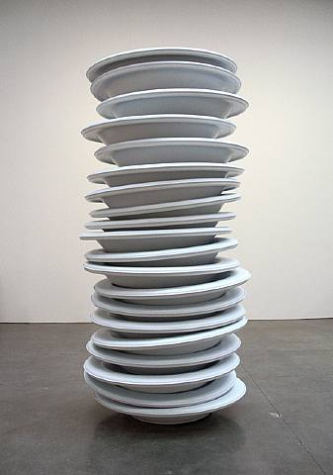
CompSci 100e Program Design and Analysis II
March 15, 2011
Prof. Rodger

Slide 2
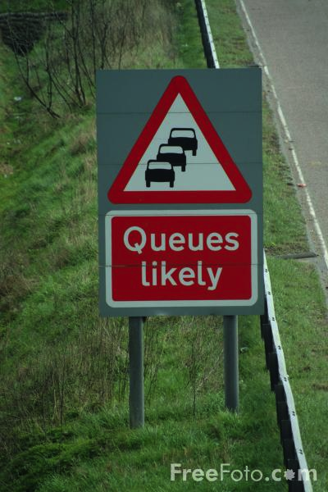
Announcements
APTs extended til 3/17 (Typing Job, Rat route hints)
New APT set out today due March 22
Today Stacks and Queues
Linear structures used in problem domains and algorithms

Slide 3
Why don't we just use arrays?
Stacks used in implementing recursion, postscript language, Java language, graph algorithms
Stacks implemented using array/ArrayList
Queues used in simulation, graph algorithms, scheduling
Queues implemented using array/LinkedList

Slide 4
Simple stack example
Stack is part of java.util.Collections hierarchy
As an ADT it's a LIFO data structure (last in, first out)
what does pop do? What does push do?
Stack<String> s = new Stack<String>();
s.push("panda");
s.push("grizzly");
s.push("brown");
System.out.println("size = "+s.size());
System.out.println(s.peek());
String str = s.pop();
System.out.println(s.peek());
System.out.println(s.pop());

Slide 5
Postfix, prefix, and infix notation
Postfix notation used in some HP calculators
No parentheses needed, precedence rules still respected
3 5 + 4 2 * 7 + 3 - 9 7 + *
Read expression
For number/operand: push
For operator: pop, pop, operate, push
See Postfix.java for example code, key ideas:
Use StringTokenizer, handy tool for parsing
Note: Exceptions thrown, what are these?
What about prefix and infix notations, advantages?

Slide 6
Interlude: Exceptions
Exceptions are raised or thrown in exceptional cases
Bad indexes, null pointers, illegal arguments, …
File not found, URL malformed, …
Runtime exceptions aren't handled or caught
Bad index in array, don't try to handle this in code
Null pointer stops your program, don't code that way!
Some exceptions are caught or rethrown
FileNotFoundException and IOException
RuntimeException extends Exception
catch not required

Slide 7
Simple queue example
Queue is part of java.util.Collections hierarchy
As an ADT it's a FIFO data structure (first in, first out)
what does add do? What does remove do?
Queue<String> s = new Queue<String>();
s.add("panda");
s.add("grizzly");
s.add("brown");
System.out.println("size = "+s.size());
System.out.println(s.peek());
String str = s.remove();
System.out.println(s.peek());
System.out.println(s.remove());

Slide 8
Analysis
Assume a Stack is implemented with an ArrayList. How are inserts and removes done?
Inserting N elements into a stack takes how long?
Removing N removes from a stack takes how long?
Assume a Queue is implemented with an ArrayList. How are inserts and removes done?
Inserting N elements into a queue takes how long?
Removing N elements from a queue takes how long?

