Slide 1
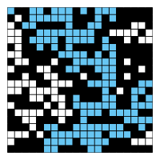
CompSci 100e Program Design and Analysis II
March 17, 2011
Prof. Rodger

Slide 2
Announcements
Apts due Tuesday March 22 – more recursion
Assignment Percolation due March 24
Talk about today and also in lab Friday-Monday

Slide 3
APTs
APT set Due Today
Talk about setting up Flood Relief
APT set due Tuesday March 22
Talk about GridGame – backtracking

Slide 4
Percolation Assignment
Read Chapter 2.4 – talks about setup
Implement DFS
Read about Union-Find - described on other documents – compare different ones
Visualizer – Look at API for princeton.StdDraw
See Wayne-Sedgewick notes

