Slide 1
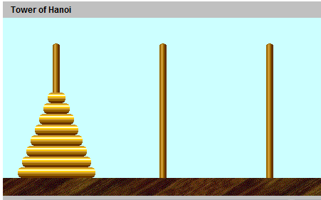
CompSci 100e Program Design and Analysis II
April 12, 2011
Prof. Rodger
“M”
“P”
“llama”
“giraffe”
“tiger”
“elephant”
“jaguar”
“monkey”

Slide 2
Announcements
APT is due tonight – WordLadder
Huffman new assignment out – due Apr 21
You can work with one other person – strongly advised!
Both people submit a README – include partner’s name
one person submits code with both names
Test 2 is Thursday April 14
My office hours this Wednesday shifted earlier,
Wed Apr 13 from 11:30-1:45pm

Slide 3
Test 2 Review – April 14
Logistics
Closed Book, closed notes
Except can bring 4 sheets of paper written on front/back
Test 2 topics
Topics from test 1 (Strings, sets, maps, hashing, arrays/ArrayList)
Focus: Trees, linked lists, stacks, queues, priority queues, heap, analysis, recursion, huffman tree

Slide 4
Ways to Study
Practice with old exams for 100 or 100E
Practice writing code on paper
Look at Lecture notes, classwork, reading, assignments
Consulting hours or office hours

