Slide 1
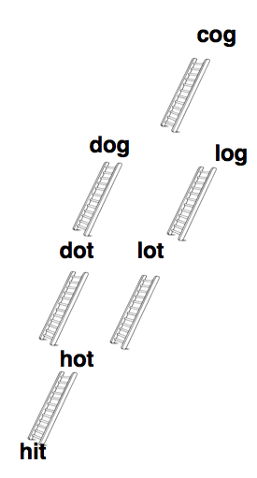
CompSci 100e Program Design and Analysis II
April 19, 2011
Prof. Rodger

Slide 2
Announcements
Huffman due Thursday, April 21
APTS (3) due Tuesday, April 26
Talk about AllWordLadders APT today, Internet APT next time
Can do extra APTs
Extra credit assignments due Wed. April 27
NOTE: NO LATE ASSIGNMENTS accepted after Wed, April 27 11:59pm!!!

Slide 3
Word Ladder APT
From->[words]->to
From hit to cog via [hot,dot,lot,dog,log]
What words reachable from 'from'?
Repeat until we get to 'cog'
Problem: reachable from 'dot'
Why not include 'hot'?
Don't re-use words
Algorithm:
Find all words 1-away
From each n-away find (n+1)-away

Slide 4
Digression: word ladders
How many ladders from cart to dire as shown?
Enqueue dare more than once?
Downside? Alternative?
We want to know number of ladders that end at W.
What do we know initially?
When we put something on the queue, what do we know?
How do we keep track?
Initialize and update per-word statistics
care
dare
cart
tart
dire
dart
dirt

Slide 5
Word Ladder: more details
care
dare
hire
here
cart
tart
dire
wire
were
pere
dart
dirt
mire
mere
# ladders that end at dare
At each word W
Ladder length to W
Calculable from??
Maps? Queue? Sets?

Slide 6
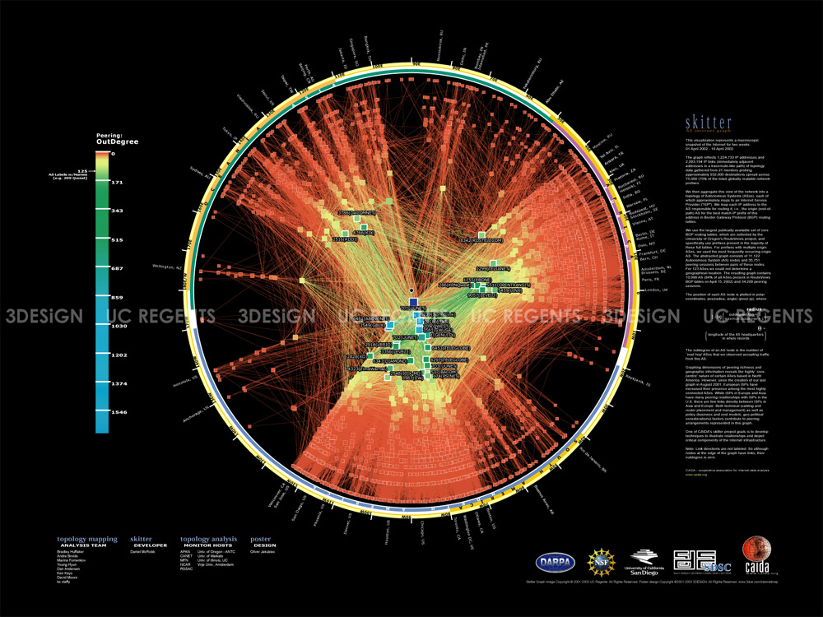
Graphs, the Internet, and Everything
http://www.caida.org/

Slide 7
Graphs: Structures and Algorithms
Mapquest, Tomtom, Garmin, Googlemap
How do you get from here to there?
What's a route? How is this known?
What about The Oracle of Bacon, Erdos Numbers, and Word Ladders?
All can be modeled using graphs
What kind of connectivity does each concept model?
Graphs are everywhere in the world (of algorithms?)
What is a graph? Algorithms on graphs?
Graph representation?

Slide 8
Sir Tim Berners-Lee
I want you to realize that, if you can imagine a computer doing something, you can program a computer to do that.
Unbounded opportunity... limited only by your imagination. And a couple of laws of physics.
TCP/IP, HTTP
How, Why, What, When?

Slide 9
Vocabulary
Graphs are collections of vertices and edges (vertex also called node)
Edge connects two vertices
Direction can be important, directed edge, directed graph
Edge may have associated weight/cost
A vertex sequence v₀, v₁, …, v_{n-1} is a path where v_{k} and v_{k+1} are connected by an edge.
If some vertex is repeated, the path is a cycle
A graph is connected if there is a path between any pair of vertices
NYC
78
Phil
204
268
190
Boston
Wash DC
394
LGA
$441
LAX
$186
$412
$1701
DCA
$186
ORD

Slide 10
Graph questions/algorithms
What vertices are reachable from a given vertex?
Two standard traversals: depth-first, breadth-first
connected components, groups of connected vertices
Shortest path between two vertices (weighted graphs?)
BFS works, possibly uses more storage than DFS
Dijkstra’s algorithm efficient, uses a priority queue!
Longest path in a graph
No known efficient algorithm
Visit all vertices without repeating? Visit all edges?
With minimal cost? Hard!

Slide 11
Depth, Breadth, other traversals
We want to visit every vertex that can be reached from a specific starting vertex (we might try all starting vertices)
Make sure we don't visit a vertex more than once
Why isn't this an issue in trees?
Mark vertex as visited, use set/array/map for this
Order in which vertices visited can be important
Storage/runtime efficiency of traversals important
What other data structures do we have: stack, queue, …
What if we traverse using priority queue?

Slide 12
Breadth first search
In an unweighted graph this finds the shortest path between a start vertex and every vertex
Visit every node one away from start
Visit every node two away from start
This is nodes one away from a node one away
Visit every node three away from start, …
Put vertex on queue to start (initially just one)
Repeat: dequeue vertex, enqueue adjacent vertices
Avoid enqueueing already visited/queued nodes
When are 1-away vertices enqueued? 2-away? N?
How many vertices on queue?

Slide 13
Code for breadth first
public void breadth(String vertex){
Set<String> visited = new TreeSet<String>();
Queue<String> q = new LinkedList<String>();
q.add(vertex);
visited.add(vertex);
while (q.size() > 0) {
String current = q.remove();
// process current
for(each v adjacent to current){
if (!visited.contains(v)){// not visited
visited.add(v);
q.add(v);
}
}
}
}
2
3
1
6
4
7
5

Slide 14
Pseudo-code for depth-first search
void depthfirst(String vertex){
if (! alreadySeen(vertex)){
markAsSeen(vertex);
System.out.println(vertex);
for(each v adjacent to vertex) {
depthfirst(v);
}
}
}
Clones are stacked up, problem? Can we make use of stack explicit?
2
3
1
6
4
7
5

Slide 15
BFS compared to DFS
public Set<String> bfs(String start){
Set<String> visited = new TreeSetString>();
Queue<String> qu = new LinkedList<String>();
visited.add(start);
qu.add(start);
while (qu.size() > 0){
String v = qu.remove();
for(String adj : myGraph.getAdjacent(v)){
if (! visited.contains(adj)) {
visited.add(adj);
qu.add(adj);
}
}
}
return visited;
}

Slide 16
BFS becomes DFS
public Set<String> dfs(String start){
Set<String> visited = new TreeSet<String>();
Queue<String> qu = new LinkedList<String>();
visited.add(start);
qu.add(start);
while (qu.size() > 0){
String v = qu.remove();
for(String adj : myGraph.getAdjacent(v)){
if (! visited.contains(adj)) {
visited.add(adj);
qu.add(adj);
}
}
}
return visited;
}

Slide 17
DFS arrives
public Set<String> dfs(String start){
Set<String> visited = new TreeSet<String>();
Stack<String> qu = new Stack<String>();
visited.add(start);
qu.push(start);
while (qu.size() > 0){
String v = qu.pop();
for(String adj : myGraph.getAdjacent(v)){
if (! visited.contains(adj)) {
visited.add(adj);
qu.push(adj);
}
}
}
return visited;
}

Slide 18
What is the Internet?
The Internet was originally designed as an "overlay" network running on top of existing phone and other networks. It is based on a small set of software protocols that direct routers inside the network to forward data from source to destination, while applications run on the Internet to rapidly scale into a critical global service. However, this success now makes it difficult to create and test new ways of protecting it from abuses, or from implementing innovative applications and services.
http://www.intel.com/labs/features/idf09041.htm

Slide 19
Graph implementations
Typical operations on graph:
Add vertex
Add edge (parameters?)
getAdjacent(vertex)
getVertices(..)
String->Vertex (vice versa)
Different kinds of graphs
Lots of vertices, few edges, sparse graph
Use adjacency list
Lots of edges (max # ?) dense graph
Use adjacency matrix
Adjacency list

Slide 20
Graph implementations (continued)
Adjacency matrix
Every possible edge represented, how many?
Adjacency list uses O(V+E) space
What about matrix?
Which is better?
What do we do to get adjacent vertices for given vertex?
What is complexity?
Compared to adjacency list?
What about weighted edges?
T
F
…

Slide 21
Shortest path in weighted graph
We need to modify approach slightly for weighted graph
Edges have weights, breadth first doesn’t work
What’s shortest path from A to F in graph below?
Use same idea as breadth first search
Don’t add 1 to current distance, add ???
Might adjust distances more than once
What vertex do we visit next?
What vertex is next is key
Use greedy algorithm: closest
Huffman is greedy, …
C
3
4
E
A
6
8
2
3
D
4
2
F
B

Slide 22
What about connected components?
What computers are reachable from this one? What people are reachable from me via acquaintanceship?
Start at some vertex, depth-first search (breadth?)
Mark nodes visited
Repeat from unvisited vertex until all visited
What is minimal size of a component? Maximal size?
What is complexity of algorithm in terms of V and E?
What algorithms does this lead to in graphs?

Slide 23
Greedy Algorithms Reviewed
A greedy algorithm makes a locally optimal decision that leads to a globally optimal solution
Huffman: choose minimal weight nodes, combine
Leads to optimal coding, optimal Huffman tree
Making change with American coins: choose largest coin possible as many times as possible
Change for $0.63, change for $0.32
What if we’re out of nickels, change for $0.32?
Greedy doesn’t always work, but it does sometimes
Weighted shortest path algorithm is Dijkstra’s algorithm, greedy and uses priority queue

Slide 24
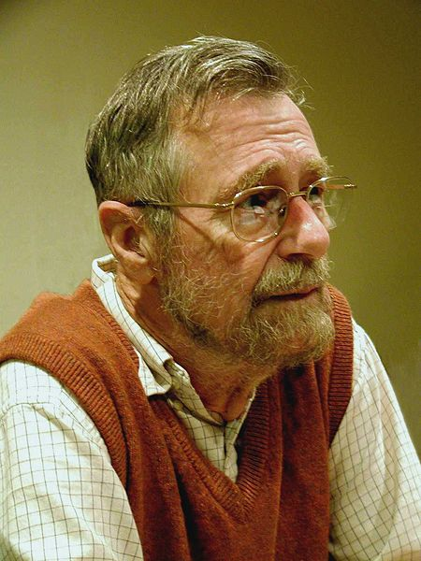
Edsger Dijkstra
Turing Award, 1972
Algol-60 programming language
Goto considered harmful
Shortest path algorithm
Structured programming
“Program testing can show the presence of bugs, but never their absence”
For me, the first challenge for computing science is to discover how to maintain order in a finite, but very large, discrete universe that is intricately intertwined. And a second, but not less important challenge is how to mould what you have achieved in solving the first problem, into a teachable discipline: it does not suffice to hone your own intellect (that will join you in your grave), you must teach others how to hone theirs. The more you concentrate on these two challenges, the clearer you will see that they are only two sides of the same coin: teaching yourself is discovering what is teachable EWD 709

Slide 25
Dijkstra’s Shortest Path Algorithm
Similar to breadth first search, but uses a priority queue instead of a queue. Code below is for breadth first search (distance[] replaces set)
Vertex cur = q.remove();
for(Vertex v : adjacent(cur)){
if (!visited.contains(v)){ // if distance[v] == INFINITY
visited.add(v); // distance[v] = distance[cur]+1
q.add(v);
}
}
Dijkstra: Find minimal unvisited node, recalculate costs through node
Vertex cur = pq.remove();
for(Vertex v : adjacent(cur))
if (distance[cur] + graph.weight(cur,v) < distance[v]) {
distance[v] = distance[cur] + graph.weight(cur,v);
pq.add(v);
}

Slide 26
Shortest paths, more details
A
4
Single-source shortest path
Start at some vertex S
Find shortest path to every reachable vertex from S
A set of vertices is processed
Initially just S is processed
Each pass processes a vertex
After each pass, shortest path from S to any vertex using just vertices from processed set (except for last vertex) is always known
Next processed vertex is closest to S still needing processing
1
E
7
3
2
6
C
S
3
7
2
S
A
B
C
E
B
0
7
2
6
8
process B
0
7
2
5
9
A
4
7
3
1
E
2
6
C
S
3
7
2
S
A
B
C
E
B
7
0
6
2
5
process C

Slide 27
Dijkstra’s algorithm works (greedily)
Choosing minimal unseen vertex to process leads to shortest paths
Vertex cur = pq.remove();
for(Vertex v : adjacent(cur))
if (distance[cur]+graph.weight(cur,v) < distance[v]){
distance[v] = distance[cur] + graph.weight(cur,v);
pq.add(v);
}
}
We always know shortest path through processed vertices
When we choose w, there can’t be a shorter path to w than distance[w] – it would go through processed u, we would have chosen u instead of w

Slide 28
Shafi Goldwasser
RCS professor of computer science at MIT
Twice Godel Prize winner
Grace Murray Hopper Award
National Academy
Co-inventor of zero-knowledge proof protocols
How do you convince someone that you know [a secret] without revealing the knowledge?
Honesty and Privacy
Work on what you like, what feels right, I know of no other way to end up doing creative work

