Slide 1
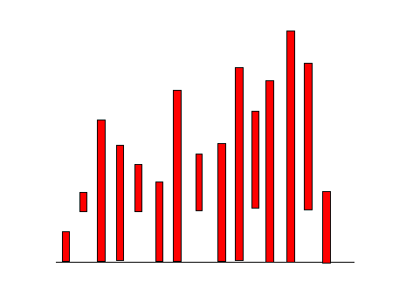
CompSci 100e Program Design and Analysis II
April 26, 2011
Prof. Rodger
Notes:
Skip 16, 18, 25 for handout

Slide 2
Announcements
Things due this week:
APTs due today, Apr 26
Extra credit assignments due Wed, Apr 27
No late assignments accepted after Wed night!
Today
Test 2 back – solutions posted on calendar page
Balanced Trees
Sorting

Slide 3
Final Exam
Final Exam – Wed, May 4, 7-10pm
Same room, old Chem 116
Covers topics up through today
Closed book, closed notes
Can bring 4 sheets of paper with your name on it
Study - practice writing code on paper
From tests this semester, from old tests
From classwork, labs, assignments, apts….
Will have different office hours til exam
will post on front page of CompSci 100e web page
Subject to change, check before coming over

Slide 4
Sorting: From Theory to Practice
Why study sorting?
Example of algorithm analysis in a simple, useful setting
Lots of sorts
Compare running times
Compare number of swaps
http://www.sorting-algorithms.com/

Slide 5
Sorting out sorts
Simple, O(n²) sorts --- for sorting n elements
Selection sort --- n² comparisons, n swaps, easy to code
Insertion sort --- n² comparisons, n² moves, stable, fast, can finish early
Bubble sort --- n² everything, easiest to code, slowest, ugly
Divide and conquer sorts: O(n log n) for n elements
Quick sort: fast in practice, O(n²) worst case
Merge sort: good worst case, great for linked lists, uses extra storage for vectors/arrays
Other sorts:
Heap sort, basically priority queue sorting O(n log n)
Radix sort: doesn’t compare keys, uses digits/characters
Shell sort: quasi-insertion, fast in practice, non-recursive

Slide 6
Selection sort: summary
Simple to code n² sort: n² comparisons, only n swaps
Repeat: Find next min, put it in its place in sorted order
void selectSort(String[] a) {
int len = a.length;
for(int k=0; k < len; k++){
int mindex = getMinIndex(a,k,len);
swap(a,k,mindex);
}
}
# comparisons
Swaps?
Invariant:
n
Σ
k = 1 + 2 + … + n = n(n+1)/2 = O(n²)
k=1
Sorted, won’t move
final position
?????

Slide 7
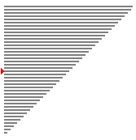
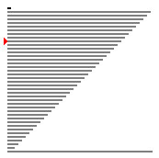
SelectionSort
Start starting 2nd pass
Starting 3rd pass starting 4th pass

Slide 8
Insertion Sort: summary
Stable sort, O(n²), good on nearly sorted vectors
Stable sorts maintain order of equal keys
Good for sorting on two criteria: name, then age
void insertSort(String[] a){
int k, loc; String elt;
for(k=1; k < a.length; ++k) {
elt = a[k];
loc = k;
// shift until spot for elt is found
while (0 < loc && elt.compareTo(a[loc-1]) < 0) {
a[loc] = a[loc-1]; // shift right
loc=loc-1;
}
a[loc] = elt;
}
}
Sorted relative to
each other
?????

Slide 9
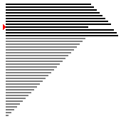
Insertion Sort
Start in 4th pass
Several later passes after more passes

Slide 10
Bubble sort: summary of a dog
For completeness you should know about this sort
Really, really slow (to run), really really fast (to code)
Can code to recognize already sorted vector (see insertion)
Not worth it for bubble sort, much slower than insertion
void bubbleSort(String[] a){
for(int j=a.length-1; j >= 0; j--) {
for(int k=0; k < j; k++) {
if (a[k] > a[k+1])
swap(a,k,k+1);
}
}
}
“bubble” elements down the vector/array
?????
Sorted, in final
position

Slide 11
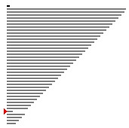
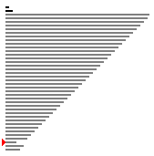
Bubble sort
Start starting 2nd pass
Starting 3rd pass starting 4th pass

Slide 12
Summary of simple sorts
Selection sort has n swaps, good for “heavy” data
moving objects with lots of state, e.g., …
In C or C++ this is an issue
In Java everything is a pointer/reference, so swapping is fast since it's pointer assignment
Insertion sort good on nearly sorted data, stable!
Also foundation for Shell sort, very fast non-recursive
More complicated to code, but relatively simple, and fast
Bubble sort is a travesty? But it's fast to code if you know it!
Can be parallelized, but on one machine don’t go near it

Slide 13
Quicksort: fast in practice
Invented in 1962 by C.A.R. Hoare, didn’t understand recursion
Worst case is O(n²), but avoidable in nearly all cases
In 1997 Introsort published (Musser, introspective sort)
Like quicksort in practice, but recognizes when it will be bad and changes to heapsort
void quick(String[], int left, int right){
if (left < right) {
int pivot = partition(a,left,right);
quick(a,left,pivot-1);
quick(a,pivot+1, right);
}
}
Recurrence?
<= X
X
> X
pivot index

Slide 14
Partition code for quicksort
what we want
Easy to develop partition
int partition(String[] a,
int left, int right)
{
string pivot = a[left];
int k, pIndex = left;
for(k=left+1, k <= right; k++) {
if (a[k].compareTo(pivot) <= 0){
pIndex++;
swap(a,k,pIndex);
}
}
swap(a,left,pIndex);
}
loop invariant:
statement true each time loop test is evaluated, used to verify correctness of loop
Can swap into a[left] before loop
Nearly sorted data still ok
<= pivot
> pivot
left
right
pIndex
what we have
??????????????
left
right
invariant
<=
>
???
left
right
pIndex
k

Slide 15
Analysis of Quicksort
Average case and worst case analysis
Recurrence for worst case: T(n) =
What about average?
Reason informally:
Two calls vector size n/2
Four calls vector size n/4
… How many calls? Work done on each call?
Partition: median of three, then sort
Avoid bad performance on nearly sorted data

Slide 16
Analysis of Quicksort
Average case and worst case analysis
Recurrence for worst case: T(n) =
What about average?
Reason informally:
Two calls vector size n/2
Four calls vector size n/4
… How many calls? Work done on each call?
Partition: median of three, then sort
Avoid bad performance on nearly sorted data
T(n-1) + T(1) + O(n)
T(n) = 2T(n/2) + O(n)

Slide 17
Merge sort: worst case O(n log n)
Divide and conquer --- recursive sort
Divide list/vector into two halves
Sort each half
Merge sorted halves together
What is complexity of merging two sorted lists?
What is recurrence relation for merge sort as described?
T(n) =
Advantage of array over linked-list for merge sort?
What about merging, advantage of linked list?
Array requires auxiliary storage (or very fancy coding)

Slide 18
Merge sort: worst case O(n log n)
Divide and conquer --- recursive sort
Divide list/vector into two halves
Sort each half
Merge sorted halves together
What is complexity of merging two sorted lists?
What is recurrence relation for merge sort as described?
T(n) =
Advantage of array over linked-list for merge sort?
What about merging, advantage of linked list?
Array requires auxiliary storage (or very fancy coding)
T(n) = 2T(n/2) + O(n)

Slide 19
Merge sort: lists or arrays or …
Mergesort for arrays
void mergesort(String[] a, int left, int right){
if (left < right) {
int mid = (right+left)/2;
mergesort(a, left, mid);
mergesort(a, mid+1, right);
merge(a,left,mid,right);
}
}
What’s different when linked lists used?
Do differences affect complexity? Why?
How does merge work?

Slide 20
Summary of O(n log n) sorts
Quicksort straight-forward to code, very fast
Worst case is very unlikely, but possible, therefore …
But, if lots of elements are equal, performance will be bad
One million integers from range 0 to 10,000
How can we change partition to handle this?
Merge sort is stable, it’s fast, good for linked lists, harder to code?
Worst case performance is O(n log n), compare quicksort
Extra storage for array/vector
Heapsort, good worst case, not stable, coding?
Basically heap-based priority queue in a vector

Slide 21
Other sorts
Shellsort
Divide and conquer approach then insertion sort kicks in
Named after?
Timsort
Sort in python
Named after?
Derived from mergesort and insertionsort
Very fast on real world data, using far fewer than the worst case of O(n log n)
Notes:
Tim sort is named after Tim Peters

Slide 22
ShellSort
Start starting 2nd pass
Starting 3rd pass starting 4th pass

Slide 23
Sorting in practice
Rarely will you need to roll your own sort, but when you do …
What are key issues?
If you use a library sort, you need to understand the interface
In C++ we have STL
STL has sort, and stable_sort
In C sort is complex to use because arrays are ugly
In Java guarantees and worst-case are important
Why won’t quicksort be used?
Comparators allow sorting criteria to change

Slide 24
Non-comparison-based sorts
lower bound: Ω(n log n) for comparison based sorts (like searching lower bound)
bucket sort/radix sort are not-comparison based, faster asymptotically and in practice
sort a vector of ints, all ints in the range 1..100, how?
(use extra storage)
radix: examine each digit of numbers being sorted
One-pass per digit
Sort based on digit
23 34 56 25 44 73 42 26 10 16
0
1
2
3
4
5
6
7
8
9
10 42 23 73 34 44 25 56 26 16
0
1
2
3
4
5
6
7
8
9
10 16 23 25 26 34 42 44 56 73

Slide 25
Non-comparison-based sorts
lower bound: Ω(n log n) for comparison based sorts (like searching lower bound)
bucket sort/radix sort are not-comparison based, faster asymptotically and in practice
sort a vector of ints, all ints in the range 1..100, how?
(use extra storage)
radix: examine each digit of numbers being sorted
One-pass per digit
Sort based on digit
23 34 56 25 44 73 42 26 10 16
16
73
44
26
10
42
23
34
25
56
0
1
2
3
4
5
6
7
8
9
10 42 23 73 34 44 25 56 26 16
26
16
25
44
10
23
34
42
56
73
0
1
2
3
4
5
6
7
8
9
10 16 23 25 26 34 42 44 56 73

