Slide 1
Synchronization
Jeff Chase
Duke University

Slide 2

Concurrency control
The scheduler (and the machine) select the execution order of threads
Each thread executes a sequence of instructions, but their sequences may be arbitrarily interleaved.
  E.g., from the point of view of loads/stores on memory.
Each possible execution order is a schedule.
It is the program’s responsibility to exclude schedules that lead to incorrect behavior.
It is called synchronization or concurrency control.

Slide 3
OSTEP pthread example (1)
volatile int counter = 0;
int loops;
void *worker(void *arg) {
int i;
for (i = 0; i < loops; i++) {
counter++;
}
pthread_exit(NULL);
}
int main(int argc, char *argv[]) {
if (argc != 2) {
fprintf(stderr, "usage: threads <loops>\n");
exit(1);
}
loops = atoi(argv[1]);
pthread_t p1, p2;
printf("Initial value : %d\n", counter);
pthread_create(&p1, NULL, worker, NULL);
pthread_create(&p2, NULL, worker, NULL);
pthread_join(p1, NULL);
pthread_join(p2, NULL);
printf("Final value : %d\n", counter);
return 0;
}
data

Slide 4
OSTEP pthread example (2)
pthread_mutex_t m;
volatile int counter = 0;
int loops;
void *worker(void *arg) {
int i;
for (i = 0; i < loops; i++) {
Pthread_mutex_lock(&m);
counter++;
Pthread_mutex_unlock(&m);
}
pthread_exit(NULL);
}
A
A
“Lock it down.”
R
R
load
add
store
☑
load
add
store

Slide 5



“Lock it down”
context switch
Use a lock (mutex) to synchronize access to a data structure that is shared by multiple threads.
A thread acquires (locks) the designated mutex before operating on a given piece of shared data.
The thread holds the mutex. At most one thread can hold a given mutex at a time (mutual exclusion).
Thread releases (unlocks) the mutex when done. If another thread is waiting to acquire, then it wakes.
☑
R
x=x+1
A
start
A
x=x+1
R
The mutex bars entry to the grey box: the threads cannot both hold the mutex.

Slide 6
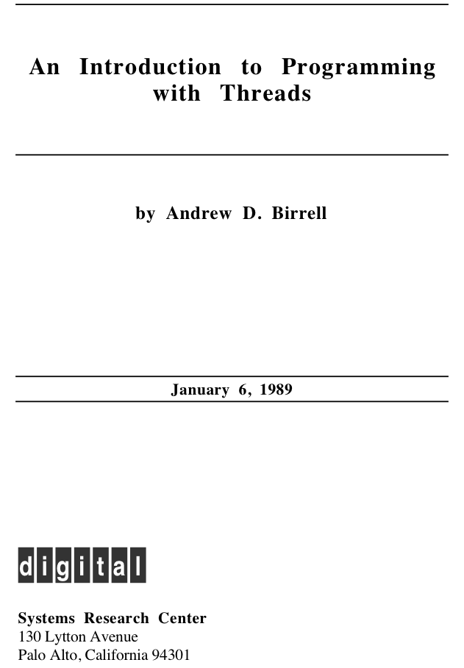

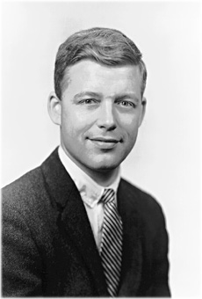

Andrew Birrell
Bob Taylor

Slide 7
^{VAR t: Thread;}
^{t := Fork(a, x);}
^{p := b(y);}
^{q := Join(t);}
^{TYPE Condition;}
PROCEDURE Wait(m: Mutex; c: Condition); PROCEDURE Signal(c: Condition); PROCEDURE Broadcast(c: Condition);
^{TYPE Thread;}
TYPE Forkee = PROCEDURE(REFANY): REFANY; PROCEDURE Fork(proc: Forkee; arg: REFANY): Thread;
PROCEDURE Join(thread: Thread): REFANY;

Slide 8
Portrait of a thread
“Heuristic fencepost”: try to detect stack overflow errors
Thread Control Block (“TCB”)
Storage for context (register values) when thread is not running.
name/status etc
0xdeadbeef
ucontext_t
Stack
Thread operations (parent)
a rough sketch:
t = create();
t.start(proc, argv);
t.alert(); (optional)
result = t.join();
Self operations (child)
a rough sketch:
exit(result);
t = self();
setdata(ptr);
ptr = selfdata();
alertwait(); (optional)
Details vary.

Slide 9
A thread: review
This slide applies to the process abstraction too, or, more precisely, to the main thread of a process.
active
ready or
running
User TCB
user
stack
sleep
wait
wakeup
signal
blocked
kernel TCB
wait
kernel
stack
When a thread is blocked its TCB is placed on a sleep queue of threads waiting for a specific wakeup event.
Program

Slide 10
Locking and blocking
H
T
If thread T attempts to acquire a lock that is busy (held), T must spin and/or block until the lock is free. T enters the kernel (via syscall) to block. When the lock holder H releases, H enters the kernel (via syscall) to wakeup a waiting thread (e.g., T).
A
A
R
running
R
yield
preempt
Note: H can block too, perhaps for some other resource! H doesn’t implicitly release the lock just because it blocks. Many students get that idea somehow.
sleep
dispatch
blocked
ready
wakeup
STOP
wait

Slide 11
The kernel
syscall trap/return
fault/return
system call layer: files, processes, IPC, thread syscalls
fault entry: VM page faults, signals, etc.
thread/CPU/core management: sleep and ready queues
memory management: block/page cache, VM maps
sleep queue
ready queue
I/O completions
interrupt/return
timer ticks

Slide 12
Locking a critical section
load
add
store
3.
☑
load
add
store
mx->Acquire();
x = x + 1;
mx->Release();
load
add
store
load
add
store
4.
☑
serialized
atomic
mx->Acquire();
x = x + 1;
mx->Release();
load
add
store
load
add
store
Holding a shared mutex prevents competing threads from entering a critical section. If the critical section code acquires the mutex, then its execution is serialized: only one thread runs it at a time.

Slide 13
How about this?
load
add
store
A
x = x + 1;
mx->Acquire();
x = x + 1;
mx->Release();
load
add
store
B

Slide 14
How about this?
load
add
store
A
x = x + 1;
The locking discipline is not followed: purple fails to acquire the lock mx.
Or rather: purple accesses the variable x through another program section A that is mutually critical with B, but does not acquire the mutex.
A locking scheme is a convention that the entire program must follow.
mx->Acquire();
x = x + 1;
mx->Release();
load
add
store
B

Slide 15
How about this?
load
add
store
lock->Acquire();
x = x + 1;
lock->Release();
A
mx->Acquire();
x = x + 1;
mx->Release();
load
add
store
B

Slide 16
How about this?
load
add
store
lock->Acquire();
x = x + 1;
lock->Release();
A
This guy is not acquiring the right lock.
Or whatever. They’re not using the same lock, and that’s what matters.
A locking scheme is a convention that the entire program must follow.
mx->Acquire();
x = x + 1;
mx->Release();
load
add
store
B

Slide 17
Locking a critical section
The threads may run the critical section in either order, but the schedule can never enter the grey region where both threads execute the section at the same time.
load
add
store
mx->Acquire();
x = x + 1;
mx->Release();
☑
R
x=x+1
load
add
store
mx->Acquire();
x = x + 1;
mx->Release();
A
x=x+1
A
R
Holding a shared mutex prevents competing threads from entering a critical section protected by the shared mutex (monitor). At most one thread runs in the critical section at a time.

Slide 18
Mutual exclusion in Java
Mutexes are built in to every Java object.
  no separate classes
Every Java object is/has a monitor.
  At most one thread may “own” a monitor at any given time.
A thread becomes owner of an object’s monitor by
  executing an object method declared as synchronized
  executing a block that is synchronized on the object
public synchronized void increment()
{
x = x + 1;
}
public void increment() {
synchronized(this) {
x = x + 1;
}
}

Slide 19

Roots: monitors
A monitor is a module in which execution is serialized.
A module is a set of procedures with some private state.
state
[Brinch Hansen 1973]
[C.A.R. Hoare 1974]
At most one thread runs in the monitor at a time.
P1()
(enter)
ready
to enter
P2()
P3()
Other threads wait until the monitor is free.
signal()
P4()
blocked
wait()
Java synchronized just allows finer control over the entry/exit points.
Also, each Java object is its own “module”: objects of a Java class share methods of the class but have private state and a private monitor.

Slide 20
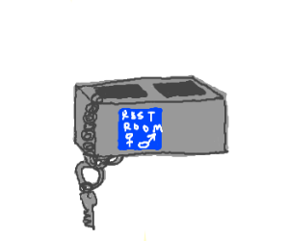
Monitors and mutexes are “equivalent”
Entry to a monitor (e.g., a Java synchronized block) is equivalent to Acquire of an associated mutex.
  Lock on entry
Exit of a monitor is equivalent to Release.
  Unlock on exit (or at least “return the key”…)
Note: exit/release is implicit and automatic if the thread exits monitored code by a Java exception.
  Much less error-prone then explicit release

Slide 21
Monitors and mutexes are “equivalent”
Well: mutexes are more flexible because we can choose which mutex controls a given piece of state.
  E.g., in Java we can use one object’s monitor to control access to state in some other object.
  Perfectly legal! So “monitors” in Java are more properly thought of as mutexes.
Caution: this flexibility is also more dangerous!
  It violates modularity: can code “know” what locks are held by the thread that is executing it?
  Nested locks may cause deadlock (later).
Keep your locking scheme simple and local!
  Java ensures that each Acquire/Release pair (synchronized block) is contained within a method, which is good practice.

Slide 22
Using monitors/mutexes
Each monitor/mutex protects specific data structures (state) in the program. Threads hold the mutex when operating on that state.
The state is consistent iff certain well-defined invariant conditions are true. A condition is a logical predicate over the state.
state
P1()
(enter)
ready
to enter
P2()
Example invariant condition
E.g.: suppose the state has a doubly linked list. Then for any element e either e.next is null or e.next.prev == e.
P3()
signal()
P4()
blocked
wait()
Threads hold the mutex when transitioning the structures from one consistent state to another, and restore the invariants before releasing the mutex.

Slide 23
Monitor wait/signal
We need a way for a thread to wait for some condition to become true, e.g., until another thread runs and/or changes the state somehow.
At most one thread runs in the monitor at a time.
state
A thread may wait (sleep) in the monitor, exiting the monitor.
P1()
(enter)
ready
to enter
A thread may signal in the monitor.
Signal means: wake one waiting thread, if there is one, else do nothing.
The awakened thread returns from its wait and reenters the monitor.
P2()
signal()
P3()
signal()
P4()
wait()
waiting
(blocked)
wait()

Slide 24
Condition variables are equivalent
A condition variable (CV) is an object with an API.
A CV implements the behavior of monitor conditions.
  interface to a CV: wait and signal (also called notify)
Every CV is bound to exactly one mutex, which is necessary for safe use of the CV.
  “holding the mutex” ←→ “in the monitor”
A mutex may have any number of CVs bound to it.
  (But not in Java: only one CV per mutex in Java.)
CVs also define a broadcast (notifyAll) primitive.
  Signal all waiters.

Slide 25
Monitor wait/signal
Design question: when a waiting thread is awakened by signal, must it start running immediately? Back in the monitor, where it called wait?
At most one thread runs in the monitor at a time.
state
Two choices: yes or no.
If yes, what happens to the thread that called signal within the monitor? Does it just hang there? They can’t both be in the monitor.
If no, can’t other threads get into the monitor first and change the state, causing the condition to become false again?
P1()
(enter)
ready
to enter
P2()
signal()
???
P3()
signal
P4()
wait()
waiting
(blocked)
wait

Slide 26
Mesa semantics
Design question: when a waiting thread is awakened by signal, must it start running immediately? Back in the monitor, where it called wait?
Mesa semantics: no.
state
An awakened waiter gets back in line. The signal caller keeps the monitor.
So, can’t other threads get into the monitor first and change the state, causing the condition to become false again?
Yes. So the waiter must recheck the condition:
“Loop before you leap”.
ready
to (re)enter
P1()
(enter)
ready
to enter
P2()
signal()
P3()
signal
P4()
wait()
waiting
(blocked)
wait

Slide 27
Alternative: Hoare semantics
As originally defined in the 1960s, monitors chose “yes”: Hoare semantics. Signal suspends; awakened waiter gets the monitor.
Monitors with Hoare semantics might be easier to program, somebody might think. Maybe. I suppose.
But monitors with Hoare semantics are difficult to implement efficiently on multiprocessors.
Birrell et. al. determined this when they built monitors for the Mesa programming language in the 1970s.
So they changed the rules: Mesa semantics.
Java uses Mesa semantics. Everybody uses Mesa semantics.
Hoare semantics are of historical interest only.
Loop before you leap!

Slide 28
Java synchronization
Every Java object has a monitor and condition variable built in. There is no separate mutex class or CV class.
public class Object {
void notify(); /* signal */
void notifyAll(); /* broadcast */
void wait();
void wait(long timeout);
}
public class PingPong extends Object {
public synchronized void PingPong() {
while(true) {
notify();
wait();
}
}
}
A thread must own an object’s monitor (“synchronized”) to call wait/notify, else the method raises an IllegalMonitorStateException.
Wait(*) waits until the timeout elapses or another thread notifies.

Slide 29
Monitor == mutex+CV
A monitor has a mutex to protect shared state, a set of code sections that hold the mutex, and a condition variable with wait/signal primitives.
At most one thread runs in the monitor at a time.
state
A thread may wait in the monitor, allowing another thread to enter.
P1()
(enter)
ready
to enter
P2()
signal()
A thread may signal in the monitor.
Signal means: wake one waiting thread, if there is one, else do nothing.
The awakened thread returns from its wait.
signal()
P3()
P4()
wait()
waiting
(blocked)
wait()

Slide 30
Using condition variables
In typical use a condition variable is associated with some logical condition or predicate on the state protected by its mutex.
  E.g., queue is empty, buffer is full, message in the mailbox.
  Note: CVs are not variables. You can associate them with whatever data you want, i.e, the state protected by the mutex.
A caller of CV wait must hold its mutex (be “in the monitor”).
  This is crucial because it means that a waiter can wait on a logical condition and know that it won’t change until the waiter is safely asleep.
  Otherwise, another thread might change the condition and signal before the waiter is asleep! Signals do not stack! The waiter would sleep forever: the missed wakeup or wake-up waiter problem.
The wait releases the mutex to sleep, and reacquires before return.
  But another thread could have beaten the waiter to the mutex and messed with the condition: loop before you leap!

Slide 31
Example: event/request queue
worker loop
We can synchronize an event queue with a mutex/CV pair.
Protect the event queue data structure itself with the mutex.
handler
Handle one event, blocking as necessary.
dispatch
Incoming event
queue
handler
threads waiting on CV
When handler is complete, return to worker pool.
Workers wait on the CV for next event if the event queue is empty. Signal the CV when a new event arrives. This is a producer/consumer problem.
handler

Slide 32
Producer-consumer problem
Pass elements through a bounded-size shared buffer
  Producer puts in (must wait when full)
  Consumer takes out (must wait when empty)
  Synchronize access to buffer
  Elements pass through in order
Examples
  Unix pipes: cpp | cc1 | cc2 | as
  Network packet queues
  Server worker threads receiving requests
  Feeding events to an event-driven program

Slide 33
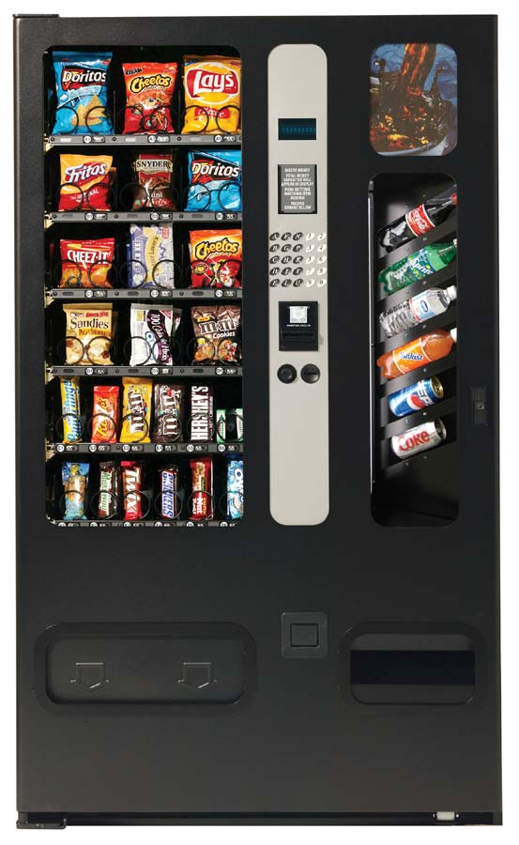



Example: the soda/HFCS machine
Soda drinker
(consumer)
Delivery person
(producer)
Vending machine
(buffer)

Slide 34
Solving producer-consumer
What are the variables/shared state?
  Soda machine buffer
  Number of sodas in machine (≤ MaxSodas)
Locks?
  1 to protect all shared state (sodaLock)
Mutual exclusion?
  Only one thread can manipulate machine at a time
Ordering constraints?
  Consumer must wait if machine is empty (CV hasSoda)
  Producer must wait if machine is full (CV hasRoom)

Slide 35
Producer-consumer code
consumer () {
lock (sodaLock)
while (numSodas == 0) {
wait (sodaLock,hasSoda)
}
take a soda from machine
signal (hasRoom)
unlock (sodaLock)
}
producer () {
lock (sodaLock)
while(numSodas==MaxSodas){
wait (sodaLock, hasRoom)
}
add one soda to machine
signal (hasSoda)
unlock (sodaLock)
}
Mx
CV1
Mx
CV2
CV2
CV1

Slide 36
Producer-consumer code
consumer () {
lock (sodaLock)
while (numSodas == 0) {
wait (sodaLock,hasSoda)
}
take a soda from machine
signal(hasRoom)
unlock (sodaLock)
}
producer () {
lock (sodaLock)
while(numSodas==MaxSodas){
wait (sodaLock, hasRoom)
}
fill machine with soda
broadcast(hasSoda)
unlock (sodaLock)
}
The signal should be a broadcast if the producer can produce more than one resource, and there are multiple consumers.
lpcox slide edited by chase

Slide 37
Variations: looping producer
Producer
  Infinite loop ok?
  Why/why not?
Release lock in wait call
producer () {
lock (sodaLock)
while (1) {
while(numSodas==MaxSodas){
wait (sodaLock, hasRoom)
}
add soda to machine
signal (hasSoda)
}
unlock (sodaLock)
}

Slide 38
Variations: resting producer
Producer
  Sleep ok?
  Why/why not?
Shouldn’t hold locks during a slow operation
producer () {
lock (sodaLock)
while (1) {
sleep (1 hour)
while(numSodas==MaxSodas){
wait (sodaLock, hasRoom)
}
add soda to machine
signal (hasSoda)
}
unlock (sodaLock)
}

Slide 39
Variations: one CV?
consumer () {
lock (sodaLock)
while (numSodas == 0) {
wait (sodaLock,hasRorS)
}
take a soda from machine
signal (hasRorS)
unlock (sodaLock)
}
producer () {
lock (sodaLock)
while(numSodas==MaxSodas){
wait (sodaLock,hasRorS)
}
add one soda to machine
signal(hasRorS)
unlock (sodaLock)
}
Mx
CV
Mx
CV
CV
CV
Two producers, two consumers: who consumes a signal?
ProducerA and ConsumerB wait while ConsumerC signals?

Slide 40
Variations: one CV?
consumer () {
lock (sodaLock)
while (numSodas == 0) {
wait (sodaLock,hasRorS)
}
take a soda from machine
signal (hasRorS)
unlock (sodaLock)
}
producer () {
lock (sodaLock)
while(numSodas==MaxSodas){
wait (sodaLock,hasRorS)
}
add one soda to machine
signal (hasRorS)
unlock (sodaLock)
}
Is it possible to have a producer and consumer both waiting?
max=1, cA and cB wait, pC adds/signals, pD waits, cA wakes

Slide 41
Variations: one CV?
consumer () {
lock (sodaLock)
while (numSodas == 0) {
wait (sodaLock,hasRorS)
}
take a soda from machine
signal (hasRorS)
unlock (sodaLock)
}
producer () {
lock (sodaLock)
while(numSodas==MaxSodas){
wait (sodaLock,hasRorS)
}
add one soda to machine
signal (hasRorS)
unlock (sodaLock)
}
How can we make the one CV solution work?

Slide 42
Variations: one CV?
consumer () {
lock (sodaLock)
while (numSodas == 0) {
wait (sodaLock,hasRorS)
}
take a soda from machine
broadcast (hasRorS)
unlock (sodaLock)
}
producer () {
lock (sodaLock)
while(numSodas==MaxSodas){
wait (sodaLock,hasRorS)
}
add one soda to machine
broadcast (hasRorS)
unlock (sodaLock)
}
Use broadcast instead of signal: safe but slow.

Slide 43
Broadcast vs signal
Can I always use broadcast instead of signal?
  Yes, assuming threads recheck condition
  And they should: “loop before you leap”!
  Mesa semantics requires it anyway: another thread could get to the lock before wait returns.
Why might I use signal instead?
  Efficiency (spurious wakeups)
  May wakeup threads for no good reason
“Signal is just a performance hint”.
lpcox slide edited by chase

Slide 44
Monitor == mutex+CV
A monitor has a mutex to protect shared state, a set of code sections that hold the mutex, and a condition variable with wait/signal primitives.
At most one thread runs in the monitor at a time.
state
A thread may wait in the monitor, allowing another thread to enter.
P1()
(enter)
ready
to enter
P2()
signal()
A thread may signal in the monitor.
Signal means: wake one waiting thread, if there is one, else do nothing.
The awakened thread returns from its wait.
signal()
P3()
P4()
wait()
waiting
(blocked)
wait()

Slide 45

Semaphore
Now we introduce a new synchronization object type: semaphore.
A semaphore is a hidden atomic integer counter with only increment (V) and decrement (P) operations.
Decrement blocks iff the count is zero.
Semaphores handle all of your synchronization needs with one elegant but confusing abstraction.
V-Up
int sem
P-Down
if (sem == 0) then
until a V
wait

Slide 46
Example: binary semaphore
A binary semaphore takes only values 0 and 1.
It requires a usage constraint: the set of threads using the semaphore call P and V in strict alternation.
  Never two V in a row.
P-Down
P-Down
1
0
wait
wakeup on V
V-Up

Slide 47
A mutex is a binary semaphore
A mutex is just a binary semaphore with an initial value of 1, for which each thread calls P-V in strict pairs.
Once a thread A completes its P, no other thread can P until A does a matching V.
V
P
P
V
P-Down
P-Down
1
0
wait
wakeup on V
V-Up

Slide 48
Semaphores vs. Condition Variables
Semaphores are “prefab CVs” with an atomic integer.
V(Up) differs from signal (notify) in that:
  Signal has no effect if no thread is waiting on the condition.
    Condition variables are not variables! They have no value!
  Up has the same effect whether or not a thread is waiting.
    Semaphores retain a “memory” of calls to Up.
2. P(Down) differs from wait in that:
  Down checks the condition and blocks only if necessary.
    No need to recheck the condition after returning from Down.
    The wait condition is defined internally, but is limited to a counter.
  Wait is explicit: it does not check the condition itself, ever.
    Condition is defined externally and protected by integrated mutex.

Slide 49
Semaphore
Step 0.
Increment and decrement operations on a counter.
But how to ensure that these operations are atomic, with mutual exclusion and no races?
How to implement the blocking (sleep/wakeup) behavior of semaphores?
void P() {
s = s - 1;
}
void V() {
s = s + 1;
}

Slide 50
Semaphore
void P() {
synchronized(this) {
….
s = s – 1;
}
}
void V() {
synchronized(this) {
s = s + 1;
….
}
}
Step 1.
Use a mutex so that increment (V) and decrement (P) operations on the counter are atomic.

Slide 51
Semaphore
synchronized void P() {
s = s – 1;
}
synchronized void V() {
s = s + 1;
}
Step 1.
Use a mutex so that increment (V) and decrement (P) operations on the counter are atomic.

Slide 52
Semaphore
synchronized void P() {
while (s == 0)
wait();
s = s - 1;
}
synchronized void V() {
s = s + 1;
if (s == 1)
notify();
}
Step 2.
Use a condition variable to add sleep/wakeup synchronization around a zero count.
(This is Java syntax.)

Slide 53
Semaphore
synchronized void P() {
if (s == 0)
………….;
s = s - 1;
ASSERT(s >= 0);
}
synchronized void V() {
s = s + 1;
……….
}

Slide 54
Semaphore
Loop before you leap!
Understand why the while is needed, and why an if is not good enough.
synchronized void P() {
while (s == 0)
wait();
s = s - 1;
ASSERT(s >= 0);
}
synchronized void V() {
s = s + 1;
signal();
}
Wait releases the monitor/mutex and blocks until a signal.
Signal wakes up one waiter blocked in P, if there is one, else the signal has no effect: it is forgotten.
This code constitutes a proof that monitors (mutexes and condition variables) are at least as powerful as semaphores.

Slide 55
Ping-pong with semaphores
blue->Init(0);
purple->Init(1);
void
PingPong() {
while(not done) {
blue->P();
Compute();
purple->V();
  }
}
void
PingPong() {
while(not done) {
purple->P();
Compute();
blue->V();
  }
}

Slide 56
Ping-pong with semaphores
V
The threads compute in strict alternation.
P
Compute
V
Compute
P
01
Compute
P
V
P
V

Slide 57
Resource Trajectory Graphs
This RTG depicts a schedule within the space of possible schedules for a simple program of two threads sharing one core.
The scheduler and machine choose the path (schedule, event order, or interleaving) for each execution.
Blue advances along the y-axis.
EXIT
Purple advances along the x-axis.
Synchronization constrains the set of legal paths and reachable states.
EXIT

Slide 58
Resource Trajectory Graphs
This RTG depicts a schedule within the space of possible schedules for a simple program of two threads sharing one core.
Every schedule ends here.
Blue advances along the y-axis.
EXIT
The diagonal is an idealized parallel execution (two cores).
Purple advances along the x-axis.
The scheduler chooses the path (schedule, event order, or interleaving).
context switch
From the point of view of the program, the chosen path is nondeterministic.
EXIT
Every schedule starts here.

Slide 59
Basic barrier
blue->Init(1);
purple->Init(1);
void
Barrier() {
while(not done) {
blue->P();
Compute();
purple->V();
  }
}
void
Barrier() {
while(not done) {
purple->P();
Compute();
blue->V();
  }
}

Slide 60
Barrier with semaphores
V
Neither thread can advance to the next iteration until its peer completes the current iteration.
Compute
Compute
P
Compute
V
Compute
Compute
Compute
P
11
P
V
P
V
Compute
Compute

Slide 61
Basic producer/consumer
empty->Init(1);
full->Init(0);
int buf;
int Consume() {
int m;
full->P();
m = buf;
empty->V(); return(m);
}
void Produce(int m) {
empty->P();
buf = m;
full->V();
}
This use of a semaphore pair is called a split binary semaphore: the sum of the values is always one.
Basic producer/consumer is called rendezvous: one producer, one consumer, and one item at a time. It is the same as ping-pong: producer and consumer access the buffer in strict alternation.

Slide 62
Example: the soda/HFCS machine
Soda drinker
(consumer)
Delivery person
(producer)
Vending machine
(buffer)

Slide 63
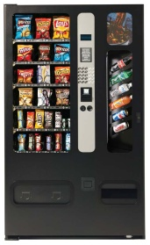


Prod.-cons. with semaphores
Same before-after constraints
  If buffer empty, consumer waits for producer
  If buffer full, producer waits for consumer
Semaphore assignments
  mutex (binary semaphore)
  fullBuffers (counts number of full slots)
  emptyBuffers (counts number of empty slots)

Slide 64
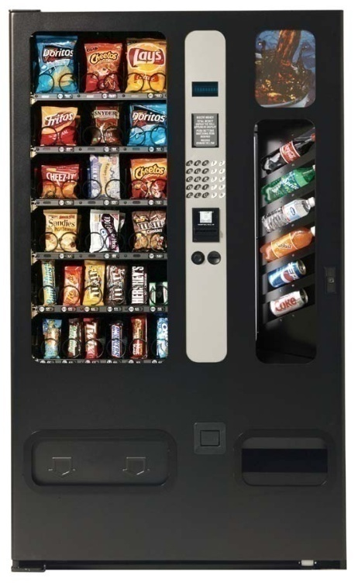
Prod.-cons. with semaphores
Initial semaphore values?
  Mutual exclusion
    sem mutex (?)
  Machine is initially empty
    sem fullBuffers (?)
    sem emptyBuffers (?)

Slide 65
Prod.-cons. with semaphores
Initial semaphore values
  Mutual exclusion
    sem mutex (1)
  Machine is initially empty
    sem fullBuffers (0)
    sem emptyBuffers (MaxSodas)

Slide 66
Prod.-cons. with semaphores
Semaphore fullBuffers(0),emptyBuffers(MaxSodas)
consumer () {
one less full buffer
down (fullBuffers)
take one soda out
one more empty buffer
up (emptyBuffers)
}
producer () {
one less empty buffer
down (emptyBuffers)
put one soda in
one more full buffer
up (fullBuffers)
}
Semaphores give us elegant full/empty synchronization.
Is that enough?

Slide 67
Prod.-cons. with semaphores
Semaphore mutex(1),fullBuffers(0),emptyBuffers(MaxSodas)
consumer () {
down (fullBuffers)
down (mutex)
take one soda out
up (mutex)
up (emptyBuffers)
}
producer () {
down (emptyBuffers)
down (mutex)
put one soda in
up (mutex)
up (fullBuffers)
}
Use one semaphore for fullBuffers and emptyBuffers?

Slide 68
Prod.-cons. with semaphores
Semaphore mutex(1),fullBuffers(0),emptyBuffers(MaxSodas)
consumer () {
down (mutex)
down (fullBuffers)
take soda out
up (emptyBuffers)
up (mutex)
}
producer () {
down (mutex)
down (emptyBuffers)
put soda in
up (fullBuffers)
up (mutex)
}
1
2
Does the order of the down calls matter?
Yes. Can cause “deadlock.”

Slide 69
Prod.-cons. with semaphores
Semaphore mutex(1),fullBuffers(0),emptyBuffers(MaxSodas)
consumer () {
down (fullBuffers)
down (mutex)
take soda out
up (emptyBuffers)
up (mutex)
}
producer () {
down (emptyBuffers)
down (mutex)
put soda in
up (fullBuffers)
up (mutex)
}
Does the order of the up calls matter?
Not for correctness (possible efficiency issues).

Slide 70
Prod.-cons. with semaphores
Semaphore mutex(1),fullBuffers(0),emptyBuffers(MaxSodas)
consumer () {
down (fullBuffers)
down (mutex)
take soda out
up (mutex)
up (emptyBuffers)
}
producer () {
down (emptyBuffers)
down (mutex)
put soda in
up (mutex)
up (fullBuffers)
}
What about multiple consumers and/or producers?
Doesn’t matter; solution stands.

Slide 71
Prod.-cons. with semaphores
Semaphore mtx(1),fullBuffers(1),emptyBuffers(MaxSodas-1)
consumer () {
down (fullBuffers)
down (mutex)
take soda out
up (mutex)
up (emptyBuffers)
}
producer () {
down (emptyBuffers)
down (mutex)
put soda in
up (mutex)
up (fullBuffers)
}
What if 1 full buffer and multiple consumers call down?
Only one will see semaphore at 1, rest see at 0.

Slide 72
Monitors vs. semaphores
Monitors
  Separate mutual exclusion and wait/signal
Semaphores
  Provide both with same mechanism
Semaphores are more “elegant”
  At least for producer/consumer
  Can be harder to program

Slide 73
Monitors vs. semaphores
Where are the conditions in both?
Which is more flexible?
Why do monitors need a lock, but not semaphores?
// Monitors
lock (mutex)
while (condition) {
wait (CV, mutex)
}
unlock (mutex)
// Semaphores
down (semaphore)

Slide 74
Monitors vs. semaphores
When are semaphores appropriate?
  When shared integer maps naturally to problem at hand
  (i.e. when the condition involves a count of one thing)
// Monitors
lock (mutex)
while (condition) {
wait (CV, mutex)
}
unlock (mutex)
// Semaphores
down (semaphore)

Slide 75
Locking a critical section
The threads may run the critical section in either order, but the schedule can never enter the grey region where both threads execute the section at the same time.
load
add
store
mx->Acquire();
x = x + 1;
mx->Release();
☑
R
x=x+1
load
add
store
mx->Acquire();
x = x + 1;
mx->Release();
A
x=x+1
A
R
Holding a shared mutex prevents competing threads from entering a critical section protected by the shared mutex (monitor). At most one thread runs in the critical section at a time.

Slide 76
Threads on cores
load
load
add
add
store
int x;
worker()
while (1)
{x++};
}
store
A
jmp
A
jmp
load
R
load
add
add
store
R
store
jmp
jmp
load
load
load
add
add
add
store
store
store
jmp
jmp
jmp

Slide 77
Spinlock: a first try
Spinlocks provide mutual exclusion among cores without blocking.
int s = 0;
lock() {
while (s == 1)
{};
ASSERT (s == 0);
s = 1;
}
unlock ();
ASSERT(s == 1);
s = 0;
}
Global spinlock variable
Busy-wait until lock is free.
Spinlocks are useful for lightly contended critical sections where there is no risk that a thread is preempted while it is holding the lock, i.e., in the lowest levels of the kernel.

Slide 78
Spinlock: what went wrong
int s = 0;
lock() {
while (s == 1)
{};
s = 1;
}
unlock ();
s = 0;
}
Race to acquire.
Two (or more) cores see s == 0.

Slide 79
We need an atomic “toehold”
To implement safe mutual exclusion, we need support for some sort of “magic toehold” for synchronization.
  The lock primitives themselves have critical sections to test and/or set the lock flags.
Safe mutual exclusion on multicore systems requires some hardware support: atomic instructions
  Examples: test-and-set, compare-and-swap, fetch-and-add.
  These instructions perform an atomic read-modify-write of a memory location. We use them to implement locks.
  If we have any of those, we can build higher-level synchronization objects like monitors or semaphores.
  Note: we also must be careful of interrupt handlers….
  They are expensive, but necessary.

Slide 80
Atomic instructions: Test-and-Set
Spinlock::Acquire () {
while(held);
held = 1;
}
Wrong
load 4(SP), R2 ; load “this”
busywait:
load 4(R2), R3 ; load “held” flag
bnz R3, busywait ; spin if held wasn’t zero
store #1, 4(R2) ; held = 1
Right
load 4(SP), R2 ; load “this”
busywait:
tsl 4(R2), R3 ; test-and-set this->held
bnz R3, busywait ; spin if held wasn’t zero
One example: tsl
test-and-set-lock
(from an old machine)
load
test
store
load
test
store
Problem: interleaved load/test/store.
Solution: TSL atomically sets the flag and leaves the old value in a register.

Slide 81
Threads on cores: with locking
tsl L
tsl L
bnz
bnz
load
tsl L
add
bnz
store
int x;
worker()
while (1) {
acquire L;
x++;
release L; };
}
tsl L
zero L
bnz
jmp
tsl L
tsl L
tsl L
bnz
bnz
bnz
load
load
tsl L
add
add
bnz
store
store
tsl L
zero L
zero L
bnz
jmp
jmp
tsl L
tsl L

Slide 82
Threads on cores: with locking
tsl L
tsl L
bnz
load
atomic
add
spin
store
int x;
worker()
while (1) {
acquire L;
x++;
release L; };
}
A
A
zero L
jmp
R
tsl L
tsl L
bnz
R
load
add
spin
store
zero L
jmp
tsl L
tsl L

Slide 83
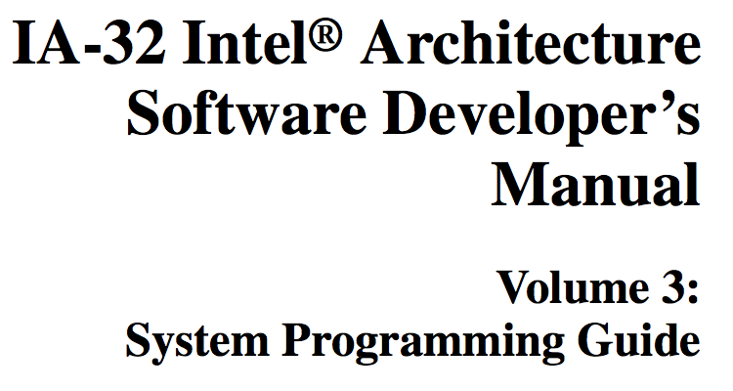
Spinlock: IA32
Idle the core for a contended lock.
^{Spin_Lock:}
CMP lockvar, 0 ;Check if lock is free
^{JE Get_Lock}
PAUSE ; Short delay
^{JMP Spin_Lock}
^{Get_Lock:}
^{MOV EAX, 1}
XCHG EAX, lockvar ; Try to get lock
CMP EAX, 0 ; Test if successful
^{JNE Spin_Lock}
Atomic exchange to ensure safe acquire of an uncontended lock.
XCHG is a variant of compare-and-swap: compare x to value in memory location y; if x == *y then set *y = z. Report success/failure.

Slide 84
Memory ordering
Shared memory is complex on multicore systems.
Does a load from a memory location (address) return the latest value written to that memory location by a store?
What does “latest” mean in a parallel system?
T1
W(x)=1
OK
R(y)
1
It is common to presume that load and store ops execute sequentially on a shared memory, and a store is immediately and simultaneously visible to load at all other threads. But not on real machines.
M
T2
W(y)=1
OK
R(x)
1

Slide 85
Memory ordering
A load might fetch from the local cache and not from memory.
A store may buffer a value in a local cache before draining the value to memory, where other cores can access it.
Therefore, a load from one core does not necessarily return the “latest” value written by a store from another core.
W(x)=1
OK
R(y)
0??
A trick called Dekker’s algorithm supports mutual exclusion on multi-core without using atomic instructions. It assumes that load and store ops on a given location execute sequentially.
But they don’t.
T1
M
T2
W(y)=1
OK
R(x)
0??

Slide 86
The first thing to understand about memory behavior on multi-core systems
Cores must see a “consistent” view of shared memory for programs to work properly. But what does it mean?
Synchronization accesses tell the machine that ordering matters: a happens-before relationship exists. Machines always respect that.
  Modern machines work for race-free programs.
  Otherwise, all bets are off. Synchronize!
W(x)=1
OK
R(y)
1
The most you should assume is that any memory store before a lock release is visible to a load on a core that has subsequently acquired the same lock.
T1
pass lock
M
T2
W(y)=1
OK
R(x)
0??

Slide 87
A peek at some deep tech
An execution schedule defines a partial order of program events. The ordering relation (<) is called happens-before.
mx->Acquire();
x = x + 1;
mx->Release();
Two events are concurrent if neither happens-before the other. They might execute in some order, but only by luck.
happens
before
(<)
before
The next schedule may reorder them.
Just three rules govern happens-before order:
mx->Acquire();
x = x + 1;
mx->Release();
Events within a thread are ordered.
Mutex handoff orders events across threads: the release #N happens-before acquire #N+1.
Happens-before is transitive:
if (A < B) and (B < C) then A < C.
Machines may reorder concurrent events, but they always respect happens-before ordering.

Slide 88
The point of all that
We use special atomic instructions to implement locks.
E.g., a TSL or CMPXCHG on a lock variable lockvar is a synchronization access.
Synchronization accesses also have special behavior with respect to the memory system.
  Suppose core C1 executes a synchronization access to lockvar at time t1, and then core C2 executes a synchronization access to lockvar at time t2.
  Then t1<t2: every memory store that happens-before t1 must be visible to any load on the same location after t2.
If memory always had this expensive sequential behavior, i.e., every access is a synchronization access, then we would not need atomic instructions: we could use “Dekker’s algorithm”.
We do not discuss Dekker’s algorithm because it is not applicable to modern machines. (Look it up on wikipedia if interested.)

Slide 89
^{7.1. LOCKED ATOMIC OPERATIONS}
The 32-bit IA-32 processors support locked atomic operations on locations in system memory. These operations are typically used to manage shared data structures (such as semaphores, segment descriptors, system segments, or page tables) in which two or more processors may try simultaneously to modify the same field or flag….
Note that the mechanisms for handling locked atomic operations have evolved as the complexity of IA-32 processors has evolved….
Synchronization mechanisms in multiple-processor systems may depend upon a strong memory-ordering model. Here, a program can use a locking instruction such as the XCHG instruction or the LOCK prefix to insure that a read-modify-write operation on memory is carried out atomically. Locking operations typically operate like I/O operations in that they wait for all previous instructions to complete and for all buffered writes to drain to memory….
This is just an example of a principle on a particular machine (IA32): these details aren’t important.

Slide 90
Blocking
This slide applies to the process abstraction too, or, more precisely, to the main thread of a process.
When a thread is blocked on a synchronization object (a mutex or CV) its TCB is placed on a sleep queue of threads waiting for an event on that object.
active
ready or
running
sleep
wait
wakeup
signal
blocked
How to synchronize thread queues and sleep/wakeup inside the kernel?
Interrupts drive many wakeup events.
kernel TCB
wait
sleep queue
ready queue

Slide 91
SharedLock: Reader/Writer Lock
A reader/write lock or SharedLock is a new kind of “lock” that is similar to our old definition:
  supports Acquire and Release primitives
  assures mutual exclusion for writes to shared state
But: a SharedLock provides better concurrency for readers when no writer is present.
class SharedLock {
AcquireRead(); /* shared mode */
AcquireWrite(); /* exclusive mode */
ReleaseRead();
ReleaseWrite();
}

Slide 92
Reader/Writer Lock Illustrated
If each thread acquires the lock in exclusive (*write) mode, SharedLock functions exactly as an ordinary mutex.
Multiple readers may hold
the lock concurrently in shared mode.
A_{r}
A_{r}
A_{w}
R_{r}
R_{r}
Writers always hold the lock in exclusive mode, and must wait for all readers or writer to exit.
R_{w}
mode read write max allowed
shared yes no many
exclusive yes yes one
not holder no no many

Slide 93
Reader/Writer Lock: outline
int i; /* # active readers, or -1 if writer */
void AcquireWrite() {
while (i != 0)
sleep….;
i = -1;
}
void AcquireRead() {
while (i < 0)
sleep…;
i += 1;
}
void ReleaseWrite() {
i = 0;
wakeup….;
}
void ReleaseRead() {
i -= 1;
if (i == 0)
wakeup…;
}

Slide 94
Reader/Writer Lock: adding a little mutex
int i; /* # active readers, or -1 if writer */
Lock rwMx;
AcquireWrite() {
rwMx.Acquire();
while (i != 0)
sleep…;
i = -1;
rwMx.Release();
}
AcquireRead() {
rwMx.Acquire();
while (i < 0)
sleep…;
i += 1;
rwMx.Release();
}
ReleaseWrite() {
rwMx.Acquire();
i = 0;
wakeup…;
rwMx.Release();
}
ReleaseRead() {
rwMx.Acquire();
i -= 1;
if (i == 0)
wakeup…;
rwMx.Release();
}

Slide 95
Reader/Writer Lock: cleaner syntax
int i; /* # active readers, or -1 if writer */
Condition rwCv; /* bound to “monitor” mutex */
synchronized AcquireWrite() {
while (i != 0)
rwCv.Wait();
i = -1;
}
synchronized AcquireRead() {
while (i < 0)
rwCv.Wait();
i += 1;
}
synchronized ReleaseWrite() {
i = 0;
rwCv.Broadcast();
}
synchronized ReleaseRead() {
i -= 1;
if (i == 0)
rwCv.Signal();
}
We can use Java syntax for convenience.
That’s the beauty of pseudocode. We use any convenient syntax. These syntactic variants have the same meaning.

Slide 96
The Little Mutex Inside SharedLock
A_{r}
A_{r}
A_{w}
R_{r}
R_{r}
A_{r}
R_{w}
R_{r}

Slide 97
Limitations of the SharedLock Implementation
This implementation has weaknesses discussed in [Birrell89].
  spurious lock conflicts (on a multiprocessor): multiple waiters contend for the mutex after a signal or broadcast.
    Solution: drop the mutex before signaling.
    (If the signal primitive permits it.)
  spurious wakeups
    ReleaseWrite awakens writers as well as readers.
    Solution: add a separate condition variable for writers.
  starvation
    How can we be sure that a waiting writer will ever pass its acquire if faced with a continuous stream of arriving readers?

Slide 98
Reader/Writer Lock: Second Try
SharedLock::AcquireWrite() {
rwMx.Acquire();
while (i != 0)
wCv.Wait(&rwMx);
i = -1;
rwMx.Release();
}
SharedLock::AcquireRead() {
rwMx.Acquire();
while (i < 0)
...rCv.Wait(&rwMx);...
i += 1;
rwMx.Release();
}
SharedLock::ReleaseWrite() {
rwMx.Acquire();
i = 0;
if (readersWaiting)
rCv.Broadcast();
else
wCv.Signal();
rwMx.Release();
}
SharedLock::ReleaseRead() {
rwMx.Acquire();
i -= 1;
if (i == 0)
wCv.Signal();
rwMx.Release();
}
Use two condition variables protected by the same mutex.
We can’t do this in Java, but we can still use Java syntax in our pseudocode. Be sure to declare the binding of CVs to mutexes!
Notes:
What if we added a writerswaiting flag and used that instead to block incoming readers?
(reader starvation)
How to do it with semaphores?
Use a binary semaphore for the writers and one for the readers. Writers hold theirs for the duration. Readers acquire the semaphore and touch a count and release the semaphore. On AcquireRead, if I’m the first reader, acquire write mutex to exclude writers. On ReleaseRead, if I’m the last reader, release the write mutex.
Can I do this with “real” mutexes?
(no)

Slide 99
Reader/Writer Lock: Second Try
synchronized AcquireWrite() {
while (i != 0)
wCv.Wait();
i = -1;
}
synchronized AcquireRead() {
while (i < 0) {
readersWaiting+=1;
rCv.Wait();
readersWaiting-=1;
}
i += 1;
}
synchronized ReleaseWrite() {
i = 0;
if (readersWaiting)
rCv.Broadcast();
else
wCv.Signal();
}
synchronized ReleaseRead() {
i -= 1;
if (i == 0)
wCv.Signal();
}
wCv and rCv are protected by the monitor mutex.
Notes:
What if we added a writerswaiting flag and used that instead to block incoming readers?
(reader starvation)
How to do it with semaphores?
Use a binary semaphore for the writers and one for the readers. Writers hold theirs for the duration. Readers acquire the semaphore and touch a count and release the semaphore. On AcquireRead, if I’m the first reader, acquire write mutex to exclude writers. On ReleaseRead, if I’m the last reader, release the write mutex.
Can I do this with “real” mutexes?
(no)

Slide 100
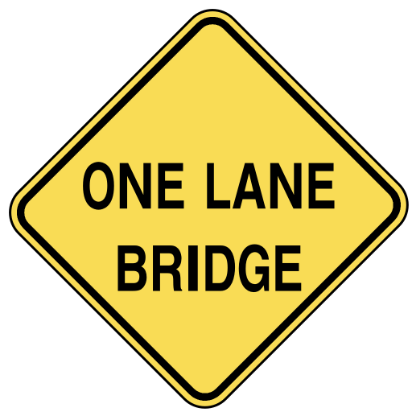
Starvation
The reader/writer lock example illustrates starvation: under load, a writer might be stalled forever by a stream of readers.
Example: a one-lane bridge or tunnel.
  Wait for oncoming car to exit the bridge before entering.
  Repeat as necessary…
Solution: some reader must politely stop before entering, even though it is not forced to wait by oncoming traffic.
  More code…
  More complexity…

Slide 101
Fair?
Loop before you leap!
But can a waiter be sure to eventually break out of this loop and consume a count?
synchronized void P() {
while (s == 0)
wait();
s = s - 1;
}
synchronized void V() {
s = s + 1;
signal();
}
What if some other thread beats me to the lock (monitor) and completes a P before I wake up?
P
V
P
V
P
V
V
P
Mesa semantics do not guarantee fairness.

Slide 102
Reader/Writer with Semaphores
SharedLock::AcquireRead() {
rmx.P();
if (first reader)
wsem.P();
rmx.V();
}
SharedLock::ReleaseRead() {
rmx.P();
if (last reader)
wsem.V();
rmx.V();
}
SharedLock::AcquireWrite() {
wsem.P();
}
SharedLock::ReleaseWrite() {
wsem.V();
}
Notes:
How to do it with semaphores?
Use a binary semaphore for the writers and one for the readers. Writers hold theirs for the duration. Readers acquire the semaphore and touch a count and release the semaphore. On AcquireRead, if I’m the first reader, acquire write mutex to exclude writers. On ReleaseRead, if I’m the last reader, release the write mutex.
Can I do this with “real” mutexes?
(no)

Slide 103
SharedLock with Semaphores: Take 2 (outline)
SharedLock::AcquireRead() {
rblock.P();
if (first reader)
wsem.P();
rblock.V();
}
SharedLock::ReleaseRead() {
if (last reader)
wsem.V();
}
SharedLock::AcquireWrite() {
if (first writer)
rblock.P();
wsem.P();
}
SharedLock::ReleaseWrite() {
wsem.V();
if (last writer)
rblock.V();
}
The rblock prevents readers from entering while writers are waiting.
Note: the marked critical systems must be locked down with mutexes.
Note also: semaphore “wakeup chain” replaces broadcast or notifyAll.
Notes:
What if we added a writerswaiting flag and used that instead to block incoming readers?
(reader starvation)
How to do it with semaphores?
Use a binary semaphore for the writers and one for the readers. Writers hold theirs for the duration. Readers acquire the semaphore and touch a count and release the semaphore. On AcquireRead, if I’m the first reader, acquire write mutex to exclude writers. On ReleaseRead, if I’m the last reader, release the write mutex.
Can I do this with “real” mutexes?
(no)

Slide 104
SharedLock with Semaphores: Take 2
SharedLock::AcquireRead() {
rblock.P();
rmx.P();
if (first reader)
wsem.P();
rmx.V();
rblock.V();
}
SharedLock::ReleaseRead() {
rmx.P();
if (last reader)
wsem.V();
rmx.V();
}
SharedLock::AcquireWrite() {
wmx.P();
if (first writer)
rblock.P();
wmx.V();
wsem.P();
}
SharedLock::ReleaseWrite() {
wsem.V();
wmx.P();
if (last writer)
rblock.V();
wmx.V();
}
Added for completeness.
Notes:
What if we added a writerswaiting flag and used that instead to block incoming readers?
(reader starvation)
How to do it with semaphores?
Use a binary semaphore for the writers and one for the readers. Writers hold theirs for the duration. Readers acquire the semaphore and touch a count and release the semaphore. On AcquireRead, if I’m the first reader, acquire write mutex to exclude writers. On ReleaseRead, if I’m the last reader, release the write mutex.
Can I do this with “real” mutexes?
(no)

Slide 105
A_{r}
A_{r}
A_{w}
R_{r}
R_{r}
A_{r}
R_{w}
R_{r}

Slide 106
EventBarrier
eb.arrive();
crossBridge();
eb.complete();
controller
raise()
arrive()
….
eb.raise();
…
complete()

Slide 107
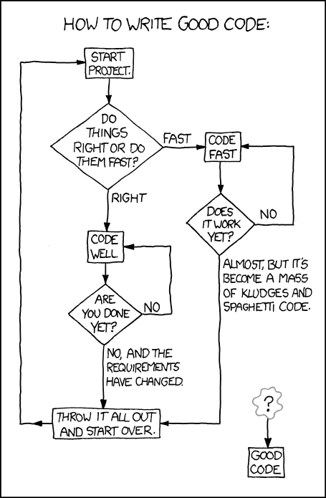

Slide 108
Debugging non-determinism
Requires worst-case reasoning
  Eliminate all ways for program to break
Debugging is hard
  Can’t test all possible interleavings
  Bugs may only happen sometimes
Heisenbug
  Re-running program may make the bug disappear
  Doesn’t mean it isn’t still there!

Slide 109
Guidelines for Lock Granularity
1. Keep critical sections short. Push “noncritical” statements outside to reduce contention.
2. Limit lock overhead. Keep to a minimum the number of times mutexes are acquired and released.
  Note tradeoff between contention and lock overhead.
3. Use as few mutexes as possible, but no fewer.
  Choose lock scope carefully: if the operations on two different data structures can be separated, it may be more efficient to synchronize those structures with separate locks.
  Add new locks only as needed to reduce contention. “Correctness first, performance second!”

Slide 110
More Locking Guidelines
1. Write code whose correctness is obvious.
2. Strive for symmetry.
  Show the Acquire/Release pairs.
  Factor locking out of interfaces.
  Acquire and Release at the same layer in your “layer cake” of abstractions and functions.
3. Hide locks behind interfaces.
4. Avoid nested locks.
  If you must have them, try to impose a strict order.
5. Sleep high; lock low.
  Where in the layer cake should you put your locks?

Slide 111
Guidelines for Condition Variables
1. Document the condition(s) associated with each CV.
    What are the waiters waiting for?
    When can a waiter expect a signal?
2. Recheck the condition after returning from a wait.
“Loop before you leap!”
    Another thread may beat you to the mutex.
    The signaler may be careless.
    A single CV may have multiple conditions.
3. Don’t forget: signals on CVs do not stack!
    A signal will be lost if nobody is waiting: always check the wait condition before calling wait.

Slide 112

Threads!
“Threads break abstraction.”
T1
T2
T1
deadlock!
calls
Module A
Module A
deadlock!
Module B
Module B
callbacks
sleep
wakeup
T2
[John Ousterhout 1995]

Slide 113
Dining Philosophers
N processes share N resources
resource requests occur in pairs w/ random think times
hungry philosopher grabs fork
...and doesn’t let go
...until the other fork is free
...and the linguine is eaten
4
A
1
D
B
3
C
2
while(true) {
Think();
AcquireForks();
Eat();
ReleaseForks();
}

Slide 114
Resource Graph or Wait-for Graph
A vertex for each process and each resource
If process A holds resource R, add an arc from R to A.
A
A grabs fork 1
B grabs fork 2
1
2
B

Slide 115
Resource Graph or Wait-for Graph
A vertex for each process and each resource
If process A holds resource R, add an arc from R to A.
If process A is waiting for R, add an arc from A to R.
A
A grabs fork 1
and
waits for fork 2.
B grabs fork 2
and
waits for fork 1.
1
2
B

Slide 116
Resource Graph or Wait-for Graph
A vertex for each process and each resource
If process A holds resource R, add an arc from R to A.
If process A is waiting for R, add an arc from A to R.
The system is deadlocked iff the wait-for graph has at least one cycle.
A
A grabs fork 1
and
waits for fork 2.
B grabs fork 2
and
waits for fork 1.
1
2
B

Slide 117
Deadlock vs. starvation
A deadlock is a situation in which a set of threads are all waiting for another thread to move.
But none of the threads can move because they are all waiting for another thread to do it.
Deadlocked threads sleep “forever”: the software “freezes”. It stops executing, stops taking input, stops generating output. There is no way out.
Starvation (also called livelock) is different: some schedule exists that can exit the livelock state, and the scheduler may select it, even if the probability is low.

Slide 118
RTG for Two Philosophers
Y
2
1
Sm
Sn
R2
R1
Sn
X
A1
2
1
Sm
A2
(There are really only 9 states we
care about: the key transitions are acquire and release events.)
A1
A2
R2
R1

Slide 119
Two Philosophers Living Dangerously
R2
X
R1
2
1
A1
Y
???
A2
A1
A2
R2
R1

Slide 120
The Inevitable Result
R2
X
R1
2
1
A1
Y
A2
This is a deadlock state:
There are no legal transitions out of it.
A1
A2
R2
R1

Slide 121
Four Conditions for Deadlock
Four conditions must be present for deadlock to occur:
1. Non-preemption of ownership. Resources are never taken away from the holder.
2. Exclusion. A resource has at most one holder.
3. Hold-and-wait. Holder blocks to wait for another resource to become available.
4. Circular waiting. Threads acquire resources in different orders.

Slide 122
Not All Schedules Lead to Collisions
The scheduler+machine choose a schedule, i.e., a trajectory or path through the graph.
  Synchronization constrains the schedule to avoid illegal states.
  Some paths “just happen” to dodge dangerous states as well.
What is the probability of deadlock?
  How does the probability change as:
    think times increase?
    number of philosophers increases?

Slide 123
Dealing with Deadlock
1. Ignore it. Do you feel lucky?
2. Detect and recover. Check for cycles and break them by restarting activities (e.g., killing threads).
3. Prevent it. Break any precondition.
  Keep it simple. Avoid blocking with any lock held.
  Acquire nested locks in some predetermined order.
  Acquire resources in advance of need; release all to retry.
  Avoid “surprise blocking” at lower layers of your program.
4. Avoid it.
  Deadlock can occur by allocating variable-size resource chunks from bounded pools: google “Banker’s algorithm”.

Slide 124
Synchronization objects
OS kernel API offers multiple ways for threads to block and wait for some event.
Details vary, but in general they wait for a specific event on some kernel object: a synchronization object.
  I/O completion
  wait*() for child process to exit
  blocking read/write on a producer/consumer pipe
  message arrival on a network channel
  sleep queue for a mutex, CV, or semaphore, e.g., Linux “futex”
  get next event/request on a poll set
  wait for a timer to expire

Slide 125
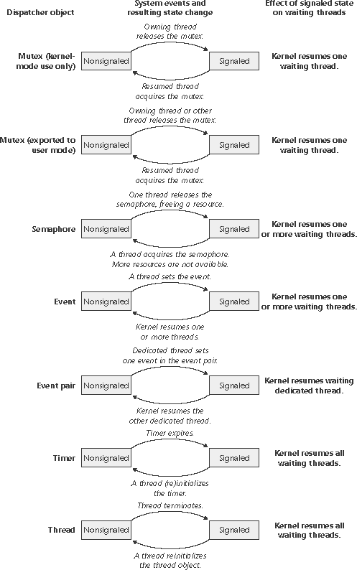

Windows synchronization objects
They all enter a signaled state on some event, and revert to an unsignaled state after some reset condition. Threads block on an unsignaled object, and wakeup (resume) when it is signaled.

Slide 126
Blocking
This slide applies to the process abstraction too, or, more precisely, to the main thread of a process.
When a thread is blocked on a synchronization object (a mutex or CV) its TCB is placed on a sleep queue of threads waiting for an event on that object.
active
ready or
running
sleep
wait
wakeup
signal
blocked
How to synchronize thread queues and sleep/wakeup inside the kernel?
Interrupts drive many wakeup events.
kernel TCB
wait
sleep queue
ready queue

Slide 127
Inside the kernel
A trap or fault handler may suspend (sleep) the current thread, leaving its state (call frames) on its kernel stack and a saved context in its TCB.
syscall traps
faults
sleep queue
ready queue
interrupts
The TCB for a blocked thread is left on a sleep queue for some synchronization object. A later event/action may wakeup the thread.

Slide 128
Wakeup from interrupt handler
trap or fault
return to user mode
sleep queue
ready queue
sleep
wakeup
switch
interrupt
Examples?
Note: interrupt handlers do not block: typically there is a single interrupt stack for each core that can take interrupts. If an interrupt arrived while another handler was sleeping, it would corrupt the interrupt stack.

Slide 129
Wakeup from interrupt handler
trap or fault
return to user mode
sleep queue
ready queue
sleep
wakeup
switch
interrupt
How should an interrupt handler wakeup a thread? Condition variable signal? Semaphore V?

Slide 130
Interrupts
An arriving interrupt transfers control immediately to the corresponding handler (Interrupt Service Routine).
ISR runs kernel code in kernel mode in kernel space.
Interrupts may be nested according to priority.
high-priority
ISR
executing thread
low-priority
handler (ISR)

Slide 131
Interrupt priority: rough sketch
N interrupt priority classes
When an ISR at priority p runs, CPU blocks interrupts of priority p or lower.
Kernel software can query/raise/lower the CPU interrupt priority level (IPL).
  Defer or mask delivery of interrupts at that IPL or lower.
  Avoid races with higher-priority ISR by raising CPU IPL to that priority.
  e.g., BSD Unix spl*/splx primitives.
Summary: Kernel code can enable/disable interrupts as needed.
low
spl0
splnet
splbio
splimp
clock
high
splx(s)
BSD example
int s;
s = splhigh();
/* all interrupts disabled */
splx(s);
/* IPL is restored to s */

Slide 132
What ISRs do
Interrupt handlers:
  bump counters, set flags
  throw packets on queues
  …
  wakeup waiting threads
Wakeup puts a thread on the ready queue.
Use spinlocks for the queues
But how do we synchronize with interrupt handlers?

Slide 133
Spinlocks in the kernel
We have basic mutual exclusion that is very useful inside the kernel, e.g., for access to thread queues.
  Spinlocks based on atomic instructions.
  Can synchronize access to sleep/ready queues used to implement higher-level synchronization objects.
Don’t use spinlocks from user space! A thread holding a spinlock could be preempted at any time.
  If a thread is preempted while holding a spinlock, then other threads/cores may waste many cycles spinning on the lock.
  That’s a kernel/thread library integration issue: fast spinlock synchronization in user space is a research topic.
But spinlocks are very useful in the kernel, esp. for synchronizing with interrupt handlers!

Slide 134
Synchronizing with ISRs
Interrupt delivery can cause a race if the ISR shares data (e.g., a thread queue) with the interrupted code.
Example: Core at IPL=0 (thread context) holds spinlock, interrupt is raised, ISR attempts to acquire spinlock….
That would be bad. Disable interrupts.
executing thread (IPL 0) in kernel mode
int s;
s = splhigh();
/* critical section */
splx(s);
disable interrupts for critical section

Slide 135
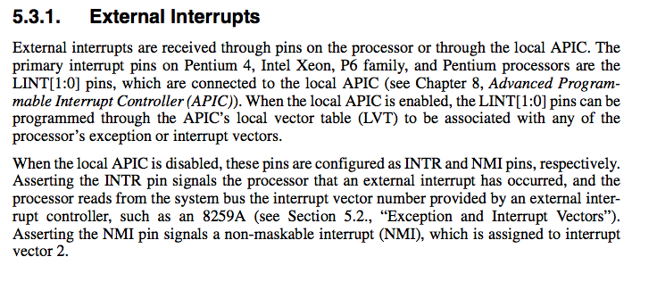
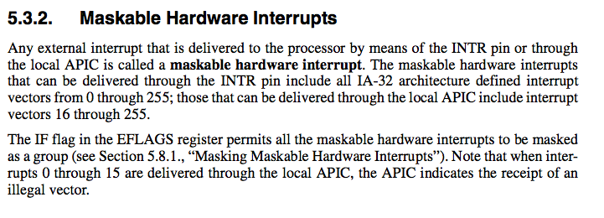
Obviously this is just example detail from a particular machine (IA32): the details aren’t important.

Slide 136
Recap: threads on the metal
An OS implements synchronization objects using a combination of elements:
  Basic sleep/wakeup primitives of some form.
  Sleep places the thread TCB on a sleep queue and does a context switch to the next ready thread.
  Wakeup places each awakened thread on a ready queue, from which the ready thread is dispatched to a core.
  Synchronization for the thread queues uses spinlocks based on atomic instructions, together with interrupt enable/disable.
  The low-level details are tricky and machine-dependent.
  The atomic instructions (synchronization accesses) also drive memory consistency behaviors in the machine, e.g., a safe memory model for fully synchronized race-free programs.
  Watch out for interrupts! Disable/enable as needed.

Slide 137
Managing threads: internals
A running thread may invoke an API of a synchronization object, and block.
The code places the current thread’s TCB on a sleep queue, then initiates a context switch to another ready thread.
running
If a thread is ready then its TCB is on a ready queue. Scheduler code running on an idle core may pick it up and context switch into the thread to run it.
yield
preempt
sleep
dispatch
blocked
wakeup
ready
STOP
wait
sleep
wakeup
dispatch
running
running
sleep queue
ready queue

Slide 138
Sleep/wakeup: a rough idea
Thread.Sleep(SleepQueue q) {
lock and disable interrupts;
this.status = BLOCKED;
q.AddToQ(this);
next = sched.GetNextThreadToRun();
Switch(this, next);
unlock and enable;
}
Thread.Wakeup(SleepQueue q) {
lock and disable;
q.RemoveFromQ(this);
this.status = READY;
sched.AddToReadyQ(this);
unlock and enable;
}
This is pretty rough. Some issues to resolve:
What if there are no ready threads?
How does a thread terminate?
How does the first thread start?
Synchronization details vary.

Slide 139
What cores do
Idle loop
scheduler
getNextToRun()
pause
idle
nothing?
get thread
put thread
sleep
exit
got thread
ready queue
(runqueue)
timer
quantum expired
switch in
switch out
run thread

Slide 140
Switching out
What causes a core to switch out of the current thread?
  Fault+sleep or fault+kill
  Trap+sleep or trap+exit
  Timer interrupt: quantum expired
  Higher-priority thread becomes ready
  …?
switch in
switch out
run thread
Note: the thread switch-out cases are sleep, forced-yield, and exit, all of which occur in kernel mode following a trap, fault, or interrupt. But a trap, fault, or interrupt does not necessarily cause a thread switch!

Slide 141
Example: Unix Sleep (BSD)
sleep (void* event, int sleep_priority)
{
struct proc *p = curproc;
int s;
s = splhigh(); /* disable all interrupts */
p->p_wchan = event; /* what are we waiting for */
p->p_priority -> priority; /* wakeup scheduler priority */
p->p_stat = SSLEEP; /* transition curproc to sleep state */
INSERTQ(&slpque[HASH(event)], p); /* fiddle sleep queue */
splx(s); /* enable interrupts */
mi_switch(); /* context switch */
/* we’re back... */
}
Illustration Only

Slide 142
Thread context switch
switch out
switch in
address space
0
common runtime
x
program
code library
data
R0
CPU
(core)
1. save registers
Rn
x
y
PC
y
stack
SP
registers
2. load registers
stack
high

Slide 143
/*
* Save context of the calling thread (old), restore registers of
* the next thread to run (new), and return in context of new.
*/
switch/MIPS (old, new) {
old->stackTop = SP;
save RA in old->MachineState[PC];
save callee registers in old->MachineState
restore callee registers from new->MachineState
RA = new->MachineState[PC];
SP = new->stackTop;
return (to RA)
}
This example (from the old MIPS ISA) illustrates how context switch saves/restores the user register context for a thread, efficiently and without assigning a value directly into the PC.

Slide 144
Example: Switch()
Save current stack pointer and caller’s return address in old thread object.
switch/MIPS (old, new) {
old->stackTop = SP;
save RA in old->MachineState[PC];
save callee registers in old->MachineState
restore callee registers from new->MachineState RA = new->MachineState[PC];
SP = new->stackTop;
return (to RA)
}
Caller-saved registers (if needed) are already saved on its stack, and restored automatically on return.
Switch off of old stack and over to new stack.
Return to procedure that called switch in new thread.
RA is the return address register. It contains the address that a procedure return instruction branches to.

Slide 145
What to know about context switch
The Switch/MIPS example is an illustration for those of you who are interested. It is not required to study it. But you should understand how a thread system would use it (refer to state transition diagram):
Switch() is a procedure that returns immediately, but it returns onto the stack of new thread, and not in the old thread that called it.
Switch() is called from internal routines to sleep or yield (or exit).
Therefore, every thread in the blocked or ready state has a frame for Switch() on top of its stack: it was the last frame pushed on the stack before the thread switched out. (Need per-thread stacks to block.)
The thread create primitive seeds a Switch() frame manually on the stack of the new thread, since it is too young to have switched before.
When a thread switches into the running state, it always returns immediately from Switch() back to the internal sleep or yield routine, and from there back on its way to wherever it goes next.

Slide 146
Contention on ready queues
A multi-core system must protect put/get on the ready/run queue(s) with spinlocks, as well as disabling interrupts.
On average, the frequency of access is linear with number of cores.
  What is the average wait time for the spinlock?
To reduce contention, an OS may partition the machine and have a separate queue for each partition of N cores.
wakeup
put
get thread to dispatch
get
put
force-yield
quantum expire or preempt
ready queue
(runqueue)

Slide 147
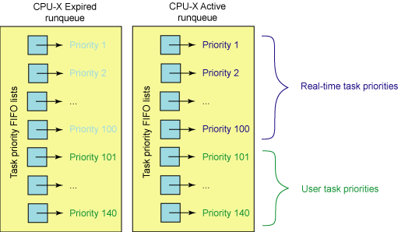
Per-CPU ready queues (“runqueue”)
lock per runqueue
preempt on queue insertion
recalculate priority on expiration
Let’s talk about priority, which is part of the larger story of CPU scheduling.

Slide 148
Separation of policy and mechanism
syscall trap/return
fault/return
system call layer: files, processes, IPC, thread syscalls
fault entry: VM page faults, signals, etc.
thread/CPU/core management: sleep and ready queues
memory management: block/page cache
policy
sleep queue
ready queue
policy
I/O completions
interrupt/return
timer ticks

Slide 149
Processor allocation policy
The key issue is: how should an OS allocate its CPU resources among contending demands?
  We are concerned with resource allocation policy: how the OS uses underlying mechanisms to meet design goals.
  Focus on OS kernel : user code can decide how to use the processor time it is given.
  Which thread to run on a free core? GetNextThreadToRun
  For how long? How long to let it run before we take the core back and give it to some other thread? (timeslice or quantum)
  What are the policy goals?

Slide 150
Scheduler Policy Goals
Response time or latency, responsiveness
  How long does it take to do what I asked? (R)
Throughput
  How many operations complete per unit of time? (X)
  Utilization: what percentage of time does each core (or each device) spend working? (U)
Fairness
  What does this mean? Divide the pie evenly? Guarantee low variance in response times? Freedom from starvation? Serve the clients who pay the most?
Meet deadlines and reduce jitter for periodic tasks (e.g., media)

Slide 151
A simple policy: FCFS
The most basic scheduling policy is first-come-first-served (FCFS), also called first-in-first-out (FIFO).
  FCFS is just like the checkout line at the QuickiMart.
  Maintain a queue ordered by time of arrival.
  GetNextToRun selects from the front (head) of the queue.
wakeup
put
runqueue
get thread to dispatch
get
put
force-yield
quantum expire or preempt
head
tail

Slide 152
Evaluating FCFS
How well does FCFS achieve the goals of a scheduler?
  Throughput. FCFS is as good as any non-preemptive policy.
    ….if the CPU is the only schedulable resource in the system.
  Fairness. FCFS is intuitively fair…sort of.
    “The early bird gets the worm”…and everyone is fed…eventually.
  Response time. Long jobs keep everyone else waiting.
    Consider service demand (D) for a process/job/thread.
D=1
D=2
D=3
Gantt
Chart
D=3
D=2
D=1
3
5
6
Time
tail
CPU
R = (3 + 5 + 6)/3 = 4.67

Slide 153
Preemptive FCFS: Round Robin
Preemptive timeslicing is one way to improve fairness of FCFS.
If job does not block or exit, force an involuntary context switch after each quantum Q of CPU time.
FCFS without preemptive timeslicing is “run to completion” (RTC).
FCFS with preemptive timeslicing is called round robin.
D=3
D=2
D=1
FCFS-RTC
round robin
3+ε
5
6
Q=1
R = (3 + 5 + 6 + ε)/3 = 4.67 + ε
In this case, R is unchanged by timeslicing.
Is this always true?
Context switch
time = ε

Slide 154
Evaluating Round Robin
D=5
D=1
R = (5+6)/2 = 5.5
R = (2+6 + ε)/2 = 4 + ε
  Response time. RR reduces response time for short jobs.
    For a given load, wait time is proportional to the job’s total service demand D.
  Fairness. RR reduces variance in wait times.
    But: RR forces jobs to wait for other jobs that arrived later.
  Throughput. RR imposes extra context switch overhead.
    Degrades to FCFS-RTC with large Q.
Notes:
Linux determines timeslice dynamically on a per-process basis based on priority.

Slide 155
Overhead and goodput
Context switching is overhead: “wasted effort”. It is a cost that the system imposes in order to get the work done. It is not actually doing the work.
This graph is obvious. It applies to so many things in computer systems and in life.
Q/(Q+ε)
1
100%
Efficiency
or goodput
What percentage of the time is the busy resource doing useful work?
Q ε
Quantum Q

Slide 156
Minimizing Response Time: SJF (STCF)
Shortest Job First (SJF) is provably optimal if the goal is to minimize average-case R.
Also called Shortest Time to Completion First (STCF) or Shortest Remaining Processing Time (SRPT).
    Example: express lanes at the MegaMart
Idea: get short jobs out of the way quickly to minimize the number of jobs waiting while a long job runs.
    Intuition: longest jobs do the least possible damage to the wait times of their competitors.
D=1
D=2
D=3
1
3
6
R = (1 + 3 + 6)/3 = 3.33

Slide 157
CPU dispatch and ready queues
In a typical OS, each thread has a priority, which may change over time. When a core is idle, pick the (a) thread with the highest priority. If a higher-priority thread becomes ready, then preempt the thread currently running on the core and switch to the new thread. If the quantum expires (timer), then preempt, select a new thread, and switch

Slide 158
Priority
Most modern OS schedulers use priority scheduling.
  Each thread in the ready pool has a priority value (integer).
  The scheduler favors higher-priority threads.
  Threads inherit a base priority from the associated application/process.
  User-settable relative importance within application
  Internal priority adjustments as an implementation technique within the scheduler.
  How to set the priority of a thread?
How many priority levels? 32 (Windows) to 128 (OS X)

Slide 159
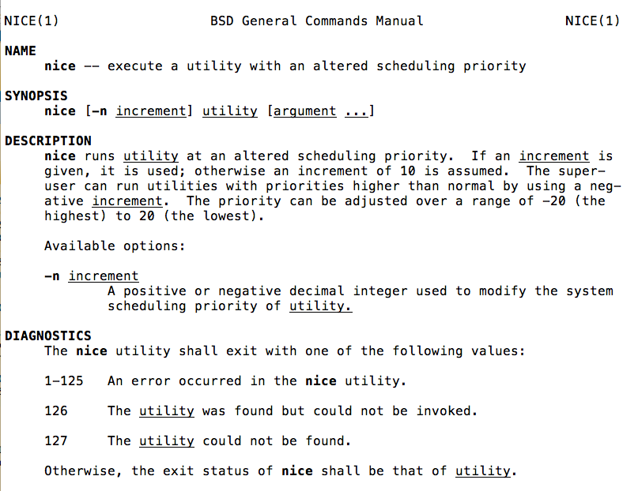

Slide 160
Per-CPU ready queues
On most architectures, a find-first-bit-set instruction is used to find the highest priority bit set in one of five 32-bit words (for the 140 priorities).

Slide 161
Two Schedules for CPU/Disk
1. Naive Round Robin
5
5
1
1
4
CPU busy 25/37: U = 67%
Disk busy 15/37: U = 40%
2. Add internal priority boost for I/O completion
33% improvement in utilization
When there is work to do,
U == efficiency. More U means better throughput.
CPU busy 25/25: U = 100%
Disk busy 15/25: U = 60%

Slide 162
Estimating Time-to-Yield
How to predict which job/task/thread will have the shortest demand on the CPU?
  If you don’t know, then guess.
    Weather report strategy: predict future D from the recent past.
Don’t have to guess exactly: we can do well by using adaptive internal priority.
  Common technique: multi-level feedback queue.
  Set N priority levels, with a timeslice quantum for each.
  If thread’s quantum expires, drop its priority down one level.
    “Must be CPU bound.” (mostly exercising the CPU)
  If a job yields or blocks, bump priority up one level.
    “Must be I/O bound.” (blocking to wait for I/O)

Slide 163
Example: a recent Linux rev
Tasks are determined to be I/O-bound or CPU-bound based on an interactivity heuristic. A task's interactiveness metric is calculated based on how much time the task executes compared to how much time it sleeps. Note that because I/O tasks schedule I/O and then wait, an I/O-bound task spends more time sleeping and waiting for I/O completion. This increases its interactive metric.

Slide 164
Multilevel Feedback Queue
Many systems (e.g., Unix variants) implement internal priority using a multilevel feedback queue.
Multilevel. Separate queue for each of N priority levels.
  Use RR on each queue; look at queue i-1 only if queue i is empty.
Feedback. Factor previous behavior into new job priority.
I/O bound jobs
high
jobs holding resouces
jobs with high external priority
GetNextToRun selects job
at the head of the highest
priority queue: constant time, no sorting
low
CPU-bound jobs
ready queues
indexed by priority
Priority of CPU-bound
jobs decays with system
load and service received.
Notes:
Linux uses a bitmap priority array to figure which queues are populated. X86 provides a find-first-set-bit instruction.
That is the vaunted Linux “O(1)” scheduler.

Slide 165
Thread priority in other queues
The scheduling problem applies to sleep queues as well.
Which thread should get a mutex next? Which thread should wakeup on a CV signal/notify or sem.V?
Should priority matter?
What if a high-priority thread is waiting for a resource (e.g., a mutex) held by a low-priority thread?
This is called priority inversion.

Slide 166
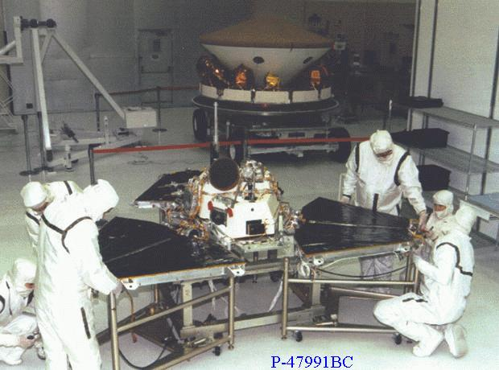
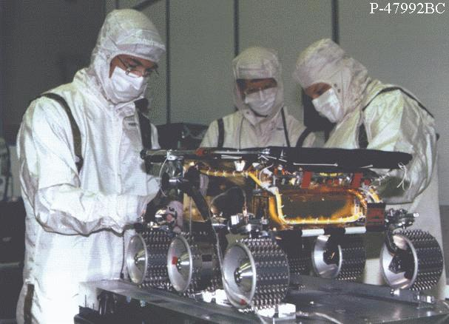
Mars Pathfinder
Mission
  Demonstrate new landing techniques
    parachute and airbags
  Take pictures
  Analyze soil samples
  Demonstrate mobile robot technology
    Sojourner
Major success on all fronts
  Returned 2.3 billion bits of information
  16,500 images from the Lander
  550 images from the Rover
  15 chemical analyses of rocks & soil
  Lots of weather data
  Both Lander and Rover outlived their design life
  Broke all records for number of hits on a website!!!
© 2001, Steve Easterbrook

Slide 167



Pictures from an early Mars rover
© 2001, Steve Easterbrook

Slide 168
Pathfinder had Software Errors
Symptoms: software did total systems resets and some data was lost each time
  Symptoms noticed soon after Pathfinder started collecting meteorological data
Cause
  3 Process threads, with bus access via mutual exclusion locks (mutexes):
    High priority: Information Bus Manager
    Medium priority: Communications Task
    Low priority: Meteorological Data Gathering Task
  Priority Inversion:
    Low priority task gets mutex to transfer data to the bus
    High priority task blocked until mutex is released
    Medium priority task pre-empts low priority task
    Eventually a watchdog timer notices Bus Manager hasn’t run for some time…
Factors
  Very hard to diagnose and hard to reproduce
    Need full tracing switched on to analyze what happened
  Was experienced a couple of times in pre-flight testing
    Never reproduced or explained, hence testers assumed it was a hardware glitch
© 2001, Steve Easterbrook

Slide 169
Internal Priority Adjustment
Continuous, dynamic, priority adjustment in response to observed conditions and events.
  Adjust priority according to recent usage.
    Decay with usage, rise with time (multi-level feedback queue)
  Boost threads that already hold resources that are in demand.
    e.g., internal sleep primitive in Unix kernels
  Boost threads that have starved in the recent past.
  May be visible/controllable to other parts of the kernel

Slide 170
Real Time/Media
Real-time schedulers must support regular, periodic execution of tasks (e.g., continuous media).
E.g., OS X has four user-settable parameters per thread:
  Period (y)
  Computation (x)
  Preemptible (boolean)
  Constraint (<y)
Can the application adapt if the scheduler cannot meet its requirements?
  Admission control and reflection
Provided for completeness

Slide 171
What’s a race?
Suppose we execute program P.
The machine and scheduler choose a schedule S
  S is a partial order of events.
The events are loads and stores on shared memory locations, e.g., x.
Suppose there is some x with a concurrent load and store to x.
Then P has a race.
A race is a bug. The behavior of P is not well-defined.

