Slide 1
Threats and defenses
Jeff Chase
Duke University

Slide 2
Protection: abstract concept
Running code can access some set of data.
Code == program, module, component, instance,
Data == objects, state, files, VM segments…
We call that set a domain or protection domain.
Defines the “powers” that the running code has available to it.
Determined by context and/or identity (label/attributes).
Protection domains may overlap (data sharing).
Domain: a set of accessible names bound to objects. Accesses are checked by a reference monitor.
Yes, this is verrry abstract.
domain
data
code

Slide 3
Protection: concept
Examples
A Unix program running in a process (VM/VAS).
The machine checks address references against the VAS maps.
The kernel checks references to files, ports, etc.
A web script running in a browser.
Browser checks access to data, cookies, server URLs.
A Java procedure.
JVM+libs check all accesses.
Java Security Architecture
domain
data
Java bytecode can access nothing more than the object references passed to it, because Java is type-safe: e.g., no pointer arithmetic.
This a form of language-based protection.
code

Slide 4
Concept: enforced modularity
pipe
(or other channel)
domain (“context”)
domain (“context”)
An important theme
By putting each program or module instance in a separate process, or (more generally) protection domain, we can enforce modularity boundaries. Each module runs in a sandbox: they can interact only through pipes or some other communication channel (e.g., a network socket). Neither can access the internals of the other.

Slide 5
Sandbox vs. lockbox
Consider two program instances A and B, each instance running within its own protection domain (e.g., process).
Domain is a sandbox: “can’t get out”.
If all code runs in a sandbox, then we can think of domain (loosely) as a lockbox: “can’t get in”.
It is my sandbox that stops me from nosing into your data.
Lockbox what we mean by isolation boundary.
A
B

Slide 6
Abstract concept: Trusted Computing Base (TCB)
The OS kernel sees everything.
No sandbox: it can access anything on the machine.
There is nothing to protect your “lockbox” from it.
Everybody trusts the kernel: Trusted Computing Base
TCB is the software that implements/enforces the sandboxes.
TCB defines everything you can see or do.
A
B
Kernel (TCB)

Slide 7
Rootkit
If an attacker subverts/compromises the kernel (TCB), then all bets are off.
The machine is “rooted”: the attacker has full control.
Attacker may install a rootkit: software that maintains continuous and/or undetectable control.
A rootkit can:
Log keystrokes
Hook system APIs
Open attacker backdoor
Subvert (re)boot
Etc….

Slide 8
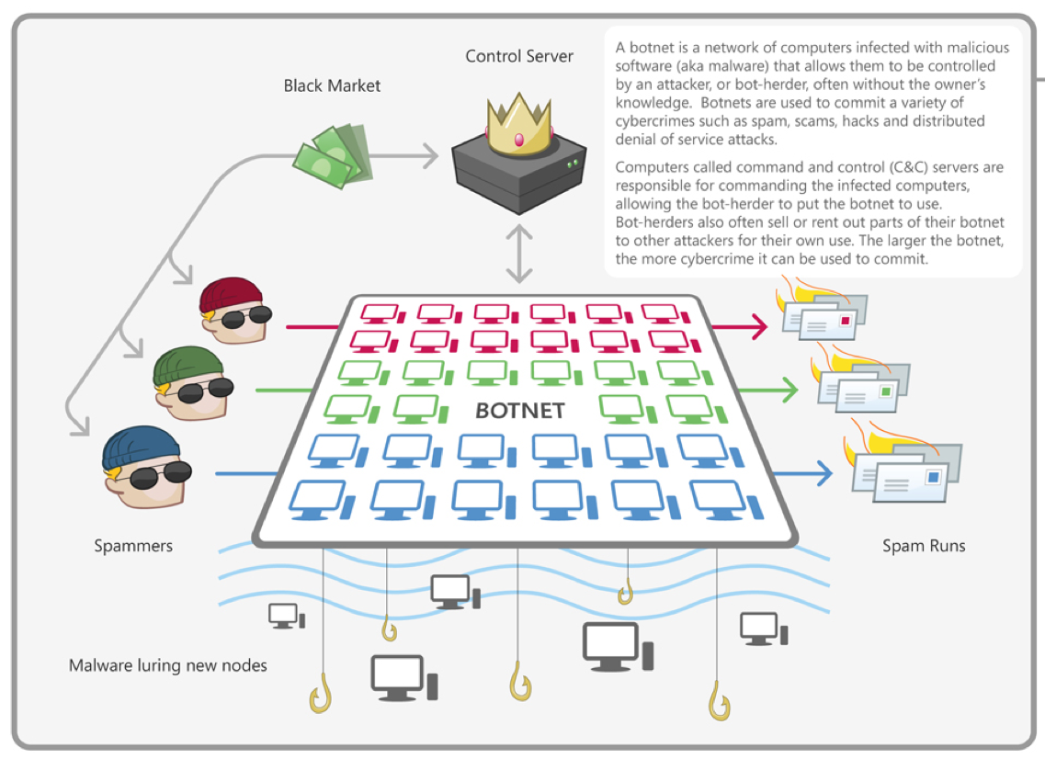
[microsoft.com]

Slide 9
Subverting protection
If we talk about protection systems, we must also talk about how they can fail.
One way is for an attacker to breach the boundary.
A more common way is for an attacker to somehow choose the code that executes inside the boundary.
For example, it can replace the guard, install a backdoor, or just execute malicious ops directly.
Inside job
But how?
Install or control code inside the boundary.

Slide 10
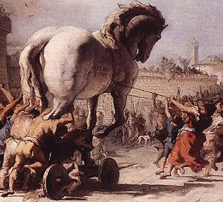
Any program you install or run can be a Trojan Horse vector for a malware payload.

Slide 11
Breaking the lockbox
If any part of a domain is tainted…
Then all of the domain is tainted.
Attacks propagate: the attacker modifies a program or uses an identity that another victim trusts.
An attacker with root controls the machine and anyone who uses it.
A
B
write
exec

Slide 12
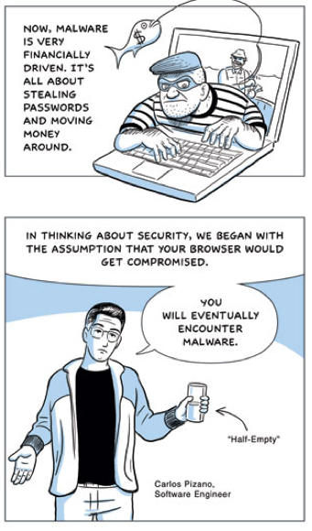
Browser as TCB?
Web scripting is a potential attack vector.
E.g., Javascript
Java applets
If a script can subvert your browser, how much damage can it do?

Slide 13
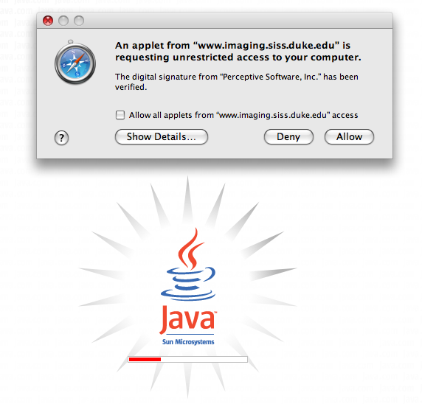
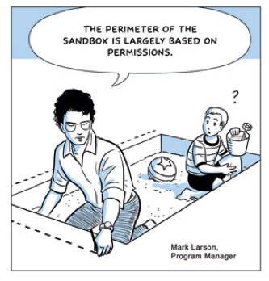

Slide 14
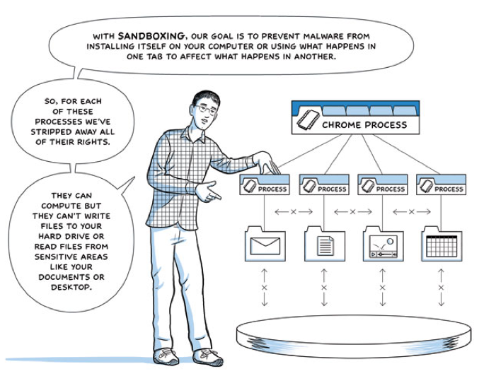

Slide 15
Enterprise security
How to gain access to an enterprise?
Compromise a user with access (e.g., admin).
Attack across the boundary, i.e., over the net.

Slide 17
2/19/13
Advanced Persistent Threat

Slide 18
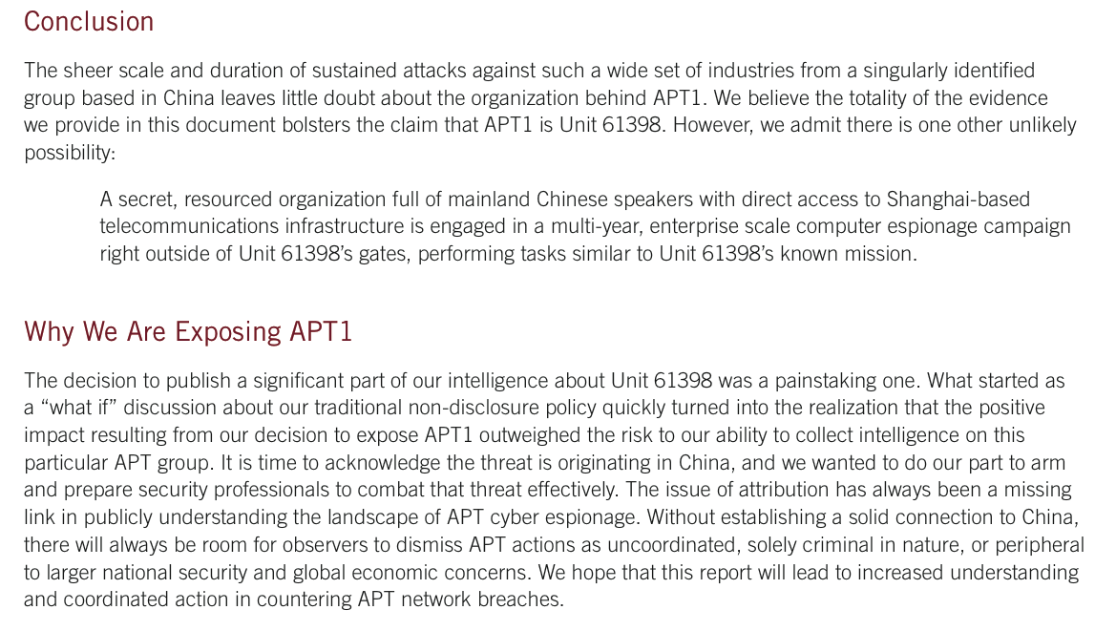

Slide 19
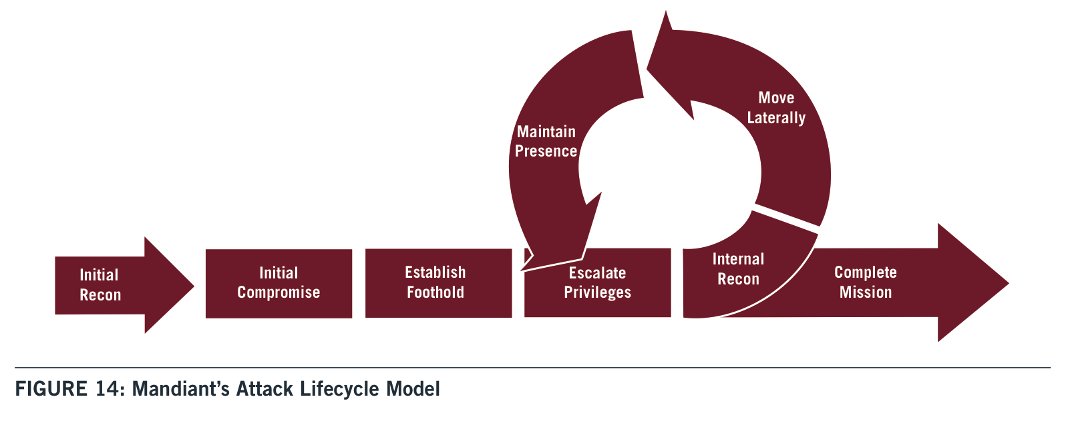
Typically open with a spear phishing attack containing a trojan horse
Spread to other users or machines.
Privilege escalation
to compromise trusted software or accounts
(e.g., buffer overflow or password crack)

Slide 20
The Initial Compromise stage represents the methods that intruders use to penetrate a target organization’s network. APT intruders frequently target individual users within a victim environment. As such, the most commonly observed method of initial compromise is spear phishing. Spear phishing messages may contain malicious attachments, a link to a malicious file, or a link to a malicious website. Less commonly, APT intruders may attempt to contact potential victims and send malicious content via social networking sites or instant messaging. Another common tactic is strategic web compromise, in which the attacker places malicious code on websites that people in targeted organizations will likely visit. When they visit these websites in the course of their normal duties, they will be compromised if their ^{computer} is vulnerable to the attacker’s exploit code. APT groups may also look for vulnerable Internet-facing web servers and upload webshells in order to gain access to a target’s internal network, or look for other technical vulnerabilities in public-facing infrastructure.
^{P63 appendix}

Slide 21
Phishing, password attacks, and other “social” attack vectors.

Slide 22
technology
people
Where are the boundaries of the “system” that you would like to secure?
Where is the weakest link?
What happens when the weakest link fails?

Slide 23
The First Axiom of Security
“Security is at least as much a social problem as it is a technical problem.”
Translation: humans are the weak link.
Never lose sight of the social dimension.
Keys left in lock
Phishing
Executable attachments
Trojan software
Post-it passwords
Bribes, torture, etc.
Etc.

Slide 24
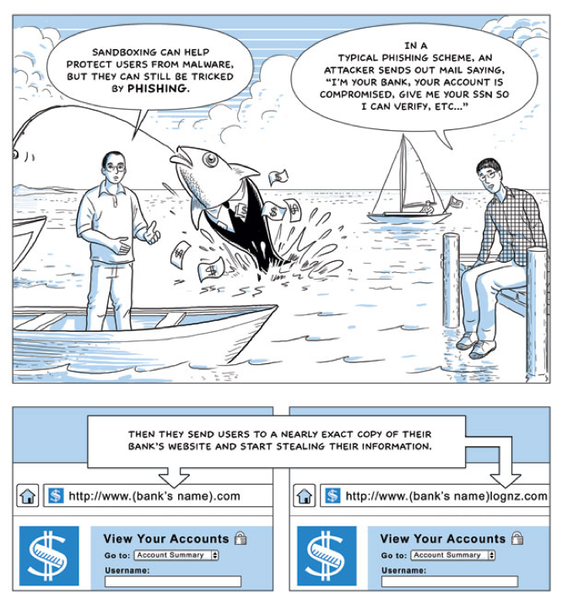
Phishing

Slide 25
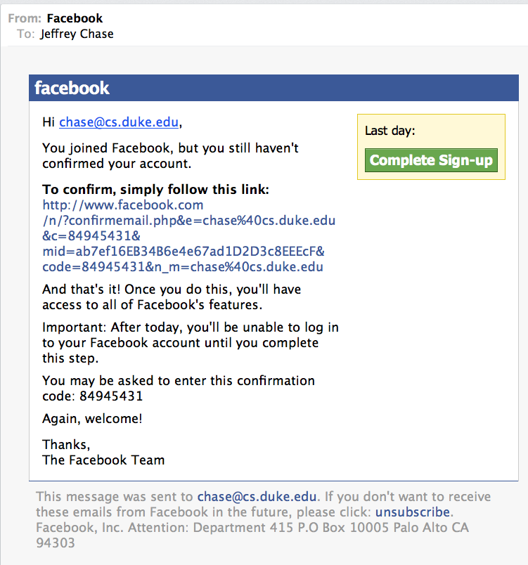

Slide 26
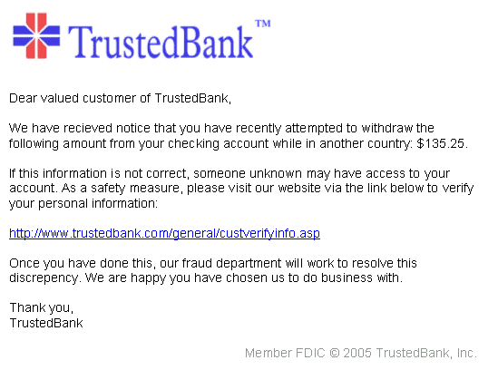
[wikipedia]

Slide 27
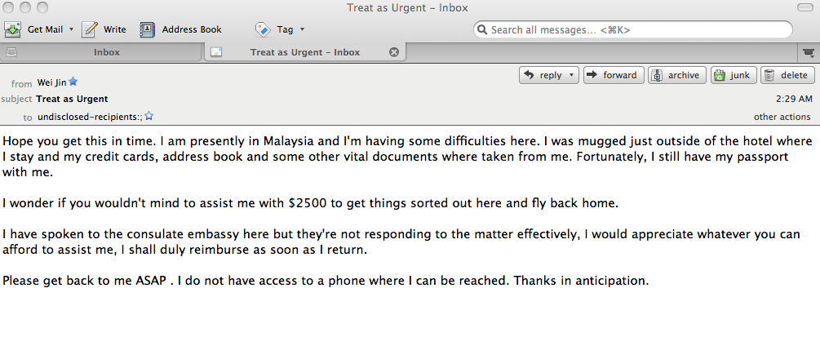
A form of spear phishing?
Former Student
Spear phishing is a social engineering attack. It is a phishing attack targeted at a specific individual. E.g., the attack message is designed to look like a communication from a trusted associate of the victim.

Slide 28
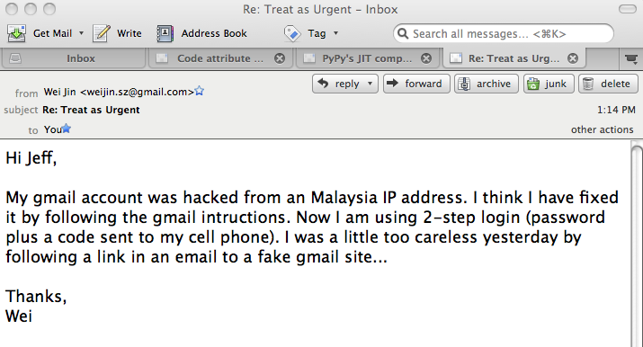
How accidents happen
Former Student
In this instance the attack came from a compromised e-mail account.

Slide 29
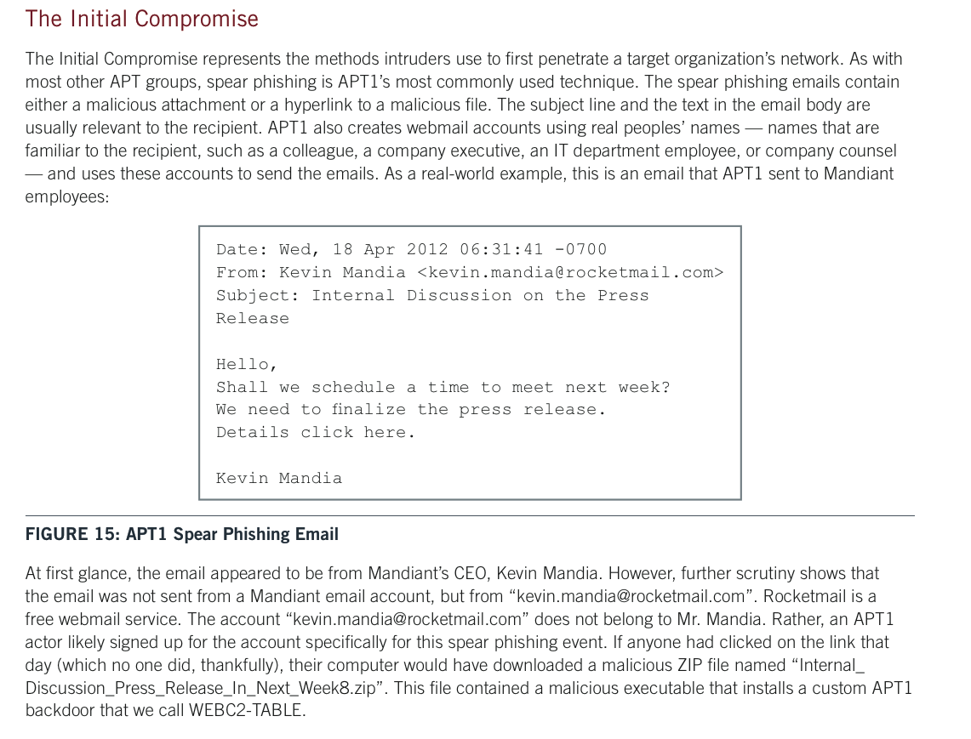

Slide 30
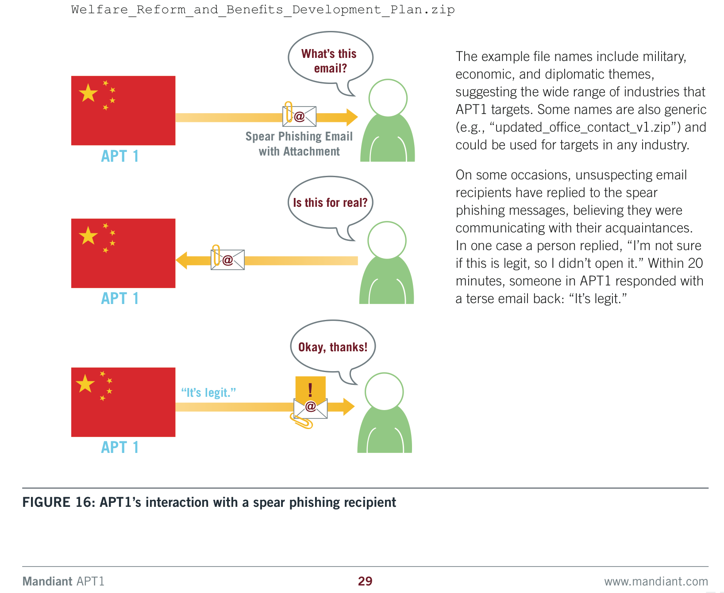
How not to authenticate an e-mail

Slide 31
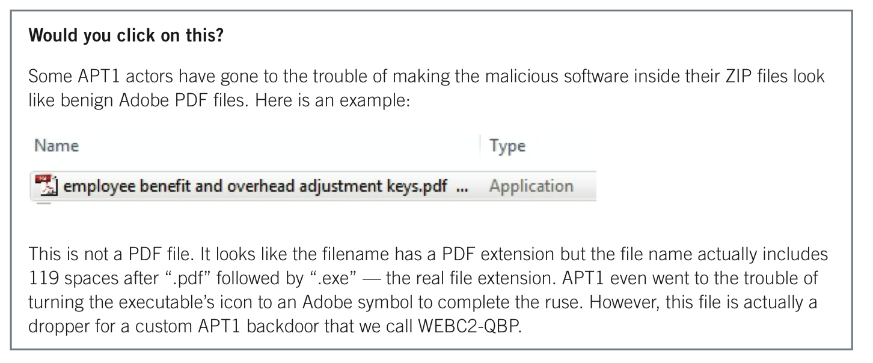
Click on it?

Slide 32
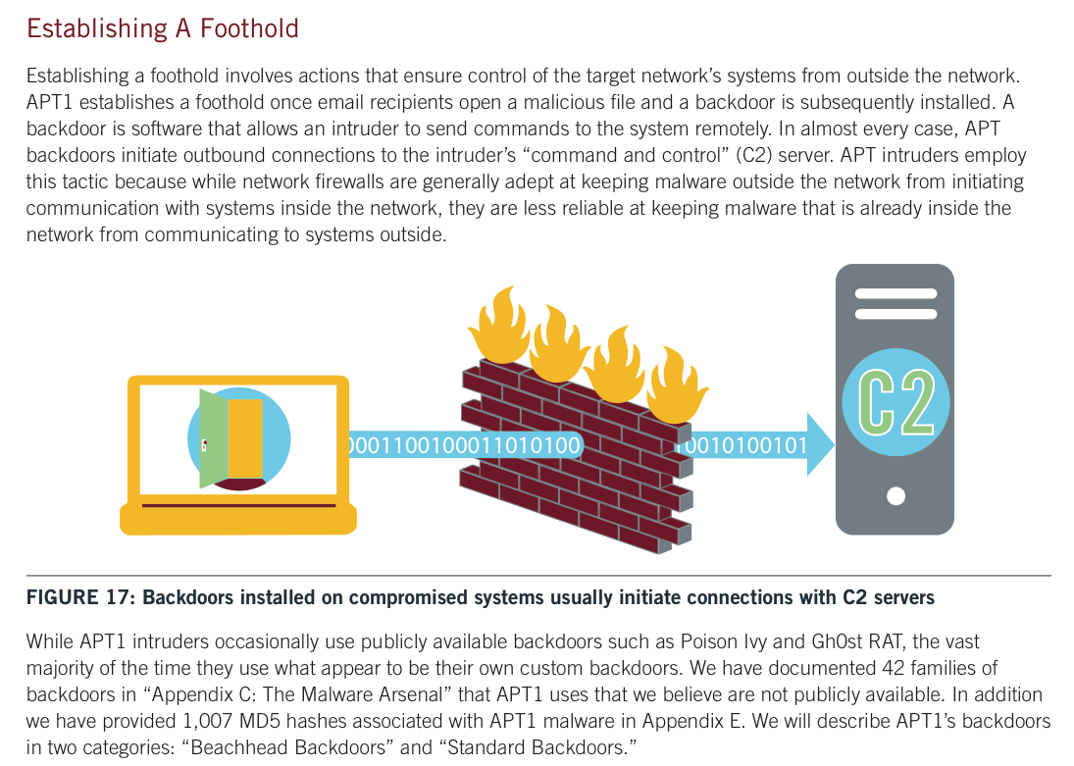

Slide 33
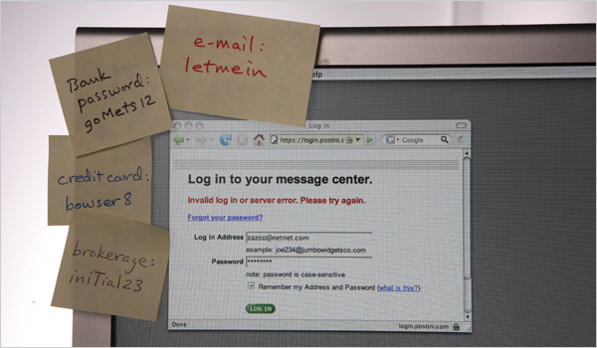

Slide 34
Crypto: The Basics
Jeff Chase
Duke University

Slide 35
Security, an overview
We reduce it to three intertwined issues:
What program am I running?
Can this program be trusted? Who says?
Can I be sure that the program has not been tampered?
Who am I talking to?
Can this entity be trusted?
Can I be sure the communication has not been tampered?
Should I approve this request? R(op, subject, object)
Who is the requester? (subject)
What program is speaking for the requester?
Does the subject have the required permissions?

Slide 36
Elements of security
Isolation/protection
Sandboxes and boundaries prevent unchecked access.
Integrity
Fingerprint data to detect tampering.
Encrypt data to prevent access or tampering.
Authentication
Identify a peer by proof that it possesses a secret.
Identity and attributes
Identities have credentials: names, tags, roles...
Authorization == access control
Guard checks credentials against an access policy.

Slide 37
Principals in a networked system
Principals are users or organizations, or software entities acting on their behalf.
Mallory
Bob
attack
How can principals communicate securely? How do they decide whom to trust?
Alice

Slide 38
Crypto primitives
Encrypt/Decrypt
Use a shared secret key
(symmetric)
or
use a keypair
one public, one private
(asymmetric)
Signing
Secure hashing
useful for
fingerprinting data

Slide 39
Finishing up from last time
Mandiant discovered that APT1 used a common technique to expand their foothold on a compromised target:
Harvest hashed passwords.
See Mandiant’s list of privilege escalation tools used.
Crack the passwords offline.
Most likely a dictionary attack.
Easy to parallelize.
Easy to defeat, but requires good security practices.
Use the stolen passwords to get more.

Slide 40
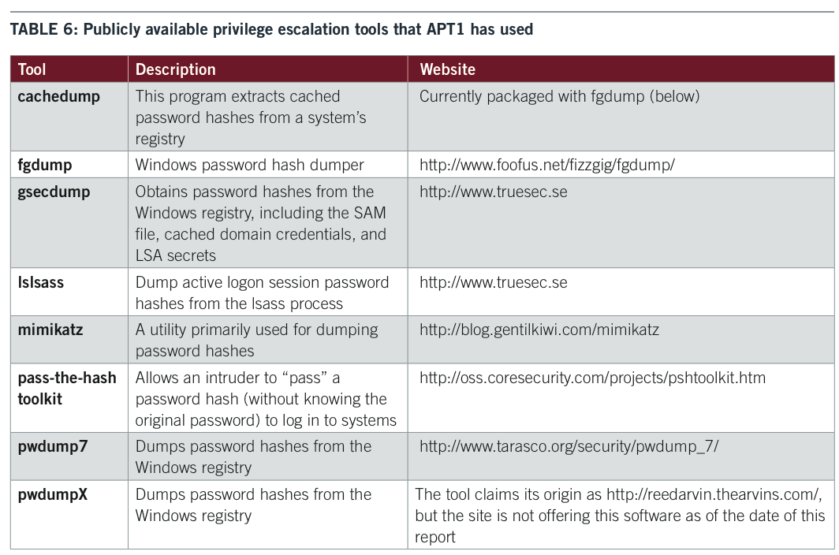

Slide 41
Hashed password file
#
hashed
This is a line from /etc/passwd for user Fred Flintstone.
login uses this record to validate the user’s password.
The file is public, but Fred’s password is secret.
Or is it?

Slide 42
Cryptographic hashes
#
Also called a secure hash or one-way hash
E.g., SHA0, MD5, SHA1, SHA2, SHA3
Result called a hash, checksum, fingerprint, digest
Very efficient
SHA-x: Secure Hashing Algorithm
SHA1 hash
“Hash digest”
Arbitrarily large
160 bits

Slide 43
Properties of Secure Hashing
Collision-resistant
There exist distinct M₁ and M₂ such that h(M₁) == h(M₂).
Such collisions are “very hard” to find.
One way
Given digest, cannot generate an M with h(M) == digest.
Such collisions are “very hard” to find.
Secure
The digest does not help to discover any part of M.
#
X
X
#
SHA1
SHA1
Cheap
“Computationally infeasible”

Slide 44
Using hashed passwords
This protocol takes place over an encrypted connection. The connection is established first, e.g., using SSL/TLS. (later)
Threat model: attacker steals stored password from server.
Defense: the server stores a hash of the password, and not the password itself. So an attacker cannot steal the password.
“Hi, this is server. Login please.”
“I’m fflintstone. Password: yabbadabbado.”
Server code:
phash = SHAx(“yabbadabbado”);
shash = getStoredHash(“fflintstone”);
verify shash == phash;
Server
Fred
“Hi Fred. Welcome back.”
…

Slide 45
Let’s get this right
Hashing is not encryption.
“One way” → No way to decrypt!
No keys!
Client uses password to login, and not the hash.
If the hash alone is sufficient to log in, then an attacker who gains access to the hashed password file can compromise all accounts, even without knowing the “real” passwords!
The goal is not to protect the password in transit: we use encryption for that. We want to protect it on the server.
Server must remember something about a password so that it can verify it, but a hash is “good enough”: the server doesn’t need to remember the password itself.
So: server stores the hash, and forgets the password.

Slide 46
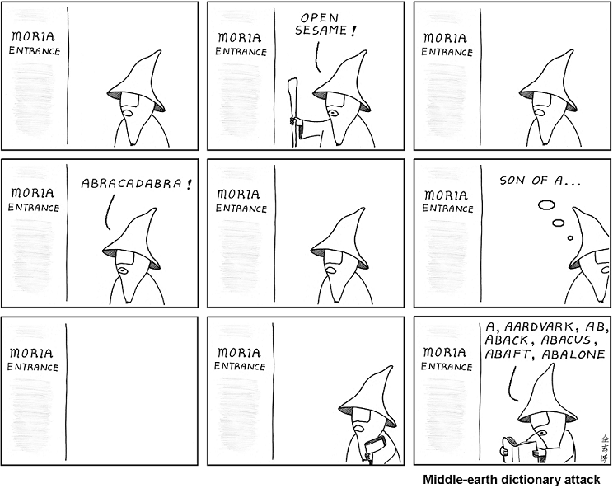
abstrusegoose.com

Slide 47
Dictionary attack
Just to spell it out…
Pick a candidate password P.
Compute H(P) or look it up in a table of precomputed hashes such as a “rainbow table”.
Compare H(P) to the hashed password.
If it’s a match, then you win: the victim’s “secret” password is P. Use P to masquerade as the victim. The victim loses.
Else go to step 1. Repeat as necessary.
Defenses:
(1) Pick a secret P that is “hard to guess”. (2) Add “salt”.

Slide 48
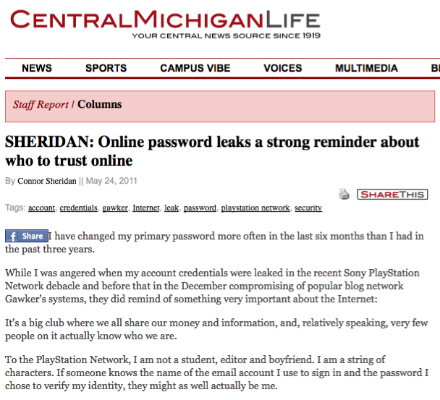
Obviously these passwords are not “hard to guess”. No meaningful password is hard to guess, because there is a limited number of meaningful passwords to choose from.

Slide 49
Digitally signed code
Another topic we touched on last time was digital signing of programs to verify that they originated from some trusted source.
Digital signatures combine hashes with encryption.
So we need to learn about some crypto.

Slide 50
wired.com, June 2012
Reuters, June 2012

Slide 51
Cryptography for Busy People
Standard crypto functions parameterized by keys.
Fixed-width “random” value (length matters, e.g., 256-bit)
Symmetric (DES: fast, requires shared key K1 = K2)
Asymmetric (RSA: slow, uses two keys)
“Believed to be computationally infeasible” to break
M
Encrypt
K1
E
M
Decrypt
D
K2
[Image: Landon Cox]

Slide 52
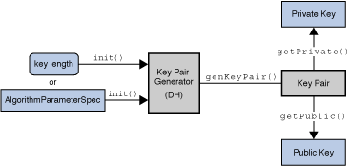
Asymmetric (public key) crypto
Each subject/principal possesses a keypair.
Decrypt(K, Encrypt(K⁻¹, M)) = M
Keep one key private; the other is public.
Either key can be used to encrypt/decrypt.
If we know one another’s public keys then we can communicate securely.
Anyone can mint a keypair.

Slide 53
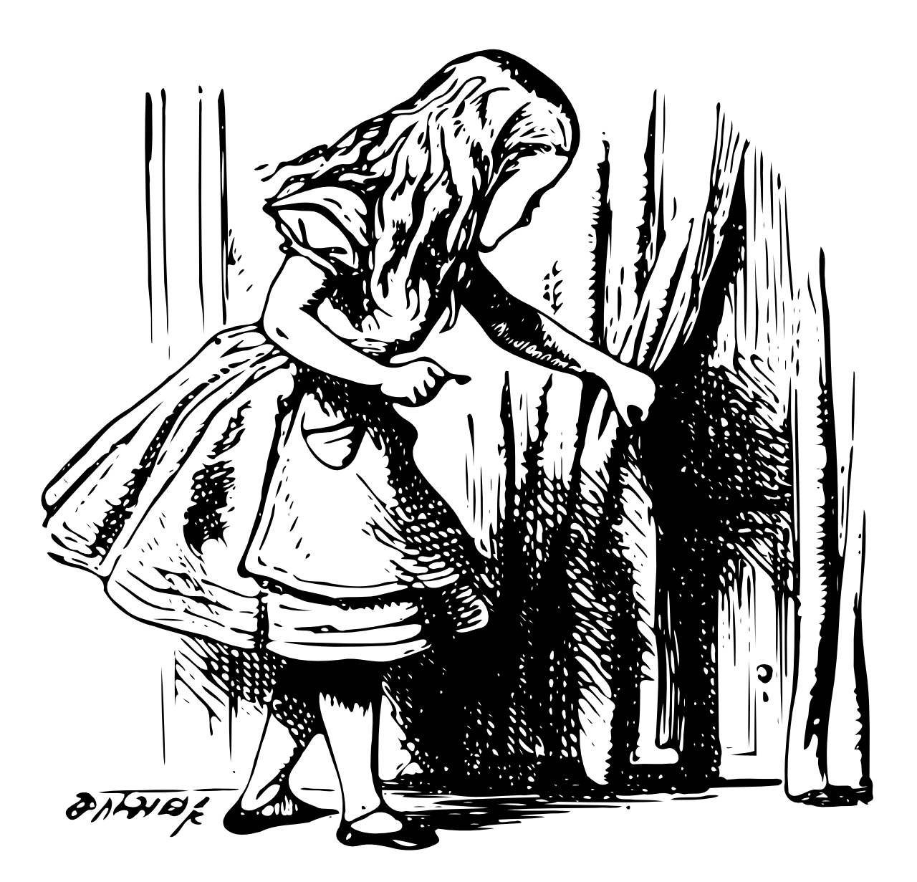
Asymmetric crypto works both ways
Crypt
E
A’s private key
or
A’s public key
Crypt
D
A’s public key
or
A’s private key
[Landon Cox]

Slide 54
Useful?
A can send a message to B, encrypted with A’s private key.
B can send a message to A, encrypted with A’s public key.
Benefits? Other possibilities?

Slide 55
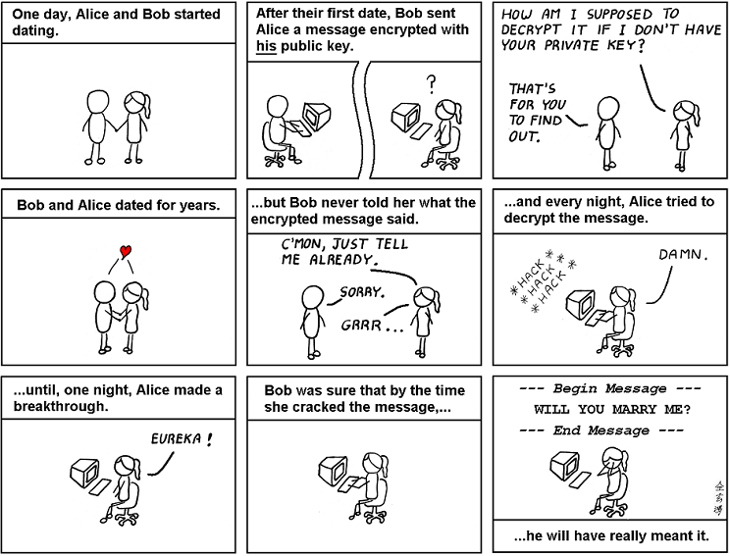
abstrusegoose.com

Slide 56
Spelling it out
Do encrypt message M with your private key to authenticate it, i.e., to convince the recipient that M really came from you.
Better yet, digitally sign M: that’s faster (next).
Do encrypt M with the recipient’s public key to keep it secret: only the intended recipient can decrypt it.
Don’t encrypt M with your public key: it’s just weird and pointless, since nobody else can read the encrypted message. Bob probably blew his chances with Alice.
Don’t encrypt M with the recipient’s private key: if you know someone’s private key then you should not use it! Forget it and don’t tell anyone.

Slide 57
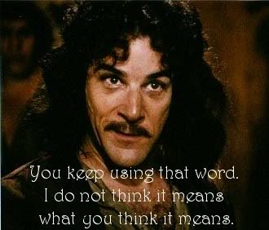
Can an attacker break the crypto?
This slide is a dated cultural reference to the 1987 film The Princess Bride, which has some blood and cruelty and uncommonly large rodents but is otherwise recommended for grownup children of all ages, and is delightful not least for its music by Mark Knopfler. Names and images are used without permission for educational purposes.

Slide 58
Follow best practices for crypto, from authoritative sources. Best practices change frequently! Key sizes must grow as computational power increases.
Cryptographic Key Management Project
Cryptographic Key Management (CKM) is a fundamental part of cryptographic technology and is considered one of the most difficult aspects associated with its use. Of particular concern are the scalability of the methods used to distribute keys and the usability of these methods. NIST has undertaken an effort to improve the overall key management strategies used by the public and private sectors in order to enhance the usability of cryptographic technology, provide scalability across cryptographic technologies, and support a global cryptographic key management infrastructure.
[http://csrc.nist.gov/groups/ST/key_mgmt/]

Slide 59
Digital Signature
A hash digest of message M encrypted with principal B’s private key is called a digital signature
Unforgeable. “Proves” that B sent M.
Certified. “Proves” M has not been tampered.
Non-repudiable. B cannot deny sending M.
But not private.
Alice,
Will you marry me?
Signed, Bob

Slide 61
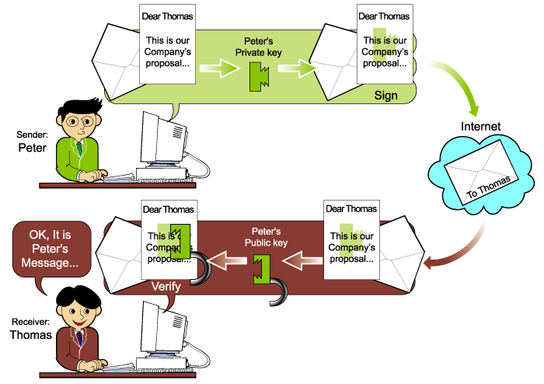
http://pst.libre.lu/mssi-luxmbg/p1/04_auth-art.html

Slide 62
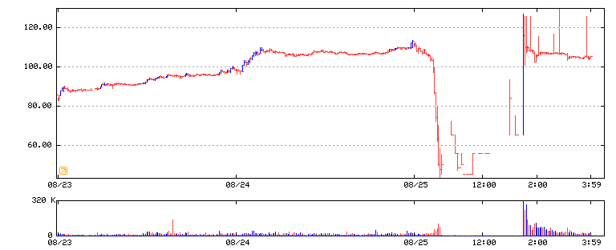
Authentication and integrity
This is a picture of a $2.5B move in the value of Emulex Corporation, in response to a fraudulent press release by short-sellers through InternetWire in 2000. The release was widely disseminated by news media as a statement from Emulex management, but media failed to authenticate it.
EMLX
[reproduced from clearstation.com]

Slide 63
Two “key points”
Digital signatures are “stronger” than physical signatures, because they are bound to the document contents.
Attacker cannot change the document contents without invalidating the signature.
To verify a signature, the receiver must already know the public key of the signer.
And it must be right.
But how to know for sure?

Slide 64
Finding the right key
How does Alice know Bob’s public key?
Alice,
Will you marry me?
Signed, Bob

Slide 65
Endorsements: certificates
A principal may endorse another’s key.
Issue a signed statement containing the key, and some statement about the key.
We call it a certificate.
But how does anyone know the endorser’s key?
Certificate
Term of validity
Issuer’s name (or key)
Bob’s key is 247E6F1A…
Signature

Slide 66
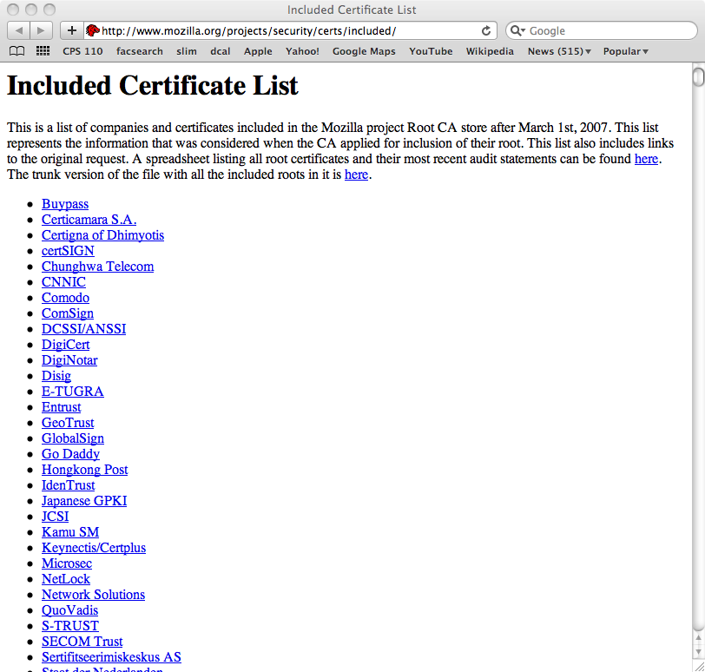
We can learn about keys from a chain of endorsements rooted in some trust anchor, whose key we “just know”.
Example: root certifying authorities (CAs) whose keys are baked into your Web browser.

Slide 67
PKI →Trust management
An entity A delegates trust to another by endorsing its public key as bound to a global name or some other attribute.
The delegation is an assertion of fact by the issuer A, and is issued as a certificate that is digitally signed by A.
In a standard x.509 identity cert (e.g., issued by a PKI CA for web), the attribute is a distinguished name.
e.g., “Alice” or “amazon.com”
PKI- CA: Public Key Infrastructure, Certifying Authority
Certificate
Term of validity
Issuer’s name (or key)
A.trusts ← B
Payload: statement
A
B
trusts
Signature

Slide 68
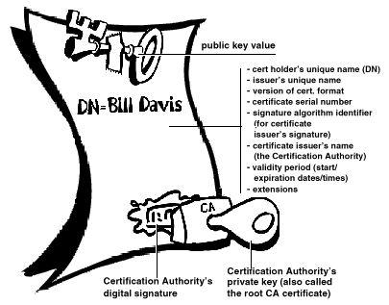
A Digital Certificate (X.509)

Slide 69
“It’s not hard”
public Identity(String cn) throws
CertificateException, NoSuchAlgorithmException,InvalidKeyException,
NoSuchProviderException, SignatureException, IOException {
X509V1CertificateGenerator gen = new X509V1CertificateGenerator();
kp = KeyPairGenerator.getInstance("RSA").genKeyPair();
gen.setIssuerDN(new X500Principal("CN=" + cn));
gen.setSubjectDN(new X500Principal("CN=" + cn));
gen.setNotAfter(new Date(System.currentTimeMillis()
+ 3600 * 1000 * 24 * 365));
gen.setNotBefore(new Date(System.currentTimeMillis()));
gen.setSerialNumber(BigInteger.valueOf(System.currentTimeMillis()));
gen.setPublicKey(kp.getPublic());
gen.setSignatureAlgorithm("SHA256WithRSAEncryption");
X509Certificate a = (X509Certificate) gen.generate(kp.getPrivate(), "BC");
init(a);
}

Slide 70
What happens…
https://www.shop.com/shop.html
How to authenticate shop.com?
How to assure integrity/privacy of communications?
How to prevent man-in-the-middle attack?
How does shop.com authenticate you?
Answer: Secure Sockets (SSL) or Transport-Layer Security (TLS)

Slide 71
Mallory-in-the-Middle attack
request
request
“GET fish.gif…”
“GET fish.gif …”
reply
reply
client (initiator)
server
If an attacker can interpose between two interacting entities, she can read and modify the messages at will without detection by either victim.

Slide 72
Symmetric Crypto
“Secret key” or “private key” cryptography.
DES, 3DES, DESX, IDEA, AES
Sender and receiver must possess a shared secret
Shared key K
K = K1 = K2
Message M, Key K
{M}_{K} = Encrypt(M, K)
M = Decrypt({M}_{K} , K)
How to arrange a shared secret?
Key distribution problem

Slide 73
Example: Java KeyGenerator class
“A key generator is used to generate secret keys for symmetric algorithms.” [oracle.com]
But how to share the secret securely? This is the key distribution problem.

Slide 74
Example: Java Cipher class
“The Cipher class provides the functionality of a cryptographic cipher used for encryption and decryption. Encryption is the process of taking data (called cleartext) and a key, and producing data (ciphertext) meaningless to a third-party who does not know the key. Decryption is the inverse process: that of taking ciphertext and a key and producing cleartext.” [oracle.com]

Slide 75
Symmetric and Asymmetric Crypto: Better Together
Use asymmetric crypto to “handshake” and establish a secret session key (slow, but allows for key distribution).
Then use the key to talk with symmetric crypto (fast and cheap)
Example: Secure Sockets Layer (SSL) or Transport-Layer Security (TLS), used in HTTPS (Secure HTTP), SSH, SCP, etc.
“SYN, etc.”
“My public key is K.”
“Let’s establish a session key: {S}_{K} .”
Client
{M}_{S}
Server
[encrypted data or content]
…

Slide 76
What are we missing?
Does C know (believe) that K really is the public key of S?
How to authenticate S?

Slide 77
How does C know the public key of S?

Slide 78
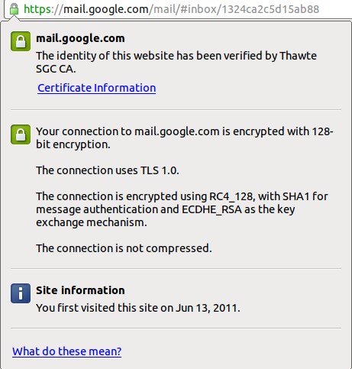

Slide 79
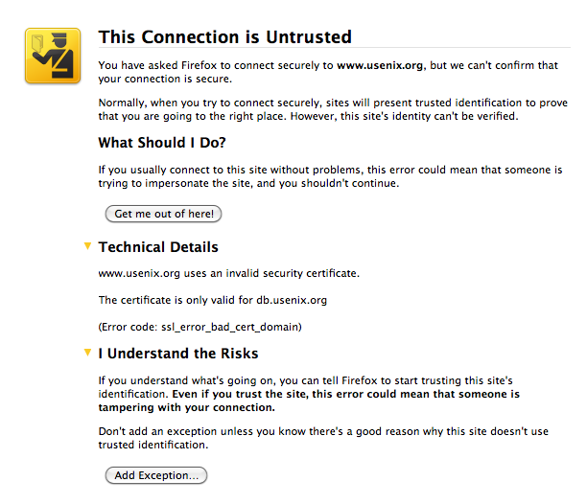

Slide 80
Take a breath
Your browser can verify the server identity if it knows the “real” server’s public key.
The server presents a certificate endorsed by a third party (CA).
Your browser can verify the certificate if it knows the CA’s public key.
How does your browser know the CA’s public key?

Slide 81
The CA’s public key is “baked into your browser”. You trust your browser provider to install a list of CAs that you can trust. Any CA on the list can issue a certificate for any name and any public key, and your browser will believe the asserted binding.
What could go wrong?
Reference: google “certified lies”, e.g., see the 2010 paper by Soghoian and Stamm.

Slide 82
Summary: HTTPS etc.
When the server passes its public key K to the client, it also passes a certificate issued by a CA. The certificate endorses the key K and binds K to a DNS name (e.g., amazon.com).
The client’s browser validates the server’s certificate and checks to verify that the DNS name matches the DNS name in the https URL that the client is fetching. I.e., the certificate "proves" that the server is the "right" server for the requested URL.
The client can validate the server's certificate iff the client (browser) trusts the issuing CA. How does the client know if it trusts the issuing CA? The browser has a "baked in" list of trusted CAs and their public keys.
The client chooses a session key and encrypts it with the server’s public key K, which it obtains from the cert. The session key is a secret shared by the client and server: the server can decrypt it (since it has the corresponding private key), but nobody else can.
What could go wrong? Should you trust your browser provider to make the list of trusted CAs? How can you can be sure that you have the "true" browser code with the "true" list, per "reflections on trusting trust" discussed earlier in the semester? Also, what if a CA goes rogue? Or loses its private key in an attack?

Slide 83
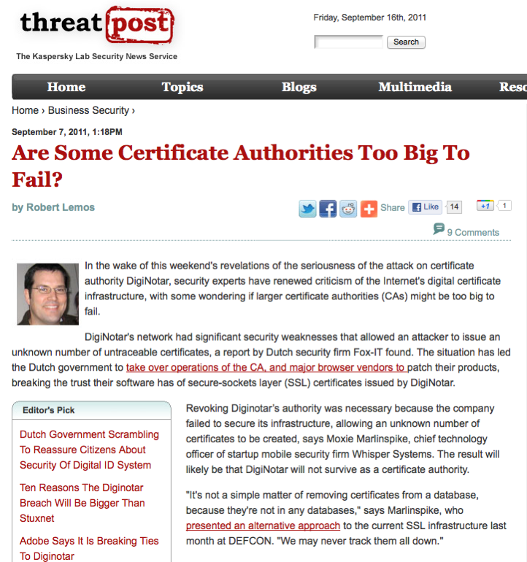

Slide 84
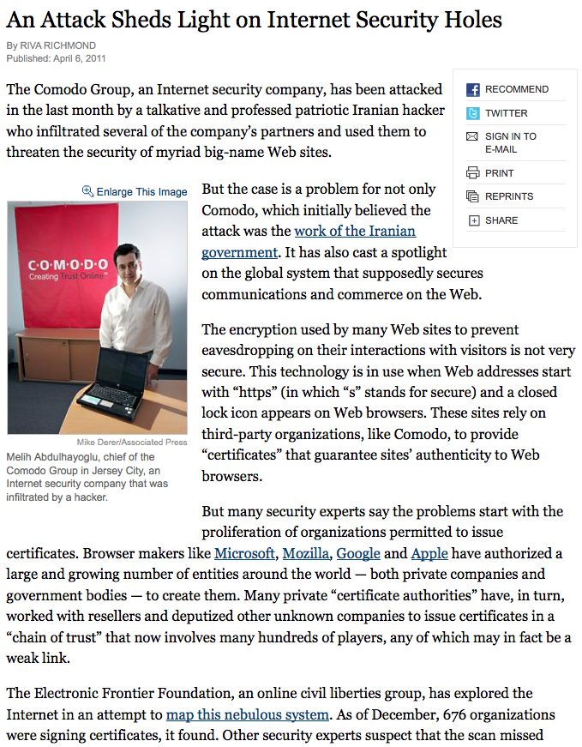

Slide 86
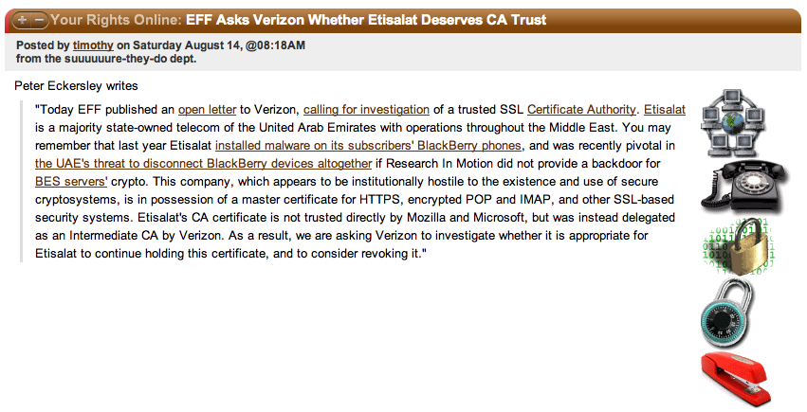

Slide 87
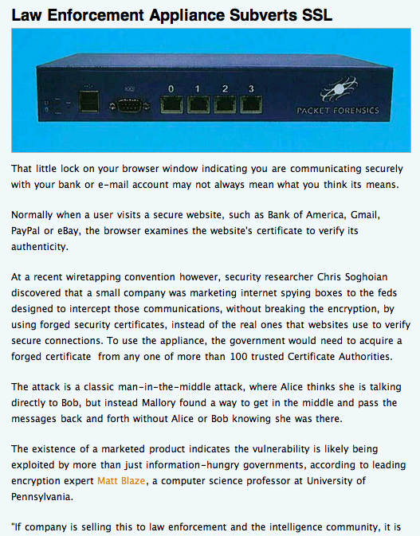

Slide 88
SSL is not so simple…
How do we know who we are talking to?
Do we care? Somebody does…
In SSL, either party MAY present a certificate.
At least one MUST (e.g., server to validate key K).
How to prevent replays of encrypted content?
Nonces, serial numbers, timestamps
SSL/TLS uses this basic handshake protocol, but there are some subtleties:
Hashes and MACs

Slide 89
Secure HTTP
Uses SSL/TLS over TCP for “end-to-end” security.
Browser always authenticates the server.
Server presents certificate signed by root CA.
Domain name must match the certificate, etc.
Browser has some set of public keys for root CAs wired into it, so it can check the signature.
Server optionally requests to authenticate the browser (user or user agent).
Browser presents certificate, OR
Password authentication is much more common. (why?)
Browser and server negotiate a bulk cipher and secret session key as in “Better Together” above.

Slide 90
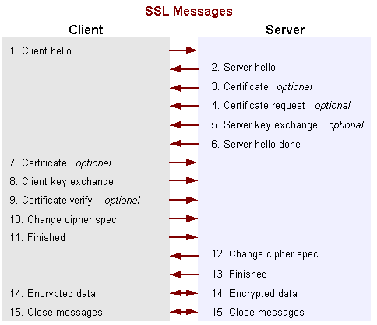
SSL in detail
http://docs.oracle.com/javase/7/docs/technotes/guides/security/crypto/CryptoSpec.html

Slide 91
Public Key Infrastructure (PKI)
Assumption: everyone trusts some root CAs.
Institutions/organizations set up their own CAs, and the root CAs endorse them to issue certificates for their members.
$$$
Recursively, to form a hierarchy like DNS.
Delegation of Authority
Network applications will have access to the keypairs and certificates of their users, and will validate the certificates of servers.
Any day now…

Slide 92
Simple shared-secret based cryptographic authentication
shuque@isc.upenn.edu

Slide 93
Add mutual authentication
shuque@isc.upenn.edu

Slide 94
Two “Key points”
The random challenge is a nonce.
“number used once”
Understand why the protocol uses a nonce.
In order for this protocol to work, Alice and Bob need a shared secret.
How can they establish this shared secret safely?

Slide 95
Note on nonces
A nonce is just a unique value we put into a message to distinguish it from all other messages: we use each nonce value at most once: nonce means "number used once”. A timestamp is an example of a nonce: the current time is different from all previous times.
The purpose of a nonce is to defend against a replay attack, in which the attacker replays a previous signed or encrypted message that is still meaningful. Even if an attacker lacks the keys to inject a valid message into a security protocol, it might be able to replay an old message to subvert the protocol somehow. A nonce defends against that because it allows the receiver to determine if a message is fresh, i.e., to detect a replayed message as invalid.
For example, in the classic challenge-response authentication protocol (similar to the military Identify Friend or Foe protocol), the challenge value is a nonce. The protocol is: I make up a nonce and send it to you as a challenge, and you decrypt it and/or encrypt/sign it and send it back, thereby proving that you possess a necessary key. The challenge value must be a nonce: if I use the same challenge repeatedly, then an attacker could overhear a valid response to an earlier challenge, and then replay the response for a future challenge.
Nonces are important. A formal analysis of the classic Needham-Schroeder authentication protocol found it to have a crucial flaw due to lack of a nonce in one step of the protocol. Note: this protocol addresses the problem raised in the challenge-response slides: it establishes a shared secret between two parties via brokering by a trusted intermediary. It is similar to the protocol used in Shibboleth Web Single Sign On (e.g., for Duke NetIDs): the trusted intermediary is a Shibboleth identity provider.

Slide 96
Distributing session keys
We want to use symmetric crypto because it is cheap.
But we need a way to negotiate and distribute a shared secret (session key).
Two examples:
SSL/TLS/HTTPS
Kerberos (Needham/Schroeder) authentication protocol
Single Sign-On (SSO), like the Shibboleth system in wide use at Duke, or OpenID.

