Slide 1
Programs and Processes
Jeff Chase
Duke University

Slide 2
The Operating System
An operating system:
Runs programs; sets up execution contexts for programs
Enables programs to interact with the outside world
Enforces isolation among programs
Mediates interactions among programs
User Applications
Operating System(s)
Substrate / Architecture

Slide 3
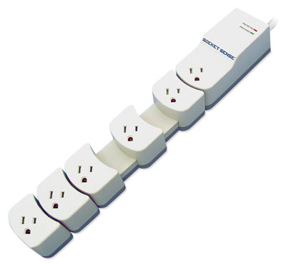
Today
What is a program?
A little bit of C on “classical OS”
How does a program run?
How are programs built?
What does the computer look like to a program?

Slide 4
A simple C program
int
main()
{
}

Slide 5
Simple I/O: args and printf
#include <stdio.h>
int
main(int argc, char* argv[])
{
int i;
printf("arguments: %d\n", argc);
for (i=0; i<argc; i++) {
printf("%d: %s\n", i, argv[i]);
}
}

Slide 6
Environment variables
#include <stdio.h>
#include <stdlib.h>
int
main(int argc, char* argv[], char* envp[])
{
int i;
int count = atoi(argv[1]);
for (i=0; i < count; i++) {
printf("env %d: %s\n", i, envp[i]);
}
}

Slide 7
OS Platform: A Better Model
Applications
Libraries: shared by multiple applications
Platform: same for all applications
E,g,, classical OS kernel
OS platform mediates access to shared resources.
[RAD Lab]

Slide 8
Libraries
Programs may incorporate (link to) libraries packaged with the OS or written by third parties.
E.g., C standard library and standard I/O library
These libraries may even define a system API that applications use. (e.g., heap manager malloc and free).
Libraries run as part of the program. Any failure in the library can damage the program, and vice versa.
These libraries have no more privilege or power than any other part of the program.
However, some libraries are merely wrappers for system calls to the trusted operating system kernel.

Slide 9
A simple module
int val = 0;
int p1(char *s) {
return 1;
}
int p2() {
char *s;
int i;
s = "hello\n";
i = p1(s);
return(i);
}
state
P1()
P2()
P3()
P4()

Slide 10
.section __TEXT,__text,regular,pure_instructions
.globl _p1
.align 4, 0x90
_p1: ## @p1
.cfi_startproc
## BB#0:
pushq %rbp
Ltmp2:
.cfi_def_cfa_offset 16
Ltmp3:
.cfi_offset %rbp, -16
movq %rsp, %rbp
Ltmp4:
.cfi_def_cfa_register %rbp
movl $1, %eax
movq %rdi, -8(%rbp)
popq %rbp
ret
.cfi_endproc
.globl _p2
.align 4, 0x90
_p2: ## @p2
.cfi_startproc
….
ret
.cfi_endproc
.section __TEXT,__cstring,cstring_literals
L_.str: ## @.str
.asciz "hello\n"
.comm _val,4,2 ## @val
.subsections_via_symbols

Slide 11
Global data (“static”)
int g;
int g0 = 0;
int g1 = 1;
.globl _g0 ## @g0
.zerofill __DATA,__common,_g0,4,2
.section __DATA,__data
.globl _g1 ## @g1
.align 2
_g1:
.long 1 ## 0x1
.comm _g,4,2 ## @g

Slide 12
Assembler directives: quick peek
From x86 Assembly Language Reference Manual
The .align directive causes the next data generated to be aligned modulo integer bytes.
The .ascii directive places the characters in string into the object module at the current location but does not terminate the string with a null byte (\0).
The .comm directive allocates storage in the data section. The storage is referenced by the identifier name. Size is measured in bytes and must be a positive integer.
The .globl directive declares each symbol in the list to be global. Each symbol is either defined externally or defined in the input file and accessible in other files.
The .long directive generates a long integer (32-bit, two's complement value) for each expression into the current section. Each expression must be a 32–bit value and must evaluate to an integer value.

Slide 13
Calling the module
#include <stdio.h>
extern int p1();
extern int p2();
int
main()
{
int i;
i = p2();
printf("%d\n", i);
}

Slide 14
The Birth of a Program (C/Ux)
myprogram.c
myprogram.o
int j;
char* s = “hello\n”;
int p() {
j = write(1, s, 6);
return(j);
}
object file
assembler
data
data
data
data
linker
libraries and other object
files or archives
…..
p:
store this
store that
push
jsr _write
ret
etc.
compiler
myprogram.s
data
program
header files
myprogram
(executable file)
Notes:
Executable images are also built from separately developed components (modules)...
separate compilation
symbol tables
...linked together by system utilities.
cross-module procedure calls and data references
relocation records and linkage sections
static link-and-load in “traditional” Unix
DLLs and shared libraries
importance of calling conventions

Slide 15
What’s in an Object File or Executable?
Header “magic number”
indicates type of file/image.
header
text
Section table an array
of (offset, len, startVA)
program instructions
p
data
immutable data (constants)
“hello\n”
idata
sections
wdata
writable global/static data
j, s
symbol
table
Used by linker; may be removed after final link step and strip. Also includes info for debugger.
j, s ,p,sbuf
int j = 327;
char* s = “hello\n”;
char sbuf[512];
int p() {
int k = 0;
j = write(1, s, 6);
return(j);
}
relocation
records

Slide 16
Running a program
code
constants
initialized data
imports/exports
symbols
types/interfaces
Process
data
Program
When a program launches, the OS creates an execution context (process) to run it, with a thread to run the program, and a virtual memory to store the running program’s code and data.

Slide 17
A Peek Inside a Running Program
CPU
0
common runtime
x
your program
code library
address space
(virtual or physical)
e.g., a virtual memory for a process
your data
R0
heap
Rn
PC
x
SP
y
registers
y
stack
high
“memory”

Slide 18
VAS example (32-bit)
0x7fffffff
Reserved
The program uses virtual memory through its process’ Virtual Address Space:
An addressable array of bytes…
Containing every instruction the process thread can execute…
And every piece of data those instructions can read/write…
i.e., read/write == load/store on memory
Partitioned into logical segments with distinct purpose and use.
Every memory reference by a thread is interpreted in the context of its VAS.
Resolves to a location in machine memory
Stack
Dynamic data
(heap/BSS)
Static data
Text
(code)
0x0

Slide 19
int P(int a){…} void C(int x){ int y=P(x); }
How do C and P share information?
Via a shared, in-memory stack
Notes:
Source: http://web.mit.edu/6.033/lec/l4.txt

Slide 20
int P(int a){…} void C(int x){ int y=P(x); }
What info is stored on the stack?
C’s registers, call arguments, RA,
P's local vars
Notes:
Source: http://web.mit.edu/6.033/lec/l4.txt

Slide 21
Review of the stack
Each stack frame contains a function’s
Local variables
Parameters
Return address
Saved values of calling function’s registers
The stack enables recursion

Slide 22
Code
Memory
Stack
SP
void C () {
A (0);
}
void B () {
C ();
}
void A (int tmp){
if (tmp) B ();
}
int main () {
A (1);
return 0;
}
0xfffffff
tmp=0
RA=0x8048347
A
0x8048347
SP
const=0
RA=0x8048354
C
SP
0x8048354
RA=0x8048361
B
…
SP
tmp=1
RA=0x804838c
0x8048361
A
SP
const1=1
const2=0
main
0x804838c
0x0

Slide 23
Code
Memory
Stack
SP
0xfffffff
bnd=0
RA=0x8048361
A
SP
bnd=1
RA=0x8048361
void A (int bnd){
if (bnd)
A (bnd-1);
}
int main () {
A (3);
return 0;
}
A
SP
0x8048361
bnd=2
RA=0x8048361
A
…
SP
…
bnd=3
RA=0x804838c
A
0x804838c
SP
const1=3
const2=0
main
How can recursion go wrong?
Can overflow the stack …
Keep adding frame after frame
0x0

Slide 24
Code
Memory
Stack
void cap (char* b){
for (int i=0;
b[i]!=‘\0’;
i++)
b[i]+=32;
}
int main(char*arg) {
char wrd[4];
strcpy(arg, wrd);
cap (wrd);
return 0;
}
0xfffffff
0x8048361
SP
b= 0x00234
RA=0x804838c
cap
…
…
SP
0x804838c
wrd[3]
wrd[2]
wrd[1]
wrd[0]
const2=0
main
What can go wrong?
Can overflow wrd variable …
Overwrite cap’s RA
0x00234
0x0

Slide 25
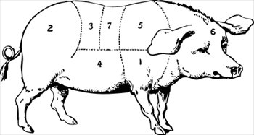
Heap: dynamic memory
A contiguous chunk of memory obtained from OS kernel.
E.g., with Unix sbrk() system call.
Allocated heap blocks for structs or objects. Align!
A runtime library obtains the block and manages it as a “heap” for use by the programming language environment, to store dynamic objects.
E.g., with Unix malloc and free library calls.

Slide 26
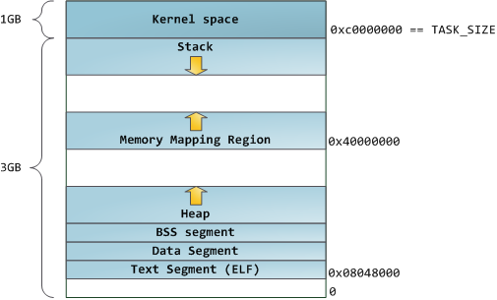
“Classic Linux Address Space”
N
http://duartes.org/gustavo/blog/category/linux

