Slide 1
Mode, space, and context: the basics
Jeff Chase
Duke University

Slide 2
mem.c (OSTEP)
data
data
p
int
main(int argc, char *argv[])
{
int *p;
p = malloc(sizeof(int));
*p = atoi(argv[1]);
while (1) {
Spin(1);
*p = *p + 1;
printf("(pid:%d) value of p: %d\n”,
getpid(), *p);
}
}
pid: 5587
pid: 5588
chase$ cc -o mem mem.c
chase$ ./mem 21 &
chase$ ./mem 42 &
(pid:5587) value of p: 22
(pid:5587) value of p: 23
(pid:5587) value of p: 24
(pid:5588) value of p: 43
(pid:5588) value of p: 44
(pid:5587) value of p: 25
(pid:5587) value of p: 26
…

Slide 3
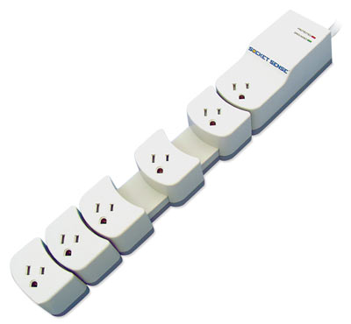
0x7fffffff
0x7fffffff
Reserved
Reserved
Stack
Stack
Dynamic data
(heap/BSS)
Dynamic data
(heap/BSS)
Static data
Static data
Text
(code)
Text
(code)
0x0
0x0

Slide 4
Operating Systems: The Classical View
Programs run as
independent processes.
Each process has a private virtual address space and one or more threads.
data
data
Protected system calls
...and upcalls (e.g., signals)
Protected OS kernel mediates access to shared resources.
Threads enter the kernel for OS services.
The kernel code and data are protected from untrusted processes.

Slide 5
Processes: A Closer Look
virtual address space
thread
process descriptor (PCB)
user ID
process ID
parent PID
sibling links
children
+
+
stack
resources
The address space is a private name space for a set of memory segments used by the process.
The kernel must initialize the process memory for the program to run.
Each process has a thread bound to the VAS.
The thread has a stack addressable through the VAS.
The kernel can suspend/restart the thread wherever and whenever it wants.
The OS maintains some state for each process in the kernel’s internal data structures: a file descriptor table, links to maintain the process tree, and a place to store the exit status.

Slide 6
A process can have multiple threads
int main(int argc, char *argv[]) {
if (argc != 2) {
fprintf(stderr, "usage: threads <loops>\n");
exit(1);
}
loops = atoi(argv[1]);
pthread_t p1, p2;
printf("Initial value : %d\n", counter);
pthread_create(&p1, NULL, worker, NULL);
pthread_create(&p2, NULL, worker, NULL);
pthread_join(p1, NULL);
pthread_join(p2, NULL);
printf("Final value : %d\n", counter);
return 0;
}
volatile int counter = 0;
int loops;
void *worker(void *arg) {
int i;
for (i = 0; i < loops; i++) {
counter++;
}
pthread_exit(NULL);
}
data
Much more on this later!

Slide 7
Key Concepts for Classical OS
kernel
The software component that controls the hardware directly, and implements the core privileged OS functions.
Modern hardware has features that allow the OS kernel to protect itself from untrusted user code.
thread
An executing instruction path and its CPU register state.
virtual address space
An execution context for thread(s) defining a name space for executing instructions to address data and code.
process
An execution of a program, consisting of a virtual address space, one or more threads, and some OS kernel state.

Slide 8
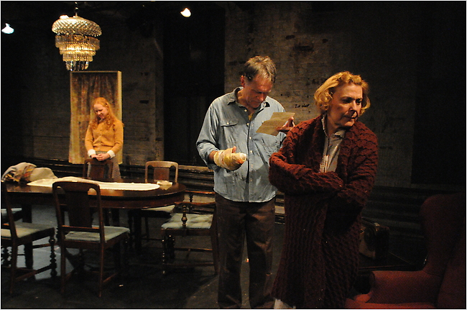
The theater analogy
virtual memory
(stage)
script
Threads
Program
Address space
Running a program is like performing a play.
[lpcox]

Slide 9
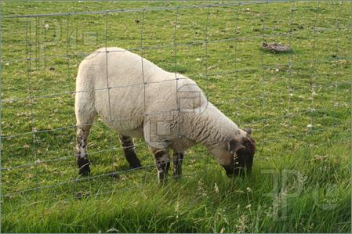
The sheep analogy
Address space
Thread
Code and data

Slide 10
CPU cores
The machine has a bank of CPU cores for threads to run on.
The OS allocates cores to threads.
Cores are hardware. They go where the driver tells them.
Switch drivers any time.
Core #1
Core #2

Slide 11
Threads drive cores

Slide 12
What was the point of that whole thing with the electric sheep actors?
A process is a running program.
A running program (a process) has at least one thread (“main”), but it may (optionally) create other threads.
The threads execute the program (“perform the script”).
The threads execute on the “stage” of the process virtual memory, with access to a private instance of the program’s code and data.
A thread can access any virtual memory in its process, but is contained by the “fence” of the process virtual address space.
Threads run on cores: a thread’s core executes instructions for it.
Sometimes threads idle to wait for a free core, or for some event. Sometimes cores idle to wait for a ready thread to run.
The operating system kernel shares/multiplexes the computer’s memory and cores among the virtual memories and threads.

Slide 13
Processes and threads
virtual address space
main thread
other threads (optional)
+
+…
stack
Each process has a virtual address space (VAS): a private name space for the virtual memory it uses.
The VAS is both a “sandbox” and a “lockbox”: it limits what the process can see/do, and protects its data from others.
Each process has a thread bound to the VAS, with stacks (user and kernel).
If we say a process does something, we really mean its thread does it.
The kernel can suspend/restart the thread wherever and whenever it wants.
From now on, we suppose that a process could have multiple threads.
We presume that they can all make system calls and block independently.
STOP
wait

Slide 14
A thread running in a process VAS
CPU
0
common runtime
x
your program
code library
address space
(virtual or physical)
e.g., a virtual memory for a process
your data
R0
heap
Rn
PC
x
SP
y
registers
y
stack
high
“memory”

Slide 15
Thread context
Each thread has a context (exactly one).
Context == the thread’s register values.
Including a (protected) identifier naming its VAS.
And a pointer to thread’s stack in VAS/memory.
Each core has a context (at least one).
Context == a register set that can hold values.
The register set is baked into the hardware.
A core can change drivers: context switch.
Save register values into memory.
Load new register values from memory.
(Think of driver settings for the seat, mirrors, audio…)
Enables time slicing or time sharing of machine.
CPU core
R0
Rn
PC
x
SP
y
registers

Slide 16
Messing with the context
#include <ucontext.h>
int count = 0;
ucontext_t context;
int main()
{
int i = 0;
getcontext(&context);
count += 1;
i += 1;
sleep(2);
printf(”…", count, i);
setcontext(&context);
}
ucontext
Standard C library routines to:
Save current register context to a block of memory (getcontext from core)
Load/restore current register context from a block of memory (setcontext)
Also: makecontext, swapcontext
Details of the saved context (ucontext_t structure) are machine-dependent.

Slide 17
Messing with the context (2)
#include <ucontext.h>
int count = 0;
ucontext_t context;
int main()
{
int i = 0;
getcontext(&context);
count += 1;
i += 1;
sleep(1);
printf(”…", count, i);
setcontext(&context);
}
Save core context to memory
Loading the saved context transfers control to this block of code. (Why?)
What about the stack?
Load core context from memory

Slide 18
Messing with the context (3)
#include <ucontext.h>
int count = 0;
ucontext_t context;
int main()
{
int i = 0;
getcontext(&context);
count += 1;
i += 1;
sleep(1);
printf(”…", count, i);
setcontext(&context);
}
chase$ cc -o context0 context0.c
<
warnings:
ucontext deprecated on MacOS
>
chase$ ./context0
1 1
2 2
3 3
4 4
5 5
6 6
7 7
…

Slide 19
Reading behind the C
count += 1;
i += 1;
On MacOS:
chase$ man otool
chase$ otool –vt context0
…
On this machine, with this cc:
Static global _count is addressed relative to the location of the code itself, as given by the PC register [%rip is instruction pointer register]
Local variable i is addressed as an offset from stack frame.
[%rbp is stack frame base pointer]
Disassembled code:
movl 0x0000017a(%rip),%ecx
addl $0x00000001,%ecx
movl %ecx,0x0000016e(%rip)
movl 0xfc(%rbp),%ecx
addl $0x00000001,%ecx
movl %ecx,0xfc(%rbp)
%rip and %rbp are set “right”, then these references “work”.

Slide 20
Messing with the context (4)
#include <ucontext.h>
int count = 0;
ucontext_t context;
int main()
{
int i = 0;
getcontext(&context);
count += 1;
i += 1;
sleep(1);
printf(”…", count, i);
setcontext(&context);
}
chase$ cc –O2 -o context0 context0.c
<
warnings:
ucontext deprecated on MacOS
>
chase$ ./context0
1 1
2 1
3 1
4 1
5 1
6 1
7 1
…
What happened?

Slide 21
The point of ucontext
The system can use ucontext routines to:
“Freeze” at a point in time of the execution
Restart execution from a frozen moment in time
Execution continues where it left off…if the memory state is right.
The system can implement multiple independent threads of execution within the same address space.
Create a context for a new thread with makecontext.
Modify saved contexts at will.
Context switch with swapcontext: transfer a core from one thread to another (“change drivers”)
Much more to this picture: need per-thread stacks, kernel support, suspend/sleep, controlled ordering, etc.

Slide 22
Two threads: closer look
address space
“on deck” and ready to run
0
common runtime
x
program
code library
running
thread
data
R0
CPU
(core)
Rn
x
y
PC
y
stack
SP
registers
stack
high

Slide 23
Thread context switch
switch out
switch in
address space
0
common runtime
x
program
code library
data
R0
CPU
(core)
1. save registers
Rn
x
y
PC
y
stack
SP
registers
2. load registers
stack
high

Slide 24
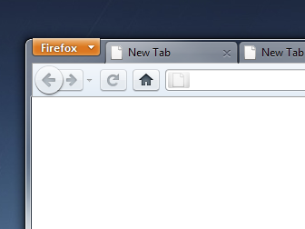
A metaphor: context/switching
1
Page links and back button navigate a “stack” of pages in each tab.
2
Each tab has its own stack.
One tab is active at any given time.
You create/destroy tabs as needed.
You switch between tabs at your whim.
3
Similarly, each thread has a separate stack.
The OS switches between threads at its whim.
One thread is active per CPU core at any given time.
time →

Slide 25
Messing with the context (5)
#include <ucontext.h>
int count = 0;
ucontext_t context;
int main()
{
int i = 0;
getcontext(&context);
count += 1;
i += 1;
sleep(1);
printf(”…", count, i);
setcontext(&context);
}
What does this do?

Slide 26
Thread/process states and transitions
running
“driving a car”
yield
Scheduler governs these transitions.
sleep
“waiting for someplace to go”
dispatch
blocked
wakeup
ready
“requesting a car”
wait, STOP, read, write,
listen, receive, etc.
Sleep and wakeup are internal primitives. Wakeup adds a thread to the scheduler’s ready pool: a set of threads in the ready state.
STOP
wait

Slide 27
Programs gone wild
int
main()
{
while(1);
}
Can you hear the fans blow?
How does the OS regain control of the core from this program?
How to “make” the process save its context and give some other process a chance to run?
How to “make” processes share machine resources fairly?

Slide 28
Timer interrupts, faults, etc.
When processor core is running a user program, the user program/thread controls (“drives”) the core.
The hardware has a timer device that interrupts the core after a given interval of time.
Interrupt transfers control back to the OS kernel, which may switch the core to another thread, or resume.
Other events also return control to the kernel.
Wild pointers
Divide by zero
Other program actions
Page faults

Slide 29
Entry to the kernel
Every entry to the kernel is the result of a trap, fault, or interrupt. The core switches to kernel mode and transfers control to a handler routine.
syscall trap/return
fault/return
OS kernel code and data for system calls (files, process fork/exit/wait, pipes, binder IPC, low-level thread support, etc.) and virtual memory management (page faults, etc.)
I/O completions
interrupt/return
timer ticks
The handler accesses the core register context to read the details of the exception (trap, fault, or interrupt). It may call other kernel routines.

Slide 30
CPU mode: User and Kernel
CPU mode (a field in some status register) indicates whether a machine CPU (core) is running in a user program or in the protected kernel (protected mode).
Some instructions or register accesses are legal only when the CPU (core) is executing in kernel mode.
CPU mode transitions to kernel mode only on machine exception events (trap, fault, interrupt), which transfers control to a trusted handler routine registered with the machine at kernel boot time.
So only the kernel program chooses what code ever runs in the kernel mode (or so we hope and intend).
A kernel handler can read the user register values at the time of the event, and modify them arbitrarily before (optionally) returning to user mode.
CPU core
mode
U/K
R0
Rn
PC
x
registers

Slide 31
Exceptions: trap, fault, interrupt
intentional
happens every time
unintentional
contributing factors
synchronous
caused by an instruction
trap: system call
open, close, read, write, fork, exec, exit, wait, kill, etc.
fault
invalid or protected address or opcode, page fault, overflow, etc.
asynchronous
caused by some other event
“software interrupt” software requests an interrupt to be delivered at a later time
interrupt
caused by an external event: I/O op completed, clock tick, power fail, etc.

Slide 32
Kernel Stacks and Trap/Fault Handling
Threads execute user code on a user stack in the user virtual memory in the process virtual address space.
System calls and faults run in kernel mode on a kernel stack.
data
stack
stack
Kernel code running in P’s process context has access to P’s virtual memory.
Each thread has a second kernel stack in kernel space (VM accessible only in kernel mode).
syscall dispatch table
stack
stack
The syscall handler makes an indirect call through the system call dispatch table to the handler registered for the specific system call.

Slide 33
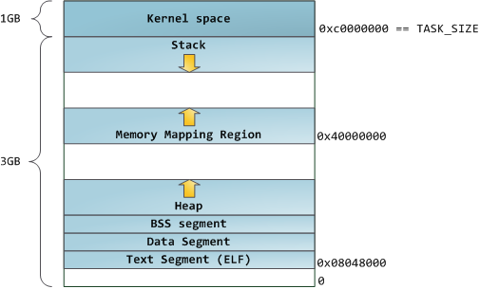
“Classic Linux Address Space”
N
http://duartes.org/gustavo/blog/category/linux

Slide 34
Note: Something Wild
The “Something Wild” example that follows was an earlier version of “Messing with the context”.
It was not discussed in class.
“Messing with the context” simplifies the example, but keeps all the essential info.
“Something Wild” brings it just a little closer to coroutines a context switch from one thread to another.

Slide 35
Something wild (1)
#include <ucontext.h>
Int count = 0;
int set = 0;
ucontext_t contexts[2];
void proc() {
int i = 0;
if (!set) {
getcontext(&contexts[count]);
}
printf(…, count, i);
count += 1;
i += 1;
if (set) {
setcontext(&contexts[count&0x1]);
}
}
time →
int
main() {
set = 0;
proc();
proc();
set = 1;
proc();
}

Slide 36
Something wild (2)
time →
#include <ucontext.h>
ucontext_t contexts[2];
void proc()
{
int i = 0;
getcontext(&contexts[count]);
printf(”…", count, i);
count += 1;
i += 1;
}
int
main() {
set=0;
proc();
proc();
…
}

Slide 37
Something wild (3)
time →
#include <ucontext.h>
ucontext_t contexts[2];
void proc() {
int i = 0;
printf(”…", count, i);
count += 1;
i += 1;
sleep(1);
setcontext(&contexts[count&0x1]);
}
int
main() {
…
set=1;
proc();
}

Slide 38
Something wild (4)
time →
We have a pair of register contexts that were saved at this point in the code.
void proc() {
int i = 0;
printf(”…", count, i);
count += 1;
i += 1;
sleep(1);
setcontext(…);
}
If we load either of the saved contexts, it will transfer control to this block of code. (Why?) What about the stack?
Switch to the other saved register context. Alternate “even” and “odd” contexts.
What will it print? The count is a global variable…but what about i?
Lather, rinse, repeat.

Slide 39
Something wild (5)
time →
void proc() {
int i = 0;
printf("%4d %4d\n", count, i);
count += 1;
i += 1;
sleep(1);
setcontext(…);
}
What does this do?

