Slide 1
The Kernel and the Unix Process API
Jeff Chase
Duke University

Slide 2
The story so far: process and kernel
A (classical) OS lets us run programs as processes. A process is a running program instance (with a thread).
Program code runs with the core in untrusted user mode.
Processes are protected/isolated.
Virtual address space is a “fenced pasture”
Sandbox: can’t get out. Lockbox: nobody else can get in.
The OS kernel controls everything.
Kernel code runs with the core in trusted kernel mode.
OS offers system call APIs.
Create processes
Control processes
Monitor process execution

Slide 3
Operating Systems: The Classical View
Programs run as
independent processes.
Each process has a private virtual address space and one or more threads.
data
data
Protected system calls
...and upcalls (e.g., signals)
Protected OS kernel mediates access to shared resources.
Threads enter the kernel for OS services.
The kernel code and data are protected from untrusted code.

Slide 4
“Limited direct execution”
Any kind of machine exception transfers control to a registered (trusted) kernel handler running in a protected CPU mode.
user mode
syscall trap
fault
fault
u-start
u-return
u-start
u-return
kernel “top half”
kernel mode
kernel “bottom half” (interrupt handlers)
clock interrupt
interrupt
return
boot
Kernel handler manipulates CPU register context to return to selected user context.

Slide 5
Exceptions: trap, fault, interrupt
intentional
happens every time
unintentional
contributing factors
synchronous
caused by an instruction
trap: system call
open, close, read, write, fork, exec, exit, wait, kill, etc.
fault
invalid or protected address or opcode, page fault, overflow, etc.
asynchronous
caused by some other event
“software interrupt” software requests an interrupt to be delivered at a later time
interrupt
caused by an external event: I/O op completed, clock tick, power fail, etc.

Slide 6
Example: Syscall traps
Programs in C, C++, etc. invoke system calls by linking to a standard library written in assembly.
The library defines a stub or wrapper routine for each syscall.
Stub executes a special trap instruction (e.g., chmk or callsys or syscall instruction) to change mode to kernel.
Syscall arguments/results are passed in registers (or user stack).
OS defines Application Binary Interface (ABI).
read() in Unix libc.a Alpha library (executes in user mode):
#define SYSCALL_READ 27 # op ID for a read system call
move arg0…argn, a0…an # syscall args in registers A0..AN
move SYSCALL_READ, v0 # syscall dispatch index in V0
callsys # kernel trap
move r1, _errno # errno = return status
return
Alpha CPU ISA (defunct)

Slide 7
MacOS x86-64 syscall example
section .data
hello_world db "Hello World!", 0x0a
section .text
global start
start:
mov rax, 0x2000004 ; System call write = 4
mov rdi, 1 ; Write to standard out = 1
mov rsi, hello_world ; The address of hello_world string
mov rdx, 14 ; The size to write
syscall ; Invoke the kernel
mov rax, 0x2000001 ; System call number for exit = 1
mov rdi, 0 ; Exit success = 0
syscall ; Invoke the kernel
Illustration only: this program writes “Hello World!” to standard output.
http://thexploit.com/secdev/mac-os-x-64-bit-assembly-system-calls/

Slide 8
Thread states and transitions
We will presume that these transitions occur only in kernel mode. This is true in classical Unix and in systems with pure kernel-based threads.
Before a thread can sleep, it must first enter the kernel via trap (syscall) or fault.
Before a thread can yield, it must enter the kernel, or the core must take an interrupt to return control to the kernel.
running
yield
preempt
In the running state, kernel code decides if/when/how to enter user mode, and sets up a suitable context.
sleep
dispatch
blocked
ready
wakeup
STOP
wait

Slide 9
Kernel Stacks and Trap/Fault Handling
Threads execute user code on a user stack in the user virtual memory in the process virtual address space.
System calls and faults run in kernel mode on a kernel stack.
data
stack
stack
Kernel code running in P’s process context has access to P’s virtual memory.
Each thread has a second kernel stack in kernel space (VM accessible only in kernel mode).
syscall dispatch table
stack
stack
The syscall handler makes an indirect call through the system call dispatch table to the handler registered for the specific system call.

Slide 10
Unix Process API
Let’s get down to it

Slide 11
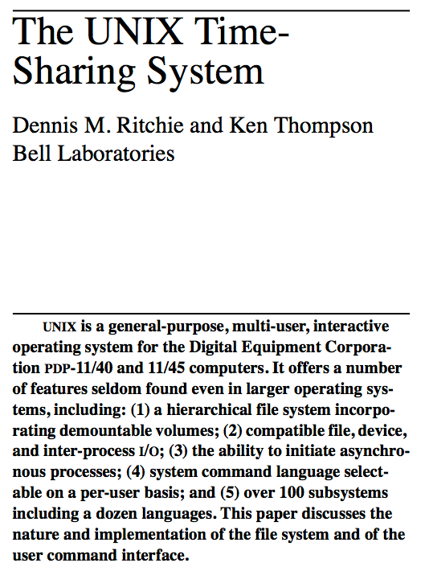
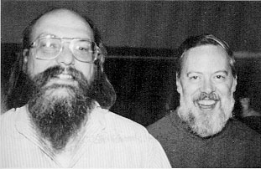
CACM
1974
Thompson and Ritchie
Turing Award ‘83

Slide 12
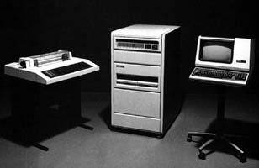
Unix: A lasting achievement?
“Perhaps the most important achievement of Unix is to demonstrate that a powerful operating system for interactive use need not be expensive…it can run on hardware costing as little as $40,000.”
DEC PDP-11/24
The UNIX Time-Sharing System*
D. M. Ritchie and K. Thompson
1974
http://histoire.info.online.fr/pdp11.html

Slide 13
Unix fork/exit syscalls
int pid = fork();
Create a new process that is a clone of its parent, return new process ID (pid) to parent, return 0 to child.
exit(status);
Exit with status, destroying the process. Note: this is not the only way for a process to exit!
fork
parent
child
time
data
data
p
exit
exit
pid: 5587
pid: 5588

Slide 14
fork
The fork syscall returns twice:
It returns a zero in the context of the new child process.
It returns the new child process ID (pid) in the context of the parent.
int pid;
int status = 0;
if (pid = fork()) {
/* parent */
…..
} else {
/* child */
…..
exit(status);
}

Slide 15
fork
Child can’t be an exact copy
Is distinguished by one variable (the return value of fork)
if (fork () == 0) {
/* child */
execute new program
} else {
/* parent */
carry on
}

Slide 16
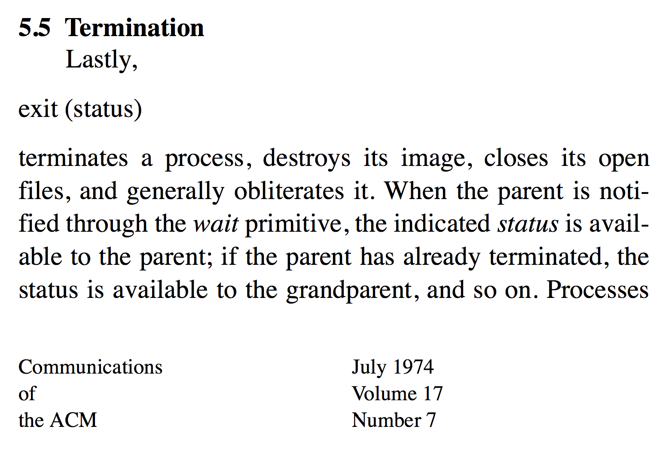
exit syscall

Slide 17
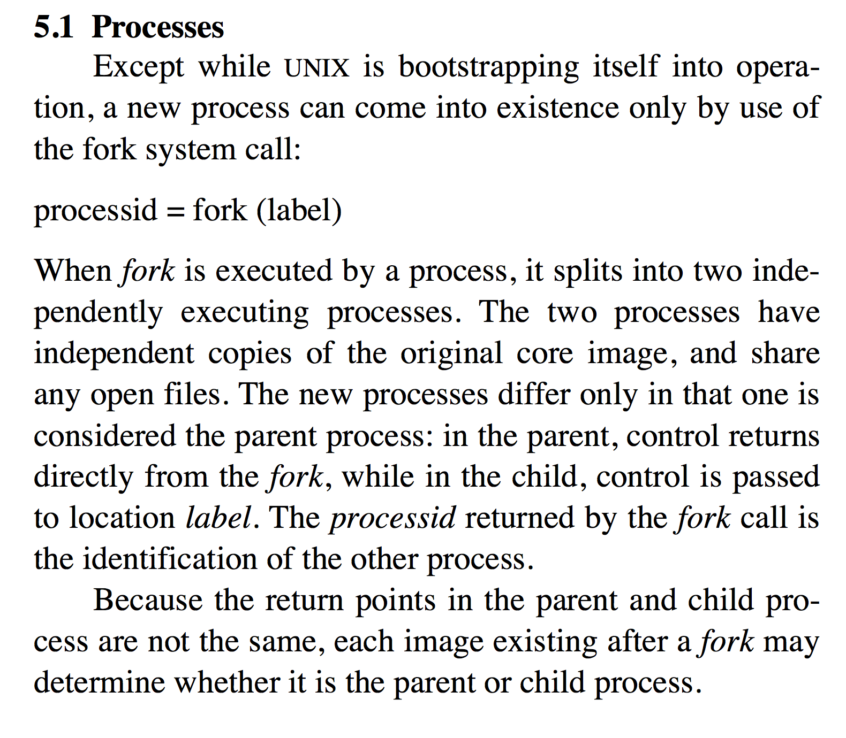
fork (original concept)

Slide 18
fork in action today
Fork is conceptually difficult but syntactically clean and simple.
I don’t have to say anything about what the new child process “looks like”: it is an exact clone of the parent!
The child has a new thread executing at the same point in the same program. The child is a new instance of the running program: it has a “copy” of the entire address space. The “only” change is the process ID and return code rc!
The parent thread continues on its way. The child thread continues on its way.
void
dofork()
{
int rc = fork();
if (rc < 0) {
perror("fork failed: ");
exit(1);
} else if (rc == 0) {
child();
} else {
parent(rc);
}
}

Slide 19
A simple program: forkdeep
int count = 0;
int level = 0;
void child() {
level++;
output pids
if (level < count)
dofork();
if (level == count)
sleep(3);
}
void parent(int childpid) {
output pids
wait for child to finish
}
main(int argc, char *argv[])
{
count = atoi(argv[1]);
dofork();
output pid
}
How?

Slide 20
chase$ ./forkdeep 4
30866-> 30867
30867
30867-> 30868
30868
30868-> 30869
30869
30869-> 30870
30870
30870
30869
30868
30867
30866
chase$

Slide 21
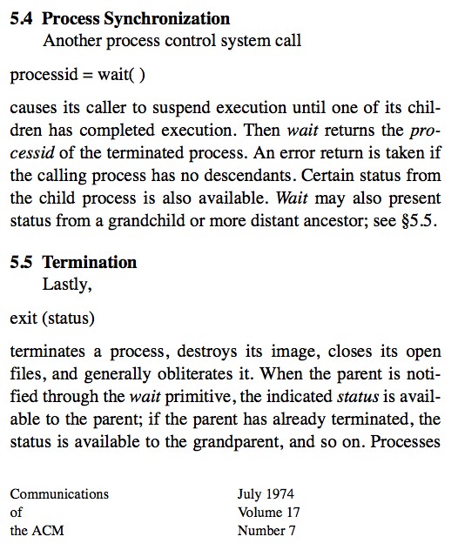
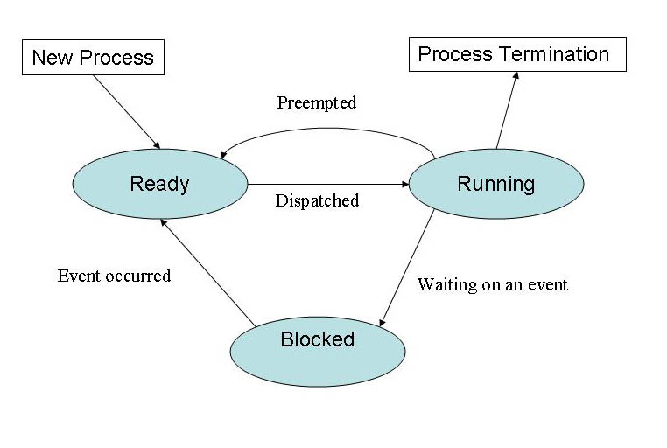
Wait
Note: in modern systems the wait syscall has many variants and options.

Slide 22
Unix process API
Parent uses wait to sleep until the child exits; wait returns child pid and status.
Wait variants allow wait on a specific child, or notification of stops and other “signals”.
int pid;
int status = 0;
if (pid = fork()) {
/* parent */
…..
pid = wait(&status);
} else {
/* child */
…..
exit(status);
}

Slide 23
But how do I run a new program?

Slide 24
But how do I run a new program?
The child, or any process really, can replace its program in midstream.
exec* system call: “forget everything in my address space and reinitialize my entire address space with stuff from a named program file.”
The exec system call never returns: the new program executes in the calling process until it dies (exits).
The code from the parent program runs in the child process and controls its future. The parent program selects the program that the child process will run (via exec), and sets up its connections to the outside world. The child program doesn’t even know!

Slide 25
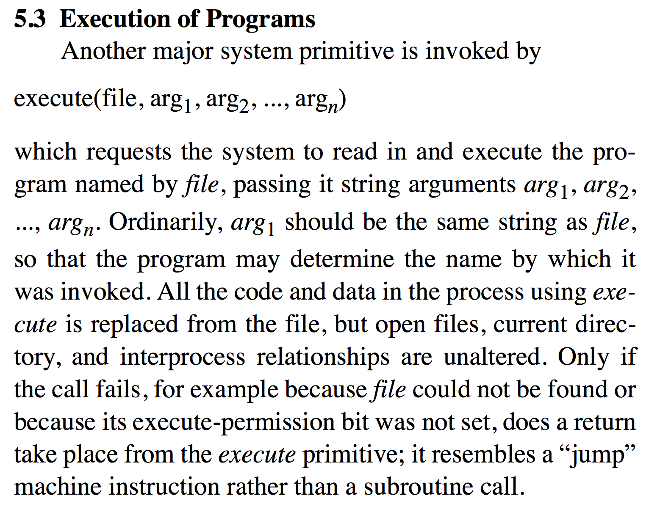
exec (original concept)

Slide 26
A simple program: forkexec
…
main(int argc, char *argv[]) {
int status;
int rc = fork();
if (rc < 0) {
perror("fork failed: ");
exit(1);
} else if (rc == 0) {
argv++;
execve(argv[0], argv, 0);
} else {
waitpid(rc, &status, 0);
printf("child %d exited with status %d\n", rc,
WEXITSTATUS(status));
}
}

Slide 27
A simple program: prog0
int
main()
{
}
chase$ cc –o forkexec forkexec.c
chase$ cc –o prog0 prog0.c
chase$ ./forkexec prog0
child 19175 exited with status 0
chase$

Slide 28
Simple I/O: args and printf
chase$ cc –o prog1 prog1.c
chase$ ./forkexec prog1
arguments: 1
0: prog1
child 19178 exited with status 0
chase$ ./forkexec prog1 one 2 3
arguments: 4
0: prog1
1: one
2: 2
3: 3
child 19181 exited with status 0
#include <stdio.h>
int
main(int argc, char* argv[])
{
int i;
printf("arguments: %d\n", argc);
for (i=0; i<argc; i++) {
printf("%d: %s\n", i, argv[i]);
}
}

Slide 29
Environment variables (rough)
#include <stdio.h>
#include <stdlib.h>
int
main(int argc, char* argv[], char* envp[])
{
int i;
int count = atoi(argv[1]);
for (i=0; i < count; i++) {
printf("env %d: %s\n", i, envp[i]);
}
}

Slide 30
Environment variables (rough)
chase$ cc –o env0 env0.c
chase$ ./env0
Segmentation fault: 11
chase$ ./env0 12
env 0: TERM_PROGRAM=Apple_Terminal
env 1: TERM=xterm-256color
env 2: SHELL=/bin/bash
env 3: TMPDIR=/var/folders/td/ng76cpqn4zl1wrs57hldf1vm0000gn/T/
env 4: Apple_PubSub_Socket_Render=/tmp/launch-OtU5Bb/Render
env 5: TERM_PROGRAM_VERSION=309
env 6: OLDPWD=/Users/chase/c210-stuff
env 7: TERM_SESSION_ID=FFCE3A14-1D4B-4B08…
env 8: USER=chase
env 9: COMMAND_MODE=unix2003
env 10: SSH_AUTH_SOCK=/tmp/launch-W03wn2/Listeners
env 11: __CF_USER_TEXT_ENCODING=0x1F5:0:0
chase$

Slide 31
Environment variables (safer)
#include <stdio.h>
#include <stdlib.h>
int
main(int argc, char* argv[], char* envp[])
{
int i;
int count;
if (argc < 2) {
fprintf(stderr,
"Usage: %s <count>\n", argv[0]);
exit(1);
}
count = atoi(argv[1]);
for (i=0; i < count; i++) {
if (envp == 0) {
printf("env %d: nothing!\n", i);
exit(1);
}
else if (envp[i] == 0) {
printf("env %d: null!\n", i);
exit(1);
} else
printf("env %d: %s\n", i, envp[i]);
}
}

Slide 32
Where do environment variables come from?
chase$ cc –o env env.c
chase$ ./env
chase$ ./forkexec env
Usage: env <count>
child 19195 exited with status 1
chase$ ./forkexec env 1
env 0: null!
child 19263 exited with status 1
chase$

Slide 33
forkexec revisited
char *lala = "lalala\n";
char *nothing = 0;
…
main(int argc, char *argv[]) {
int status;
int rc = fork();
if (rc < 0) {
…
} else if (rc == 0) {
argv++;
execve(argv[0], argv, &lala);
} else {
…
}
chase$ cc –o fel forkexec-lala.c
chase$ ./fel env 1
env 0: lalala
child 19276 exited with status 0
chase$

Slide 34
forkexec revisited again
…
main(int argc, char *argv[],
char *envp[]) {
int status;
int rc = fork();
if (rc < 0) {
…
} else if (rc == 0) {
argv++;
execve(argv[0], argv, envp);
} else {
…
}
chase$ cc –o fe forkexec1.c
chase$ ./fe env 3
env 0: TERM_PROGRAM=Apple_Terminal
env 1: TERM=xterm-256color
env 2: SHELL=/bin/bash
child 19290 exited with status 0
chase$

Slide 35
How about this?
chase$ ./fe fe fe fe fe fe fe fe fe fe fe fe env 3
<???>

Slide 36
How about this?
chase$ ./fe fe fe fe fe fe fe fe fe fe fe fe env 3
env 0: TERM_PROGRAM=Apple_Terminal
env 1: TERM=xterm-256color
env 2: SHELL=/bin/bash
child 19303 exited with status 0
child 19302 exited with status 0
child 19301 exited with status 0
child 19300 exited with status 0
child 19299 exited with status 0
child 19298 exited with status 0
child 19297 exited with status 0
child 19296 exited with status 0
child 19295 exited with status 0
child 19294 exited with status 0
child 19293 exited with status 0
child 19292 exited with status 0
chase$
It is easy for children to inherit environment variables from their parents.
Exec* enables the parent to control the environment variables and arguments passed to the children.
The child process passes the environment variables “to itself” but the parent program controls it.

Slide 37
Unix fork/exec/exit/wait syscalls
int pid = fork();
Create a new process that is a clone of its parent.
exec*(“program” [argvp, envp]);
Overlay the calling process with a new program, and transfer control to it, passing arguments and environment.
exit(status);
Exit with status, destroying the process.
int pid = wait*(&status);
Wait for exit (or other status change) of a child, and “reap” its exit status.
Recommended: use waitpid().
fork parent
fork child
parent
program
initializes child context
exec
wait
exit

Slide 38
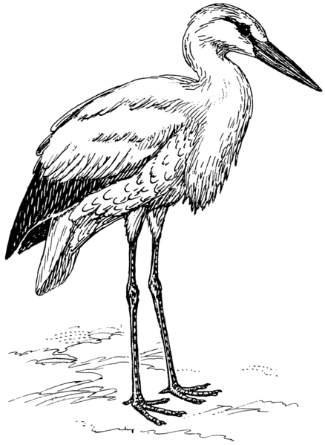
But how is the first process made?

Slide 39
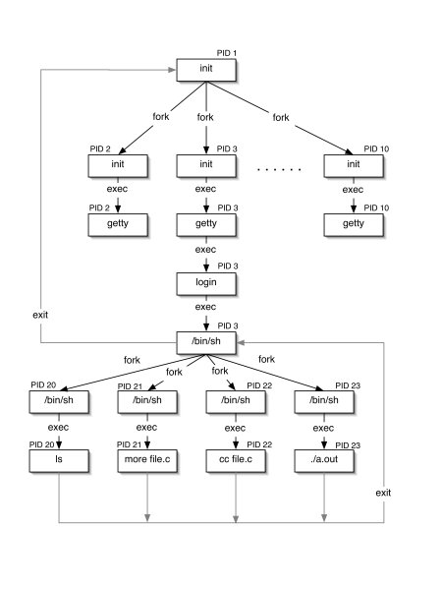
Init and Descendents
Kernel “handcrafts” initial process to run “init” program.
Other processes descend from init, including login program.
Login runs user shell in a child process after user authenticates.
User shell runs user commands as child processes.

Slide 40
The Shell
Users may select from a range of command interpreter (“shell”) programs available. (Or even write their own!)
csh, sh, ksh, tcsh, bash: choose your flavor…
Shells execute commands composed of program filenames, args, and I/O redirection symbols.
Fork, exec, wait, etc., etc.
Can coordinate multiple child processes that run together as a process group or job.
Shells can run files of commands (scripts) for more complex tasks, e.g., by redirecting I/O channels (descriptors).
Shell behavior is guided by environment variables, e.g., $PATH
Parent may control/monitor all aspects of child execution.

Slide 41
Unix process: parents rule
Created with fork by parent program running in parent process.
Virtual address space
(Virtual Memory, VM)
Process
text
data
Parent program running in child process, or exec’d program chosen by parent program.
heap
Thread
Inherited from parent process, or modified by parent program in child
(see next lecture)
Program
Clone of parent VM.
Environment (argv[] and envp[]) is configured by parent program on exec.
kernel state

Slide 42
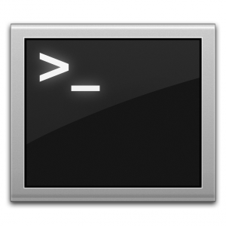
Unix process view: data
A process has multiple channels for data movement in and out of the process (I/O).
I/O channels
(“file descriptors”)
stdin
stdout
Process
tty
stderr
The parent process and parent program set up and control the channels for a child (until exec).
pipe
Thread
socket
Files
Program

Slide 43
Standard I/O descriptors
I/O channels
(“file descriptors”)
stdin
Open files or other I/O channels are named within the process by an integer file descriptor value.
stdout
tty
stderr
count = read(0, buf, count);
if (count == -1) {
perror(“read failed”); /* writes to stderr */
exit(1);
}
count = write(1, buf, count);
if (count == -1) {
perror(“write failed”); /* writes to stderr */
exit(1);
}
Standard descriptors for
primary input (stdin=0), primary output (stdout=1), error/status (stderr=2).
These are inherited from the parent process and/or set by the parent program.
By default they are bound to the controlling terminal.

Slide 44
Shell: foreground command
Shell waits in read call for next command from tty, forks child, and exec*s the named command program in child.
dsh
fork
“echo y”
exec
argv[0]=“echo”
argv[1]=“y”
argc = 2
wait
If a child is running in the foreground, the parent shell blocks in a wait* system call until the child changes state (e.g., exits).
Child process continues on to execute “echo” program independently of parent.

Slide 45
Unix: signals
A signal is a typed upcall event delivered to a process by kernel.
Process P may use kill* system call to request signal delivery to Q.
Process may register signal handlers for signal types. A signal handler is a procedure that is invoked when a signal of a given type is delivered. Runs in user mode, then returns to normal control flow.
A signal delivered to a registered handler is said to be caught. If there is no registered handler then the signal triggers a default action (e.g., “die”).
A process lives until it exits voluntarily or receives a fatal signal.
data
data
...and upcalls (signals)
Kernel sends signals, e.g., to notify processes of faults.
Protected system calls

Slide 46
Unix signals
Unix signals are “musty”. We don’t teach/test the details.
Sometimes you can’t ignore them!
(See next lecture)
A signal is an “upcall” event delivered to a process.
Sent by kernel, or by another process via kill* syscall.
An arriving signal transfers control to a handler routine in receiving process, designated to handle that type of signal.
The handler routine returns to normal control flow when done.
Or: if no designated handler, take a standard action.
e.g., DEFAULT, IGNORE, STOP, CONTINUE
Default action is often for receiving process to exit.
An exit from an unhandled signal is reported to parent via wait*.

Slide 47
Signals and dsh
Your shell must set up itself and its children properly for “stuff to work like it should”.
We have provided you code to initialize shell, spawn job.
You do not need to understand that code
You should not need to mess with that code.
Please don’t mess with that code.
If you are messing with that code, please talk to us.
What that code does: transfer control of terminal to foreground child job, using process groups and signals, prepare for proper handling of various events that might occur.

Slide 48
Process status change: STOP
dsh
fork
Child blocks when it receives a STOP signal (e.g., resulting from ctrl-z on keyboard).
“echo y”
A wait returns when the status of the child changes (e.g., STOP).
exec
wait
SIGSTOP
The awakened shell blocks in read to accept the next command.
“<ctrl-z>”
STOP
Child wakes up when it receives a CONTINUE signal (e.g., sent by shell on fg builtin command).
“fg”
kill SIGCONT
What if a foreground job exits before the parent calls wait?
exit
wait
EXIT

Slide 49
Extra slides
I hope we get to here

Slide 50
Mode Changes for Fork/Exit
Syscall traps and “returns” are not always paired.
Fork “returns” (to child) from a trap that “never happened”
Exit system call trap never returns
System may switch processes between trap and return
parent
Fork
call
Fork
return
Wait
call
Wait
return
Exec enters the child by
doctoring up a saved user context to “return” through.
child
Fork
entry to
user space
Exit
call
transition from user to kernel mode (callsys)
transition from kernel to user mode (retsys)
Notes:
In general, interrupts and returns are strictly paired, and every interrupt handler returns without switching context (i.e., process switch). This is necessary to guarantee reentrancy, even with a single interrupt stack.
Traps and faults demand no such guarantees. A trap or fault might never return. The system may process switch after a trap or fault, and then return from some other trap or fault. The system may doctor up a stack and appear to return from a trap (or even a fault) that never occurred.

Slide 51
Using the shell
Commands: ls, cat, and all that
Current directory: cd and pwd
Arguments: echo
Signals: ctrl-c
Job control, foreground, and background: &, ctrl-z, bg, fg
Environment variables: printenv and setenv
Most commands are programs: which, $PATH, and /bin
Shells are commands: sh, csh, ksh, tcsh, bash
Pipes and redirection: ls | grep a
Files and I/O: open, read, write, lseek, close
stdin, stdout, stderr
Users and groups: whoami, sudo, groups

Slide 52
The Kernel
Today, all “real” operating systems have protected kernels.
The kernel resides in a well-known file: the “machine” automatically loads it into memory (boots) on power-on/reset.
Our “kernel” is called the executive in some systems (e.g., Windows).
The kernel is (mostly) a library of service procedures shared by all user programs, but the kernel is protected:
User code cannot access internal kernel data structures directly.
User code can invoke the kernel only at well-defined entry points (system calls).
Kernel code is “just like” user code, but the kernel is privileged:
The kernel has direct access to all hardware functions, and defines the handler entry points for interrupts and exceptions.

Slide 53
Protecting Entry to the Kernel
Protected events and kernel mode are the architectural foundations of kernel-based OS (Unix, Windows, etc).
The machine defines a small set of exceptional event types.
The machine defines what conditions raise each event.
The kernel installs handlers for each event at boot time.
e.g., a table in kernel memory read by the machine
user
The machine transitions to kernel mode only on an exceptional event.
The kernel defines the event handlers.
Therefore the kernel chooses what code will execute in kernel mode, and when.
trap/return
interrupt or
fault
interrupt or
fault
kernel

Slide 54
The Role of Events
A CPU event (an interrupt or exception, i.e., a trap or fault) is an “unnatural” change in control flow.
Like a procedure call, an event changes the PC.
Also changes mode or context (current stack), or both.
Events do not change the current space!
On boot, the kernel defines a handler routine for each event type.
The machine defines the event types.
Event handlers execute in kernel mode.
Every kernel entry results from an event.
Enter at the handler for the event.
control flow
exception.cc
In some sense, the whole kernel is a “big event handler.”
event handler (e.g., ISR: Interrupt Service Routine)

Slide 55
Examples
Illegal operation
Reserved opcode, divide-by-zero, illegal access
That’s a fault! Kernel generates a signal, e.g., to kill process or invoke PL exception handlers.
Page fault
Fetch and install page, maybe block process
Nothing illegal about it: “transparent” to faulting process
I/O completion, arriving input, clock ticks.
These external events are interrupts.
Include power fail etc.
Kernel services interrupt in handler.
May wakeup blocked processes, but no blocking.

Slide 56
Faults
Faults are similar to system calls in some respects:
Faults occur as a result of a process executing an instruction.
Fault handlers execute on the process kernel stack; the fault handler may block (sleep) in the kernel.
The completed fault handler may return to the faulted context.
But faults are different from syscall traps in other respects:
Syscalls are deliberate, but faults are “accidents”.
divide-by-zero, dereference invalid pointer, memory page fault
Not every execution of the faulting instruction results in a fault.
may depend on memory state or register contents

Slide 57
Note
The following material on resource management was not discussed in class.
I’m leaving it in for completeness. We’ll come back to it later in the semester.
But this basic stuff should be easily understandable, given the reading and what we have covered in class.
So: please understand it.

Slide 58
Resource management
This is a fast first course in computer systems. We will skimp a little on classical resource management. A couple of points to remember:
In general, resource management is a quantity allocation problem: e.g., how many CPU cycles and how many pages of memory to give to a process?
Resources are allocated to some resource group or unit of accounting: per process or per user account, or some other accounting domain.
Time matters: domains consume an allocation over time. The allocation at any point in time may vary. The total consumption is determined by the magnitude and its integral over time: it’s like power vs. energy.
The rate of resource flow over time matters for performance, especially response time for apps that are interactive (like web services).
A key desired property: performance isolation. The mechanisms must keep each process/account/domain within its allocation: attempts to overuse resources by one user/process should not affect others. You already know how this works. The policies choose how much to allocate and when.

Slide 59
The kernel
syscall trap/return
fault/return
system call layer: files, processes, IPC, thread syscalls
fault entry: VM page faults, signals, etc.
thread/CPU/core management: sleep and ready queues
memory management: block/page cache, VM maps
sleep queue
ready queue
I/O completions
interrupt/return
timer ticks

Slide 60
The kernel
syscall trap/return
fault/return
system call layer: files, processes, IPC, thread syscalls
fault entry: VM page faults, signals, etc.
thread/CPU/core management: sleep and ready queues
memory management: block/page cache
policy
sleep queue
ready queue
policy
I/O completions
interrupt/return
timer ticks

Slide 61
Separation of policy and mechanism
Every OS platform has mechanisms that enable it to mediate access to machine resources. E.g:
Gain control of core by timer interrupts
Fault on access to non-resident virtual memory
I/O through system call traps
Internal protected (kernel) code and data structures to track resource usage and allocate resources
But the mechanisms do not and must/should not determine the policy.
We might want to change the policy!

Slide 62
Time sharing vs. space sharing
Two common modes of resource allocation. What kinds of resources do these work for?
space
time →

Slide 63
Example: Processor Allocation
The key issue is: how should an OS allocate its CPU resources among contending demands?
We are concerned with resource allocation policy: how the OS uses underlying mechanisms to meet design goals.
Focus on OS kernel : user code can decide how to use the processor time it is given.
Which thread to run on a free core?
For how long? When to take the core back and give it to some other thread? (timeslice or quantum)
What are the policy goals?

Slide 64
CPU Scheduling 101
The OS scheduler makes a sequence of “moves”.
Next move: if a CPU core is idle, pick a ready thread t from the ready pool and dispatch it (run it).
Scheduler’s choice is “nondeterministic”
Scheduler’s choice determines interleaving of execution
blocked
threads
If timer expires, or wait/yield/terminate
ready pool
Wakeup
GetNextToRun
SWITCH()

Slide 65
Goals of policy
Share resources fairly.
Use machine resources efficiently.
Be responsive to user interaction.
But what do these things mean?
How do we know if a policy is good or not?
What are the metrics?
What do we assume about the workload?

