Slide 1
Unix: Process I/O and IPC
Jeff Chase
Duke University

Slide 2
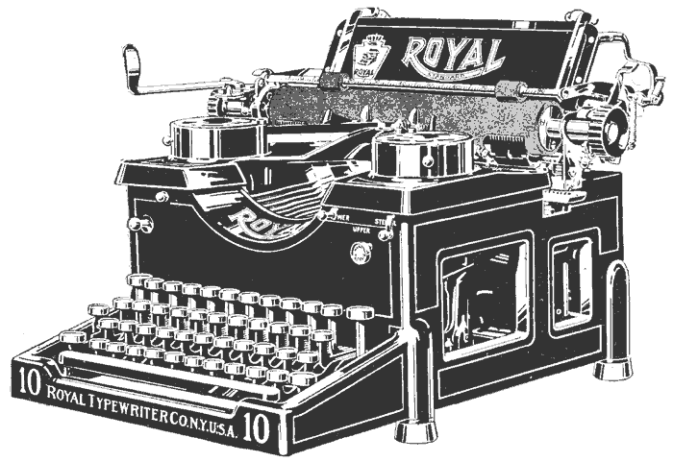
Today
Day 2 of Unix Boot Camp
How processes interact and do I/O
How parents control their children
I/O objects / kernel abstractions / channel types:
Terminal: user interaction via “teletypewriter”: tty
Pipe: Inter Process Communication (IPC)
Socket: networking
File: storage
Signals for IPC, process control, faults
Some shellish grunge needed for Lab 2
“typewriter”

Slide 3
Unix fork/exec/exit/wait syscalls
int pid = fork();
Create a new process that is a clone of its parent.
exec*(“program” [argvp, envp]);
Overlay the calling process with a new program, and transfer control to it, passing arguments and environment.
exit(status);
Exit with status, destroying the process.
int pid = wait*(&status);
Wait for exit (or other status change) of a child, and “reap” its exit status.
Recommended: use waitpid().
fork parent
fork child
parent
program initializes child
process context
exec
wait
exit

Slide 4
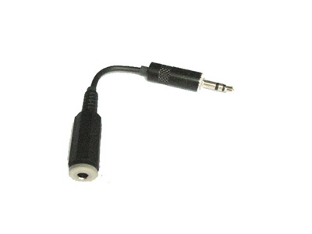
Unix process view: data
A process has multiple channels for data movement in and out of the process (I/O).
I/O channels
(“file descriptors”)
stdin
stdout
Process
tty
stderr
The parent process and parent program set up and control the channels for a child (until exec).
pipe
Thread
socket
Files
Program

Slide 5
Standard I/O descriptors
I/O channels
(“file descriptors”)
stdin
Open files or other I/O channels are named within the process by an integer file descriptor value.
stdout
tty
stderr
count = read(0, buf, count);
if (count == -1) {
perror(“read failed”); /* writes to stderr */
exit(1);
}
count = write(1, buf, count);
if (count == -1) {
perror(“write failed”); /* writes to stderr */
exit(1);
}
Standard descriptors for
primary input (stdin=0), primary output (stdout=1), error/status (stderr=2).
These are inherited from the parent process and/or set by the parent program.
By default they are bound to the controlling terminal.

Slide 6
Unix “file descriptors” illustrated
user space
kernel space
file
int fd
pointer
pipe
Disclaimer: this drawing is oversimplified
per-process
descriptor
table
socket
tty
system-wide open file table
Processes often reference OS kernel objects with integers that index into a table of pointers in the kernel. (Why?) Windows calls them handles.
In Unix, processes may share I/O objects (i.e., “files”: in Unix “everything is a file”). But the descriptor name space is per-process: fork clones parent descriptor table for child, but then they may diverge.

Slide 7
Unix I/O: the basics
char buf[BUFSIZE];
size_t count = 5;
count = read(0, buf, count);
if (count == -1) {
perror(“read failed”);
exit(1);
}
count = write(1, buf, count);
if (count == -1) {
perror(“write failed”);
exit(1);
}
fprintf(stderr, “\n%zd bytes moved\n”, count);
chase$ cc –o cat5 cat5.c
chase$ ./cat5
<waits for tty input>
12345<enter>
12345
5 bytes moved
chase$
tty input:
output:
TTY read blocks until <enter> or <EOF>, then returns all bytes entered on the line. A read returns 0 after <EOF>.

Slide 8
Unix I/O: the basics
chase$ ./cat5
1234
1234
5 bytes moved
chase$ ./cat5
123
123
4 bytes moved
chase$ ./cat5
123456
12345
5 bytes moved
chase$ 6
-bash: 6: command not found
chase$
char buf[BUFSIZE];
size_t count = 5;
count = read(0, buf, count);
if (count == -1) {
perror(“read failed”);
exit(1);
}
count = write(1, buf, count);
if (count == -1) {
perror(“write failed”);
exit(1);
}
fprintf(stderr,
“\n%zd bytes moved\n”, count);

Slide 9
Unix I/O: the basics
chase$ ./cat5
1234
1234
5 bytes moved
chase$ ./cat5
123
123
4 bytes moved
chase$ ./cat5
123456
12345
5 bytes moved
chase$ 6
-bash: 6: command not found
chase$
char buf[BUFSIZE];
size_t count = 5;
count = read(0, buf, count);
if (count == -1) {
perror(“read failed”);
exit(1);
}
count = write(1, buf, count);
if (count == -1) {
perror(“write failed”);
exit(1);
}
fprintf(stderr,
“\n%zd bytes moved\n”, count);
TTY read returns the <enter> as ‘\n’ char.
And prints it.
read syscall returns the number of bytes actually read.
Any bytes not consumed by read are returned by the next read
(in shell process).

Slide 10
Shell and child
1
3
tty
stdin
dsh
tty
stdin
dsh
fork
tcsetpgrp
exec
wait
stdout
stdout
stderr
stderr
2
tty
stdin
Child process inherits standard I/O channels to the terminal (tty).
stdout
stderr
If child is to run in the foreground:
Child receives/takes control of the terminal (tty) input (tcsetpgrp).
The foreground process receives all tty input until it stops or exits.
The parent waits for a foreground child to stop or exit.

Slide 11
Jobs and job control
A job is a set of processes that run together.
The processes are joined in a process group.
Process group ID (pgid) is pid of leader.
A foreground job receives/takes control of the tty.
The parent passes control; the job’s process group takes control; parent waits on processes in group. Call this “set-fg”.
When a foreground job stops or completes, the parent awakes and receives/takes back control of the tty.
These mechanisms exist to share the controlling tty among multiple processes/jobs that active at the same time.
Before the advent of GUIs, each user had only one tty! Job control was an important innovation that enabled users to “multitask”.

Slide 12
Process goups
The process(es) of a job run as a process group.
Process group ID (pgid) is pid of leader.
Every process is in exactly one process group.
Exactly one process group controls the tty.
The members of the controlling process group are foreground.
If a user types ctrl-c (cancel) or ctrl-z (snooze):
The kernel (tty driver) sends a signal to all members of the controlling process group. They die or stop if they don’t catch it.
The shell keeps its own process group separate from its children, so it doesn’t receive their signals.
If a process does a read from the tty:
If it is not in the foreground then it receives a signal (SIGTTIN). It stops if it doesn’t catch it. Optionally, write generates a signal too (SIGTTOU).

Slide 13
Job states and transitions
User can send a STOP signal to a foreground process/job by typing ctrl-z on tty.
fg
exit
fork + set-fg
EXIT
SIGCONT
set-fg
ctrl-z (SIGTSTP)
exit
Continue a stopped process or job by sending it a SIGCONT signal with “kill” or “killpg” syscall.
stop
SIGCONT
bg
STOP
tty in
tty out
P receives SIGTTIN if it attempts to read from tty and is not in controlling process group. Optionally, P receives SIGTTOU if it attempts to write to tty and is not in controlling process group. Default action of these signals is STOP.

Slide 14
Unix: signals
A signal is a typed upcall event delivered to a process by kernel.
Process P may use kill* system call to request signal delivery to Q.
Process may register signal handlers for signal types. A signal handler is a procedure that is invoked when a signal of a given type is delivered. Runs in user mode, then returns to normal control flow.
A signal delivered to a registered handler is said to be caught. If there is no registered handler then the signal triggers a default action (e.g., “die”).
A process lives until it exits voluntarily or receives a fatal signal.
data
data
...and upcalls (signals)
Kernel sends signals, e.g., to notify processes of faults.
Protected system calls

Slide 15
You shouldn’t have to know
How to seize control of the terminal
if (tcsetpgrp(0, getpid()) < 0) {
perror("tcsetpgrp failure");
exit(EXIT_FAILURE);
}
Translation: “Terminal control set process group for stdin (file descriptor 0) to the process group of which I am a leader. Stdin is a tty and I want control of it.”
You can also use tcsetpgrp to pass control of the terminal to some other process group named by pgid.

Slide 16
Shell and children
dsh
Any of these child jobs/processes could exit or stop at any time.
&
How should a process wait for the next event, if there are many possible events to wait for?
If the process blocks to wait for for one event, could it miss another event that happens first?
P1A
P1B
P3A
Job 1
Job 3
&
P2A
Job 2

Slide 17
Monitoring background jobs
dsh
Parent can use a non-blocking wait syscall to poll (query) the status of a child.
waitpid(pid, &status, WNOHANG);
“echo y&”
fork
“jobs”
exec
wait
EXIT
But how should a parent learn of status changes to a child if parent is busy with something else and does not poll?
“Do you know where your children are?”

Slide 18
Monitoring background jobs
dsh
What if a child changes state while the shell is blocked on some other event, e.g., waiting for input, or waiting for a foreground job to complete?
“echo y&”
fork
coffee….
exec
EXIT
A “real” shell should notice and inform the user immediately. But dsh will not.
Parent is waiting for read to return the next input command.
How should parent learn of the child exit event?

Slide 19
Monitoring background jobs
dsh
A “real” shell receives SIGCHLD signals from the kernel when a child changes state.
If the shell is blocked on some other system call (e.g., read), then SIGCHLD interrupts the read.
“echo y&”
fork
coffee….
exec
Event notifications
STOP
SIGCHLD
Key point: many programs need to be able to receive and handle multiple event types promptly, regardless of what order they arrive in. Unix has grown some funky mechanisms to deal with that.
EXIT
SIGCHLD

Slide 20
Pipes
int pfd[2] = {0, 0};
pipe(pfd);
/*pfd[0] is read, pfd[1] is write */
b = write(pfd[1], "12345\n", 6);
b = read(pfd[0], buf, b);
b = write(1, buf, b);
pipe
A pipe is a bounded kernel buffer for passing bytes.
12345
The pipe() system call creates a pipe object.
A pipe has one read end and one write end: unidirectional.
Bytes placed in the pipe with write are returned by read in order.
The read syscall blocks if the pipe is empty.
The write syscall blocks if the pipe is full.
Write fails (SIGPIPE) if no process has the other end open.

Slide 21
Notes on pipes
All the processes in a pipeline run concurrently. The order in which they run is not defined. They may execute at the same time on multiple cores.
Their execution is “synchronized by producer/consumer bounded buffer”. (More about this next month.) It means that a writer blocks if there is no space to write, and a reader blocks if there are no bytes to read. Otherwise they may both run: they might not, but they could.
The pipe itself must be created by a common parent. The children inherit the pipe’s file descriptors from the parent on fork. Unix has no other way to pass a file descriptor to another process.
How does a reader “know” that it has read all the data coming to it through a pipe? Answer: there are no bytes in the pipe, and no process has the write side open. Then the read syscall returns EOF. By convention a process exits if it reads EOF from stdin.

Slide 22
Shell and children
chase$ who | grep chase
chase console Jan 13 21:08
chase ttys000 Jan 16 11:37
chase ttys001 Jan 16 15:00
chase$
tty
stdin
dsh
stdout
stderr
Job
stderr
stderr
tty
tty
stdout
stdin
tty
tty
stdin
pipe
stdout
who
grep

Slide 23
But how to rewire the pipe?
1
P creates pipe.
P
2
P forks C1 and C2.
Both children inherit both ends of the pipe, and stdin/stdout/stderr.
Parent closes both ends of pipe after fork.
stdout
stdin
tty
tty
stdin
stdout
C1
C2
3A
C1 closes the read end of the pipe, closes its stdout, “dups” the write end onto stdout, and execs.
3B
C2 closes the write end of the pipe, closes its stdin, “dups” the read end onto stdin, and execs.

Slide 24
Simpler example Feeding a child through a pipe
Parent
close(ifd[0]);
count = read(0, buf, 5);
count = write(ifd[1], buf, 5);
waitpid(cid, &status, 0);
printf("child %d exited…”);
Parent
int ifd[2] = {0, 0};
pipe(ifd);
cid = fork();
parent
stdout
stdin
stderr
pipe
Child
close(0);
close(ifd[1]);
dup2(ifd[0],0);
close(ifd[0]);
execve(…);
stdin
chase$ man dup2
chase$ cc -o childin childin.c
chase$ ./childin cat5
12345
12345
5 bytes moved
child 23185 exited with status 0
chase$
stdout
stderr
child cid

Slide 25
A key idea: Unix pipes
[http://www.bell-labs.com/history/unix/philosophy.html]

Slide 26
Unix programming environment
Standard unix programs read a byte stream from standard input (fd==0).
They write their output to standard output (fd==1).
stdin
stdout
Stdin or stdout might be bound to a file, pipe, device, or network socket.
The processes may run concurrently and are automatically synchronized
That style makes it easy to combine simple programs using pipes or files.
If the parent sets it up, the program doesn’t even have to know.

Slide 27
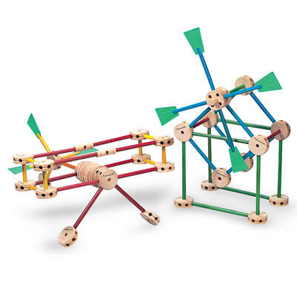
Platform abstractions
Platforms provide “building blocks”…
…and APIs to use them.
Instantiate/create/allocate
Manipulate/configure
Attach/detach
Combine in uniform ways
Release/destroy
The choice of abstractions reflects a philosophy of how to build and organize software systems.

Slide 28
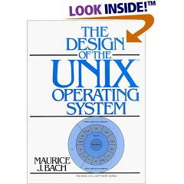
Unix defines uniform, modular ways to combine programs to build up more complex functionality.
Other application programs
nroff
sh
who
cpp
a.out
Kernel
date
comp
cc
Hardware
as
wc
ld
grep
vi
ed
Other application programs

Slide 29
Unix: a lesson here
Classical Unix programs are packaged software components: specific functions with narrow, text-oriented interfaces.
Shell is a powerful (but character-based) user interface.
It is also a programming environment for composing and coordinating programs interactively.
So: it’s both an interactive programming environment and a programmable user interface.
Both ideas were “new” at the time (late 1960s).
Unix has inspired a devoted (druidic?) following over 40+ years.
Its powerful scripting environment is widely used in large-scale system administration and services.
And it’s inside your laptop, smartphone, server, cloud.

Slide 30
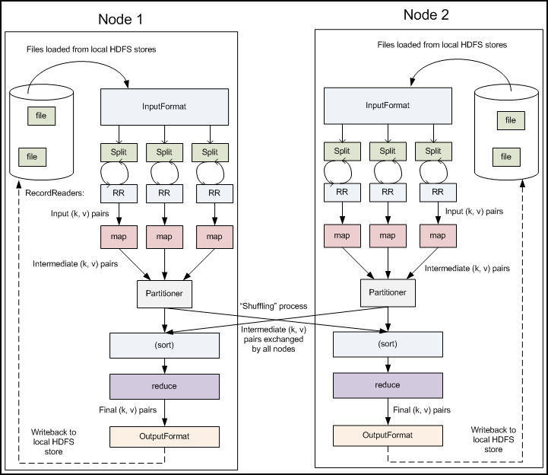
MapReduce/Hadoop
Hadoop
Dataflow programming
MapReduce is a filter-and-pipe model for data-intensive cluster computing. Its programming model is “like” Unix pipes. It adds “parallel pipes” (my term) that split output among multiple downstream children.

Slide 31
Sockets
client
int sd = socket(<internet stream>);
gethostbyname(“www.cs.duke.edu”);
<make a sockaddr_in struct>
<install host IP address and port>
connect(sd, <sockaddr_in>);
write(sd, “abcdefg”, 7);
read(sd, ….);
socket
A socket is a buffered channel for passing data over a network.
The socket() system call creates a socket object.
Other socket syscalls establish a connection (e.g., connect).
A file descriptor for a connected socket is bidirectional.
Bytes placed in the socket with write are returned by read in order.
The read syscall blocks if the socket is empty.
The write syscall blocks if the socket is full.
Both read and write fail if there is no valid connection.

Slide 32
A simple, familiar example
request
“GET /images/fish.gif HTTP/1.1”
reply
client (initiator)
server
sd = socket(…);
connect(sd, name);
write(sd, request…);
read(sd, reply…);
close(sd);
s = socket(…);
bind(s, name);
sd = accept(s);
read(sd, request…);
write(sd, reply…);
close(sd);

Slide 33
Network names
Socket endpoints are the first objects we’re dealing with that exist outside of our process.
How do we name a network endpoint?
Depends on the network protocols in use.
Meaning of the names depends on the network we’re attached to….might be more than one.
Internet Protocols (IP) and Ethernet
DNS (“domain”) name: www.cs.duke.edu
IP address: 152.3.140.5 (IPv4 address is 32 bits: 4 bytes)
MAC: 00:03:ba:09:2e:a1 (48 bits: 12 hex digits)
Port: 16-bit logical endpoint on node
More on these later

Slide 34
IP+Ethernet network names
linux11:~> nslookup www.cs.duke.edu
Server: 152.3.140.5
…
www.cs.duke.edu canonical name = prophet.cs.duke.edu.
Name: prophet.cs.duke.edu
Address: 152.3.140.5
linux11:~> arp -n 152.3.140.5
Address HWtype HWaddress Flags Mask Iface
152.3.140.5 ether 00:03:ba:09:2e:a1 C eth0
linux11:~>

Slide 35
The network stack, simplified
Internet client host
Internet server host
Client
User code
Server
Sockets interface
(system calls)
TCP/IP
Kernel code
TCP/IP
Hardware interface
(interrupts)
Network
adapter
Hardware
and firmware
Network
adapter
Global IP Internet

Slide 36
TCP/IP Ports
What port number to connect to?
We have to agree on well-known ports for common services
Look at /etc/services
Ports 1023 and below are ‘reserved’.
This port abstraction is an Internet Protocol concept.
Source/dest port is named in every packet.
Kernel looks at port to demultiplex incoming traffic.
Clients need a return port, but it can be an ephemeral port assigned dynamically by the kernel.

Slide 37
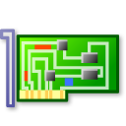
Packet demultiplexing
Kernel network stack demultiplexes incoming network traffic to processes based on destination port.

Slide 38
Files
fd = open(name, <options>);
write(fd, “abcdefg”, 7);
read(fd, buf, 7);
lseek(fd, offset, SEEK_SET);
close(fd);
creat(name, mode);
mkdir(name, mode);
rmdir(name);
unlink(name);
Files
A file is a named, variable-length sequence of data bytes that is persistent: it exists across system restarts, and lives until it is removed.
An offset is a byte index in a file. By default, a process reads and writes files sequentially. Or it can seek to a particular offset.

Slide 39
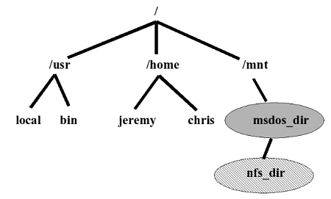
Files: hierarchical name space
root directory
applications etc.
mount point
user home directory
external media volume or network storage
directories (“folders”)
mkdir(name, mode);
rmdir(name);

Slide 40
File I/O
Pathnames are translated through the directory tree, starting at the root directory (/) or process current directory.
char buf[BUFSIZE];
int fd;
if ((fd = open(“../zot”, O_TRUNC | O_RDWR) == -1) {
perror(“open failed”);
exit(1);
}
while(read(0, buf, BUFSIZE)) {
if (write(fd, buf, BUFSIZE) != BUFSIZE) {
perror(“write failed”);
exit(1);
}
}
Every system call should check for errors and handle appropriately.
Do as I say, not as I do.
File grows as process writes to it → system must allocate space dynamically.
Process does not specify current file offset: the system remembers it.

Slide 41
Unix process view: data
I/O channels
(“file descriptors”)
VM mappings
stdin
stdout
Process
tty
text
stderr
data
pipe
Thread
anon VM
socket
etc.
Program
etc.
Files
Segments
Labels: uid

Slide 42
Processes reference objects
text
Files
data
anon VM

Slide 43
Fork clones all references
text
Files
data
anon VM
Cloned file descriptors share a read/write offset.
Cloned references to VM segments are likely to be copy-on-write to create a lazy, virtual copy of the shared object.
The kernel objects referenced by a process have reference counts. They may be destroyed after the last ref is released, but not before.
What operations release refs?

Slide 44
Close
Close(fd) is an important system call!
Always close descriptors when not in use.
You don’t want to “leak” file descriptors and references.
Some objects like pipes and sockets won’t work right if you (ore someone) keeps them open.
E.g., Objects that a parent opens to pass to its children (like pipes) should be closed in the parent at a suitable time.
All descriptors are closed automatically on exit.

Slide 45
Note
The following supplementary slides were not discussed in class.
They were added to help with the shell lab project, and fill in some topics mentioned in passing.
Copy-on-write is a common concept and crucial for fork. You should understand that the child gets a logical copy of the parent’s address space. So: now you know how.
It copies the page table mappings, and then copies the pages themselves lazily, if and only if they are modified. Details vary.
We haven’t really discussed virtual memory implementation, so I’m not going to test the slide details.

Slide 46
Unix dup* syscall
int fd2 = 0
tty in
int fd1 = 5
tty out
per-process
descriptor
table
pipe in
pipe out
Hypothetical initial state before dup2(fd1, fd2) syscall.
dup2(fd1, fd2). What does it mean?
Yes, fd1 and fd2 are integer variables. But let’s use “fd” as shorthand for “the file descriptor whose number is the value of the variable fd”.
Then fd1 and fd2 denote entries in the file descriptor table of the calling process. The dup2 syscall is asking the kernel to operate on those entries in a kernel data structure. It doesn’t affect the values in the variables fd1 and fd2 at all!

Slide 47
Unix dup* syscall
int fd2 = 0
X
tty in
int fd1 = 5
>
tty out
per-process
descriptor
table
pipe in
pipe out
Final state after dup2(fd1, fd2) syscall.
Then dup2(fd1,fd2) means: “close(fd2), then set fd2 to refer to the same underlying I/O object as fd1.”
It results in two file descriptors referencing the same underlying I/O object. You can use either of the descriptors to read/write.
But you should probably just close(fd1).

Slide 48
Unix dup* syscall
int fd2 = 0
tty in
int fd1 = 5
X
tty out
per-process
descriptor
table
pipe in
pipe out
Final state after dup2(fd1, fd2) syscall.
Then dup2(fd1,fd2); close(fd1) means: “remap the object referenced by file descriptor fd1 to fd2 instead”.
It is convenient for remapping descriptors onto stdin, stdout, stderr, so that some program will use them “by default” after exec*.
Note that we still have not changed the values in fd1 or fd2. Also, changing the values in fd1 and fd2 can never affect the state of the entries in the file descriptor table. Only the kernel can do that.

Slide 49
Unix, looking backward: UI+IPC
Conceived around keystrokes and byte streams
User environment is centered on a text-based command shell.
The mess with signals, process groups, foreground/background, and job control is mostly about which processes “control” the user’s (single) terminal. With a big-screen GUI that is no longer the dominant concern. (What about a smartphone?)
Limited view of how programs interact
files: byte streams in a shared name space
pipes: byte streams between pairs of sibling processes

Slide 50
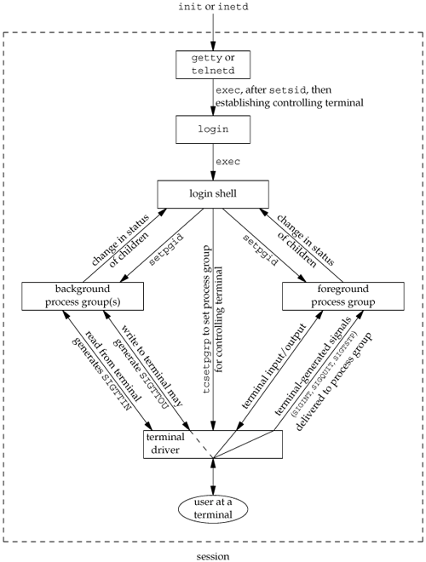

Slide 51
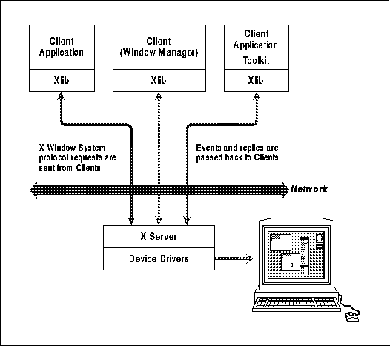
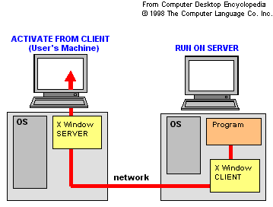
X Windows (1985)
Big change: GUI.
Windows
Window server
App events
Widget toolkit

Slide 52
Unix: simple abstractions?
These persist across reboots. They have symbolic names (you choose it) and internal IDs (the system chooses).
users
files
processes
pipes
which “look like” files
These exist within a running system, and they are transient: they disappear on a crash or reboot. They have internal IDs.
Unix supports dynamic create/destroy of these objects.
It manages the various name spaces.
It has system calls to access these objects.
It checks permissions.

Slide 53
Unix: some key concepts
Names and namespaces
directories and pathnames
name tree and subtree grafting (mount: TDL)
root directory and current directory
path prefix list
resolution
links (aliases TDL) and reference counting
Access control by tags and labels (TDL)
inheritance of tags and labels
Context manipulation
fork vs. exec
TDL:
To Discuss Later

Slide 54
Copy on write
Physical memory
Parent memory
Child memory
What happens if parent writes to a page?
Landon Cox

Slide 55
Copy on write
Physical memory
Parent memory
Child memory
Have to create a copy of pre-write page for the child.
Landon Cox

