Slide 1
Protection, identity, and trust
Jeff Chase
Duke University

Slide 2
Processes and you
Your processes act on your behalf.
They represent you to the outside world.
They can spy on you.
Why do you trust them?
What is “trust” anyway?
How might an attacker exploit your trust?
What about servers?

Slide 3

The need for access control
Processes run on behalf of users. (“subjects”)
Processes create/read/write/delete files. (“objects”)
The OS kernel mediates these accesses.
How should the kernel determine which subjects can access which objects?
This problem is called access control or authorization (“authz”). It also encompasses the question of who is authorized to make a given statement.
The concepts are general, but we can consider Unix as an initial example.

Slide 4
Concept: reference monitor
Reference monitor
Example: Unix kernel
Isolation boundary
Principles of Computer System Design ♥ Saltzer & Kaashoek 2009
Notes:
Authentication is easy: the kernel

Slide 5
More terminology
A reference monitor monitors references to its objects…
…by a subject (one or more), also called a principal.
  I generally reserve the term “principal” for an entity with responsibility and accountability in the real world (e.g.: you).
  A subject identity may be a program speaking for a user, which is distinct from the user herself.
The reference monitor must determine the true and correct identity of the subject.
  This is called authentication. Example: system login
  We’ll return to this later. In Unix, once a user is logged in, the kernel maintains the identity across chained program executions.
  Things are different on a network, where there is no single trusted kernel to anchor all interactions.

Slide 6
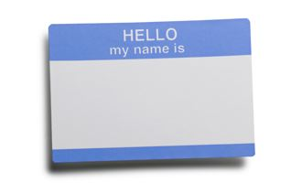
Reference monitor
requested operation
“boundary”
Alice
identity
protected
state/objects
subject
program
guard
What is the nature of the isolation boundary?
If we’re going to post a guard, there should also be a wall. Otherwise somebody can just walk in past the guard, right?

Slide 7
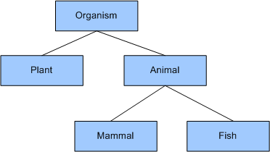
Example: Unix kernel
The Unix kernel is an example of a reference monitor.
  Reference monitor is a general concept.
  We’re going to keep most of the discussion general and abstract.
The kernel protects all objects accessed by user processes through the syscall API.
How does the kernel protect itself? What is the boundary?

Slide 8
Concept: access control matrix
We can imagine the set of all allowed accesses for all subjects over all objects as a huge matrix.
obj1
obj2
Alice
RW
---
Bob
R
RW
How is the matrix stored?

Slide 9
Concept: ACLs and capabilities
How is the matrix stored?
ACL
obj1
obj2
Alice
RW
---
capability list
Bob
R
RW
Capabilities: each subject holds a list of its rights and presents them as proof of access rights. A capability is an unforgeable token that confers rights to access a specific object.
Access control list (ACL): each object stores a list of subjects permitted to access it.

Slide 10
Concept: roles or groups
roles, groups
objects
wizard
student
obj1
obj2
Alice
yes
no
wizard
RW
---
Bob
no
yes
student
R
RW
A role or group is a named set S of subjects. Or, equivalently, it is a named boolean predicate that is true for s iff s ∈ S.
Roles/groups provide a level of indirection that simplifies the access control matrix, and makes it easier to store and manage.

Slide 11
Attributes and policies
name = “Alice”
wizard = true
Name = “obj1”
access: wizard
name = “Bob”
student = true
Name = “obj2”
access: student
More generally, we may view a subject/object identity as a list of named attributes with typed values (e.g., boolean).
Generally, an access policy for a requested access is a boolean (logic) function over the subject and object identities.

Slide 12
Access control: general model
We use this simple model for identity and authorization.
Real-world access control schemes use many variants of and restrictions of the model, with various terminology.
  Role-Based Access Control (RBAC)
  Attribute-Based Access Control (ABAC)
A guard is the code that checks access for an object, or (alternatively) the access policy that the code enforces.
There are many extensions. E.g., some roles are nested (a partial order or lattice). The guard must reason about them.
  Security clearance level TopSecret ⊆ Secret [subset]
  Equivalently: TopSecret(s) → Secret(s) [logical implication]
Notes:
The set of all things that are classified TopSecret is a subset of the set of things classified as Secret.
The set of all people with TopSecret security clearance is a subset of the set of all people with Secret clearance.
Anything classified as TopSecret is also classified as Secret (can’t access it without clearance as Secret or higher).
Anyone with TopSecret clearance also has Secret clearance.

Slide 13
Identity in an OS (Unix)
Every process has a security label that governs access rights granted to it by kernel.
Abstractly: the label is a list of named attributes and values. An OS defines a space of attributes and their interpretation.
Some attributes and values represent an identity bound to the process.
Unix: e.g., userID: uid
uid=“alice”
Alice
Every Unix user account has an associated userID (uid). (an integer)
credentials
uid
There is a special administrator uid==0 called root or superuser or su.
Root “can do anything”: normal access checks do not apply to root.

Slide 14
Unix: identity and access
A Unix program running in a process with Alice’s identity can do anything that Alice herself can do.
In particular, a process running as Alice can access any of Alice’s files.
  Saved passwords, security keys, etc.
  Programs and their configuration files
  Browser history, cookies…
How does Alice sleep at night?
How does the system determine what program executions can run as Alice?
Alice

Slide 15
Unix: setuid and login
A process with uid==root may change its userID with the setuid system call.
This means that a root process can speak for any user or act as any user, if it tries.
This mechanism enables system processes to set up an environment for a user after login.
Alice
log in
login
fork, setuid(“alice”), exec
shell
fork/exec
A privileged login program verifies a user password and starts a command interpreter (shell) and/or window manager for a logged-in user. A user may then interact with a shell to direct launch of other programs. They run as children of the shell, with the user’s uid.
tool
uid=“alice”

Slide 16
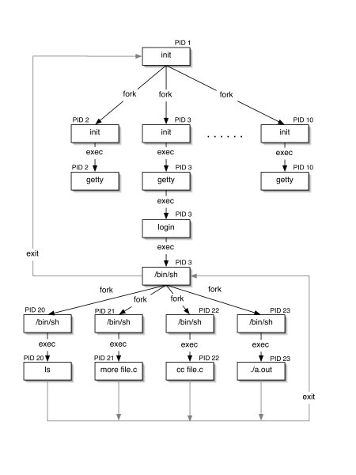
Init and Descendents
Kernel “handcrafts” initial root process to run “init” program.
Other processes descend from init, and also run as root, including user login guards.
Login invokes a setuid system call to run user shell in a child process after user authenticates.
Children of user shell inherit the user’s identity (uid).

Slide 17
Labels and access control
Alice
Every file and every process is labeled/tagged with a user ID.
Bob
log in
A privileged process may set its user ID.
login
login
fork, setuid(“alice”), exec
fork, setuid(“bob”), exec
shell
shell
fork/exec
creat(“foo”)
fork/exec
tool
foo
open(“foo”)
write,close
read
tool
uid=“alice”
owner=“alice”
uid=“bob”
A process inherits its userID from its parent process.
A file inherits its owner userID from its creating process.

Slide 18
Labels and access control
Alice
Every system defines rules for assigning security labels to subjects (e.g., Bob’s process) and objects (e.g., file foo).
Bob
login
login
Every system defines rules to compare the security labels to authorize attempted accesses.
shell
shell
creat(“foo”)
tool
foo
open(“foo”)
write,close
read
tool
uid=“alice”
owner=“alice”
uid=“bob”
Should processes running with Bob’s userID be permitted to open file foo?

Slide 19
File permissions in Unix (vanilla)
The owner of a Unix file may tag it with a mode value specifying access rights for subjects. (Don’t confuse with kernel/user mode.)
  Access types = {read, write, execute} [3 bits]
  Subject types = {owner, group, other/anyone} [3 bits]
  If the file is executed, should the system setuid the process to the userID of the file’s owner. [1 bit, the setuid bit]
  10 bits total: (3x3)+1. Usually given in octal: e.g., “777” means 9 bits set: anyone can r/w/x the file, but no setuid.
  Unix “mode bits” are a simple form of an access control list (ACL). Later systems like AFS have richer ACLs.
Unix provides a syscall and shell command for owner to set the permission bits on each file or directory (inode).
  chmod, chown, chgrp
“Group” was added later and is a little more complicated: a user may belong to multiple groups.

Slide 20
Another way to setuid
Alice
A program file itself may be tagged to setuid to program owner’s uid on exec.
This is called setuid bit. Some call it the most important innovation of Unix.
It enables users to request protected ops by running secure programs.
The user cannot choose the code: only the program owner can choose the code to run with the owner’s uid.
Parent cannot subvert/control a child after program launch: a property of Unix exec.
log in
login
fork
setuid(“alice”)
exec
shell
fork
exec(“sudo”)
setuid bit set
/usr/bin/sudo
sudo
fork
exec(“tool)
Example: sudo program runs as root, checks user authorization to act as superuser, and (if allowed) executes requested command as root.
tool
uid=“root”

Slide 21
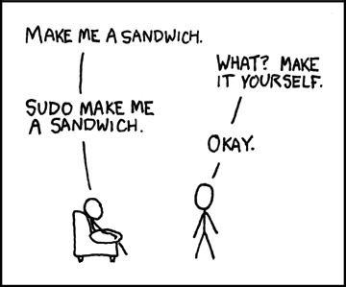
Protected programs
Alice
log in
login
fork
setuid(“alice”)
exec
shell
“sudo tool”
fork/exec
uid = 0
sudo
xkcd.com
fork
exec(“tool”)
With great power comes great responsibility.
tool
Example: sudo program runs as root, checks user authorization to act as superuser, and (if allowed) executes requested command as root.
uid=“root”

Slide 22
The secret of setuid
The setuid bit is best seen as a mechanism for programs to function as reference monitors.
A setuid program can govern access to files.
  Protect the files with the program owner’s uid.
  Make them inaccessible to other users.
  Other users can access them via the setuid program.
  But only in the manner permitted by the program.
  Example: “moo accounting problem” in 1974 paper (cryptic)
What is the reference monitor’s “isolation boundary”? What protects it from its callers?
Note: setuid can also be used to restrict the program’s privileges by stripping it of the user’s uid.

Slide 23
MOO accounting problem
Multi-player game called Moo
  Want to maintain high score in a file
Should players be able to update score?
  Yes
Do we trust users to write file directly?
  No, they could lie about their score
Game client (uid x)
“x’s score = 10”
High score
“y’s score = 11”
Game client
(uid y)
[Landon Cox]

Slide 24
MOO accounting problem
Multi-player game called Moo
  Want to maintain high score in a file
Could have a trusted process update scores
Is this good enough?
Game client (uid x)
“x’s score = 10”
Game server
High score
“x:10
y:11”
“y’s score = 11”
Game client
(uid y)
[Landon Cox]

Slide 25
MOO accounting problem
Multi-player game called Moo
  Want to maintain high score in a file
Could have a trusted process update scores
Is this good enough?
  Can’t be sure that reported score is genuine
  Need to ensure score was computed correctly
Game client (uid x)
“x’s score = 100”
Game server
High score
“x:100
y:11”
“y’s score = 11”
Game client
(uid y)
[Landon Cox]

Slide 26
Access control
Insight: sometimes simple inheritance of uids is insufficient
  Tasks involving management of “user id” state
  Logging in (login)
  Changing passwords (passwd)
Why isn’t this code just inside the kernel?
  This functionality doesn’t really require interaction w/ hardware
  Would like to keep kernel as small as possible
How are “trusted” user-space processes identified?
  Run as super user or root (uid 0)
  Like a software kernel mode
  If a process runs under uid 0, then it has more privileges
[Landon Cox]

Slide 27
Access control
Why does login need to run as root?
  Needs to check username/password correctness
  Needs to fork/exec process under another uid
Why does passwd need to run as root?
  Needs to modify password database (file)
  Database is shared by all users
What makes passwd particularly tricky?
  Easy to allow process to shed privileges (e.g., login)
  passwd requires an escalation of privileges
How does UNIX handle this?
  Executable files can have their setuid bit set
  If setuid bit is set, process inherits uid of image file’s owner on exec
[Landon Cox]

Slide 28
MOO accounting problem
“fork/exec
game”
Multi-player game called Moo
  Want to maintain high score in a file
How does setuid solve our problem?
  Game executable is owned by trusted entity
  Game cannot be modified by normal users
  Users can run executable though
  High-score is also owned by trusted entity
This is a form of trustworthy computing
  Only trusted code can update score
  Root ownership ensures code integrity
  Untrusted users can invoke trusted code
Shell
(uid x)
Game
client (root)
“x’s score = 10”
High score
“y’s score = 11”
Shell
(uid y)
Game client
(root)
“fork/exec
game”

Slide 29
Reference monitor revisited
What is the nature of the isolation boundary?

Slide 30
Reference monitor revisited
requested operation
“boundary”
protected
state/objects
subject
(with attributes)
program
The reference monitor pattern can work with various protection mechanisms. Let’s talk about it generally. Later we’ll see how it applies to servers as well.

Slide 31
Protection: abstract concept
Programs run with an ability to access some set of data/state/objects.
We call that set a domain or protection domain.
  Defines the “powers” that the running code has available to it.
  Determined by context and/or identity (label/attributes).
  The domain is not (directly) a property of the program itself.
  Protection domains may overlap.
Some mechanism must prevent the code from accessing state outside of its domain. Examples?

Slide 32
Protection
Programs may invoke other programs.
  E.g., call a procedure/subprogram/module.
  E.g., launch a program with exec.
Often/typically/generally the invoked program runs in the same protection domain as the caller.
(Or i.e., it has the same privilege over some set of objects. It may also have some private state. We’re abstracting.)
Examples?

Slide 33
Protection
Real systems always use protection.
They have various means to invoke a program with more/less/different privilege than the caller.
In the reference monitor pattern, B has powers that A does not have, and that A wants. B executes operations on behalf of A, with safety checks.
Be sure that you understand the various examples from Unix.
Why?
A
B

Slide 34

Subverting protection
If we talk about protection systems, we must also talk about how they can fail.
One way is for an attacker to breach the boundary.
A more common way is for an attacker to somehow choose the code that executes inside the boundary.
For example, it can replace the guard, install a backdoor, or just execute malicious ops directly.
Inside job
But how?
Install or control code inside the boundary.

Slide 35
Program integrity

Slide 36
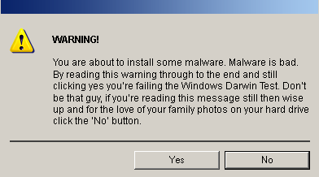
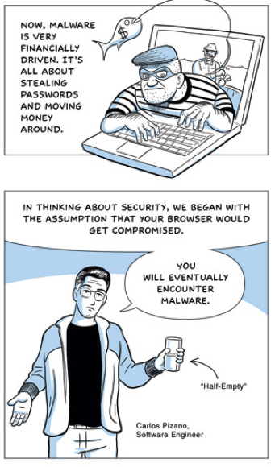
Malware
[Source: somewhere on the web.]
[Source: Google Chrome comics.]

Slide 37
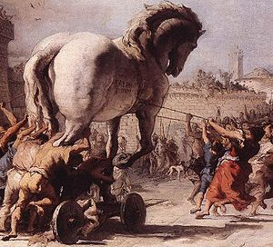
Any program you install or run can be a Trojan Horse vector for a malware payload.

Slide 38
Note
The following slides were not discussed in class.
We might come back to the Thompson “Trusting trust” slides.
  These should be interesting and easy to understand, but I won’t test them.
The others just throw more words at what we already know, and are in scope.

Slide 39
Trusting Programs
In Unix
  Programs you run use your identity (process UID).
  Maybe you even saved them with setuid so others who trust you can run them with your UID.
  The programs that run your system run as root.
You trust these programs.
  They can access your files
  send mail, etc.
  Or take over your system…
Where did you get them?

Slide 40
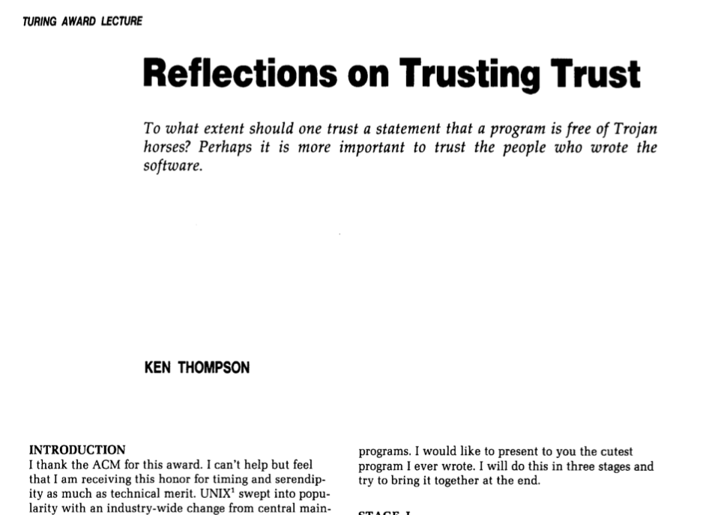
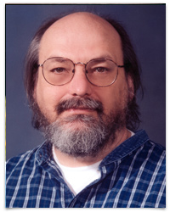

Slide 41
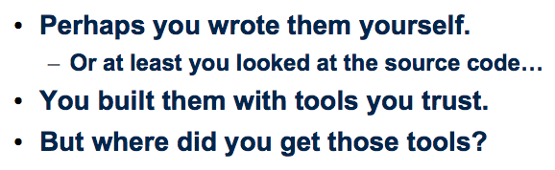
Trusting Trust
Perhaps you wrote them yourself.
  Or at least you looked at the source code…
You built them with tools you trust.
But where did you get those tools?

Slide 42
Where did you get those tools?
Thompson’s observation: compiler hacks cover tracks of Trojan Horse attacks.

Slide 43
Login backdoor: the Thompson Way
Step 1: modify login.c
  (code A) if (name == “ken”) login as root
  This is obvious so how do we hide it?
Step 2: modify C compiler
  (code B) if (compiling login.c) compile A into binary
  Remove code A from login.c, keep backdoor
  This is now obvious in the compiler, how do we hide it?
Step 3: distribute a buggy C compiler binary
  (code C) if (compiling C compiler) compile code B into binary
  No trace of attack in any (surviving) source code

Slide 44
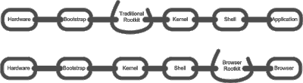
Reflections on trust
What is “trust”?
  Trust is a belief that some program or entity will be faithful to its expected behavior.
Thompson’s parable shows that trust in programs is based on a chain of reasoning about trust.
  We often take the chain for granted. And some link may be fragile.
  Corollary: successful attacks can propagate down the chain.
The trust chain concept also applies to executions.
  We trust whoever launched the program to select it, configure it, and protect it. But who booted your kernel?

Slide 45

How much damage can malware do?
If it compromises a process with your uid?
  Read and write your files?
  Overwrite other programs?
  Install backdoor entry points for later attacks?
  Attack your account on other machines?
  Attack your friends?
  Attack other users?
  Subvert the kernel?
What if an attacker compromises a process running as root?

Slide 46

Concept: enforced modularity
pipe
(or other channel)
An important theme
By putting each program or component instance in a separate process, we can enforce modularity boundaries among components. Each component runs in a sandbox: they can interact only through pipes or some other channel. Neither can access the internals of the other.

Slide 47
Isolation
We need protection domains and protected contexts (“sandboxes”), even on single-user systems like your smartphone. There are various dimensions of isolation for protected contexts (e.g., processes):
Fault isolation. One app or app instance (context or process) can fail independently of others. If it fails, the OS can kill the process and reclaim all of its memory, etc.
Performance isolation. The OS manages resources (“metal and glass”: computing power, memory, disk space, I/O throughput capacity, network capacity, etc.). Each instance needs the “right amount” of resources to run properly. The OS prevents apps from impacting the performance of other apps. E.g., the OS can prevent a program with an endless loop from monopolizing the processor.
Security. An app may contain malware that tries to corrupt the system, steal data, or otherwise compromise the integrity of the system. The OS uses protected contexts and a reference monitor to check and authorize all accesses to data or objects outside of the context, including channel setup.

