Slide 1
Servers
Jeff Chase
Duke University

Slide 2
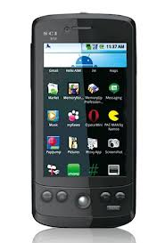
Servers and the cloud
Where is your application?
Where is your data?
Where is your OS?
networked server “cloud”
Cloud and Software-as-a-Service (SaaS)
Rapid evolution, no user upgrade, no user data management.
Agile/elastic deployment on clusters and virtual cloud utility-infrastructure.

Slide 3



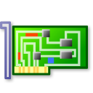

Networked services: big picture
client host
NIC device
Internet “cloud”
client applications
kernel network software
server hosts with server applications

Slide 4
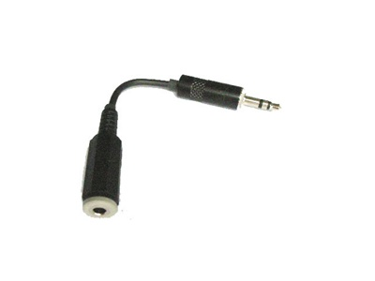
Sockets
client
int sd = socket(<internet stream>);
gethostbyname(“www.cs.duke.edu”);
<make a sockaddr_in struct>
<install host IP address and port>
connect(sd, <sockaddr_in>);
write(sd, “abcdefg”, 7);
read(sd, ….);
socket
A socket is a buffered channel for passing data over a network.
The socket() system call creates a socket object.
Other socket syscalls establish a connection (e.g., connect).
A file descriptor for a connected socket is bidirectional.
Bytes placed in the socket with write are returned by read in order.
The read syscall blocks if the socket is empty.
The write syscall blocks if the socket is full.
Both read and write fail if there is no valid connection.

Slide 5



A simple, familiar example
request
“GET /images/fish.gif HTTP/1.1”
reply
client (initiator)
server
sd = socket(…);
connect(sd, name);
write(sd, request…);
read(sd, reply…);
close(sd);
s = socket(…);
bind(s, name);
sd = accept(s);
read(sd, request…);
write(sd, reply…);
close(sd);

Slide 6
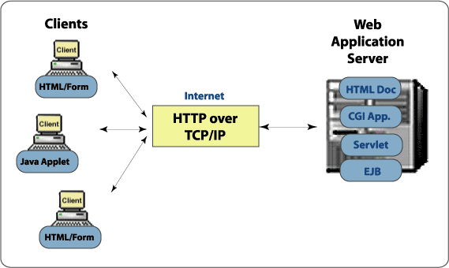
SaaS platform elements
container
browser
“Classical OS”
[wiki.eeng.dcu.ie]

Slide 7

SaaS platforms
New!
$10!
SaaS application frameworks is a topic in itself.
Rests on material in this course
We’ll cover the basics
  Internet/web systems and core distributed systems material
But we skip the practical details on specific frameworks.
  Ruby on Rails, Django, etc.
Recommended: Berkeley MOOC
  Fundamentals of Web systems and cloud-based service deployment.
  Examples with Ruby on Rails
Web/SaaS/cloud
http://saasbook.info

Slide 8

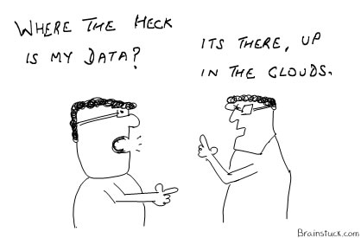
What is a distributed system?
"A distributed system is one in which the failure of a computer you didn't even know existed can render your own computer unusable." -- Leslie Lamport
Leslie Lamport

Slide 9
Networking in the kernel
Sockets, looking “down”

Slide 10
Unix “file descriptors” illustrated
user space
kernel space
file
int fd
pointer
pipe
Disclaimer: this drawing is oversimplified
per-process
descriptor
table
socket
tty
“open file table”
There’s no magic here: processes use read/write (and other syscalls) to operate on sockets, just like any Unix I/O object (“file”). A socket can even be mapped onto stdin or stdout.
Deeper in the kernel, sockets are handled differently from files, pipes, etc.
Sockets are the entry/exit point for the network protocol stack.

Slide 11

The network stack, simplified
Internet client host
Internet server host
Client
User code
Server
Sockets interface
(system calls)
TCP/IP
Kernel code
TCP/IP
Hardware interface
(interrupts)
Network
adapter
Hardware
and firmware
Network
adapter
Global IP Internet
Note: the “protocol stack” should not be confused with a thread stack. It’s a layering of software modules that implement network protocols: standard formats and rules for communicating with peers over a network.

Slide 12

Network “protocol stack”
Layer / abstraction
app
Socket layer: syscalls and move data between app/kernel buffers
app
Transport layer: end-to-end reliable byte stream (e.g., TCP)
L4
L4
Packet layer: raw messages (packets) and routing (e.g., IP)
L3
L3
L2
Frame layer: packets (frames) on a local network, e.g., Ethernet
L2

Slide 13
End-to-end data transfer
sender
receiver
move data from application to system buffer
move data from system buffer to application
buffer queues
(mbufs, skbufs)
buffer queues
TCP/IP protocol
TCP/IP protocol
compute checksum
compare checksum
packet queues
packet queues
network driver
network driver
DMA + interrupt
DMA + interrupt
transmit packet to network interface
deposit packet in host memory

Slide 14
Stream sockets with
Transmission Control Protocol (TCP)
user transmit buffers
user receive buffers
TCP user
COMPLETE
TCP send buffers (optional)
SEND
COMPLETE
TCP rcv buffers (optional)
RECEIVE
TCP
implementation
transmit queue
receive queue
get
data
data
window
flow
ack
flow
ack
TCP/IP protocol sender
TCB
TCP/IP protocol receiver
checksum
outbound segments
inbound segments
checksum
network path
Integrity: packets are covered by a checksum to detect errors.
Reliability: receiver acks received packets, sender retransmits if needed.
Ordering: packets/bytes have sequence numbers, and receiver reassembles.
Flow control: receiver tells sender how much / how fast to send (window).
Congestion control: sender “guesses” current network capacity on path.

Slide 15
Packet demultiplexing
Kernel network stack demultiplexes incoming network traffic: choose process/socket to receive it based on destination port.
Apps with open sockets
Incoming network packets
Network adapter hardware aka, network interface controller (“NIC”)

Slide 16
TCP/IP Ports
Each transport endpoint on a host has a logical port number (16-bit integer) that is unique on that host.
This port abstraction is an Internet Protocol concept.
  Source/dest port is named in every IP packet.
  Kernel looks at port to demultiplex incoming traffic.
What port number to connect to?
  We have to agree on well-known ports for common services
  Look at /etc/services
  Ports 1023 and below are ‘reserved’.
Clients need a return port, but it can be an ephemeral port assigned dynamically by the kernel.

Slide 17
TCP/IP connection
For now we just assume that if a host sends an IP packet with a destination address that is a valid, reachable IP address (e.g., 128.2.194.242), the Internet routers and links will deliver it there, eventually, most of the time.
But how to know the IP address and port?
socket
socket
Client
Server
TCP byte-stream connection
(128.2.194.242, 208.216.181.15)
Client host address
128.2.194.242
Server host address
208.216.181.15
[adapted from CMU 15-213]

Slide 18
TCP/IP connection
Client socket address
128.2.194.242:51213
Server socket address
208.216.181.15:80
Client
Server
(port 80)
Connection socket pair
(128.2.194.242:51213, 208.216.181.15:80)
Client host address
128.2.194.242
Server host address
208.216.181.15
Note: 51213 is an
ephemeral port allocated
by the kernel
Note: 80 is a well-known port
associated with Web servers
[adapted from CMU 15-213]

Slide 19


A peek under the hood
chase$ netstat -s
tcp:
11565109 packets sent
1061070 data packets (475475229 bytes)
4927 data packets (3286707 bytes) retransmitted
7756716 ack-only packets (10662 delayed)
2414038 window update packets
29213323 packets received
1178411 acks (for 474696933 bytes)
77051 duplicate acks
27810885 packets (97093964 bytes) received in-sequence
12198 completely duplicate packets (7110086 bytes)
225 old duplicate packets
24 packets with some dup. data (2126 bytes duped)
589114 out-of-order packets (836905790 bytes)
73 discarded for bad checksums
169516 connection requests
21 connection accepts

Slide 20
Internet systems
Sockets, looking “up”

Slide 21
A simple, familiar example
request
“GET /images/fish.gif HTTP/1.1”
reply
client (initiator)
server
sd = socket(…);
connect(sd, name);
write(sd, request…);
read(sd, reply…);
close(sd);
s = socket(…);
bind(s, name);
sd = accept(s);
read(sd, request…);
write(sd, reply…);
close(sd);

Slide 22

Inside your Web server
Server operations
create socket(s)
bind to port number(s)
listen to advertise port
wait for client to arrive on port
(select/poll/epoll of ports)
accept client connection
read or recv request
write or send response
close client socket
Server application
(Apache, Tomcat/Java, etc)
accept queue
packet queues
listen queue
disk queue

Slide 23
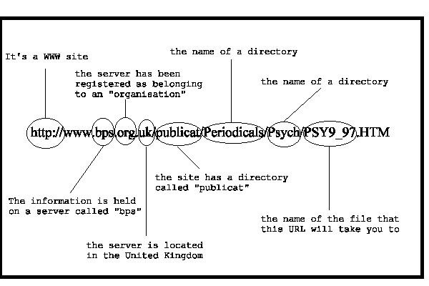
Uniform Resource Locator

Slide 24
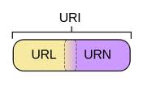
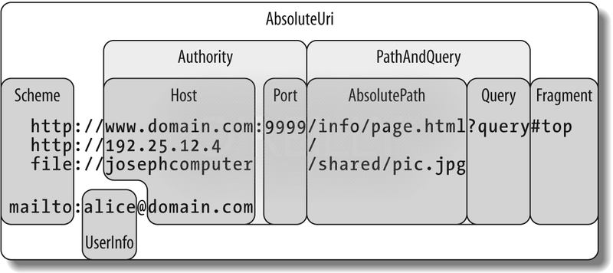
URIs and URLs
[image: msdn.microsoft.com]

Slide 25
Web services
HTTP is the standard protocol for web systems.
  GET, PUT, POST, DELETE
HTTP is typically layered over TCP transport.
Various standards and styles layer above it, e.g., Web services based on “REST” or “SOAP” (TBD).
What’s important is that the URI/URL authority always has the info to bind a channel to the server.
  E.g., translate domain name to an IP address and port using DNS service.
The URI path is interpreted by the server: it may encode the name of a file on the server, or a program entry point and arguments, or…

Slide 26
DNS and the Web
Web Page
Browser
a.com
DNS
<A HREF=
http://a.com/dog.jpg>Spot</A>
http://
IP addr
HTTP GET: /dog.jpg
www
[Michael Walfish]

Slide 27
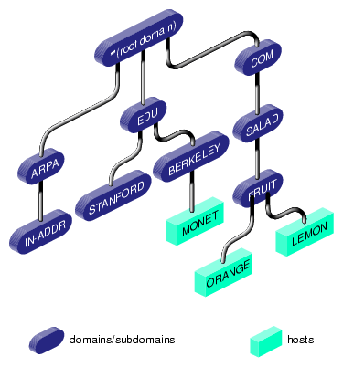
Domain Name Service (DNS)

Slide 28
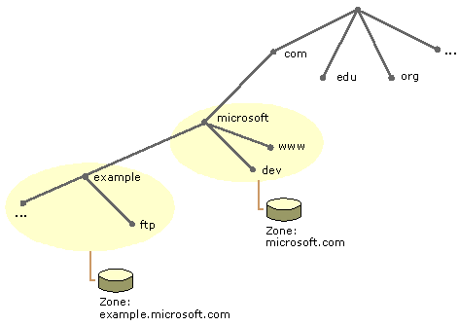

DNS as a distributed service
DNS is a “cloud” of name servers
owned by different entities (domains)
organized in a hierarchy (tree) such that
each controls a subtree of the name space.

Slide 29
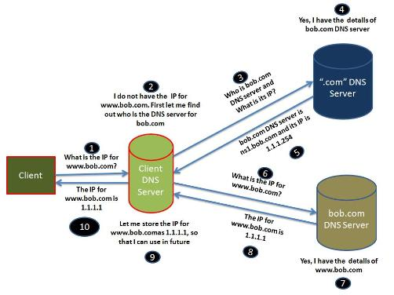
Lookup

Slide 30
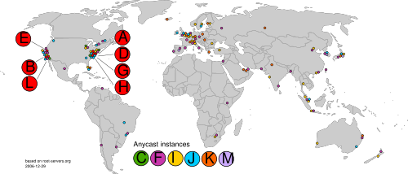
DNS Roots
There are 13 root “clusters”, each with its own IP address.
Each cluster replicates the root domain, and can serve queries.
Most root clusters have multiple instances (replicas).
Queries to a cluster are routed to the “closest” instance by IP anycast.

Slide 31
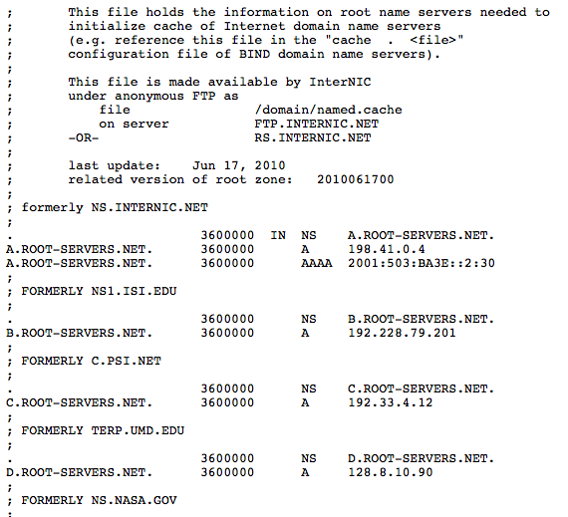
http://www.internic.net/zones/named.root

Slide 32
Anatomy of an HTTP Transaction
unix> telnet www.aol.com 80 Client: open connection to server
Trying 205.188.146.23... Telnet prints 3 lines to the terminal
Connected to aol.com.
Escape character is '^]'.
GET / HTTP/1.1 Client: request line
host: www.aol.com Client: required HTTP/1.1 HOST header
Client: empty line terminates headers.
HTTP/1.0 200 OK Server: response line
MIME-Version: 1.0 Server: followed by five response headers
Date: Mon, 08 Jan 2001 04:59:42 GMT
Server: NaviServer/2.0 AOLserver/2.3.3
Content-Type: text/html Server: expect HTML in the response body
Content-Length: 42092 Server: expect 42,092 bytes in the resp body
Server: empty line (“\r\n”) terminates hdrs
<html> Server: first HTML line in response body
... Server: 766 lines of HTML not shown.
</html> Server: last HTML line in response body
Connection closed by foreign host. Server: closes connection
unix> Client: closes connection and terminates
[CMU 15-213]

Slide 33
Servers and protection
Keeping it safe

Slide 34

Server as reference monitor
requested operation
“boundary”
Alice
protected
state/objects
subject
program
guard
What is the nature of the isolation boundary?
Clients can interact with the server only by sending messages through a socket channel. The server chooses the code that handles received messages.

Slide 35

Subverting network services
There are lots of security issues here.
TBD Q: Are DNS and IP secure? How can the client and server authenticate over a network? How can they know the messages aren’t tampered? How to keep them private? A: crypto.
TBD Q: Can an attacker inject malware scripting into my browser? What are the isolation defenses?
Q for now: Can an attacker penetrate the server, e.g., to choose the code that runs in the server?
Inside job
But how?
Install or control code inside the boundary.

Slide 36
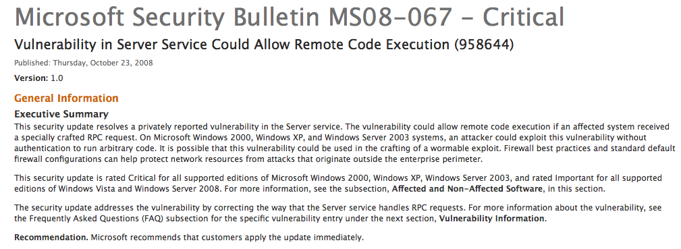


Slide 37

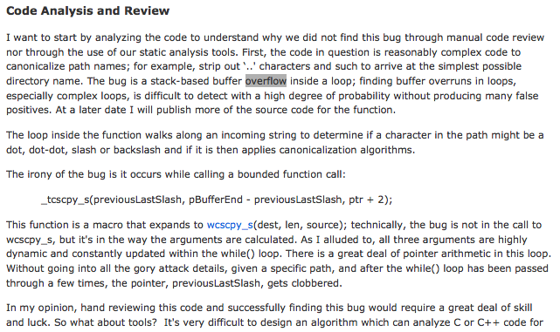
http://blogs.msdn.com/b/sdl/archive/2008/10/22/ms08-067.aspx

Slide 38
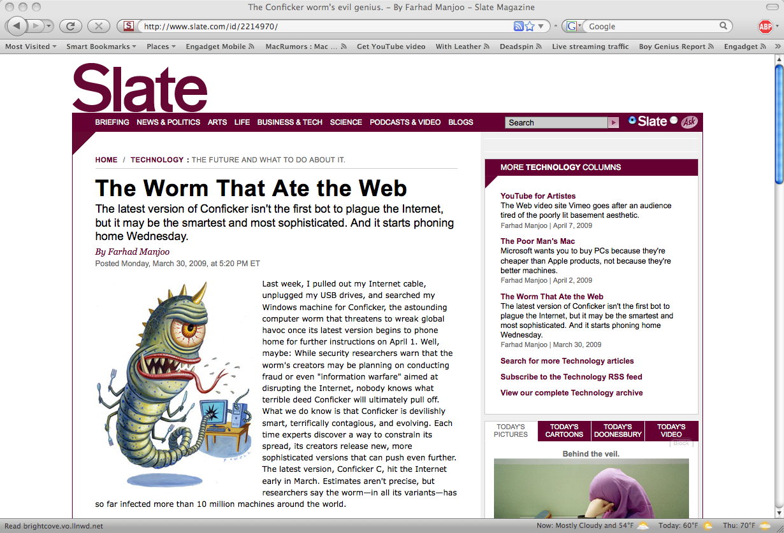

Slide 39
Servers and concurrency
Making it work

Slide 40
A simple, familiar example
request
“GET /images/fish.gif HTTP/1.1”
reply
client (initiator)
server
A client application may initiate many concurrent requests to different servers, or to the same server.
Servers may accept many concurrent requests to overlap request processing, e.g., from different users.
How should we manage concurrency? Threads? Processes?

Slide 41
Processes and threads
virtual address space
main thread
other threads (optional)
+
+…
stack
Each process has a virtual address space (VAS): a private name space for the virtual memory it uses.
The VAS is both a “sandbox” and a “lockbox”: it limits what the process can see/do, and protects its data from others.
Each process has a thread bound to the VAS, with stacks (user and kernel).
If we say a process does something, we really mean its thread does it.
The kernel can suspend/restart the thread wherever and whenever it wants.
From now on, we suppose that a process could have additional threads.
We are not concerned with how to implement them, but we presume that they can all make system calls and block independently.
STOP
wait

Slide 42
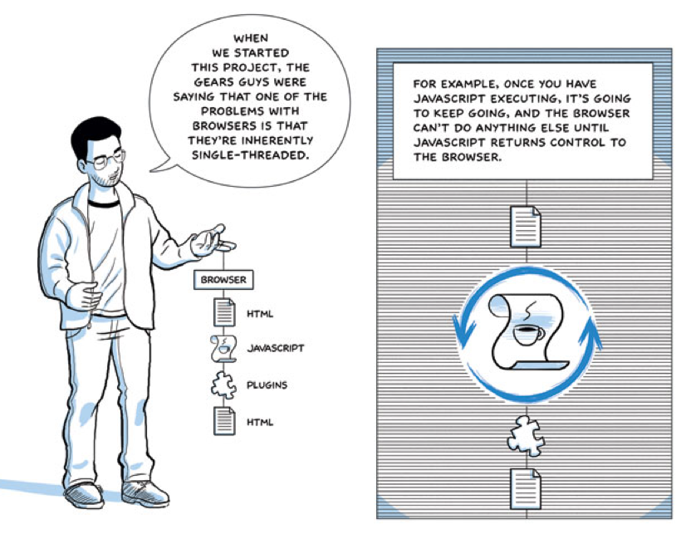
Example: browser
[Google Chrome Comics]

Slide 43
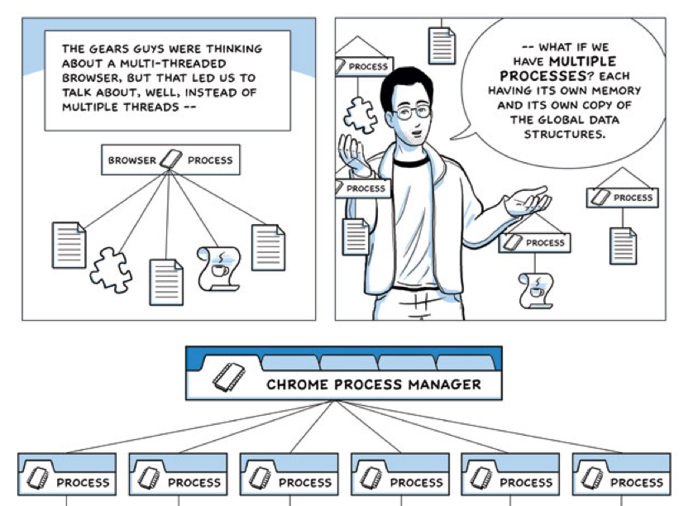
Processes in the browser
Chrome makes an interesting choice here. But why use processes?
[Google Chrome Comics]

Slide 44
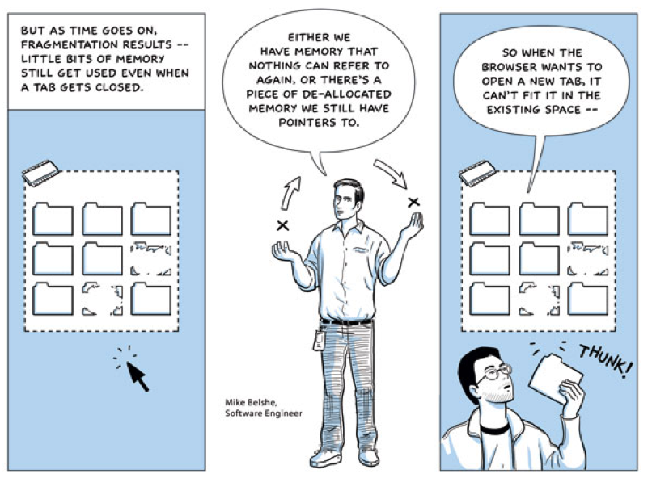
Problem: heap memory and fragmentation
[Google Chrome Comics]

Slide 45
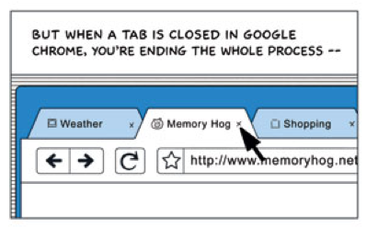
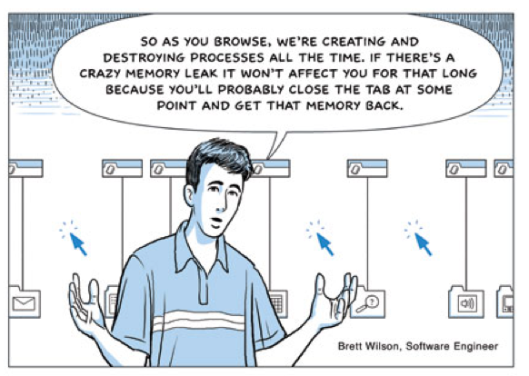
Solution: whack the whole process
When a process exits, all of its virtual memory is reclaimed as one big slab.
[Google Chrome Comics]

Slide 46
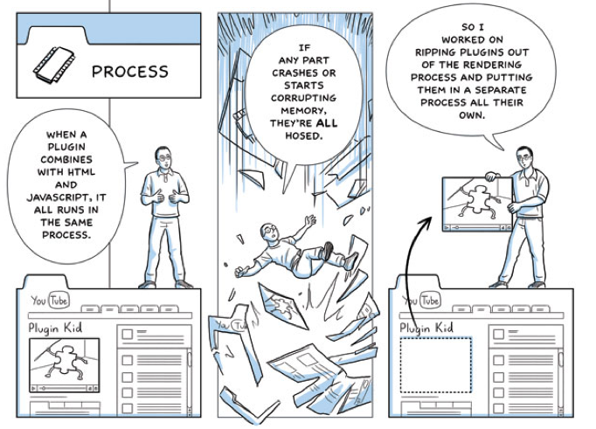
Processes for fault isolation
[Google Chrome Comics]

Slide 47
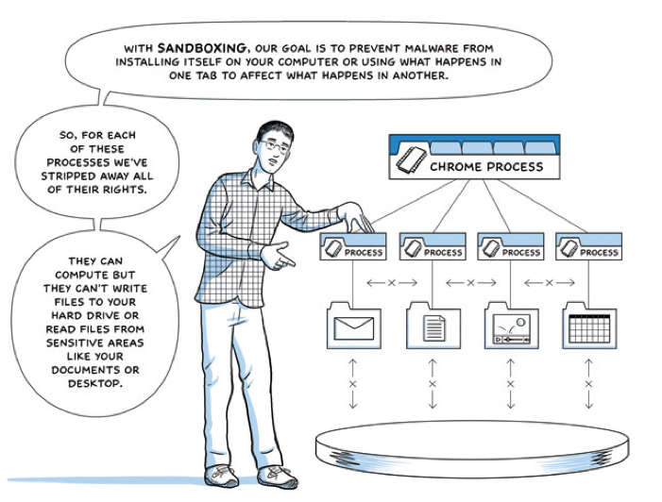
[Google Chrome Comics]

Slide 48
Multi-process server architecture
Each of P processes can execute one request at a time, concurrently with other processes.
If a process blocks, the other processes may still make progress on other requests.
Max # requests in service concurrently == P
The processes may loop and handle multiple requests serially, or can fork a process per request.
  Tradeoffs?
Examples:
  inetd “internet daemon” for standard /etc/services
  Design pattern for (Web) servers: “prefork” a fixed number of worker processes.

Slide 49
Example: inetd
Classic Unix systems run an inetd “internet daemon”.
Inetd receives requests for standard services.
  Standard services and ports listed in /etc/services.
  inetd listens on the ports and accepts connections.
For each connection, inetd forks a child process.
Child execs the service configured for the port.
Child executes the request, then exits.
[Apache Modeling Project: http://www.fmc-modeling.org/projects/apache]

Slide 50
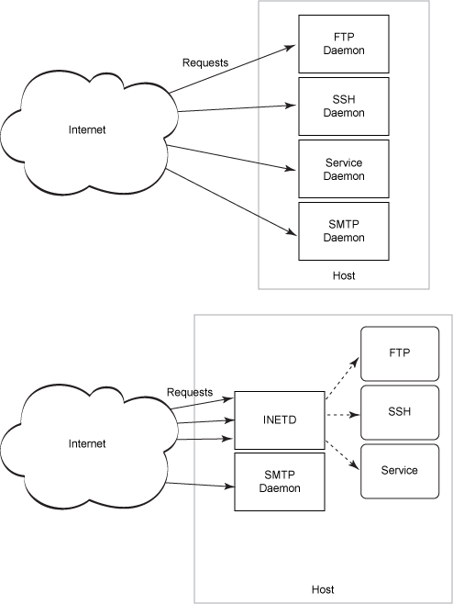
Children of init: inetd
New child processes are created to run network services.
They may be created on demand on connect attempts from the network for designated service ports.
Should they run as root?

Slide 51
High-throughput servers
Various server systems use various combinations models for concurrency.
Unix made some choices, and then more choices.
These choices failed for networked servers, which require effective concurrent handling of requests.
They failed because they violate properties for “ideal” event handling.
There is a large body of work addressing the resulting problems. Servers mostly work now. We skip over the noise.

Slide 52
WebServer Flow
Create ServerSocket
128.36.232.5
128.36.230.2
TCP socket space
connSocket = accept()
state: listening
address: {*.6789, *.*}
completed connection queue:
sendbuf:
recvbuf:
read request from connSocket
state: established
address: {128.36.232.5:6789, 198.69.10.10.1500}
sendbuf:
recvbuf:
read
local file
state: listening
address: {*.25, *.*}
completed connection queue:
sendbuf:
recvbuf:
write file to connSocket
close connSocket
Discussion: what does each step do and how long does it take?

Slide 53
Handling a Web request
Accept Client
Connection
Read HTTP
Request Header
may block
waiting on
network
may block
waiting on
disk I/O
Find
File
Send HTTP
Response Header
Read File
Send Data
Want to be able to process requests concurrently.

Slide 54
Note
The following slides were not discussed in class. They add more detail to other slides from this class and the next.
E.g., Apache/Unix server structure and events.
RPC is another non-Web example of request/response communication between clients and servers. We’ll return to it later in the semester.
The networking slide adds a little more detail in an abstract view of networking.
None of the new material on these slides will be tested (unless and until we return to them).

Slide 55
Server listens on a socket
struct sockaddr_in socket_addr;
sock = socket(PF_INET, SOCK_STREAM, 0);
int on = 1;
setsockopt(sock, SOL_SOCKET, SO_REUSEADDR, &on, sizeof on);
memset(&socket_addr, 0, sizeof socket_addr);
socket_addr.sin_family = PF_INET;
socket_addr.sin_port = htons(port);
socket_addr.sin_addr.s_addr = htonl(INADDR_ANY);
if (bind(sock, (struct sockaddr *)&socket_addr, sizeof socket_addr) < 0) {
perror("couldn't bind");
exit(1);
}
listen(sock, 10);

Slide 56
Accept loop: trival example
while (1) {
int acceptsock = accept(sock, NULL, NULL);
char *input = (char *)malloc(1024*sizeof (char));
recv(acceptsock, input, 1024, 0);
int is_html = 0;
char *contents = handle(input,&is_html);
free(input);
…send response…
close(acceptsock);
}
If a server is listening on only one port/socket (“listener”), then it can skip the select/poll/epoll.

Slide 57
Send HTTP/HTML response
const char *resp_ok = "HTTP/1.1 200 OK\nServer: BuggyServer/1.0\n";
const char *content_html = "Content-type: text/html\n\n";
send(acceptsock, resp_ok, strlen(resp_ok), 0);
send(acceptsock, content_html, strlen(content_html), 0);
send(acceptsock, contents, strlen(contents), 0);
send(acceptsock, "\n", 1, 0);
free(contents);

Slide 58
Multi-process server architecture
Process 1
Accept
Conn
Read
Request
Find
File
Send
Header
Read File
Send Data
…
separate address spaces
Process N
Accept
Conn
Read
Request
Find
File
Send
Header
Read File
Send Data

Slide 59
Multi-threaded server architecture
Thread 1
Accept
Conn
Read
Request
Find
File
Send
Header
Read File
Send Data
…
Thread N
Accept
Conn
Read
Request
Find
File
Send
Header
Read File
Send Data
This structure might have lower cost than the multi-process architecture if threads are “cheaper” than processes.

Slide 60
Servers in classic Unix
Single-threaded processes
Blocking system calls
  Synchronous I/O: calling process blocks until is “complete”.
Each blocking call waits for only a single kind of a event on a single object.
  Process or file descriptor (e.g., file or socket)
Add signals when that model does not work.
  Oops, that didn’t really help.
With sockets: add select system call to monitor I/O on sets of sockets or other file descriptors.
  select was slow for large poll sets. Now we have various variants: poll, epoll, pollet, kqueue. None are ideal.

Slide 61
Event-driven programming vs. threads
Often we can choose among event-driven or threaded structures.
So it has been common for academics and developers to argue the relative merits of “event-driven programming vs. threads”.
But they are not mutually exclusive, e.g., there can be many threads running an event loop.
Anyway, we need both: to get real parallelism on real systems (e.g., multicore), we need some kind of threads underneath anyway.
We often use event-driven programming built above threads and/or combined with threads in a hybrid model.
For example, each thread may be event-driven, or multiple threads may “rendezvous” on a shared event queue.
Our idealized server is a hybrid in which each request is dispatched to a thread, which executes the request in its entirety, and then waits for another request.

Slide 62

Prefork
In the Apache MPM “prefork” option, only one child polls or accepts at a time: the child at the head of a queue. Avoid “thundering herd”.
[Apache Modeling Project: http://www.fmc-modeling.org/projects/apache]

Slide 63
Details, details
“Scoreboard” keeps track of child/worker activity, so parent can manage an elastic worker pool.

Slide 64
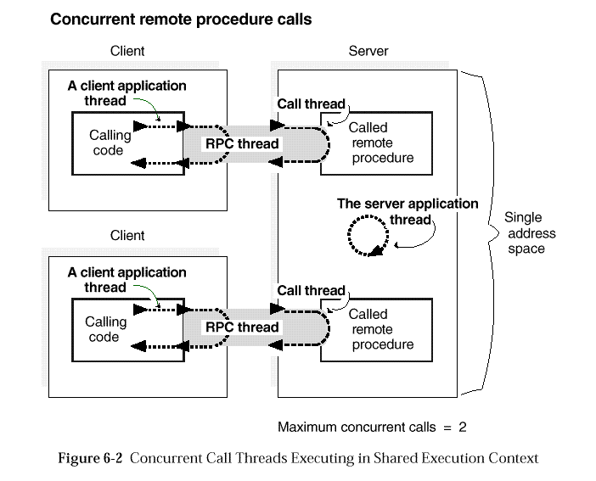
Remote Procedure Call (RPC)
[OpenGroup, late 1980s]

Slide 65
Networking
endpoint
port
operations
advertise (bind)
listen
connect (bind)
close
write/send
read/receive
channel
binding
connection
node A
node B
Some IPC mechanisms allow communication across a network.
E.g.: sockets using Internet communication protocols (TCP/IP).
Each endpoint on a node (host) has a port number.
Each node has one or more interfaces, each on at most one network.
Each interface may be reachable on its network by one or more names.
E.g. an IP address and an (optional) DNS name.

