Slide 1
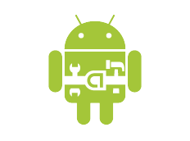
Android
(Simplified)
Jeff Chase
Duke University
I am not affiliated with Google or any Android device manufacturer. This presentation uses borrowed graphics (including some copyrighted or trademarked material) without explicit permission. It is for educational use only.

Slide 2
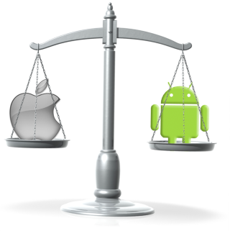
Part 1: Background

Slide 3
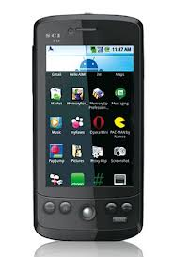
End-to-end application delivery
Where is your application?
Where is your data?
Where is your OS?
Cloud and Software-as-a-Service (SaaS)
Rapid evolution, no user upgrade, no user data management.
Agile/elastic deployment on virtual infrastructure. Seamless integration with apps on personal devices.

Slide 4
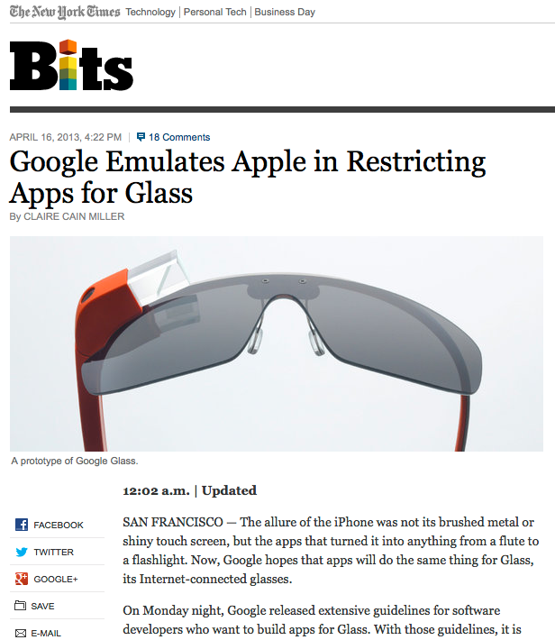

Slide 5
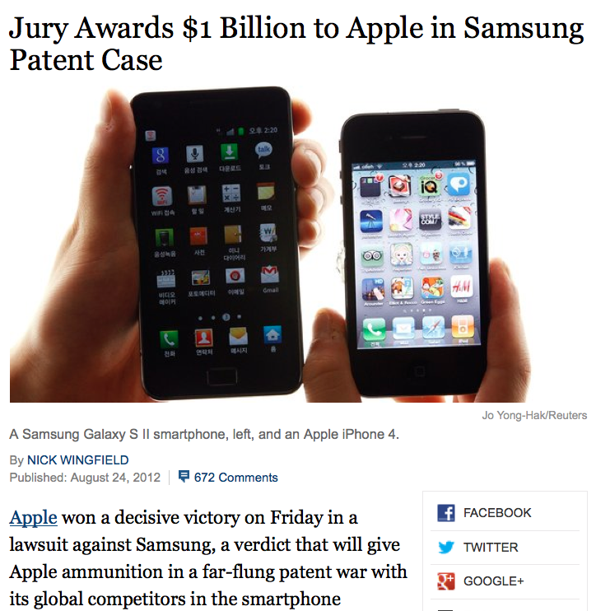

Slide 6
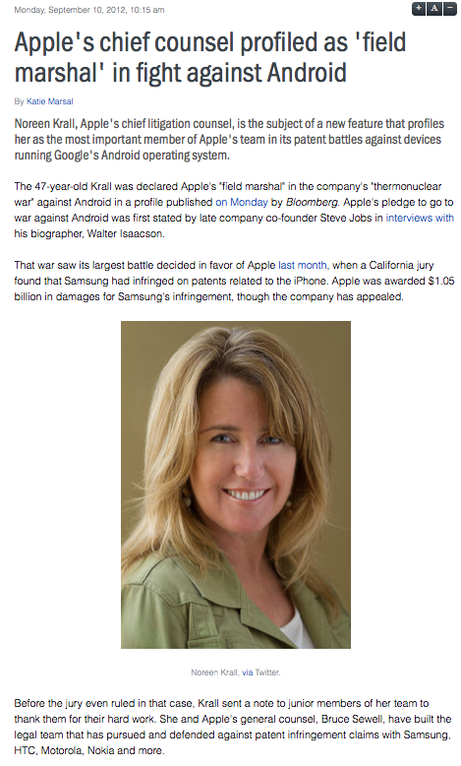
From Bloomberg (9/10/12)
Krall and General Counsel Bruce Sewell have amassed a team of lawyers from inside Apple and some of the top U.S. law firms to fight Samsung, HTC, and Google’s Motorola Mobility unit over Google’s Android mobile operating system and the smartphones and tablets that run on it.
The fight is central to Apple’s identity…it got 46.4 percent of its sales from the iPhone last quarter and 26 percent from the iPad. The iPhone generated $47 billion in sales last fiscal year….
Apple and Samsung together make more than half of the smartphones sold in the world. Samsung is the biggest player in the global market and Apple is dominant in the U.S. The companies are vying for …a market that …grew 62 percent to $219 B…

Slide 7
Part 2, Android technology
The goal here is to present an overview of the Android structure, and rationale for that structure.
We won’t learn how to program Android apps. Detailed docs are available.
developer.android.com
What we offer is the conceptual underpinnings and connections to other OS concepts.
Android is instructive, e.g., modern platform / open source.
Some images are borrowed from material on the web. E.g., Google material:
Anatomy and Physiology of Android

Slide 8
Android in a nutshell
Linux kernel inside: Android uses the Unix OS abstractions with a few mods (e.g., they added “binder” IPC as a kernel module).
Apps run as multi-threaded Linux processes. Typ. one process per-app per-device (per-user). The process runs whenever some part of the app is active --- then the system kills it for its memory.
Linux is hidden behind Java. All apps run over Dalvik JVM with canned libraries (bionic). System APIs are in Java.
Android subsystems run as services outside of the kernel. Android environment combines various managers (running as processes) and a baked-in runtime library linked with the apps.
Event-driven app ecosystem. Apps can integrate seamlessly with other apps, providing services, data, UI screens, etc. to one another.
Object/component model with object-oriented IPC and asynchronous event notification. IDL/RPC with objects, permissions, reference counting, thread pools, upcalls.

Slide 9
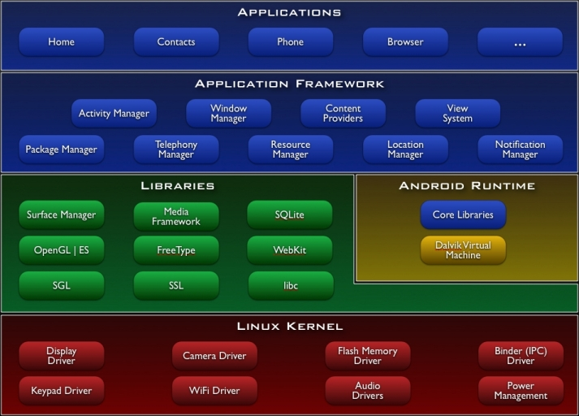
Virtual Machine
(JVM)
C/C++
[http://www.android.com]

Slide 10
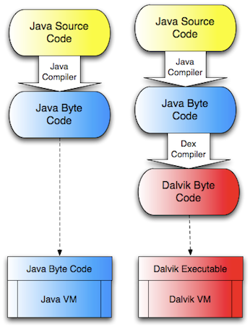
Dalvik/JVM (Interpreter)
Java Virtual Machine interprets Java bytecode.
Bytecode is an abstract machine instruction set.
Java source compiles to bytecode.
JVM is an interpreter: a program that reads other programs as data and executes them.
Android apps compile to bytecode.
Dalvik has various optimizations for the Android platform.
(Dalvik interprets “DEX” bytecode rather than Java bytecode.)

Slide 11
Android: components
An app is a set of components.
App declares a metadata list (manifest) of its components, and what events (intents) they respond to.
System instantiates and destroys components automatically, driven by various events in the system and UI.
Components have upcall interfaces invoked from the system to notify them of lifecycle events
activate, deactivate, etc.
Apps may interact with one another by typed messages among components.
intents and binder RPC
Component
instance
intents, RPC
instance
upcalls
System
App
class
class
manifest

Slide 12
Some symbols
Figures follow conventions established in previous lectures.
API / linkage / binding
Module (component)
file
Light blue indicates a trusted system element
Virtual address space
A process/VAS with component instances and a trusted library.
program
JVM+lib

Slide 13
Components run in contexts
context
(app process)
Components are Java code.
A component is a class in an app.
Its name is (appname, classname).
Apps are named as Java packages.
Components run in JVM contexts.
Each component runs at most one instance in exactly one context.
Components may activate/deactivate independently of one another.
The context is a Linux process with a JVM and a trusted system library.
Android library defines context object with system API for use by app threads.
instances
JVM+lib
component launch (activate)
app

Slide 14
Apps are isolated
app “sandbox”
Components in the same app (generally) share a context.
Components in different apps are always in different contexts.
Apps cannot reference each other’s memory contexts (sandbox/lockbox):
“soft” JVM protection
“hard” process boundaries
Apps interact only via IPC.
intents, events
service RPC and content put/get
Apps run with distinct user IDs.
Principle of Least Privilege
app files
context
JVM+lib
app

Slide 15
Android protection model
Each app runs with its own Linux userID.
Each app has a private space of files, processes, etc. that defines its “sandbox” and/or “lockbox”.
It does not matter that they run on behalf of the same user: each installed app receives its own userID.
The system mediates app access to the sensors and UI.
GPS, camera, microphone, touch screen, etc.
Access requires permissions subject to user approval.
Apps may interact (e.g., by invoking one another’s components) subject to permissions checks.

Slide 16
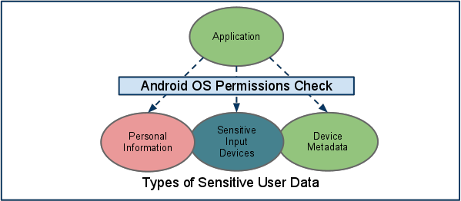
Android permissions
http://source.android.com/tech/security/
The Android system declares named permissions that an app must have in order to access platform devices (e.g., sensors) and data. Apps may also define new permissions and require them of their clients.

Slide 17
Android permissions
A permission is a named label, declared by system or an app.
An app may declare new permissions in its manifest.
Apps declare (in manifest) the permissions they want/require/use.
An app may request any declared permission by global name.
System grants requested permissions according to policy at app install time. Once installed the app’s permissions don’t change.
Permissions protect interactions among apps.
Each component states permissions required by its counterparty.

Slide 18
Granting permissions
“At application install time, permissions requested by the application are granted to it by the package installer, based on checks against the signatures of the applications declaring those permissions and/or interaction with the user.”
Each permission is either a system permission or it is bound to the provider key that signed the app that declared it.
The declaring app (or system) associates a protection level with the permission.
The protection level drives system policy to grant permissions.
normal: granted on request
dangerous: requires user approval
signature: granted on request to apps signed by the same provider
system: granted only to apps installed on the system image

Slide 19
The four component types
Activity. Display a screen.
Push on a “back stack”, like a browser.
May be launched to respond to intents sent by other apps.
Service. Serve an API.
Export binder RPC interface to other apps.
Provider. Get/put content objects.
Serve a URI space with MIME types.
Backed by SQLite database tables.
Receiver. Respond to events.
E.g., low battery, wifi up/down, storage full, USB insert, …

Slide 20
Apps offer services to other apps
RPC
(binder/AIDL)
service
content provider
GET (HTTP)
etc.
Clients
initiate connection and send requests.
Server
listens for and accepts clients, handles requests, sends replies

Slide 21
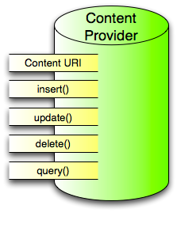
Android content providers: URIs
Define the provider's authority string, its content URIs, and column names….To avoid conflicts with other providers, you should use Internet domain ownership (in reverse) as the basis …for Android package names…define your provider authority as an extension of the name of the package containing [it]…
Developers usually create content URIs from the authority by appending paths that point to individual tables…
By convention, providers offer access to a single row in a table by accepting a content URI with an ID value for the row at the end of the URI. …
[images from http://www.tutos-android.com/contentprovider-android]

Slide 22
Binding to an Android service
public abstract boolean bindService
(Intent service, ServiceConnection conn, int flags)
Connect to an application service, creating it [instantiating the component] if needed. …The given conn will receive the service object when it is created and be told [via upcalls] if it dies and restarts. …
This function will throw SecurityException if you [the client app] do not have permission to bind to the given service.

Slide 23
Structuring systems using upcalls
Component instantiations have a lifecycle.
Birth, do-this, do-that, death
Lifecycle is largely managed by the system
Components are acted upon by other components.
And by the system: e.g., the system decides when you die.
These actions may cause lifecycle transitions.
Described by a finite state machine!
Components are notified of lifecycle events and other operations by upcalls.
A component API method is invoked (on some thread) to notify the component and give it an opportunity to respond.

Slide 24
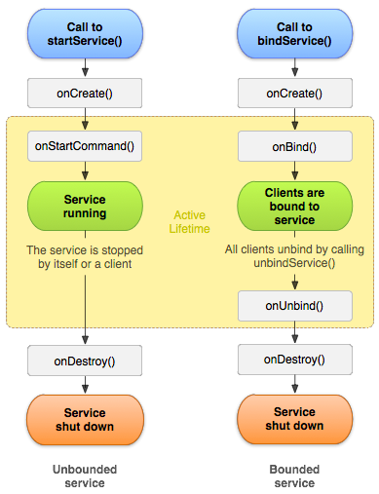
Service
Services may advertise one or more binder endpoints.
Clients choose to bind/unbind (or unbind when stopped).
A service with no bound clients may be shut down.

Slide 25
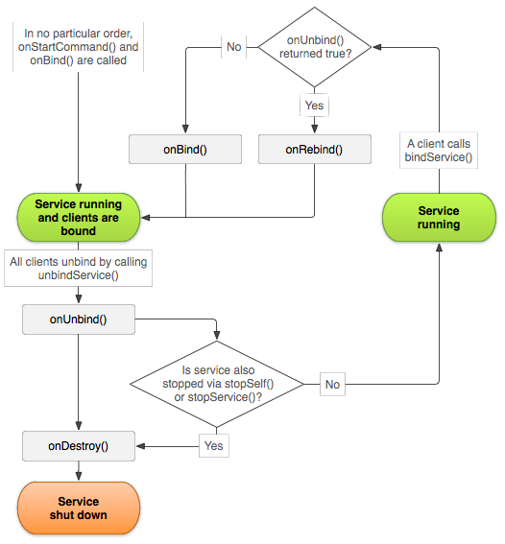
Service

Slide 26
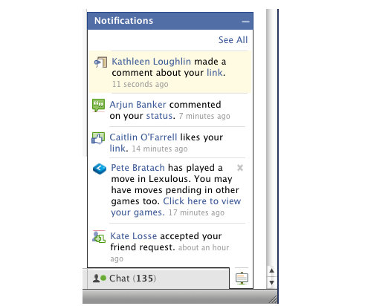
Events and implicit invocation
publish
notify
subscribe
register
An Android receiver component can register to receive broadcast intents published by other components, or by the system.
Event producers {publish/raise/announce/signal} events to notify {consumers/receivers/subscribers} of occurrences relating to a {subject/topic/category}. The system invokes a registered handler method/procedure in each receiver. Delivery is synchronous or asynchronous.

Slide 27
Component launch
To launch a component, the system:
Selects a JVM context to run it.
Tells JVM to instantiate the class.
System communicates with the context via its system library.
System obtains info about the component from app manifest.
Class → component type: the component class descends from a system base class.
List of event profiles (intent filters) that trigger component launch.
app context
launch
JVM+lib
load class
System
manifest
read manifest
app
If there is no JVM context active for the component’s app, then the system starts one.

Slide 28
App launch
Zygote is a preinitialized “warm” JVM image for unborn children.
Zygote
children
Activity Manager Service
etc.
setuid to app uid
start
JVM+lib
fork
JVM+lib
JVM+lib
Linux kernel
How do we launch the application’s code? Exec?

Slide 29
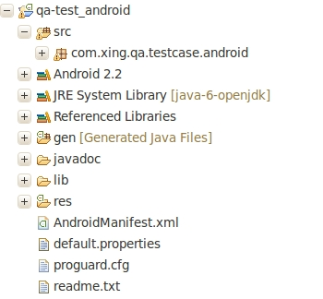
App launch
Zygote
forked child context
Activity Manager Service
etc.
JVM+lib
launch
JVM+lib
open
read
App files
Linux kernel
No exec needed: all Android contexts run the same Linux program: the JVM. Fork is just right!

Slide 30
Notes:
From Anatomy and Physiology of Android

Slide 31
Binder: object-based RPC channels
Services register to advertise for clients.
Activity Manager Service
etc.
JVM+lib
Bindings are reference-counted.
A client binds to a service.
JVM+lib
Android binder
an add-on kernel driver for binder RPC
Linux kernel
Android services and libraries communicate by sending messages through shared-memory channels set up by binder.

Slide 32
Android environment server
Activity Manager Service
etc.
JVM+lib
JVM+lib
The Activity Manager maintains a binding to every app context.
Apps call system APIs and receive events via binder RPC calls to/from Android Activity Manager etc.

Slide 33
Init and service manager
Zygote also forks a system service manager (SM) on system startup. SM is a process to init the system.
SM forks a lot of the basic Android services. E.g., window manager, activity manager.
SM looks for installed apps with binder services in the manifest, and starts those components/apps.
E.g., daemons that listen to USB, audio etc. and/or that send events.
SM also enables lookup for registered services: everyone knows how to talk to it (SM itself uses constant binder handle 0).
Once the system is running, app launch and app actions are triggered by events/intents:
screen touch, app launch (e.g., from system menu), USB insert/remove, connectivity enable/disable

Slide 34
Deactivating components and apps
If a service has no bound clients, the system may deactivate it.
Activity Manager Service
etc.
X
JVM+lib
JVM+lib
The Activity Manager decides when to deactivate components and tear down app contexts.

Slide 35
Deactivating components and apps
If an app has no active components, the system may deactivate it.
Activity Manager Service
etc.
JVM+lib
X
JVM+lib
The Activity Manager decides when to deactivate components and tear down app contexts.

Slide 36
Deactivating components and apps
If an app has no active components, the system may deactivate it.
Activity Manager Service
etc.
X
JVM+lib
JVM+lib
The Activity Manager decides when to deactivate components and tear down app contexts.

Slide 37
Deactivating components and apps
The user navigates with the screen and buttons, activating components and moving on.
Activity Manager Service
etc.
JVM+lib
The components set up interactions among themselves as needed to serve the user.
The system monitors activity and memory pressure and cleans up behind components as needed.

Slide 38
Intents for activities and receivers
Intents are named events.
Components signal intents with various attributes and data.
They declare filters to specify which intents they may receive.
Filter specifies named permissions the sender must have.
A component may invoke an activity with an explicit intent, which invokes a named target component.
A component may broadcast an implicit intent for delivery to any interested receiver component.
Sender names permissions that each receiver must have.
The event may be sent to its receivers in order or in parallel.
Explicit intents and ordered broadcasts may receive a result.

Slide 39
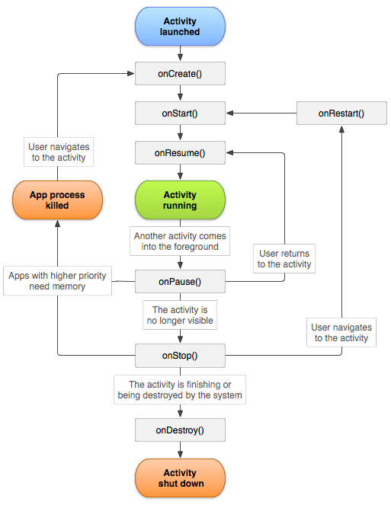
Activity
System upcalls component as its state changes due to user actions.
If another activity is started, the activity is paused.
If a paused activity is not visible to the user, it is stopped.
A stopped activity may be destroyed.
And its app process may be killed.

Slide 40
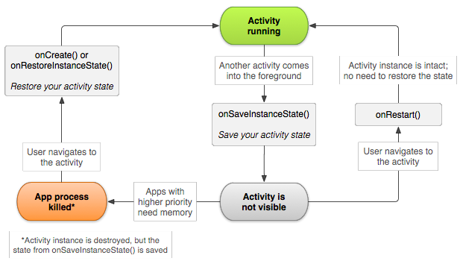
Saving/restoring activity state

Slide 41
A few more points
Threading models and concurrency
Each app has a main thread (activity thread) that controls its UI and invokes the upcalls of its components as they are needed. Apps must never block the activity thread.
Components can create other threads in various ways.
Binder/RPC structure
Service threading/queue models and request handling
RPC data translation
Permission structure
An extensible namespace of permissions whose meaning is defined by system or by apps. For any interaction, both components define the permissions needed by the other.

Slide 42
A note on “subsystems”
A subsystem is a server that provides system functions to untrusting contexts, but runs with only partial system privilege.
E.g., this code cannot manipulate the hardware state except by invoking the kernel.
Android AMS manipulates contexts.
With no special kernel support! It uses same syscalls as anyone else.
Unix provides no syscalls for managing another context (just kill).
AMS controls user contexts by forking them with a trusted lib, and issuing RPC commands to that lib.
Android
AMS
subsystem
JVM+lib
Linux kernel
binder

Slide 43
Web services
HTTP is the standard for web systems.
GET, PUT, POST, DELETE
Naming by Uniform Resource Identifiers (URIs)
Various standards and styles layer above it.
Android content providers follow that style.
Use URIs and simple data model, but no HTTP: no network.
URI/API follows style of REST, as in some SaaS frameworks.
In both uses the URI/URL authority always has the info to bind a channel to the server.
The URI path is interpreted by the server: it may encode the name of a file on the server, or a program entry point and arguments, or…

Slide 44
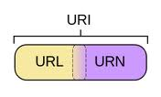
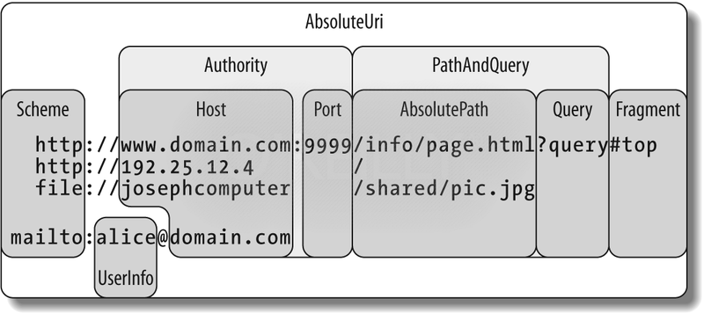
URIs and URLs
[image: msdn.microsoft.com]

