Slide 1
Files and Storage: Intro
Jeff Chase
Duke University

Slide 2

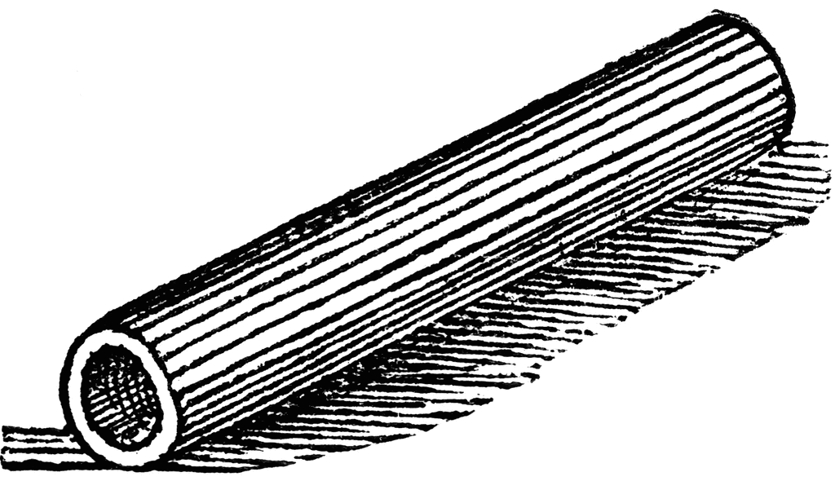
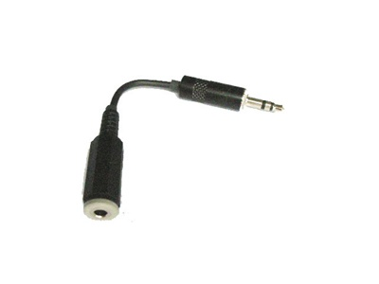
Unix process view: data
A process has multiple channels for data movement in and out of the process (I/O).
I/O channels
(“file descriptors”)
stdin
stdout
Process
tty
stderr
The parent process and parent program set up and control the channels for a child (until exec).
pipe
Thread
socket
Files
Program

Slide 3
Files
Unix file syscalls
fd = open(name, <options>);
write(fd, “abcdefg”, 7);
read(fd, buf, 7);
lseek(fd, offset, SEEK_SET);
close(fd);
creat(name, mode);
fd = open(name, mode, O_CREAT);
mkdir (name, mode);
rmdir (name);
unlink(name);
Files
A file is a named, variable-length sequence of data bytes that is persistent: it exists across system restarts, and lives until it is removed.
An offset is a byte index in a file. By default, a process reads and writes files sequentially. Or it can seek to a particular offset.

Slide 4
Unix file I/O
Symbolic names (pathnames) are translated through the directory tree, starting at the root directory (/) or process current directory.
char buf[BUFSIZE];
int fd;
if ((fd = open(“../zot”, O_TRUNC | O_RDWR) == -1) {
perror(“open failed”);
exit(1);
}
while(read(0, buf, BUFSIZE)) {
if (write(fd, buf, BUFSIZE) != BUFSIZE) {
perror(“write failed”);
exit(1);
}
}
File grows as process writes to it → system must allocate space dynamically.
The file system software finds the storage locations of the file’s logical blocks by indexing a per-file block map (the file’s index node or “inode”).
Process does not specify current file offset: the system remembers it.

Slide 5
Unix file commands
Unix has simple commands to operate on files and directories (“file systems”: FS).
Some just invoke one underlying syscall.
  mkdir
  rmdir
  rm
  “ln” and “ln -s” to create names (“links”) for files
What are the commands to create a file? Read/write a file? Truncate a file?

Slide 6
Names and layers
User
view
notes in notebook file
Application
fd
notefile: fd, byte range*
bytes
File System
block#
device, block #
Disk Subsystem
surface, cylinder, sector
Add more layers as needed.

Slide 7
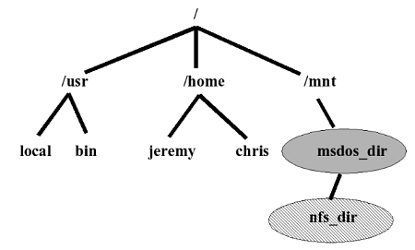

Files: hierarchical name space
root directory
applications etc.
mount point
user home directory
external media volume or network storage

Slide 8
A typical Unix file tree
A host’s file tree is the set of directories and files visible to processes on a given host. The layout is sort of standardized, but not really.
File trees are built by grafting
FS volumes from different storage
volumes or from network servers. Each volume contains a tree of directories and files. We can graft it onto a node in the file tree.
/
bin
etc
tmp
usr
kernel
ls
sh
project
users
In Unix, the graft operation is
the privileged mount system call,
and each volume is a filesystem.
packages
volume
(volume root)
mount point
mount (coveredDir, volume)
  coveredDir: directory pathname
  volume: device specifier or network volume
volume root contents become visible at pathname coveredDir
tex
emacs
volume

Slide 9
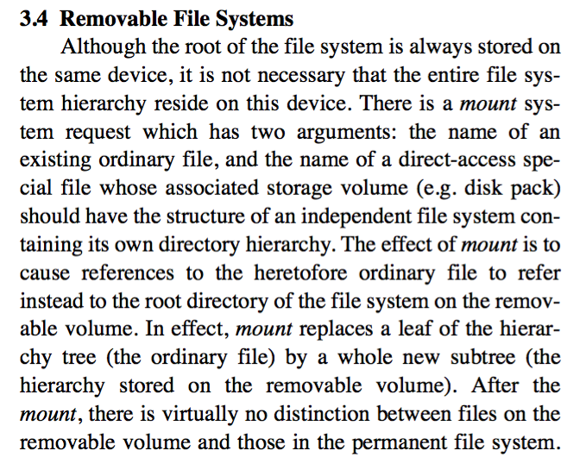
The UNIX Time-Sharing System*
  D. M. Ritchie and K. Thompson,1974

Slide 10
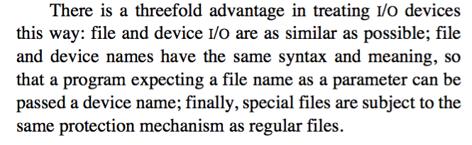
Unix: “Everything is a file”
Universal Set
A symbolic name in the file tree for a storage volume, a logical device.
E.g., /dev/disk0s2.
“Files”
special files
B
regular files
A
directories
A directory/folder is nothing more than a file containing a list of symbolic name mappings (directory entries) in some format known to the file system software.
E.g., /dev/disk0s2.
The UNIX Time-Sharing System*
  D. M. Ritchie and K. Thompson,1974

Slide 11
Files as “virtual storage”
Files have variable size.
  They grow (when a process writes more bytes past the end) and they can shrink (e.g., see truncate syscall).
Most files are small, but most data is in large files.
  Even though there are not so many large files, some are so large that they hold most of the data.
  These “facts” are often true, but environments vary.
Files can be sparse, with huge holes in the middle.
  Creat file, seek to location X, write 1 byte. How big is the file?
Files come and go; some live long, some die young.
So how can we implement these diverse files efficiently on a common shared storage device?

Slide 12
Variable Partitioning
Variable partitioning is the strategy of parking differently sized cars
along a street with no marked parking space dividers.
1
2
3
Wasted space
external fragmentation

Slide 13
Fixed Partitioning
Wasted space
internal fragmentation

Slide 14
Using block maps
File allocation is different from heap allocation.
Blocks allocated from a heap must be contiguous in the virtual address space: we can’t chop them up.
But files are accessed through e.g. read/write syscalls: the kernel can chop them up, allocate space in pieces, and reassemble them.
Allocate in units of fixed-size blocks, and use a block map.
Each logical block in the object has an address (logical block number or blockID), corresponding to an index in the map. The value stored in the map entry at that index is an address of a block on a storage device: a block pointer. “It’s just a level of indirection.”
Also works for other kinds of storage objects

Slide 15
Page/block maps
Idea: use a level of indirection through a map to assemble a storage object from “scraps” of storage in different locations.
The “scraps” can be fixed-size slots: that makes allocation easy because they are interchangeable.
map
Example: page tables that implement a VAS or inode block map for a file.

Slide 16
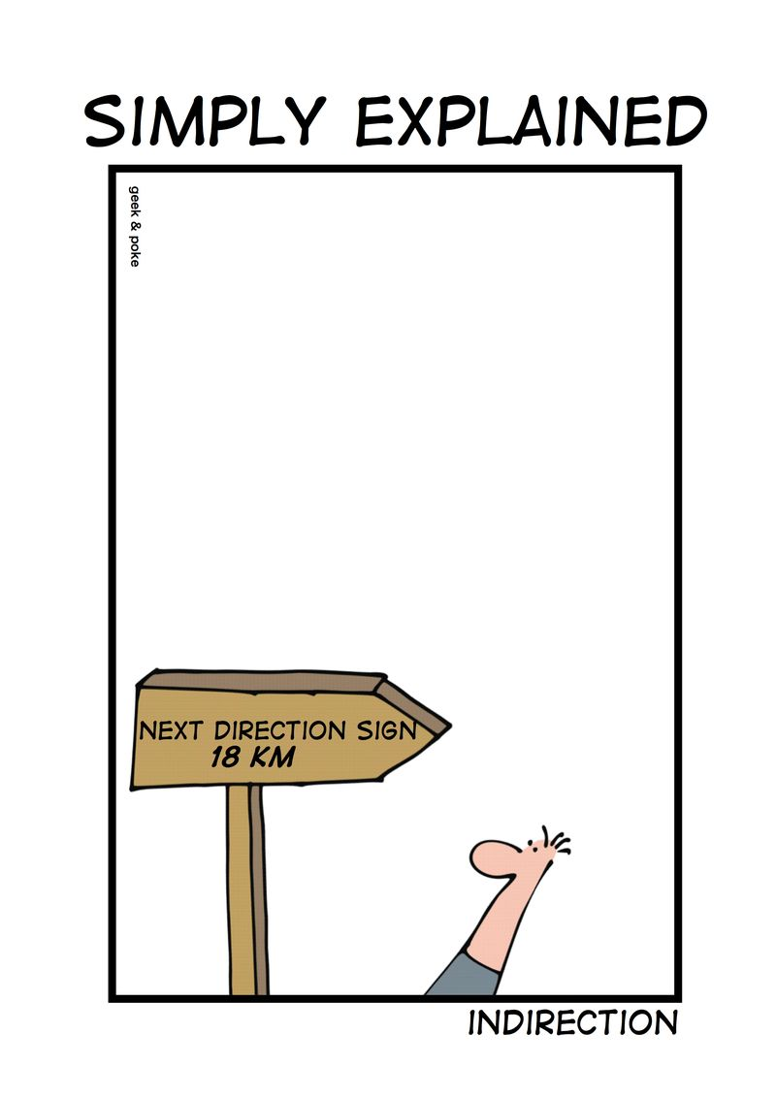
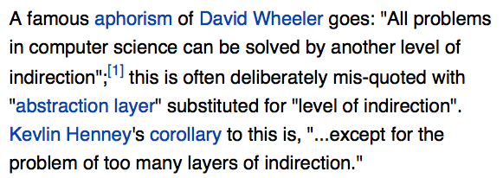
Indirection

Slide 17
Block maps: overview
Storage systems, including virtual memory, involve translating names to other name spaces: file names, byte/block offsets, virtual addresses, inode numbers, etc.
  Look up the name in some kind of table, and read from the table the value of the corresponding name in some target name space, e.g., a mapping to a storage location.
In particular, we have various block map data structures for mapping storage objects: numbered sequences of bytes or blocks.
  Storage objects: virtual address spaces, files, segments, virtual storage volumes (later).
  Canonical map examples: virtual page tables and Unix inodes. Understand similarities/differences and how/why.
Index map with name, e.g., logical blockID #.
Read address of the block from map entry.

Slide 18
Virtual memory
Memory
0:
Page Table
1:
Virtual
Addresses
Physical
Addresses
0:
1:
CPU
P-1:
N-1:
Disk
VMs (or segments) are storage objects described by maps. A page table is just a block map of one or more VM segments in memory. The hardware hides the indirection from the threads that are executing within that VM.
CMU 15-213

Slide 19
Cartoon view of a page table
process page table (map)
Each process/VAS has its own page table. Virtual addresses are translated relative to the current page table.
PFN 0
PFN 1
PFN i
In this example, each VPN j maps to PFN j, but in practice any physical frame may be used for any virtual page.
PFN i
+
offset
VPN #i
offset
user virtual address
The maps are themselves stored in memory; a protected CPU register holds a pointer to the current map.
physical memory
page frames
Virtual page: a logical block in a segment.
VPN: Virtual Page Number (a logical block number).
Page frame: a physical block in machine memory.
PFN: Page Frame Number (a block pointer).
PTE: Page Table Entry (an entry in the block map).

Slide 20
Example: Windows/IA32
Two-level block map (page table) structure reduces the space overhead for block maps in sparse virtual address spaces.
  Many process address spaces are small: e.g., a page or two of text, a page or two of stack, a page or two of heap.
Windows provides a simple example of a hierarchical page table:
  Each address space has a page directory (“PDIR”)
  The PDIR is one page: 4K bytes, 1024 4-byte entries (PTEs)
  Each PDIR entry points to a map page, which MS calls a “page table”
  Each map page (“page table”) is one page with 1024 PTEs
  Each PTE maps one 4K virtual page of the address space
  Therefore each map page (page table) maps 4MB of VM: 1024*4K
  Therefore one PDIR maps a 4GB address space, max 4MB of tables
  Load PDIR base address into a register to activate the VAS

Slide 21
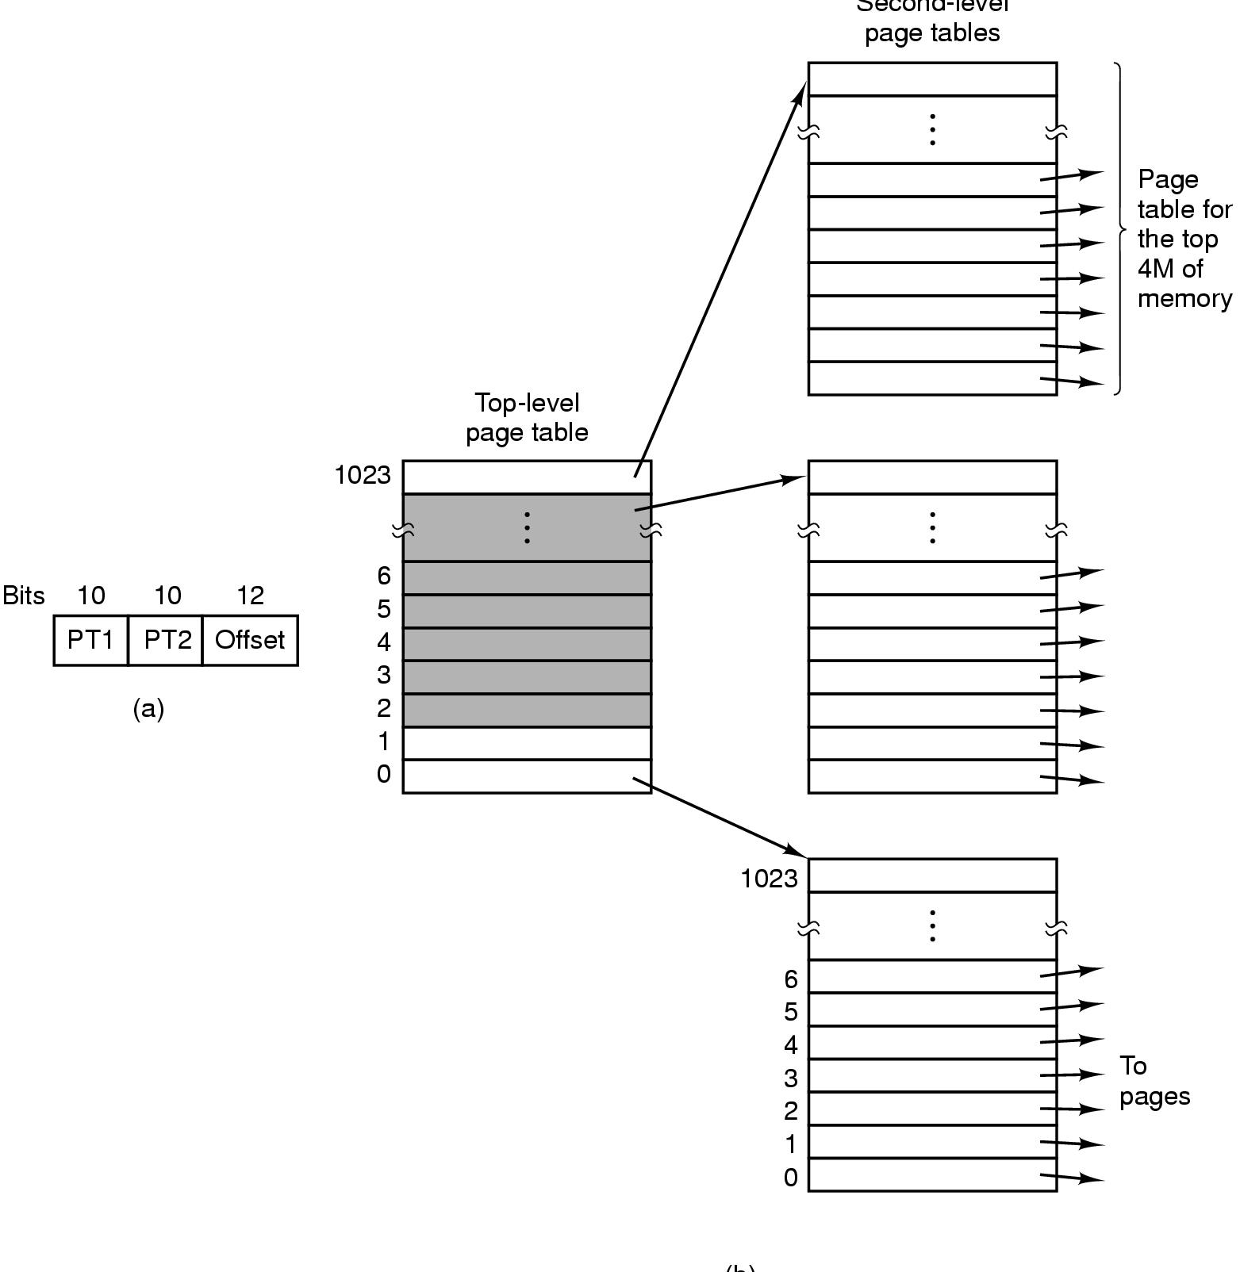
Page table structure for a process on Windows on IA 32 architecture
Step 2. Index page table with PT2
Step 1. Index PDIR with PT1
virtual address
32 bits
Two-level page table
32-bit virtual address
Two 10-bit page table index fields (PT1, PT2)
(10 bits represents index values 0-1023)
[from Tanenbaum]

Slide 22
Virtual Address Translation
Example: typical 32-bit
architecture with 4KB pages.
12
0
VPN
offset
Virtual address translation maps a virtual page number (VPN) to a physical page frame number (PFN): the rest is easy.
address
translation
Deliver exception to
OS if translation is not
valid and accessible in
requested mode.
{
+
PFN
physical address
offset

Slide 23
Representing files: inodes
There are many many file system implementations.
Most of them use a block map to represent each file.
Each file is represented by a corresponding data object, which is the root of its block map, and holds other information about the file (the file’s “metadata”).
In classical Unix and many other systems, this per-file object is called an inode. (“index node”)
The inode for a file is stored “on disk”: the OS/FS reads it in and keeps it in memory while the file is in active use.
When a file is modified, the OS/FS writes any changes to its inode/maps back to the disk.

Slide 24
Inodes
A file’s data blocks could be “anywhere” on disk. The file’s inode maps them.
A fixed-size inode has a fixed-size block map.
How to represent large files that have more logical blocks than can fit in the inode’s map?
attributes
Once upo
n a time
/nin a l
block map
and far
far away
,/nlived t
he wise and sage
wizard.
inode
An inode could be “anywhere” on disk. How to find the inode for a given file? Inodes are uniquely numbered: we can find an inode from its number.
data blocks

Slide 25
Representing Large Files
inode
Classic Unix file systems
inode == 128 bytes
inodes are packed into blocks
Each inode has 68 bytes of attributes and 15 block map entries that are the root of a tree-structured block map.
direct
block
map
indirect
block
double
indirect
block
Suppose block size = 8KB
12 direct block map entries: map 96KB of data.
One indirect block pointer in inode: + 16MB of data.
One double indirect pointer in inode: +2K indirects.
Maximum file size is 96KB + 16MB + (2K*16MB) + ...
indirect
blocks
The numbers on this slide are for illustration only.

Slide 26
Skewed tree block maps
Inodes are the root of a tree-structured block map.
  Like multi-level hierarchical page tables, but
These maps are skewed.
  Low branching factor at the root: just enough for small files.
  Small files are cheap: just need the inode to map it.
  Inodes for small files are small…and most files are small.
Use indirect blocks for large files
  Requires another fetch for another level of map block
  But the shift to a high branching factor covers most large files.
Double indirect blocks allow very large files.
Other advantages to trees?

Slide 27
Post-note: what to know about maps
What is the space overhead of the maps? Quantify.
Understand how to lookup in a block map: logical block + offset addressing, arithmetic to find the map entry.
Design tradeoffs for hierarchical maps.
  Pro: less space overhead for sparse spaces.
  Con: more space overhead overall, e.g., if space is not sparse.
  Con: more complexity, multiple levels of translation.
Skew: why better for small file files? What tradeoff?
  No need to memorize the various parameters for inode maps: concept only.

Slide 28
Post-note: symbolic name maps
Hierarchy for symbolic names (directory hierarchy):
  Multiple naming contexts, possibly under control of different owners. E.g., each directory is a separate naming context.
  Avoids naming conflicts when people reuse the same names.
  Pathname lookup by descent through the hierarchy from some starting point, e.g., root (/) or current directory.
  Build the name space by subtree grafting: mounts.
  Accommodates different directory implementations per-subtree.
    E.g., modern Unix mixes FS implementations through Virtual File System (VFS) layer.
  Scales to very large name spaces.
Note: Domain Name Service (DNS) is the same!
  www.cs.duke.edu “==“ /edu/duke/cs/www

Slide 29
More pictures
We did not discuss these last three pictures to help understand name mapping structures.
COW: one advantage of page/block maps is that it becomes easy to clone (logical copy) a block space.
  Copy a storage object P to make a new object C. P could be a file, segment, volume, or virtual address space (for fork!).
  Copy the map P: make a new map C referencing the same blocks. The map copy is cheap: no need to copy the data itself.
  Since a clone is a copy, any changes (writes) to P after the clone should not affect C, and vice versa.
  Use a lazy copy or copy-on-write (COW). Intercept writes (how?) and copy the affected block before executing the write.

Slide 30
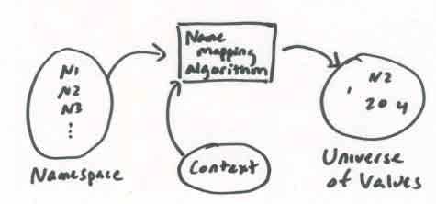
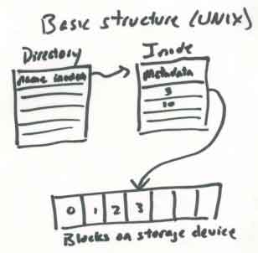
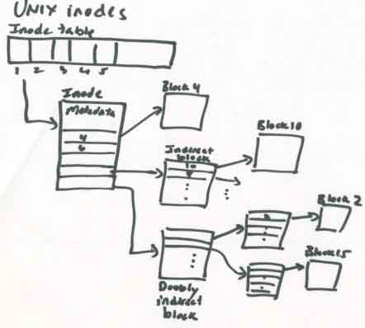
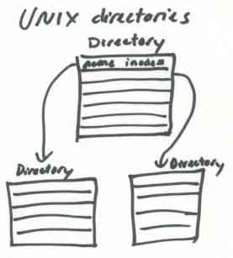
http://web.mit.edu/6.033/2001/wwwdocs/handouts/naming_review.html

Slide 31
Copy on write
Physical memory
Parent memory
Child memory
What happens if parent writes to a page?
Landon Cox

Slide 32
Copy on write
Physical memory
Parent memory
Child memory
Have to create a copy of pre-write page for the child.
Landon Cox

Slide 33
File Systems and Storage
Part the Second
Jeff Chase
Duke University

Slide 34
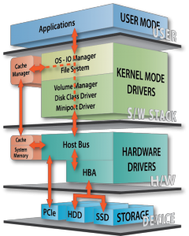
Storage stack
Databases, Hadoop, etc.
We care mostly about this stuff.
File system API. Generic, for use over many kinds of storage devices.
(for now, e.g., Lab #4)
Device driver software is a huge part of the kernel, but we mostly ignore it.
Standard block I/O internal interface.
Block read/write on
numbered blocks on each device/partition.
For kernel use only: DMA + interrupts.
Many storage technologies, advancing rapidly with time.
Rotational disk (HDD): cheap, mechanical, high latency.
Solid-state “disk” (SSD): low latency/power, wear issues, getting cheaper.
[Calypso]

Slide 35
Names and layers
User
view
notes in notebook file
Application
fd
notefile: fd, byte range*
bytes
File System
block#
device, block #
Disk Subsystem
surface, cylinder, sector
Add more layers as needed.

Slide 36
Directories
A directory contains a set of entries. Each directory entry is a record mapping a symbolic name to an inode number. The inode can be found on disk from its number.
directory
inode
wind: 18
0
snow: 62
There can be no duplicate name entries: the name-to-inode mapping is a function.
0
rain: 32
hail: 48
A creat or mkdir operation must scan the directory to ensure that creates are exclusive.
Note: implementations vary. Large directories are problematic.
inode 32
Entries or free slots are typically found by a linear scan.

Slide 37
Unix file naming: hard links
directory A
directory B
A Unix file may have multiple names.
Each directory entry naming the file is called a hard link.
Each inode contains a reference count showing how many hard links name it.
0
wind: 18
rain: 32
0
hail: 48
sleet: 48
inode link
count = 2
inode 48
link system call
link (existing name, new name)
create a new name for an existing file
increment inode link count
unlink system call (“remove”)
unlink(name)
destroy directory entry
decrement inode link count
if count == 0 and file is not in active use
free blocks (recursively) and on-disk inode
Illustrates: garbage collection by reference counting.

Slide 38
Unix file naming: soft links
A symbolic or “soft” link is a file whose contents is the pathname of another file. They are useful to customize the name tree, and also can be confusing and error-prone.
symlink system call
symlink (existing name, new name)
allocate a new file (inode) with type symlink
initialize file contents with existing name
create directory entry for new file with new name
directory A
directory B
0
wind: 18
rain: 32
0
hail: 48
sleet: 67
The target of the soft link may be removed at any time, leaving a dangling reference.
inode link
count = 1
../A/hail/0
inode 48
inode 67
How should the kernel handle recursive soft links?
See command “ln –s”.

Slide 39
Unix file naming: links
usr
ln -s /usr/Marty/bar bar
Lynn
Marty
creat foo
creat bar
ln /usr/Lynn/foo bar
unlink foo
unlink bar
foo
bar

Slide 40
Concepts
Reference counting and reclamation
Redirection/indirection
Dangling reference
Binding time (create time vs. resolve time)
Referential integrity

Slide 41
Filesystem layout on disk
inode 0
bitmap file
inode 1
root directory
inode 1
root directory
fixed locations on disk
wind: 18
11100010
00101101
10111101
11100010
00101101
10111101
0
snow: 62
0
once upo
n a time
/n in a l
rain: 32
10011010
00110001
00010101
hail: 48
file blocks
allocation
bitmap file
for disk blocks
bit is set iff the corresponding block is in use
00101110
00011001
01000100
and far
far away
, lived th
inode
This is a toy example (Nachos).

Slide 42
A Filesystem On Disk
sector 0
sector 1
allocation
bitmap file
directory
file
wind: 18
11100010
00101101
10111101
0
snow: 62
0
once upo
n a time
/n in a l
rain: 32
10011010
00110001
00010101
hail: 48
00101110
00011001
01000100
and far
far away
, lived th
Data

Slide 43
A Filesystem On Disk
sector 0
sector 1
allocation
bitmap file
directory
file
wind: 18
11100010
00101101
10111101
0
snow: 62
0
once upo
n a time
/n in a l
rain: 32
10011010
00110001
00010101
hail: 48
00101110
00011001
01000100
and far
far away
, lived th
Metadata

Slide 44
Classical Unix inode
A classical Unix inode has a set of file attributes (below) in addition to the root of a hierarchical block map for the file. The inode structure size is fixed, e.g., total size is 128 bytes: 16 inodes fit in a 4KB block.
/* Metadata returned by the stat and fstat functions */
struct stat {
dev_t st_dev; /* device */
ino_t st_ino; /* inode */
mode_t st_mode; /* protection and file type */
nlink_t st_nlink; /* number of hard links */
uid_t st_uid; /* user ID of owner */
gid_t st_gid; /* group ID of owner */
dev_t st_rdev; /* device type (if inode device) */
off_t st_size; /* total size, in bytes */
unsigned long st_blksize; /* blocksize for filesystem I/O */
unsigned long st_blocks; /* number of blocks allocated */
time_t st_atime; /* time of last access */
time_t st_mtime; /* time of last modification */
time_t st_ctime; /* time of last change */
};
Not to be tested

Slide 45
Inodes on disk
Where should inodes be stored on disk?
They’re a good size, so we can dense-pack them into blocks. We can find them by inode number. But where should the blocks be?
Early Unix reserved a fixed array of inodes at the start of the disk.
  But how many inodes will we need? And don’t we want inodes to be stored close to the file data they describe?
Older file systems (FFS) reserve a fixed set of blocks at known locations distributed throughout the storage volume.
Newer file systems add a level of indirection: make a system inode file in the volume, and store inodes in the inode file.
  That allows a variable number of inodes, and we can move them to different locations as they’re modified.
  Originated with Berkeley’s Log Structured File System (LFS) and NetApp’s Write Anywhere File Layout (WAFL).

Slide 46
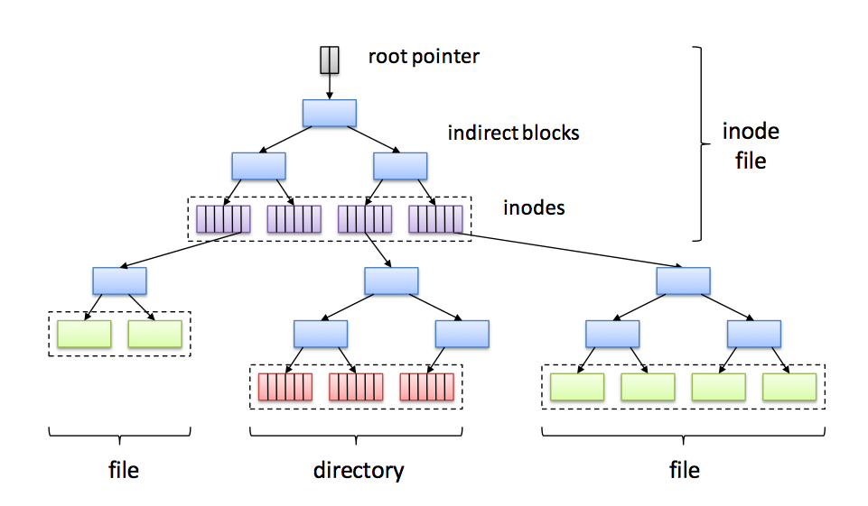
Write Anywhere File Layout (WAFL)

Slide 47
File Systems and Storage
Day Three
Jeff Chase
Duke University

Slide 48
Memory as a cache
virtual address spaces
Processes access external storage objects through file APIs and VM abstraction. The OS kernel manages caching of pages/blocks in main memory.
data
data
files and filesystems,
databases,
other storage objects
disk and other storage
network RAM
page/block read/write accesses
memory
(frames)
backing storage volumes
(pages and blocks)

Slide 49
The block storage abstraction
Read/write logical blocks of size b on a logical storage device.
CPU (typically executing kernel code) forms buffer in memory and issues read or write command to device queue/driver.
Device DMAs data to/from memory buffer, then interrupts the CPU to signal completion of each request.
Device I/O is asynchronous: the CPU is free to do something else while I/O in progress.
Transfer size b may vary, but is always a multiple of some basic block size (e.g., sector size), which is a property of the device, and is always a power of 2.
A logical storage device is a numbered array of these basic blocks.
Storage blocks containing data/metadata are cached in memory buffers while in active use: called buffer cache or block cache.

Slide 50
Memory/storage hierarchy
small and fast
(ns)
registers
caches
L1/L2
Terms to know
cache index/directory
cache line/entry, associativity
cache hit/miss, hit ratio
spatial locality of reference
temporal locality of reference
eviction / replacement
write-through / writeback
dirty/clean
off-core
L3
off-chip
main memory (RAM)
big and slow
(ms)
off-module
disk, other storage, network RAM
In general, each layer is a cache over the layer below.
  inclusion property
Technology trends → rapid change
The triangle is expanding vertically → bigger gaps, more levels

Slide 51
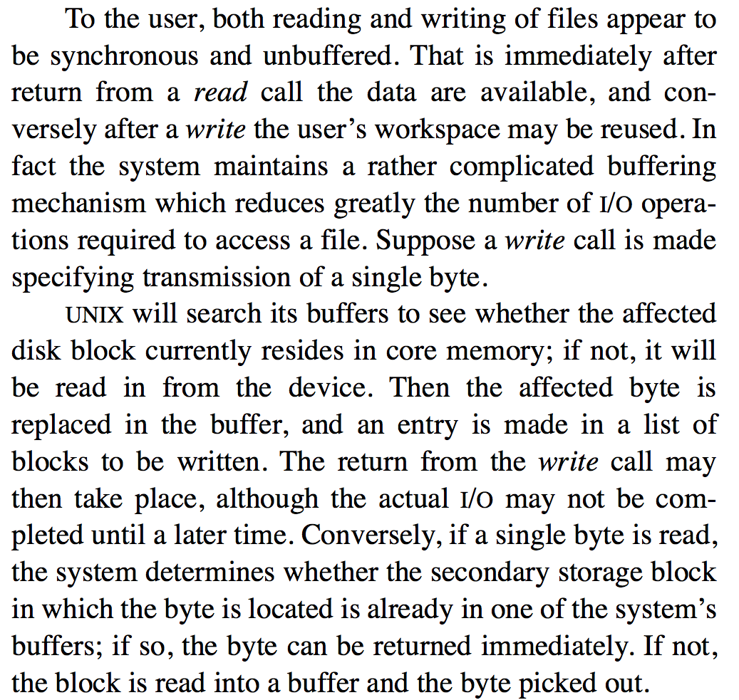
The Buffer Cache
Proc
Memory
File
cache
Ritchie and Thompson The UNIX Time-Sharing System, 1974

Slide 52
Editing Ritchie/Thompson
The system maintains a buffer cache (block cache, file cache) to reduce the number of I/O operations.
Suppose a process makes a system call to access a single byte of a file. UNIX determines the affected disk block, and finds the block if it is resident in the cache. If it is not resident, UNIX allocates a cache buffer and reads the block into the buffer from the disk.
Then, if the op is a write, it replaces the affected byte in the buffer. A buffer with modified data is marked dirty: an entry is made in a list of blocks to be written. The write call may then return. The actual write may not be completed until a later time.
If the op is a read, it picks the requested byte out of the buffer and returns it, leaving the block in the cache.
Proc
Memory
File
cache

Slide 53
Lab #4: DFS (“DeFiler”) buffer cache
File abstraction implemented in upper DFS layer.
All knowledge of how files are laid out on disk is at this layer.
Access underlying disk volume through buffer cache API.
Obtain buffers (dbufs), write/read to/from buffers, orchestrate I/O.
DBuffer dbuf = getBlock(blockID)
releaseBlock(dbuf)
read(), write()
startFetch(), startPush()
waitValid(), waitClean()
DBufferCache
DBuffer
Device I/O interface
Asynchronous I/O to/from buffers
block read and write
Blocks numbered by blockIDs

Slide 54
DeFiler interfaces: overview
create, destroy, read, write a dfile
list dfiles
DFS
DBuffer dbuf = getBlock(blockID)
releaseBlock(dbuf)
read(), write()
startFetch(), startPush()
waitValid(), waitClean()
DBufferCache
DBuffer
ioComplete()
startRequest(dbuf, r/w)
VirtualDisk

Slide 55
DBufferCache internals
HASH(blockID)
If the requested block is not resident, then getBlock allocates a dbuf for the block and places the correct block contents in its buffer (cache miss). If there are no free dbufs in the cache, then we must evict some other block from the cache and reuse its dbuf.
DBuffer dbuf = getBlock(blockID)
DBufferCache
DBuffer
I/O cache buffers
Each is byte[blocksize]
Buffer headers
DBuffer dbuf

Slide 56
Managing files
create, destroy, read, write a dfile
list dfiles
1. Fetch blocks for data and metadata (or zero new ones fresh) into cache buffers (dbufs).
2. Copy bytes to/from dbufs with read and write.
3. Track which data/metadata blocks are valid, and which valid blocks are clean and which are dirty.
4. Clean the dirty blocks by writing them back to the disk with push.
“inode”
for DFileID
DBuffer dbuf = getBlock(blockID)
releaseBlock(dbuf)
sync()
read(), write()
startFetch(), startPush()
waitValid(), waitClean()
DBufferCache
DBuffer

Slide 57
Dbuffer (dbuf) states
DFS
read(…)
write(...)
startFetch(), startPush()
waitValid(), waitClean()
A DBuffer dbuf returned by getBlock is always associated with exactly one block in the disk volume. But it might or might not be “in sync” with the underlying disk contents.
DBuffer
A dbuf is valid iff it has the “correct” copy of the data. A dbuf is dirty iff it is valid and has an update (a write) that has not yet been written to disk. A valid dbuf is clean if it is not dirty.
Your DeFiler should return only valid data to a client. That may require you to zero the dbuf or fetch data from the disk. Your DeFiler should ensure that all dirty data is eventually pushed to disk.

Slide 58
Asynchronous I/O on dbufs
Start I/O on a dbuf by posting it to a producer/consumer queue for service by a device thread.
startFetch(), startPush()
waitValid(), waitClean()
startFetch(), startPush()
Client threads may wait on the dbuf for asynchronous I/O to complete.
DBuffer
waitValid(), waitClean()
ioComplete()
startRequest(dbuf, r/w)
Thread upcalls dbuf ioComplete when I/O operation is done.
Device I/O interface
Async I/O on dbufs
device threads
VirtualDisk

Slide 59
Why “logical” devices/volumes?
The block storage abstraction is an abstraction! We can implement block storage in a wide variety of ways.
Partition a block space on some physical device into multiple smaller logical devices (logical volumes).
Concatenate devices to form a larger logical volume.
Add software and indirection (block maps) to map a space of logical blocks to a dynamic mix of underlying devices and/or servers.
Servers and/or devices can implement block storage service over a network: network disk, network storage, …
  Storage Area Network (SAN) or iSCSI (Internet SCSI).
  Network-Attached Storage (NAS) generally refers to a network file system abstraction, built above block storage.
Add another level of indirection! Storage virtualization.

Slide 60
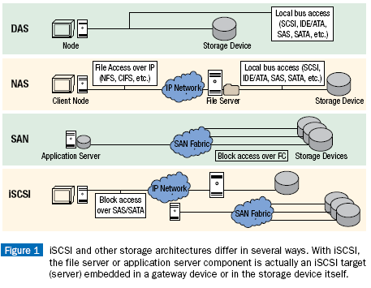
NAS, SAN, and all that
[rtcmagazine.com]

Slide 61
Logical storage volumes
So: let us always remember that a logical storage volume can be implemented in all kinds of wild ways: storage virtualization.
Even “simple” devices have complex mapping/translation internally.
  E.g., Flash Translation Layer to spread write load across SSD device.
  E.g., disk electronics automatically hide bad blocks on the platter.
So: it is hard to generalize about performance behavior.
  “All generalizations are false.”
How can we build higher-level storage abstractions (like file systems or databases) above block storage?
In general, we make one assumption: “seeking takes time”.
  Blocks whose addresses (logical block numbers) are close together are cheaper to access together.
Let us start by looking at basic devices: hard disks (HDD).

Slide 62
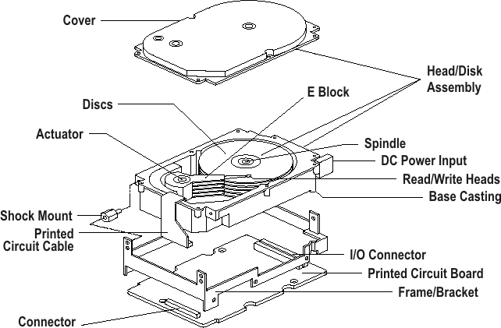
A disk

Slide 63
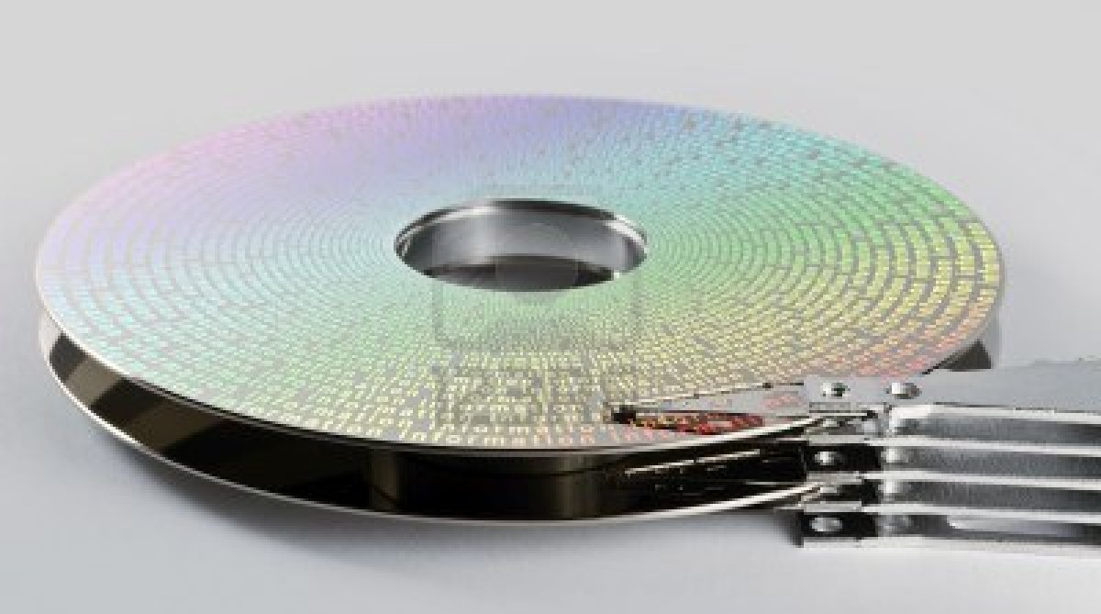
A disk

Slide 64
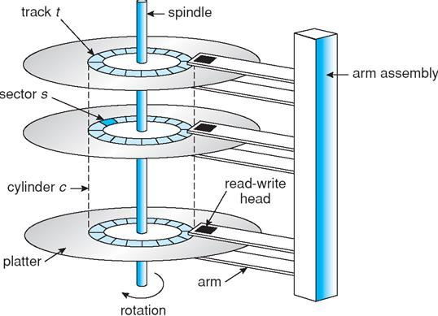
A disk

Slide 65
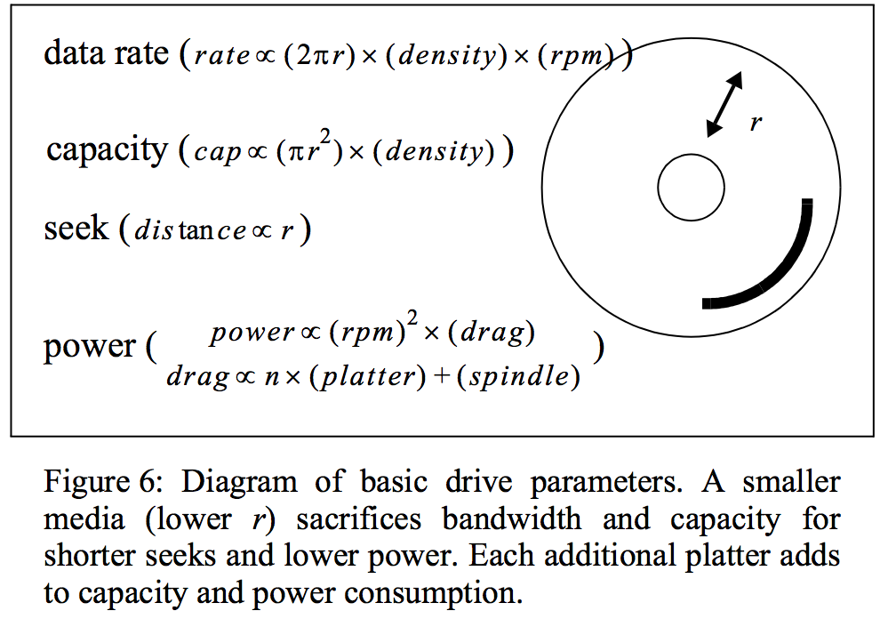
Not to be tested
More than an interface — SCSI vs. ATA
D. Anderson, J. Dykes, and E. Riedel, FAST 2003

Slide 66
A few words about SSDs
Technology advancing rapidly; costs dropping.
Faster than disk, slower than DRAM.
No seek cost. But writes require slow block erase, and/or limited # of writes to each cell before it fails.
How should we use them? Are they just fast/expensive disks? Or can we use them like memory that is persistent? Open research question.
Trend: use them as block storage devices, and/or combine them with HDDs to make hybrids optimized for particular uses.
  Examples everywhere you look.

Slide 67
^{IBM Research Report}
GPFS Scans 10 Billion Files in 43 Minutes
Richard F. Freitas, Joe Slember, Wayne Sawdon, Lawrence Chiu
IBM Research Division Almaden Research Center
^{7/22/11}
The information processing…by leading business, government and scientific organizations continues to grow at a phenomenal rate (90% CAGR).
[Compounded Annual Growth Rate]
Unfortunately, the performance of the current, commonly-used storage device -- the disk drive -- is not keeping pace....
Recent advances in solid-state storage technology deliver significant performance improvement and performance density improvement...
This document describes…GPFS [IBM’s parallel file system] taking 43 minutes to process the 6.5 TBs of metadata needed for…10 Billion files. This accomplishment combines …enhanced algorithms…with solid-state storage as the GPFS metadata store. IBM Research once again breaks the barrier...to scale out to an unprecedented file system size…and simplify data management tasks, such as placement, aging, backup and replication..

Slide 68
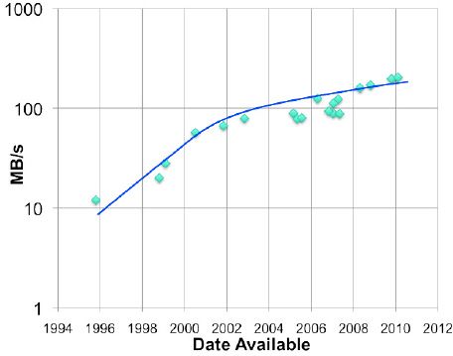
HDD read bandwidth (ideal)
“spindle speed”
“Currently a high performance disk drive would have a maximum sustained bandwidth of approximately 171 MB/s. The actual average bandwidth would depend on the workload and the location of data on the surface. Further, current projections do not show much change in this over the next few years.”
IBM Research Report 2012
GPFS Scans 10 Billion Files in 43 Minutes

Slide 69
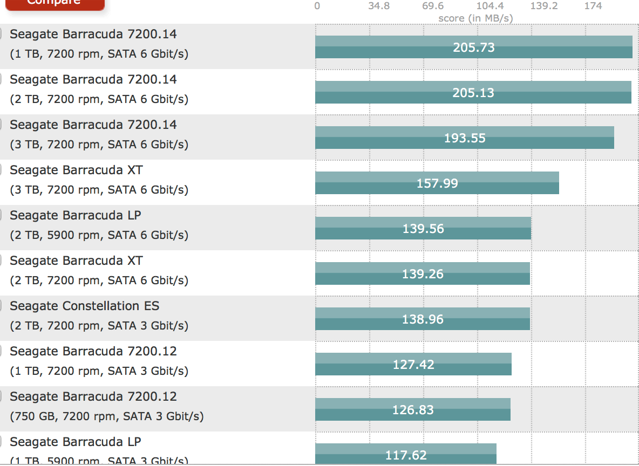
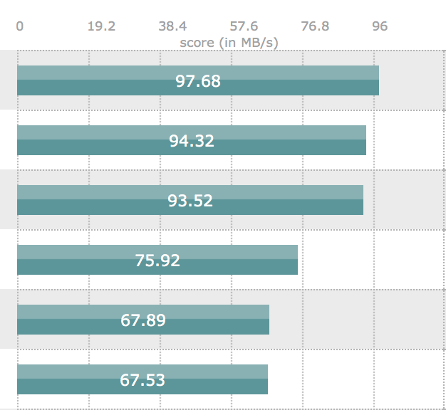
Enterprise disk bandwidth (2012)
2012 Seagate HDD
tomshardware.com
Max/min read bandwidth
Why does sustained bandwidth vary by a factor of two on the same drive?

Slide 70
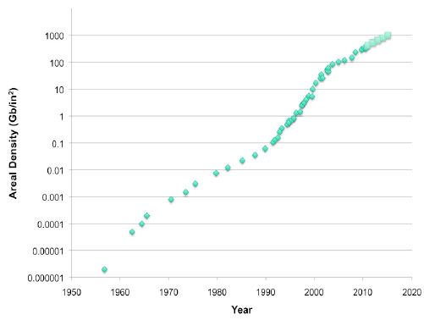
Areal density (storage capacity)
“The bandwidth is roughly proportional to the linear density. So, if the growth in linear density and track density were equal, then one would expect the growth rate for linear density to be the square root of the areal density. That would make it about 20% CAGR.”
“But, if you examine the recent history…you will see that it is more likely to fall within the range of 10 - 15%.... Generally, the track density has grown more quickly than the linear density.”
IBM Research Report 2011
GPFS Scans 10 Billion Files in 43 Minutes

Slide 71
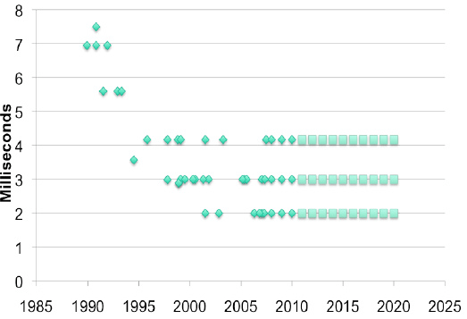
Rotational latency
The average disk latency is ½ the rotational time of the disk drive. As you can see from its recent history…[it] has settled down to three values 2, 3 and 4.1 milliseconds. These are ½ the inverses of 15,000, 10,000 and 7,200 revolutions per minute (RPM), respectively.
It is unlikely that there will be a disk rotational speed increase in the near future. In fact, the 15K RPM drive and perhaps the 10K RPM drive may disappear from the marketplace…driven by the successful combination of SSD and slower disk drives into storage systems that provide the same or better performance, cost and power.
Drives spin at a fixed constant RPM. (A few can “shift gears” to save power, but the gains are minimal.)
IBM Research Report 2011
GPFS Scans 10 Billion Files in 43 Minutes

Slide 72
Access time
How long to access data on disk?
  5-15 ms on average for access to random location
  Includes seek time to move head to desired track
    Roughly linear with radial distance
  Includes rotational delay
    Time for sector to rotate under head
  These times depend on drive model:
    platter width (e.g., 2.5 in vs. 3.5 in)
    rotation rate (5400 RPM vs. 15K RPM).
    Enterprise drives use more/smaller platters spinning faster.
  These properties are mechanical and improve slowly as technology advances over time.
Track
Sector
Arm
Cylinder
Platter
Head

Slide 73
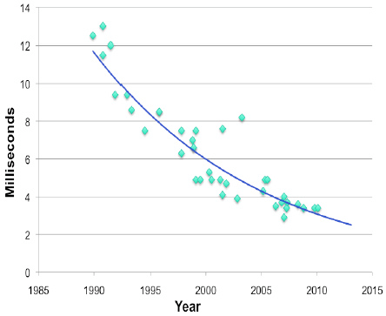
Average seek time
“The seek time is due to the mechanical motion of the head when it is moved from one track to another. It is improving by about 5% CAGR. In general, this is a mature technology and is not likely to change dramatically in the future. “
IBM Research Report 2011
GPFS Scans 10 Billion Files in 43 Minutes

Slide 74
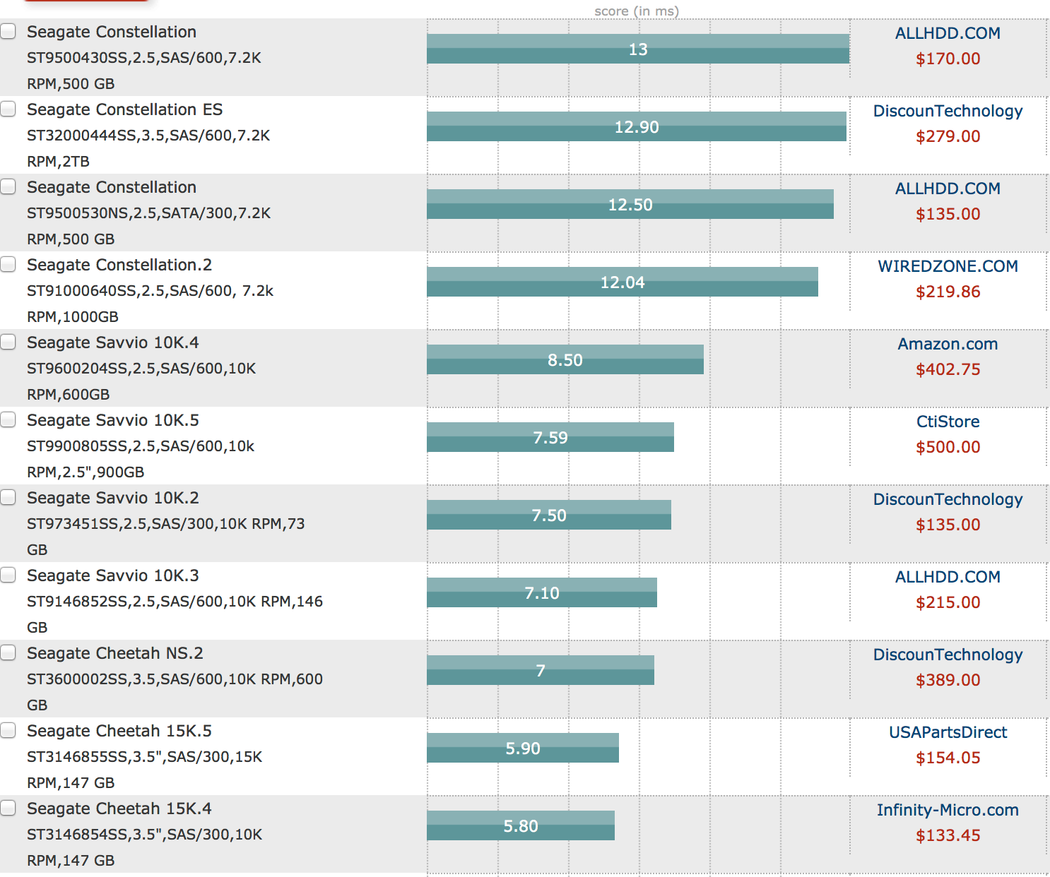
2012 Seagate HDD
tomshardware.com
random read access time

Slide 75
Effective bandwidth
Effective bandwidth or bandwidth utilization is the share or percentage of potential bandwidth that is actually delivered. E.g., what percentage of time is the disk actually transferring data, vs. seeking etc.?
Define
b Block size
B Raw disk bandwidth (“spindle speed”)
s Average access (seek+rotation) delay per block I/O
Then
Transfer time per block = b/B
I/O completion time per block = s + (b/B)
Delivered bandwidth for I/O request stream = b/(s + (b/B))
Bandwidth wasted per I/O: sB
So
Effective bandwidth: bandwidth utilization or efficiency (%): b/(sB + b)

Slide 76
Effective bandwidth
Seeks are overhead: “wasted effort”. It is a cost that the device imposes in order to get to the data. It is not actually transferring data.
This graph is obvious. It applies to so many things in computer systems and in life.
b/(sB+b)
1
Spindle bandwidth B
100%
Effective bandwidth is efficiency or goodput
What percentage of the time is the busy resource (the disk head) doing useful work, i.e., transferring data?
b/B s
Transfer size b

Slide 77
Effective bandwidth by access time
b/(sB+b)
1
Spindle bandwidth B (90 MB/s
100%
b=256K
b=64K
b=4K
access time s
5ms
Bigger is better. Other things being equal, effective bandwidth is higher when access costs can be amortized over larger transfers. High access cost is the reason we use tapes primarily for backup! As B grows and s is unchanged, disks are looking more and more like tapes! (Jim Gray)

Slide 78
Storage system performance
How to get better storage performance?
  Build better disks: new technology, SSD hybrids.
  Gang disks together into arrays (RAID logical devices).
  Smart disk head scheduling (when there is a pool of pending requests to choose from).
  Location, location, location: place data on disk carefully to keep related items close together (smart block allocation).
  Use larger b (larger blocks, clustering, extents, etc.)
  Smaller s (placement / ordering, sequential access, logging, etc.)
  Caching
  Asynchronous I/O: prefetching, read ahead, “write behind”
This is a big part of what storage systems are about.

Slide 79
Anatomy of a read
3. getBlock for maps, traverse cached maps, getBlock for data, and start fetch.
6. Return to user program.
2. Enter kernel for read syscall.
5. Copy data to user buffer in read.
1. Compute
(user mode)
4. sleep for I/O (stall)
CPU
seek
transfer
Disk
Time

Slide 80
Prefetching for high read throughput
Read-ahead (prefetching)
  Fetch blocks into the cache in expectation that they will be used.
  Requires prediction. Common for sequential access.
1. Detect access pattern.
Reduce I/O stalls
2. Start prefetching

Slide 81
Sequential read-ahead
Prediction is easy for sequential access.
Read-ahead also helps reduce seeks by reading larger chunks if data is laid out sequentially on disk.
App requests block n
App requests block n+1
n
n+1
n+2
System prefetches block n+2
System prefetches block n+3

Slide 82
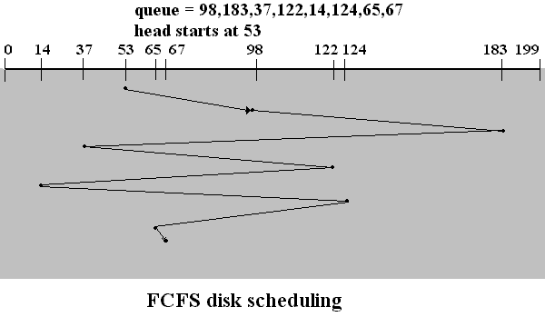
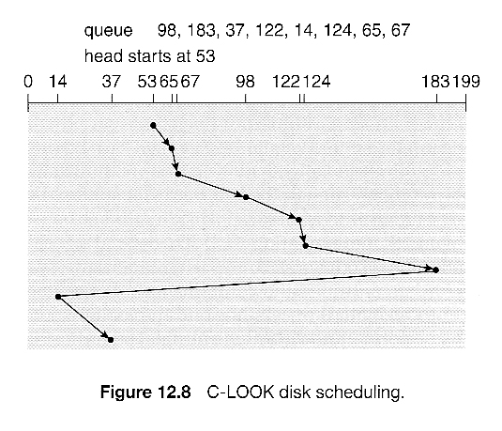
Disk head scheduling
FCFS: too much seeking.
What about Shortest Seek Time First? (SSTF)
“Elevator algorithm”: sweep back and forth, serving all requests in one direction, then reverse.
Most of today’s drives have smart head scheduling built in.

Slide 83
Fast File System (FFS)
Fast File System (FFS) [McKusick81] is the historical, canonical Unix file system that actually works.
In the old days (1970s-1980s), file systems delivered only 10% of the available disk bandwidth, even on the old disks.
FFS extended the classic 1970s Unix file system design with a new focus on performance in the Berkeley Unix release (BSD: 1982).
  Multiple block sizes: use small blocks called frags in small files, to reduce internal fragmentation.
  Smart block allocation that pays attention to disk locality via cylinder groups.
FFS was still lousy, but it laid the groundwork for development of high-performance file systems over the next 20 years.

Slide 84
Building better file systems
The 1990s was a period of experimentation with new strategies for high-performance file system design.
The new file systems generally used the FFS mechanisms and data structures, but changed the policies for block allocation.
  Block allocation policy: where to place new data (or modified old data) on the storage volume? Which block number to choose?
  “File system design is 99% block allocation.” - Larry McVoy
  Example: Group large-file data into big contiguous chunks called clusters or extents, that can be read or written as a unit. [McVoy91] and [Smith/Seltzer96]
  Example: Write new data wherever convenient to minimize seeking, at least on the writes: “log-structured” file systems (LFS) and WAFL. [Rosenblum91] and [Hitz95]. Note: requires use of an inode file so placement of an inode can change.

Slide 85
FFS block allocation policy
FFS partitions space on a disk into regions as a unit of locality. When it allocates a block, it chooses the region carefully.
  A cylinder group is a region of contiguously numbered disk blocks that are believed to “probably” reside on a group of adjacent tracks on the disk. The idea is that seeks within a CG are “short”.
  Every block is considered to be in exactly one CG. Blocks in the same CG are “close together”. Blocks in different CGs are “far apart”.
Policy: Place “related” data in the same CG whenever possible.
Policy: Smear large files across CGs, so they don’t fill up a CG.
Policy: Reserve space for inodes in each CG, so inodes can be close to directory entries that reference them.
Policy: Place maps (inodes or indirect blocks) in the same CG as the data blocks they reference.
You can see the impact of these policies in the plots!

Slide 86
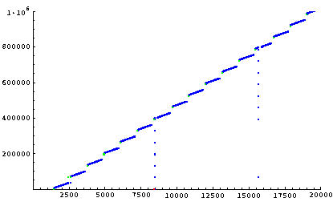
A quick peek at sequential write in BSD Unix “FFS” (Circa 2001)
note sequential block allocation
write
write stall
read
physical
disk
sector
sync command
(typed to shell)
pushes indirect
blocks to disk
read next
block of
free space
bitmap (??)
sync
time in milliseconds

Slide 87
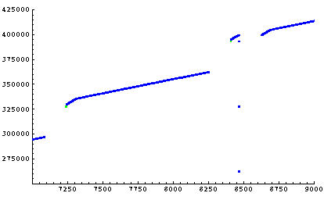
Sequential writes: a closer look
16 MB in one second
(one indirect block worth)
physical
disk
sector
longer delay
for head movement
to push indirect
blocks
140 ms
delay for
cylinder seek
etc. (???)
write
write stall
time in milliseconds
Push indirect blocks synchronously.

Slide 88
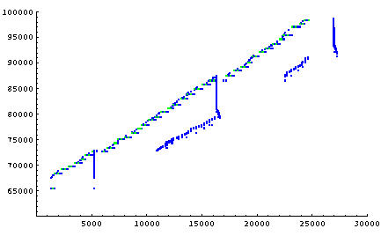
Small-File Create Storm
50 MB
note synchronous
writes for some
metadata
inodes and
file contents
(localized allocation)
sync
physical
disk
sector
sync
delayed-write
metadata
sync
write
write stall
time in milliseconds

