Slide 1
A Short Quiz: HTTPS/SSL
What is the most important advantage of symmetric crypto (DES) relative to asymmetric crypto (RSA)?
What is the most important advantage of asymmetric crypto relative to symmetric crypto?
What is the most important limitation/challenge for asymmetric crypto with respect to security?
Why does SSL “change ciphers” during the handshake?
How does SSL solve the key distribution problem for symmetric crypto?
Is key exchange vulnerable to man-in-the-middle attacks?

Slide 2
File Systems and Storage
Day 4: Failures, recovery, atomicity, scale
Jeff Chase
Duke University

Slide 3
Memory as a cache
virtual address spaces
Processes access external storage objects through file APIs and VM abstraction. The OS kernel manages caching of pages/blocks in main memory.
data
data
files and filesystems,
databases,
other storage objects
disk and other storage
network RAM
page/block read/write accesses
memory
(frames)
backing storage volumes
(pages and blocks)

Slide 4
Defiler: overview
create, destroy, read, write a dfile
list dfiles
1. Fetch blocks for data and metadata (or zero new ones fresh) into cache buffers (dbufs).
2. Copy bytes to/from dbufs with read and write.
3. Track which data/metadata blocks are valid, and which valid blocks are clean and which are dirty.
4. Clean the dirty blocks by writing them back to the disk with push.
“inode”
for DFileID
DBuffer dbuf = getBlock(blockID)
releaseBlock(dbuf)
sync()
read(), write()
startFetch(), startPush()
waitValid(), waitClean()
DBufferCache
DBuffer

Slide 5
Page/block Caching Policy
Each thread/process/job utters a stream of page/block references.
reference string: e.g., abcabcdabce..
The OS tries to minimize the number of fetches/faults.
Try to arrange for the resident set of blocks to match the set of blocks that will be needed in the near future.
Replacement policy is the key.
On each access, select a victim block to evict from memory; read the new block into the victim’s frame/dbuf.
Simple: replace the page whose next reference is furthest in the future (OPT). It is provably optimal.

Slide 6
Selecting a victim: policy
The oldest block? (FIFO policy)
The coldest block? (Least Recently Used)
The hottest block? (Most Recently Used)?
The least popular block? (Least Frequently Used)
A random block?
A block that has not been used recently?
X Y Z A Z B C D E Z A B C D E

Slide 7
Page/block cache internals
HASH(blockID)
List(s) of free buffers (dbufs) or eviction candidates. These dbufs might be listed in the cache directory if they contain useful data, or not, if they are truly free.
To replace a dbuf
Remove from free/eviction list.
Remove from cache directory.
Change dbuf blockID and status.
Enter in directory w/ new blockID.
Re-register on eviction list.
Beware of concurrent accesses.
cache directory

Slide 8
Replacement policy: file systems
File systems often use a variant of LRU.
A file system sees every block access (through syscall API), so it can do full LRU: move block to tail of LRU list on each access.
Sequential files have a cache wiping effect with LRU.
Most file systems detect sequential access and prefer eviction of blocks from the same file, e.g., using MRU.
That also prevents any one file/object from consuming more than its “fair share” of the cache.

Slide 9
VM systems
VM memory management is similar to file systems.
Page caching in physical memory frames
Unified with file block caching in most systems
Virtual address space is a collection of regions/segments, which may be considered as “objects” similar to files.
Only it’s different.
Mapped by page tables
VM system software does not see most references, since they are accelerated by Memory Management Unit hardware.
Requires a sampling approximation for page replacement.
All data goes away on a system failure: no write atomicity.

Slide 10
Virtual Addressing: Under the Hood
probe
page table
MMU
start
here
load
TLB
access
physical
memory
yes
miss
probe
TLB
access
valid?
raise
exception
hit
no
load
TLB
zero-fill
OS
no (first reference)
page on
disk?
page
fault?
fetch
from disk
allocate
frame
signal
process
yes
legal reference
illegal reference
How to monitor page reference events/frequency along the fast path?

Slide 11
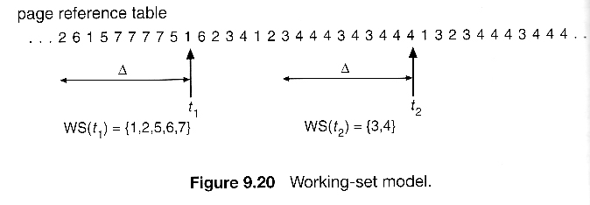
VM page replacement
Try to guess the working set of pages in active use for each VAS.
To determine if a page is being used, arrange for MMU to notify OS on next use.
E.g., reference bit, or disable read access to trigger a fault.
Sample pages systematically to approximate LRU: e.g., CLOCK algorithm, or FIFO-with-Second-Chance (FIFO-2C)

Slide 12
Writes in the FS buffer cache
Delayed writes
Partial-block writes may be left dirty in the cache. The “push” to disk is deferred in expectation of later writes to the same block.
Write-behind
Dirty blocks are pushed asynchronously; write call returns before push is complete.
May lose data! Be sure you know the failure semantics of the file systems you use in your life. A classic UNIX file system may discard any subset of recent writes on failure.
Fsync system call to wait for push, for use by applications that really want to know their data is “safe”.
Good file systems sync-on-close.

Slide 13
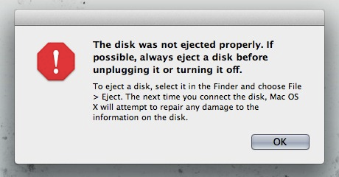
Failures, Commits, Atomicity
Hard state is state (data) that the service needs to function correctly. Soft state is non-critical.
What guarantees does the system offer about the hard state if the system fails?
Durability
Did my writes commit, i.e., are they saved? Can I get it back?
Failure atomicity
Can a set of writes “partly commit”?
Recoverability and Corruption
Can we recover a previous state?
Is the state consistent?
Is the metadata well-formed?

Slide 14
Failure/Atomicity
File writes are not guaranteed to commit until close.
A process can force commit with a sync.
The system forces commit every (say) 30 seconds.
Failure may lose an arbitrary subset of writes.
Want better reliability? Use a database.
Problem: safety of metadata.
How to protect the integrity of the metadata structures?
E.g., directory tree, inodes, block map trees
Metadata is a complex linked data structure, e.g., a tree.
Must be possible to restore with a scrub (“fsck”) on restart.

Slide 15
Metadata updates and recovery
Metadata updates incur extra seek overhead.
E.g., extending a file requires writes to the inode, direct and/or indirect blocks, cylinder group bit maps and summaries, and the file block itself.
Metadata items are often updated repeatedly, so delayed writes help.
But delayed writes incur a higher risk of file system corruption in a crash.
If you lose your metadata, you are dead in the water.
Option 1: careful write ordering, with scrub on recovery
Option 2: shadowing (e.g., WAFL)
Option 3: logging/journaling (used in databases)

Slide 16
Disk write behavior (cartoon version)
Disk may reorder pending writes.
Limited ordering support (“do X before Y”).
Can enforce ordering by writing X synchronously: wait for write of X to complete before issuing Y.
Writes at sector grain are atomic (512 bytes?).
Writes of larger blocks may fail “in the middle”.
Disk may itself have a writeback cache.
Even “old” writes may be lost.
(Can be disabled.)

Slide 17
Metadata write ordering
A common approach to safety of file system metadata:
Order essential metadata writes carefully.
Various techniques to enforce a partial order of writes to the disk, i.e., ensure that write A completes before write B begins.
Maintain invariants! E.g., avoid dangling references.
Never recycle a structure (block or inode) before zeroing all pointers to it (truncate, unlink, rmdir).
Never point to a new structure before it has been initialized. E.g., sync inode on creat before filling directory entry, and sync a new block before writing the block map.
Traverse the metadata tree to rebuild derived structures.
Can rebuild e.g., free block bitmaps, free inode bitmaps.

Slide 18
WAFL and Writes
In WAFL, any modified data or metadata can go anywhere on the disk.
Don’t overwrite the “old” copies!
Group writes together and write them in bursts!
Avoid small writes! → better performance, esp. on RAID
An arbitrary stream of updates can be installed atomically.
Retain the old copy, switch to new copy with a single write to the root of the tree (shadowing).
Old copy lives on as a point-in-time snapshot.

Slide 19
Concept: shadowing
1. starting point
modify purple/grey blocks
2. write new blocks to disk
prepare new block map
3. overwrite block map
(atomic commit)
and free old blocks
(optional)
Just to spell it out: if the system crashes before step 3, then the update fails, but the previous version is still intact. To abort the failed update we just need to free any blocks written in step 2. Step 3 completes the update: it replaces the old map with the new. Because it is a single disk write, the system cannot fail “in the middle”: it either completes or it does not: it is atomic. Once it is complete, the new data is safe.

Slide 20
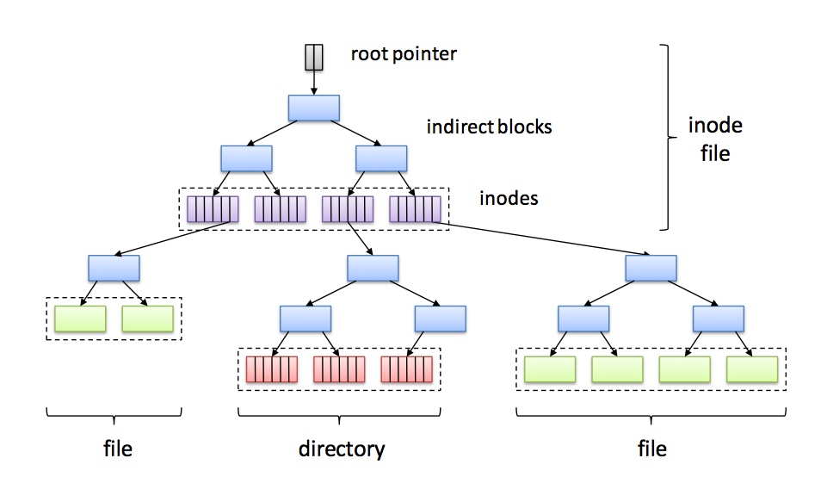
Write Anywhere File Layout (WAFL)

Slide 21
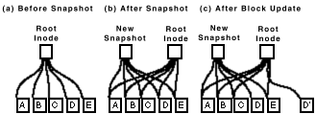
WAFL Snapshots
The snapshot mechanism is used for user-accessible snapshots and for transient consistency points.

Slide 22
WAFL’s on-disk structure (high level)
Root Inode
Metadata
File Data Blocks
Notes:
Green: active file system
Key point: never overwrite existing data
CP: flush all “dirty” buffers to disk, update the root inode (move the active file system forward)
Root Inode -> Inode File -> Blockmap
Nets you:
Snapshot
Dedupe

Slide 23
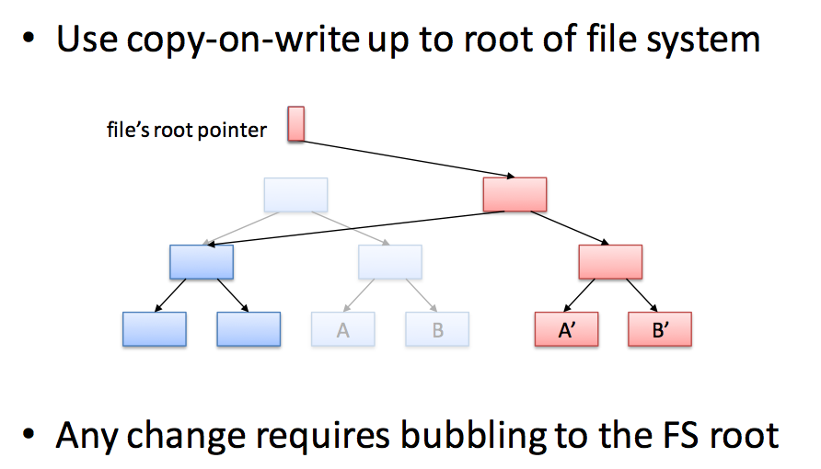
Another Look

Slide 24
Alternative: Logging/Journaling
Logging is another technique for atomic storage update.
Universally used in database systems.
Used for metadata writes in “journaling” file systems
Key idea: write each group of related updates into a sequential log file; commit the group atomically by writing a single commit record to the log.
Log records are written to the log file or log disk synchronously and sequentially.
No seeks, and preserves temporal ordering.
Log record writes are atomic: each log record is trailed by a marker (e.g., checksum) that says “this log record is complete”.
To recover: scan the log in order, reapply (or roll back) updates.
Restore a consistent state, in which each group of updates either committed in entirety, or had no effect on the data at all.

Slide 25
Transactions
Database systems and other systems use a programming construct called atomic transactions to represent a group of related reads/writes, often on different data items.
BEGIN T1
read X
read Y
…
write X
END
BEGIN T2
read X
write Y
…
write X
END
Transactions commit atomically in a serial order.

Slide 26
Recoverable Data with a Log
volatile memory (e.g., buffer cache)
Your data structures in memory
Your program (or file system or database software) executes transactions that read or change the data structures in memory.
Push a checkpoint or snapshot to disk periodically
Log transaction events as they occur
snapshot
log
After a failure, replay the log into the last snapshot to recover the data structure.

Slide 27
Transactions: logging
Begin transaction
Append info about modifications to a log
Append “commit” to log to end x-action
Write new data to normal database
Single-sector write commits x-action (3)
Begin
Transaction Complete
Write1
…
WriteN
Commit
Invariant: append new data to log before applying to DB
Called “write-ahead logging”

Slide 28
Transactions: logging
Begin transaction
Append info about modifications to a log
Append “commit” to log to end x-action
Write new data to normal database
Single-sector write commits x-action (3)
Begin
Write1
…
WriteN
Commit
What if we crash here (between 3,4)?
On reboot, reapply committed updates in log order.

Slide 29
Transactions: logging
Begin transaction
Append info about modifications to a log
Append “commit” to log to end x-action
Write new data to normal database
Single-sector write commits x-action (3)
Begin
Write1
…
WriteN
What if we crash here?
On reboot, discard uncommitted updates.

Slide 30
Anatomy of a Log
head (old)
...
A log is a sequence of records (entries) on recoverable storage.
Each entry is associated with some transaction.
The entries for transaction T record execution progress of T.
Atomic operations:
Append/write entry to log tail
Truncate entries from log head
Read/scan entries
Log writes are atomic and durable, and complete detectably in order.
Log
Sequence
Number
(LSN)
LSN 11
XID 18
LSN 12
XID 18
Transaction
ID (XID)
LSN 13
XID 19
commit
record
LSN 14
XID 18
commit
tail (new)

Slide 31
Using a Log
head (old)
...
Log
Sequence
Number
(LSN)
LSN 11
XID 18
Log entries for T record the writes by T (or operations in T).
Redo logging
To recover, read the checkpoint and replay committed log entries.
“Redo” by reissuing writes or reinvoking the methods.
Redo in order (head to tail)
Skip the records of uncommitted Ts
No T can be allowed to affect the checkpoint until T commits.
Technique: write-ahead logging
LSN 12
XID 18
Transaction
ID (XID)
LSN 13
XID 19
commit
record
LSN 14
XID 18
commit
tail (new)

Slide 32
Managing a Log
head (old)
...
Log
Sequence
Number
(LSN)
LSN 11
XID 18
On checkpoint, truncate the log
No longer need the entries to recover
Checkpoint how often? Tradeoff:
Checkpoints are expensive, BUT
Long logs take up space
Long logs increase recovery time
Checkpoint+truncate is “atomic”
Is it safe to redo/replay records whose effect is already in the checkpoint?
Checkpoint “between” transactions, so checkpoint is a consistent state.
Lots of approaches
LSN 12
XID 18
Transaction
ID (XID)
LSN 13
XID 19
commit
record
LSN 14
XID 18
commit
tail (new)

Slide 33
File Systems and Storage
Day 5: Network File Service
(And Surrounding Topics)
Jeff Chase
Duke University

Slide 34
Defiler: overview
create, destroy, read, write a dfile
list dfiles
1. Fetch blocks for data and metadata (or zero new ones fresh) into cache buffers (dbufs).
2. Copy bytes to/from dbufs with read and write.
3. Track which data/metadata blocks are valid, and which valid blocks are clean and which are dirty.
4. Clean the dirty blocks by writing them back to the disk with push.
“inode”
for DFileID
DBuffer dbuf = getBlock(blockID)
releaseBlock(dbuf)
sync()
read(), write()
startFetch(), startPush()
waitValid(), waitClean()
DBufferCache
DBuffer

Slide 35
Filesystem layout on disk
inode 0
bitmap file
inode 1
root directory
inode 1
root directory
fixed locations on disk
wind: 18
11100010
00101101
10111101
11100010
00101101
10111101
0
snow: 62
0
once upo
n a time
/n in a l
rain: 32
10011010
00110001
00010101
hail: 48
file blocks
allocation
bitmap file
for disk blocks
bit is set iff the corresponding block is in use
00101110
00011001
01000100
and far
far away
, lived th
inode
This is a toy example (Nachos).

Slide 36
Filesystem layout on disk
inode 0
bitmap file
X
X
inode 1
root directory
DeFiler must be able to find all valid inodes on disk.
X
11100010
00101101
10111101
X
0
Your DeFiler volume is small. You can keep the free block/inode maps in memory. You don’t need metadata structures on disk for that. But you have to scan the disk to rebuild the in-memory structures on initialization.
once upo
n a time
/n in a l
rain: 32
hail: 48
file blocks
DeFiler has no directories.
You just need to keep track of which DFileIDs are currently valid, and return a list.
and far
far away
, lived th
inode

Slide 37
Disk layout: the easy way
Given a list of valid inodes,
you can determine which inodes and blocks are free and which are in use.
DeFiler must be able to find all valid inodes on disk.
once upo
n a time
/n in a l
file blocks
and far
far away
, lived th
inode

Slide 38
A few words on VFS/NFS/RPC

Slide 39
Filesystems and pseudo-filesystems
A host’s file tree (name space) is built from a set of file volumes.
Each volume (“filesystem”) covers a subtree of the name space.
Use mount to graft subtrees onto the name tree. E.g., the tree is built automatically from a configuration file on init.
Each mounted volume has a filesystem type, associated with its disk layout or the network protocol used to access it.
Each filesystem type has a module (“file system driver”) that implements the operations on that type of filesystem.
May also include “logical” pseudo-filesystems in the tree.
procfs: (/proc) for access to process status
mfs: a memory-based scratch store

Slide 40
VFS: the Filesystem Switch
Sun Microsystems introduced the Virtual File System interface in 1985 to accommodate diverse filesystem types cleanly.
VFS allows diverse specific file systems to coexist in a file tree, isolating all FS-dependencies in pluggable filesystem modules.
user space
syscall layer (file, uio, etc.)
network
protocol
stack
(TCP/IP)
Virtual File System (VFS)
NFS
FFS
LFS
*FS
etc.
etc.
device drivers

Slide 41
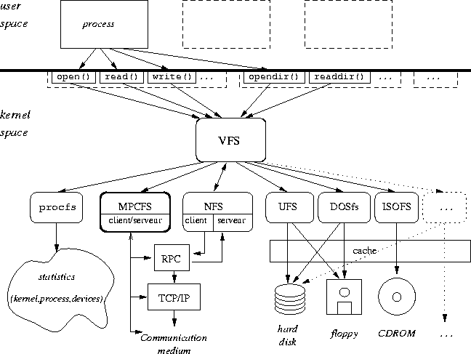
File System Modules/Drivers
inria.fr

Slide 42
Network File System (NFS)
client
server
user programs
syscall layer
VFS
syscall layer
NFS
server
VFS
UFS
UFS
NFS
client
network
In principle, VFS allows a host to serve any local filesystem to NFS clients over the network.
Separate inode into in-memory common part (vnode) and internal representation.

Slide 43
Delegating the name space
An important aspect of NFS is that different servers may have authority for different parts of the name space.
A pathname lookup traverses a branch of the tree, issuing lookup ops to the servers encountered along the branch.
The mountpoints encountered along the branch indicate which server has authority for the descendent subtree.
It’s a common concept: the Domain Name Service is similar in key respects.
server
NFS Clients
Network
server
server

Slide 44
(DNS subdomains, authority, and delegation)
The DNS name space is a hierarchy of naming domains.
root
A domain is a zone of administrative control.
.com
.edu
A domain is authoritative for the names in its part (zone) of the tree.
stuff.com
duke.edu
A domain can delegate control of a subtree to a subdomain.
shop.stuff.com
cs.duke.edu
apps1.shop.stuff.com
www.cs.duke.edu

Slide 45
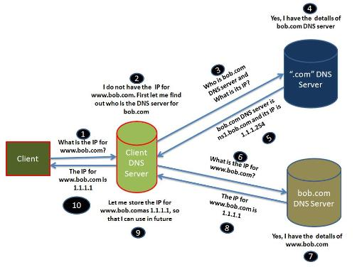
DNS Lookup

Slide 46
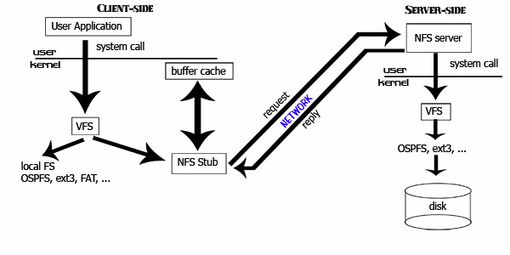
Network File System (NFS)
Remote Procedure Call (RPC)
External Data Representation (XDR)
[ucla.edu]

Slide 47
Remote Procedure Call (RPC)
NFS was an early popular application of RPC.
“RPC is a canonical structuring paradigm for client/server request/response services.”
Used in .NET, Android, RMI, distributed component frameworks
Humans focus on getting this code right.
client
server
Auto-generate this code from API spec (IDL).
“glue”
sockets
sockets
This code is “canned”, independent of the specific application.

Slide 48
RPC
call
Client
stub
send
recv
return
return
send
Server
stub
call
recv
A stub is a procedure that is linked in to the client or server program. E.g., the client stub exports the service API, and contains code to format a request as a network message, send it to the server, and receive and unpack the response.

Slide 49
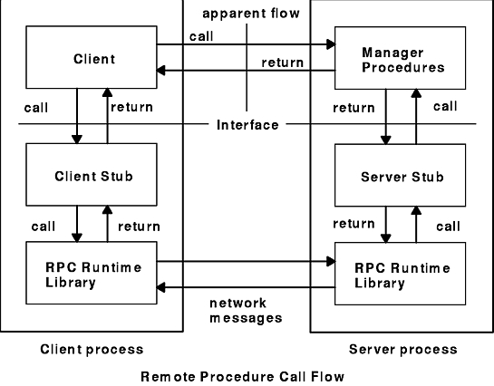
RPC: Language integration
Stubs link with the client/server code to “hide” the boundary crossing.
Marshal arguments/results into standard data representation.
Propagate exceptions
Binding: need some way to name the server and map the name to a network endpoint.
Stub procedures for each API method are auto-generated from an Interface Description Language (IDL) file containing interface declarations in some programming language.
(e.g., Android’s AIDL)

Slide 50
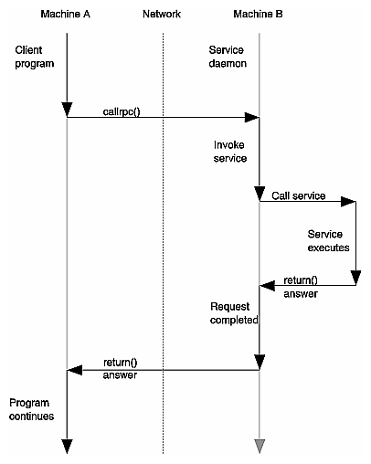
RPC execution
It “looks like” an ordinary local procedure call.
It “is like” a system call: it calls a stub containing code to transmit a message across a boundary and receive reply.
RPC is integrated with thread system: calling thread blocks; server thread receives/handles message; calling thread is awakened on reply.
Performance depends on server capacity and load.
Client and server may fail independently!
[OpenGroup, late 1980s]

Slide 51
Scaling storage services Understanding/quantifying service performance

Slide 52
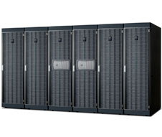
“Filers”
Network-attached (IP)
RAID appliance
Multiple protocols
iSCSI, NFS, CIFS
Admin interfaces
Flexible configuration
Lots of virtualization: dynamic volumes
Volume cloning, mirroring, snapshots, etc.
NetApp technology leader since 1994 (WAFL)

Slide 53
What is clustered Data ONTAP?
NetApp’s “scale-out” clustering solution
1-24 “nodes” (filers), 10 Gb ethernet interconnect
Designed for extreme performance and flexibility
Key concepts:
Vserver
Aggregate
Volume (FlexVol)
Notes:
Vserver: Logical entity that defines the boundaries of a server.
Aggregate: Physical entity, owned by a node, that is a collection of “disks” in a RAID group.
Volume: Logical entity, owned by a Vserver, that is loosely bound to an aggregate.

Slide 54
Architecture of clustered Data ONTAP
Client
Client
Client
Client
Client
Network
SpinNP
N-Blade
Network,
Protocols
N-Blade
Network,
Protocols
N-Blade
Network,
Protocols
N-Blade
Network,
Protocols
HA Pair
HA Pair
D-Blade
WAFL,
RAID,
Storage,
HA,
NVRAM
D-Blade
WAFL,
RAID,
Storage,
HA,
NVRAM
D-Blade
WAFL,
RAID,
Storage,
HA,
NVRAM
D-Blade
WAFL,
RAID,
Storage,
HA,
NVRAM
HA
Node
Disks
Notes:
Client: *nix, Windows, … SAN, NAS, …
Network: Ethernet, FC, …
N-Blade: “Network” blade, kernel module, client protocol <-> SpinNP, state machines
D-Blade: “Disk” blade, kernel module, SpinNP <-> WAFL/RAID

Slide 55
Notes on “scale-out”
NetApp filer solution is “scalable”.
“Just buy more blades.”
Load is distributed: among the blades, interfaces, disks, etc..
If we add another blade, it adds to the total load we can serve.
What about failure?
Redistribute load to the surviving blades.
But what if the failed blade has some critical state?
E.g., D-blades have writeback I/O caches.
Replicate nodes in “HA pairs” (Highly Available).
If one fails, the other can take over. (like the “buddy system”)

Slide 56
WAFL and the disk system
WAFL generates a continuous stream of large-chunk contiguous writes to the disk system.
WAFL does not overwrite the old copy of a modified structure: it can write a new copy anywhere. So it gathers them together.
Large writes minimize seek overhead and deliver the full bandwidth of the disk.
WAFL gets excellent performance by/when using many disks in tandem (“RAID”)…
…and writing the chunks in interleaved fashion across the disks (“striping”).
Old copies of the data and metadata survive on the disk and are accessible through point-in-time “snapshots”.

Slide 57
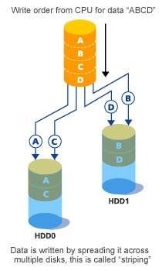
RAID 0
Striping
Sequential throughput?
Random throughput?
Random latency?
Read vs. write?
MTTF/MTBF?
Cost per GB?
Fujitsu

Slide 58
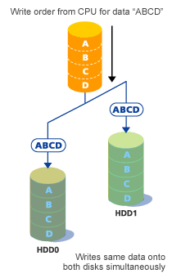
RAID 1
Mirroring
Sequential throughput?
Random throughput?
Random latency?
Read vs. write?
MTTF/MTBF?
Cost per GB?
Fujitsu

Slide 59
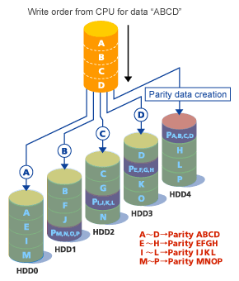
Building a better disk: RAID 5
Redundant Array of Independent Disks
Striping for high throughput for pipelined reads.
Data redundancy: parity
Enables recovery from one disk failure
RAID5 distributes parity: no“hot spot” for random writes
Market standard
Fujitsu

Slide 60
Benchmarks and performance
Benchmarks enable standardized comparison under controlled conditions.
Compare “apples to apples”, avoid misrepresentation e.g., by vendor selected benchmarks (“atrocities in the marketplace” – Jeff Mogul).
They embody some specific set of workload assumptions.
Subject a system to a selected workload, and measure its performance.
Server/service metrics:
Throughput: request/sec at peak (saturation)
Response time: t(response) – t(request)

Slide 61
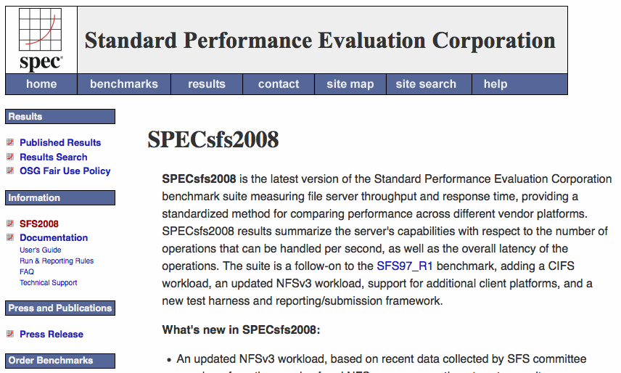
http://www.spec.org/sfs2008/

